Slide 1
RBS OUTREACH
Jim Emmons
Executive Director
The Water Sports Foundation
Wednesday, March 16, 2022

Slide 2
Effective Outreach since 2011
Successfully managed 41 outreach projects.
Delivered more than 1.5 billion laser-targeted boating safety messages exclusively to boaters & paddlers.
Currently managing 10 projects valued at $1.4 million scheduled to deliver 146 million safe boating media impressions.
WSF’s National Public Relations project earned two National Awards.
In December, at the Sea Tow Foundation’s Boating Industry Safety Awards, the project won The Top Marine Marketing and Boating Safety Outreach Award.
In February, at the Marine Marketers Association of America’s Neptune Awards, the project won the Top Public Relations Campaign Award amongst more than 1,000 entries.
New website WaterSportsFoundation.com including the National Boating Safety Media Center, one-stop repository of recreational boating safety materials for journalists, editors and producers.

Slide 3
Boating Safety Outreach Campaigns
Impaired Boating Awareness
Anti-BUI outreach using boating and fishing celebrities. Minimum: 3.5 million impressions.
Lessons for Life
Boating safety outreach based on real-life incidents. Minimum: 7.6 million impressions.
Navegantes Latinos
Uses Spanish language radio to deliver a minimum of 29.1 million media impressions.
Industry Safety Outreach
“Teach the Teachers” to talk (and sell) safety. Minimum: 2 million media impressions.
Search Content Marketing
Safety messaging embedded in content beginners search most often. Minimum: 5.6 million media impressions.
Notes:
I won’t go through the nitty-gritty details of every campaign, but I do want to mention two new ones that make great use of data science.
The one we call Search Content Marketing embeds safety messaging in content that beginners search most often.
That’s a very effective way to reach a group that is notoriously hard to target – the so-called Unreachables.
And Retargeting is a marketing term for those ads that follow you all over the internet.
So an example of that . . . One Christmas I was looking for a special pair of shoes for my wife, and I searched and searched online. And for months afterward I was getting women’s shoe ads on all my devices.
That’s retargeting, and with Glenn’s help we’re going to use it to share safety messages.

Slide 4
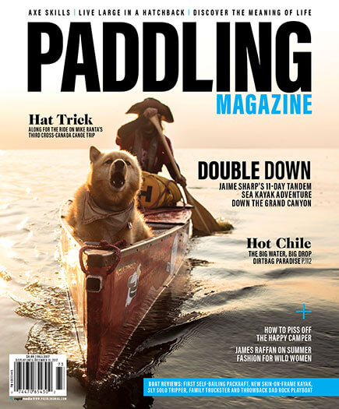
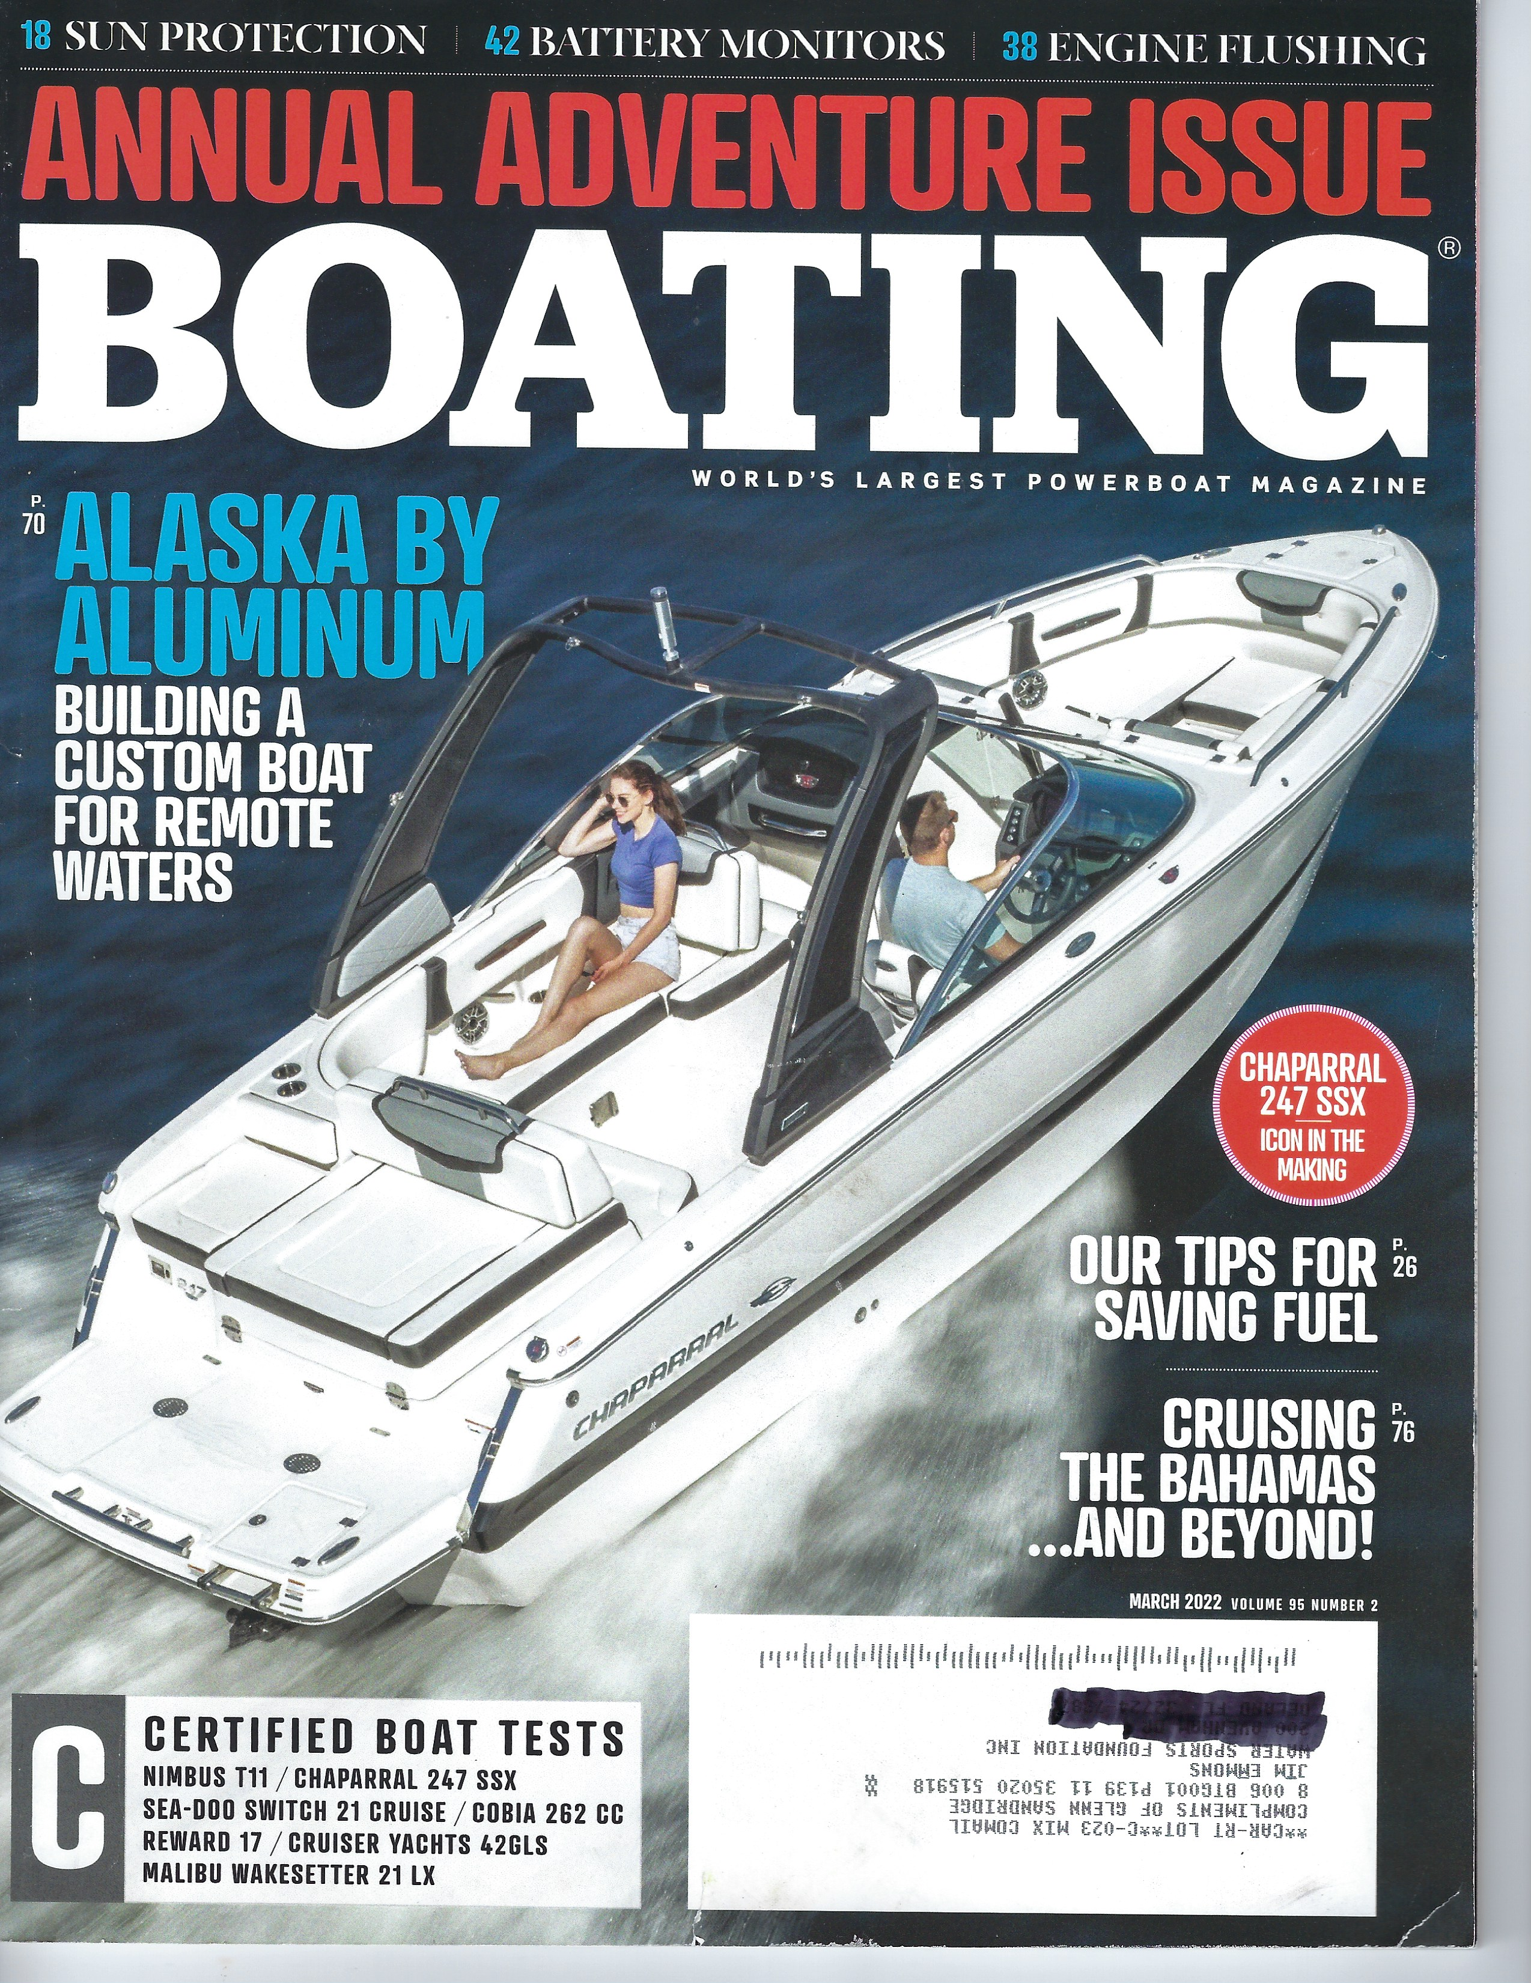
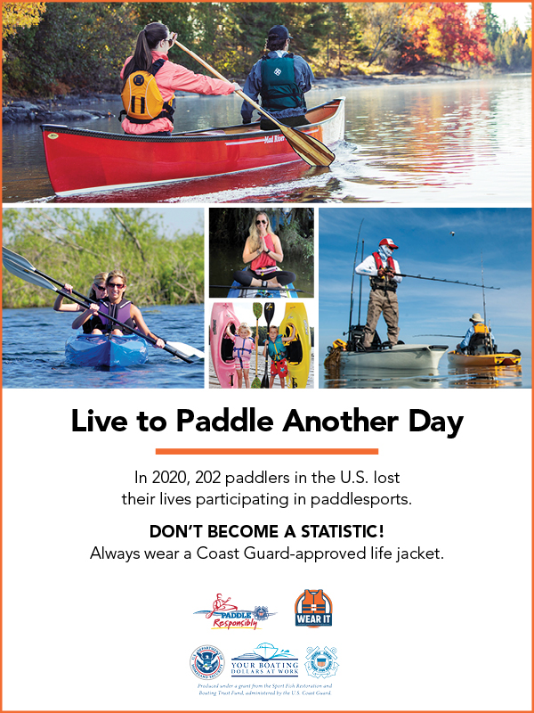
Boating Safety Outreach Campaigns
Safe Boating campaign
Our oldest and broadest program
Print and online since 2011
Minimum: 10 million media impressions.
Safe Paddle campaign
Paddling accounts for nearly 30 percent of boating fatalities since 2016.
Minimum: 4 million media impressions.
Notes:
I do want to highlight just a few of the campaigns.
Our oldest campaign is called Safe Boat. It’s a classic integrated outreach campaign using print, online and social media.
It builds on the capabilities of our media partners, in particular Bonnier and the Outdoor Sportsman Group. Its success has been the foundation of our more specialized campaigns.
Safe Paddle followed in 2016, when we realized that about one-third of boating fatalities involved paddlers. Since then that percentage has declined, so we’re making a difference.

Slide 5
Boating Safety Outreach Campaigns
Public Relations
Boating safety for the mainstream
Minimum: 65 million media impressions.
Boating Safety on Fishing TV
Coming this spring to: Discovery, Pursuit, Outdoor channel, Sportsman channel, Outdoor America, Fox Sports Florida, and the World Fishing Network.
1,127 airings of 30-second ad spots – plus, one 8-minute mini-documentary.
Minimum: 15.3 million media impressions.
Notes:
We’re also really excited about our Public Relations outreach campaign.
It’s not a big-budget project, but it exceeded expectations by a factor of almost 10.
Our partner Kenton-Smith marketing projected 65 million impressions and delivered over 600 million.

Slide 6
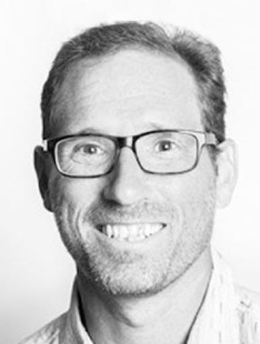
Jeff Moag Content Director Water Sports Foundation
What is “content” anyway?
Notes:
Thank you Jim.
For those of you who haven’t met me in the first aid tent – congratulations. I’m Jeff Moag, the Water Sports Foundation Content Director.
If you’re wondering what that means, I know the feeling.
“Content” sounds like filling—like the stuff they put in pillows and stuffed animals.

Slide 7
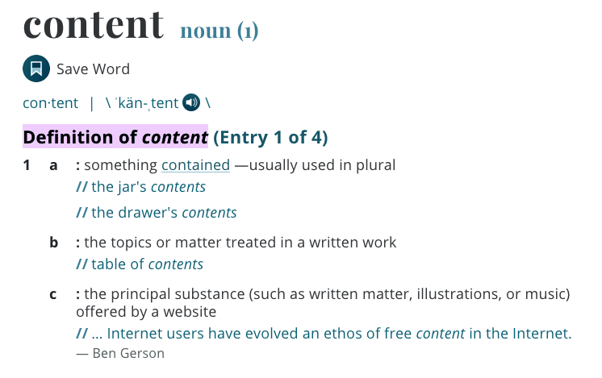
Jeff Moag Content Director Water Sports Foundation
What is “content” anyway?
Notes:
And lately that’s what it’s become.
The first definition makes sense – Content is stuff that is contained. You fill up a bucket with content.
They added the new definition at the bottom just recently. Now “content” is the words and pictures that fill up the internet

Slide 8
Notes:
So my job as content director is to get our content to float to the top of the bucket.
And to do that it helps to have a great story—and especially great pictures. Here’s one we did last summer for our Lessons for Life program.
This was an actual incident captured on the body cam of the officer in the interview – Lt. Brian Parkton of the Okaloosa County Sheriff’s Department.

Slide 9
Lessons for Life “Pulled Under” Video and Written Narrative
1.1 million Facebook views
682,000 YouTube views
20,100 “Likes”
2,200 shares
1,813 comments
Aggregate view time: 24,000 hours (= 2.7 years)
Notes:
The beauty of this video is we didn’t have to explain all the dumb stuff the boaters did.
That left Lt Parkton basically the entire four-minute video to explain how the only thing that they did do right – wearing lifejackets – saved their lives.
This clip racked up more than 2 million views on different platforms, but to me, the best part was the comments.

Slide 10
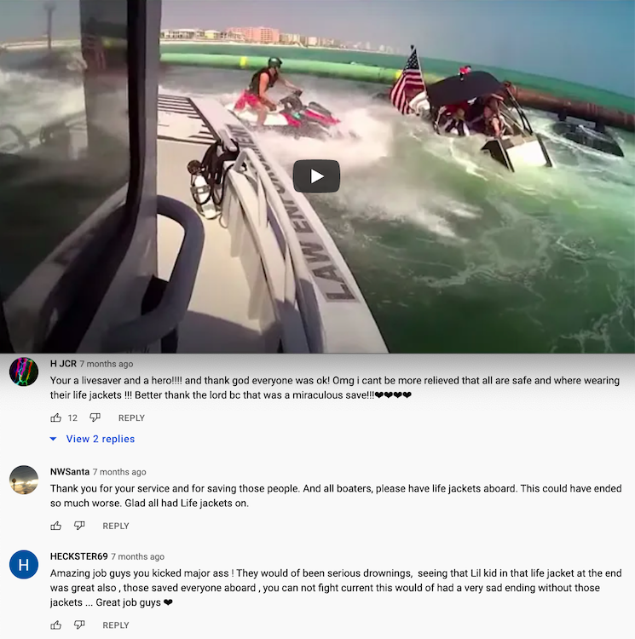
comments echo safety messaging
“Seeing that ‘lil kid in the life jacket in the end was great . . . those life jackets saved everyone aboard.” — Heckster69
“OMG I can’t believe all are safe and were wearing their life jackets !!!” — H JCR
“All boaters, please have life jackets aboard . . .” — NWSanta
Notes:
They were overwhelmingly positive and echoed back our safety message about life jacket wear. That was the number-one viewer takeaway.
Actually, life jackets was number two. The number one comment was about what a stud the jetski driver was. At the time he was an 18-year-old summer lifeguard with Destin Fire Rescue. After this he joined the U.S. Coast Guard.

Slide 11
Outreach Strategy
Engaging Content
Targeted Audiences
The Best Media Partners
“It’s as easy as 1-2-3” — M. Jackson
Notes:
I wanted to show that clip because it’s a good example of our core strategy.
We currently have ten campaigns, each targeting different audiences in various ways. But the basic recipe has the same three ingredients
First, we create good content. We want to rise to the top of the bucket, so we make cream.
Next is targeting. We use various methods to make sure our safety messages reach our target audience of boaters or paddlers – and sometimes, specific sub-groups of boaters.
And finally, we do this in partnership with the best boating and paddling magazines out there.
I’m talking about you Glenn. Groups like Bonnier have spent decades building their audience and credibility. And we capitalize on that, so their influence rubs off on us. Thanks Glenn.

Slide 12
Notes:
I’ll wrap up with a teaser for our new foray into the final frontier – television.
Starting this spring we’re launching a series of 30-second ads on major television fishing shows.
The ads promote an 8-minute mini-doc about the men and women of the U.S. Coast Guard, and what boaters can do to avoid getting rescued by them.
(play video, then:)
That was Glenn’s team at Bonnier, and even from that short spot you can see they absolutely nailed the camera work.

Slide 14
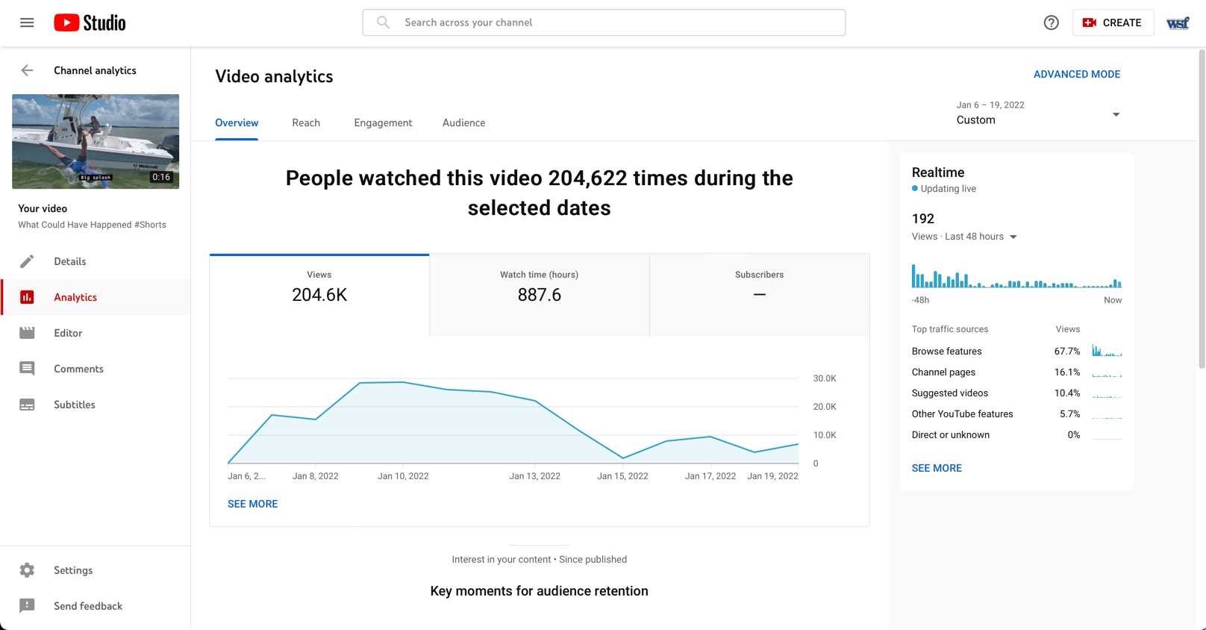
204,622 Views
2 weeks
Budget $1,850

Slide 16
Effective Outreach since 2011
QUESTIONS?
www.WaterSportsFoundation.com
Jim@WaterSportsFoundation.com
Jeff@WaterSportsFoundation.com

