Slide 4
Technology In
Boating & Water
Safety

Slide 5
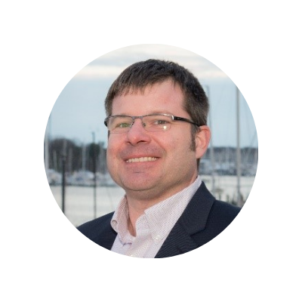
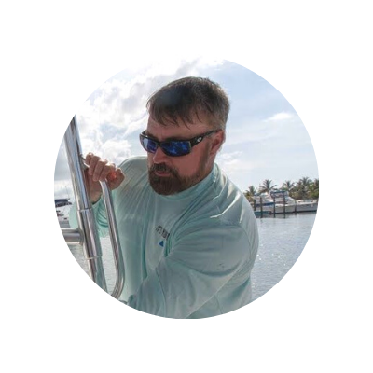
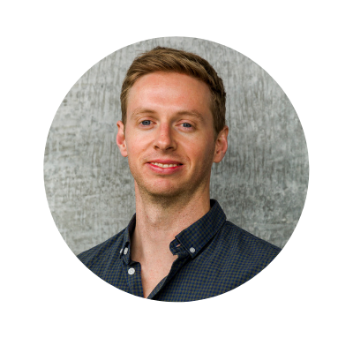
Panelists
Brian Goodwin
Technical Director
American Boat & Yacht Council
Mike McKiernan
Founder & CEO
Deckee
David DeVos
Senior RSM for Marine
Garmin
Drew Orvieto
Senior Product Manager
Sea Machines Robotics

Slide 6
ASK A QUESTION
Submit questions via the IBWSS 2022 Facebook Group
Open the IBWSS 2022 Facebook Group
Go to the group’s newsfeed, look for the Q&A box for this session
Type your question in the comments section of that post

Slide 7
American Boat & Yacht Council
Brian Goodwin, Technical Director
abycinc.org

Slide 8
Deckee
Mike McKiernan, Founder & CEO
deckee.com

Slide 9
GARMIN
David DeVos, Senior RSM for Marine
garmin.com

Slide 10
SEA MACHINES ROBOTICS
Drew Orvieto, Senior Product Manager
sea-machines.com

Slide 11
Question 1:
What is the why behind your organization using technology to advance boating and water safety education?

Slide 12
Question 2:
What is an example of the latest technology used by your organization?

Slide 13
Question 3:
How is your technology influencing boater behavior?

Slide 14
Question 4:
How has technology changed the learning experience? What challenges have you faced?

Slide 15
Question 5:
How have mobile devices impacted boater education?

Slide 16
Question 6:
How can we measure the impact on boater behavior?

Slide 17
Question 7:
With emerging trends, how do we classify the vessels?

Slide 21
Overcoming the Strike: Diving and Boating Safety Working Together

Slide 22
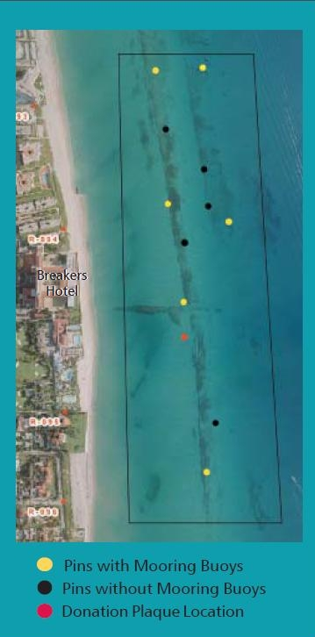

Slide 23
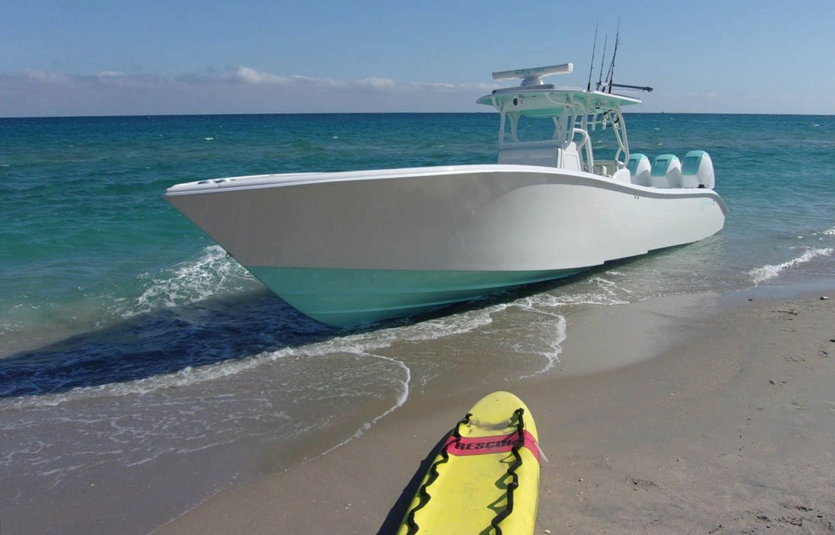

Slide 24
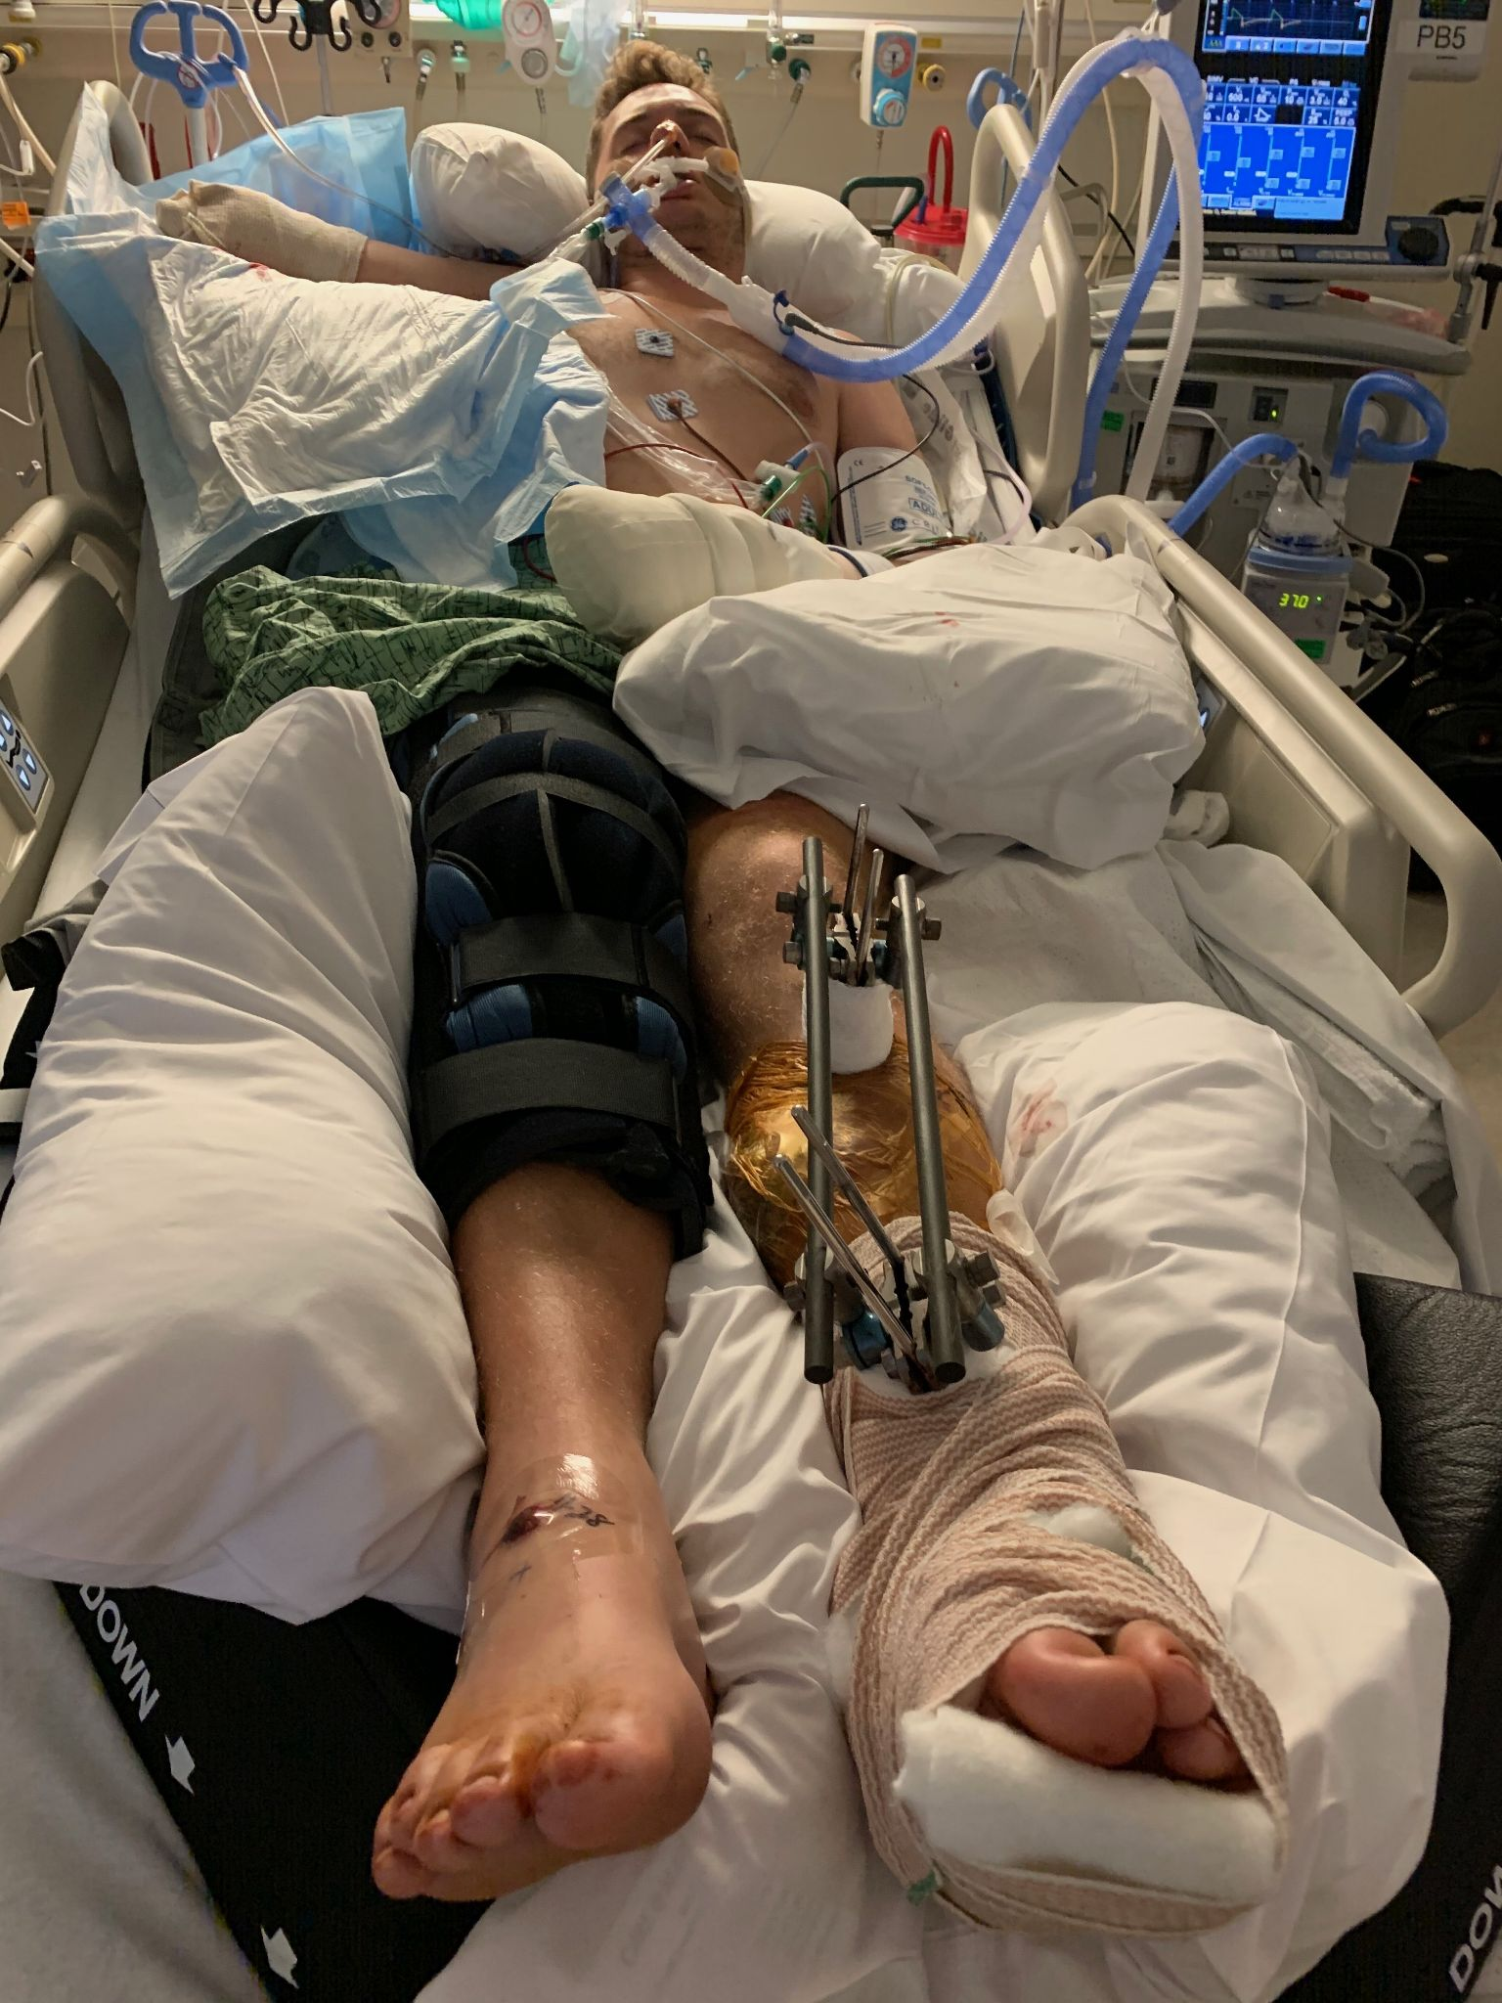

Slide 25
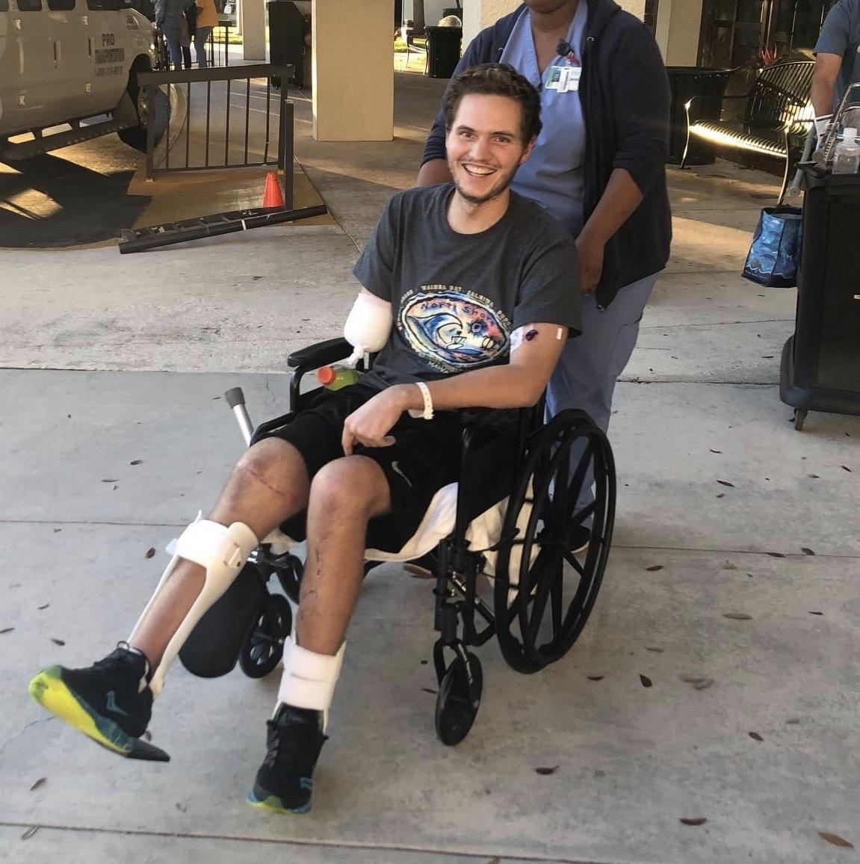

Slide 26
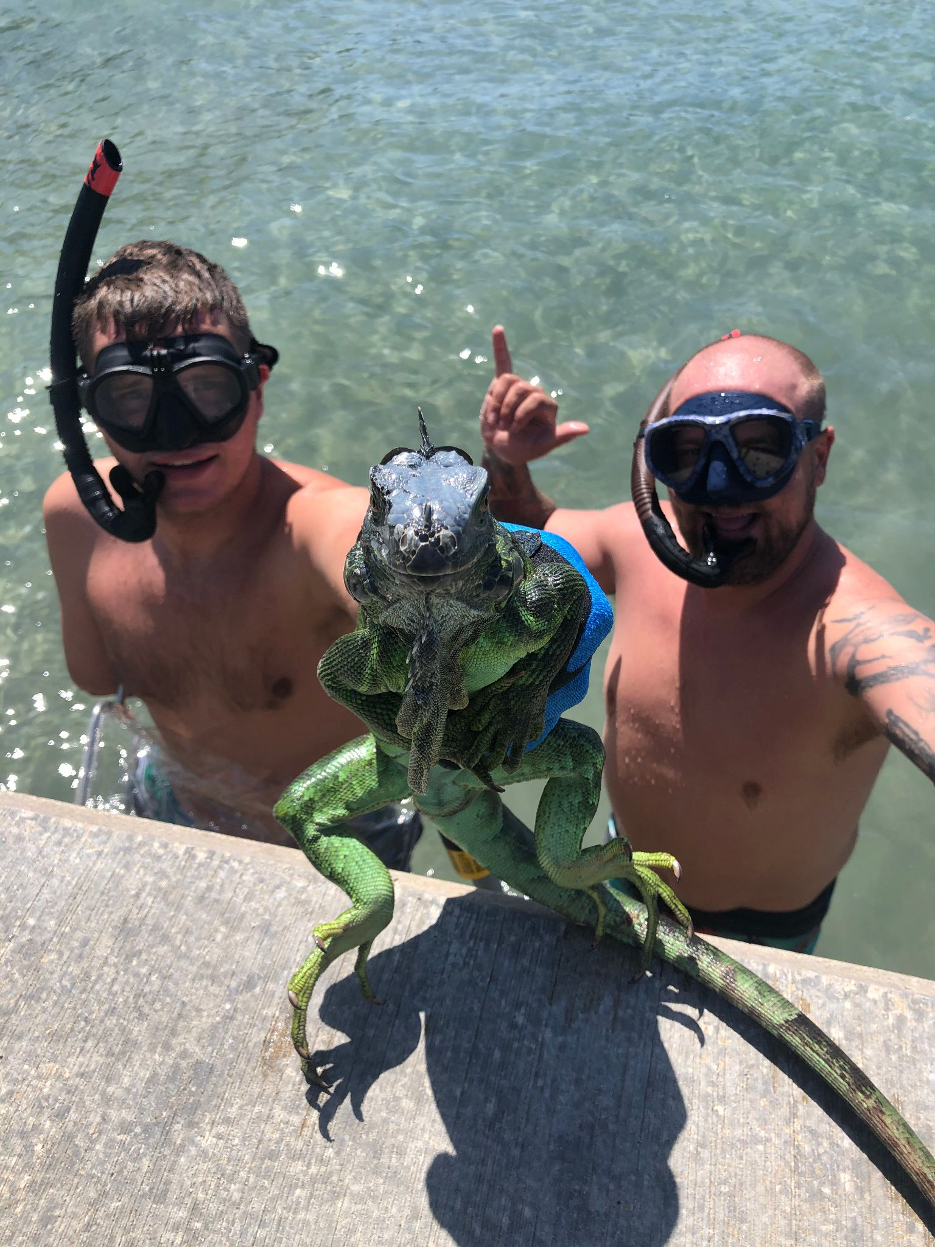

Slide 27
