Slide 1
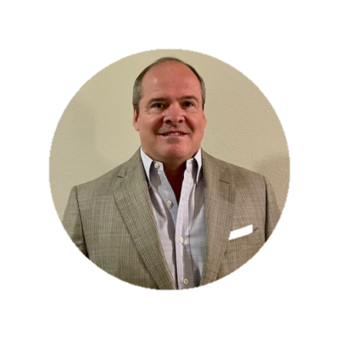
Safer, More-secure, Stress-free Boating with Telematics (IoT)
Steve Pitsos
CEO
BoatFix

Slide 2
Keeping Boaters Safe & Secure with On-board Telematics

Slide 3
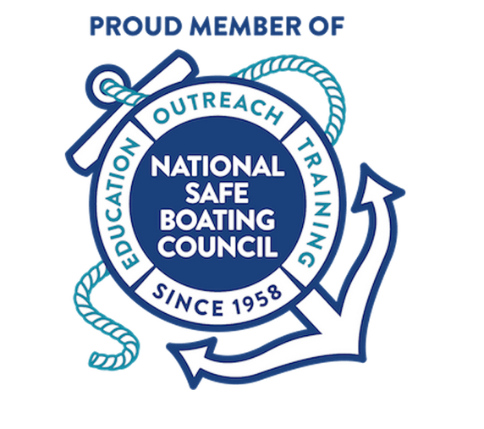
Recreational Marine industry is embracing on-board telematics to address safety, a more secure feeling on the water and peace-of-mind.
Boater retention is crucial and when boating is hard, boating is dangerous, no longer fun, new boaters will leave/churn.
With our combined beliefs and commitment to safety passion in the recreational marine industry, it felt like a great and honor to join as Admiral member of National Safe Boating Council

Slide 4
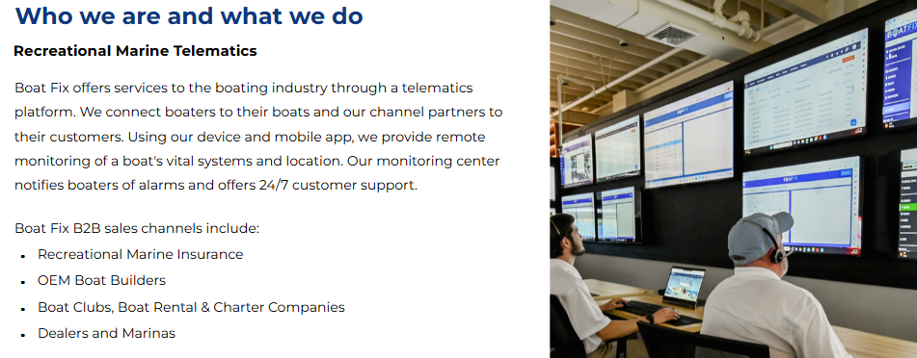

Slide 5
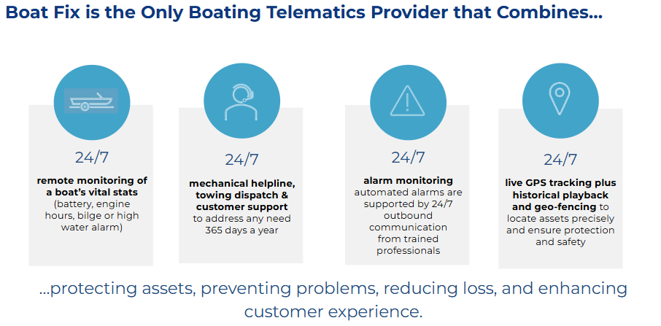
Our Approach - Safety for YOU and YOUR boat

Slide 6
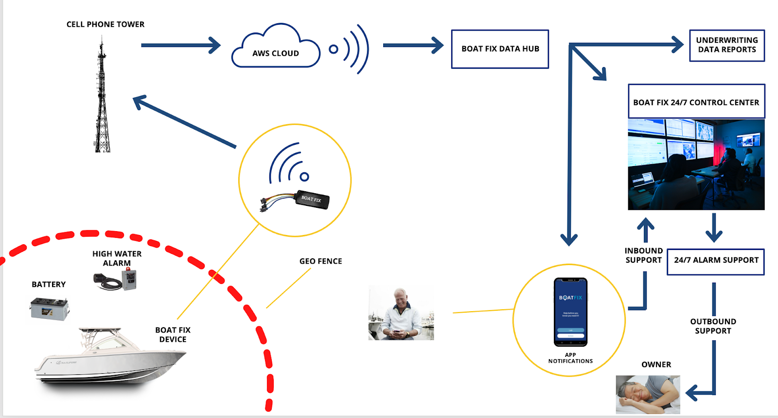
How it works
24/7 MONITORING CENTER

Slide 7
IoT - Telematics Service Providers (TSP’s)

Slide 8
Identifying Mechanical Needs
Remote on-water live agent support…calls answered in seconds 27/7/365

Slide 9
A Lifeline When You Need It
If we can’t get you up and running, we stay on the line with towing dispatch

Slide 10
Issuing Weather Alerts
Real-time weather data at boat’s location

Slide 11
Deterring Theft
Help before you know you need it! Instant notifications and quick access to law enforcement

Slide 12
Filling the Gap
Insurers want to reward safe boaters with lower premiums

Slide 13
Rental Operations and Fleet Management
Ensure boaters are boating in safe areas and manage speeding events

Slide 14
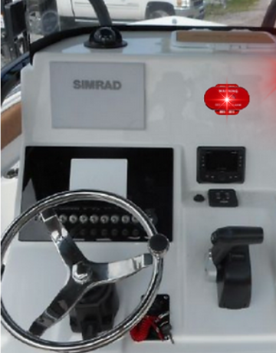

Slide 15
Boater Mobile App - Showcasing the Benefits
Chart
Protect Mode
Status

Slide 16
Boater Mobile App - Showcasing the Benefits
Voltage

Slide 17
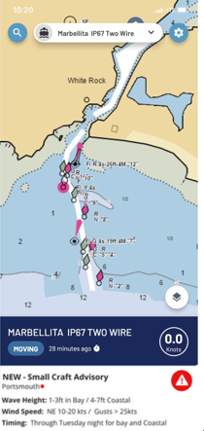
Boater Mobile App - Showcasing the Benefits
Safety Checklists & Weather

Slide 18
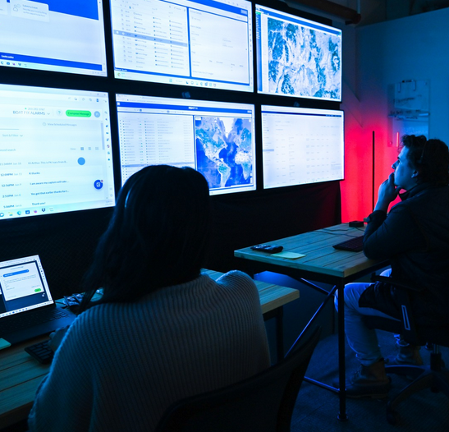
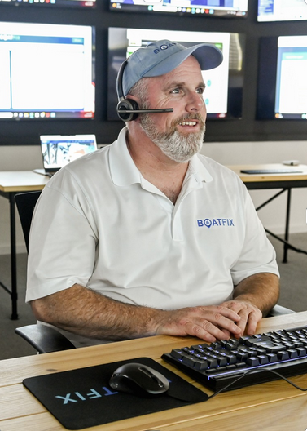
24/7 Monitoring and Control Center
Safe and secure peace of mind on the water

Slide 19
Thank you!
Telematics solutions are making a difference in driving a safer, more secure, stress-free fun boating experience.
Stop by the Gear Station if you’d like to see the app, ask questions, or just say Hello.
Steve Pitsos, CEO Boat Fix
Charleston, SC

