Slide 1
SHARED WATERWAYS
Pamela Dillon, NASBLA
Risa Shimoda, River Management Society
March 15, 2022

Slide 2
WHAT ARE WE TALKING ABOUT HERE?

Slide 3
Scenario A
For four decades, a waterski club has maintained an slalom course on a public waterway. Club members use the course at various times. In recent years, the number of paddlers on the waterway has grown, with paddlers using the slalom buoys for their own activities often in conflict with the desired use of the area by waterski club members.
Both groups claim their right to use this area on the public waterway.
Notes:
(Two scenarios – Break into small groups of 2-3 people to discuss for 5-7 minutes, noting what questions, information, data, and process to take to address this challenge.)
As Waterway Managers, you are charged with this challenge. In small teams of 2-3 members, determine a course of action you will take to address the following:
Group A – For several decades, a water-ski club has maintained a slalom course on a narrow public waterway. Club members use the course at various times during the course of the week. In recent years, the number of paddlers (canoes, kayaks, and SUPs) on the waterway have grown with many paddlers using the waterski buoys for their own activities. These activities often conflict with the desired use of the area by waterski club members. Both groups claim their right to use this area on the public waterway.

Slide 4
Scenario B
An artificial fish attracter is located just off-shore in a public lake near a popular beaching area for personal watercraft (PWC) operation. In recent years, the amount of fishing, including permitted fishing tournaments, has increased, with heightened interest by anglers to the waters surrounding the fish attracter. Anglers complain the attracter was purchased and placed with funding from fishing license sales, but they cannot reasonably fish the attracter due to PWC activity.
PWC operators claim their rights to continue use of this public waterway and beach area.
Notes:
(Two scenarios – Break into small groups of 2-4 people to discuss for 5-7 minutes, noting what questions, information, data, and process to take to address this challenge.)
As Waterway Managers, you are charged with this challenge. In small teams of 2-4 members, determine a course of action you will take to address the following: How would you approach this if you walked,
Group A – For several decades, a water-ski club has maintained a slalom course on a narrow public waterway. Club members use the course at various times during the course of the week. In recent years, the number of paddlers (canoes, kayaks, and SUPs) on the waterway have grown with many paddlers using the waterski buoys for their own activities. These activities often conflict with the desired use of the area by waterski club members. Both groups claim their right to use this area on the public waterway.
Group B
An artificial fish attracter is located just off-shore in a public lake near a popular beaching area for PWC operators. In recent years, the amount of fishing, including permitted fishing tournaments, has increased, with heightened interest by anglers to waters surrounding the fish attracter. Anglers complain they cannot reasonably access the attracters which were purchased and placed with funding from fishing licenses sales, due to PWC activity. PWC operators claim their rights to use this public waterway and beach area.

Slide 5
How do you proceed? Is there a solution to each scenario?

Slide 6
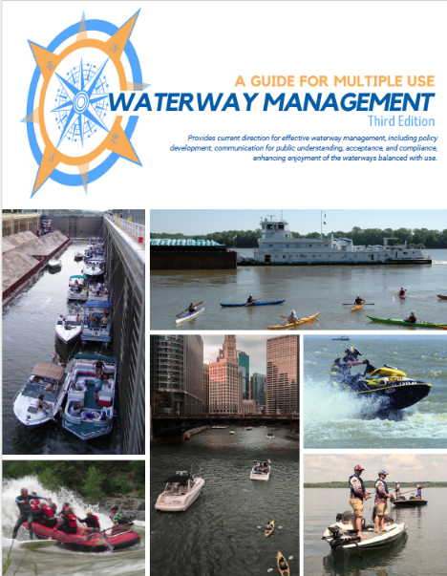
A GUIDE For MULTIPLE USE WATERWAY MANAGEMENT (THIRD EDITION) AVAILABLE FOR FREE DOWNLOAD www.waterwaymanagement.org
Notes:
Here’s a new tool for your Waterway Management tool kit.
We are pleased to announce the release of A Guide to Multiple Use Waterway Management (Third Edition). The Guide is available for FREE download from www.waterwaymanagement.org.

Slide 7
Notes:
Regarding the two scenarios, Section 3 provides a six-step planning process based on widely accepted best practices for stakeholder involvement. This section represents the heart of Waterway Management practices.

Slide 8
Six Step Planning Process:
Step 1 – ORGANIZE
Notes:
Section 3 provides a six-step planning process based on widely accepted best practices for stakeholder involvement. This section represents the heart of Waterway Management practices.
O R G A N I Z E
P L A N N I N G T H E P L A N
Initial assessment of problems, constraints,
assets, and opportunities
Dissemination of purpose
Identification of participants
Preparation of work program and budget

Slide 9
Six Step Planning Process:
Step 1 – ORGANIZE
Step 2 – RESEARCH
Notes:
Section 3 provides a six-step planning process based on widely accepted best practices for stakeholder involvement. This section represents the heart of Waterway Management practices.
RESEARCH
D I S C O V E R I N G A N D L E A R N I N G – L O O K I N G
O B J E C T I V E L Y A T S I T U A T I O N S
Inventory of existing information
Preparation of base and analysis maps
Analysis of safety, conflict, and quality
Analysis of economic impact
Analysis of policies, regulations, and
Circumstances

Slide 10
Six Step Planning Process:
Step 1 – ORGANIZE
Step 2 – RESEARCH
Step 3 – PLAN
Notes:
Section 3 provides a six-step planning process based on widely accepted best practices for stakeholder involvement. This section represents the heart of Waterway Management practices.
P L A N – C R E A T I N G A N D E V A L U A T I N G
W E I G H I N G A L T E R N A T I V E P R O P O S A L S
Statement of overall goals
Statement of preliminary management
techniques
Preparation of evaluation of alternative
Solutions and their implications

Slide 11
Six Step Planning Process:
Step 1 – ORGANIZE
Step 2 – RESEARCH
Step 3 – PLAN
Step 4 – DECIDE
Notes:
Section 3 provides a six-step planning process based on widely accepted best practices for stakeholder involvement. This section represents the heart of Waterway Management practices.
D E C I D E – C H O O S I N G A N D D E T A I L I N G
M A K I N G S P E C I F I C R E C O M M E N D A T I O N S
Statement of overall goals
Statement of preliminary management
techniques
Preparation of evaluation of alternative
solutions and their Implications

Slide 12
Six Step Planning Process:
Step 1 – ORGANIZE
Step 2 – RESEARCH
Step 3 – PLAN
Step 4 – DECIDE
Step 5 – ACTION
Notes:
Section 3 provides a six-step planning process based on widely accepted best practices for stakeholder involvement. This section represents the heart of Waterway Management practices.
A C T I O N – P R E P A R I N G
Determination of priorities and scheduling
Identification of solicitation of funding
Attraction and coordination of roles and
responsibilities
Monitoring and adjustment for change
of actions

Slide 13
Six Step Planning Process:
Step 1 – ORGANIZE
Step 2 – RESEARCH
Step 3 – PLAN
Step 4 – DECIDE
Step 5 – ACTION
Step 6 – MONITOR
Notes:
Section 3 provides a six-step planning process based on widely accepted best practices for stakeholder involvement. This section represents the heart of Waterway Management practices.
MO N I T O R - E V A L U A T I N G A N D U P D A T I N G
Evaluation of the plan
Adjustment of the plan
Communication of success stories

Slide 14
Notes:
So what else is in the Guide? There are seven main sections.
Section 1 introduces trends and emerging issues, providing participation data, describing audiences, access, products and activities and influential technology.

Slide 15
Notes:
Section 2 introduces types of multiple use waterway issues and conflicts, including terminology such as “commercial” as defined by the USCG vs. terms used by recreational business operators including an overview on what is defined as “navigable” and how it is determined.
Issues resulting in conflicts between commercial vs. business interests vs. the recreational public; recreational public vs. recreational public, and private landowners vs. everyone else are also introduced and acknowledged.

Slide 16
Notes:
We have already shared an overview of the Planning Process in Section 3.

Slide 17
Notes:
Section 4 includes details of the unique roles played in Waterway Management by both the US Coast Guard and the US Army Corps of Engineers, and includes a descriptive inventory of Activity Controls and Traffic Management ranging from “Access” to “Zoning”.

Slide 18
Notes:
Section 5 describes the range of organizations involved in Waterway Management, from federal, tribal, state, regional, and local governments and a range of non-government organizations.

Slide 19
#1 – Ballasted Boats
#2 – Jupiter Inlet, Florida
#3 – Regulated Navigation Area, Pittsburgh, PA
#4 – Nonmotorized Access Program - Oregon
Notes:
Section 6 includes four case studies. These are:
Ballasted Boats
Jupiter Inlet, Florida
Pittsburgh Regulated Navigation Area
Oregon’s Nonmotorized Access Program
In it hoped that the online version of this Guide will provide a tool to expand greatly on these case studies in the future.

Slide 20
Notes:
Section 7 is References and suggest reading …. More on that in a bit, first let’s back up….

Slide 21
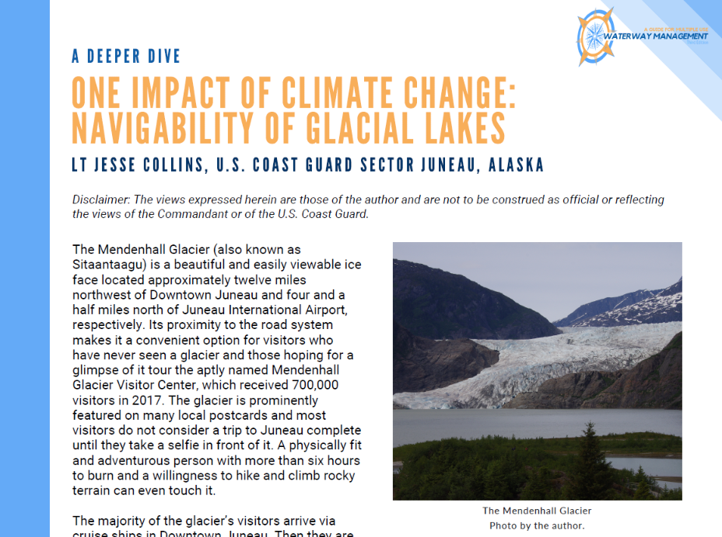
Deeper Dives by Subject Matter Experts
Notes:
There are five Deeper Dives throughout the Guide, to review topics on a more granular level, such as this deeper dive addressing changing issues of navigability and commercial activities resulting from melting glaciers in Alaska:
The issue(s) is(are) 1), 2), 3) and the resolution/solution/status is _____. This may be helpful for ____ who are confronted with challenges related to ______.

Slide 22
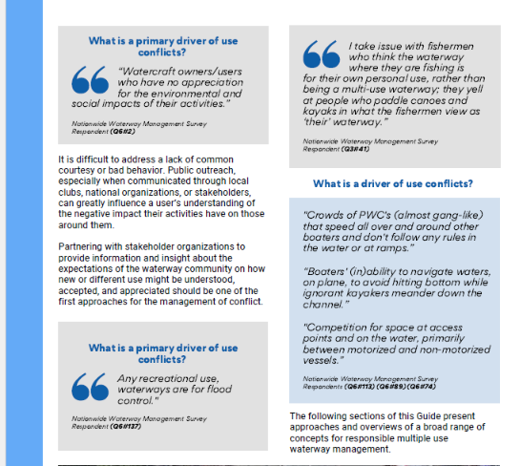
Quotes from Survey Respondents
Notes:
Throughout the Guide, quotes from survey respondents are inserted, sometimes demonstrating 180 degree differences in the public’s point of view, and reflecting the realities and complexities faced by today’s multiple use waterways manager. Voices expressing positions, challenges and worries about 1), 2), 3) and the resolution/solution/status illustrated by _____ may be helpful for ____ who are confronted with challenges related to ______.
Example of impact of specific communities:
Q4 Which of the following aspect(s) of waterway management do you think are or will be most impacted by new and evolving usage trends?
Human powered recreation (e.g., swimming, canoeing, kayaking, stand-up paddle boarding, surfing)
11 points LOWER with Florida responses included.
All Responses – Total – 787 / 44%
Non-Florida Responses – Total – 274 / 55%
Derelict and at-risk vessels 10 points HIGHER with Florida responses included.
All Responses – Total – 499 / 28%
Non-Florida Responses – Total – 91 / 18%
While this issue does not rank as a priority, the much higher level of importance with responses from Florida) suggests noting this as important for Florida, the region or southern tier areas.
*** Motorized boats vs. paddle or rowing craft 9 points LOWER with Florida responses included.
All Responses – Total – 540 / 30%
Non-Florida Responses – Total – 197 / 39%
This is a high priority topic with and without responses from Florida.

Slide 23
….SECTION REFERENCES!
Notes:
Each section if fully referenced with endnotes. Over 200 references were considered and reviewed for this project…..

Slide 24
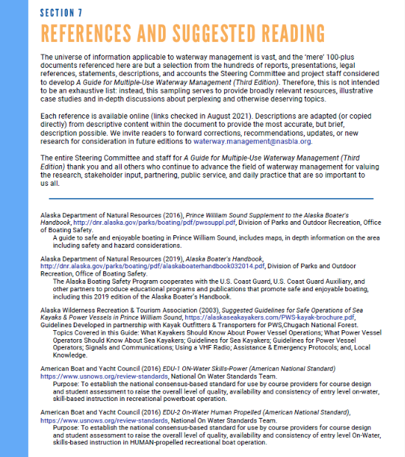
…. OVER 100 ANNOTATED REFERENCES IN SECTION 7!
Notes:
… in fact, the Section 7 References and suggested Reading list includes links and short descriptions for over 100 of references and background materials of relevance to Waterway Management. There is also an in-depth index to the Guide content.

Slide 25
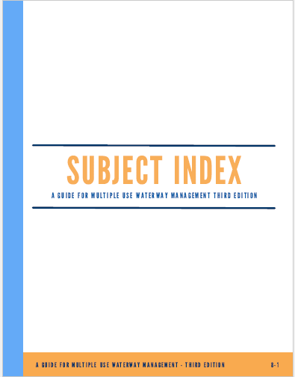
Notes:
… in fact, the Section 7 References and suggested Reading list includes links and short descriptions for over 100 of references and background materials of relevance to Waterway Management. There is also an in-depth index to the Guide content.

Slide 26
Notes:
Over two years, Guide development was overseen by the Project Steering Committee who have contributed significantly to the content and presentation of this work. As you can see, the Steering Committee represented a wide range of use experiences and expertise.
After a planned in-person meeting was cancelled in April of 2020, the Steering Committee regrouped, meeting in full session via teleconference on 13 separate occasions, which included development and launch of a nationwide survey generating nearly 3500 responses. As Risa indicated, results of the survey significantly shaped the content and context of the Guide….

Slide 27
A GUIDE For MULTIPLE USE WATERWAY MANAGEMENT (THIRD EDITION) USCG GRANT 1192.08 TOM DARDIS, GTM
Notes:
I would be remiss if I did not recognize our Grant Technical manager, Tom Dardis, and the NASBLA staff and contractors pushed this project forward to completion and availability. We hope this Guide will significantly advance understanding of this complex topic.

Slide 28
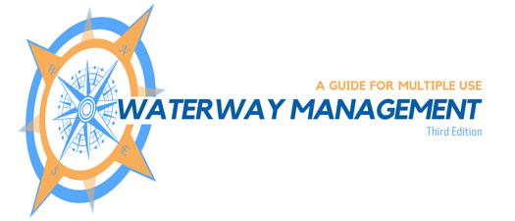
Questions?
DOWNLOAD at www.waterwaymanagement.org
Pamela Dillon, pam@nasbla.org
Risa Shimoda, executivedirector@river-management.org
Notes:
Thank you. I hope to see many more topics surrounding Shared Waterways discussed in future meetings and conferences.

