Slide 1
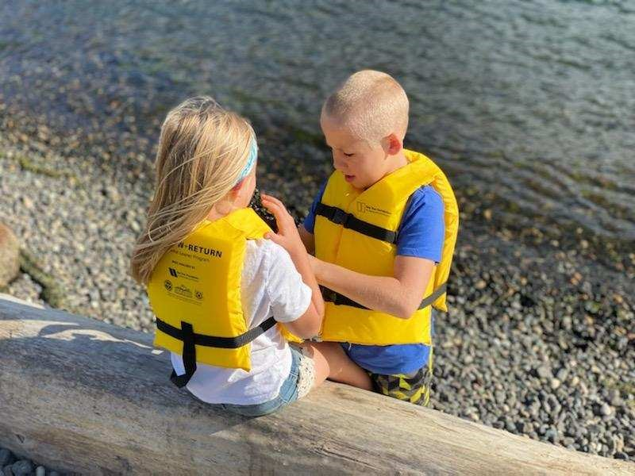
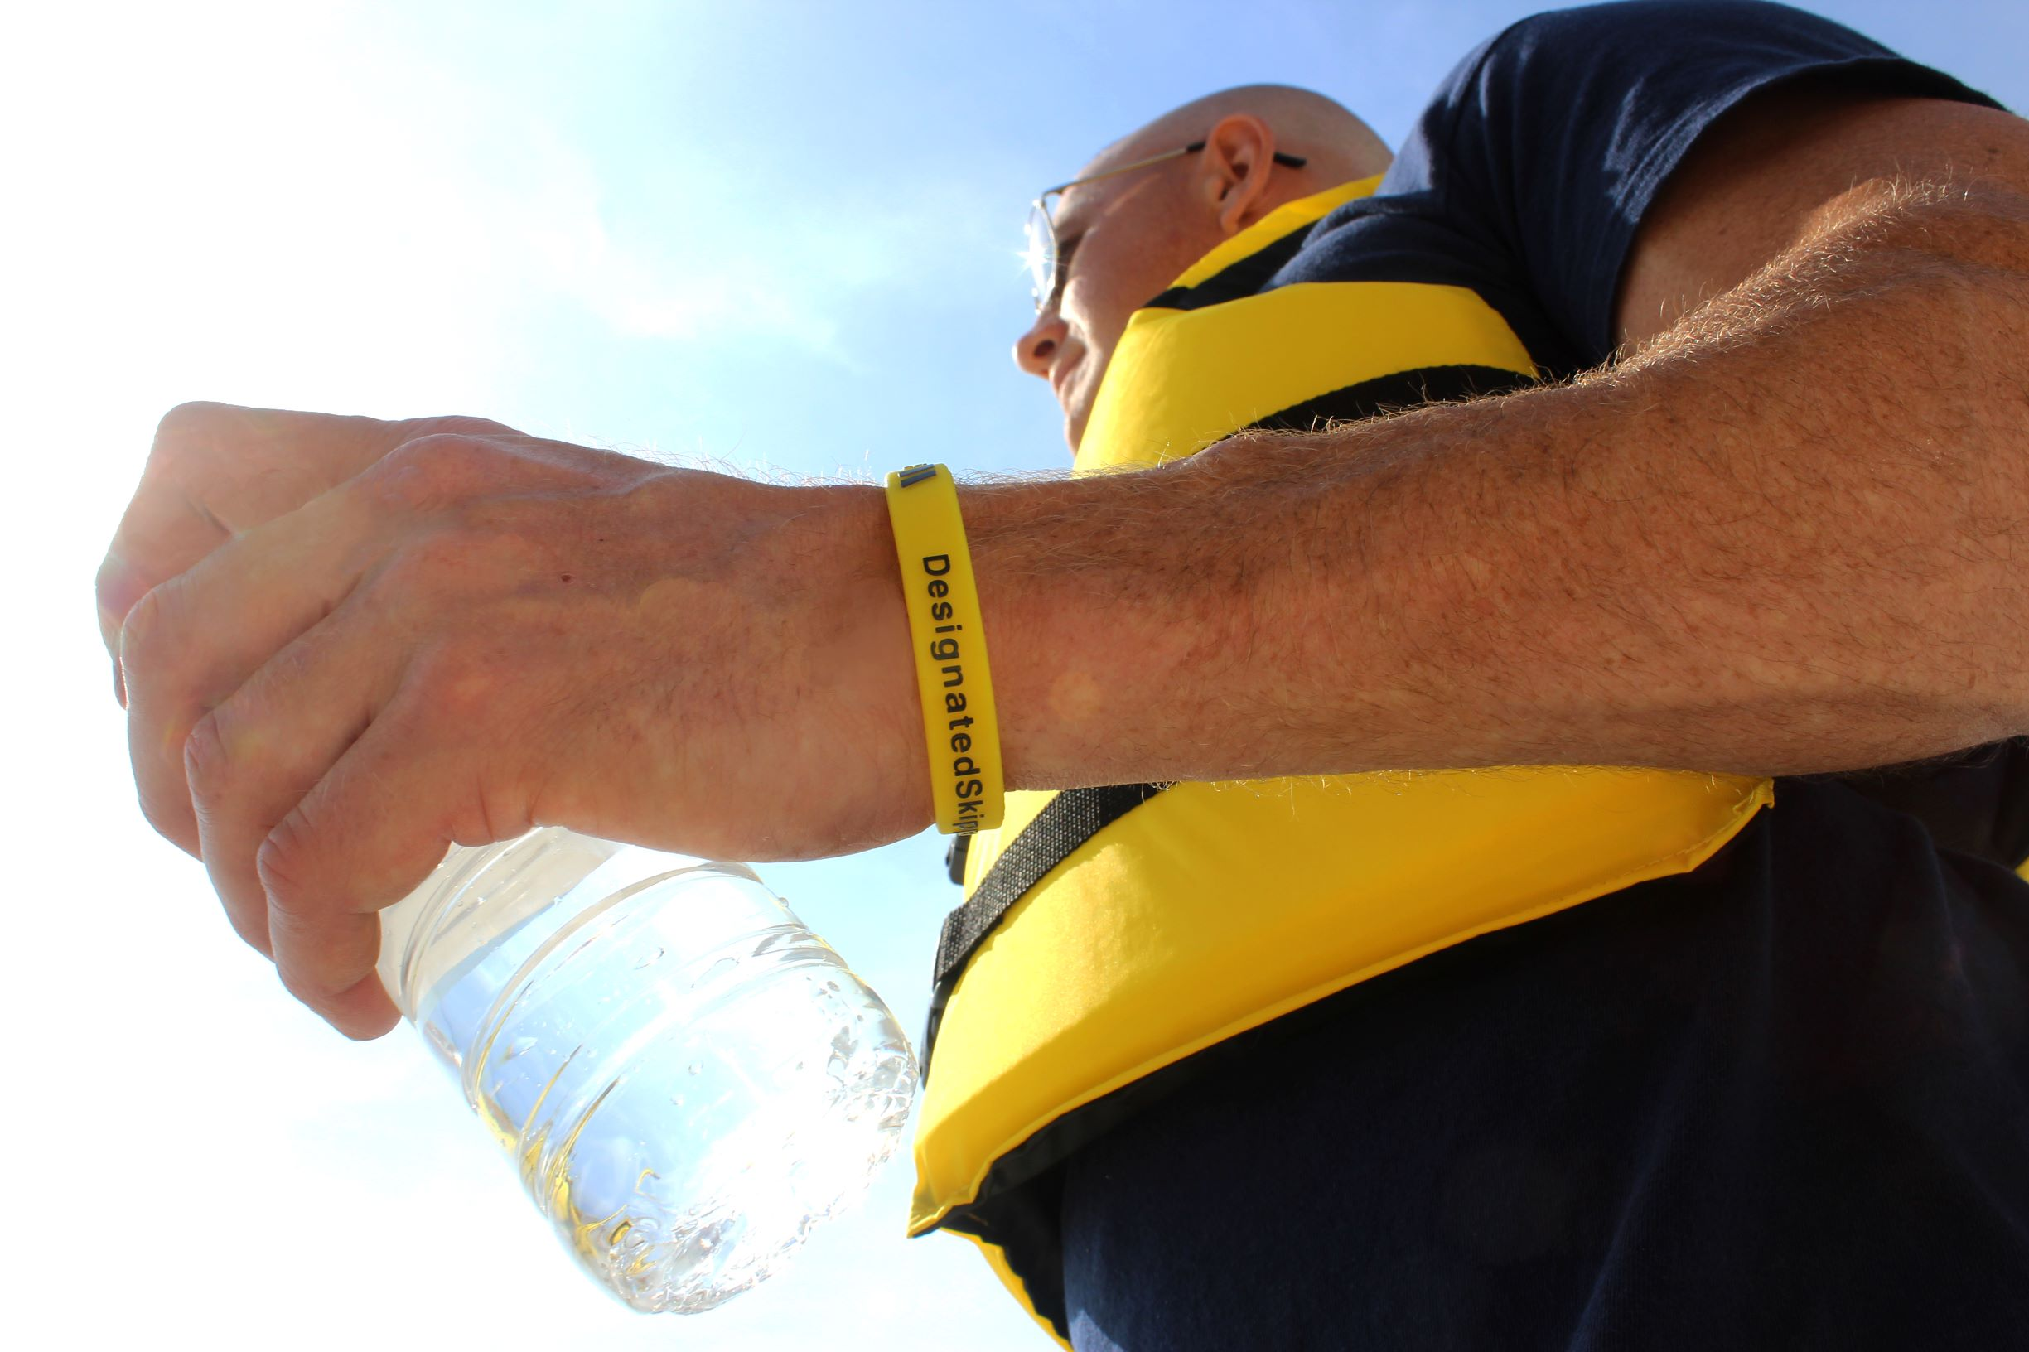
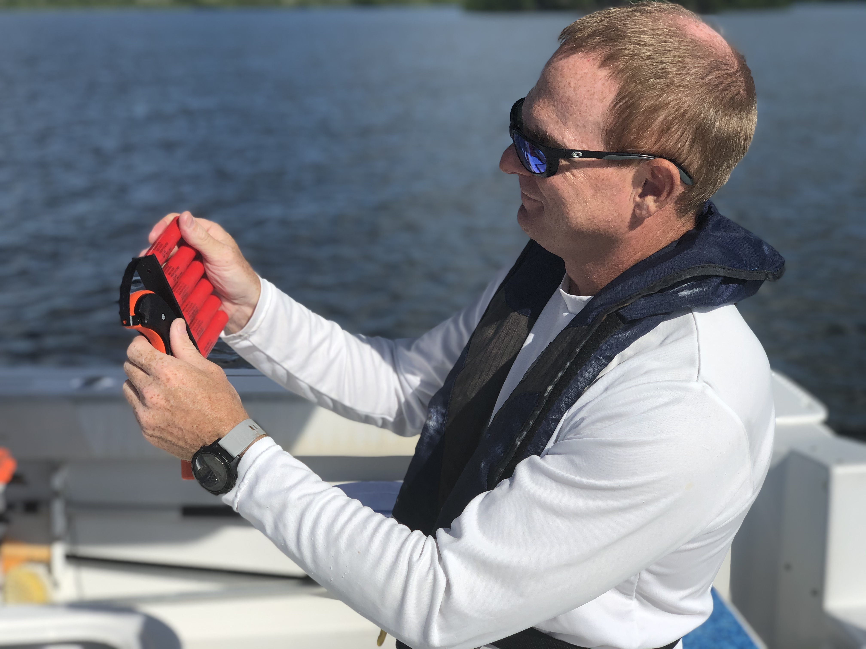
Sea Tow Foundation Grant Update IBWSS – March 16, 2022

Slide 2
We have 4 Active Grant-Funded Programs
Life Jacket Loaner Program
Sober Skipper Campaign
Flare Research Grant
Electronic VDS Education & Awareness
Notes:
The Sea Tow Foundation has 4 active grant-funded programs that I’ll be talking to you about today.

Slide 3
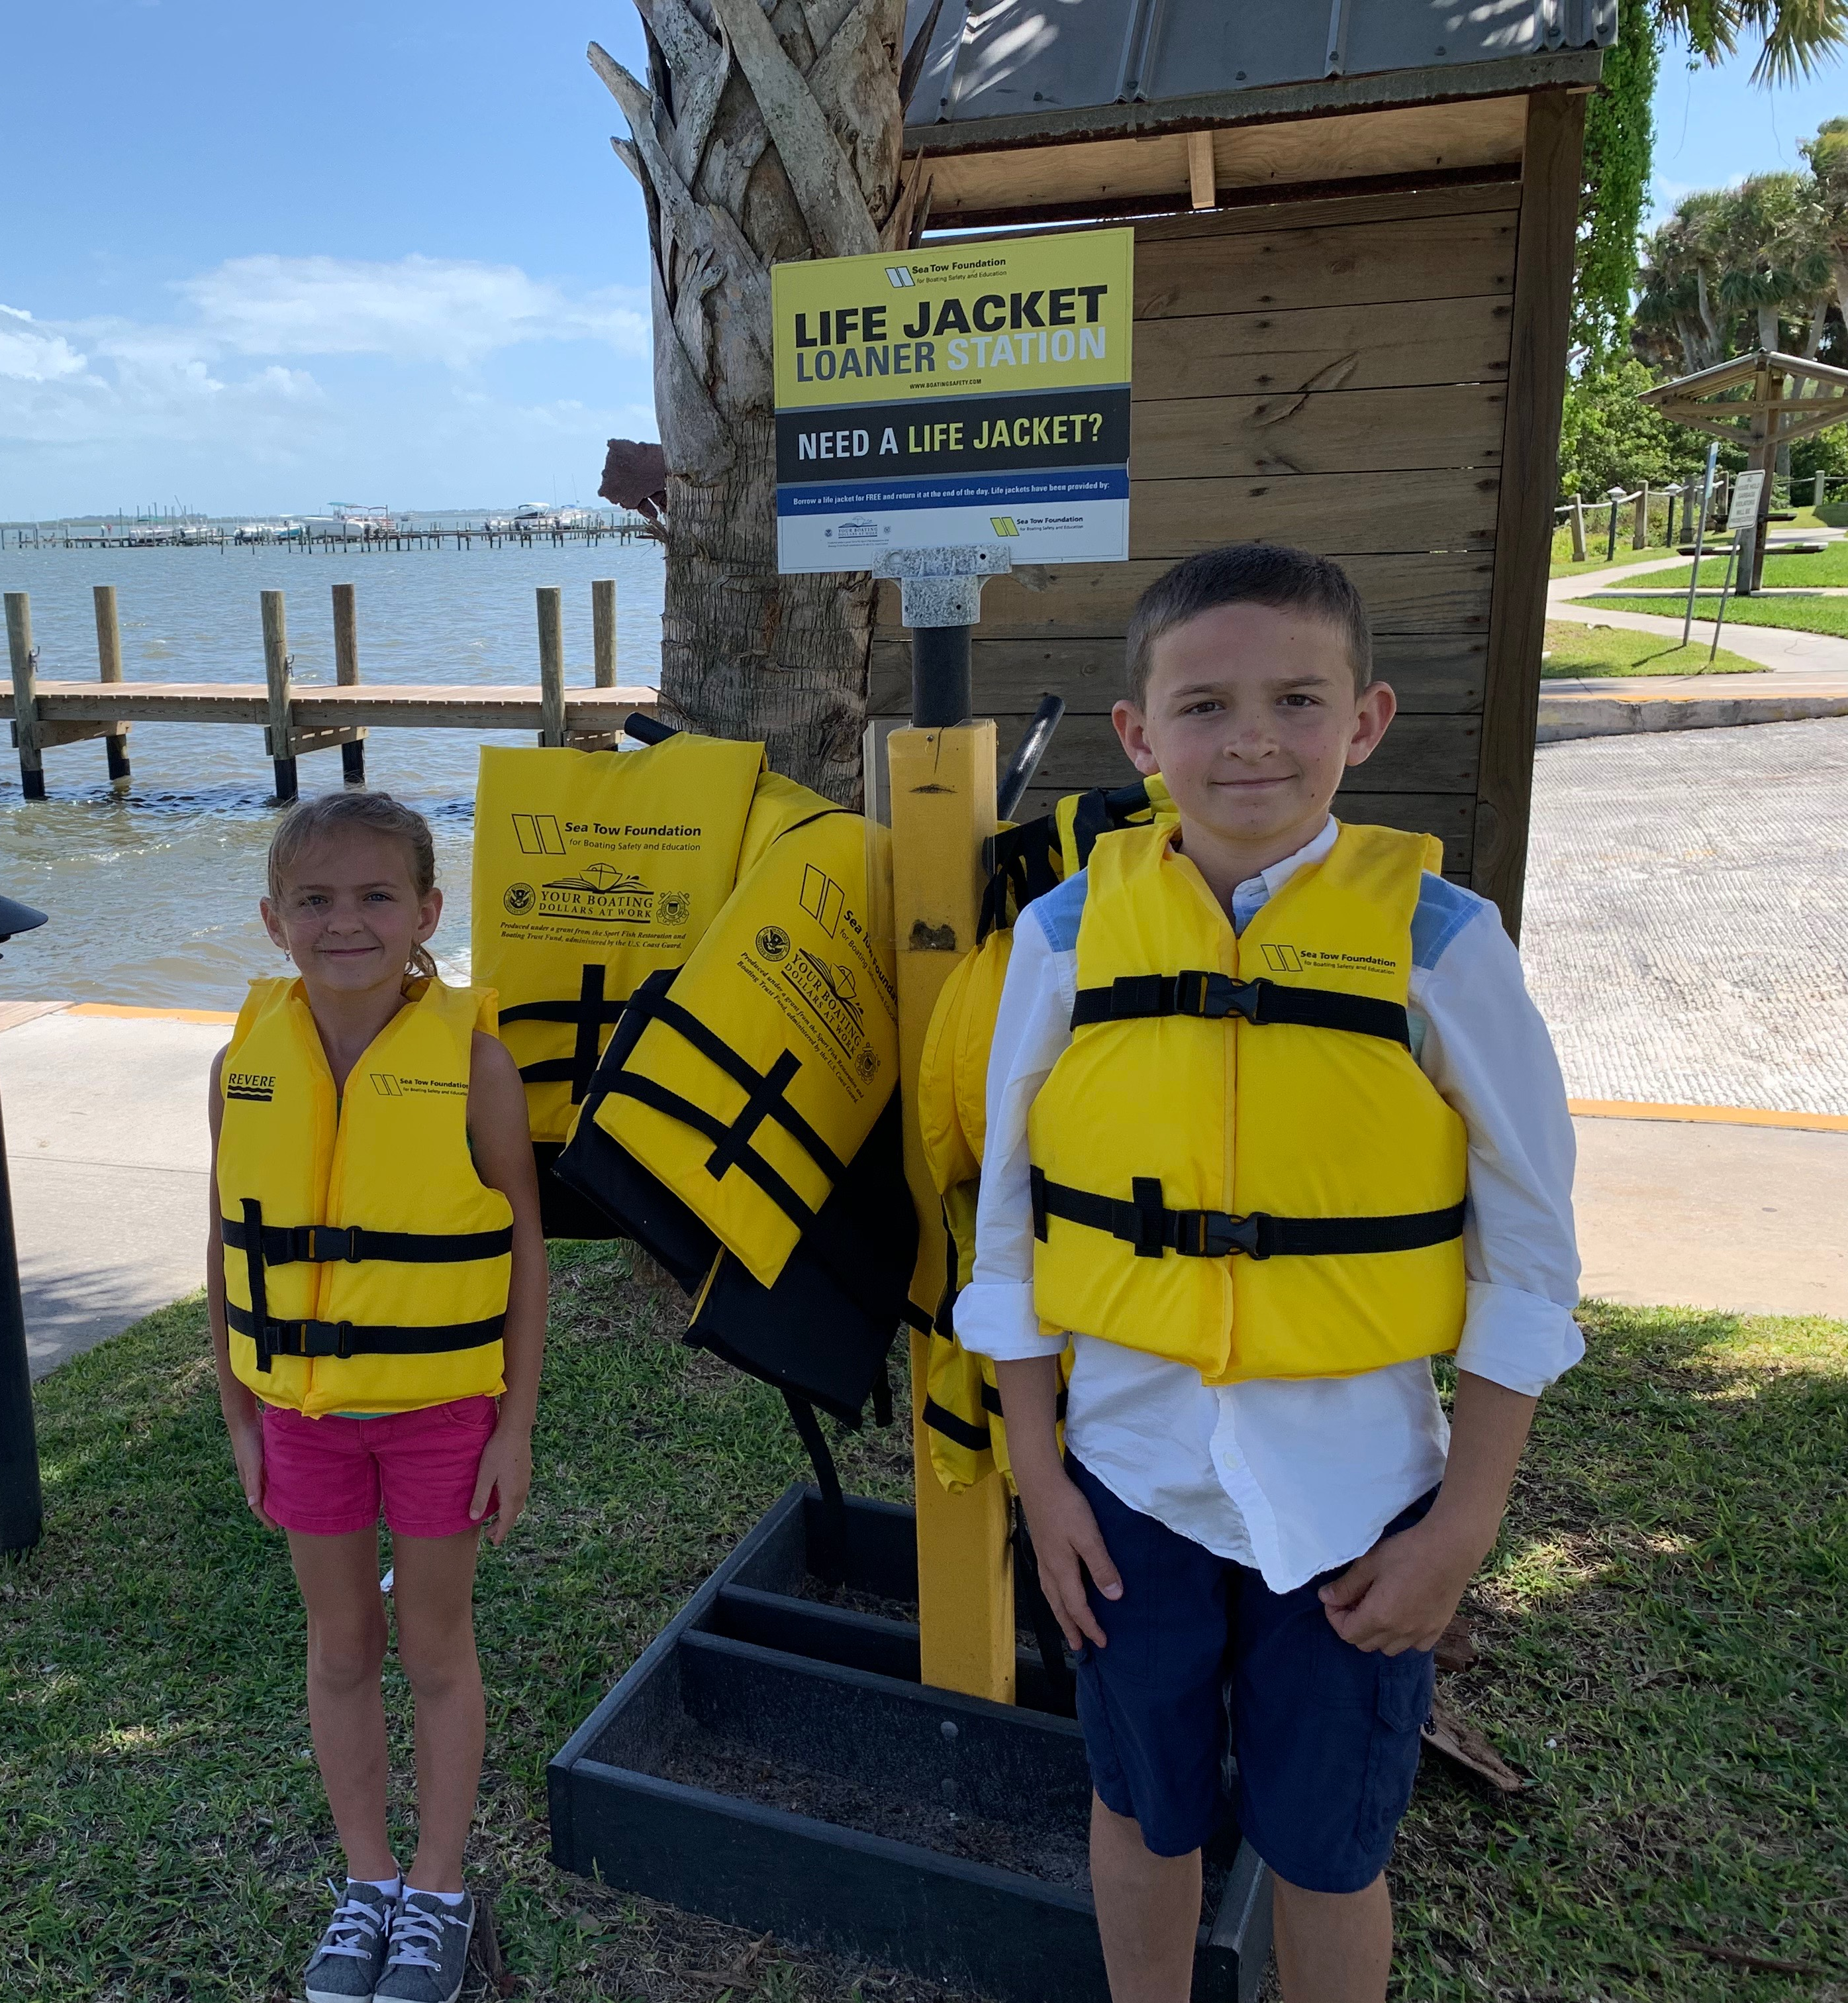
Life Jacket Loaner Program
Began in 2008
Life jackets available for the public to borrow and return for free
Located at boat ramps, fuel docks, marinas, parks, offices, etc.
Loaner station hosts can be businesses, government agencies, municipalities, small non-profits, and Sea Tow Franchisees
Notes:
Our longest running program is the Life Jacket Loaner Program.
It is starting its 14th season this summer and this is the 3rd year of our 3 year grant awarded by the US Coast Guard.
The basic concept is that the program makes life jackets available for free for boaters and water users to borrow at boat ramps, fuel docks, marinas, state and local parks, offices and lots of other places.
We work with businesses, government agencies, municipalities, small non-profits and the Sea Tow franchisees to locally host the stands.

Slide 4
Over 930 Locations and Growing!
www.boatingsafety.com/map
Notes:
We currently have over 930 locations where Sea Tow Foundation life jackets can be found as indicated by the yellow pins on the map.
The purple pins are where other life jacket loaner programs are located. They have shared their locations with us to help boaters find them. And we’re always adding more locations, so you can visit the website on this screen and provide us with your locations to share on the map at no charge. Our goal is to make sure that boaters know where they can find life jackets to borrow to prevent drowning.
We only have 3 states left to fill up the map – Arizona, North Dakota and Vermont – and we received applications from all 3 of these before the applications closed on February 1st, so we will be able to claim that we have all 50 states, DC and 4 territories by the start of this summer! The only territory missing are the Northern Mariana Islands.
The organization that has the most locations containing Sea Tow Foundation life jacket loaner stations is the US Army Corps of Engineers.

Slide 5
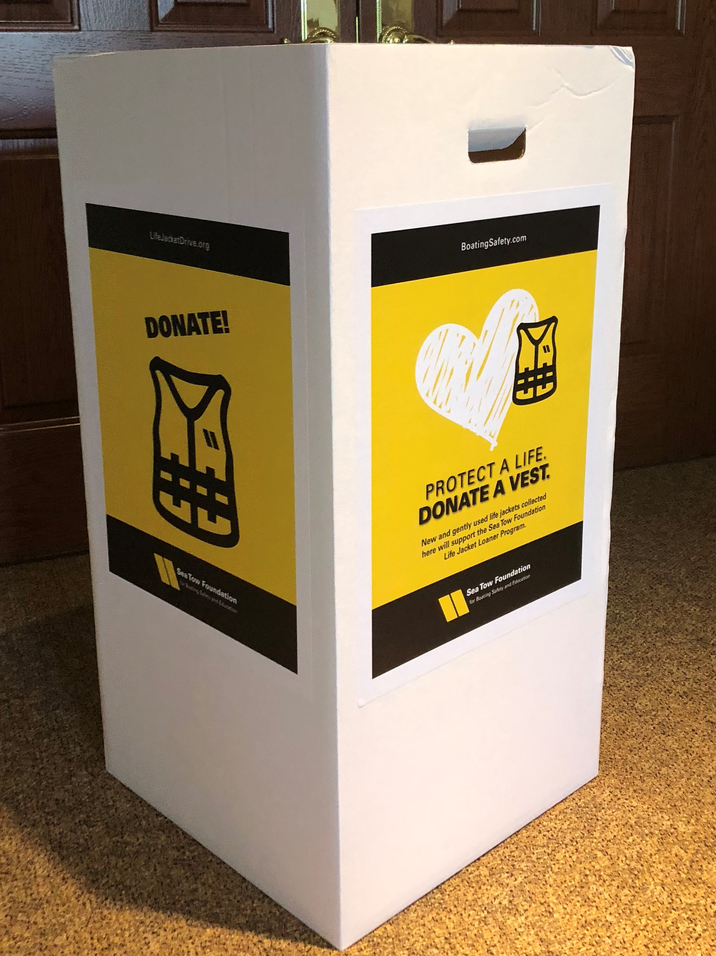
Life Jacket Drive Program
Way to collect new and gently used life jackets from the local community for a life jacket loaner station
Provided by the Sea Tow Foundation:
Box signage decals
Program Manual
www.lifejacketdrive.com
Notes:
A relatively new addition to our life jacket loaner program is our Life Jacket Drive program which was started 4 years ago. This program allows loaner station hosts to collect new and gently used life jackets from their community to restock a loaner station. We have box labels like those shown on this screen and we also can provide groups with a manual, signage, and PR templates to help them run a collection event in their local area.
This program also works in reverse in that when someone has a life jacket to donate, they can contact us and we then put them in touch with the local loaner station in their area so that they can donate their life jackets to their loaner program. This prevents the need to have life jackets shipped to us and then shipping them somewhere else and encourages them to be reused in their local communities. And, we match them up with the purple pins on the map just as much as the yellow pins, so having more loaner station locations on the map will only benefit you.
In 2021, we had over 900 life jackets that were collected in our Life Jacket Drive, the most in 1 year since the program was started.

Slide 6
Goal: Prevent Drowning
Each year, 3,710 people drown (CDC)
In boating, 534 people drowned in 2020 (USCG)
76% of all fatal boating accident victims
84% were not wearing a life jacket
It takes 30 seconds to put on a life jacket
State boating laws differ on who is required to wear life jackets
Notes:
Why do we continue to work so hard to continue and grow our life jacket loaner program?
We want to prevent drowning
Each year, 3,710 people drown (CDC Statistic)
In boating, 534 people drowned in 2020 (USCG Statistic)
76% of all fatal boating accident victims
84% were not wearing a life jacket
It takes 30 seconds to put on a life jacket and people don’t realize just how tough it is to do that.
State boating laws differ, but usually only certain ages of people, certain types of boats or during cold weather are when people are required to wear life jackets.

Slide 7
We want to work with you!
Promote life jacket wear programs
Help us set up new life jacket loaner stations and care for them
Tell the boaters in your areas about the life jacket loaner station map
Collect new and gently used life jackets to help keep other boaters safe
Notes:
We want to work together more in the future.
So many of the nonprofit organizations have life jacket wear programs and we want to work together to promote your message at the same time that you can share the loaner stand locations to your audience. It will be a win-win for boating and water safety.
We are always looking for new groups to help set up and care for life jacket loaner stations. A lot of Waves of Hope families have reached out to us about setting up loaner stations in memory of lost loved ones. Some of these families haven’t officially joined Waves of Hope, but we let them know about the group and also provide them with the support to host a loaner stand to prevent the tragedy that shook their lives to the core from ever happening to another family. And, we even have groups that are helping maintain existing loaner stations. We have an area in Florida that has 22 stands that were set up by a couple of Sea Tow franchises, but there is no way that the captains and their staff can manage them all, so they work with a bunch of groups including the US Power Squadrons/America’s Boating Club to take care of the stands.
Again, tell your boaters and your members about the life jacket loaner station map and let us know if we need to add or remove any of the pins.
Lastly, we can help you with your own Life Jacket Drive to collect new and gently used life jackets to keep boaters safe. It’s a great way to make sure life jackets get a second life after the original owner outgrows them or doesn’t want them anymore.

Slide 8
Notes:
Our second grant-funded program is our Sober Skipper Campaign.

Slide 9
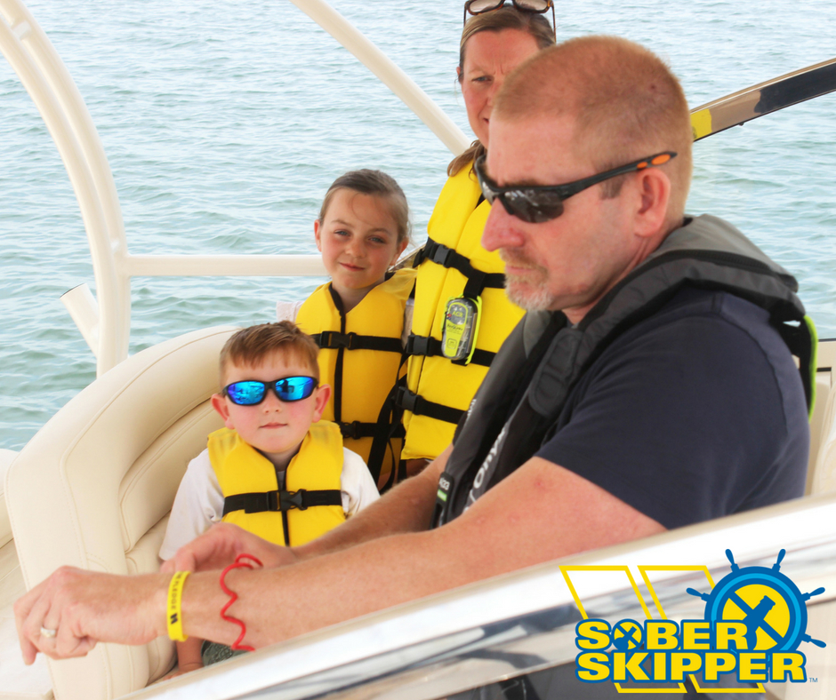
Sober Skipper Campaign
Began in 2014
Ask boaters to make the right choice before every boating trip
Be or designate a sober skipper
Main audience: 26-55 year old males who operate open motorboats, mostly on the weekends
Notes:
The Sober Skipper Campaign is our second-longest running program and has been around since 2014.
Our current grant from the Coast Guard is a 2021-2022 fiscal year project.
The basic idea behind it is that we want boaters to make the right choice before heading out on the water and to be or designate a sober skipper
Our main audience is the 26-55 year old males who operate open motorboats that are 16-26 feet in length and go out mostly on the weekends. This is the demographic responsible for causing the BUI accidents on the water or they are the ones being cited the most for BUI by law enforcement. But, we also have a secondary audience of the family and friends in their lives who can help assert their influence over the men in the target demographic.

Slide 10
Take the Pledge
They will not consume alcohol or drugs
They know how to operate the boat and will do so safely
They will be responsible for the safety of the passengers
www.soberskipper.com
Notes:
What does it mean when we ask boaters to Take the Pledge?
First of all, it means that the Sober Skipper will not consume alcohol or drugs. At all. We know that marijuana use is on the rise as more and more states legalize it for medical or recreational use. At last count, only 17 states haven’t legalized it yet. And, there are tons of other drugs, both legal and illegal that could be an issue as well. Even cold medicine and allergy medicine could be an issue for some people.
The second part of the pledge is that they are a competent boat operator and know how to operate the boat safely. This doesn’t mean giving the helm to a kid so that mom and dad can drink. It means that whomever is driving the boat has been educated on how to operate it which includes docking and navigation.
The last part is that the Sober Skipper will be responsible for the safety all of the passengers in their boat. That means making sure that the passengers don’t do anything dangerous and, if necessary, that means making the passengers wear life jackets, stay seated and stop them from drinking any more alcohol.
We have wristbands that we send to everyone who takes the pledge and we also have wristbands in packs of 100 and will soon have a new stock of floating key chains that we can send to you for free so that you can promote Sober Skipper.

Slide 11
Goal: Eliminate BUI Accidents & Deaths
Alcohol is the leading known contributing factor in fatal boating accidents (USCG Statistics)
Accounts for 18% of deaths
Sober Skipper = non-alcohol drinking, non-drug taking, qualified boat operator designated BEFORE getting in the boat.
Sea Tow Foundation surveyed a segment of boaters in January of 2020 and 83% of them reported that they were likely to utilize the Sober Skipper concept
Notes:
The goal of the Sober Skipper Campaign is to eliminate Boating Under the Influence accidents and deaths.
BUI is 100% Preventable and there is no excuse for anyone to drink or do drugs. Ever.
Alcohol use is the leading known contributing factor in fatal boating accidents and accounts for 18% of all deaths. In 2020, that was 115 deaths.
That’s why we defined the sober skipper as a non-alcohol drinking, non-drug taking, qualified boat operator. And why we want the Sober Skipper to be chosen before the group of people get in the boat.

Slide 12
Results from Beta Survey of Boaters
January of 2020
Survey sent to 79,000 boaters in select states via email
82.5% agreed or strongly agreed with the Sober Skipper concept
70.4% were likely or very likely to share the Sober Skipper concept with other boaters
83.3% would be very likely or likely to utilize the Sober Skipper concept on their next boating trip
Notes:
The Sea Tow Foundation contracted with Dr. James Lange to conduct a survey of a small segment of boaters. Dr. Lange is and internationally recognized researcher in the Alcohol and Other Drug (AOD) abuse field and he serves as a tenured faculty member and researcher at San Diego State University and is also the Executive Director of the Higher Education for Alcohol and Drug Misuse Prevention and Recovery at The Ohio State University. He’s published dozens of research-based articles on the role of alcohol use in passengers of cars while studying designated driver and has also noted that the concept would apply to boating as well.
While the Sea Tow Foundation had wanted to conduct a nationwide survey and has requested funding to do so on a number of occasions, the funding was not provided to do so. Therefore, the survey took place using 79,000 Sea Tow members located in Connecticut, Florida, Massachusetts, New York and Rhode Island because we had access to that member list without paying for a list of registered boaters elsewhere. We emailed the survey initially out and got 3,670 responses.
We did not use the actual term “Sober Skipper” because one of the later questions dealt with name recognition and we didn’t want to skew our results by providing the campaign’s name in the survey questions.
What we told the respondents was that if there was a campaign designed to encourage the boating public to make sure at least one person is capable of operating the boat and that person is alcohol and drug free while underway, how would you rate your agreement, would your share this concept with other boaters and how likely would you be to utilize the concept on your next boating trip. As you can see, 82.5% agreed or strongly agreed with the concept, 70.4% would share the concept with other boaters and 83.3% would use it on their next boating trip.

Slide 13
Campaign Name Recognition
Have you seen or heard of any of the following boating safety campaigns?
Campaign Name | Yes | Uncertain | No
Life Jackets Lift Lives (BOGUS) | 30.1% | 10.3% | 59%
Life Jacket Loaner Program (REAL) | 45.6% | 5.7% | 48.6%
Sun Care is Boat Care (BOGUS) | 13.1% | 9.9% | 77.0%
Wear It (REAL) | 31.3% | 10.5% | 58.0%
Wakes Make Others Shake (BOGUS) | 11.6% | 7.9% | 80.6%
Cannabis and Boats Don’t Mix (BOGUS) | 12.4% | 5.7% | 81.9%
Take the Sober Skipper Pledge (REAL) | 13.8% | 8.3% | 77.8%
Notes:
Going back to the campaign name recognition, since we’d been using the term “Sober Skipper” for roughly 5 years at the time of the survey, including in newsletters and social media, we thought it would be highly recognizable, but that was not the case. We included other real campaign names along with bogus names when we asked the respondents if they had seen or heard of any of them. As you can see, none of the 3 real campaigns (shown in green) scored higher than 45% in terms of name recognition. But, the Life Jacket Loaner Program and the Wear It Program have both been around for a long time and have been highly successful, which shows that the name alone is not all that goes into a campaign. A campaign needs multiple ways of reaching their audience in multiple locations. As Dr. Lange, the researcher, said, “It all comes down to cueing or reminding people of the message.” And advertisers will tell you the same thing. People need to see the message lots of times in lots of different ways to believe it and buy into it.

Slide 14
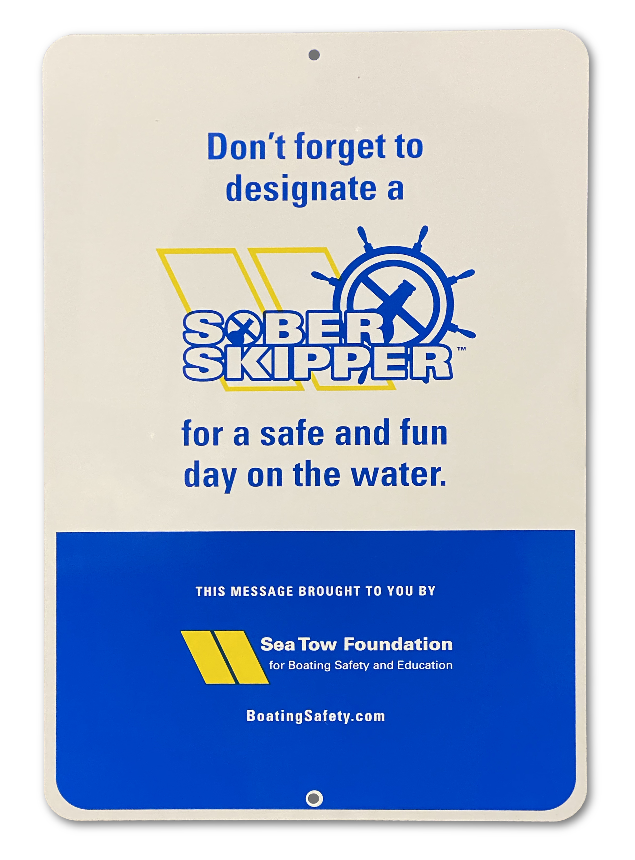
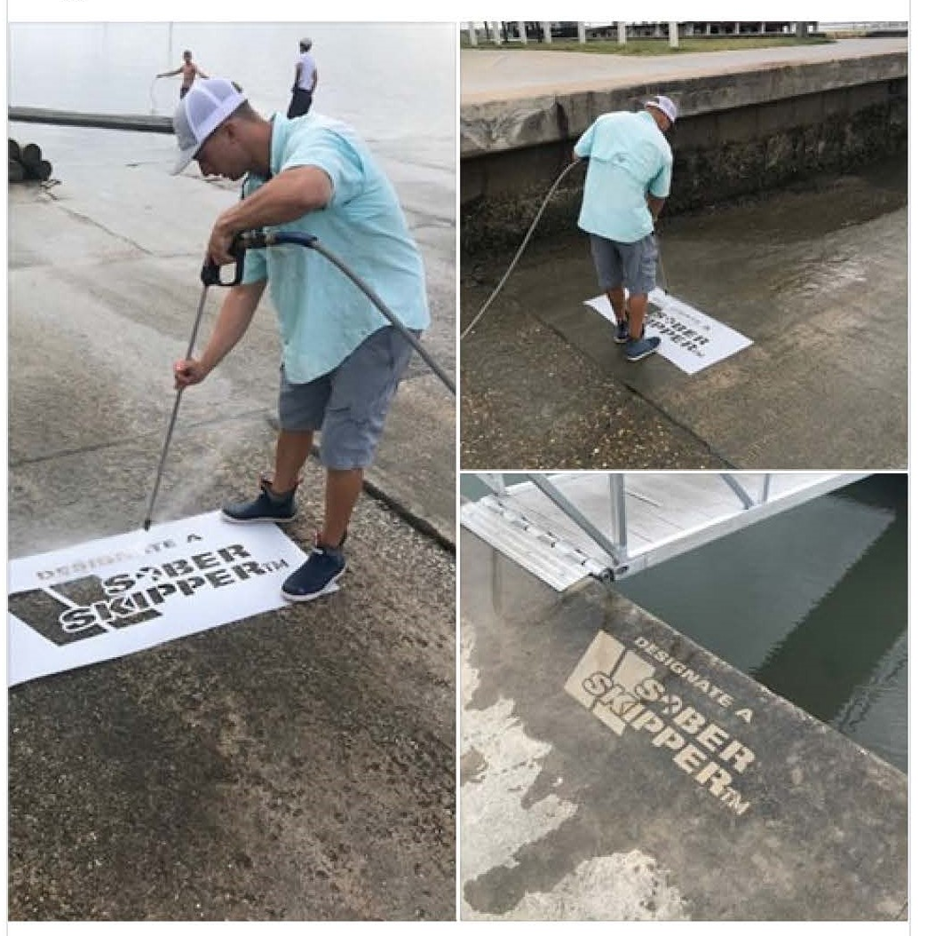
Notes:
With that in mind, the Sea Tow Foundation developed aluminum signage and a stencil to help spread the Sober Skipper message. Our in-person events (like many others) were cancelled as a result of COVID and so our partners and friends in the boating industry weren’t able to give out Sober Skipper floating key chains and wristbands at boat shows, festivals, vessel safety checks, in classroom boating safety classes, or in other places. But, we still wanted to get the message out so that boaters, especially the hundreds of thousands of new boaters that entered the waters as a result of COVID, would see it.
The aluminum sign is about the same size as a parking lot sign and the stencil can be used with traditional paint, but we encourage people to use water so that it is a Clean Graffiti Stencil. A power washer blasts the stencil image into a surface and we’ve found that it lasted for over 9 months in Florida on their boat ramps, sea walls and sidewalks. We made 100 of each available for free last year to see how well they were used, and they were a success. Right now, we have both available for sale, but we hope to make more available for free before the summer starts.

Slide 15
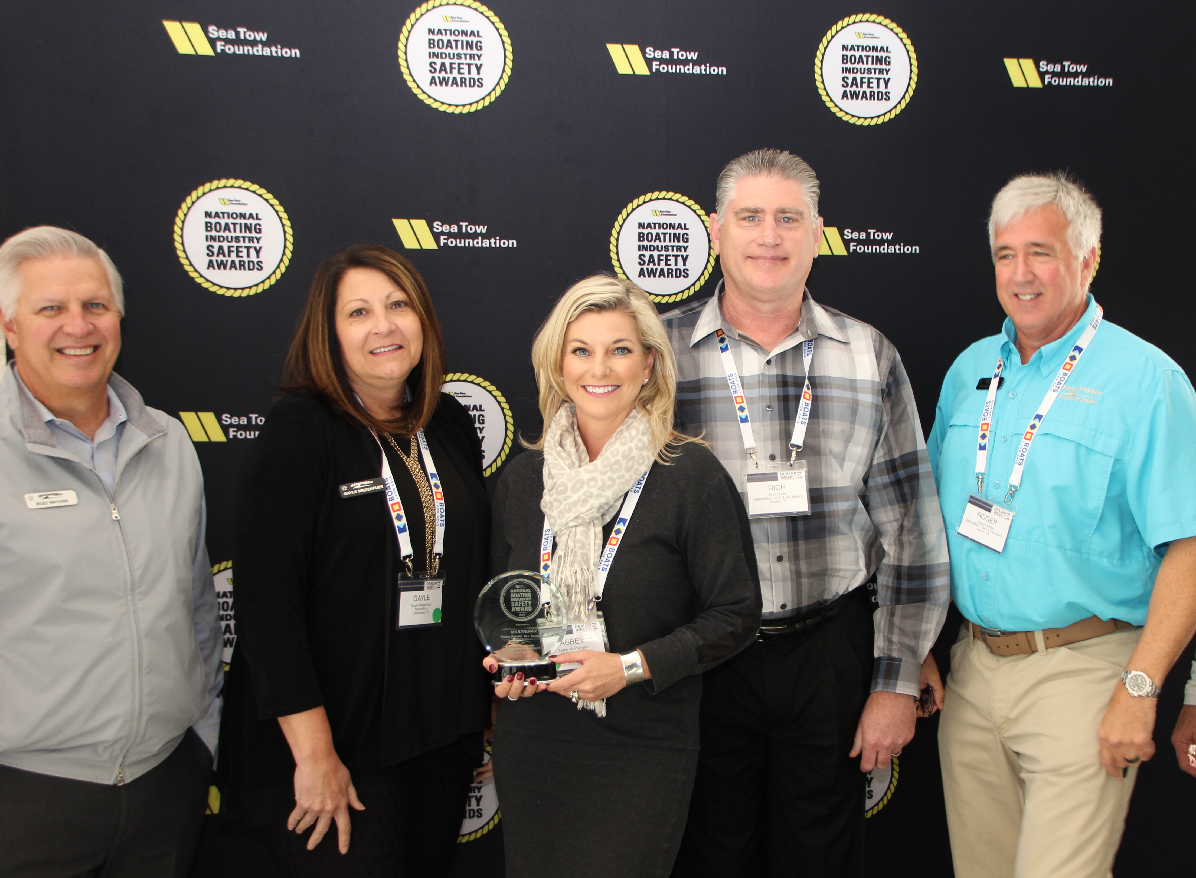
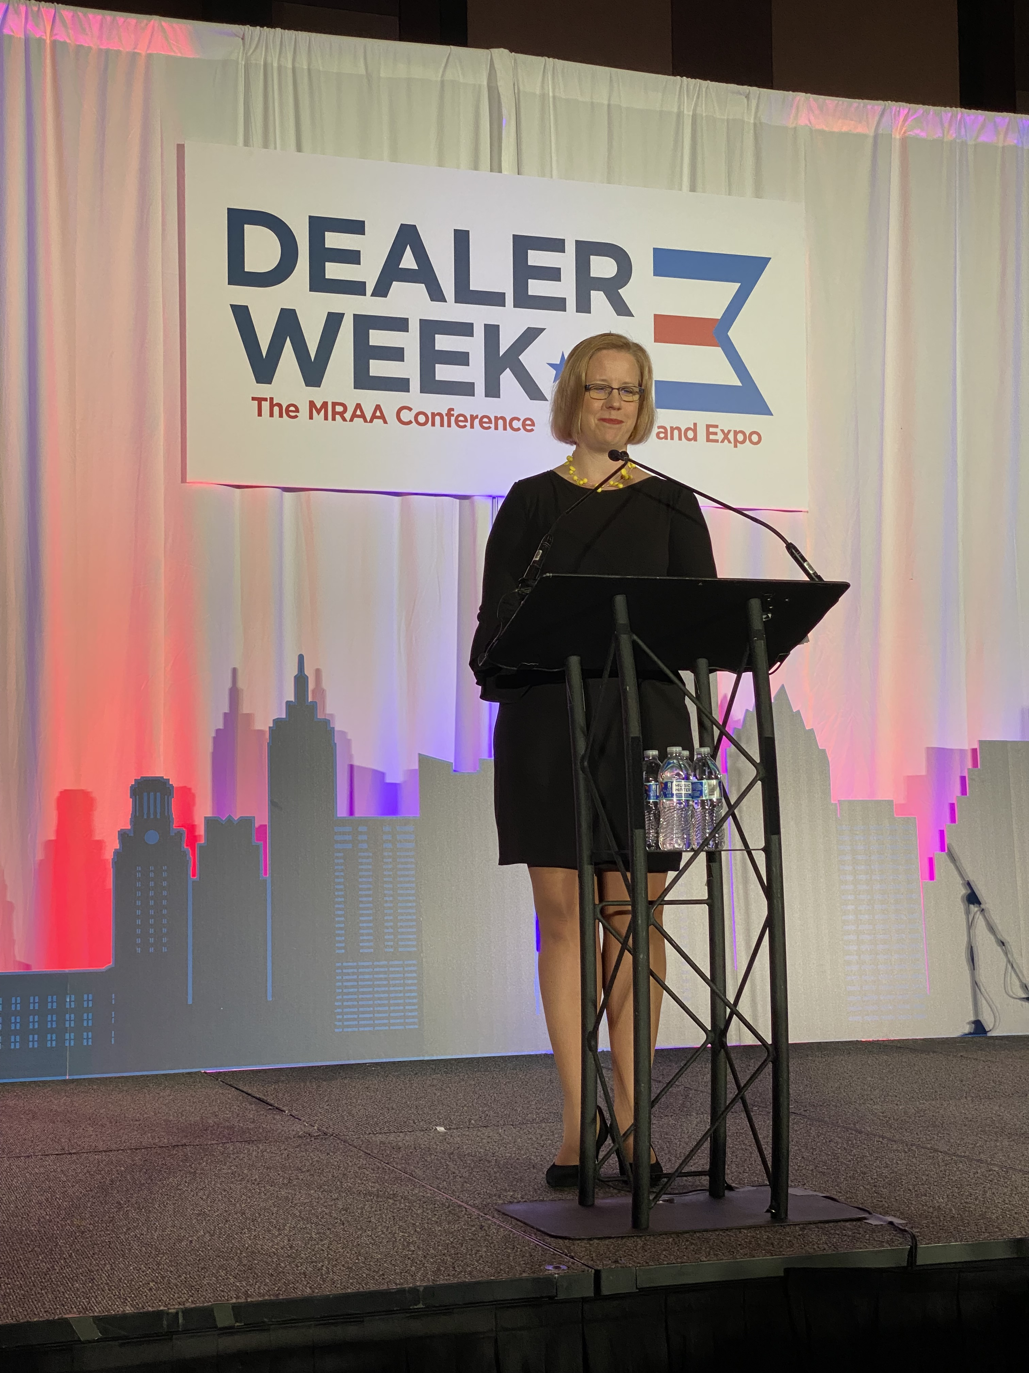
National Boating Industry Safety Awards
Awards generated $1.35 Million in media value as of the end of 2021
Notes:
The National Boating Industry Safety Awards have been around for 3 years and they were developed as part of the Sober Skipper Campaign in an older grant year. The Sea Tow Foundation’s Boating Safety Advisory Council oversees the awards and the council is made up of some of the big movers and shakers in the boating industry including Boating Magazine, Freedom Boat Club, Yamaha, NMMA, Mercury Marine, West Marine, Marine Max, Cruising World, Boating Industry Magazine, and the Recreational Boating & Fishing Foundation.
The goal behind the awards is to recognize for-profit boating industry representatives who are promoting boating safety initiatives. These include encouraging boaters to wear life jackets, using VHF radios, using Engine Cut off Lanyards, recommending that boaters take a boating safety course, designate a sober skipper, and lots of other topics.
We’ve awarded them since 2019 and this past year’s awards were presented on the stage at Dealer Week in Austin, TX in front of 3,000 boat dealers, manufacturers and retailers. Past and current winners have included MarineMax, Sea Ray Boats, Garmin, Freedom Boat Club, FELL Marine, Rapid Media, Bonnier Corporation, Yamaha, and many more.
And these awards have meant big media numbers for the Sea Tow Foundation. The 2021 awards led to 119.6 M impressions valued at $13.7 M so far. And with every mention of the awards, we are talking about boating safety that the for-profit industry is paying attention to because it deals with their competitors or their partners in business. And it is showing that boating safety doesn’t have to be a bad word any more and it doesn’t have to be hidden. Just walking around the Miami Boat Show last month showed that there are some companies that are really promoting boating safety front and center. Sea Doo (BRP) had a huge life jacket display on how to pick the right life jacket for your boating activity in the convention center and then had life jackets for every person going out on their boats at the in-water portions of the show. And, Grady White had a video at their display showing people having a great day on the water and included life jackets on every person, use of the engine cut-off lanyard, water and soda in the cooler instead of alcohol, and the list goes on. Companies are getting it and we are starting to see a change.

Slide 16
Flare Disposal Research Grant
Project Started in 2020
Pyrotechnic Flares
Meet USCG requirements for Visual Distress Signals
Expire after 42 months
Can burn people/property
Burns for only a few seconds to a few minutes
Contain toxic chemicals
Must be incinerated
Developed Flare Incineration Project as Beta Test in Florida
Notes:
The grant project was started in July of 2020
The reason behind the project is that Pyrotechnic Flares have a lot of issues.
Meet USCG requirements for Visual Distress Signals
Expire after 42 months
Can burn people/property
Burns for only a few seconds to a few minutes
Contain toxic chemicals
Must be incinerated
And if each boater was carrying the minimum of 3 flares and then getting 3 more when the first ones expired, we are looking at millions of expired flares that need to be disposed of.
Developed Flare Incineration Project as Beta Test in Florida

Slide 17
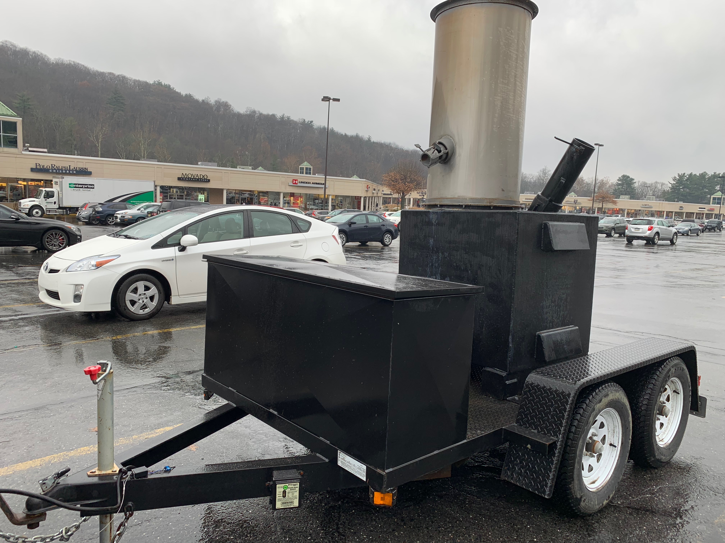
Flare Disposal Problems
USCG Study from 2014 was basis for project along with 2000 EPA study in Florida
Project met the requirements for DOT, FHA, ATF, and EPA and we had insurance
Plan was to collect flares at public events in ATF-approved storage containers
Take flares to off-site location for incineration
Notes:
The project was based off a 2014 study conducted by the USCG that looked at flare disposal options and suggested a pilot project modeled after an existing program in Canada.
Another study conducted by the EPA in Florida looked at flare disposal options and suggested a mobile thermal destruction burn unit or incinerator to be used to dispose of flares
Other states had worked with military bases to collect flares, but that option was no longer possible after 9-11
So, the proposed project met the requirements of the Dept. of Transportation, the Federal Highway Administration, the Alcohol Tobacco and Firearms and Environmental Protection Agency, and we got insurance coverage.
The plan was to collect flares at public events throughout Florida, store them in ATF approved storage containers, then take them to an off-site location for incineration in this mobile incinerator pictured on the screen. The incinerator could be pulled by regular truck or SUV and it ran off propane tanks. We would burn the flares at a fire department training facility and then the ash would be disposed of in the regular trash as inert.
And in the space of just 2 weeks in November of 2020, that all ended. We learned that the EPA required all operators of hazardous waste to get a TSD permit. That is for the treatment, storage and disposal of the waste. And, because the incinerator was mobile, the permit would be needed for each location it would be parked. Each location’s permit cost $32,500.
Then, a flood plain map would be needed for each location where the incinerator would be located.
And then a Hauler Permit was needed to transport the flares. “But wait,” I said. “The Dept of Transportation requires that Class 1.4 explosive devices need to be put into ATF storage containers and that there isn’t anything additional needed for transporting them,” but I was told the EPA law supersedes that (which it does).
We would also need a chemical analysis of every burn to ensure the ash was inert plus compliance monitoring fees to ensure the incinerator was properly inspected and maintained. And a bond would need to be set aside as financial assurance funding in case we skipped town and left a mess to be cleaned up.
Oh, and they suggested that we contract with an environmental attorney to assist with the permits and requirements.
Total cost per location was estimated to be $85,000 before hiring the attorney.
We looked at other states and found that all had expensive permitting, so we approached the planning committee and recommended getting refunds on ordered items before they were shipped and contacted the coast guard for next steps. The Coast Guard was part of the planning committee and agreed that stopping was the best option, but they suggested that we conduct research into flare disposal options and what is available, so we revised the grant scope, revised the budget and got a one-year extension to complete the work.

Slide 18
Flare Disposal Research Results (so far)
When asked if they were aware of existing flare disposal options in their state:
BLAs – 23%
EPA Office – 6%
Waste Management Locations – 43%
Marinas, Boat Dealers and Yacht Clubs – 9%
Notes:
In conducting the research, the first task was to collect data and the best method to do that was to develop surveys. We sent the survey to lots of audiences with slight variations for each audience. And, we learned that there either aren’t a lot of flare disposal options or the BLAs, EPA offices, Waste Management facilities and the marina, boat dealers and yacht clubs haven’t found them.
In fact, we found that most waste management locations have the mechanism to deal with flares, but don’t have the insurance coverage. So, they don’t advertise that they take flares, but when they get a few, they can take them. However, opening up to taking thousands would be difficult for them because they aren’t getting paid to handle flares like they are to handle regular waste.
Our next step is to survey boaters to find out if they know about flare disposal options. I’m betting that it will be the lowest number score yet.

Slide 19
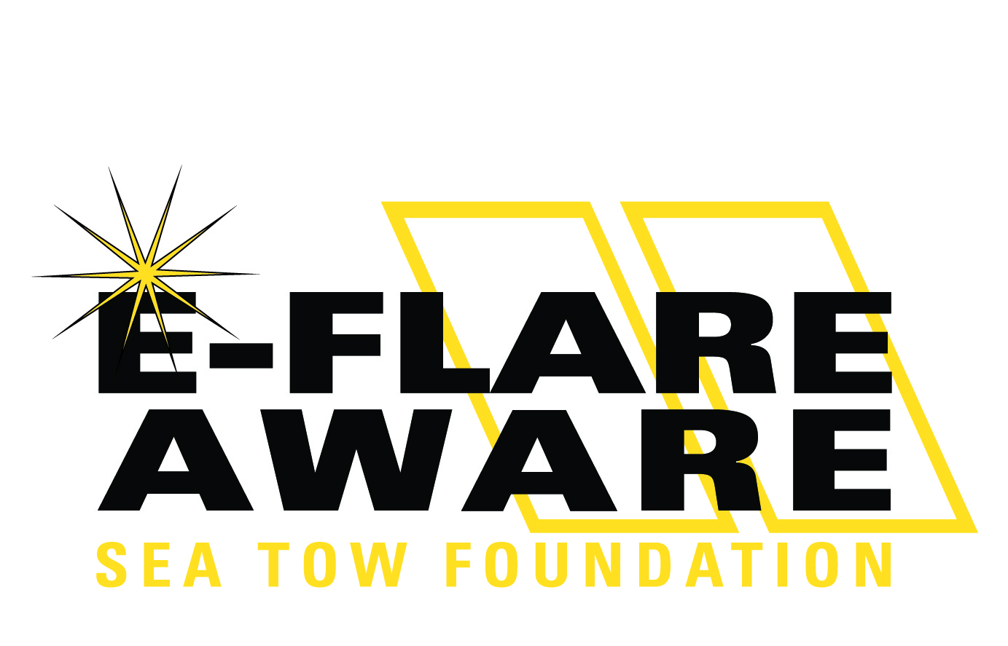
Notes:
So, our newest program and the last grant funded project to talk about is our E-Flare Aware Program. Actually, the full name is the Electronic Visual Distress Signal Education and Awareness Grant.

Slide 20
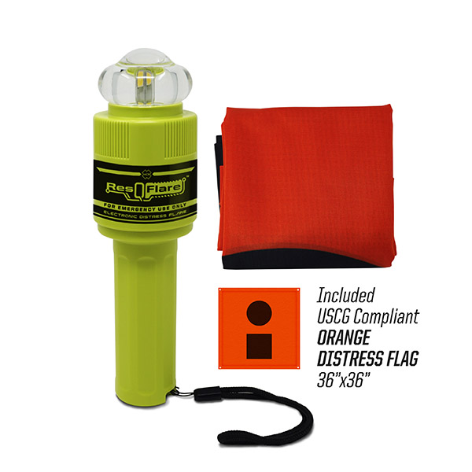
What is an E-Flare?
Electronic Visual Distress Signals (DVS) Devices
Certified by the US Coast Guard
Meets Carriage Requirements
Never Expires – just replace batteries
Can be used again and again
Light lasts 2-6 hours (some up to 20 hours)
Visible for miles
Floats and is waterproof
Safe to use and won’t burn you
A few manufacturers make them
Notes:
So, e-flares are relatively new to the market, but they are certified by the USCG and meet carriage requirements along with an orange distress flag or some other type of daytime signaling device. The majority are sold with the flag.
The e-flares never expire and run off of regular batteries that must be replaced after it’s been used or whenever is recommended by the manufacturer. And, they can be used again and again, unlike pyrotechnic flares.
The light lasts for 2-6 hours and, in some devices, up to 20 hours. Much longer than the 2-3 minutes of a pyrotechnic flares. And the light is visible for miles.
The e-flares float and are waterproof, unlike pyrotechnic flares, plus they won’t burn you. You could give an e-flare to your 5 year old to hold and not worry whereas you’d never give a flare to a 5 year old.
The cost of an e-flare is about 2-3 times the cost of a pack of pyrotechnic flares, but without the need to replace them or risk burning yourself and your boat, the e-flare will pay for itself.

Slide 21
Goal: Educate boaters on e-flares
When asked if they were aware of an alternative to pyrotechnic flares that is certified by the USCG and meets carriage requirements and is known as an electronic visual distress signal (eVDS):
State BLAs: 21% were not aware
EPA Office: 64% were not aware
Waste Management Office: 63% were not aware
Marina, Boat Dealer, Yacht Club: 16% were not aware
Notes:
In the same survey that I mentioned earlier, we also asked whether the audience was aware of an alternative to pyrotechnic flares that is certified by the USCG and meets carriage requirements and is known as an electronic visual distress signal (eVDS):
State BLAs: 21% were not aware
EPA Office: 64% were not aware
Waste Management offices: 63% were not aware
Marina, Boat Dealer, Yacht Club: 16% were not aware
And, again, we haven’t asked boaters yet, but just in general conversation, I doubt they are aware of them. What is the most troubling is that nearly a quarter of the BLAs aren’t aware of E-Flares which means that their staff members likely aren’t as well. So, if a boater gets stopped by a law enforcement officer and is boarded to check for safety equipment, if the boater were to produce an e-flare, the officer is likely to write a ticket to those boaters for failure to carry flares when these devices meet carriage requirements.

Slide 22
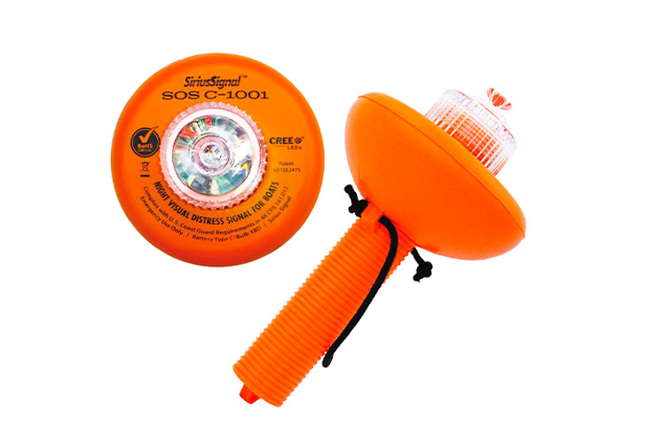
Next steps for the E-Flare Grant
Video/photo shoot
Webpage
Social Media
Brochure
Ready by the summer boating season to help bring awareness to boaters on these devices
Ask for help distributing information to boaters in your networks
Notes:
I just got back from shooting some video and photo on the topic of e-flares. We’ll be using the images in a webpage on the topic and also on social media as well as developing a brochure that will have details on e-flares and how they compare to pyrotechnic flares. The goal is to have everything ready and available by the start of the summer boating season to be able to bring awareness to boaters on these devices.
I hope that you can help us with distributing this information to the boaters in your networks. It is important to make sure that everyone is aware of these devices, including the law enforcement officers in each of the states.

Slide 23
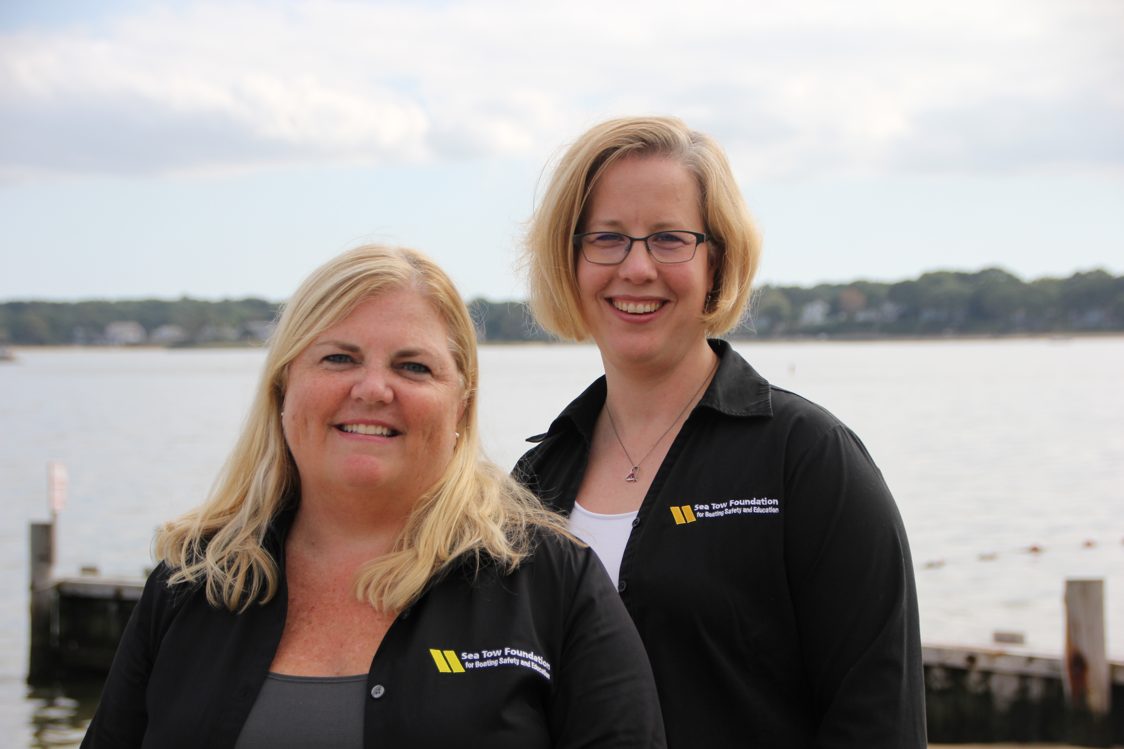
Thank you!
Any Questions?
Kim Perry
Program Administrator Sea Tow Foundation
kperry@seatow.com
631-876-5085
Gail Kulp
Executive Director Sea Tow Foundation
gkulp@seatow.com
631-876-5077
Notes:
Reach out to Kim or myself with any questions.

