Slide 1
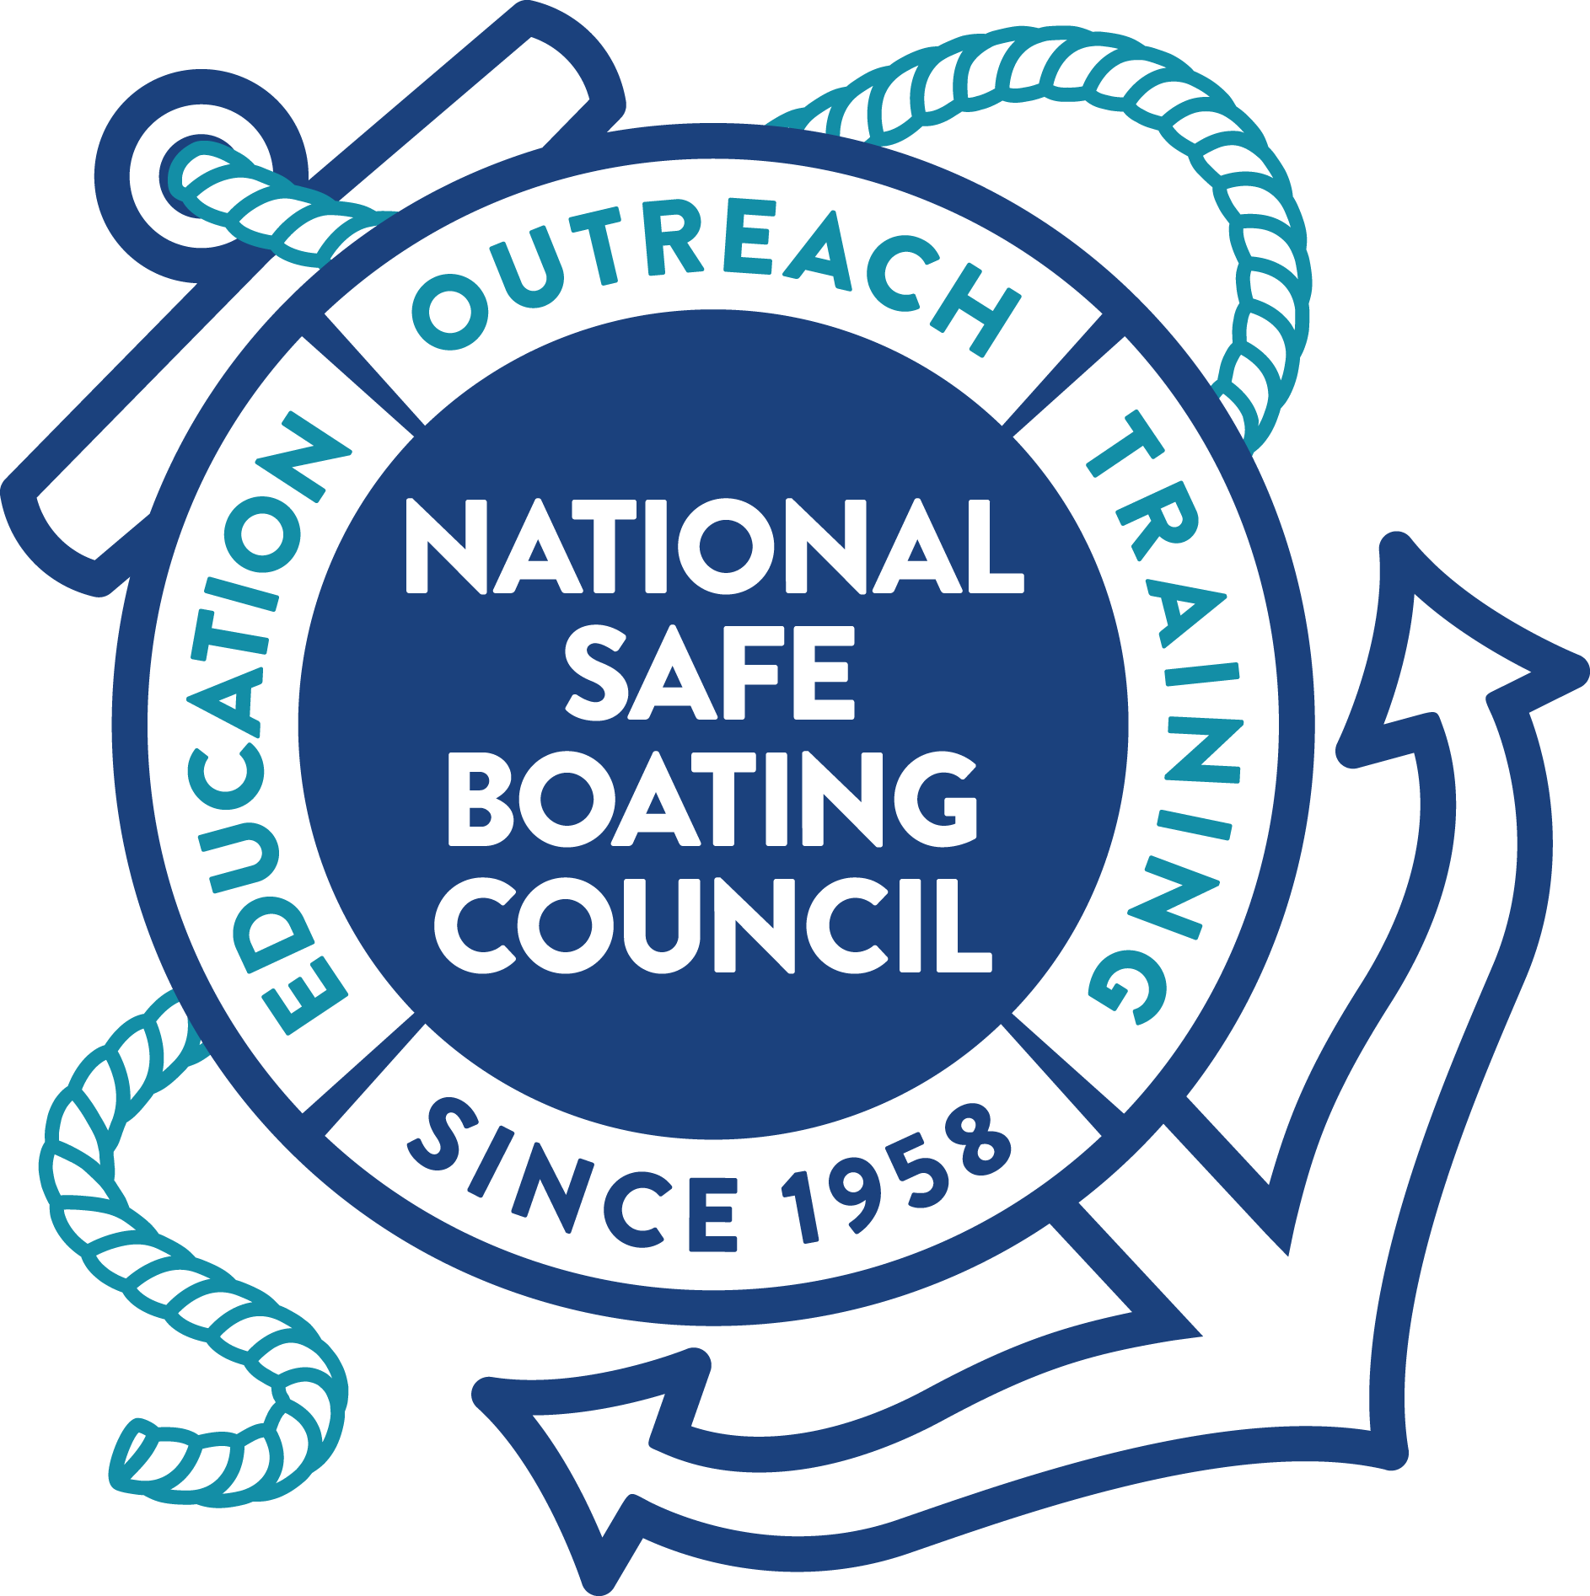
State of the
NSBC
TRIVIA

Slide 2
Let’s play some trivia!
Please form 2 lines
Person at the front of each line must listen carefully to the question
First person to raise their hand may answer the question
If they answer correctly, the team receives a point
If they answer incorrectly, the other team has a chance to answer
Team with the most points wins!

Slide 3
Question
The Safe Boating Campaign is a worldwide effort focused on responsible boating, encouraging boaters to always wear a [what] while on the water.

Slide 4
ANSWER
Life Jacket

Slide 5
Question
When was IBWSS founded?

Slide 6
ANSWER
In 1997. The first International Boating and Water Safety Summit was hosted in San Diego, CA in 1997. This is a tricky question because IBWSS was canceled in 2020.

Slide 7
Question
On August 10, 1971, which U.S. President signed the Federal Boat Safety Act (FBSA)?

Slide 8
ANSWER
President Richard Nixon

Slide 9
Question
The National Safe Boating Council’s Skipper Club™ is for what ages interested in learning on-water powerboating skills and maneuvers?

Slide 10
ANSWER
Ages 13-19

Slide 11
Question
What is Waves of Hope?

Slide 12
ANSWER
A coalition of families and friends working to prevent boating and water tragedies.

Slide 13
Question
On what date, as part of the National Defense Authorization Act, did it become required for individuals operating vessels required to have an engine cut-off switch to use them?

Slide 14
ANSWER
April 1, 2021

Slide 15
Question
Which of the National Safe Boating Council’s online programs teach the basic navigation rules of boating?

Slide 16
ANSWER
Boat on Course!

Slide 17
Question
The NSBC’s Saved by the Beacon national campaign educates recreational boaters on … what?

Slide 18
ANSWER
The importance of 406 MHz beacons and how to use them correctly in the case of a boating emergency.

Slide 19
Question
The annual campaign kicks off the weekend before [what holiday] with National Safe Boating Week and continues throughout the year.

Slide 20
ANSWER
Memorial Day

Slide 21
Question
What award is offered at IBWSS showcasing outstanding outreach efforts of organizations, agencies, and groups who advocate for boating and water safety?

Slide 22
ANSWER
IBWSS Communication Awards

Slide 23
Question
During what decade were there more people boating than ever before and high number of boating-related accidents and fatalities? A) The 1940’s B) The 1950’s C) The 1960’s D) The 1970’s

Slide 24
ANSWER
C) The 1960’s

Slide 25
Question
In the Skipper Club, what is the student to instructor ratio?

Slide 26
ANSWER
The student to instructor ratio is 4:1

Slide 27
Question
True or False? Waves of Hope provides a platform for survivors and families to take action, share their stories, and educate others.

Slide 28
ANSWER
True

Slide 29
Question
This might be a tricky one! As of 2019, a provision of [what act] requires boat manufacturers, dealers, and distributors to ensure boats less than 26 feet and with engines capable of more than 115 pounds of thrust have an engine cut-off switch?

Slide 30
ANSWER
The Frank LoBiondo Coast Guard Authorization Act

Slide 31
Question
When heading out for a fun day on the water, you should always dress for: A) Getting a tan B) Submersion C) Immersion D) Success

Slide 32
ANSWER
B) Submersion

Slide 33
Question
What is an emergency locator beacon used for?

Slide 34
ANSWER
An emergency locator beacon is used to alert Search and Rescue assets by transmitting a coded message on the via satellite to the nearest Rescue Coordination Center.

Slide 35
Question
When is Wear Your Life Jacket at Work Day this year?

Slide 36
ANSWER
May 20, 2022

Slide 37
Question
Who is this year’s premier sponsor of the International Boating and Water Safety Summit?

Slide 38
ANSWER
Deckee

Slide 39
Question
What program did the FBSA help establish?

Slide 40
ANSWER
The National Recreational Boating Safety Program

Slide 41
Question
Prior to taking the course, students are required to complete what approved online boating safety course as well as meet the legal requirements of the state where the course is being held?

Slide 42
ANSWER
A NASBLA-approved online boating safety course

Slide 43
Question
What is one way you can inspire hope and be a responsible boater?

Slide 44
ANSWER
Take a boating safety course, wear a life jacket, assign a water watcher, use an engine cut-off switch, be responsible, and be educated.

Slide 45
Question
True or False? Most propeller injuries and fatalities are preventable.

Slide 46
ANSWER
True! Most propeller injuries and fatalities result from operator inattention, improper lookout, operator inexperience, excessive speed, and alcohol.

Slide 47
Question
True or False? Following each Boat on Course video, there is a free quiz to help test your knowledge.

Slide 48
ANSWER
True

Slide 49
Question
What is the coded message distress frequency?

Slide 50
ANSWER
The 406 MHz distress frequency

Slide 51
Question
What is the website where you can find Safe Boating Campaign resources?

Slide 52
ANSWER
www.SafeBoatingCampaign.com

Slide 53
State of the
NSBC
Thanks for playing!

