Slide 1
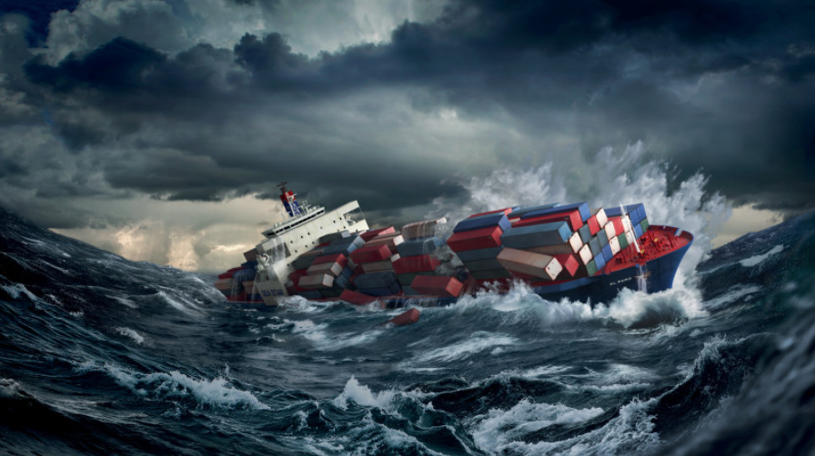
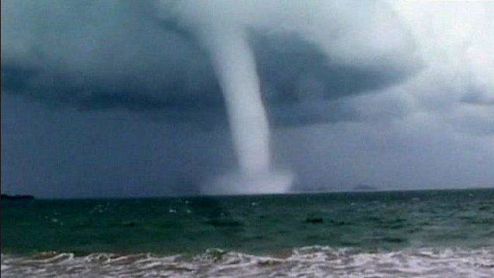
National Weather Service
Marine Weather Safety
National Weather Service
Darren Wright
National Marine Program Manager

Slide 2
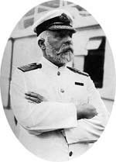
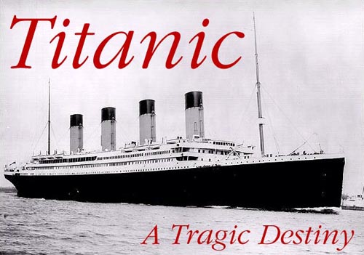
“Expect the Unexpected”
“When anyone asks me how I can best describe my experience of nearly forty years at sea, I merely say uneventful.
Of course there have been winter gales and storms and fog and the like, but in all my experience, I have never been in an accident of any sort worth speaking about. I have seen but one vessel in distress in all my years at sea…
I never saw a wreck and have never been wrecked, nor was I ever in any predicament that threatened to end in disaster of any sort.”
Captain of the Titanic
- from a presentation by E.J. Smith, 1907

Slide 3
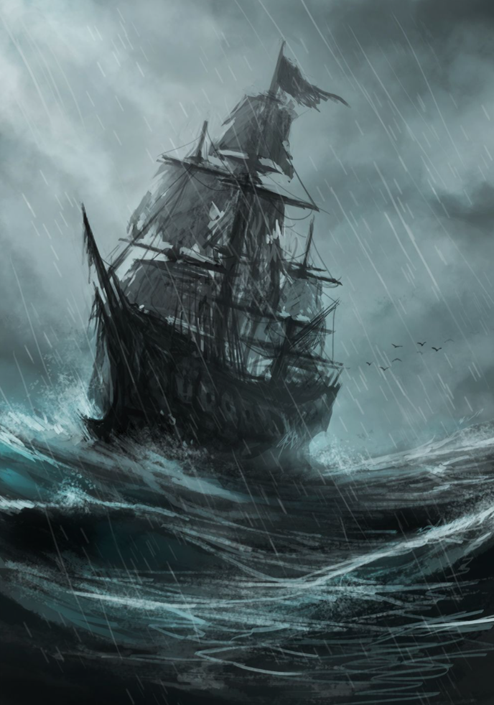
Outline
About the NWS Marine Program
Know Before You Go!
Marine Hazards
Future Products and Changes

Slide 4
NWS National Service Programs
Notes:
The NWS has 11 Service Programs
I am responsible for the marine and coastal program

Slide 5
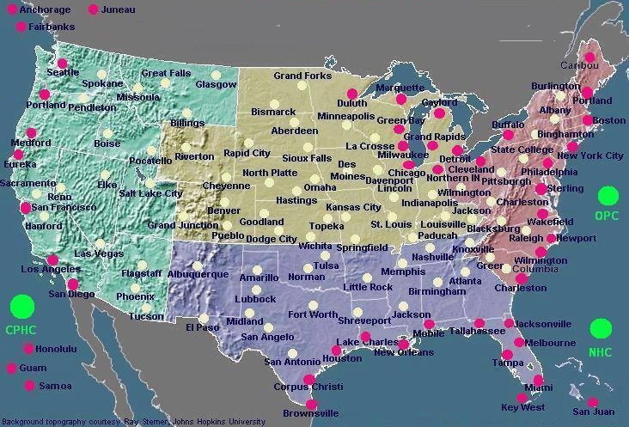
NWS Weather Forecast Offices
Provides Marine & Land Forecasts
Provides Land Forecasts
Notes:
122 Total WFOs, 47 are Marine

Slide 6
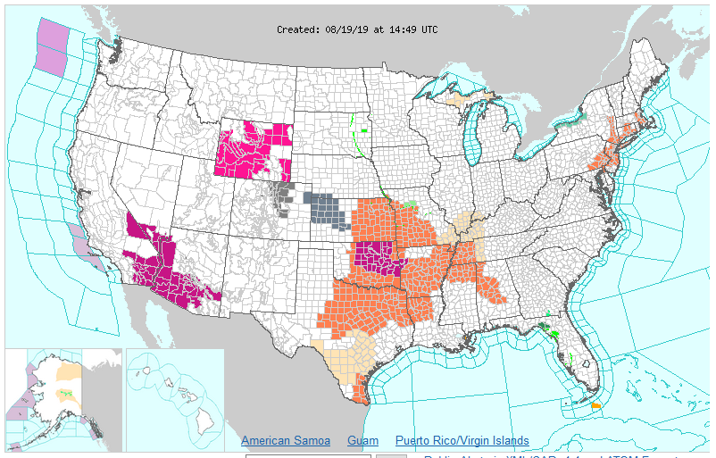
Coastal and Offshore areas

Slide 7
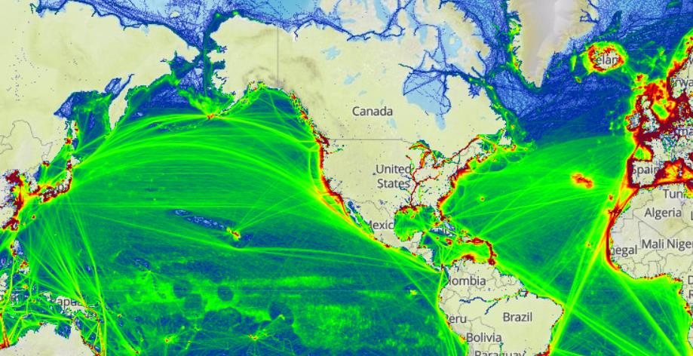
2016 Global Ship Tracks NWS High Seas Marine Zones
Shipping lanes in green:
OPC
OPC
NHC TAFB
NHC TAFB
WFO Honolulu
Source of 2013 total ship tracks and background: marinetraffic.com
Notes:
Ocean Prediction Center (OPC)
Tropical Analysis & Forecast Branch (TAFB)
Honolulu Weather Forecast Office (WFO)

Slide 8
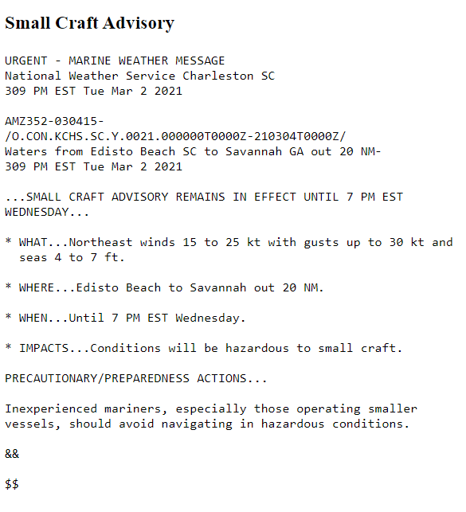
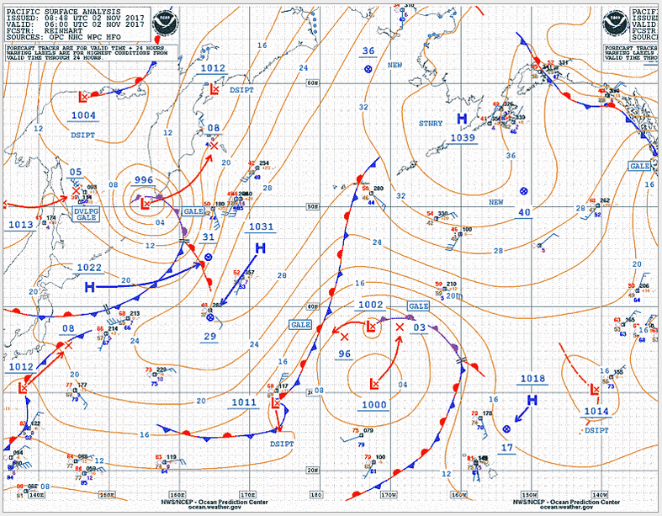
NWS Marine Products
Marine Text Forecasts and Products
Marine Graphic Forecasts and Products
Coastal and Marine Watches/Warnings
Impact-Based Decision Support Services (IDSS)
Computer Generated Model Guidance
Ice Analysis, Forecasts and Iceberg Reports

Slide 9
Dissemination Methods
NOAA Weather Radio - Reliable weather broadcasts out to 25nm from shore
HF radio - Long distance broadcast range with coastal and offshore weather information
VHF radio - Marine radio on channels 16 and 22A. Primarily broadcasts for coastal areas
NAVTEX - Medium Frequency weather broadcasts on 518 khz with a range up to 200 nm. Low cost and automated
InMarsat C SafetyNET - Satellite transmission of high seas forecasts and warnings.
Iridium SafetyCast - Near future satellite transmission of high seas forecasts and warnings (Platform operational in December 2020)
FTPMail - User can request and receive NWS text and graphic products via email using ftp commands. Low bandwidth.
For more information: https://weather.gov/marine (Dissemination menu)

Slide 10
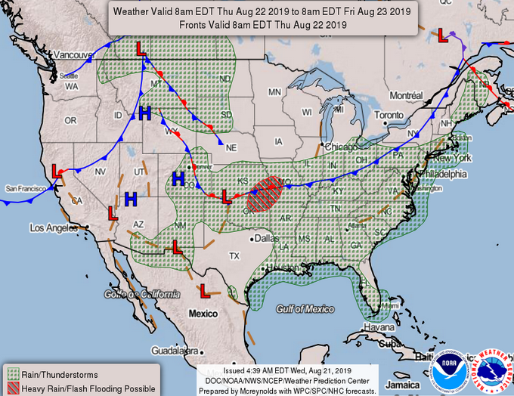
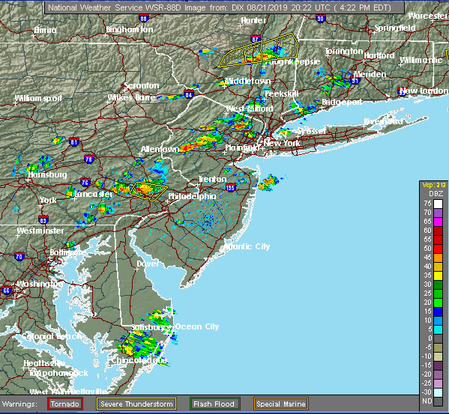
Know Before You Go!

Slide 11
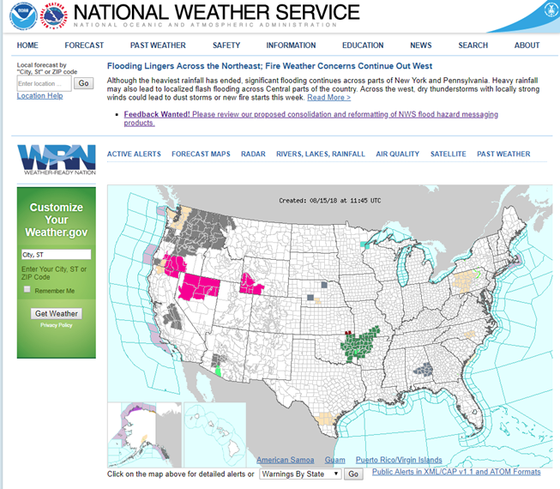
Know Before You Go! - Check the Forecast
https://weather.gov
Point and Click
Notes:
Are you all familiar with getting your own point-and-click forecast? Even over the water and off the coast? The NWS has divided the land into 2.5 by 2.5 KM squares, and there’s a forecast for each one. We can demonstrate it later.

Slide 12
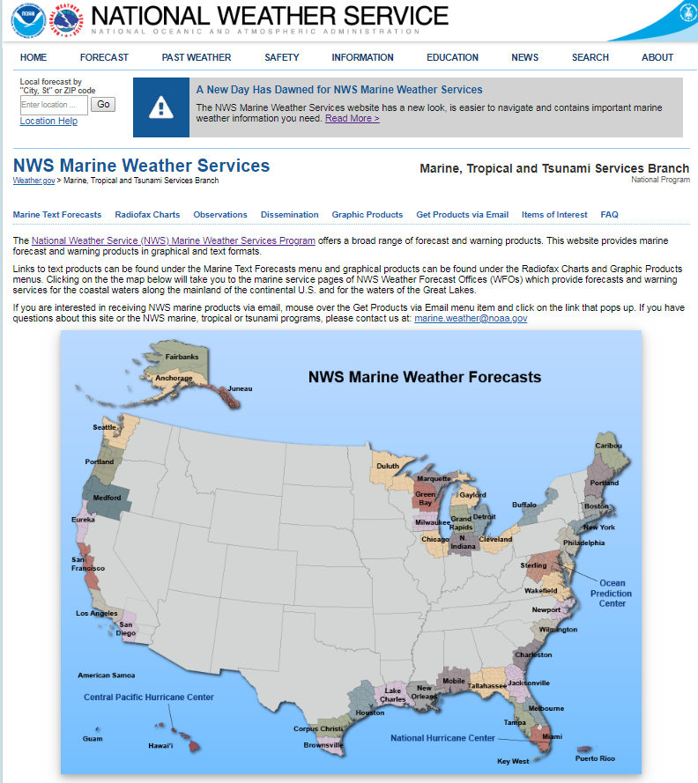
Marine Program Website
https://weather.gov/marine
Notes:
On or about September 17th.

Slide 13
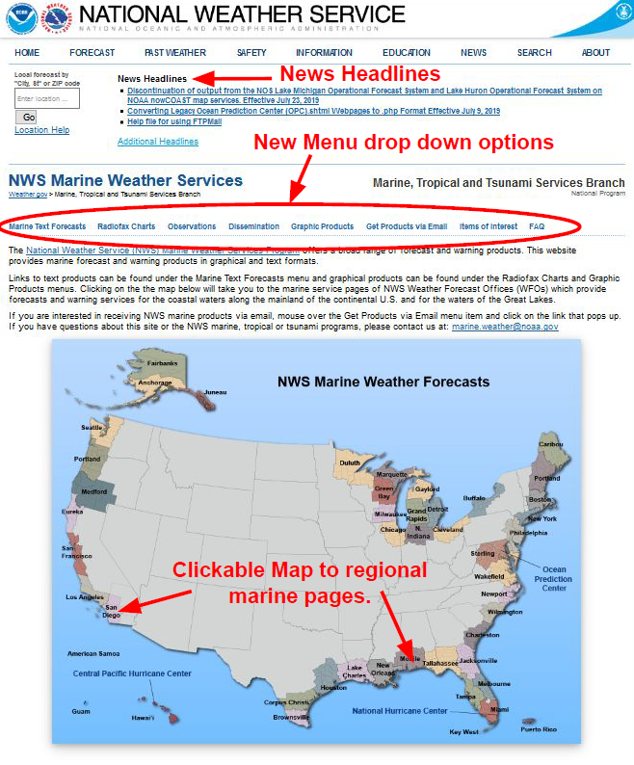
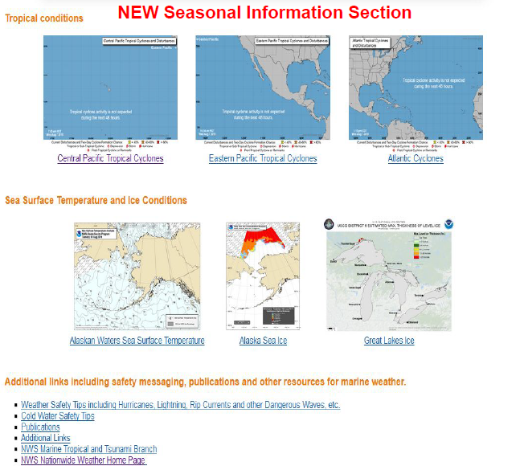
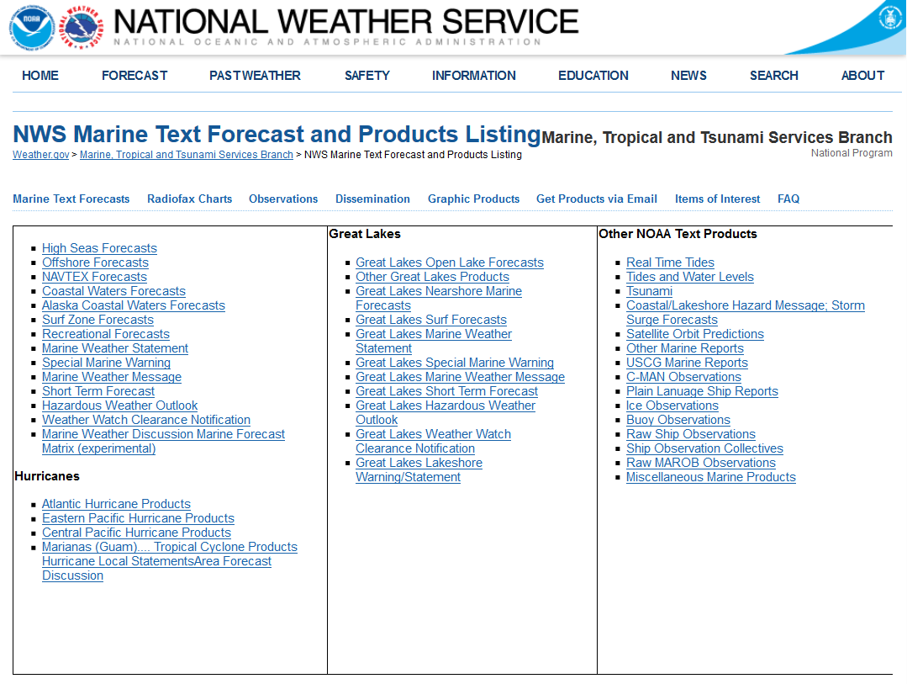
Marine Website Features

Slide 14
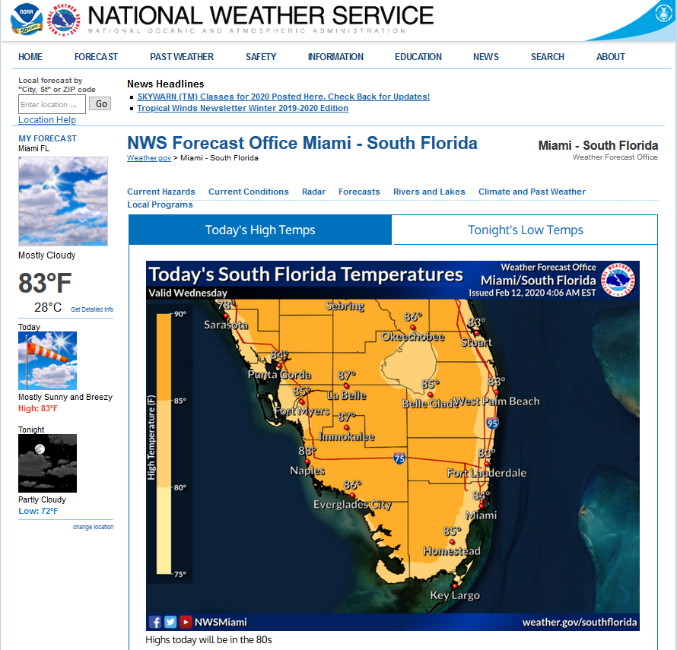
Marine “Point and Click” Spot Forecast Replace “Miami” with local forecast office
https://www.weather.gov/mfl/
Notes:
Or from weather.gov, just click on a spot close to Miami.

Slide 15
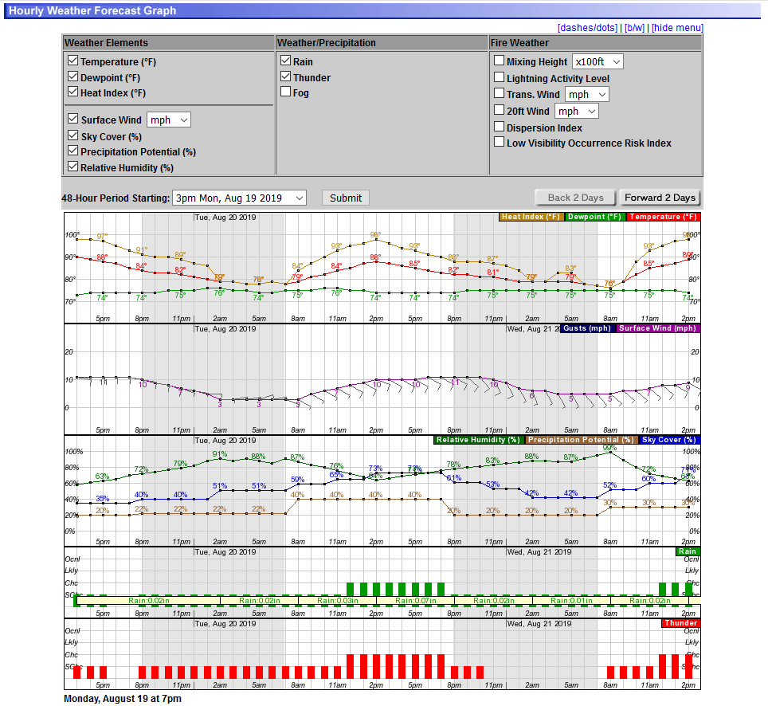
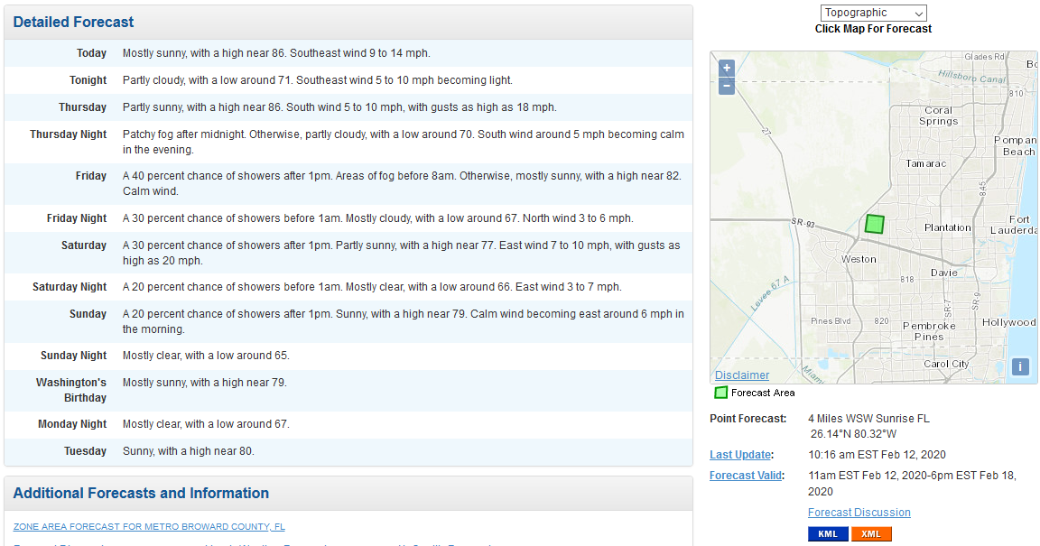
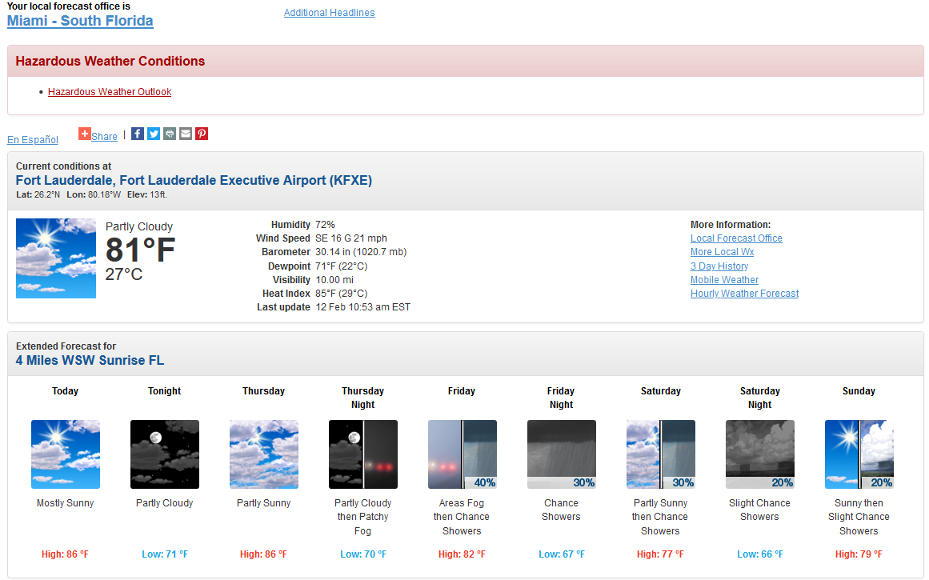
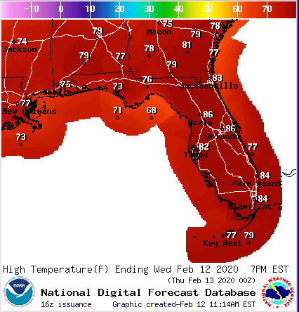
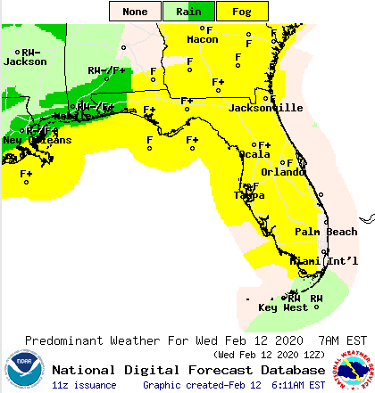
Marine Forecast Products
Notes:
If there’s time we can go over NDFD for marine (this has been popular)

Slide 16
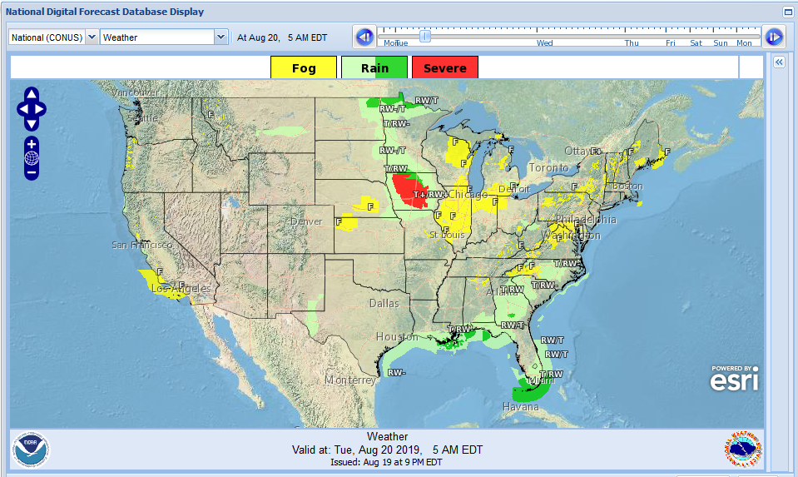
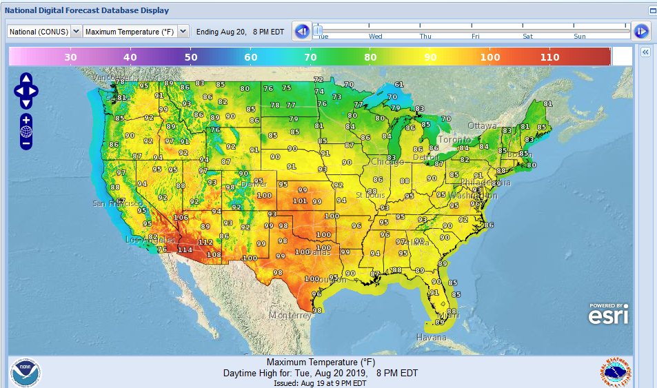
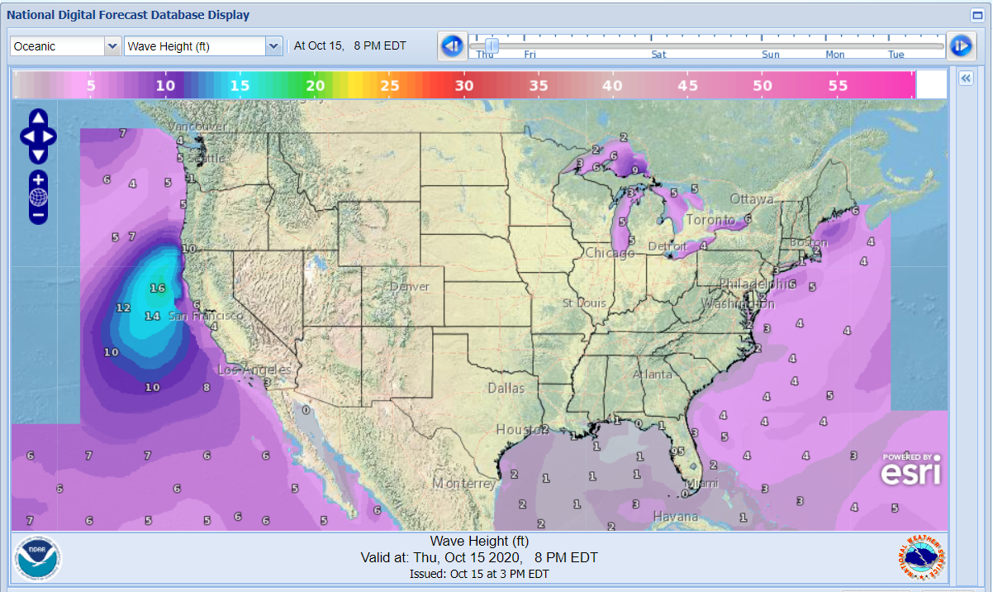
Graphical Forecasts
https://digital.weather.gov/

Slide 17
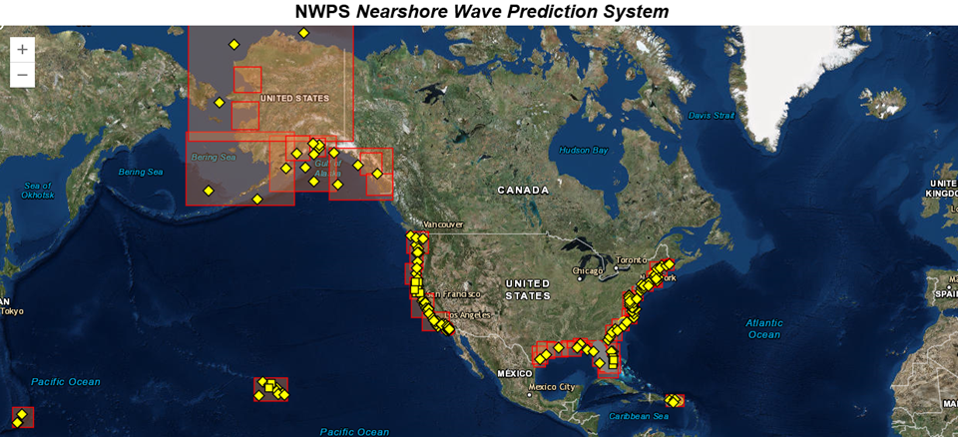
Nearshore Wave Prediction System (NWPS)
http://polar.ncep.noaa.gov/nwps/viewer.shtml

Slide 18
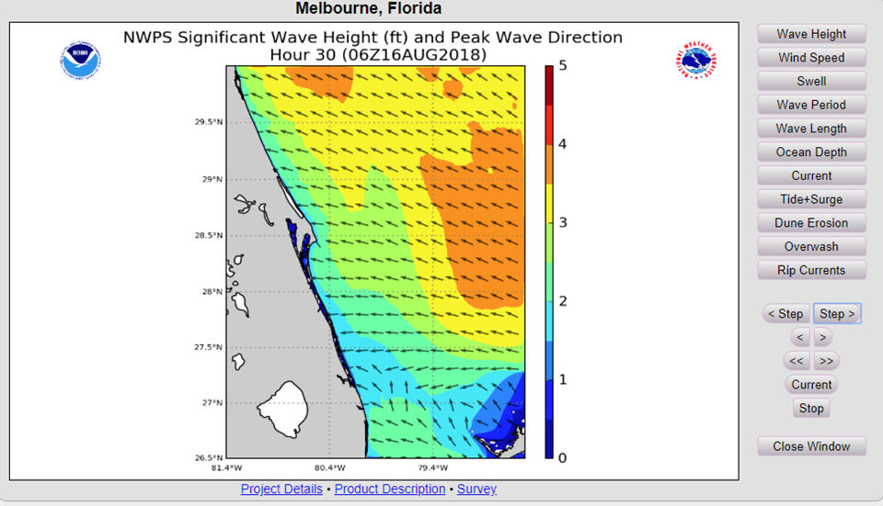
NWPS Animated Graphics
http://polar.ncep.noaa.gov/nwps/viewer.shtml

Slide 19
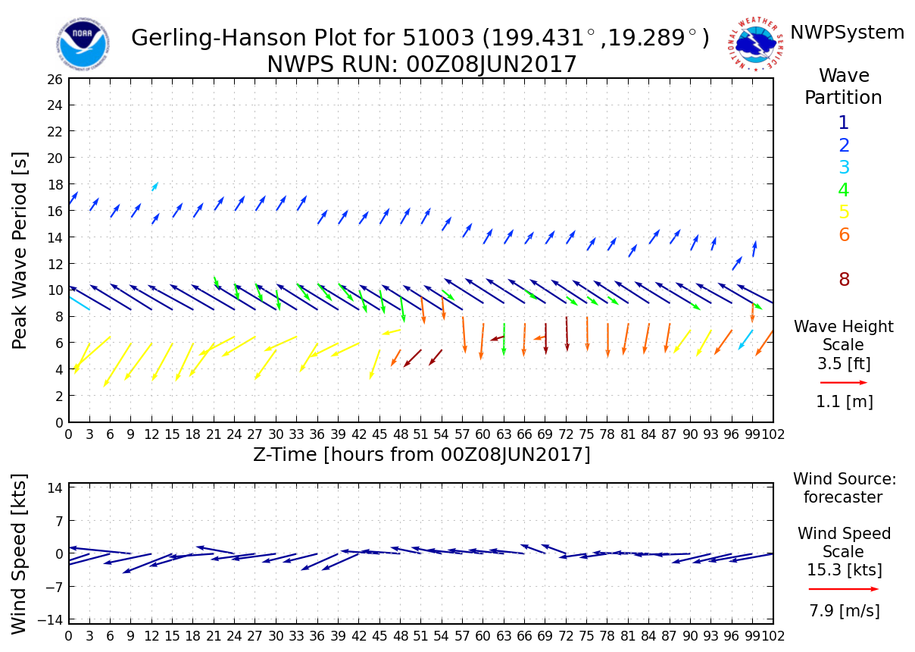
NWPS Wave System Detection

Slide 20
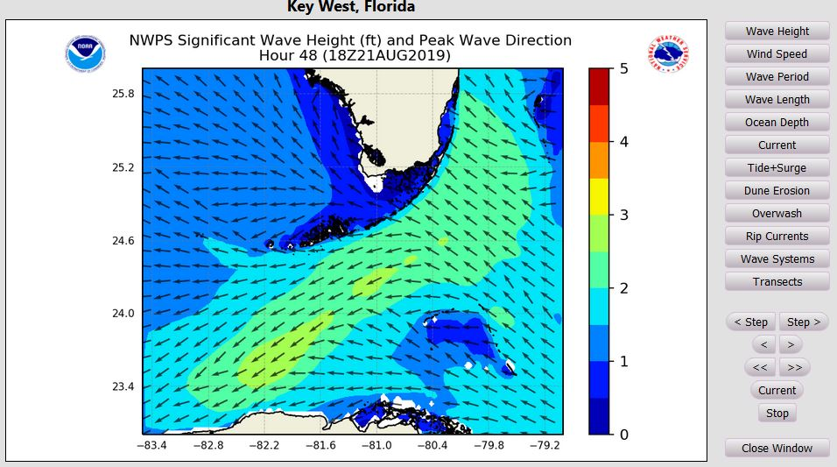
Wave and Wind Forecast Along Transect
Nearshore Wave Prediction System (NWPS)
Small Craft Advisory Line
https://polar.ncep.noaa.gov/nwps/viewer.shtml
Notes:
Forecasts out to 144 hours or 6 days
These locations include: Miami (MFL), Key West (KEY), Chesapeake and Delaware Bay (AKQ), Los Angeles (LOX), SW Pass (LIX), Juneau (AJK), Anchorage (AER) and Fairbanks (AFG). (Click the “Transects” button on the right)
https://polar.ncep.noaa.gov/nwps/para/nwpsloop.php?site=MFL&cg=1
https://polar.ncep.noaa.gov/nwps/para/nwpsloop.php?site=KEY&cg=1
https://polar.ncep.noaa.gov/nwps/para/nwpsloop.php?site=AKQ&cg=1
https://polar.ncep.noaa.gov/nwps/para/nwpsloop.php?site=LOX&cg=1
https://polar.ncep.noaa.gov/nwps/para/nwpsloop.php?site=LIX&cg=1
https://polar.ncep.noaa.gov/nwps/para/nwpsloop.php?site=AJK&cg=1
https://polar.ncep.noaa.gov/nwps/para/nwpsloop.php?site=AER&cg=1
https://polar.ncep.noaa.gov/nwps/para/nwpsloop.php?site=AFG&cg=1

Slide 21
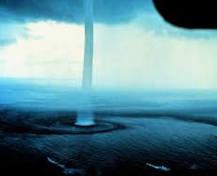
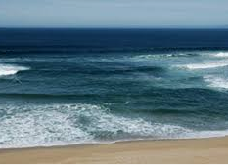
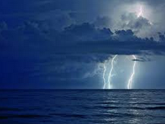
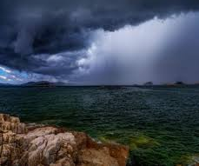
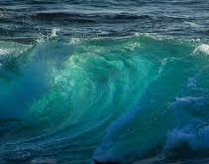
Marine Hazards

Slide 22
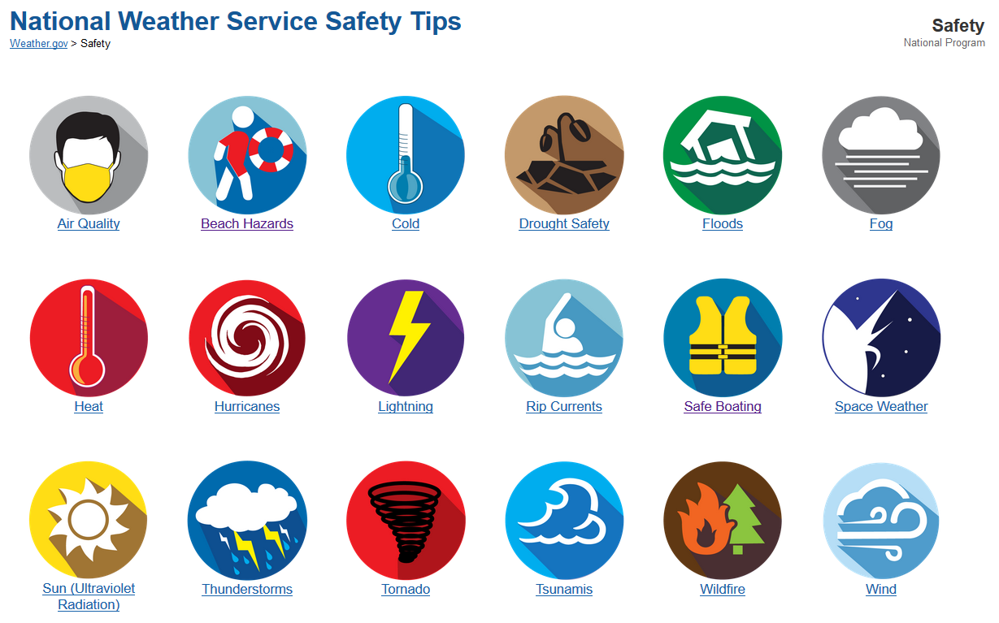
NWS Safety Web Page
https://www.weather.gov/safety/
Notes:
Cold water, too. Many of these NWS alerts are way beyond marine and coastal.

Slide 23
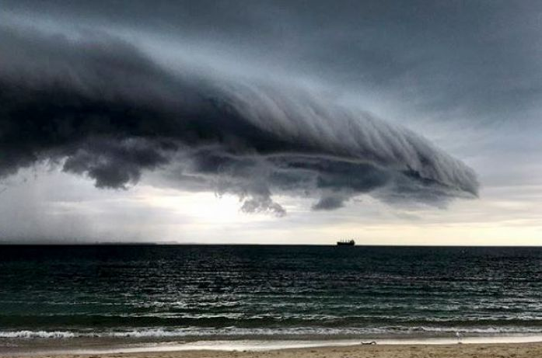
Marine Thunderstorms
Severe thunderstorms are officially defined as storms that are capable of producing hail that is 3/4 inch or larger or wind gusts over 34 KT and/or waterspouts.
Be Weather-Ready: Check the forecast before leaving.
Sign Up for Notifications: Sign up for phone alerts; Listen to NOAA Weather Radio
Create a Communications Plan: Tell someone when you’re going out and where you’re going
https://www.weather.gov/safety/thunderstorm

Slide 24
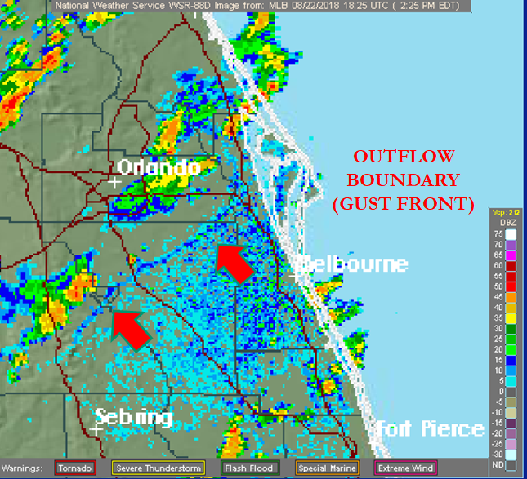
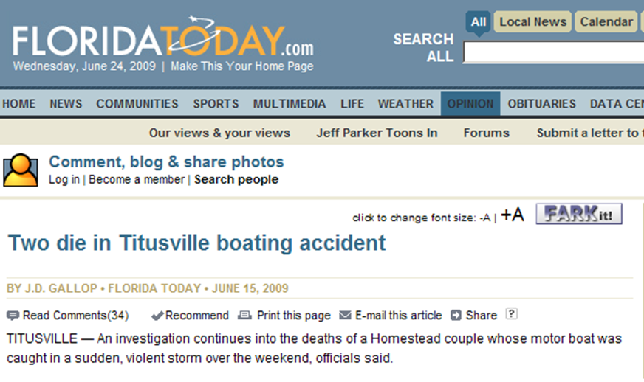
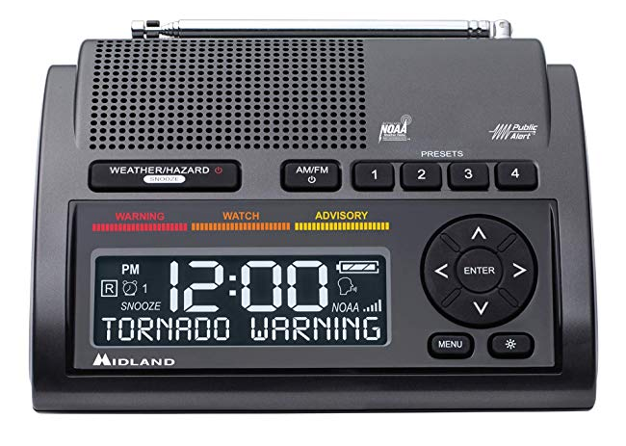
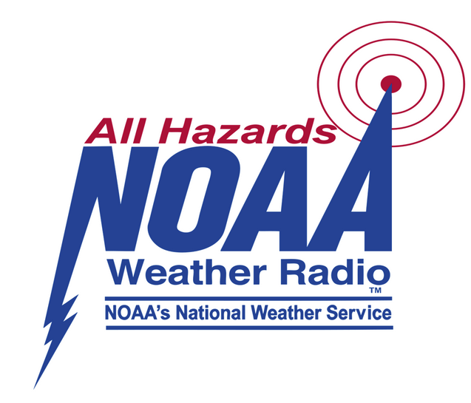
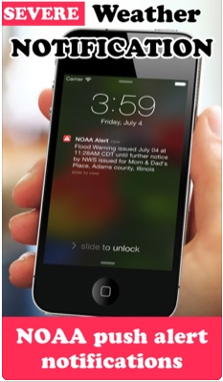
Special Marine Warnings - Pay Attention!
Notes:
Adding Special Marine Warnings to the Emergency Alert System (EAS)

Slide 25
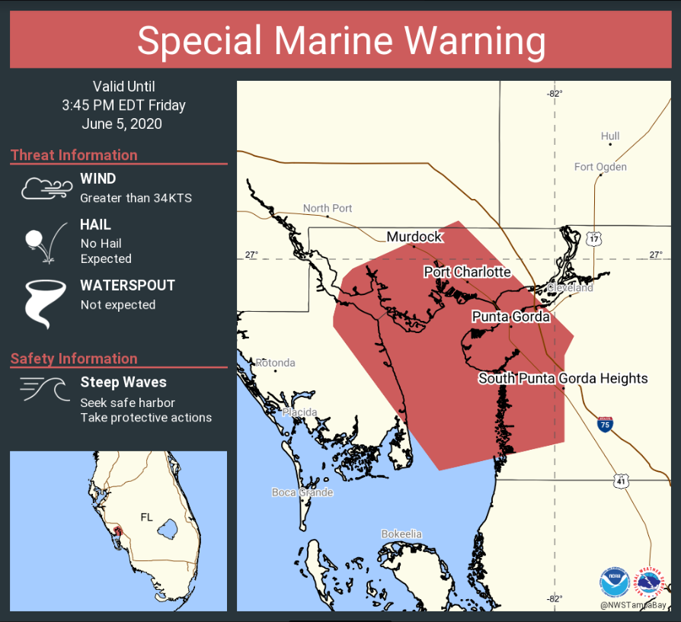
Special Marine Warning - Auto-tweet

Slide 26
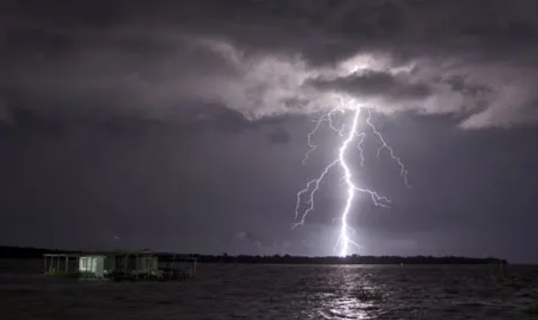
Lightning Safety
Lightning: What You Need to Know
NO PLACE outside is safe when thunderstorms are in the area!!
If you hear thunder, lightning is close enough to strike you.
When you hear thunder, immediately head back to shore.
Stay in safe shelter at least 30 minutes after you hear the last sound of thunder.
https://www.weather.gov/safety/lightning

Slide 27
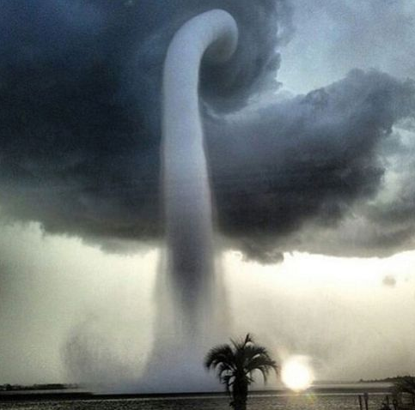
Waterspouts
Regardless of whether the waterspout is fair weather or tornadic in origin, all sea going vessels should take caution.
Never navigate through a waterspout or move closer to it for investigation.
To avoid a waterspout, try traveling at right angles to its apparent direction of movement
https://oceantoday.noaa.gov/waterspouts/
Notes:
The Great Lakes have many waterspouts also.

Slide 28
Cold Water
Always Wear a Lifejacket
Water temperatures can be cold even if the air temperature is warm. Check before going.
Immersion in cold water can be life threatening very quickly due cold water shock and loss of muscle control.
Wear recommended cold water protective gear
https://www.weather.gov/safety/coldwater

Slide 29
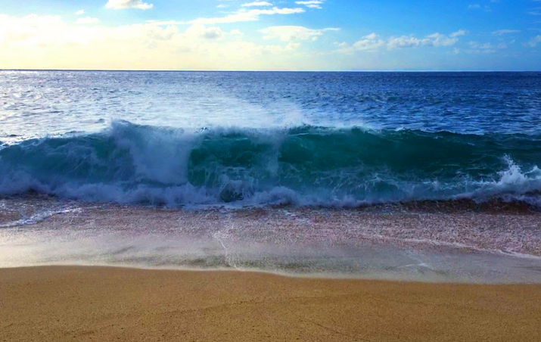
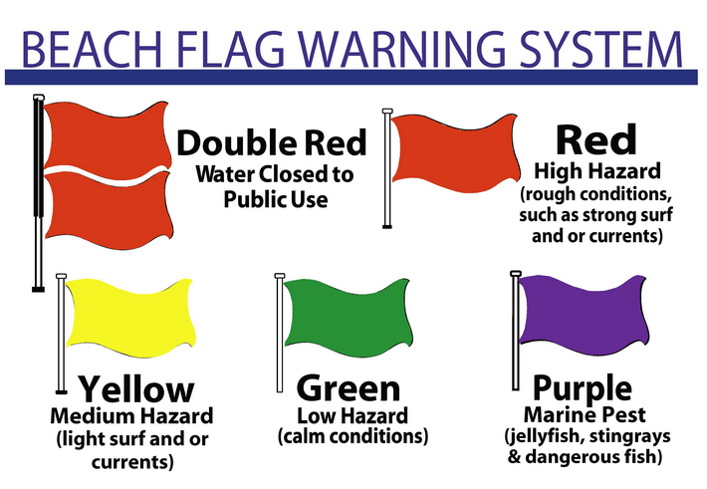
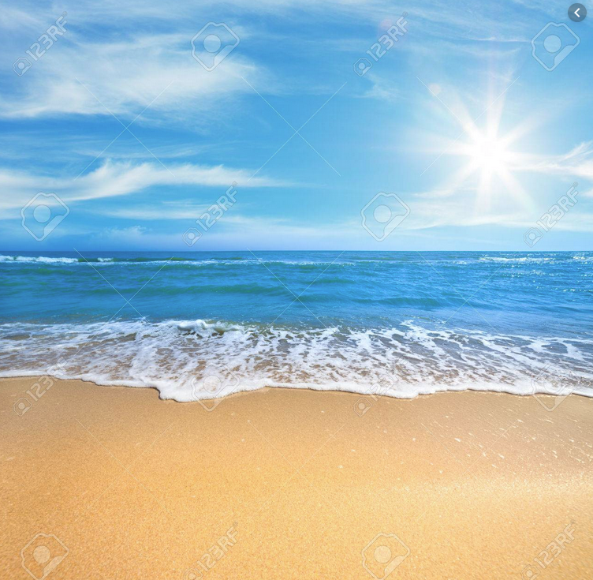
Beach Hazards
High Surf
Check the National Weather Service Surf Zone Forecast (UV, Waves, H2O Temp, Tides, Winds, etc.)
Know How to Swim BEFORE You Venture In: Swimming in a pool is NOT the same as swimming at a surf beach with crashing waves, winds, and dangerous currents.
Know What the Warning Flags Mean: Look for beach warning flags
(where available)
https://www.weather.gov/safety/beachhazards
UV

Slide 30
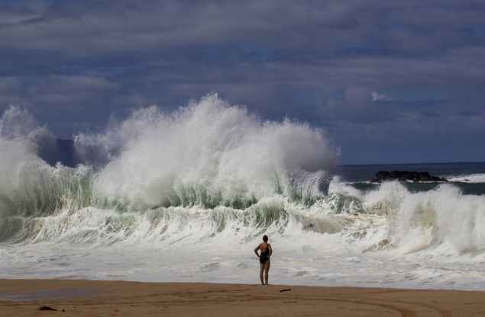
Waves and High Surf
Check you local forecast for surf and tide conditions
Watch for signs, flags, or lifeguards warning of present danger/s
Always stay alert to changing weather, waves, and tides
If you are unsure whether conditions are dangerous, don’t go out.
https://www.weather.gov/safety/ripcurrent-waves

Slide 31
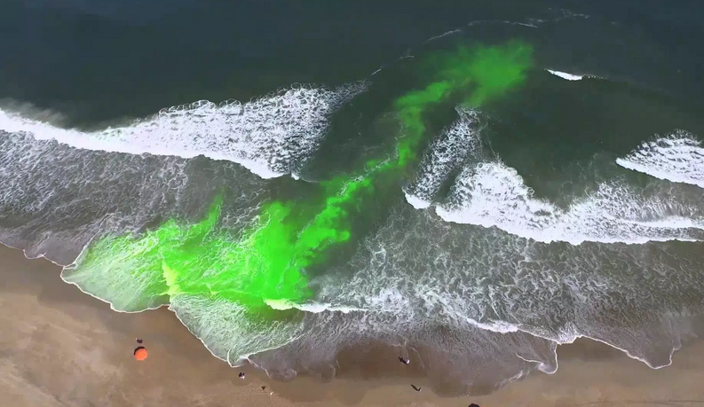
Rip Currents
Stay Clear of Piers
https://www.weather.gov/safety/ripcurrent

Slide 32
NOAA and USLA Rip Current Safety Toolkit
Relevant websites
Rip Current Safety Presentation in several formats (PDF, PPT, Video)
Downloadable signs, brochures, stickers, posters, and other materials
Rip Current Videos
https://youtu.be/bqtclrm39M0
https://www.weather.gov/safety/ripcurrent-toolkit

Slide 33
Beach Hazards Webpage
http://weather.gov/beach/

Slide 34
Weather-Ready Nation Ambassador
From People to Ports to Communities, we are working to build a Weather-Ready Nation – Ready, Responsive and Resilient to extreme weather and other hazards
The Ambassador campaign aims to magnify those efforts through partnerships with key businesses and organizations
Who can be a Weather-Ready Nation Ambassador?
All levels of government
Academia
Businesses & non-profits
Weather-dependent sectors of economy
https://www.weather.gov/wrn/

Slide 35
Weather-Ready Nation Marine Ambassador
Weather-Ready Nation Marine Ambassador Network
Comprehensive toolkit including virtual marine weather hazard training
Promotes weather safety messaging to their stakeholders
Engages with NOAA personnel on potential collaboration opportunities
Sharing Success Stories of Preparedness and Resiliency
Virtual WRN recognition and share the WRN logo for your use
Direct line of feedback for NWS product improvements
Receive a quarterly newsletter from the NWS about marine weather
https://www.weather.gov/wrn/wrna-marine

Slide 36
Future Products

Slide 37
Proposed New Coast Waters Forecast Format for Waves
From: Seas 5 to 7 ft. or Wind waves 7 feet.
Northeast swell 8 feet. Swell north 3 feet.
To: Seas 5 to 7 ft, occasionally to 10 ft. Wave Detail: NW 5 ft at 5 seconds, and SW 6 ft at 15 seconds.
This information is provided straight from NWPS.

Slide 38
Proposed New CWF Format for Waves
To: Seas 5 to 7 ft, occasionally to 10 ft. Wave Detail: NW 5 ft at 5 seconds, and SW 6 ft at 15 seconds.
First wave system

Slide 39
Proposed New CWF Format for Waves
To: Seas 5 to 7 ft, occasionally to 10 ft. Wave Detail: NW 5 ft at 5 seconds, and SW 6 ft at 15 seconds.
Note: If only one main wave group, a second system may not be present.
Second wave system

Slide 40
NWS Hazards Simplification

Slide 41
Question #1
What is the definition of a weather Advisory?

Slide 42
Question #1
A life - and/or property-threatening event is possible - but not yet certain
A life- and/or property-threatening event is happening or about to happen
An event less serious than a Warning is happening or about to happen

Slide 43
Answer #1
C) An event less serious than a Warning is happening or about to happen.

Slide 44
The NWS “Watch, Warning and Advisory” System
How We Message for Weather & Water Hazards Today
Watch: Issued when a life - and/or property-threatening event is possible - but not yet certain
Warning: Issued when a life- and/or property-threatening event is happening or about to happen
Advisory: Issued when an event less serious than a Warning is happening or about to happen
Special Weather Statement: Issued when an event less serious (or of shorter duration) than an Advisory is happening or about to happen

Slide 45
What is the Planned Major Change?
These changes will not be made prior to 2024

Slide 46
Why Make this Major Change?
Summary of Social Science Research
Too many products and product types
Watches, Warnings, Advisories, Special Weather Statements
“Advisory” headline is very misunderstood and is also confused with “Watch”
Emergency Managers prefer plain language headlines; they can be conveyed clearly and quickly.
Survey results from 2020 engagements with NWS partners and the public indicated strong support for plain language as well.

Slide 47
Replacing Advisories & Special Weather Statements
Initial Suggestions for Plain Language Headlines
“Wind Advisory in effect”
could become...
“WINDY: Westerly winds today gusting to 40 mph”
=============
“Coastal Flood Advisory in effect”
could become...
“CAUTION:Coastal flooding expected today”
=============
“Wind Chill Advisory in effect”
could become...
“VERY COLD TONIGHT: Wind chills between -5F and -10F”
These are just examples - stay tuned for feedback opportunities!

Slide 48
Reformatted Example - MWW
(changes shown in red)
Old Product
Reformatted Product
Notes:
Marine Weather Warning (MWW)

Slide 49
Text Product Consolidation - Small Craft Advisory
Previous Products
Updated Product
Dec. 2019
Small Craft Advisory
Small Craft Advisory for Hazardous Seas
Small Craft Advisory for Rough Bar
Small Craft Advisory for Winds
Consolidated to
Small Craft Advisory
Notes:
On or about December 3rd

Slide 50
Questions #2
What term was used for a Small Craft Advisory level event back in the 1970’s?
Notes:
On or about December 3rd

Slide 51
Questions #2
ANSWER: Small Craft Warning
Notes:
On or about December 3rd

Slide 52
Proposed Removal of the Term “Advisory”
Small Craft Advisory
Changing to
Small Craft Warning
Estimated implementation no sooner than 2024
Notes:
“Small Craft Advisory” is issued when sustained wind speeds or frequent gusts have reached 20 to 33 knots and/or seas or waves 4 feet and greater and/or waves or seas are potentially hazardous.

Slide 53
List of Advisories to be Discontinued
Winter Weather Advisory | Lake Wind Advisory | Air Stagnation Advisory* | High Surf Advisory
Wind Chill Advisory | Frost Advisory | El Nino/La Nina Advisory | Small Craft Advisory - transition to “Warning”
Dense Fog Advisory | Blowing Dust Advisory | Tsunami Advisory - transition to “Warning” | Lakeshore Flood Advisory
Dense Smoke Advisory | Dust Advisory | Freezing Spray Advisory | Coastal Flood Advisory
Wind Advisory | Ashfall Advisory | Low Water Advisory | Flood Advisory (Areal)
Heat Advisory | Freezing Fog Advisory | Brisk Wind Advisory | Flood Advisory (River)
* Issued in collaboration with EPA
‹#›
Notes:
On or about December 3rd

Slide 54
New GMDSS Provider - Iridium
Global Maritime Distress and Safety System (GMDSS) - an internationally agreed-upon set of safety procedures, types of equipment, and communication protocols used to increase safety and make it easier to rescue distressed ships, boats and aircraft.
Iridium - Platform became operational in December 2020
NWS, USCG, and NGA are working to ensure provision of weather and navigation MSI within the next year.
Notes:
Maritime Safety Information

Slide 55
Precision Marine Navigation
^{Office of Coast Survey}
National Oceanic and Atmospheric Administration
Notes:
Started as a budget initiative back in 2017 and really before that but it really got traction around this point. Coast Survey is not providing PN but rather providing tools and services for the mariner to be able to navigate more confidently in a digital age.
Here is a screenshot of a pilots home screen on his phone and these are all of the NOAA and other APPs he has to use to understand the state of play on the water in real time. Each NOAA office keeps its own data on its own website and makes it hard for the user to take all of the pieces of information they need into account in a way that they make an informed decision about when and how to transit into a port. PN is working to standardize the data so that it can be interoperable and machine to machine readable.

Slide 56
S-41X
IHO S-100 Standards for Marine Weather Overlays for Electronic Charting Systems
What is precision marine navigation?
…the ability of a vessel to safely and efficiently navigate within the U.S. EEZ and operate in close proximity to the seafloor, bridges, narrow channels, or other marine hazards.
Notes:
International Hydrographic Organization (IHO)
World Meteorological Organization (WMO)

Slide 57
S-41X
IHO S-100 Standards for Overlays for Electronic Charting Systems
Precision Marine Navigation Project
Increasing the Safety and Efficiency of Navigation
by Providing Mariners with Integrated and Accessible Data and Information
Notes:
International Hydrographic Organization (IHO)
World Meteorological Organization (WMO)

Slide 58
S-41X
S-100 provides the framework for precision marine navigation
Framework for maritime data and product specifications
supports a wide variety of navigation-related digital data sources, products and customers
enables the transfer of data between and among ships and shore facilities,
integrates and transforms that data into decision and actionable information for maritime operations
Notes:
International Hydrographic Organization (IHO)
World Meteorological Organization (WMO)

Slide 59
Marine Weather Overlays
S-41X
Hazards
Conditions
Observations
Features e.g fronts
Satellite, AIS, Buoy Data, Etc.
S-412
Wave and Weather Hazards
Polygons
S-413
Wave and Weather Conditions
Graphics and Gridded Data
S-414
Wave and Weather Observations
Point Based Data

Slide 60
Weather Overlay Goal
S-41X
Develop a navigation safety product specification for weather information for use in Electronic Chart and Navigation Display System (ECDIS)

Slide 61
S-412 - Warning Polygons
S-41X
Wind Warnings (24 hour composites)
Gale 34-47 kts
Storm 48 – 63 kts
Hurricane Force
> 63 kts
Prototype Wind Warning Polygons
HF
STORM
GALE
U.S. Government Seavision

Slide 62
S-412 - Warning Polygons
S-41X
Wave Warnings (24 hour composites)
4 meters
6 meters
9 meters
14 meters
4 m
Prototype Wave Polygons
4 m
6 m
6 m
9 m
14 m
U.S. Government Seavision

Slide 63
Thank you! Questions?
Darren Wright
National Marine Program Manager
darren.wright@noaa.gov
(202) 936-5993

