Slide 1
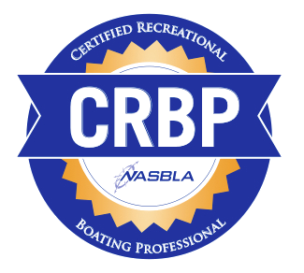
Certified Recreational Boating Professional
Curt Lewis, CRBP Pam Dillon, NASBLA
Tom Hayward, NASBLA
Notes:
Good afternoon.
I’m….
Pam Dillon…
Tom Hayward….
Curt Lewis, boating law administrator for Illinois and member of the NASBLA Executive Board. I am also a Certified Recreational Boating Professional.

Slide 2
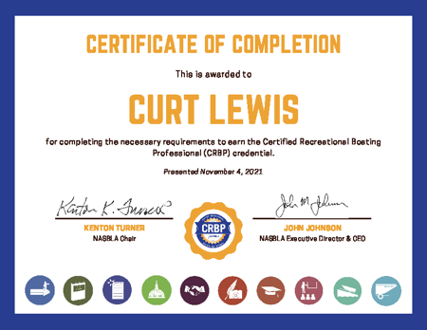
Notes:
We’re hear to talk with you today about the Certified Recreational Boating Professional credential and why it may be valuable to you

Slide 3
WHAT WE’LL COVER
What is a CRBP?
Why is it valuable?
What will I learn?
Who is eligible?
How do I get it?
Notes:
Quickly, here’s what we’re going to cover in the time we have together.
What is a C-R-B-P?
Why is it valuable?
What will I learn?
Who is eligible?
And How do I get it?

Slide 4
What is A CRBP?
The Certified Recreational Boating Professional (CRBP) certification is a voluntary credential for recreational boating professionals developed by NASBLA.
The credential is broad-based and addresses boating professionals’ knowledge, performance and career achievements in the identified program domains.
Notes:
What is a CRBP?
The Certified Recreational Boating Professional certification is a voluntary credential for recreational boating professionals developed by NASBLA. The credential is broad-based and addresses boating professionals’ knowledge, performance and career achievements in the identified program domains.
NASBLA developed this career-enriching and program enhancing national certification for salaried and volunteer recreational boating professionals.

Slide 5
What is A CRBP?
The program was designed to:
Elevate professional standards,
Enhance individual performance, and
Designate those who demonstrate knowledge essential to the recreational boating profession.
Notes:
The CRBP is designed to elevate professional standards, enhance individual performance, and designate recreational boating professionals who demonstrate the knowledge essential to recreational boating program management.

Slide 6
Why a Certification Program?
Credential is evidence of knowledge, experience and competence.
Those who hold the certification will be sought out for leadership positions in government, nonprofit and for-profit recreational boating agencies and organizations.
Notes:
Why a Certification Program?
This credential serves as evidence of knowledge, experience and competency related to the recreational boating safety profession
Those who hold the certification will be sought out for leadership positions in government, nonprofit and for-profit recreational boating agencies and organizations.

Slide 7
Why a Certification Program?
Ensure Professional Competency
Provide a defined Professional Development Path
Formally recognize professionals (paid & volunteer) qualified by a combination of education and experience, adherence to high standards of integrity, and an assessed commitment to lifelong learning and professional development.
Notes:
The process an individual has to take to acquire this credential ensure professional competency, provides a defined path for Professional Development and then provides formal recognition of qualified professionals. The combination of education and experience, adherence to high standards of integrity, and an assessed commitment to lifelong learning and professional development is the foundation of this credential.

Slide 8
What is the value of holding the CRBP designation?
Becoming a Certified Recreational Boating Professional shows your commitment to the recreational boating safety profession.
Individuals pursue the CRBP credential for a variety of reasons, including:
Professional development Career planning and professional pride
Dedication to their career Personal belief in the RBS profession
Self-fulfillment
Notes:
So – what is the value of holding the CRBP designation? Why would you want to achieve this?
Becoming a Certified Recreational Boating Professional shows your commitment to the recreational boating safety profession.
Individuals pursue the CRBP credential for a variety of reasons, including- Professional development, Career planning and professional pride, Dedication to their career, a personal belief in the RBS profession and for their own Self-fulfillment

Slide 9
What is the value of holding the CRBP designation?
Increase, demonstrate, and validate your skills and knowledge
Support continued professional development
Achieve personal accomplishment
Enhance your professional reputation
Demonstrate a high level of commitment to the recreational boating profession
Recognition by peers and associates
Differentiate yourself in a competitive job market
Improve opportunities for career advancement and increased earnings
Notes:
After being successful in receiving the CRBP designation what are some of the benefits you may experience as a result?
Increase, demonstrate, and validate your skills and knowledge
Support continued professional development
Achieve personal accomplishment
Enhance your professional reputation
Demonstrate a high level of commitment to the recreational boating profession
Recognition by peers and associates
Differentiate yourself in a competitive job market
Improve your opportunities for career advancement and increased earnings

Slide 10
What will I learn?
The composition of the CRBP exam is guided by extensive research on the job competencies performed and knowledge needed by recreational boating professionals. The following is a list of the 10 major domains or content areas which will be used to guide the composition of the CRBP exam.
Notes:
Now that we can haver the WHAT and the WHY… let’s talk about what you will learn and what information is covered.

Slide 11
THE DOMAINS
 | DOMAIN | ICON
1 | Management, Leadership, Ethics and Character
2 | Boating Law Administration
3 | Boating Laws and Compliance
4 | Federal Programs
5 | Partnerships
 | DOMAIN | ICON
6 | Boating Safety Marketing, Outreach and Public Relations
7 | Boating Safety Education
8 | Boating Safety Training and Program Development
9 | Waterways Management and Access
10 | Vessel Numbering, Tilting and Vessel Identification System (VIS)
Notes:
The composition of the CRBP exam is guided by extensive research of job competencies performed and knowledge needed by recreational boating professionals. Here is the list of the 10 domains, or content areas, used to guide the composition of the CRBP exam.
1 Management, Leadership, Ethics and Character
2 Boating Law Administration
3 Boating Laws and Compliance
4 Federal Programs
5 Partnerships
6 Boating Safety Marketing, Outreach and Public Relations
7 Boating Safety Education
8 Boating Safety Training and Program Development
9 Waterways Management and Access
Vessel Numbering, Titling and Vessel Identification System (VIS)
Numerous questions related to each of these domain makes up the CRBP exam. Let’s take a look at some sample questions…

Slide 12
FEDERAL PROGRAMS
Sample questions
What is the name of the fund that allows the Coast Guard to distribute money to the states, territories, and nonprofit grant applicants?
A. Recreational Fishing and Boating Fund
B. Sporting Fish and Recreational Boating Fund
C. Sport Fish Restoration and Boating Trust Fund
D. Fishing and Recreational Boating Trust fund
Notes:
What is the name of the fund that allows the Coast Guard to distribute money to the states, territories, and nonprofit grant applicants?
A. Recreational Fishing and Boating Fund
B. Sporting Fish and Recreational Boating Fund
C. Sport Fish Restoration and Boating Trust Fund
D. Fishing and Recreational Boating Trust fund
C. Sport Fish Restoration and Boating Trust Fund

Slide 13
FEDERAL PROGRAMS
Sample questions
What is the name of the fund that allows the Coast Guard to distribute money to the states, territories, and nonprofit grant applicants?
A. Recreational Fishing and Boating Fund
B. Sporting Fish and Recreational Boating Fund
C. Sport Fish Restoration and Boating Trust Fund
D. Fishing and Recreational Boating Trust fund
Notes:
What is the name of the fund that allows the Coast Guard to distribute money to the states, territories, and nonprofit grant applicants?
A. Recreational Fishing and Boating Fund
B. Sporting Fish and Recreational Boating Fund
C. Sport Fish Restoration and Boating Trust Fund
D. Fishing and Recreational Boating Trust fund
C. Sport Fish Restoration and Boating Trust Fund

Slide 14
Boating LAW ADMINISTRATION
Sample questions
A notice or proposed rule or other item open for comments will specify a deadline and all acceptable methods for submitting comments. Often the most efficient and timely way to comment will be on the related docket online at _____. A. Regulations.gov
B. Grants.gov
C. FederalResources.com
D. USCG.mil
Notes:
A notice or proposed rule or other item open for comments will specify a deadline and all acceptable methods for submitting comments. Often the most efficient and timely way to comment will be on the related docket online at _____. A. Regulations.gov
B. Grants.gov
C. FederalResources.com
D. USCG.mil
A. Regulations.gov

Slide 15
Boating LAW ADMINISTRATION
Sample questions
A notice or proposed rule or other item open for comments will specify a deadline and all acceptable methods for submitting comments. Often the most efficient and timely way to comment will be on the related docket online at _____. A. Regulations.gov
B. Grants.gov
C. FederalResources.com
D. USCG.mil
Notes:
A notice or proposed rule or other item open for comments will specify a deadline and all acceptable methods for submitting comments. Often the most efficient and timely way to comment will be on the related docket online at _____. A. Regulations.gov
B. Grants.gov
C. FederalResources.com
D. USCG.mil
A. Regulations.gov

Slide 16
Sample questions
Management, Leadership,
Ethics and Character
The main role of a leader is to:
A. Develop workplans for employees to get the job done
B. Create an environment in which good ideas can flourish
C. Make the customer happy
Keep everything on-time
Notes:
The main role of a leader is to:
A. Develop workplans for employees to get the job done
B. Create an environment in which good ideas can flourish
C. Make the customer happy
Keep everything on-time
B. Create an environment in which good ideas can flourish

Slide 17
Sample questions
Management, Leadership,
Ethics and Character
The main role of a leader is to:
A. Develop workplans for employees to get the job done
B. Create an environment in which good ideas can flourish
C. Make the customer happy
Keep everything on-time
Notes:
The main role of a leader is to:
A. Develop workplans for employees to get the job done
B. Create an environment in which good ideas can flourish
C. Make the customer happy
Keep everything on-time
B. Create an environment in which good ideas can flourish

Slide 18
Waterways Management
and Access
Sample questions
The level of recreational use that a body of water can withstand before both the recreational experience for the boaters and degradation of the resources begins is called:
A. Crowding experience
B. Marine threshold
C. Applicability assessment
D. Carrying capacity
Notes:
The level of recreational use that a body of water can withstand before both the recreational experience for the boaters and degradation of the resources begins is called:
A. Crowding experience
B. Marine threshold
C. Applicability assessment.
D. Carrying capacity.
D. Carrying capacity

Slide 19
Waterways Management
and Access
Sample questions
The level of recreational use that a body of water can withstand before both the recreational experience for the boaters and degradation of the resources begins is called:
A. Crowding experience
B. Marine threshold
C. Applicability assessment
D. Carrying capacity
Notes:
The level of recreational use that a body of water can withstand before both the recreational experience for the boaters and degradation of the resources begins is called:
A. Crowding experience
B. Marine threshold
C. Applicability assessment.
D. Carrying capacity.
D. Carrying capacity

Slide 20
Boating Safety Marketing,
Outreach and Public Relations
Sample questions
To create an effective and innovative advertising message, the first thing to be done is to ___________________
A. Develop a survey
B. Determine the audience
C. Consult with boating staff
D. Obtain permission from the budget director
Notes:
To create an effective and innovative advertising message, the first thing to be done is to ___________________
A. Develop a survey
B. Determine the audience
C. Consult with boating staff
D. Obtain permission from the budget director
B. Determine the audience

Slide 21
Boating Safety Marketing,
Outreach and Public Relations
Sample questions
To create an effective and innovative advertising message, the first thing to be done is to ___________________
A. Develop a survey
B. Determine the audience
C. Consult with boating staff
D. Obtain permission from the budget director
Notes:
To create an effective and innovative advertising message, the first thing to be done is to ___________________
A. Develop a survey
B. Determine the audience
C. Consult with boating staff
D. Obtain permission from the budget director
B. Determine the audience

Slide 22
Core resources
A list of core resources has been compiled to reflect a sample of literature that is aligned with the CRBP domain assessments and would be useful in preparing to be a recreational boating professional or preparing to earn the CRBP.
Notes:
So those were a few examples of the types of questions you will see on the CRBP exam.
To prepare for the example, a list of core resources has been compiled to reflect a sample of literature that is aligned with the CRBP domain assessments and would be useful in preparing to be a recreational boating professional or preparing to earn the CRBP.
While these resources are not required reading and should not be interpreted as constituting the sole source of all CRBP exam questions, candidates may find them useful when preparing for the exam. This list is available on the NASBLA website with links to the resources.

Slide 23
Who is eligible?
You have Recreational Boating Professional experience being employed or volunteering at a qualifying organization. You currently, or within the last six months, have been employed or volunteering at a qualifying organization.
A qualifying organization is a state boating agency, U.S. Coast Guard, recreational boating business, recreational boating-related nonprofit organization.
Notes:
Who is eligible to apply for the CRBP certification?
Here is a list of pre-application qualifications:
You mush have Recreational Boating Professional experience being employed or volunteering at a qualifying organization and you are currently, or within the last six months, have been employed or volunteering at a qualifying organization.
A qualifying organization is a state boating agency, U.S. Coast Guard, recreational boating business, recreational boating-related nonprofit organization.
boating.

Slide 24
Who is eligible?
A associate's degree or higher, (or equivalent experience).
You are committed to upholding the CRBP Standards of Conduct and have no felony convictions related to the recreational boating.
You have completed 25 hours of broad-based qualifying professional development within the last five years preceding the application submission.
Notes:
You have an associate's degree or higher, (or equivalent experience) – there are more detail on the application about what qualifies as equivalent experience
You have completed 25 hours of broad-based qualifying professional development within the last five years.
** FYI - If you attend all of the sessions at this Summit, you’d get 12.5 hours of continuing education credit toward the 25 hours.
You must also be committed to upholding the CRBP Standards of Conduct and have no felony convictions related to the recreational

Slide 25
How do I get started?
Notes:
How do I get started?
Earning and maintaining the CRBP is a three-part process.

Slide 26
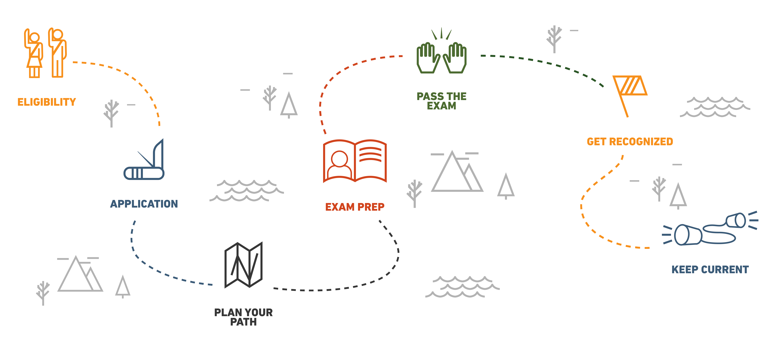
THE CRBP JOURNEY
WWW.NASBLA.ORG/CRPB
Notes:
First, you must meet eligibility requirements we just discussed and submit an application.
Once your application is accepted you begin your exam prep then when you are ready, take and pass the CRBP exam online. One point to mention is you can choose to take individual domain examinations one at a time or you can decide you want to take them all at once. It is up to you.
Lastly, after passing your exam you all be responsible for maintain your credential by fulfilling certification renewal requirements every three years.
One question we get is “How long does it take?” - That depends on the individual, whether you want to take them individually or all at once, and how much studying you need to do for each domain. A person new in recreational boating may take longer to build out their knowledge, however someone with more RBS experience may THINK they know this but while some domains are more black and white, some domains will challenge you and what you think you know!

Slide 27
THE CRBP JOURNEY
WWW.NASBLA.ORG/CRPB
Notes:
To apply and learn more about the CRBP
Go to the NASBLA homepage and click on Training in the top right menu. That is where you will see the pages for the Certified Recreational Boating Professional.
If questions about costs ---
$50 application fee
$25 per domain assessment ( you pay the per domain fee for each exam when you are ready to take the test for that domain)

Slide 28
questions
Notes:
We hope this was informative and answered some questions about what the Certified Recreational Boating Professional designation is and why it is valuable in the Recreational Boating Safety community. If you have any more questions were happy to take those now!

Slide 29
Certified Recreational Boating Professional
WWW.NASBLA.ORG/CRBP
Curt Lewis, CRBP |Curt.Lewis@Illinois.gov
Ron Sarver, NASBLA | ron@nasbla.org
Notes:
Contact Information

