Slide 1
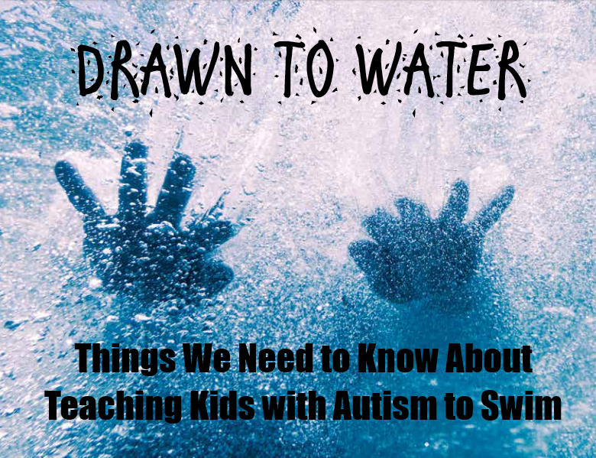

Slide 2
JUST THE FACTS

Slide 3
150 children are diagnosed with Autism every hour. That’s about 1.3 million diagnosed every year. CDC – 1:44

Slide 4
Drowning is the number one leading cause of death of children and adults with autism

Slide 5
Children with Autism Spectrum Disorder (ASD) are 160 times more likely to drown than their neurotypical peers.

Slide 6
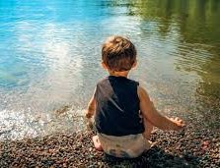
50% of children with autism wander – nearly all gravitate towards water.

Slide 7
74% of fatal drowning incidents resulted from wandering. 91% of wandering related deaths in autism is due to drowning.

Slide 8
36% of parents report that they have had a drowning “Close Call”

Slide 9
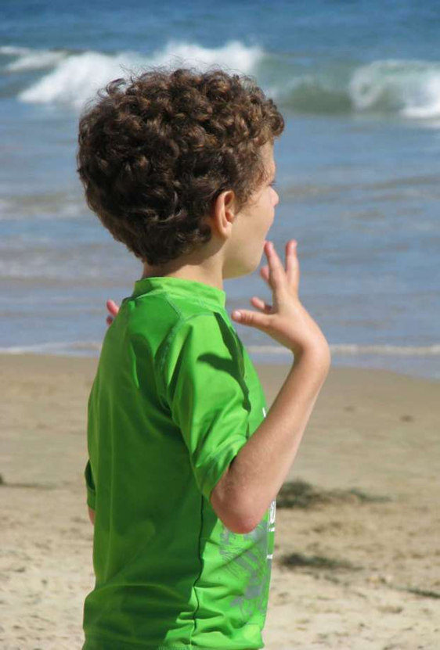
Lack of Awareness
Only 50% of parents of children with ASD have received advice about wandering prevention from their physicians.

Slide 10
No Fear of Dangerous Situations
The more significant the person’s impact of autism, the greater the risk of drowning.

Slide 11
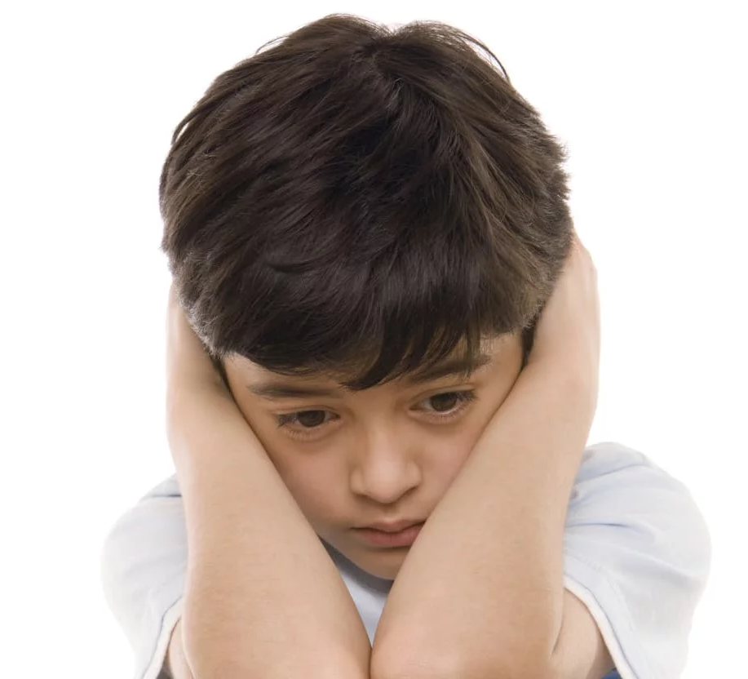
Children with autism see, feel and understand things in a different way, which makes teaching them about water safety a huge challenge.

Slide 12
Why Is Water So Attractive to Kids with Autism?

Slide 13
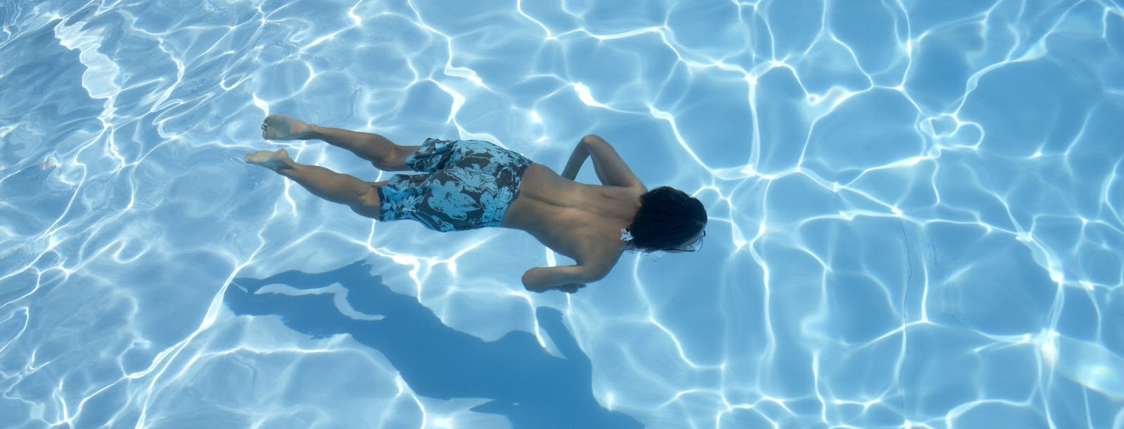
Typically
It sparkles, bubbles, reflects and refracts light
Feels good on the skin
Pressure underneath fulfills many sensory needs
The smell of salt or chlorine is unusual and can be strong and stimulating

Slide 14
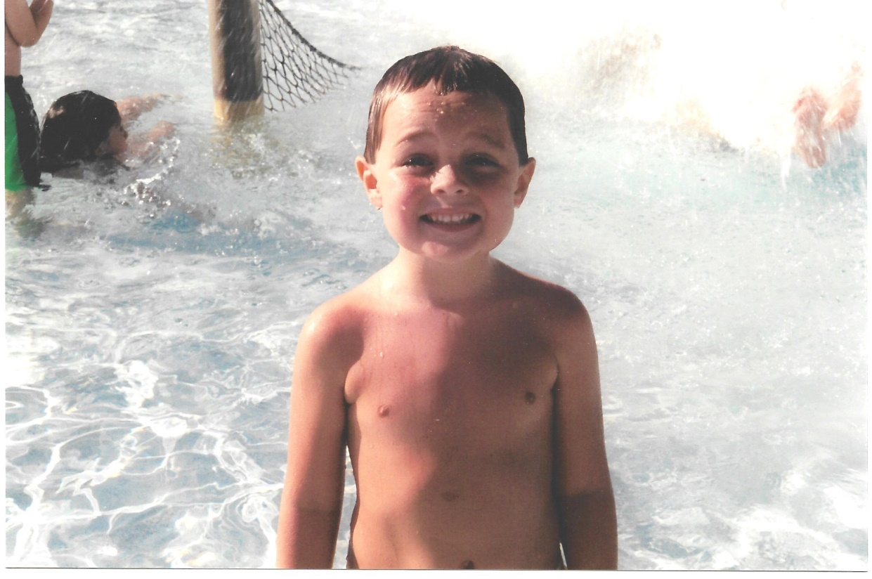
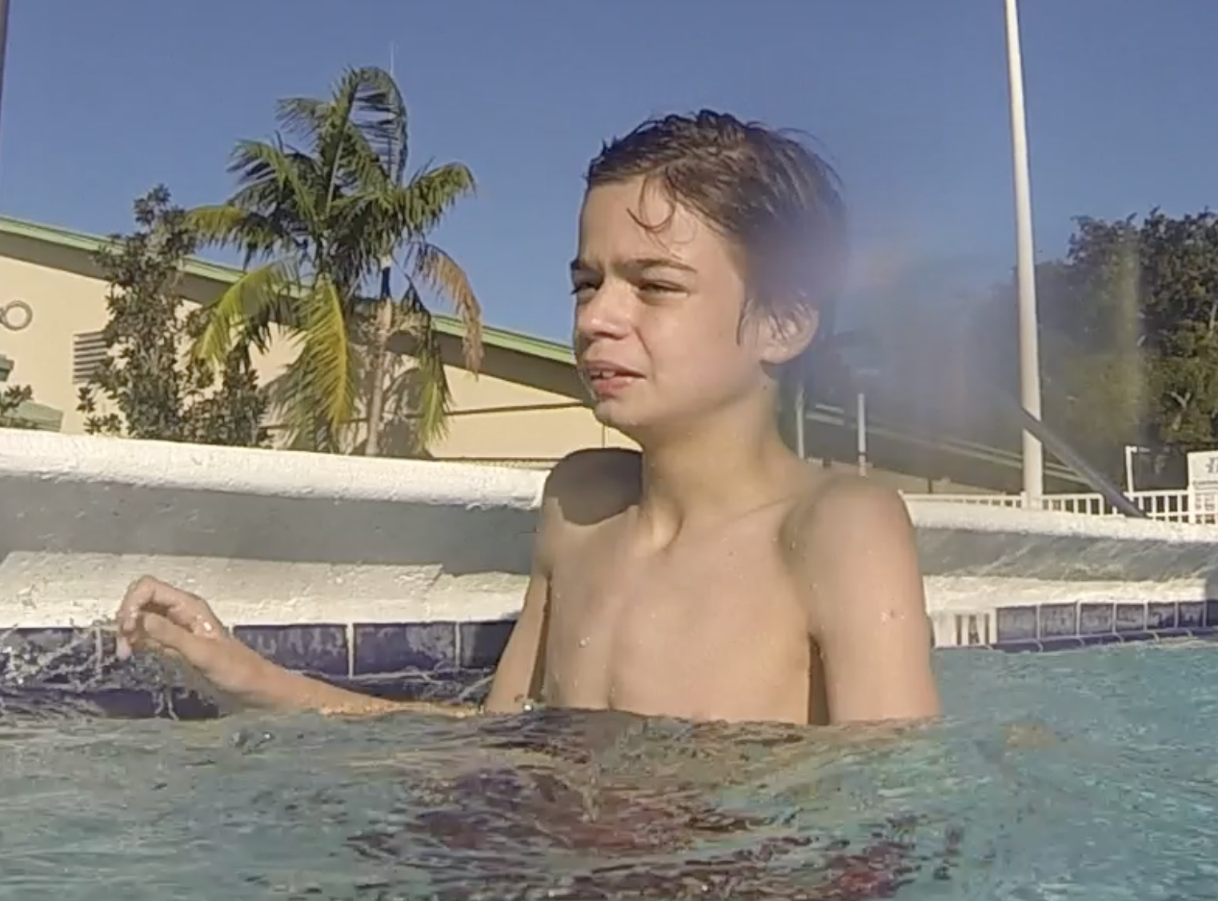
What Does Autism “Look” Like?
There is no “LOOK” for all people with autism.
Everyone is UNIQUE.

Slide 15
Individuals with Autism MAY Demonstrate Difficulty with:
Communication: both verbal and nonverbal
Sensory Processing: may have sensitivity to sound, smell, light and touch
Social Interactions: may not make eye contact, pick up on social cues, body language or understand personal space
Behavior: may have obsessive tendencies, exhibit outbursts, or wander

Slide 16
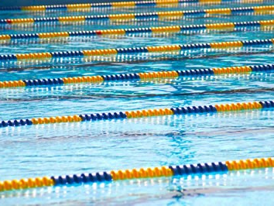
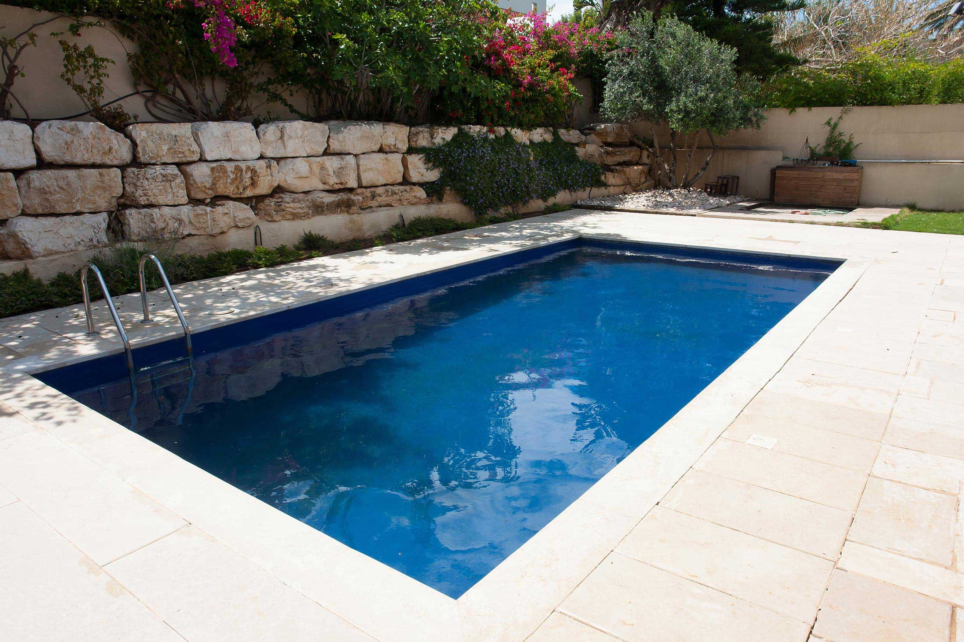
Poor Generalization
One of the core deficits in autism is generalization – meaning they have the skill in one place, but not in another

Slide 17
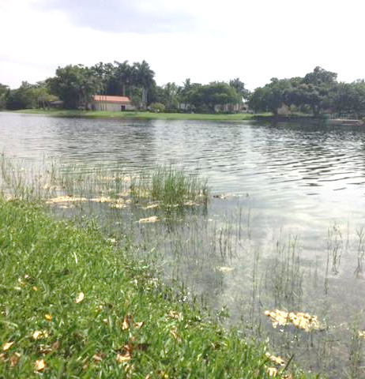
68% of the deaths resulting from wandering, died in a nearby pool, pond, lake, creek or river…even though many had had swimming lessons.

Slide 18
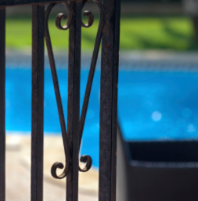
Think about it……
WHAT ARE THE TYPICAL CONDITIONS WHEN KIDS DROWN?
Lack of supervision, unrestricted access, lack of knowledge and an inability to problem solve
First Time Problem (FTP) is when a swimmer enters cold water, swims in clothing, swims in footwear, swims without goggles, and swims in the dark.

Slide 19
“Most people drown because they don’t know how NOT to drown.” – John Connelly, the Lifesaving Foundation

Slide 20
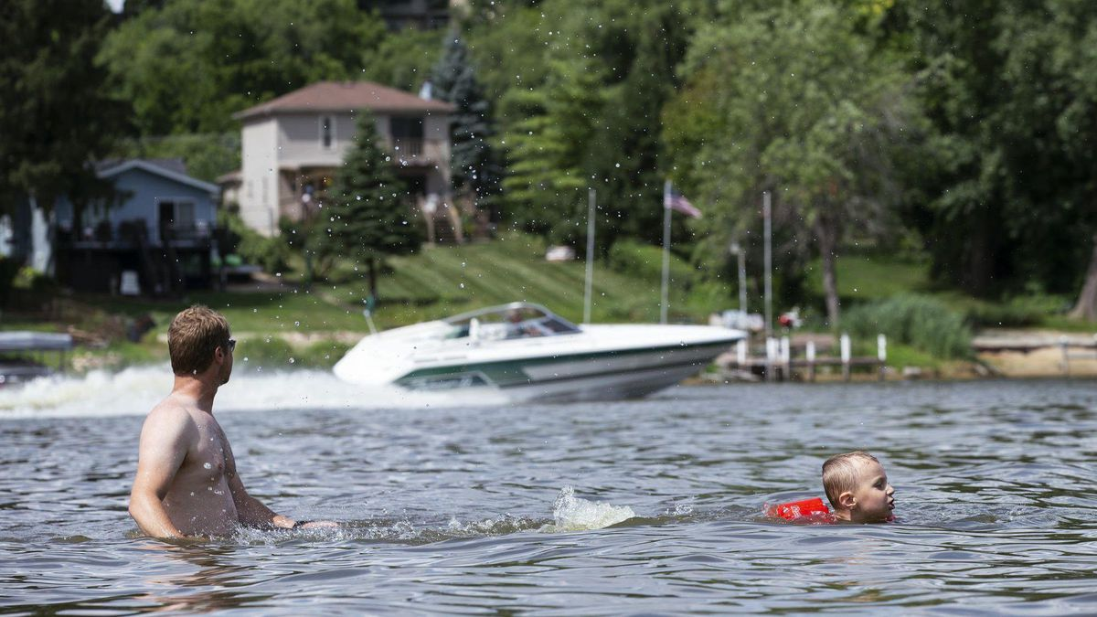
What Are Some Boating Hazards?
Love to watch the splash of water
No fear
May be Houdini-like (“The vest must come off”)
If child is nonverbal, they may be unheard & go unnoticed
They may not be able to handle a motorboat engine (smell, sound or vibration) – OR they may love it
Lack of environmental attention or awareness

Slide 21
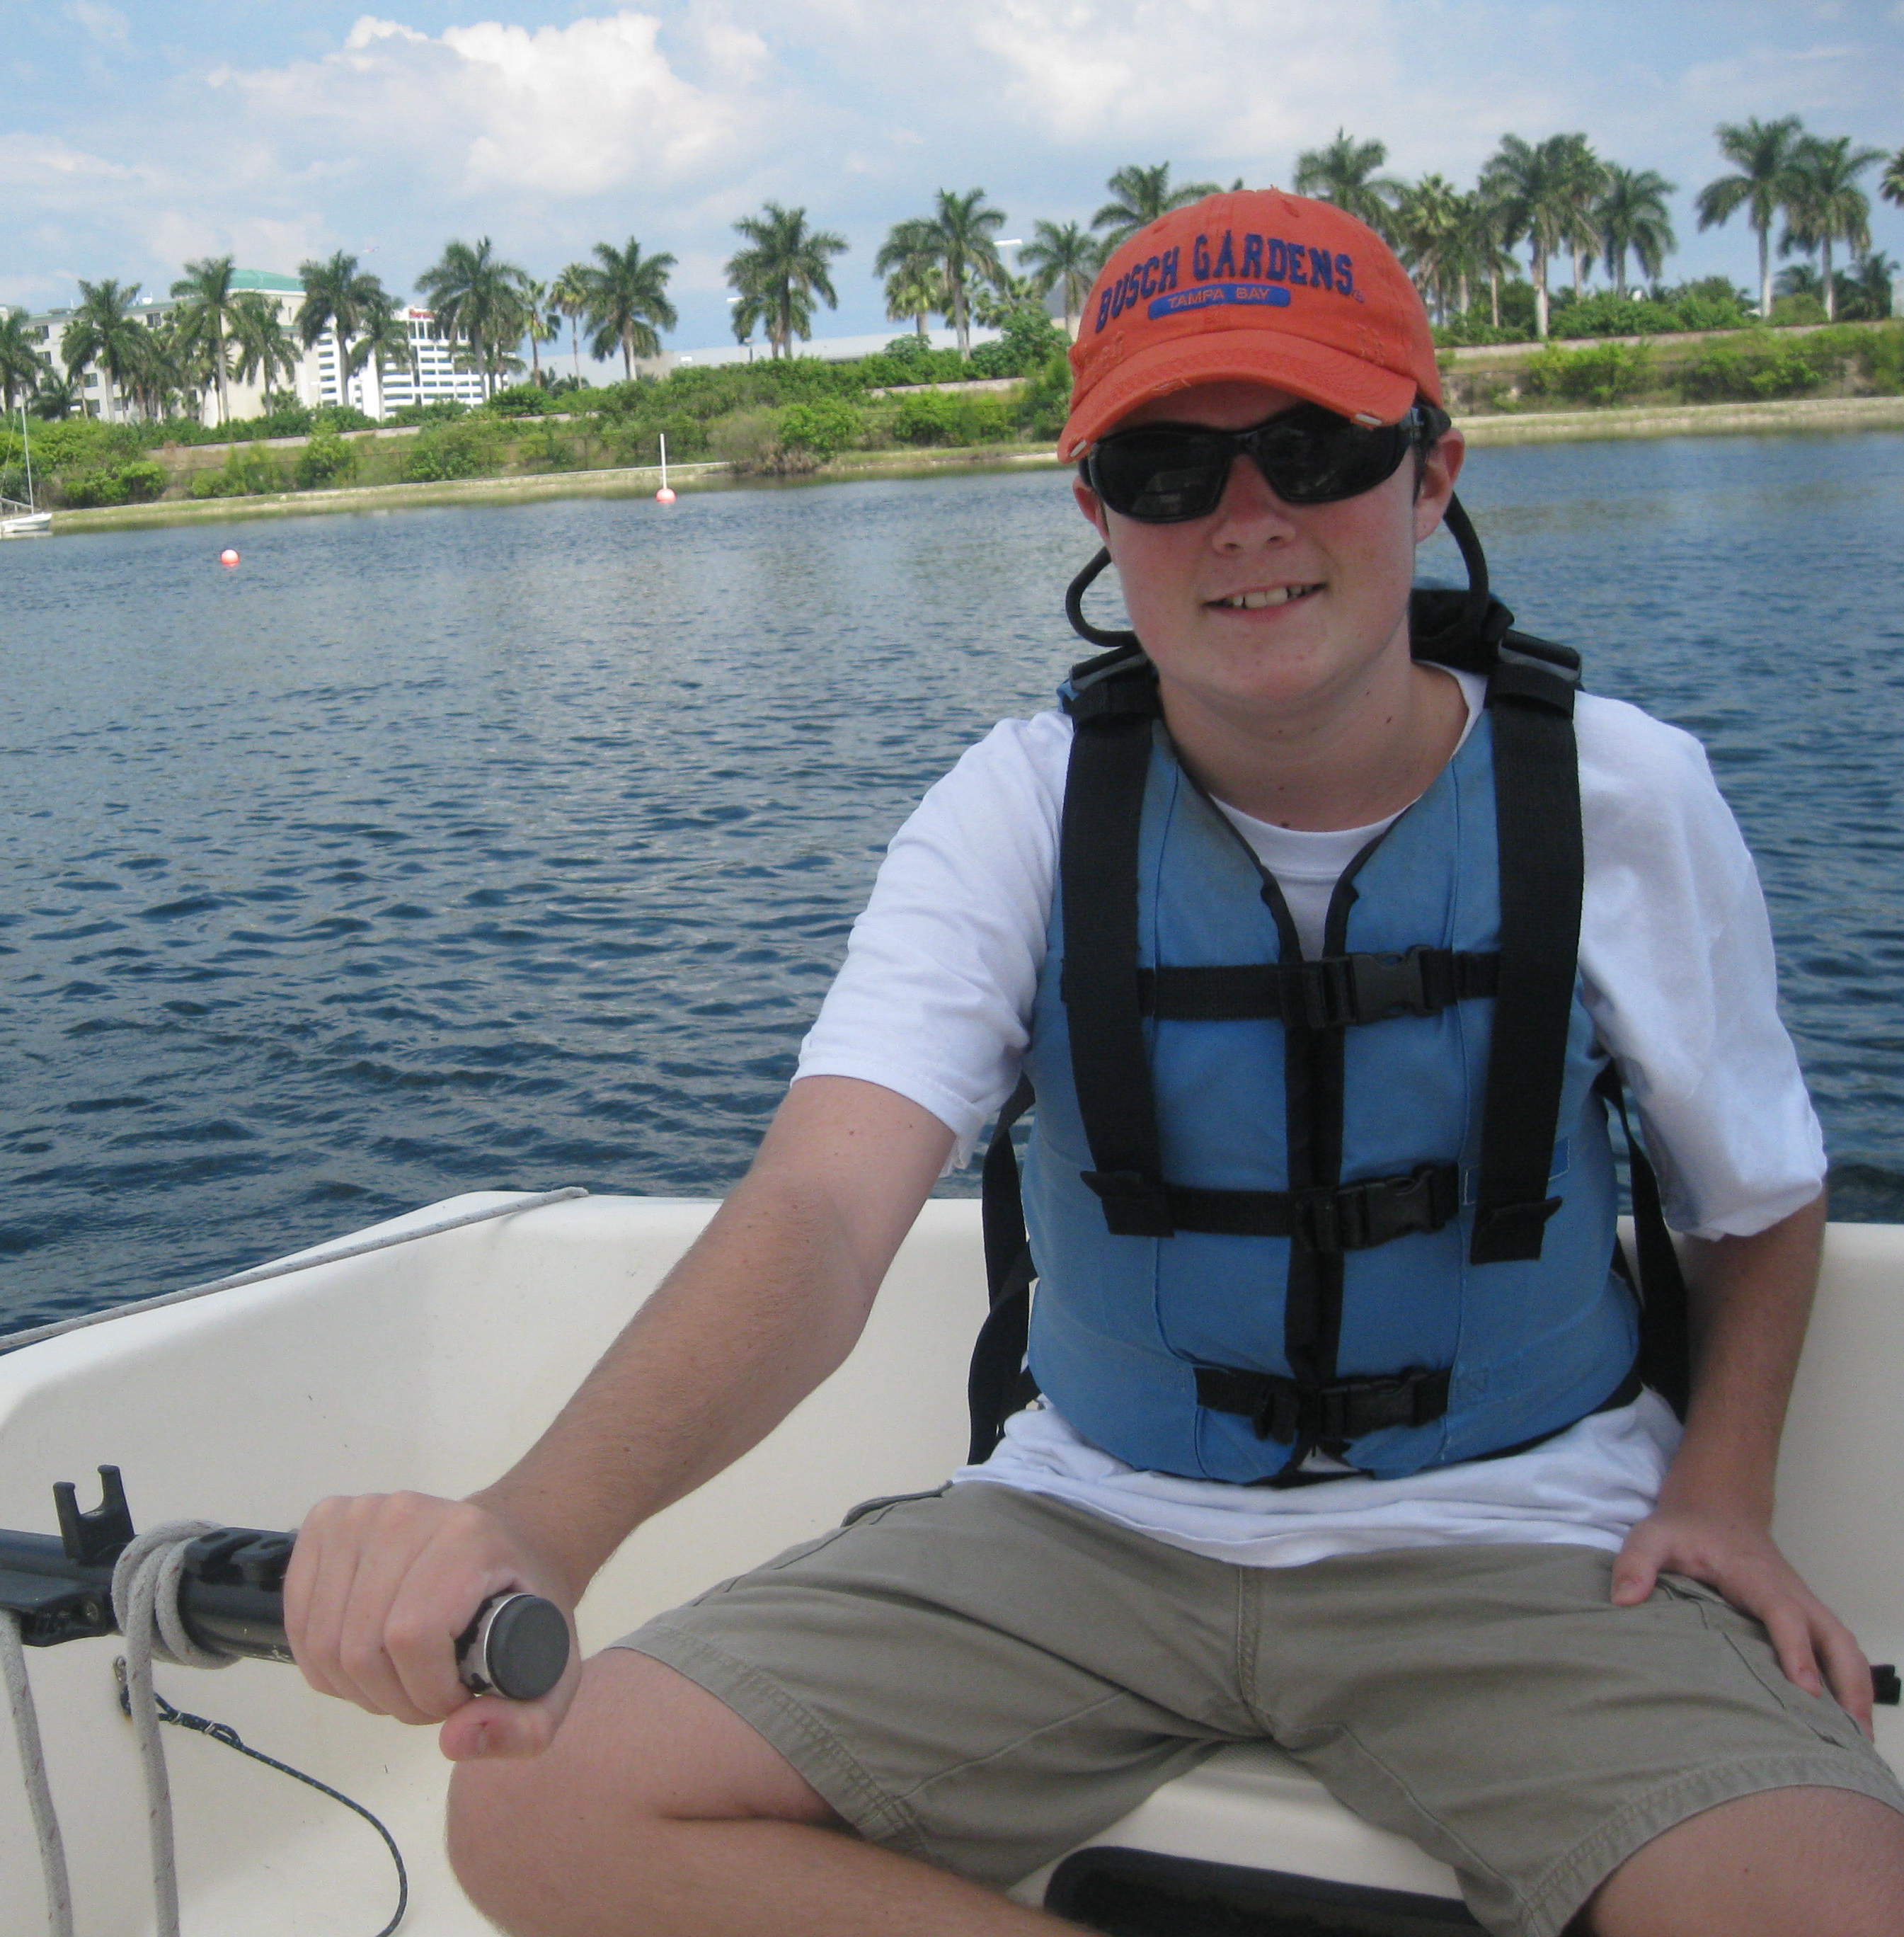
BUT… your student could be the best sailor EVER
Super focused
Likes to be alone
Loves the silence on the water
Can be themselves

Slide 22
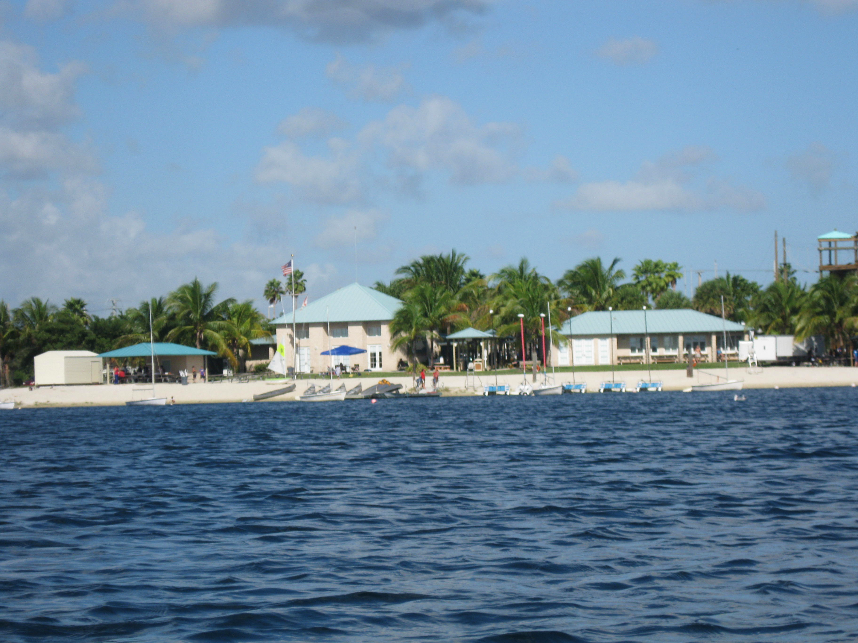
How Can You Assist Your Student Who Has an ASD?

Slide 23
Model what you expect

Slide 24
Presume Intellect
Simplify language. Avoid metaphors and sarcasm.
Don’t rely on facial expressions to convey meaning.
Allow the student to use coping strategies (ie; hand flapping or putting their fingers in their ears when overstimulated)

Slide 25
Break down instruction – 1 step at a time

Slide 26
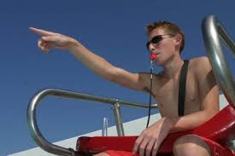
Prepare students for the loud sound of the lifeguards’ whistles. Demonstrate the whistles, explain why they are used, and possibly allow the student to blow the whistle.

Slide 27
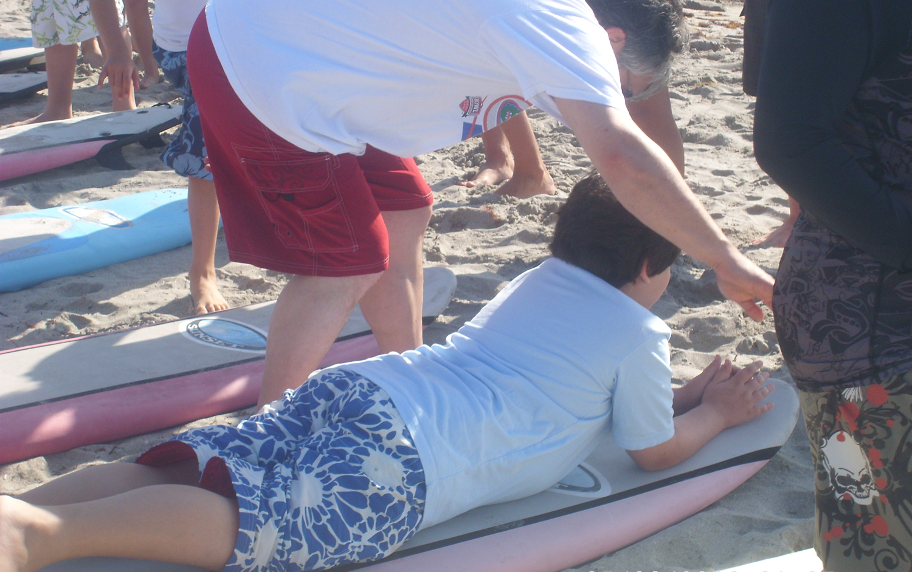
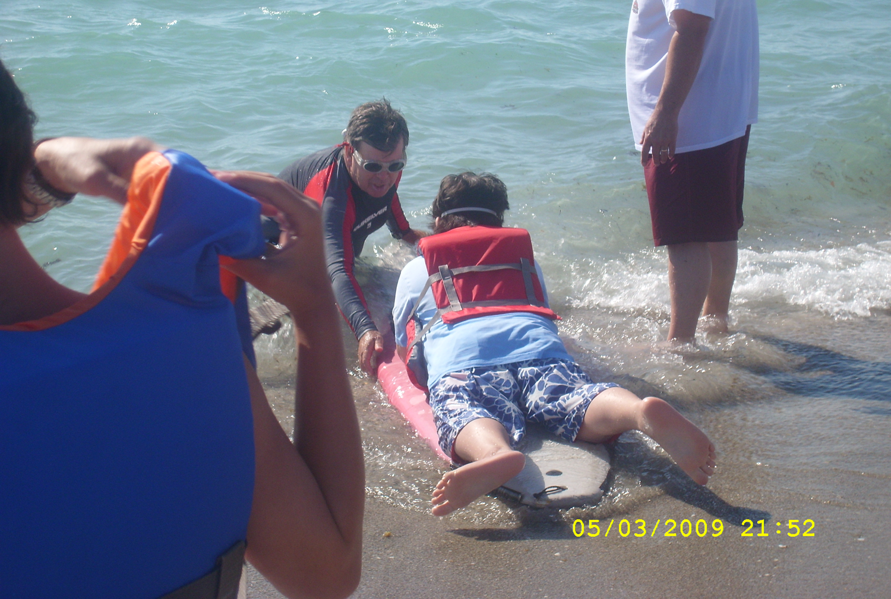
Familiarization is KEY
Allow the student the time to familiarize themselves with the boat/water, the instructor, and objects they will be using.

Slide 28
Familiarization helps to minimize social difficulties and discomfort that a child with autism might experience.

Slide 29
Hanging out on the dock is OK Don’t Rush It

Slide 30
Have them take on part of the process. Give them an assigned task

Slide 31
Model and have them imitate – Try not to do things for them

Slide 32
Let them tell you when they’re ready

Slide 33
It’s ok to sit at the dock and go nowhere

Slide 34
Pay attention to what the child loves
Give social reinforcement, like verbal praise or high-fives.
Some need tangible rewards to begin.

Slide 35
Offer a ‘quiet room’. It doesn’t need to be an actual room, but this would be an area away from the noise and activities where the student could go if he/she needs a quiet break.

Slide 36
The BIG 4:
1. Understanding of aquatic environments like moving water, breaking waves and strong currents.
2. Enter & Exit water safely
3. Swimming Skills - submerging underwater, floating in water with airway above the surface of the water (i.e. for minimum of 30 secs), gliding, kicking
4. Rescue skills - ability to be rescued by grasping poles and/or clinging to floatation devices

Slide 37
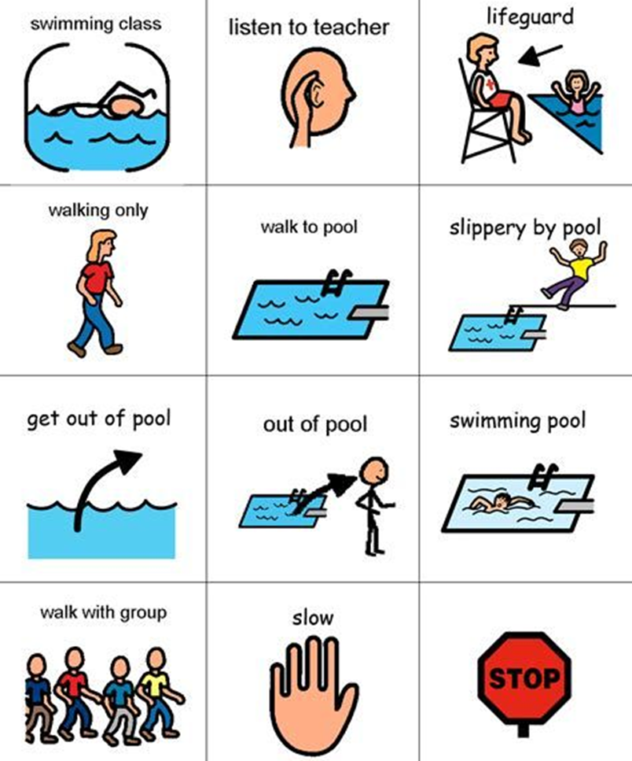
Make It Visual
US Sailing Level 1 book “Teaching and Coaching Fundamentals for Sailing” -
In the first chapter they talk about different learning styles: visual, auditory and kinesthetic. Focus on visual and kinesthetic

Slide 38
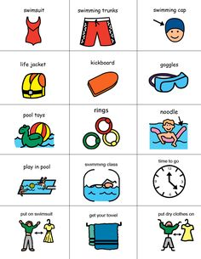
Provide a written or picture schedule.
Offer a wipe-off board with an agenda. Be sure to include the expectations of the student for that particular lesson.

Slide 39
Laminated cards can be used in the water to give directions.

Slide 40
Accommodations to Consider
Adjust the student-teacher ratio. Many students with ASD perform better in smaller classes.
Hold classes during times when there’s not as many kids in the water.
Consider potential fear of water among older children and adult students (and not just in young kids)
Allow use of apparel that they prefer (fidget item, favorite t-shirt)
Wearing a life vest may take a few classes all on its own due to sensory issues.

Slide 41
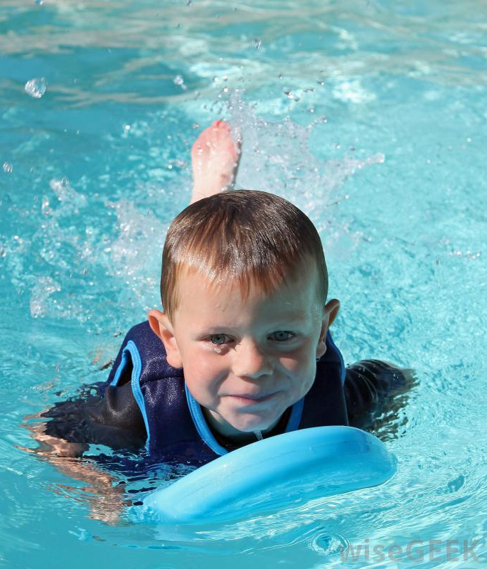
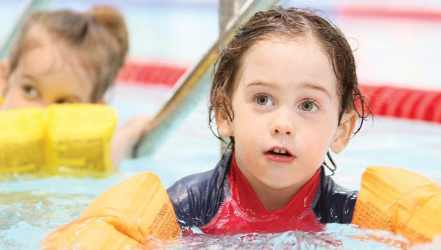
CAUTION Flotation Devices
Due to poor generalization skills, a child MUST experience swimming without a flotation device, or they may assume this is what it will be like if they fall in any water source

Slide 42
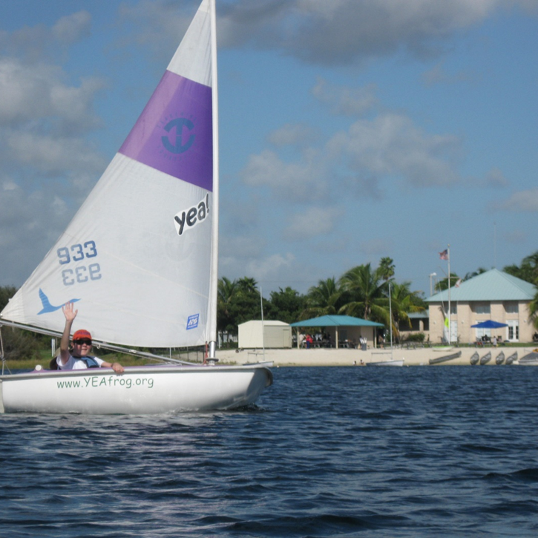
Benefits of Boating or Swimming Instruction to Kids with Autism

Slide 43
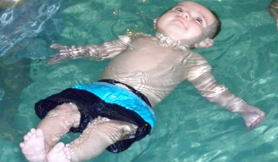
IT COULD SAVE THEIR LIVES
Often it is simply a lack of water safety awareness that causes danger among children with special needs. They don’t know what they don’t know.

Slide 44
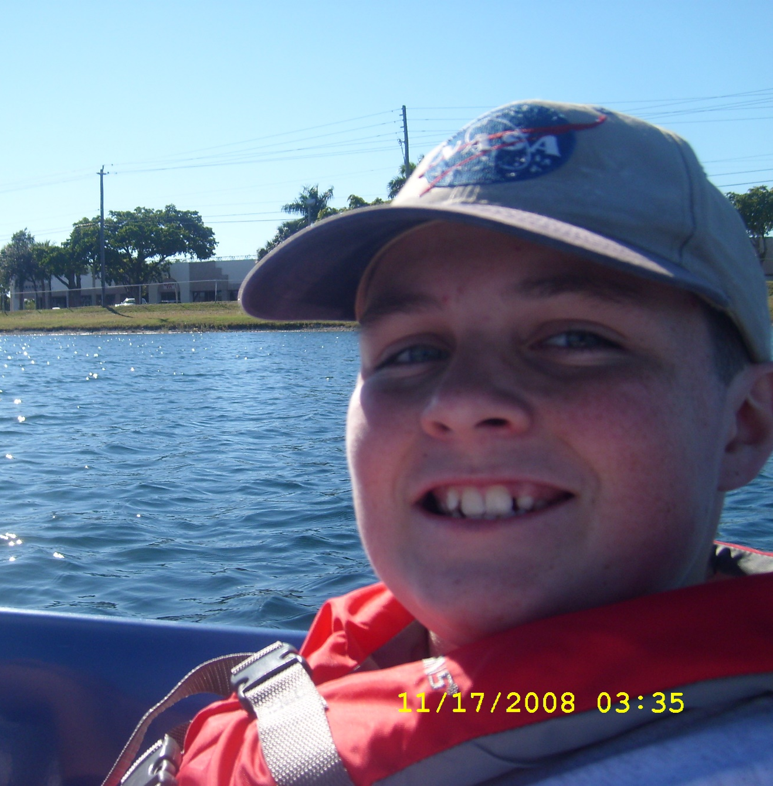
HELP BOOST CONFIDENCE & SELF-ESTEEM
Many children with special needs have problems with confidence, but successfully learning a new skill like sailing can make all the difference.

Slide 45
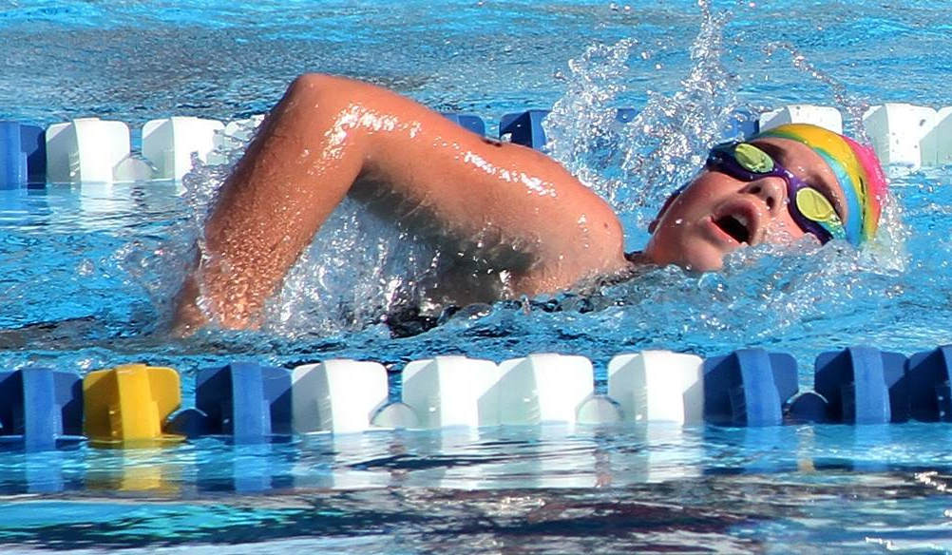
IMPROVES THEIR FITNESS & STRENGTH
Improvement of strength and fitness makes them healthier and more competitive

Slide 46
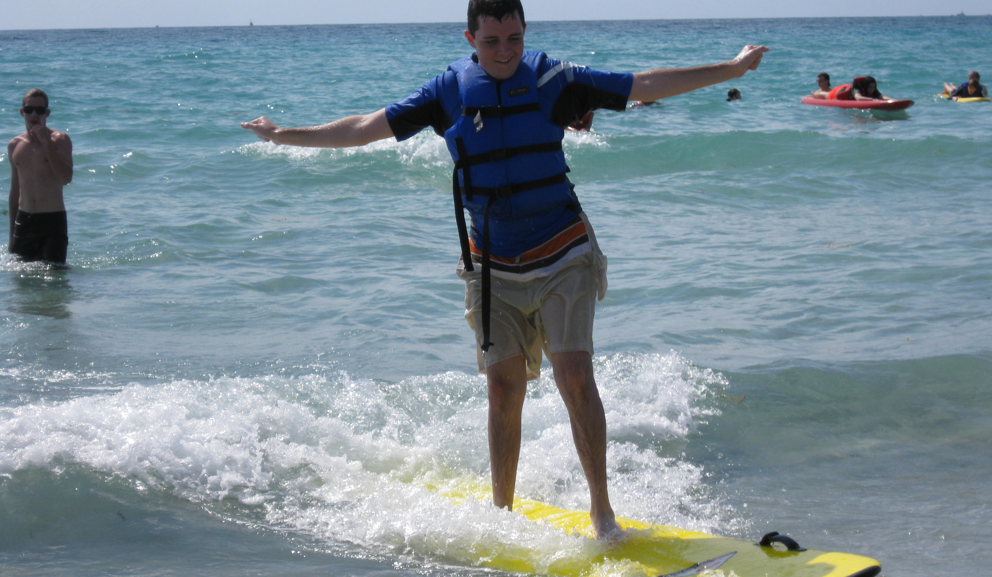
IMPROVE COORDINATION & RANGE OF MOTION
Improves balance, coordination and range of motion, all things that many children with autism struggle with.

Slide 47
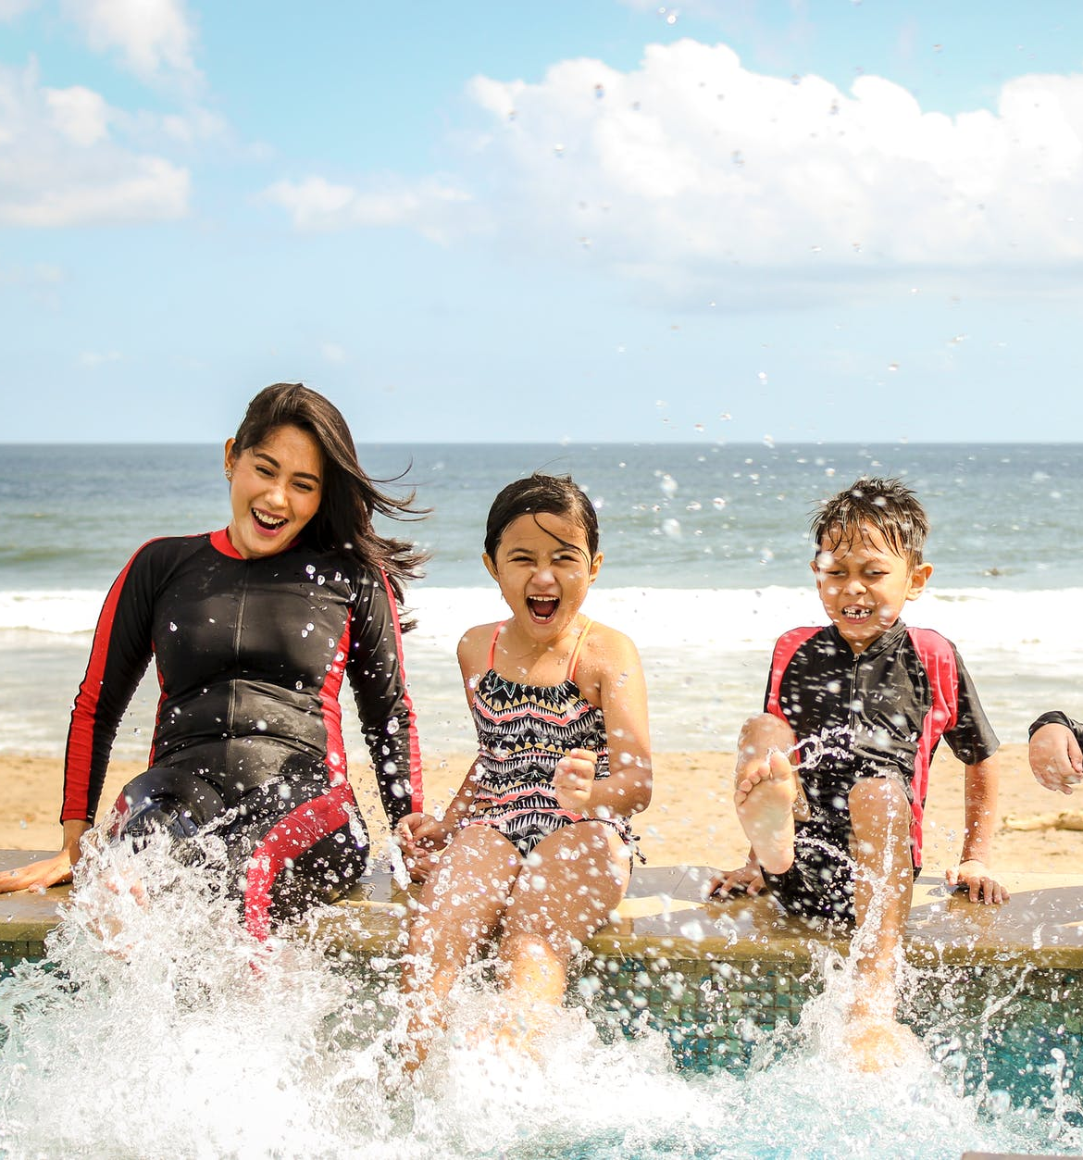
How to Engage with Families
Let them know they are welcome to watch (or be in the boat if you like)
Keep them involved by asking what their child likes/enjoys
Inform them about how kids create friendships through boating
Assure them that their child will be safe and that they are learning a skill they can use their entire lifetime

Slide 48
How to Market Your Program
Create a friendly “front door” website
Focus on friendships
Make it affordable and advertise info on scholarships
Promote to aftercare & therapy programs
Use social media to show your personality – especially video content
Hold an Open House

Slide 49
There Is Help
For more information about autism:
autismfl.org/water-safety/

Slide 50
Stacey Hoaglund Autism Society of Florida www.autismfl.org Stacey@autismfl.org 954-252-8764
THANK YOU!

