Slide 1
Resilient Leadership in Boating and Water Safety
Prepared for:
Prepared By:
Kevin M. Coleman
www.KMCEmpowerment.com

Slide 2
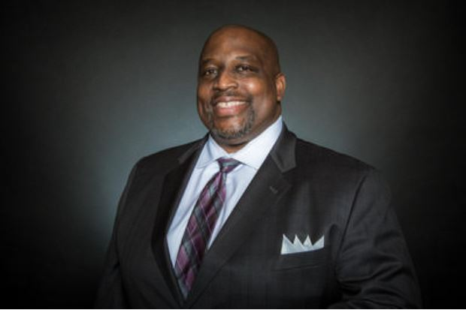
Resilient Leadership in Boating and Water Safety
SPEAKER:
Leadership Training and Development Consultant
Communication Training and Development Consultant
Diversity, Equity, and Inclusion (DEI) Consultant
Certified FICTP Coach
Certified John C. Maxwell Coach, Trainer, and Speaker
Certified John C. Maxwell D.I.S.C. Consultant
Employee Engagement Expert
Performance Improvement Practitioner (PIP)
Kevin M. Coleman “The Empowerment Coach”
www.KMCEmpowerment.com

Slide 3
Resilient Leadership in Boating and Water Safety
Six (6) Transformational Principles for Today’s
2022 Resilient Leaders!
www.KMCEmpowerment.com
Notes:
The Biggest difference between Training and Development? How many of you go to Trainings and Remember everything about it? Most don’t it goes in one ear and right out the other. That is why I am giving each of you an opportunity to get in a Development Program after this training by going to my website to learn more.

Slide 4
Resilient Leadership in Boating and Water Safety
1. The Foundation of Resilient Leadership
2. The Ultimate Test of Resilient Leadership
3. The Quickest Way to Display Resilient Leadership
4. The Extra Plus in Resilient Leadership
5. The Indispensable Quality of Resilient Leadership
6. The Expansion of Resilient Leadership
www.KMCEmpowerment.com

Slide 5
5 Levels of Leadership: John C. Maxwell
www.KMCEmpowerment.com

Slide 6
Resilient Leader “Interactive” Question # 1
When it comes to your Character, what are some of your non-negotiables?
www.KMCEmpowerment.com

Slide 7
1. The Foundation of Resilient Leadership: Character
www.KMCEmpowerment.com

Slide 8
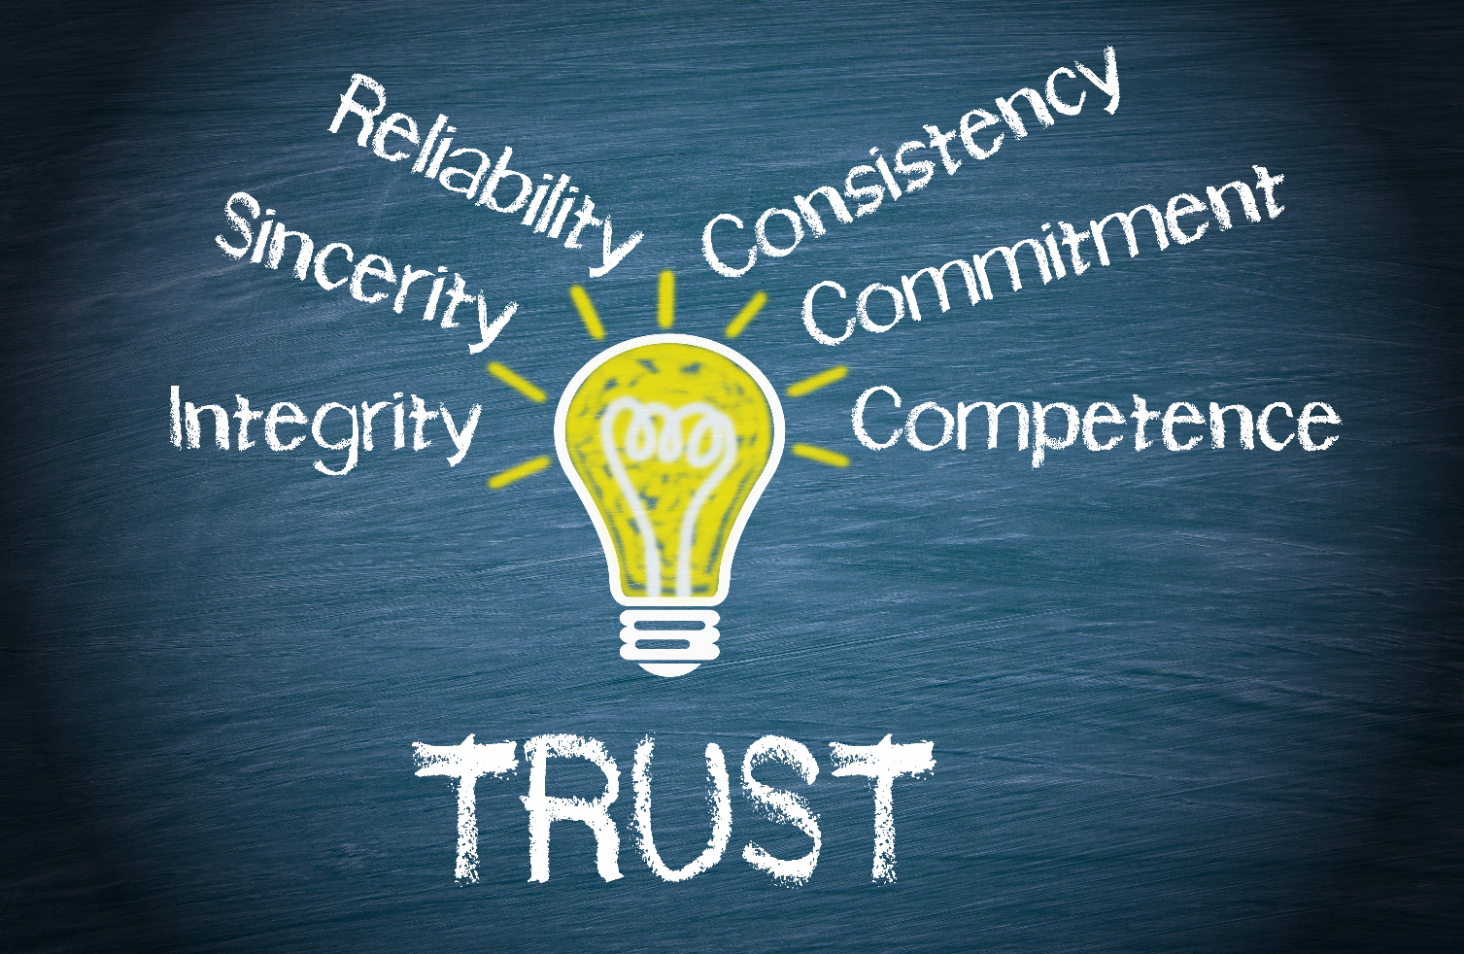
1. The Foundation of Resilient Leadership: Character
www.KMCEmpowerment.com

Slide 9
Resilient Leader “Interactive” Question # 2
Why is it a challenge to wait on others to accept Change?
www.KMCEmpowerment.com

Slide 10
2. The Ultimate Test of Resilient Leadership: Creating Positive Change
www.KMCEmpowerment.com

Slide 11
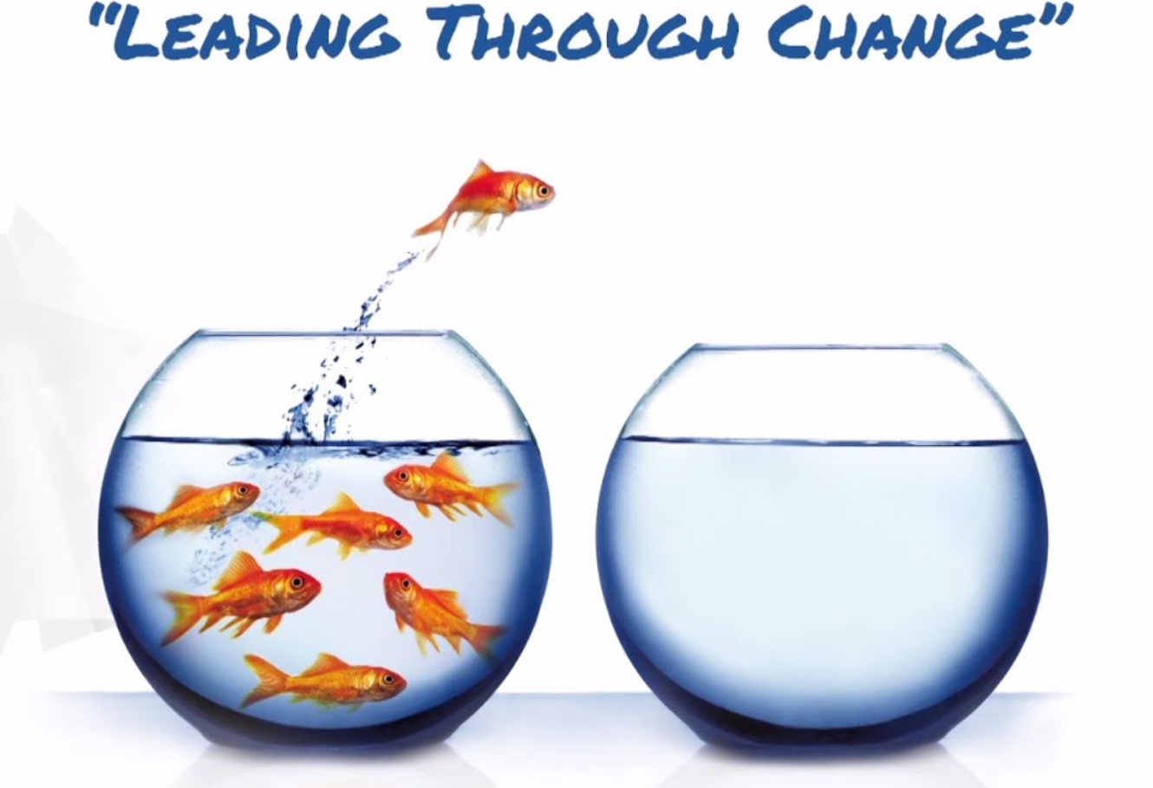
2. The Ultimate Test of Leadership: Creating Positive Change
www.KMCEmpowerment.com

Slide 12
Resilient Leader “Interactive” Question # 3
Describe a problem when your reaction to the problem made the problem worse?
www.KMCEmpowerment.com

Slide 13
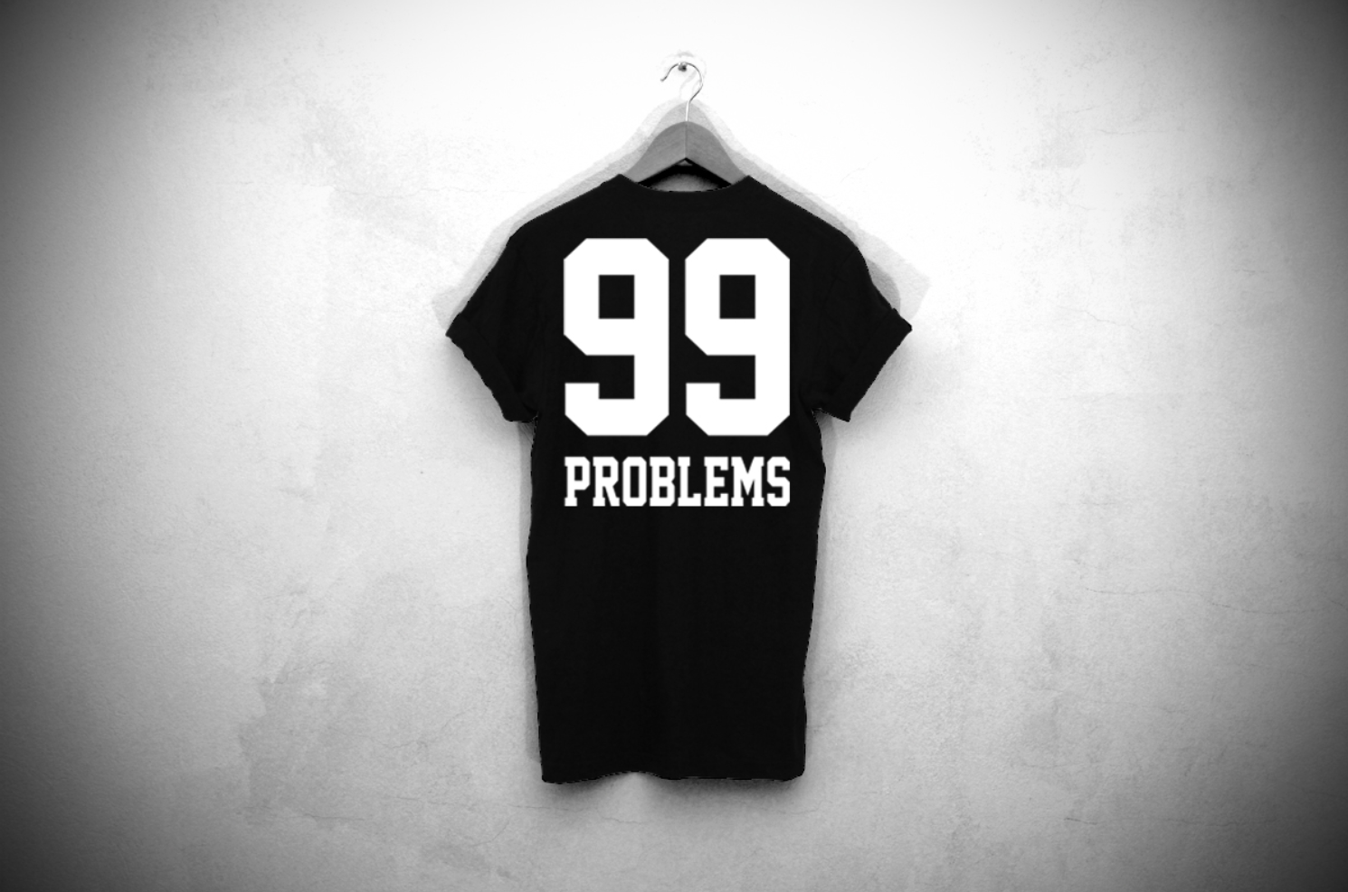
3. The Quickest Way to Display Resilient Leadership: Problem Solving
www.KMCEmpowerment.com

Slide 14
3. The Quickest Way to Display Resilient Leadership: Problem Solving
Create a Framework to Examine Problems and Solutions
Six (6) Critical Keys for Framework:
Leadership: How does this problem affect our people?
Personnel: Do we have the right people to help us with this problem?
Timing: Is this the right time for a solution, and do we have enough time for it?
Vision: How does this problem affect where we’re trying to go?
Priorities: Are my problems taking me or the team away from our priorities?
Values: Are my values or my team’s being compromised by this problem?
www.KMCEmpowerment.com

Slide 15
Resilient Leader “Interactive” Question # 4
Who do you admire most in your Personal or Professional Career? Write down 5 things about the person you admire?
www.KMCEmpowerment.com

Slide 16
4. The Extra Plus in Resilient Leadership: Attitude
www.KMCEmpowerment.com

Slide 17
Resilient Leader “Interactive” Question # 5
What does the below Zig Ziglar’s quote mean to you?
“If you help people get what they want, they will help you get what you want.” - Zig Ziglar
www.KMCEmpowerment.com

Slide 18
Resilient Leader “Interactive” Question # 6
“If the leader doesn’t see the vision, the people never will.” When have you seen this occur in your experience?
www.KMCEmpowerment.com

Slide 19
5. The Indispensable Quality of Resilient Leadership: Vision
QUOTE - Author Napoleon Hill said, “Cherish your visions and dreams as they are the children of your soul: The blueprints of your ultimate achievements.”
www.KMCEmpowerment.com

Slide 20
5. The Indispensable Quality of Resilient Leadership: Vision
www.KMCEmpowerment.com

Slide 21
Resilient Leader “Interactive” Question # 7
What is the hardest thing you have done to improve yourself or your circumstances?
www.KMCEmpowerment.com

Slide 22
6. The Expansion of Resilient Leadership: Personal Growth
GROWTH MATTERS
www.KMCEmpowerment.com

Slide 23
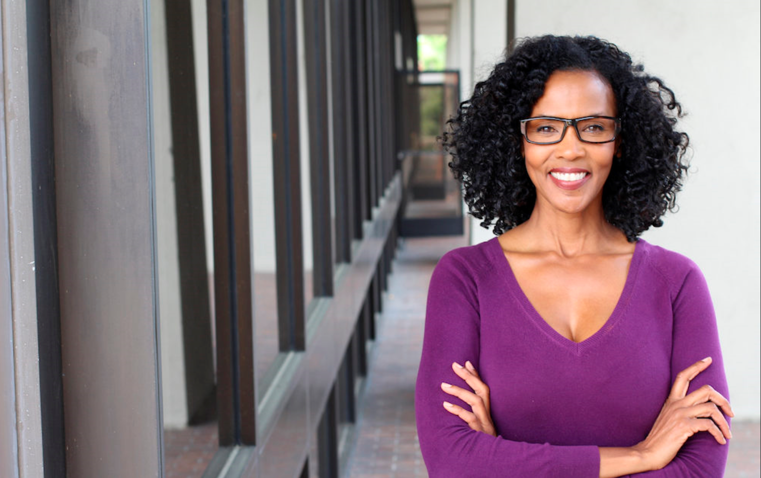
6. The Expansion of Resilient Leadership: Personal Growth
Adopt a Learner’s Mind-Set:
Develop a Specific Growth Strategy:
www.KMCEmpowerment.com

Slide 24
Resilient Leader “Interactive” Question # 8
How will you Develop the Resilient Leader Within You?
www.KMCEmpowerment.com

Slide 25
Resilient Leadership in Boating and Water Safety:
1. The Foundation of Resilient Leadership: Character
2. The Ultimate Test of Resilient Leadership: Creating Positive Change
3. The Quickest Way to Display Resilient Leadership: Problem Solving
4. The Extra Plus in Resilient Leadership: Attitude
5. The Indispensable Quality of Resilient Leadership: Vision
2022
6. The Expansion of Resilient Leadership: Personal Growth
www.KMCEmpowerment.com

Slide 26
Resilient Leadership in Boating and Water Safety
Remember M.O.R.E. is required of you!
Maximize
Opportunities
With
Relentless
Enthusiasm
www.KMCEmpowerment.com

Slide 27
THANK YOU!
Kevin M. Coleman
KMC Empowerment, LLC
Contact me: www.KMCEmpowerment.com
Email: Kevin@KMCEmpowerment.com
Phone: 703.597.1897
www.KMCEmpowerment.com
Kevin M. Coleman “The Empowerment Coach”
www.KMCEmpowerment.com

