Slide 1


Partnering With The Media
International Boating and Water Safety Summit 2022

Slide 2
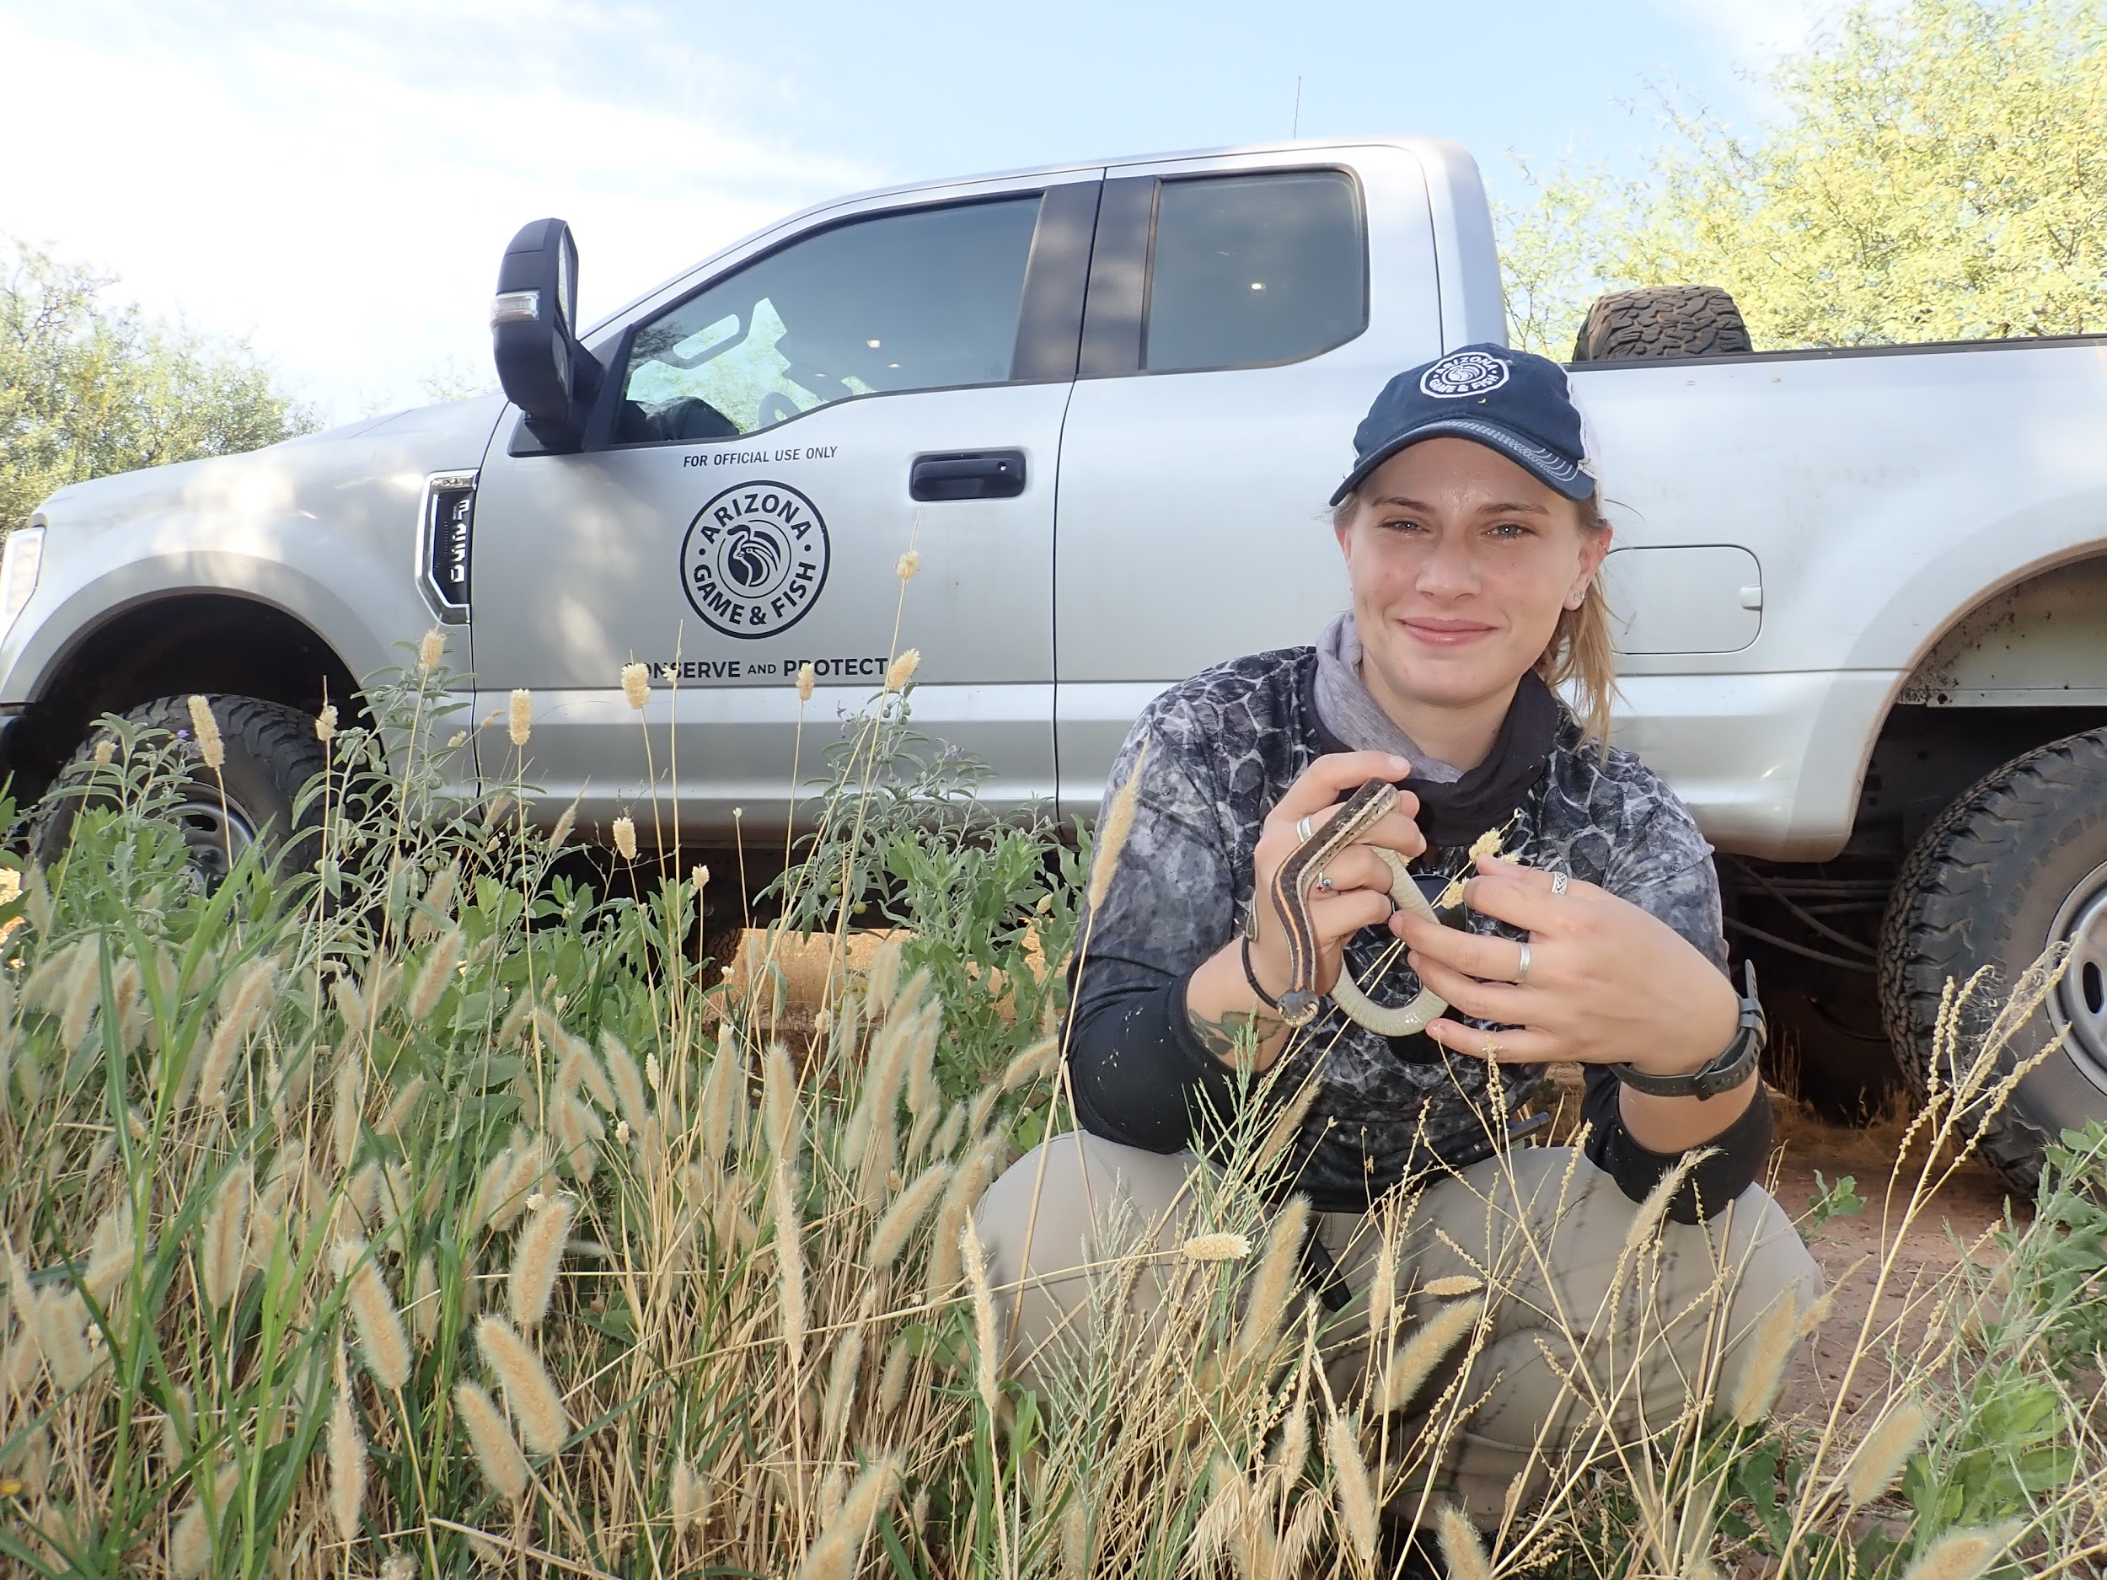
Our goals today
Get you comfortable with media and news
Learn to create effective partnerships with the media
Get you comfortable with being on-camera
Address any fears you may have
Help you better understand the media
  How they work
  Their needs and wants

Slide 3
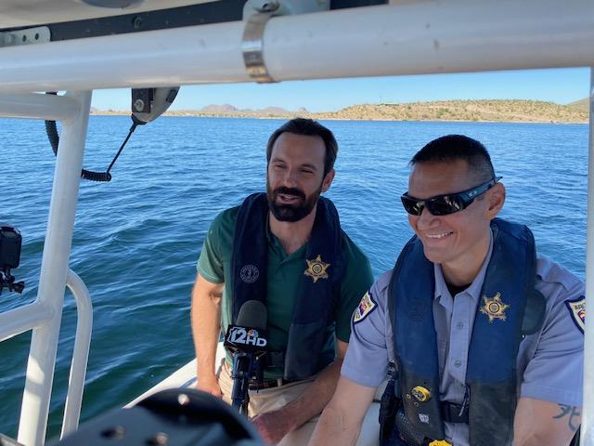
What a partnership looks like
Getting your message and information out to the public
Having a connection with members of the media
Knowing when and how we should partner with media outlets
Understand it’s a two-way street
Notes:
The person who sets the agenda often forces everyone else to play catch up.
If you get the media’s attention with a story first, chances are they won’t do a follow-up story because they’ve already covered the story.
Often you get one bite at the apple.
As long as it’s nothing controversial, media will do the one story and move on.

Slide 4
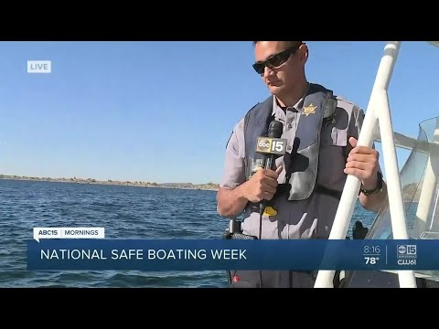
Example - National Safe Boating Week

Slide 5
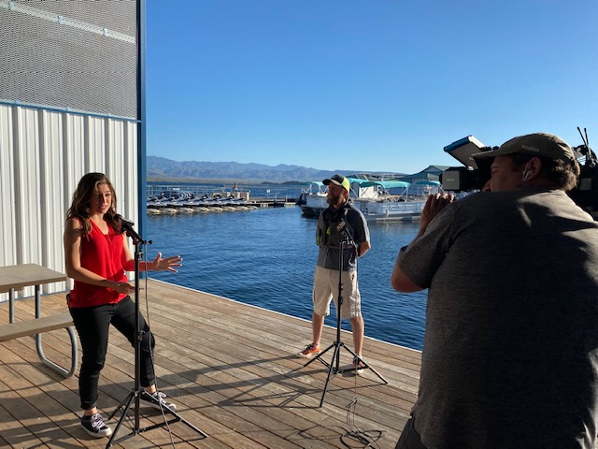
Pitching a story
News stories can help push your initiatives
Understand your audience
Know when and how to pitch a story
Connect with reporters/media who follow or are interested in your messaging
Build public support and increase visibility

Slide 6
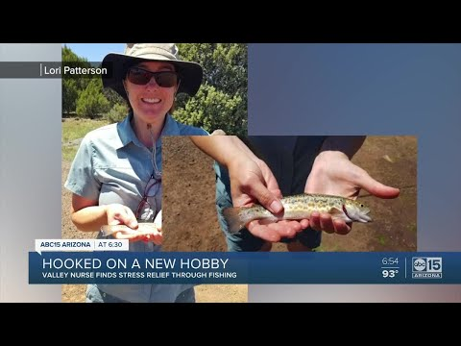
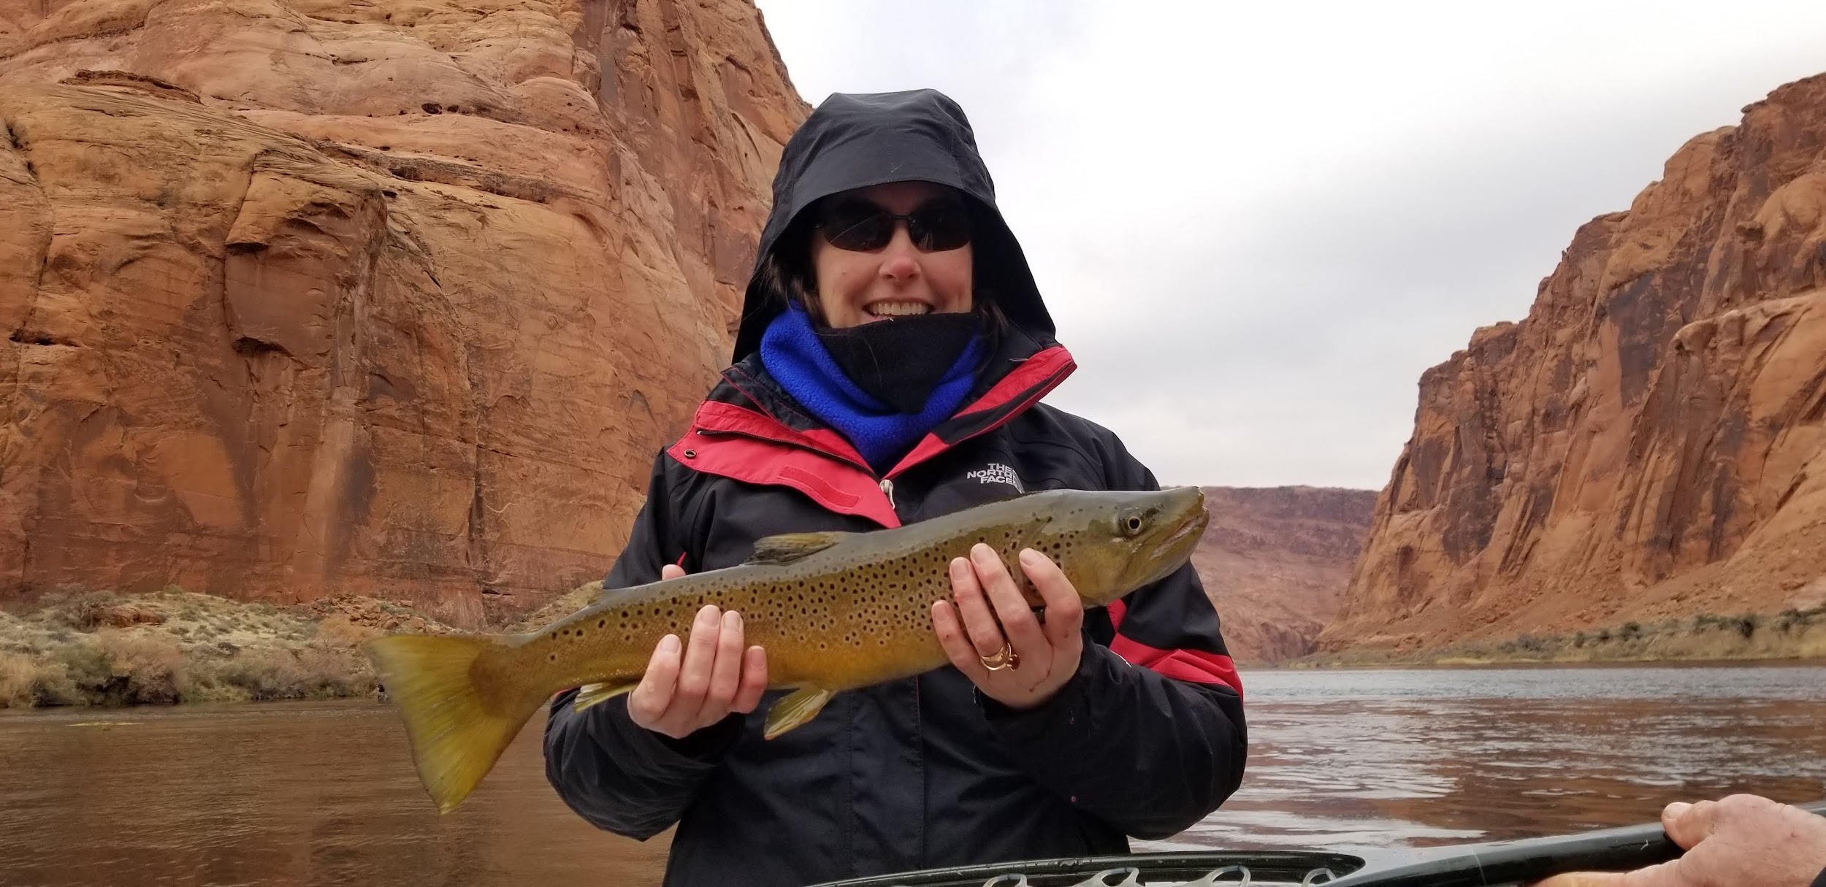
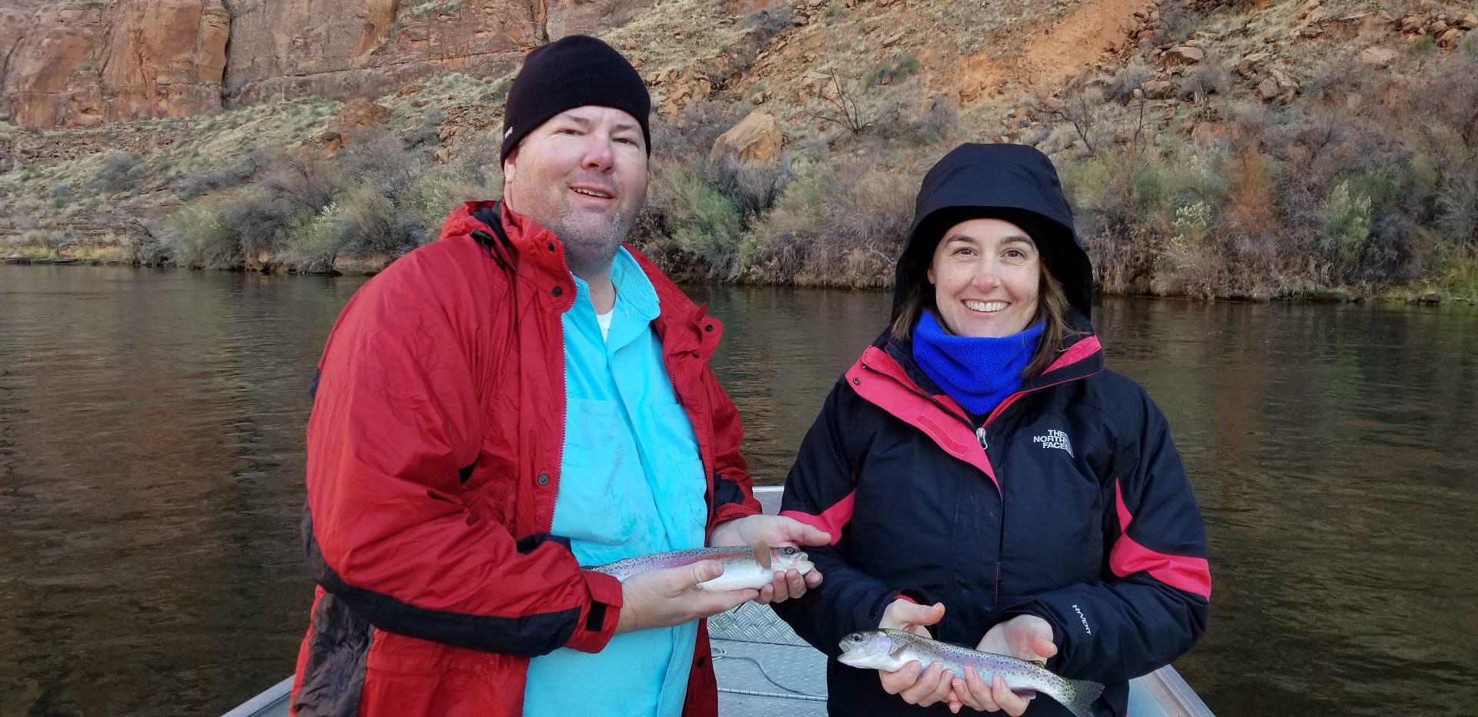
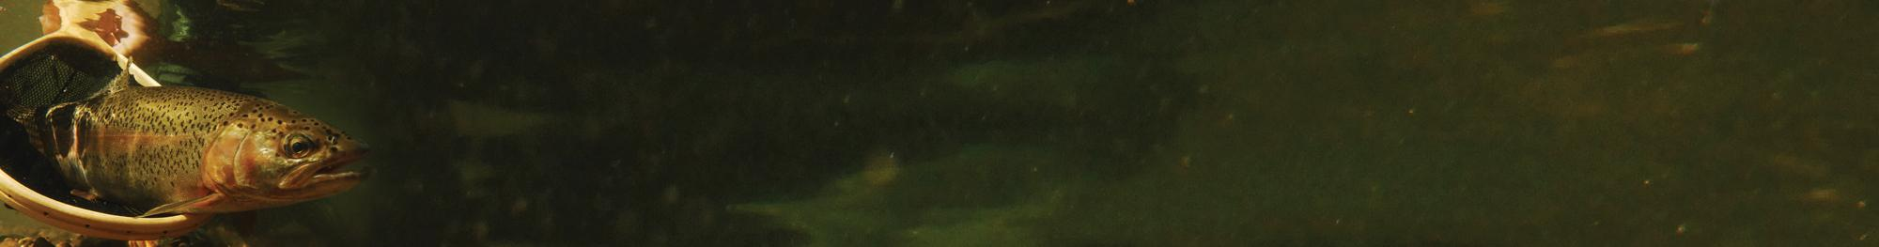

Slide 7
The Pace of News
“Slow news day” vs. “Busy News Day”
Notes:
As a public affairs staff, we’re good in a pinch, but you’re the expert.
We know talking points, but you know the project, the case or the end goal.

Slide 8

The Pace of News
“Slow news day” vs. “Busy News Day”
Limited amount of news locally or nationally
Outlets may reach out for coverage
Good opportunity to pitch stories

Slide 9
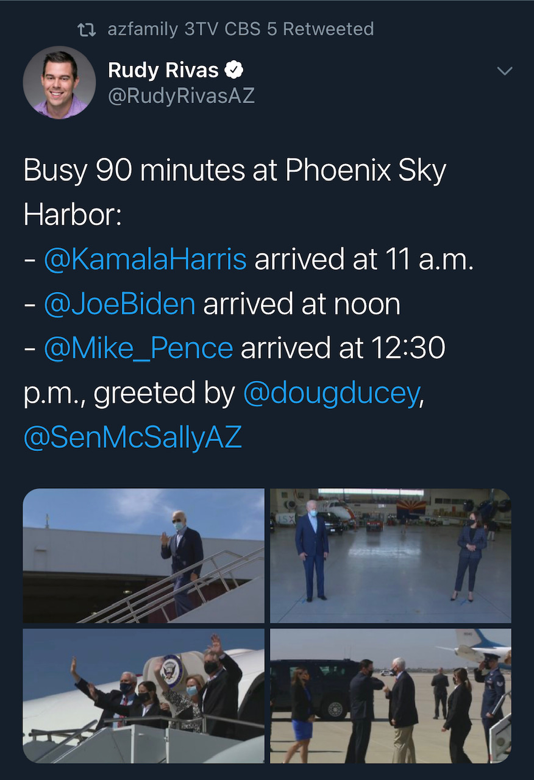
The Pace of News
“Slow news day” vs. “Busy News Day”
VIP or Presidential visit
Local or national breaking or major news
News outlets full for coverage
Bad day to pitch / good day for local connection
Limited amount of news locally or nationally
Outlets may reach out for coverage
Good opportunity to pitch stories

Slide 10
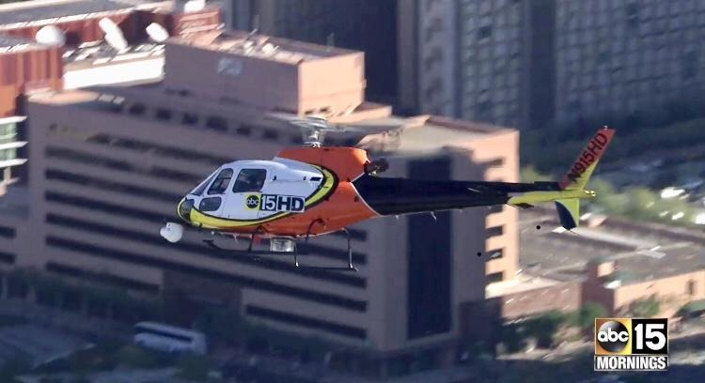
The Business of News
News is a business
  Selling advertising
  Supporting investors
  Constantly changing
News provides a service
  Inform the public
  Provide emergency information & communication
  Provide a community service

Slide 11
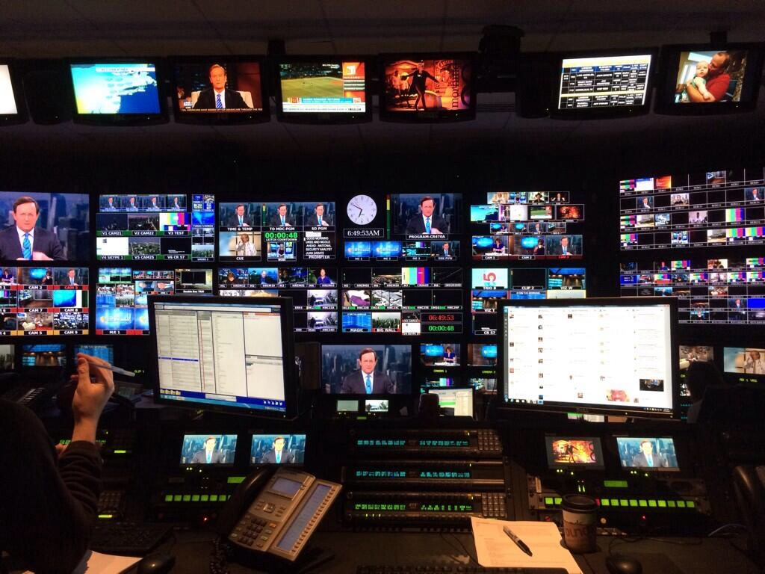
Informing the Public
Alert you to what’s happening in your community
Tell you about good and bad news
  Positive, feel-good stories
  Serious hard news stories
Create beneficial content for their viewers, listeners or readers
Create memorable moments while engaging their audience
Notes:
Miss your shot, and your competitors are telling our story for us

Slide 12
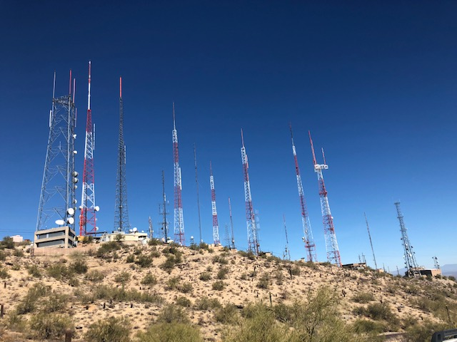
Providing Emergency Communication
The reach of TV and radio broadcasting is huge
Reach a large audience at moment’s notice
Provide lifesaving information
  Wildfire
  Severe Weather
  Evacuation
  Flood
  Dangerous animal
  Amber alert
Notes:
12 News polls people and asking them to vote on the story they’ll play or a ridiculous question

Slide 13
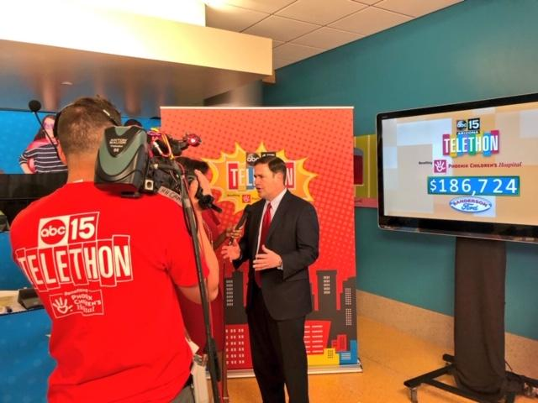
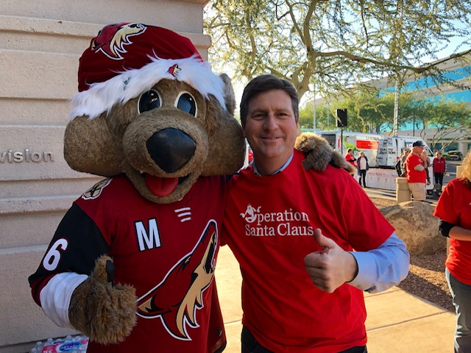
Providing a Community Service
Give back to their community using the power of broadcasting
  Telethon
  Radiothon
  Food Drive
  Disaster Relief Drive
Better serve and become better connected to their community
Makes good programming

Slide 14




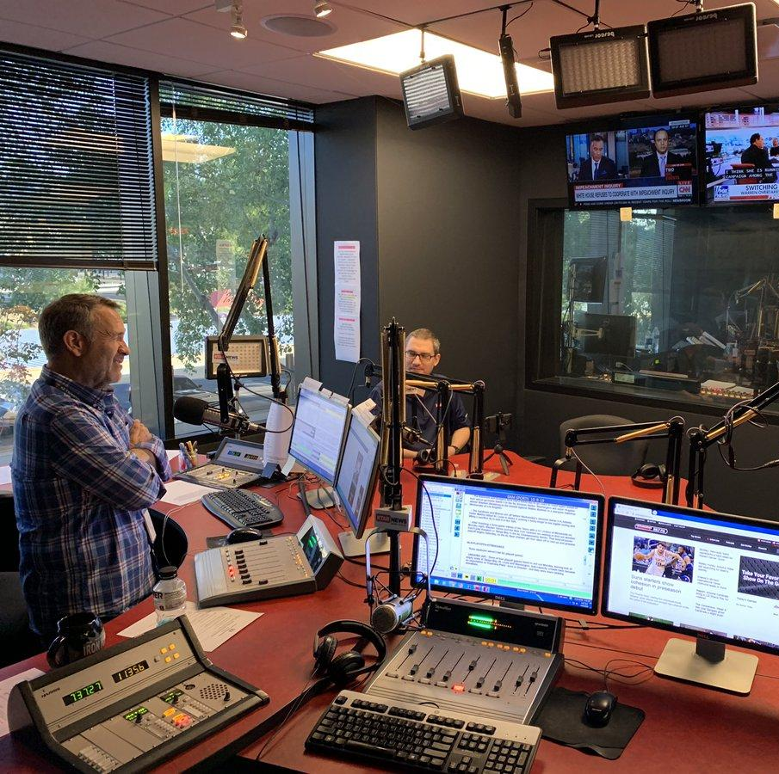
Different media has different needs
TV: Visuals sell, interview experts on camera, see exciting video, fast day of deadline
  VO/SOT
  PKG
  Quick and to the point
  Interview in person or video conference
Print: Room to tell more of the story, deadline can vary
  Magazine
  Newspaper
  Interview over the phone
Radio: Phone interview or in-studio, solid sound bite

Slide 15
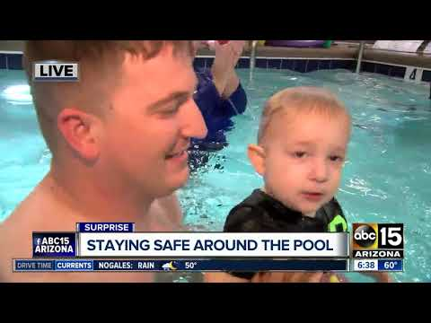
Visuals Sell - Example

Slide 16
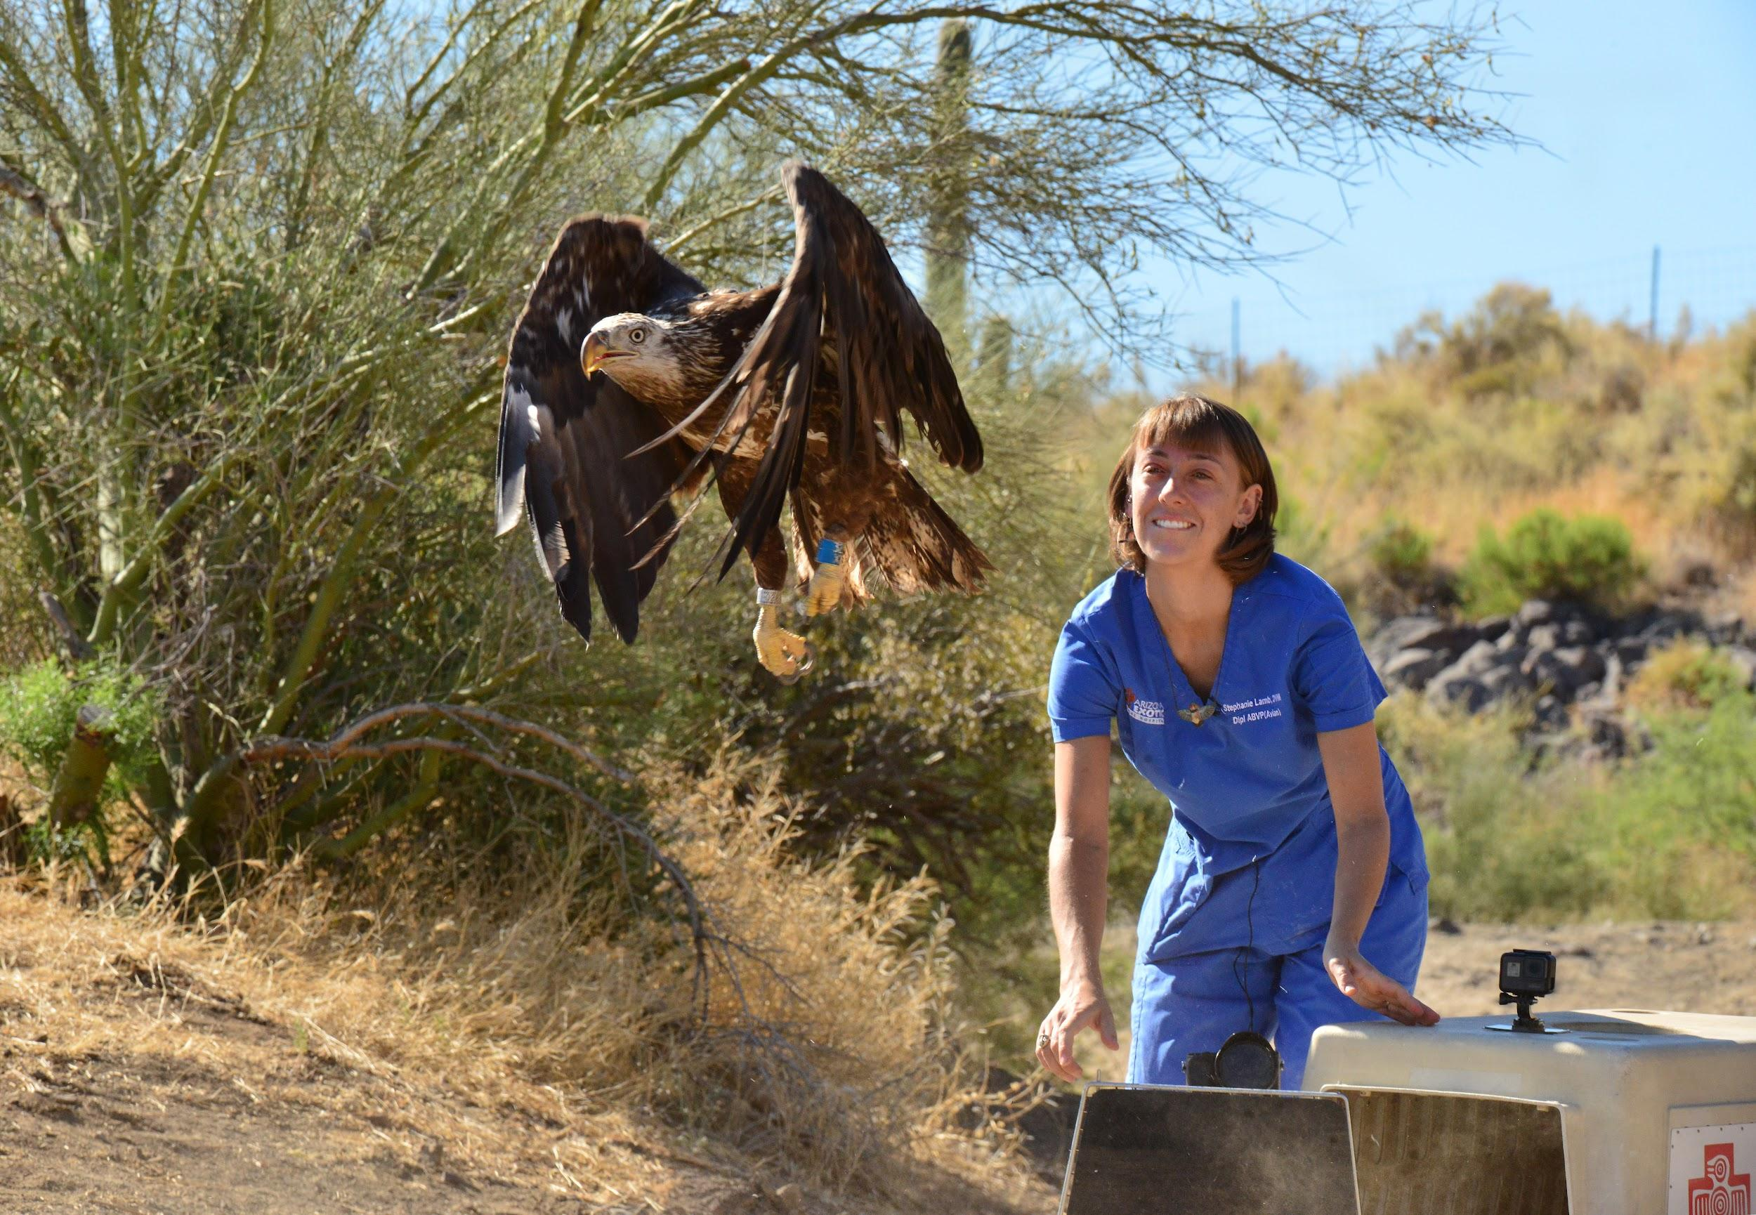
What media likes to see
Fast, accurate information
Access to staff/experts
Witness the story with their own eyes
Sources/connections for future stories
Meet or accommodate their deadline
GOOD stories
Notes:
How did this shot come about? Through a positive relationship with the media: Fox 10’s Anita Roman and special projects producer Rod Haberer

Slide 17
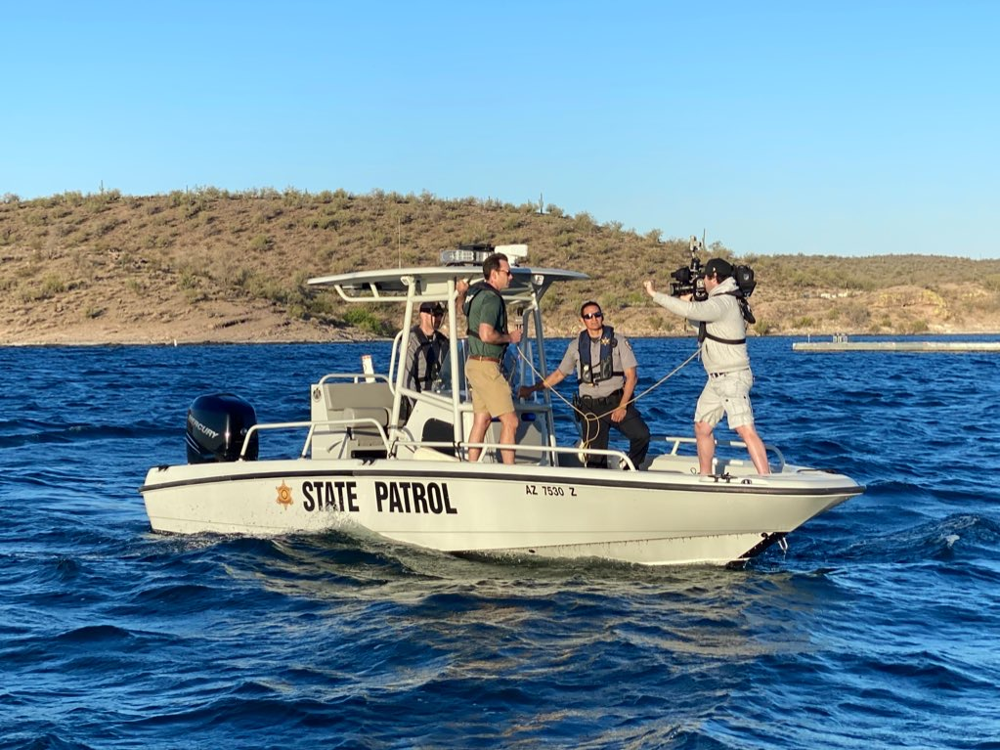
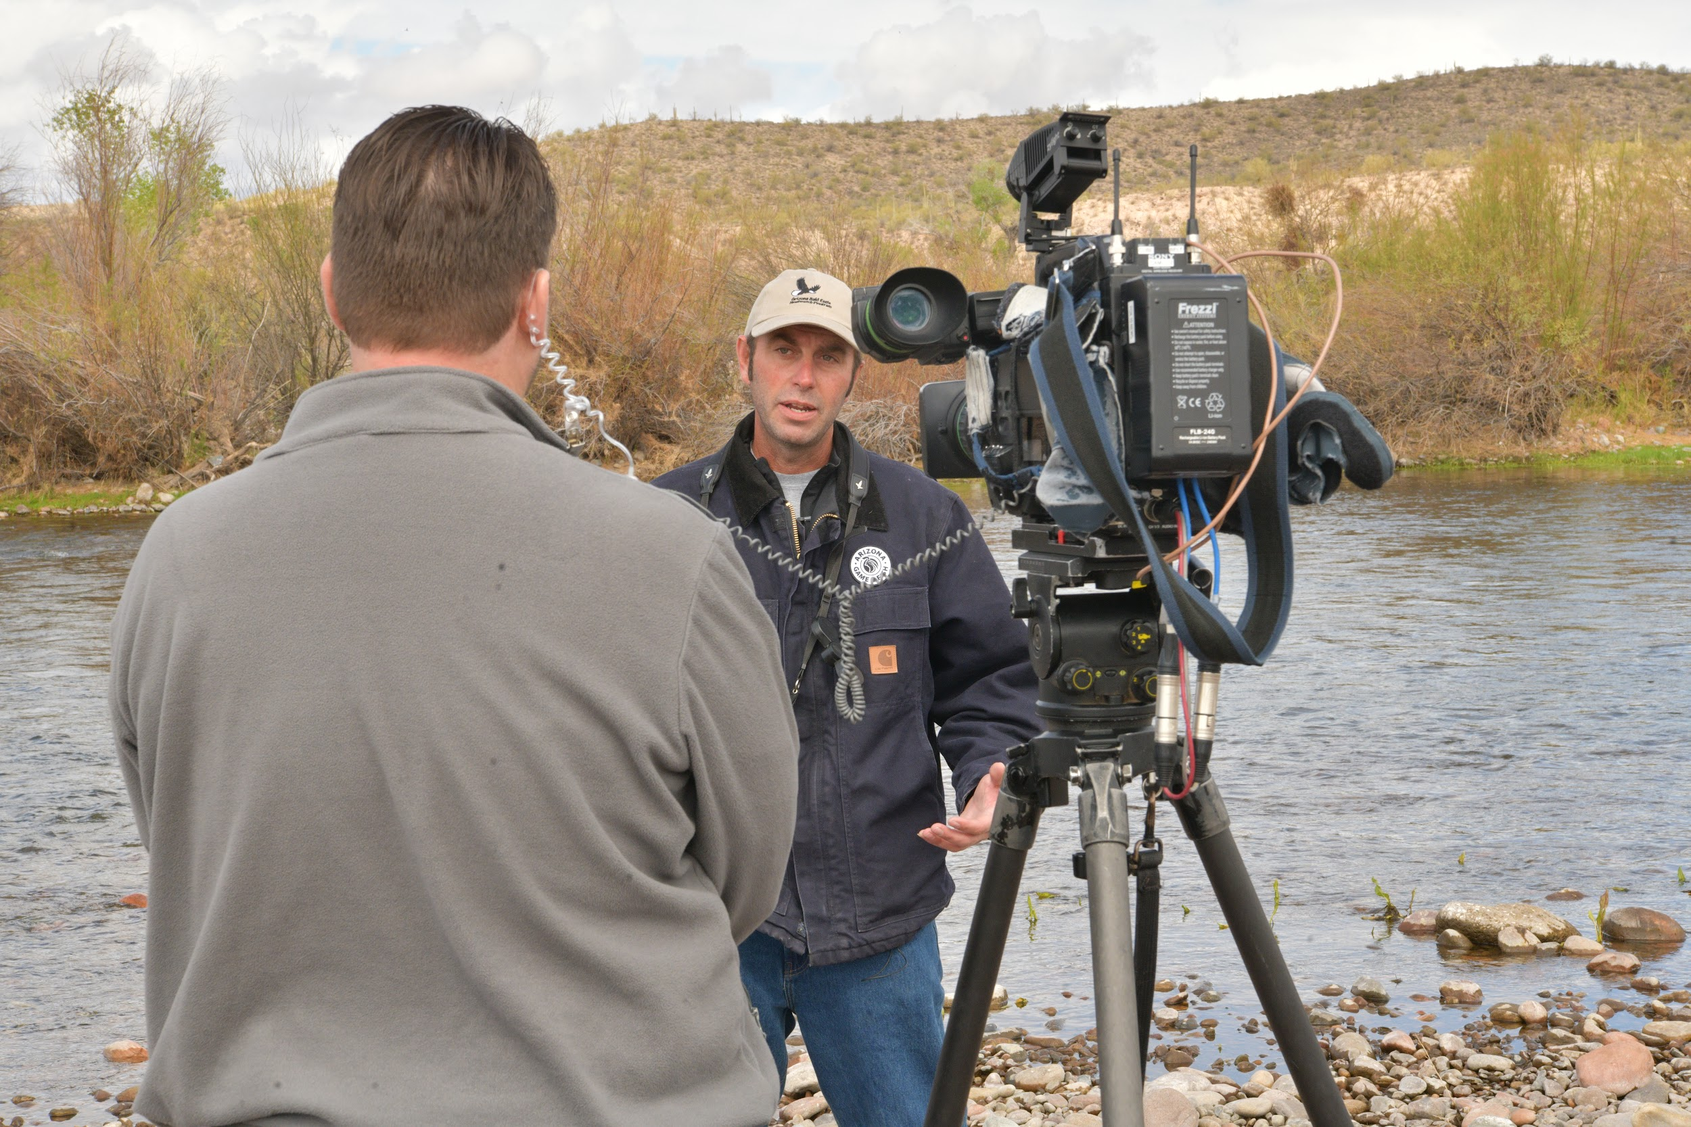
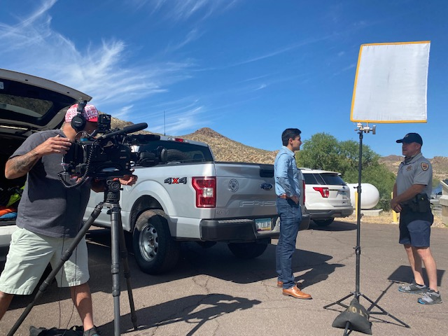
Speaking To The Media

Slide 18
You’re the Subject Matter Expert
When you speak to the media:
Stay on message, but don’t lie or embellish the truth
Help a reporter find other sources
Nurture relationships
Tell great stories
BE AVAILABLE!

Slide 19
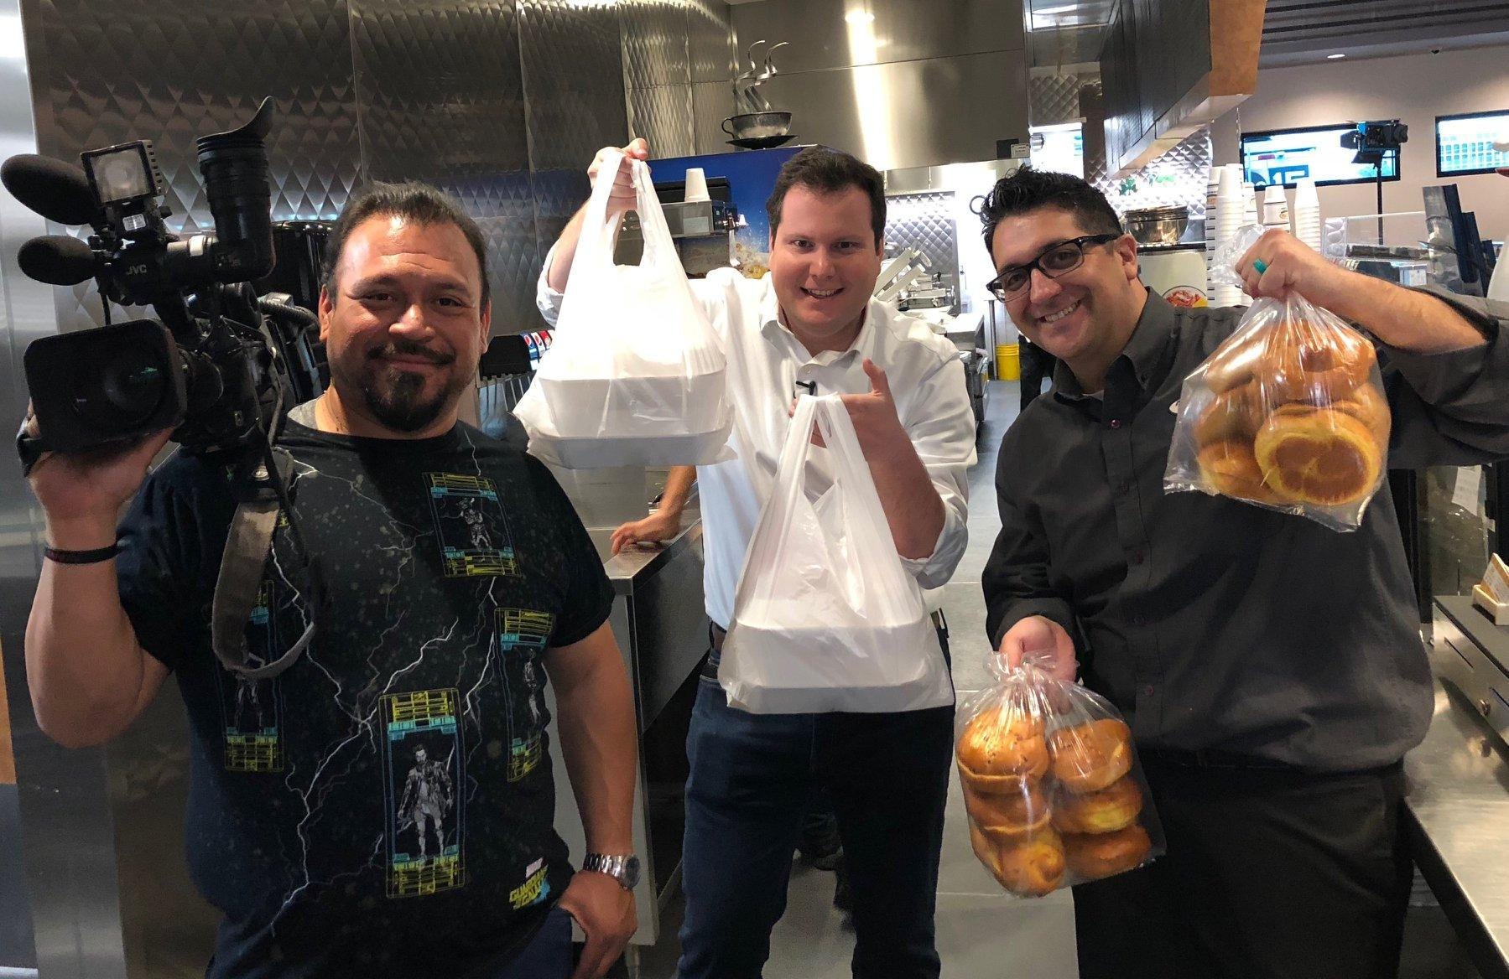
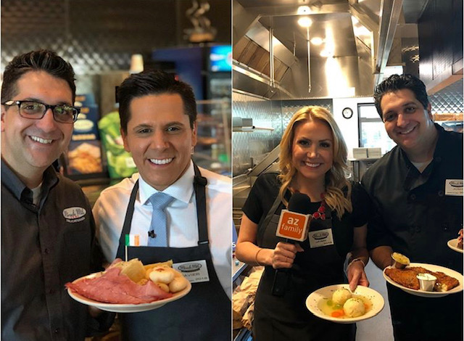
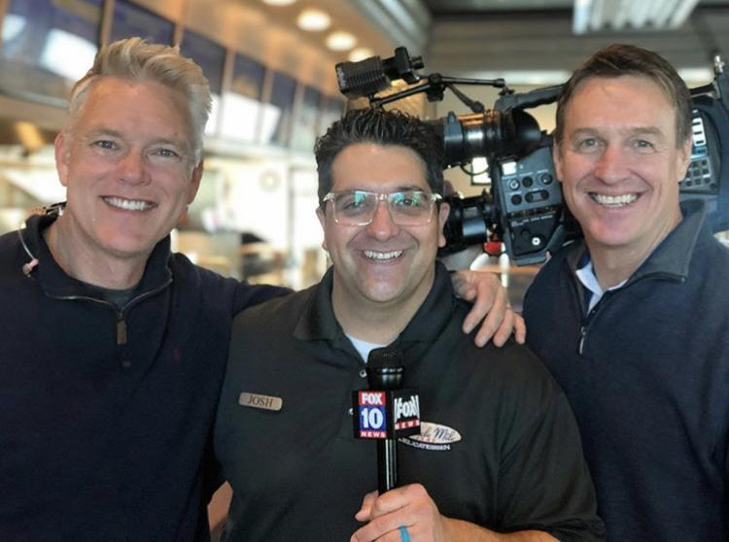

When you’re available..

Slide 20
When media calls, who should speak?
First thing:
SHOULD we comment?

Slide 21
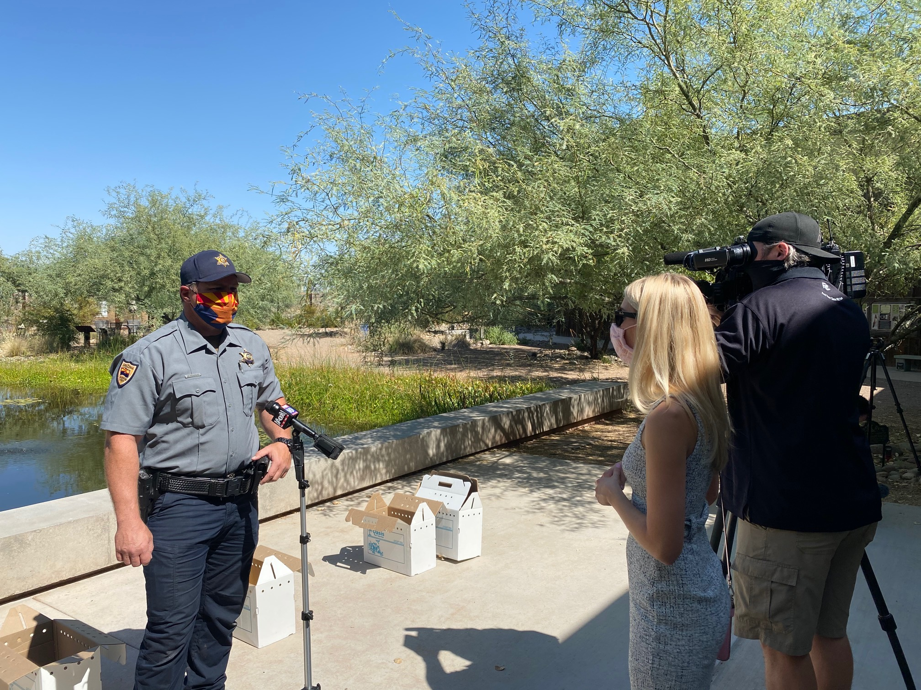
When media calls, who should speak?
If you’re contacted or talking, notify:
Your supervisor
Your Public Affairs team
Who should speak?
Subject matter expert
Wildlife Manager
You don’t have to talk
Different issues have different spokespeople

Slide 22
Always be aware...
When you speak to a journalist or member of the media:
Everything you say is fair game!
Refrain from going “off the record”
The interview may be done, but the microphone may still be on.
If you’re in front of a camera or wearing a mic, you could be hot at anytime.
You could be on a live stream

Slide 23
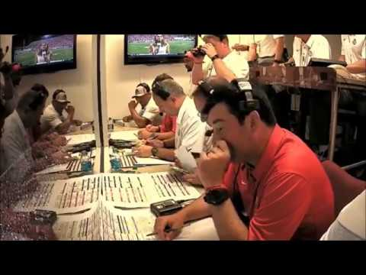
The camera is always on
Notes:
As a public affairs staff, we’re good in a pinch, but you’re the expert.
We know talking points, but you know the project, the case or the end goal.

Slide 24
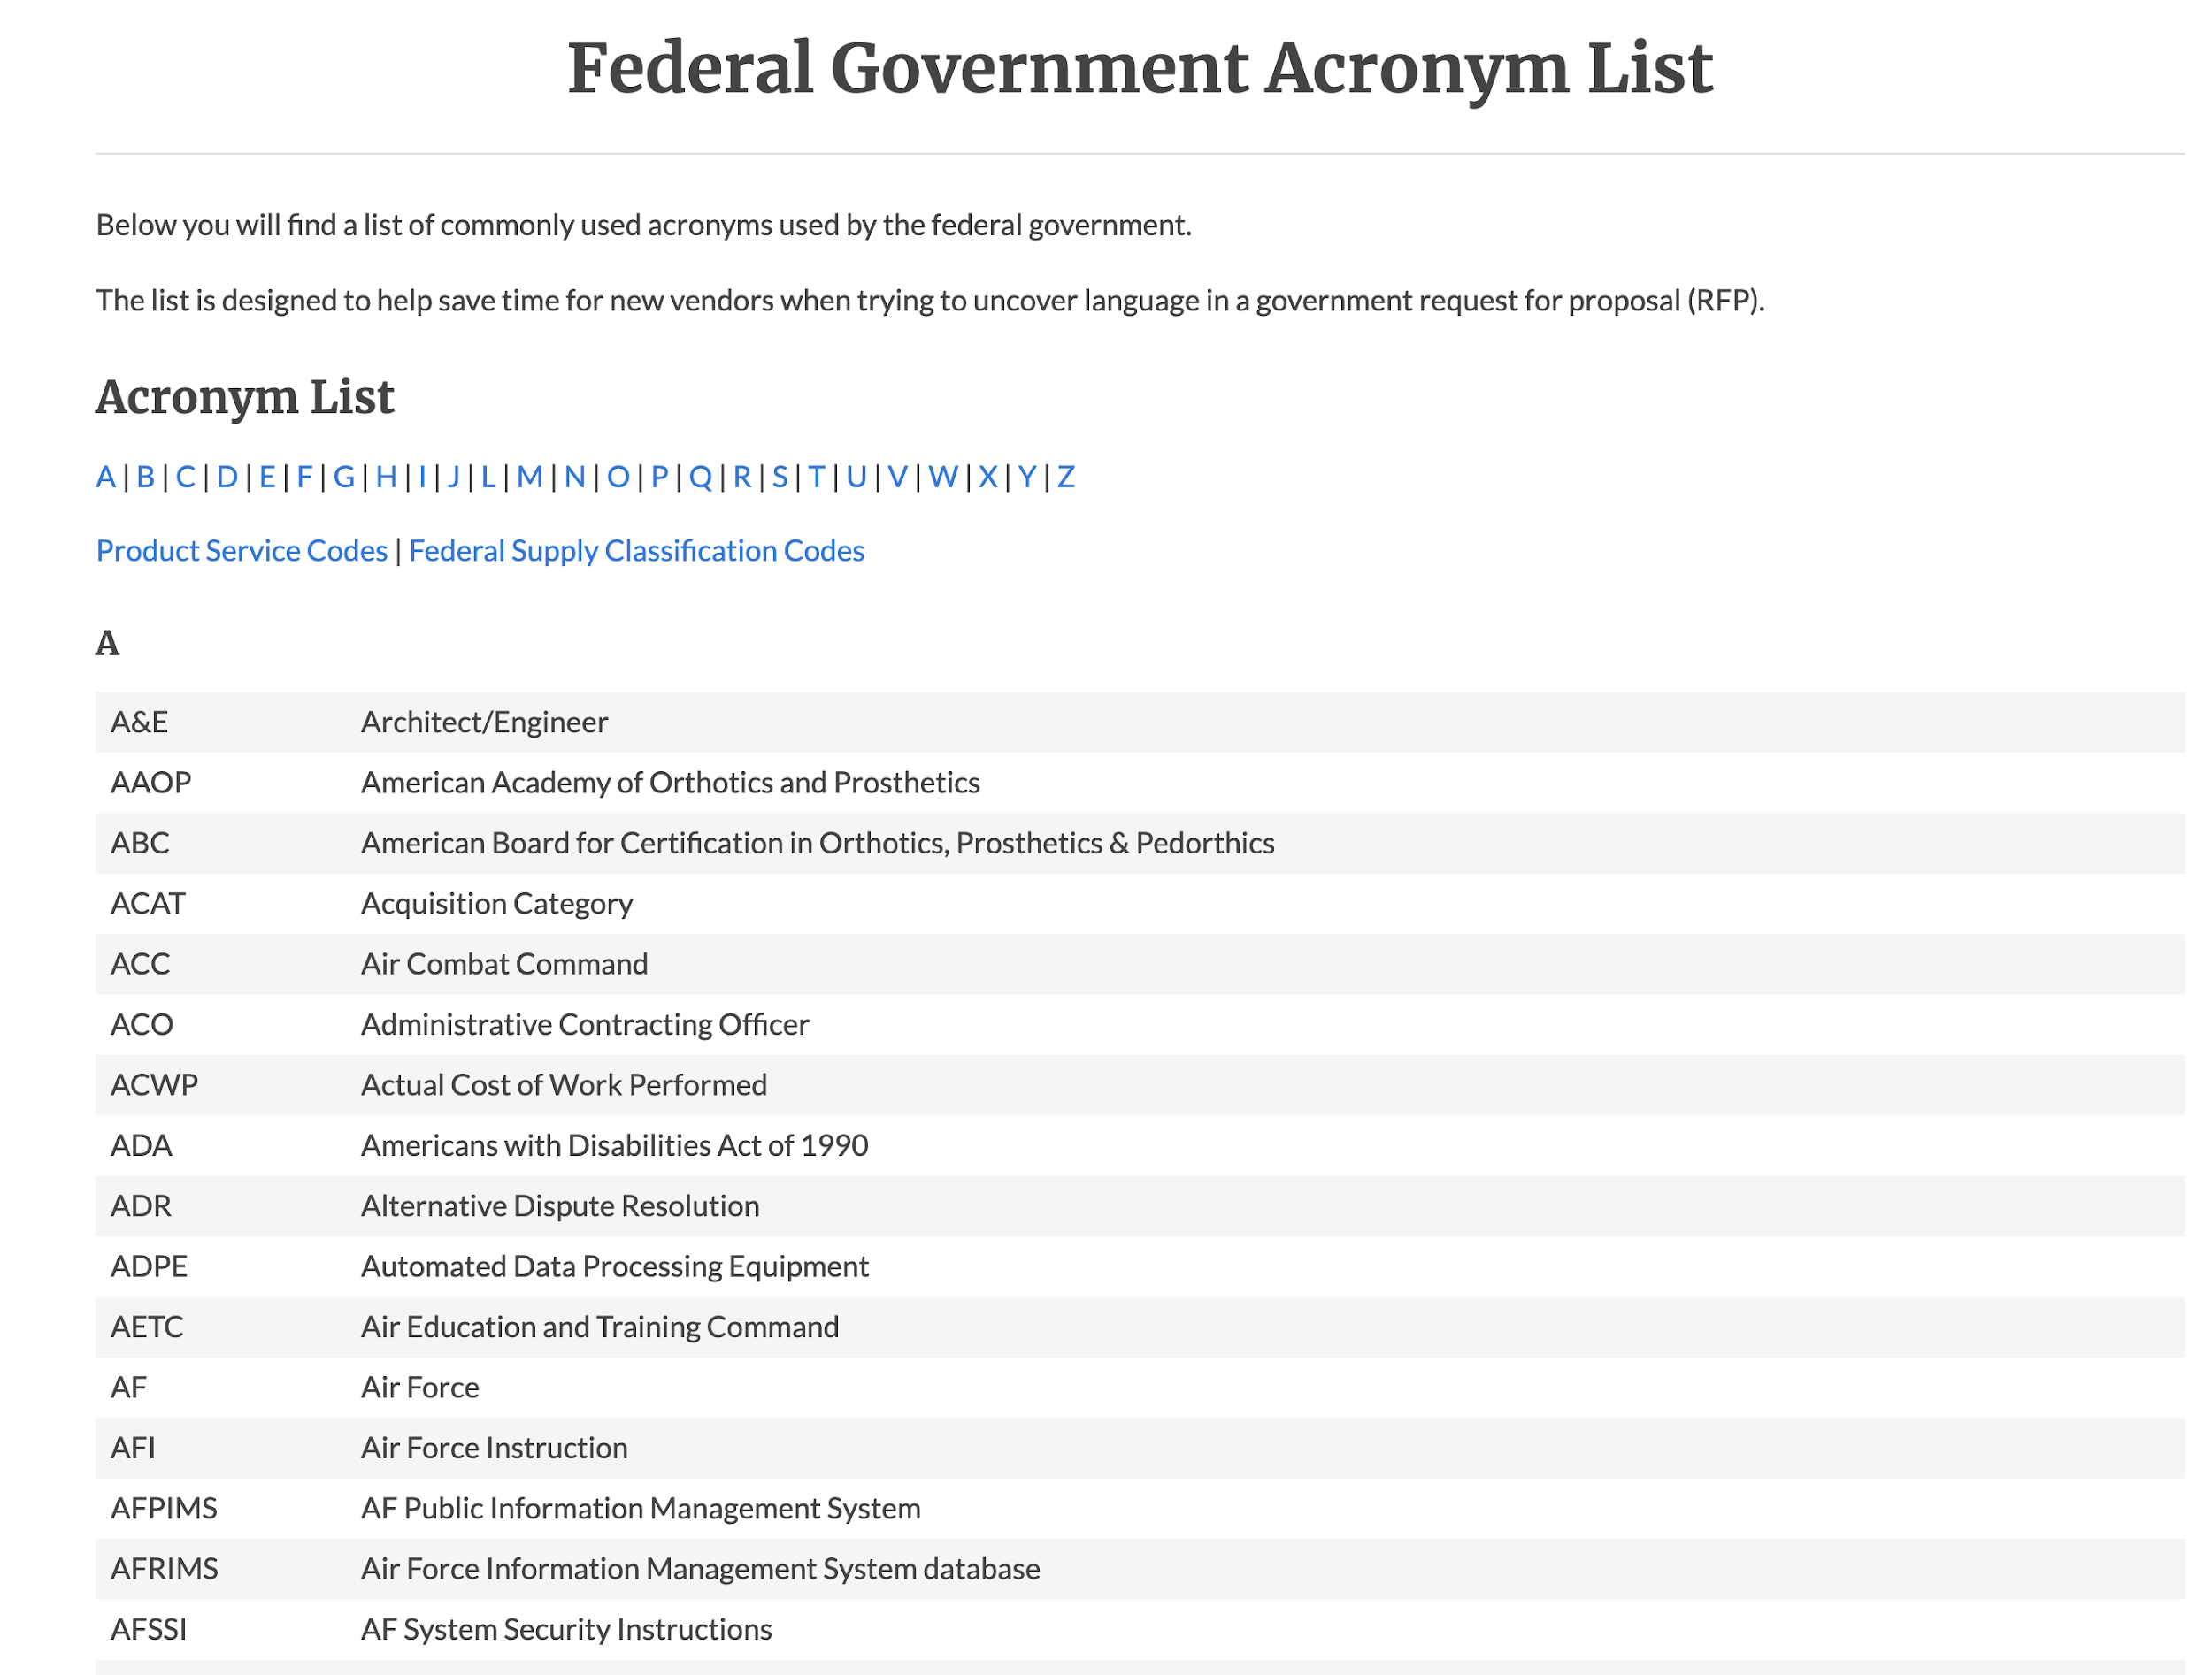
Be quoted accurately
Don’t speak in jargon
Use common language
99.5% of the public are not scientists
Speak in complete sentences
No police talk
Don’t use acronyms
You’re having a conversation
Talk in complete sentences
Notes:
Generalize. Explain in plain terms

Slide 25
Be quoted accurately
Generalize
Use common English
  Speak in concise soundbites (10-12 seconds)
  Don’t ramble - make your point, stop talking
Provide extra detail only when asked
  Too much information may lead to more questions
Confuse the media, lose the message

Slide 26
Concise messaging
Before speaking with a reporter, condense your ideas.
Keep them short and simple
Capture the main points of your argument
Think about your audience
Include or rephrase the question in your response
Your answer should always come back to your key points.
Stay to YOUR agenda.

Slide 27
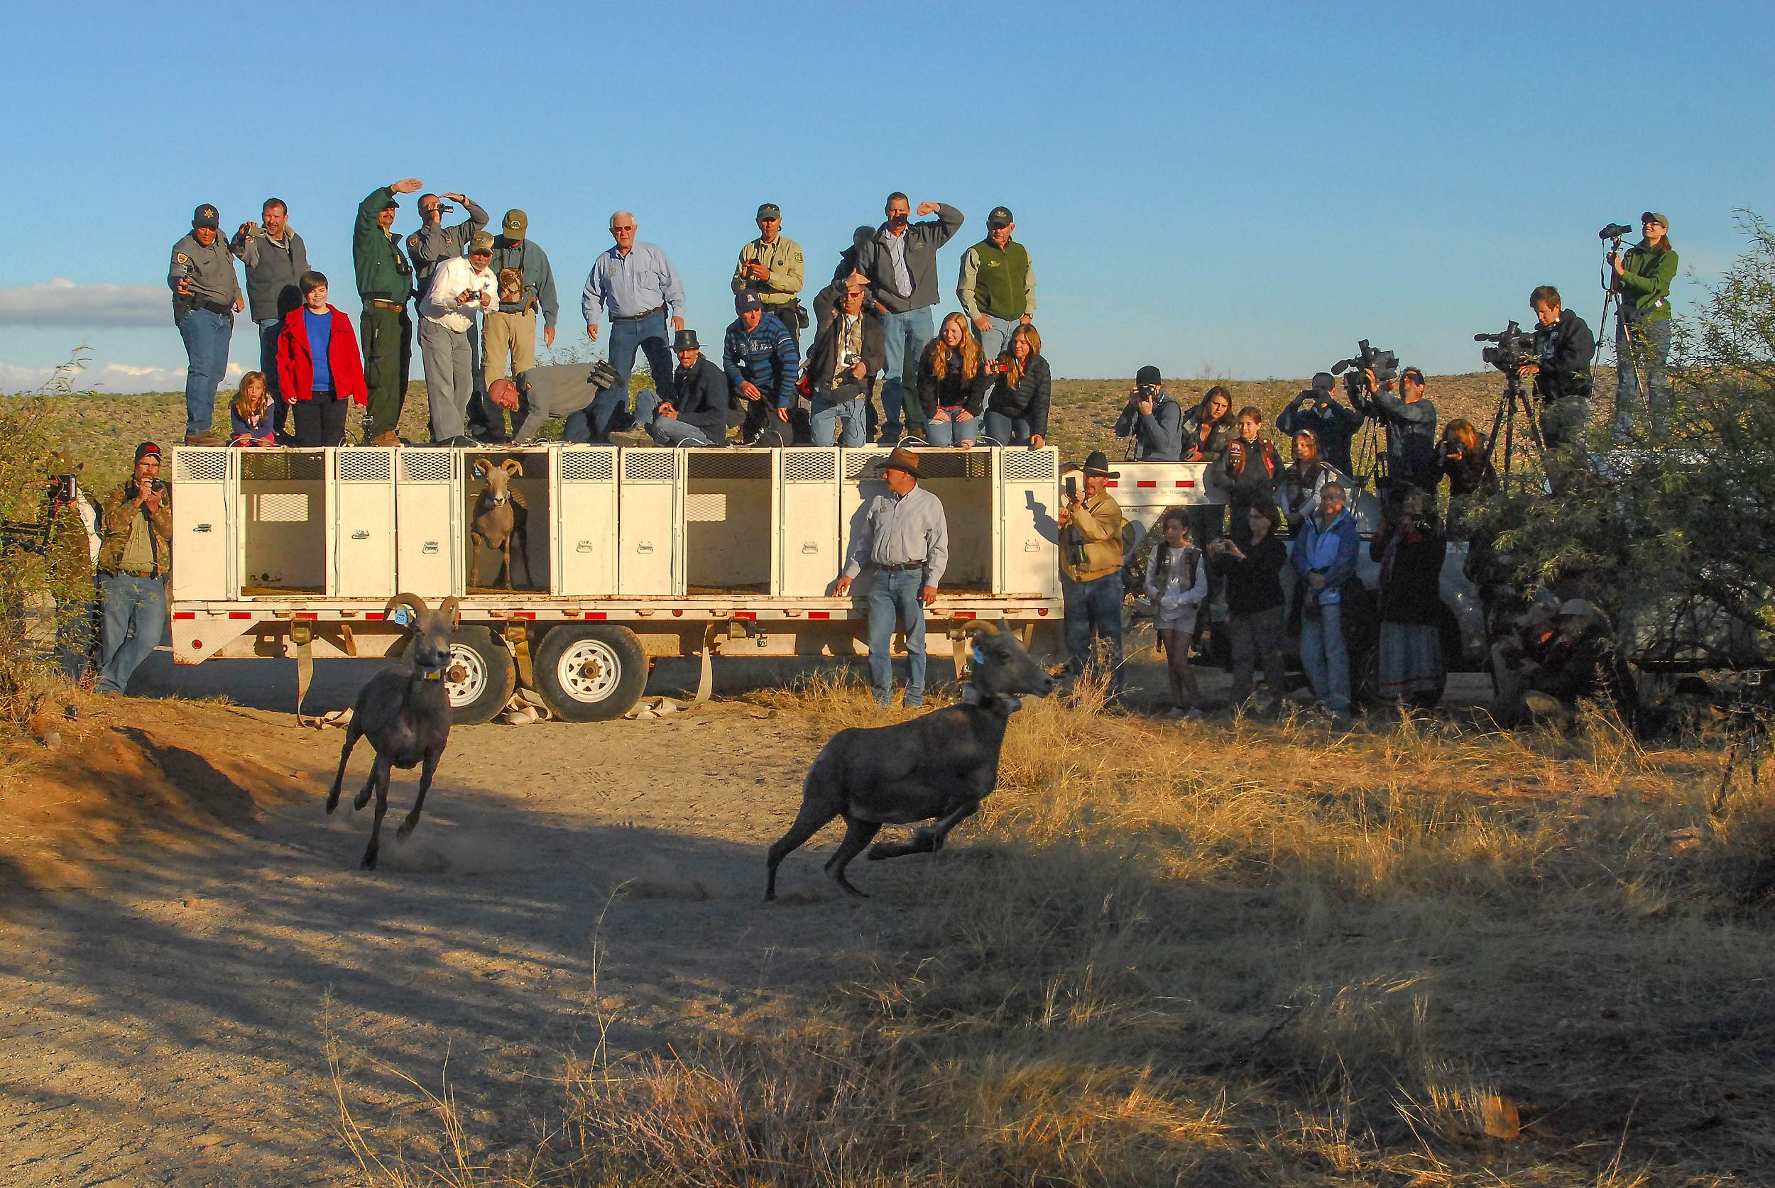
Be prepared
Practice but not too much
  Don’t sound rehearsed
Dress appropriately, wear a logo
Lead with your key points early and often
Anticipate the reporter’s questions
NEVER SPECULATE

Slide 28
“Bridging” to get back on message
Conversation may get off topic, “bridge” the discussion back to your key messages
“Of course we’re concerned, but we must keep in mind…”
“That’s something we can look at, however the big takeaway here is..”
“That’s one viewpoint. Another view is…”

Slide 29
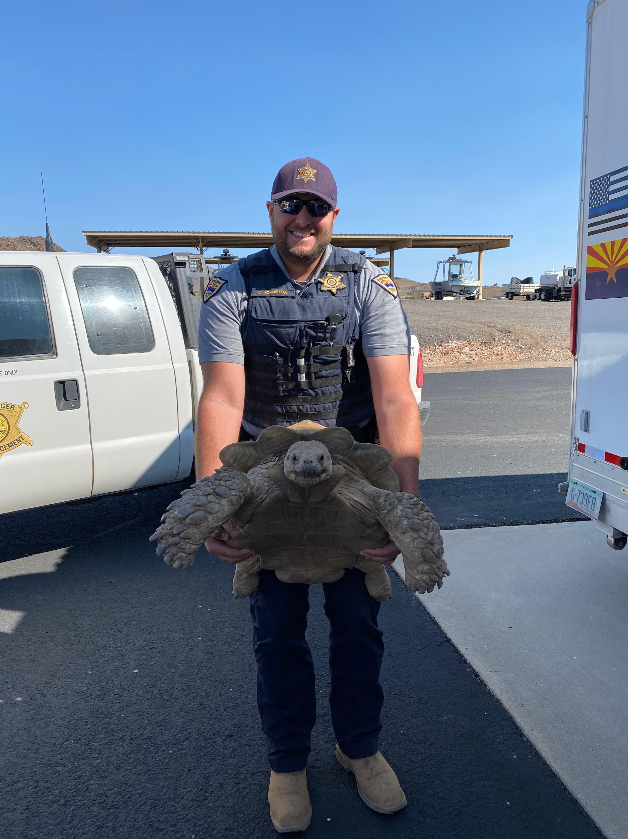
“Flagging” to control the conversation
When you “flag,” you’re signalling that you have important information.
Start statement with:
“The important thing to note is…”
“Let me remind you that…”
“What’s interesting about this is…”
“A takeaway from this…”
“Let’s never forget...”
Notes:
Conversation about bears. People hate to hear news of bears being put down. But each incident is an opportunity to educate about our publicly vetted policy.
What’s important is for people not to attract bears. Pick up your trash, bird feeders….

Slide 30
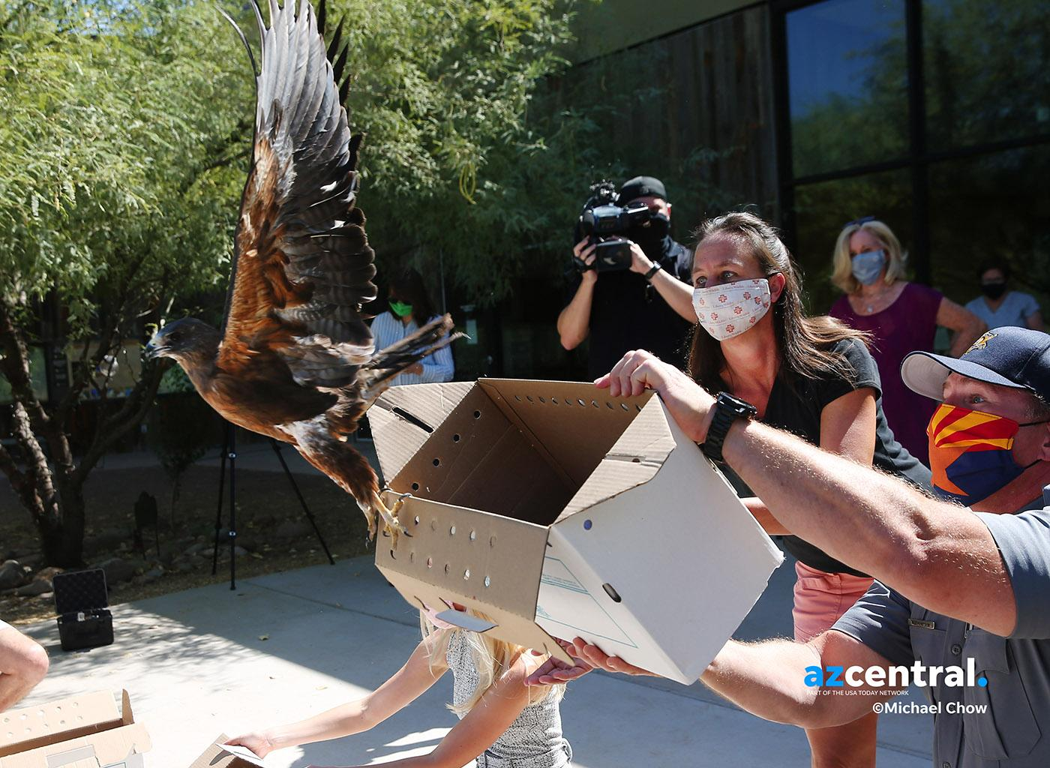
Developing message points
3 most important points about how Game and Fish is handling the incident
Make these points in every interview, speech or media opportunity
Points should be:
Memorable statements
Clear
Concise
Quotable
Work with the public affairs team, we’re here to help

Slide 31
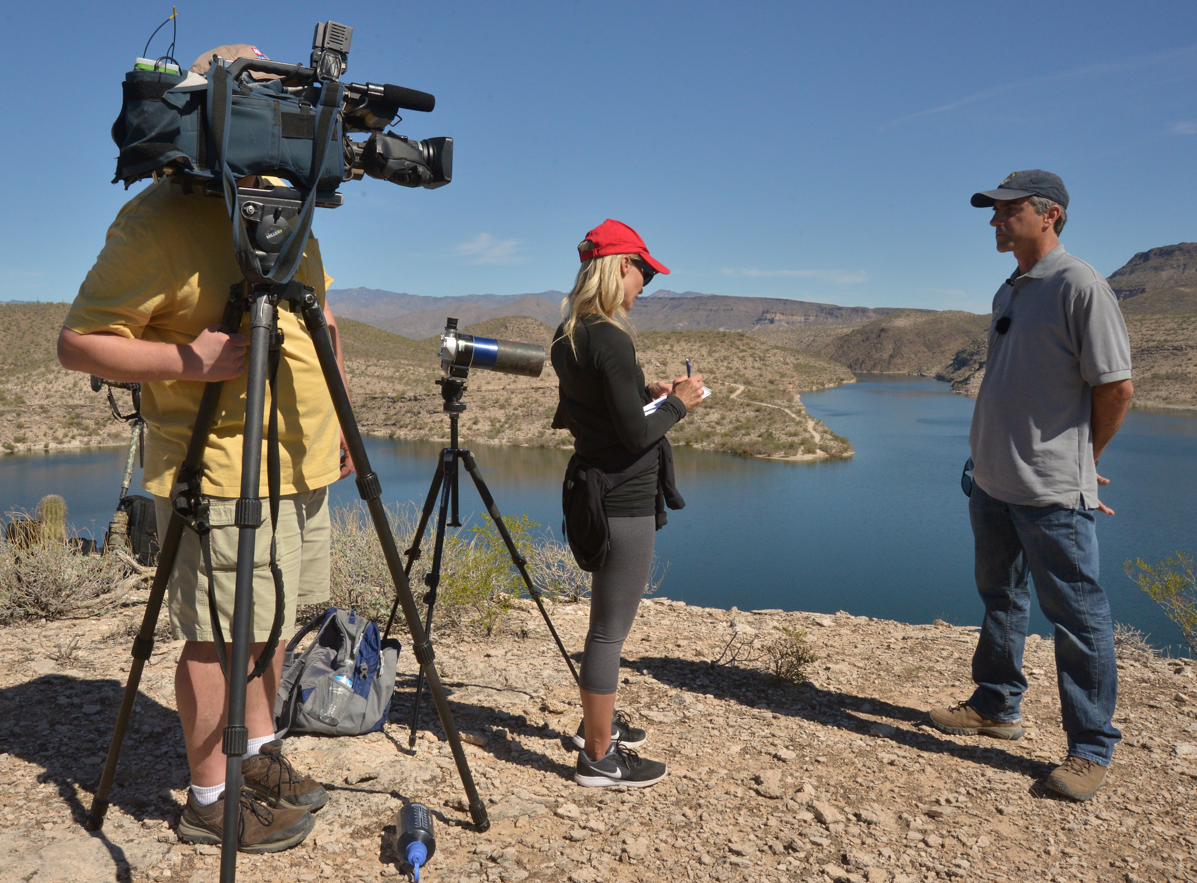
During the Interview
Stick to your key message points
Speak in concise soundbites
Keep control of the conversation
Don’t get off topic or get taken off topic

Slide 32
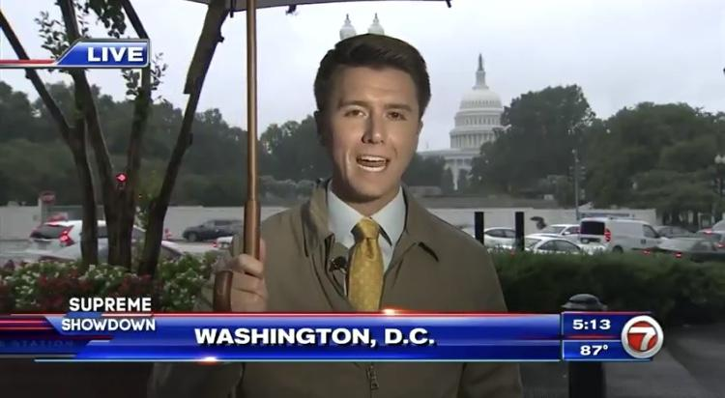
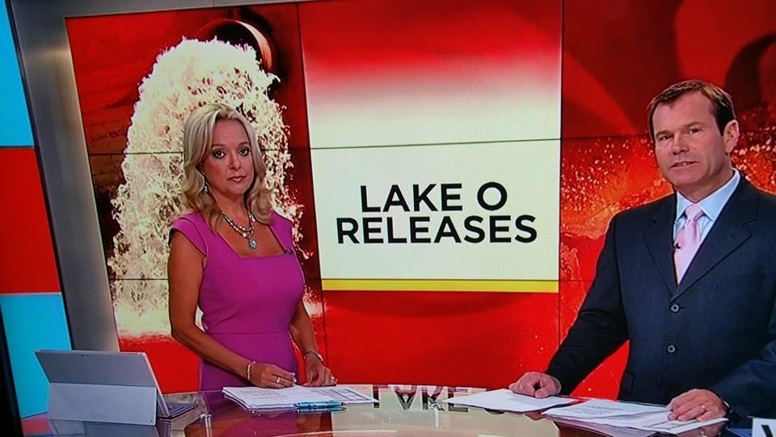
Know your surroundings

Slide 33
After the interview / publication
Ask when the story will run and communicate that with your team and leadership
Follow up with the reporter - maintain the partnership
If there’s an error: contact the PA team first, you or we can then:
Contact the reporter or outlet
Point out factual errors
Find out what went wrong
We may not like how the story was written/broadcast, we want accuracy

Slide 34
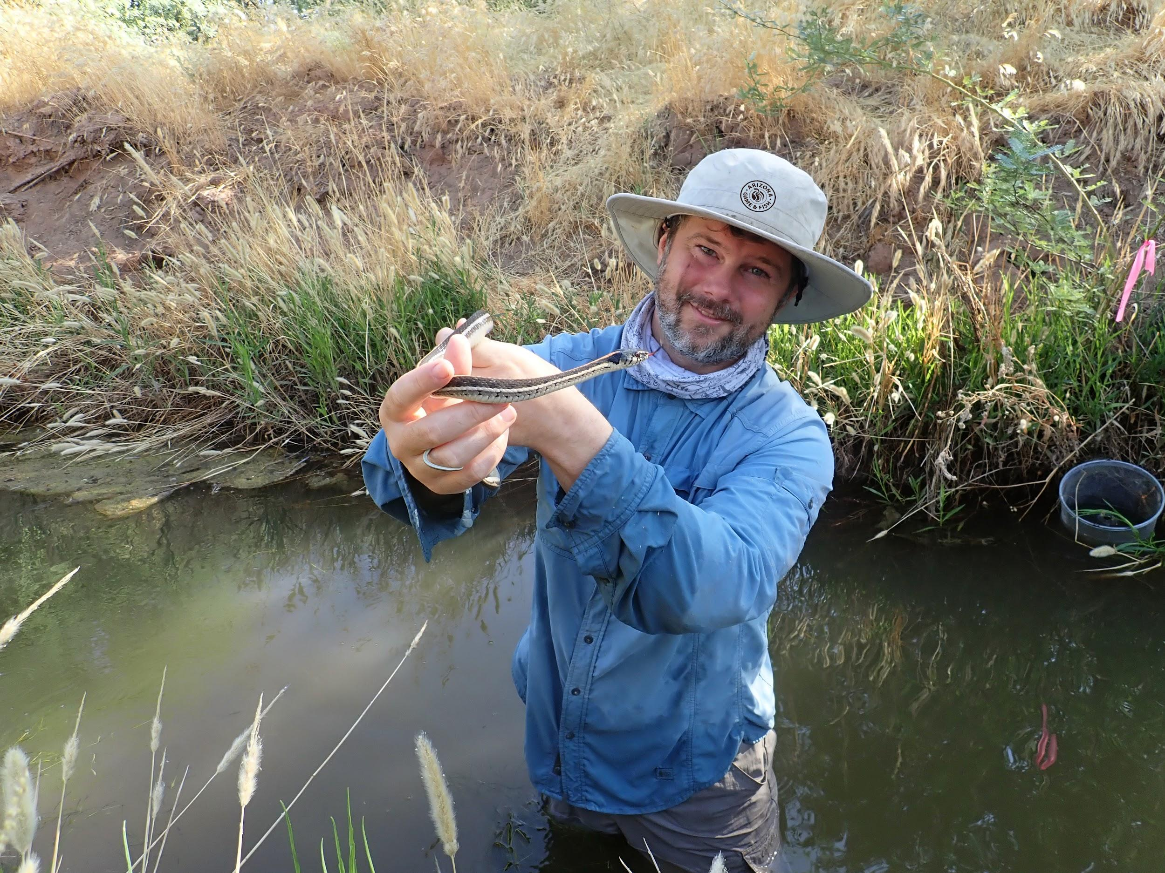
Remember...
Condense your ideas into key messages.
Keep them short and simple
Capture the main points of your argument
Don’t lie or embellish
Stay on topic, don’t get taken off topic, don’t go off topic
Be cautious when near in front of camera/microphone
Stay to YOUR agenda, not the reporter’s

Slide 35
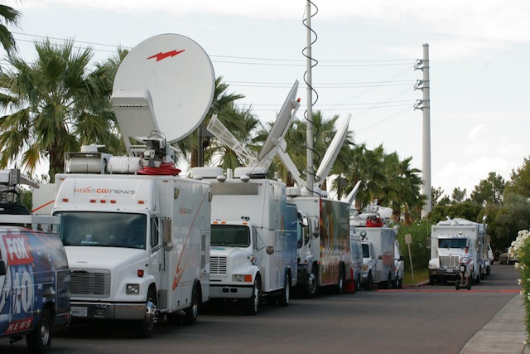
Incident scenario

Slide 36
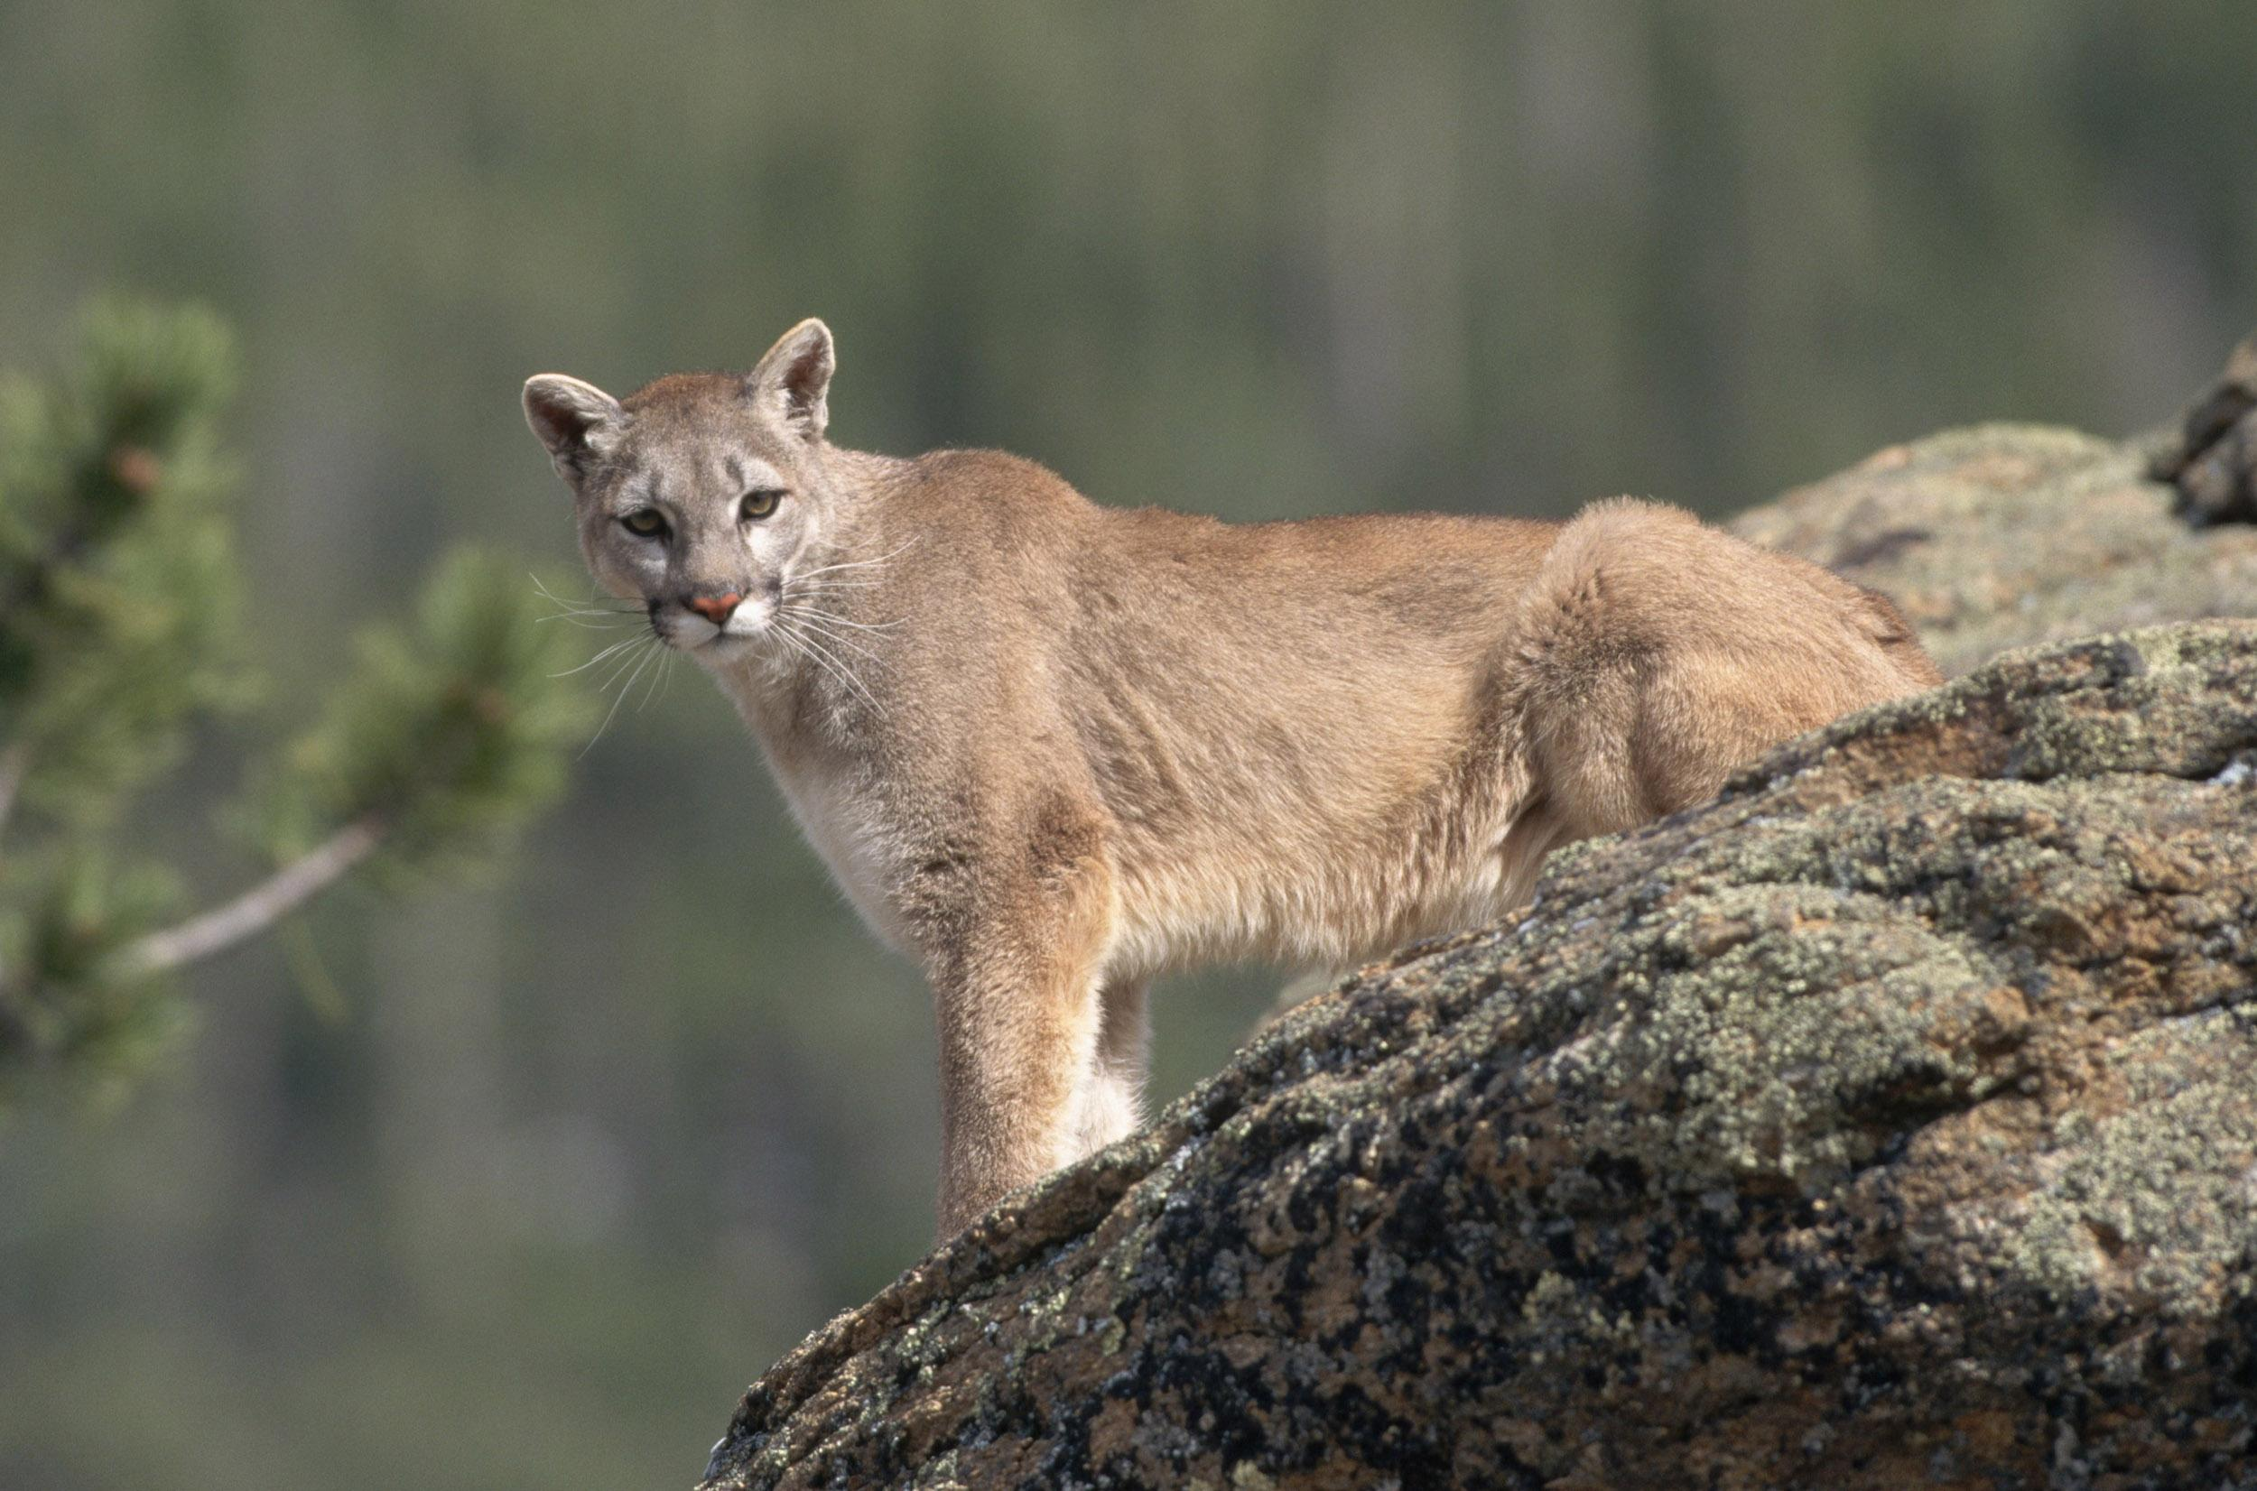
Mountain Lion Incident

Slide 37
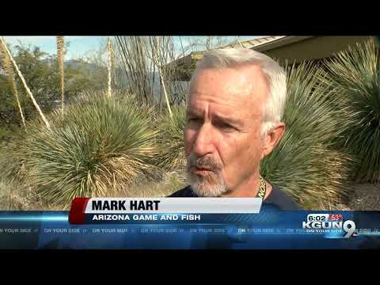
What that looked like in real life

Slide 38
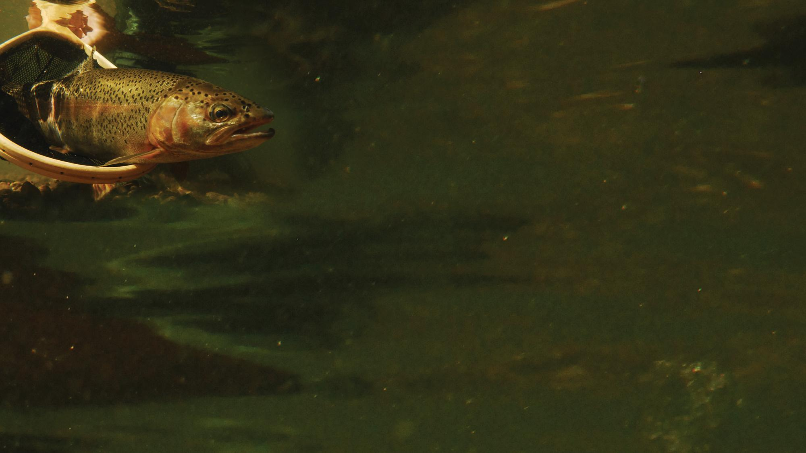
Questions?

