Slide 1
USCG Captain License Requirements
Exploring this Professional Credential
Captain Peg Phillips
Captain Virgil Chambers
Captain Pamela Dillon

Slide 2
Scenario 1 – Do these Instructors need a Captain’s License?
“Boat club” members are trained in boat handling skills using the NSBC curriculum. The NSBC instructors are contracted employees of the “boat club” and paid either an hourly or flat rate for their services that include classroom and on-water instruction. Unless in an emergency, the trainer does not operate the boat.
Notes:
Peg to present 3 Scenarios with Audience Polling

Slide 3
Scenario 2 – Do these Instructors need a Captain’s License?
The Boat Club advertises on-water training using their Club boats. A customer registers for a course taught by a contracted instructor. The customer is not a Club member (yet), but this model is a way to lure in potential members. Unless in an emergency, the trainer does not operate the boat.
Notes:
Peg to present 3 Scenarios with Audience Polling

Slide 4
Scenario 3 – Do these Instructors need a Captain’s License?
Law enforcement officers and first responders (fire departments, paramedics) who are on marine patrol are becoming NSBC certified instructors. The officers are paid by their agencies to operate the boats while in marine patrol and search and rescue operations. As NSBC instructors, the officers are training new hires using the NSBC Boat Control On-Water Training curriculum. If they are working on the boat - training new hires - and being paid by their agency, do they need a Captain's license?
Notes:
Peg to present 3 Scenarios with Audience Polling

Slide 5
Key Terms
– Defined in Title 46 USC 2101
Uninspected Passenger Vessel
Passenger
Passenger for Hire
Consideration
Notes:
Peg to cover Key Terms from USCG opinion document

Slide 6
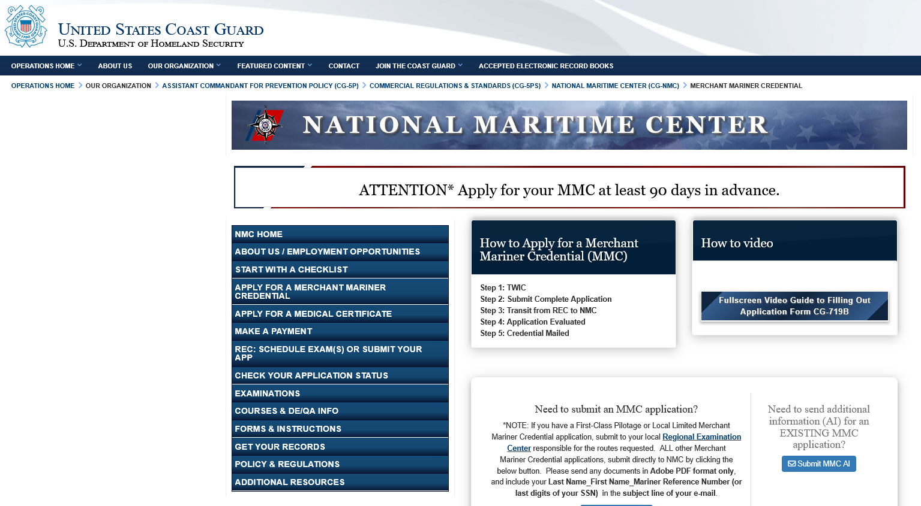
So what does it take?
https://www.dco.uscg.mil/nmc/merchant_mariner_credential/
Notes:
Pam - So where do we start? Start by visiting the National Maritime center and open Merchant Mariner Credential.

Slide 7
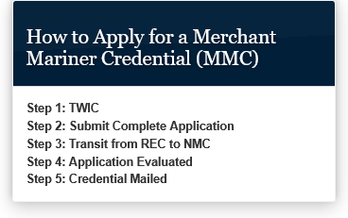
So what does it take?
https://www.dco.uscg.mil/nmc/merchant_mariner_credential/
Notes:
On the website, the process APPEARS straightforward listing 5 steps to apply for and receive your credential.
Step 1: Get a TWIC – A Transportation Workers Identification Credential – So I will start with an overview of this process.
Find an Application Center, Apply Online (allow 60 days), There are disqualifying offenses.
Should they accept your application, then schedule an in-person appointment to confirm identity (Passport, birth certificate, or other; if name has changed, may have to provide documentation such as a marriage license). At the appointment they will photograph and finger-print you, then send you card in the mail.
There is a fee ($125.00 for 5 years) but TWIC can also be used for TSA-Pre-check. (COOL!)
Step 2: Submit a complete Application - Send to Regional Evaluation Center (REC). They notify you that it has been received and let you know the status. They perform a review all the submitted information and will get in touch with you if there are questions or omissions. This took some time.
Step 3: Transit from REC (Regional to National Maritime Center where…
Step 4: Application is Evaluated
Step 5: the Credential is mailed.
OK - So far, so good!

Slide 8
So what does it take?
https://www.dco.uscg.mil/nmc/merchant_mariner_credential/
Notes:
Back to Step 2, Submit Complete Application - There is a “How To Video” that explains the 5-page application.
But hang on! Watching this video is NOT for the faint of heart, as it provides a foreshadowing of the complexity of the process, including a high-level overview of the numerous levels of credentials and endorsements administered.
I would like to say here how valuable it is to work with a consultant, a private school, an informed colleague, or others who understand the system. We had the benefit of working with the late Captain Chris Day who was invaluable to us. But he was not the only one we consulted. A shout out here to USCG RBS Scott Szczepaniak, and others who answered multiple questions and assisted us in this effort.

Slide 9
National Officer Endorsements (licensed) for Deck
Click on the collapsible panel below to open and close it. Choose A Checklist
National Master Unlimited OC or NC
National ChiefMate Unlimited OC or NC
National 2nd Mate Unlimited OC or NC
National 3rd Mate Unlimited OC or NC
National Master 500/1600 OC or NC
National Mate 500/1600OC
National Mate 500/1600NC
National Master 200OC
National Mate 200OC
National Master 200NC
National Mate 200NC
National Master 100NC
National Limited Master 100/Limited OUPV
National Master Unlimited GL and Inland
National Mate Unlimited GL and Inland
National Master 500/1600 GL and Inland
First Class Pilot accompanies vessels while they enter or leave port to ensure safe navigation of entrance and departure.
National Master 200 GL and Inland
National Mate 200 GL and Inland
National Master 100 GL and Inland
National Master UFIV
National Mate UFIV
National Grandfathering Master and Mate Pilot of Towing
National Master of Towing OC, NC, GL-IN, WR
National Mate Pilot of Towing OC,NC,GL-IN,WR
National Apprentice Mate of Towing Vessels
National Limited Apprentice Mate Of Towing
National Limited towing Vessels Upon Great Lakes-Inland & Western Rivers
National OUPV Less Than 100 GRT
National Ballast Control Operator
National Master OSV Less Than OR More Than 1600GRT/3000GT
National Chief Mate OSV Less Than OR More Than 1600GRT/3000GT
National Mate OSV
National Radio Officer
National First Class Pilot
National Staff Officers
National HSC Orig/Renewal/Extension of Route
National OIM Bottom Bearing Units On Location
National OIM Bottom Bearing Underway
National OIM Surface Units On Location
National OIM Surface Units Underway
National OIM Unrestricted
National Barge Supervisor
National Mate OSV Restricted to Liftboats
National Chief Mate OSV Restricted to Liftboats
National Master OSV Restricted to Liftboats
Students Observer,Apprentice Mate,or Apprentice Engineer
National Lower Level Tonnage Increases
National Tonnage and Horsepower Limitation Removal
National Master and Mate Rivers
STCW Officer Endorsements (licensed) for Deck
Click on the collapsible panel below to open and close it. Choose A Checklist
STCW - GMDSS Radio Operator
STCW - Advanced Firefighting
National HSC Orig/STCW - Master 3000 GT or More Management Level
STCW - Chief Mate 3000 GT or More Management Level
STCW - OICNW 500 GT or More Operational Level
STCW - Master 500 GT or More and Less Than 3000 GT Management Level
STCW - Chief Mate 500 GT or More and Less Than 3000 GT Management Level
STCW - Master Less Than 500 GT OC Management Level
STCW - Master Less Than 500 GT Limited To Near Coastal Waters Management Level
STCW - OICNW Less Than 500 GT NC Operational Level
STCW - OICNW Less Than 500 GT OC Operational Level § 11.319
STCW - Vessel Security Officer (VSO)
STCW - PSC, PSC Limited, Fast Rescue Boats 1
STCW - Medical First Aid Provider / PIC of Medical Care 1
STCW - Vessel Personnel with Designated Security Duties / Security Awareness
STCW II/2 – OSV Chief Mate 500 GT And More And Less Than 3000 GT Management Level
STCW II/2-OSV Master 3000 GT Or More Management Level
STCW II/2 –OSV Chief Mate 3000 GT Or More Management Level
STCW II/1 – OSV OICNW 500 GT Or More Operational Level
STCW II/2 – OSV (Less Than 1600/3000 GT) Master 500 GT Or More And Less Than 3000 GT Management Level
STCW - Basic TrainingOriginal And Renewal
STCW - Basic and Advanced Polar Code Original and Revalidation
STCW - Basic and Advanced IGF Code Operations Original and Renewal
Captains, mates, operators and pilots supervise ship operations on domestic waterways and the high seas. The following are officer endorsements in the deck department:
Master means the officer having command of a vessel.
Mate means a qualified officer in the deck department other than the master.
Operator means an individual qualified to operate uninspected passenger vessels.
First Class Pilot accompanies vessels while they enter or leave port to ensure safe navigation of entrance and departure.
Hundreds of Professional Mariner Credentials
- additional options/endorsements!
Notes:
Here is an example of why you may need help. There are literally hundreds of unique licenses, ratings, and endorsements to apply for, with additional options for each.

Slide 10
OUPV – Operator of Uninspected Passenger Vessel
Notes:
After reviewing the many options, we focused on the OUPV – Operator of Uninspected Passenger Vessel as it met our needs for training under the NSBC program. We downloaded the checklist for that only to discover additional options for that credential, such as ….

Slide 11
OUPV – Operator of Uninspected Passenger Vessel
Limited Master
      formal camps, yacht clubs, educational institutions, and marinas
Restricted Master
      also for above to satisfy unique qualification requirements
Limited OUPV
      with Officer in Charge, Marine Inspection (OCMI) approval for a vessel
Restricted OUPV
      with OCMI approval for a specific body of water
Restricted OUPV
      to satisfy unique qualification requirements of an applicant or distinct group of mariners per 11.201(I)
Notes:
Limited Master
formal camps, yacht clubs, educational institutions, and marinas
Restricted Master
also for formal camps, yacht clubs, educational institutions, and marinas to satisfy unique qualification requirements
Limited OUPV
with OCMI approval for a vessel
Officer in Charge, Marine Inspection, (OCMI).
The term Officer in Charge, Marine Inspection, (OCMI) means any person from the civilian or military branch of the Coast Guard designated as such by the Commandant and who, under the superintendence and direction of the Coast Guard District Commander, is in charge of an inspection zone for the performance of duties with respect to the inspections, enforcement, and administration of Subtitle II, Title 46, U.S. Code, Title 46 and Title 33 U.S. Code, and regulations under these statutes.
Restricted OUPV
with OCMI approval for a specific body of water
Or another option for a Restricted OUPV
to satisfy unique qualification requirements of an applicant or distinct group of mariners per 11.201(I)
Hmmmmm…..

Slide 12
National OUPV Less Than 100 GRT
National Operator of Uninspected Passenger Vessels
All Waters 11.467
Notes:
After reviewing the many options, we determined that we needed an option that was not listed on the previous checklist. That credential is the National OUPV Less than 100 GRT. This would allow us to offer NSBC training in any inland water within the U.S.
We were elated that this was only a one-sheet check sheet. Here are the requirements in order of presentation on the check sheet (which was not exactly the order we completed them in):

Slide 13
National OUPV Less Than 100 GRT
Notes:
General Requirements:
1) US Citizenship – The TWIC card which I previously mention documented that (although there was guidance provided if you are NOT a US Citizen).
2) You must be 18 or older – again, the TWIC process documented that.
3) The Medical Exam requirement was new to us – It is a separate 10- page document that must be completed at an approved medical facility. (Which took us at least 3 separate Doctor visits to complete.) The exam requires an eye test and hearing test, in addition to specific physical exam.
4) Drug Testing must also be completed at an approved testing facility (so the recommendation is to find an occupational health medical facility that does BOTH USCG-specific exams AND drug testing. After several visits to facilities that advised us they could complete the form but course not, we finally found an occupational health testing facility that actually understood what we needed and got an appointment. It cost approximately $250 to complete the medical and drug testing processes.
5) Merchant Mariner User Fees must be paid via pay.gov website – Cost $145.00

Slide 14
National OUPV Less Than 100 GRT
Notes:
The Sea Service Requirements can be challenging if you have not been previously logging your Sea Time.
For this OUPV credential, 360 days (counted as 8-hour time periods) must be documented in the operation of vessels including 90 days within the past 3 years. Fortunately, we could go back to our prior state agencies for letters documenting our days of prior service. There are specific guidelines, documents, vessel descriptions, and attestations needed for this process which took several months for us to put together.

Slide 15
Notes:
Under “Other Requirements”, the First Aid and CPR seemed straightforward until you begin to look into the various course offerings for each. One size does not fit all, and we needed additional guidance from our consultant network to identify the specific courses to satisfy this requirement. An additional challenge was to find an instructor who would teach those specific courses. But it turns out that our local YMCA instructor gave us a private class to help us out. Cost of $95/person. What a bargain!

Slide 16
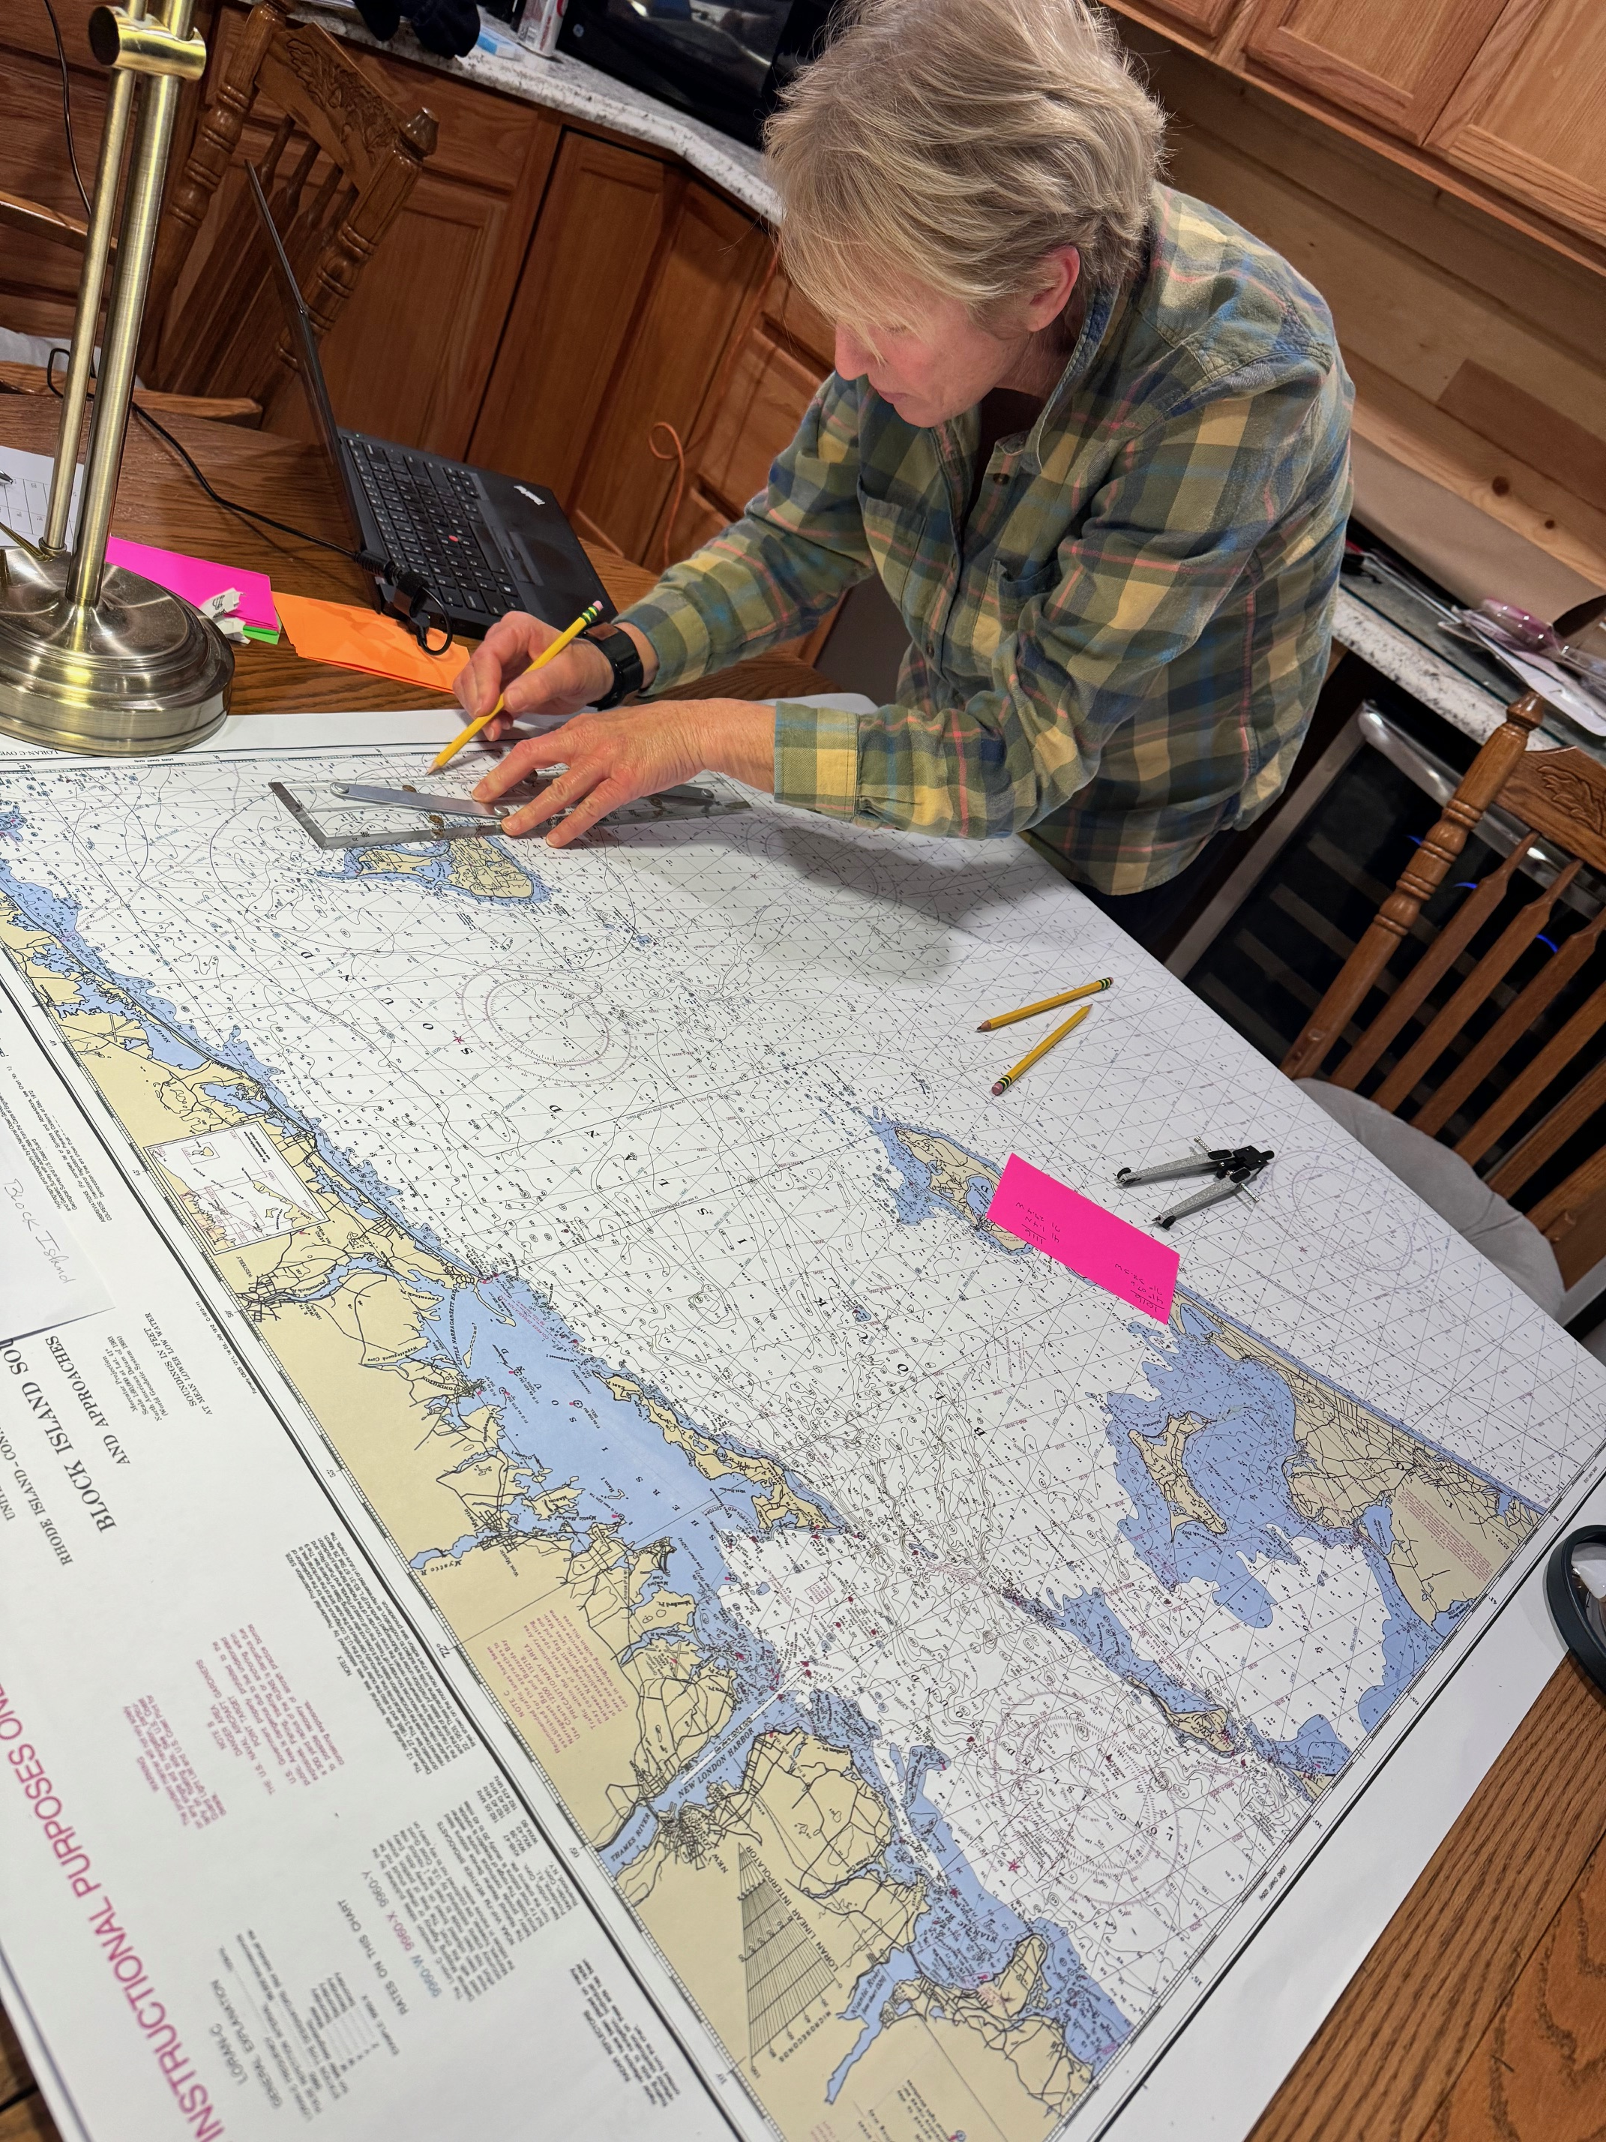
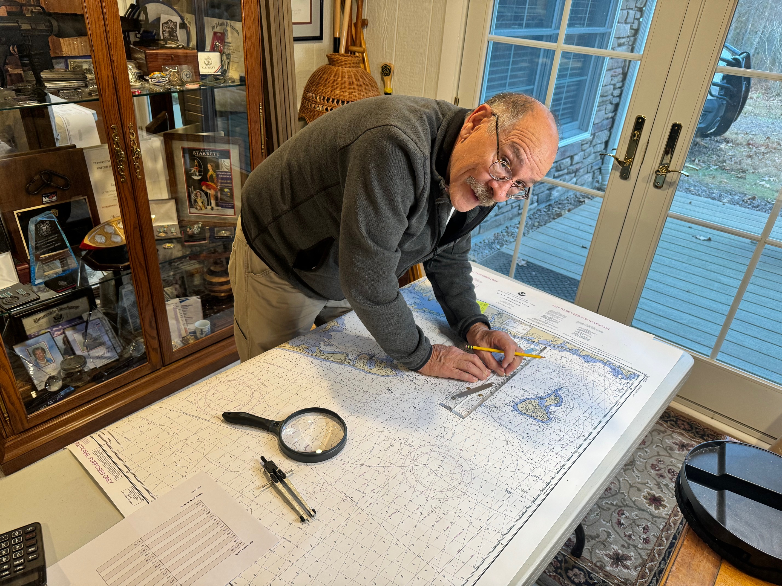
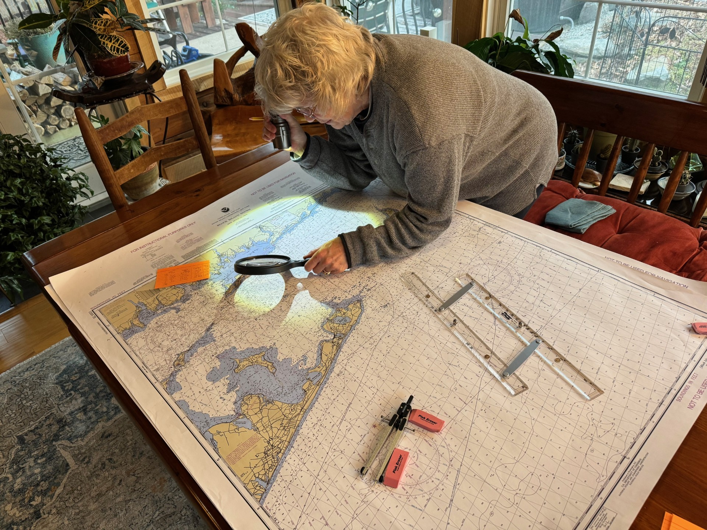
Exam!
Notes:
All this, and we have yet to address the examination requirement. We opted for a course completion certificate in lieu of a Coast Guard examination. (Cost approx. $750). We actually started here in the process under the tutelage of the late Captain Chris Day along with the services of a private online Coast Guard Captain licensing program which provided the content and proctored the test. We did an intensive study session of 5-plus full days (all day and evenings) to review and study the course materials, including several practice exams.
Oh yes, the test! Even though the test was proctored by a third party, it followed the same process and content that we understand would have been experienced if we had taken this at a Coast Guard examination center.

Slide 17
Exam!
Notes:
The OUPV test has 4 parts with specific performance requirements for each:
Part 1 – Rules of the Road – 50 questions with passing score of 90
Part 2 – Deck General/ Safety – 50 questions with passing score of 70
Part 3 – Navigation General – 50 questions with a passing score of 70
Part 4 – Navigation Programs - Chart Plot 10 questions with a passing score of 90
Pam - I wish I had realized that there was a 4-hour time limit on the test, as I found myself scrambling on the chart plotting section. (I advise you to become VERY familiar with charts to be used in the exam, as finding place names proved to be tedious when you are on the clock).
We were happy to have passed the test on the first attempt, but there are accommodations if you are not fully successful.
If an applicant fails one or two sections of an examination, the applicant may be retested twice on these sections during the next 3 months. If the applicant does not successfully complete these sections within the 3-month period, a complete re-examination must be taken at least 3 months from the date of the last retest, and a new examination fee is required.
If an applicant fails three or more sections of the examination, a complete re-examination must be taken.
All examinations and retests must be completed within 1 year of approval for examination.

Slide 18
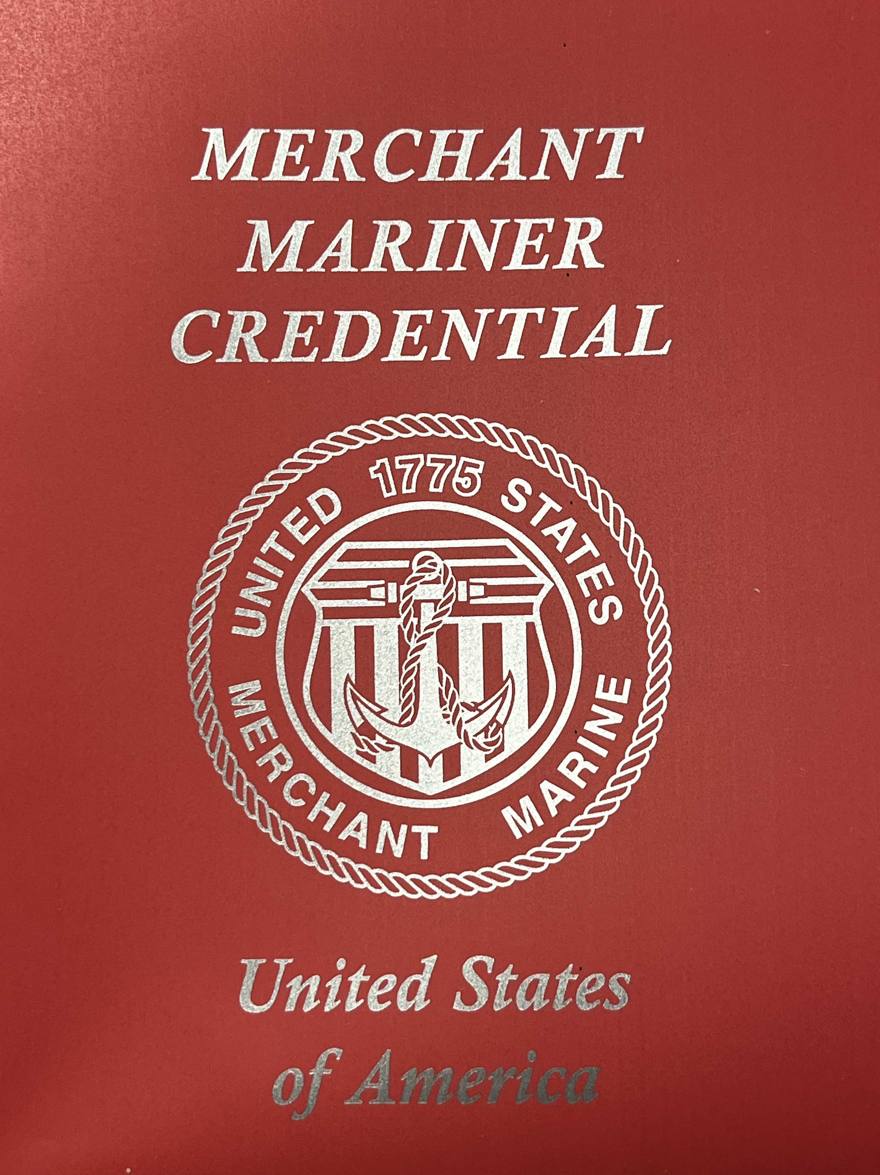
Success!!
Notes:
Success! Over one-year and nearly $1500 later (not counting travel and other in-direct costs) we were successful and are proud to claim the title of “Captain.”
So lessons learned:
Be patient and persistent.
Do not underestimate the need for mentors and consultants. Don’t be afraid to “phone a friend.”
Will it make us better at teaching the NSBC course? Maybe. It gives us more credibility but is not a substitute for completing the NSBC Instructor Training and understanding and practicing that curricula.

Slide 19
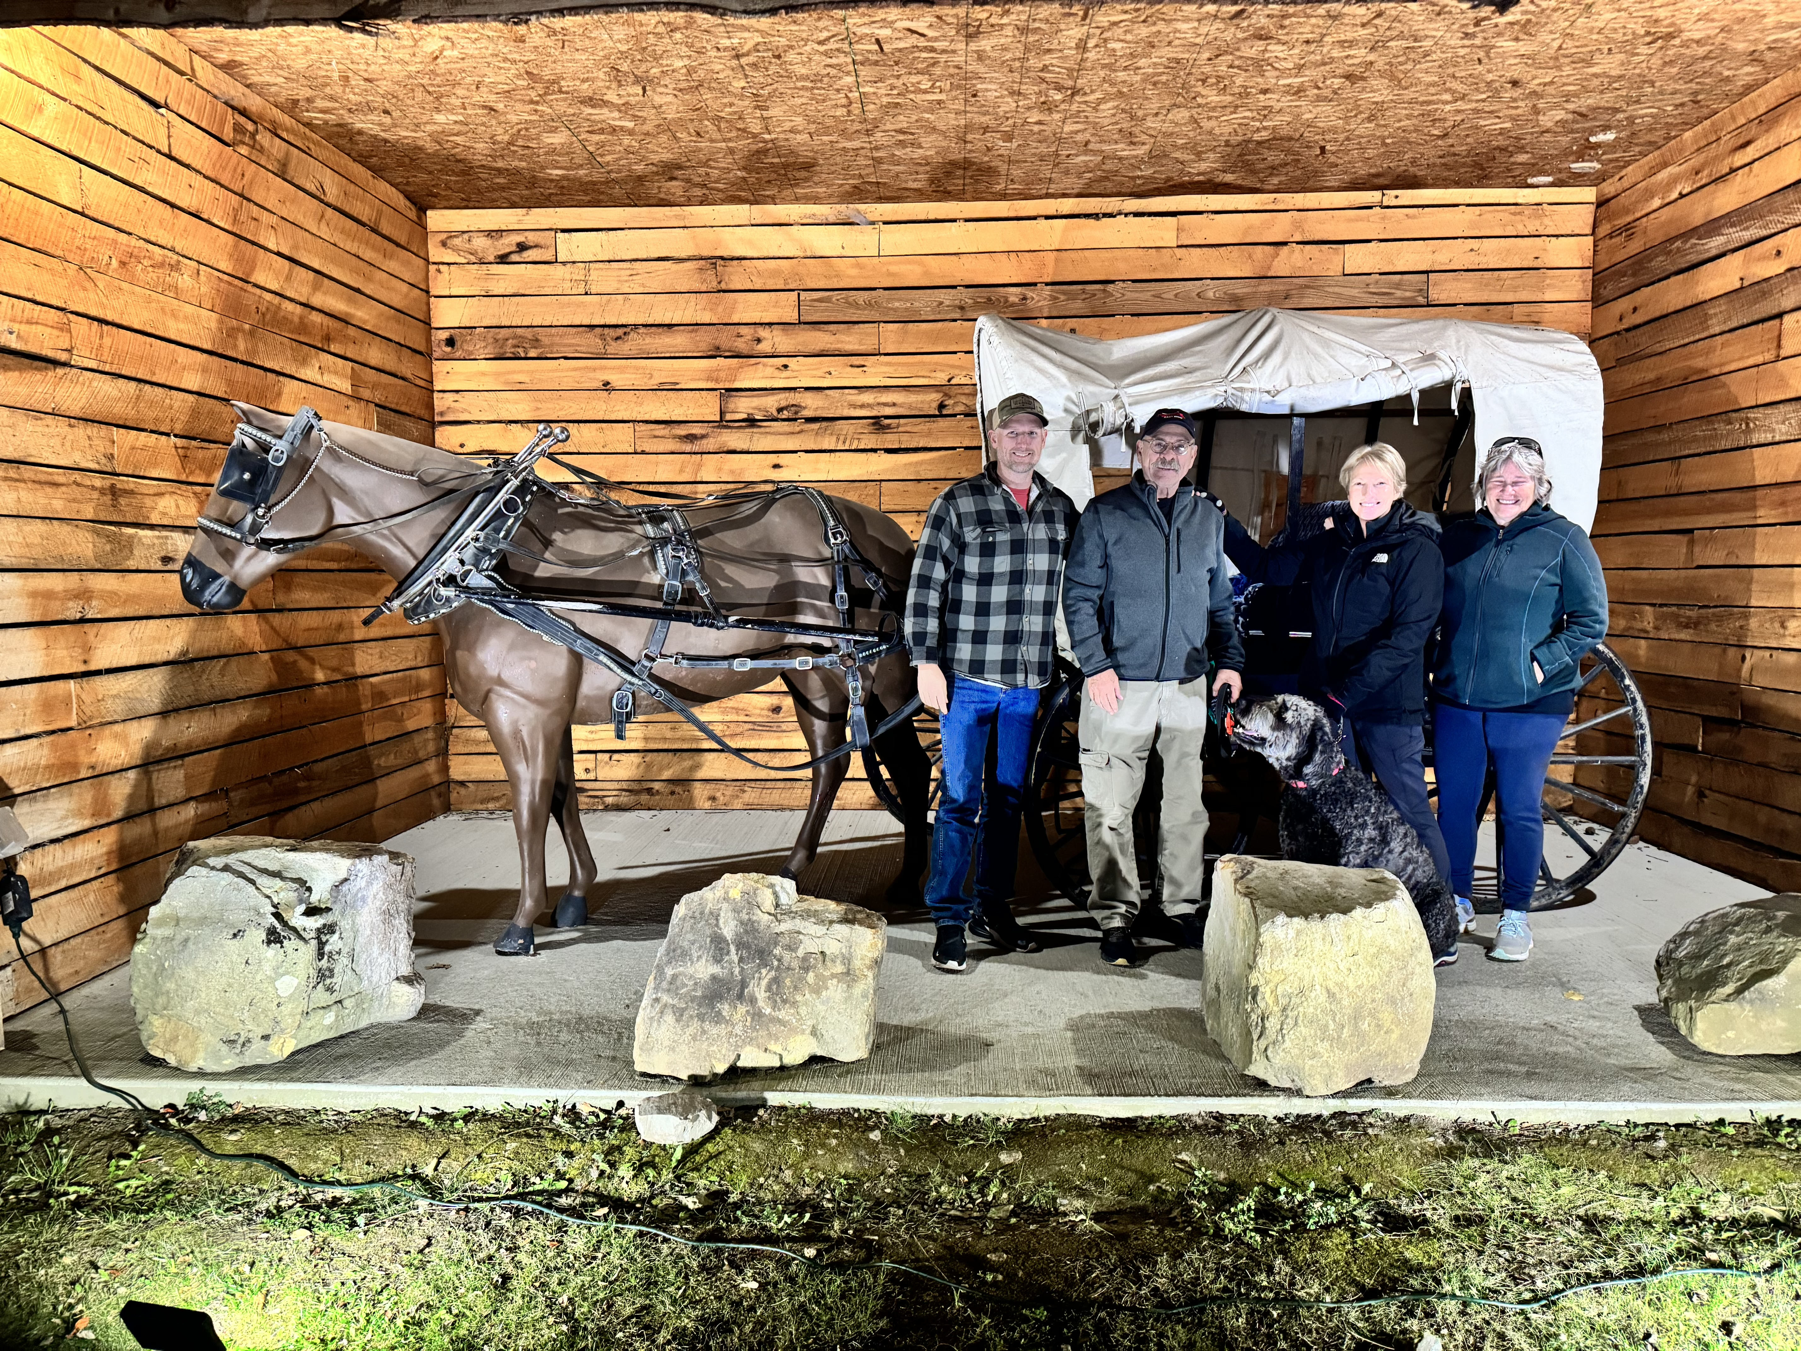
Good Luck with your Coast Guard License Journey
Notes:
So, we are paying it forward. Just as Captain Chris Day did with us, we provide this overview to encourage and motivate you. We are here to share our experiences and offer support as we can with your Merchant Mariner Credential journey.

Slide 20
Questions??
Captain Peg Phillips
pphillips@safeboatingcouncil.org
Captain Virgil Chambers
vhchambers@aol.com
Captain Pamela Dillon
pamsdillon@aol.com
Notes:
Success! Over one-year and nearly $1500 later (not counting travel and other in-direct costs) we were successful and are proud to claim the title of “Captain.”
So lessons learned:
Be patient and persistent.
Do not underestimate the need for mentors and consultants. Don’t be afraid to “phone a friend.”
Will it make us better at teaching the NSBC course? Maybe. It gives us more credibility but is not a substitute for completing the NSBC Instructor Training and understanding and practicing that curricula.

