Slide 1

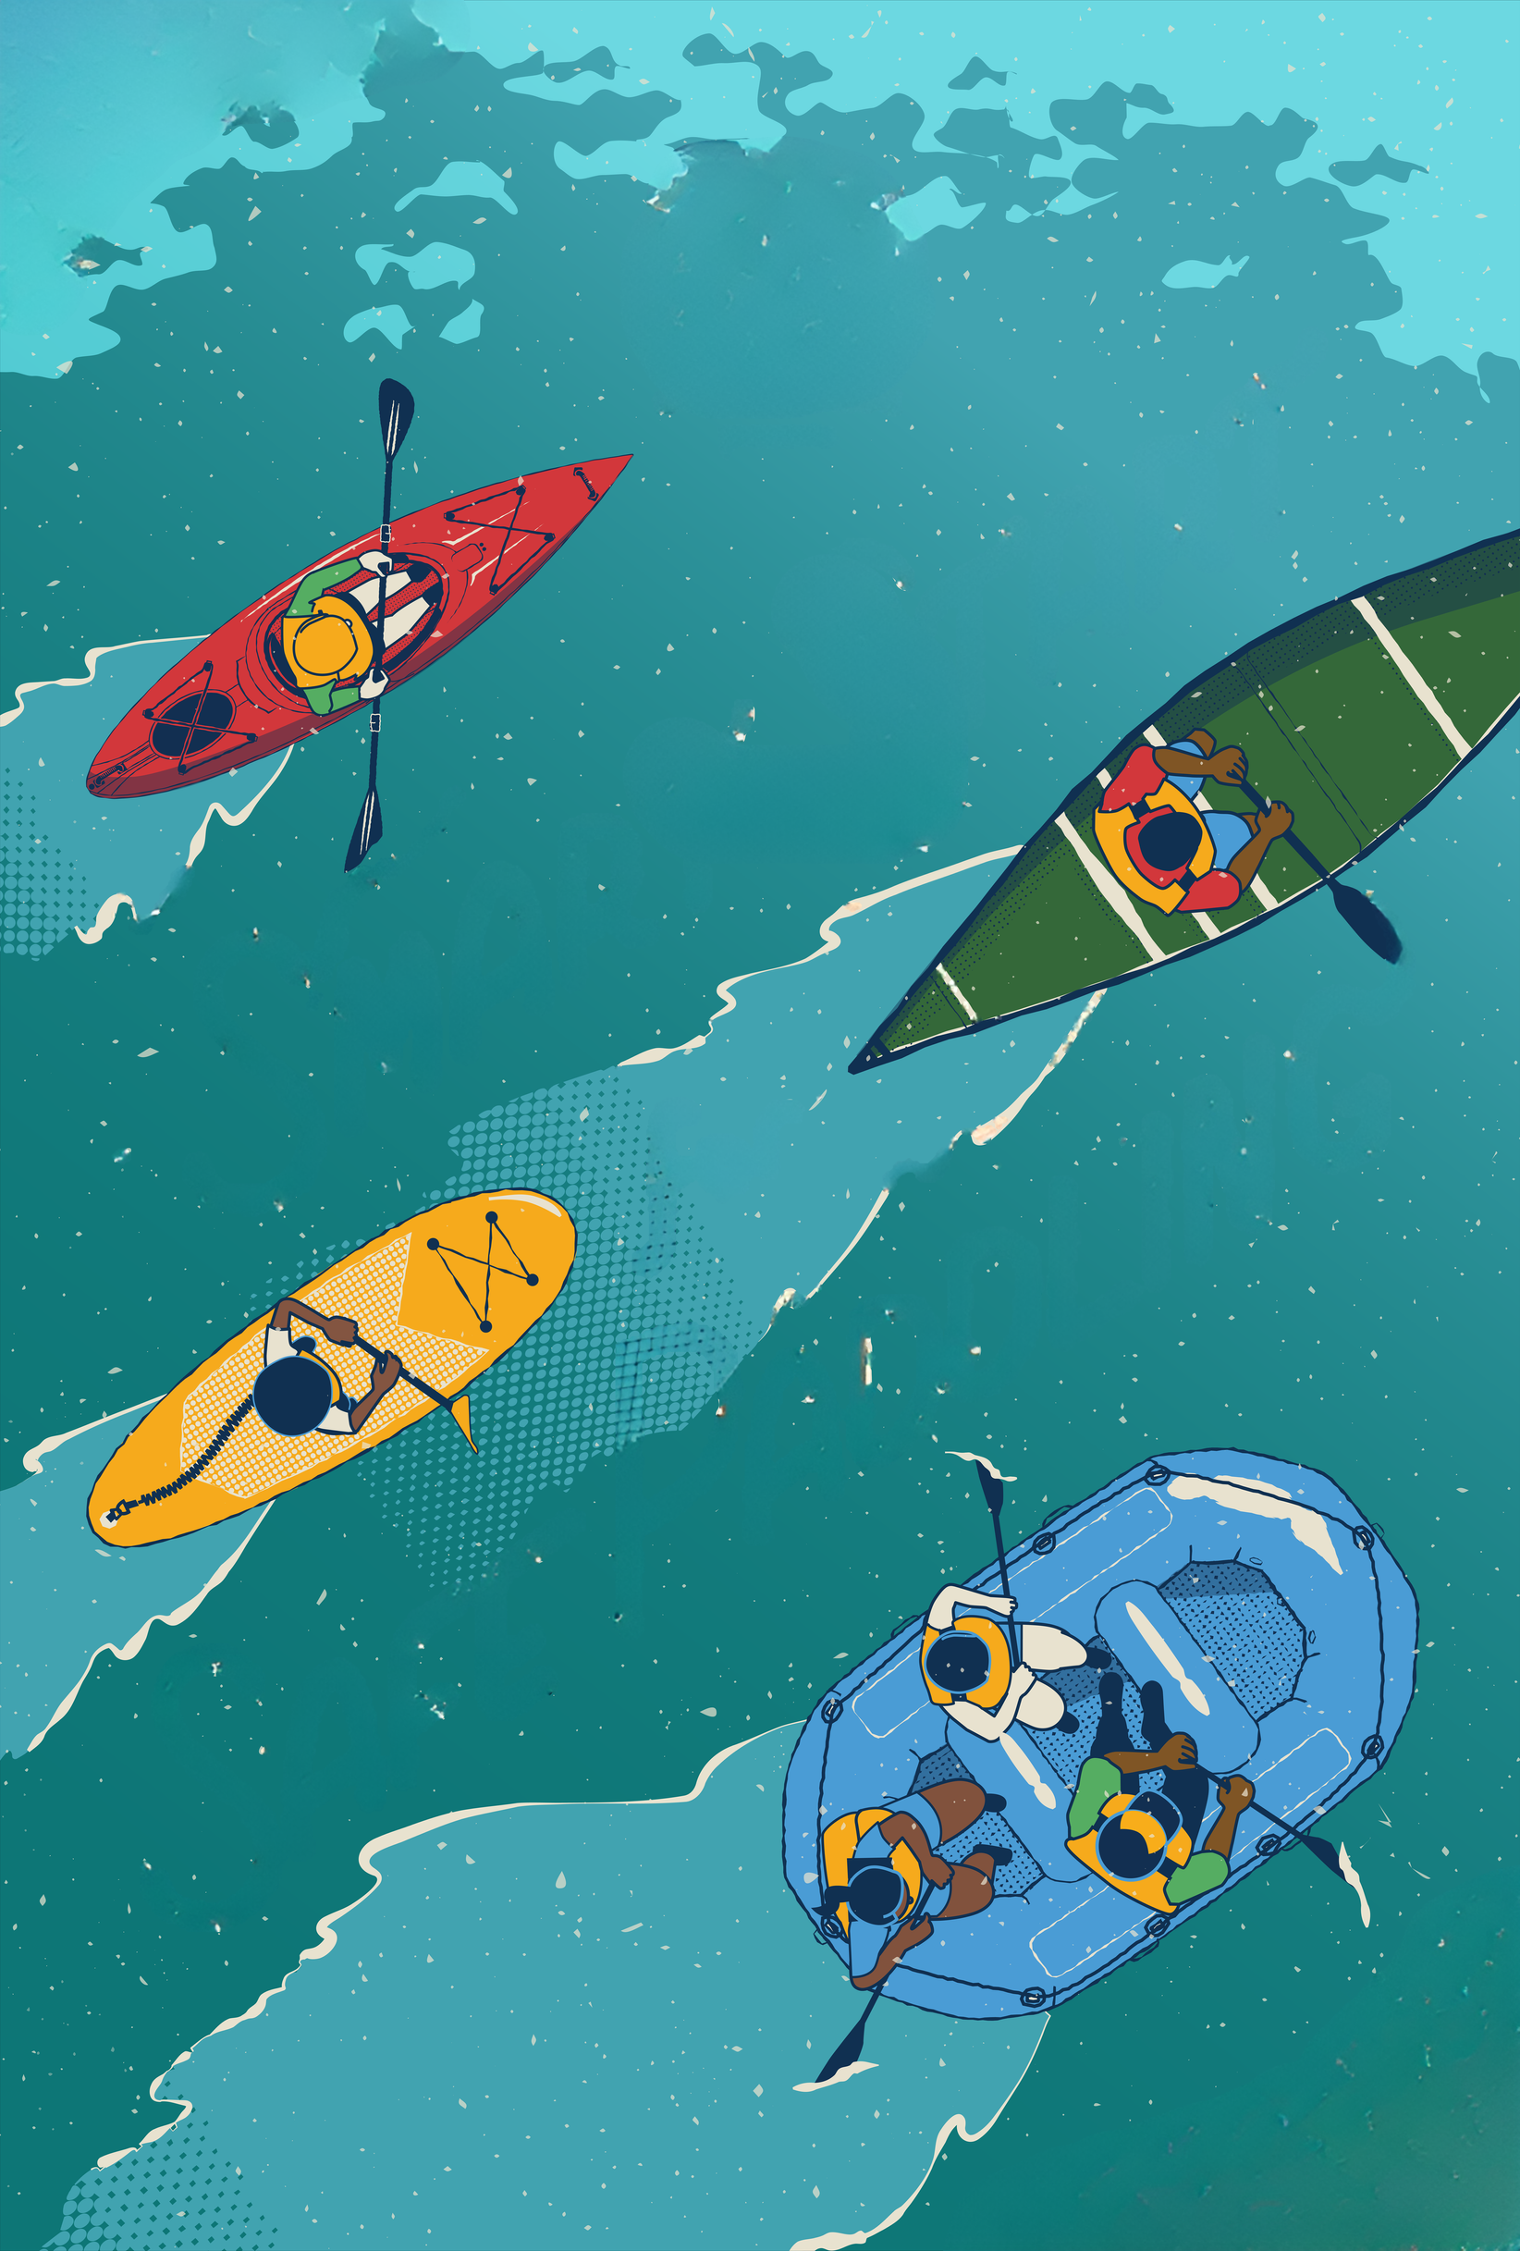

Smart Start
Safe Paddling
Paddle Smart
Paddle Safe
Have Fun!
For

Slide 2
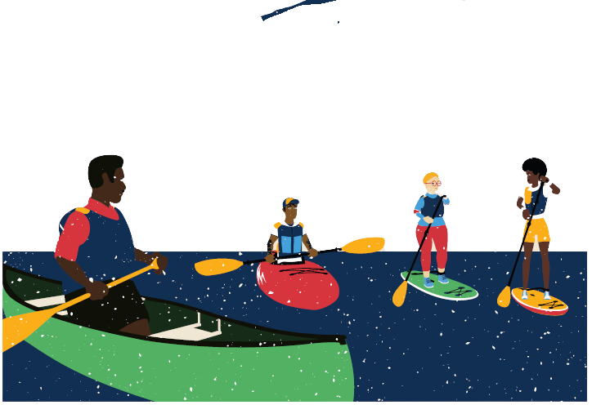







The Smart Start for Safe Paddling program is a suite of resources that provides essential information to help novice paddlers stay safe and have fun while on the water. The comprehensive program book addresses each NASBLA core and human-propelled standard and provides in-text citations for easy cross reference.
  Resource Book
  Student Workbook
  Free Online Safety Course
  Presentation Slides
  Course Delivery Guide
  On-Water Course Outline
Smart Gear
Smart Skills
Smart Plan
Smart Decisions

Slide 3
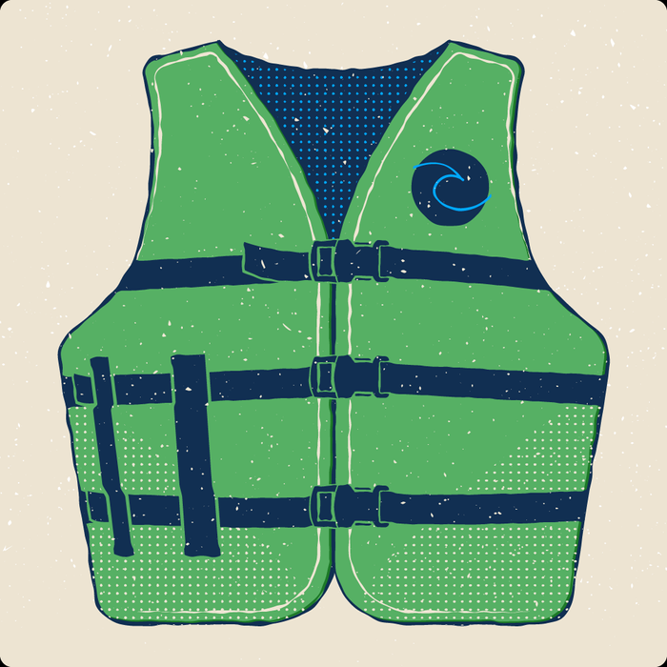



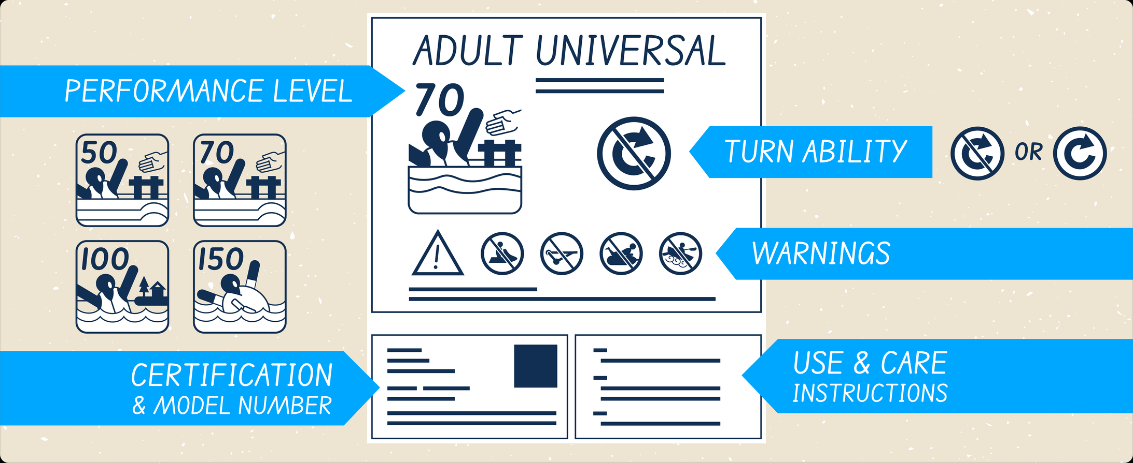
Smart Gear
Life Jackets
  Regulations
  Types
  Labels
  Properly Fitted
  Activity Appropriate

Slide 4
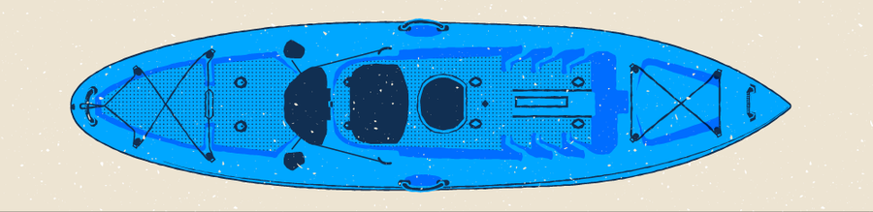


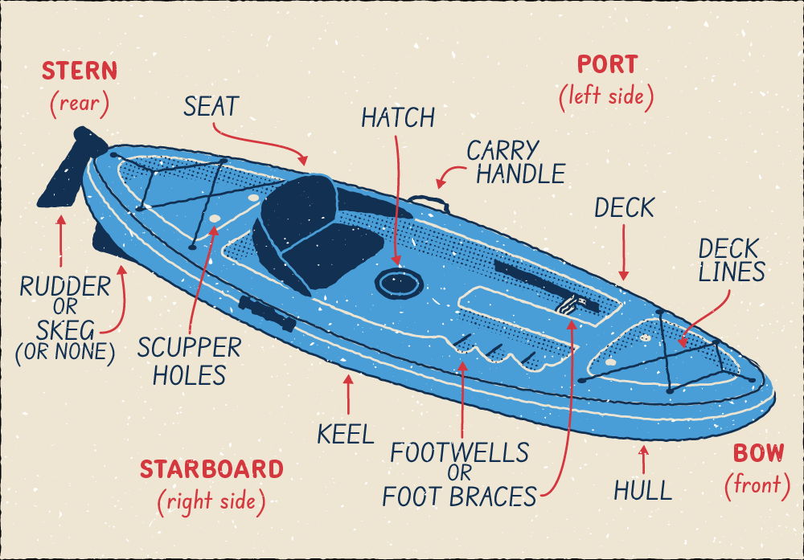


Smart Gear, Continued
  Craft Terminology and Design:
    Canoe, Kayak, SUP, Rafts
  Paddle Terminology & Maintenance

Slide 5
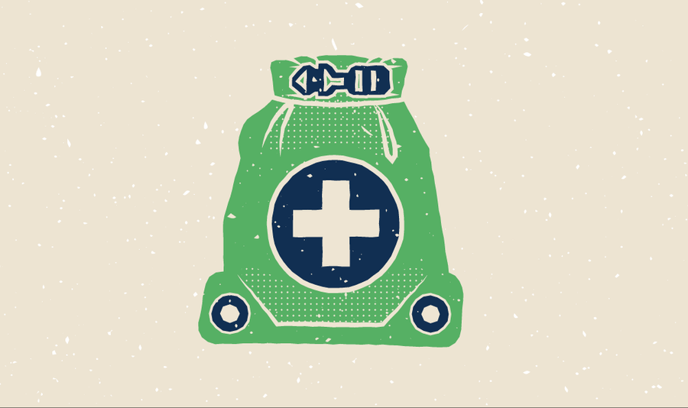

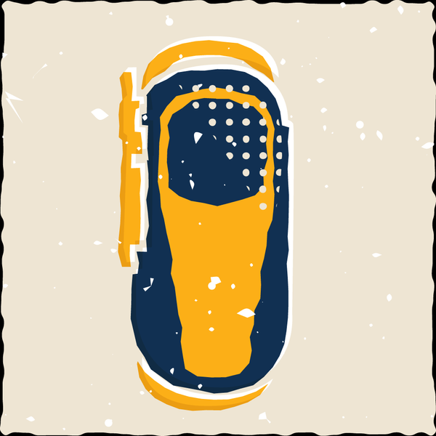
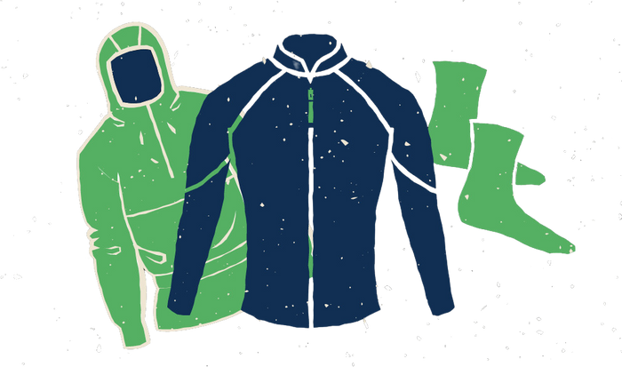
Smart Gear, Continued
  Basic Gear: Life Jacket, Craft, Paddle, Clothing, Food/Water
  Safety and Survival Gear: First Aid, Repair Kit, White Light, Pin Kit, Cuting Tool
  Communications Gear: Whistle, Cell Phone, VHF, Air Horn
  Navigation: Nautical Chart, Compass, Phone
  Clothing and Thermal Protection: Layering, Staying Cool, Staying Warm
  Other: Anchors, De-Watering Devices, Drybags
  And more...

Slide 6





Smart Skills
  Transporting A Boat: Securing to car or trailer
  Carrying boats to the water
  Loading boats with gear: including capacities
  Entering/boarding a boat
  Boat handling, departing, returning / arriving
  Strokes: Forward, Reverse, Sweep, Pivot, Draw

Slide 7

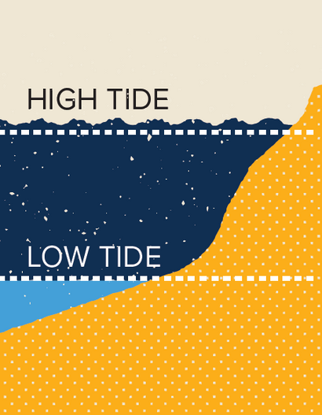



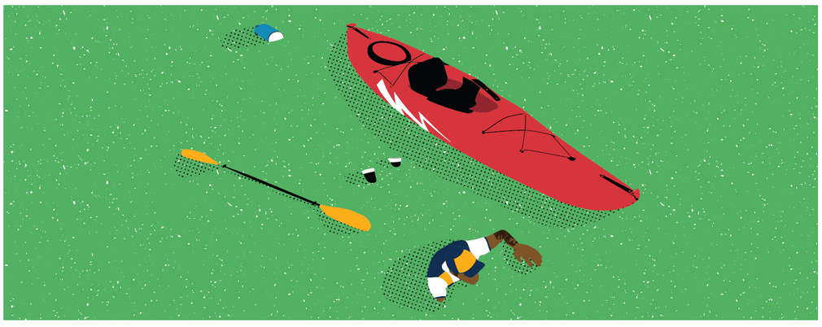

Smart Skills, Continued
Rapids or Waves
Tides
  Environmental Risks, Human-Made Hazards
  Rescue Principles and Priorities
Strainers
Low Head Dams

Slide 8



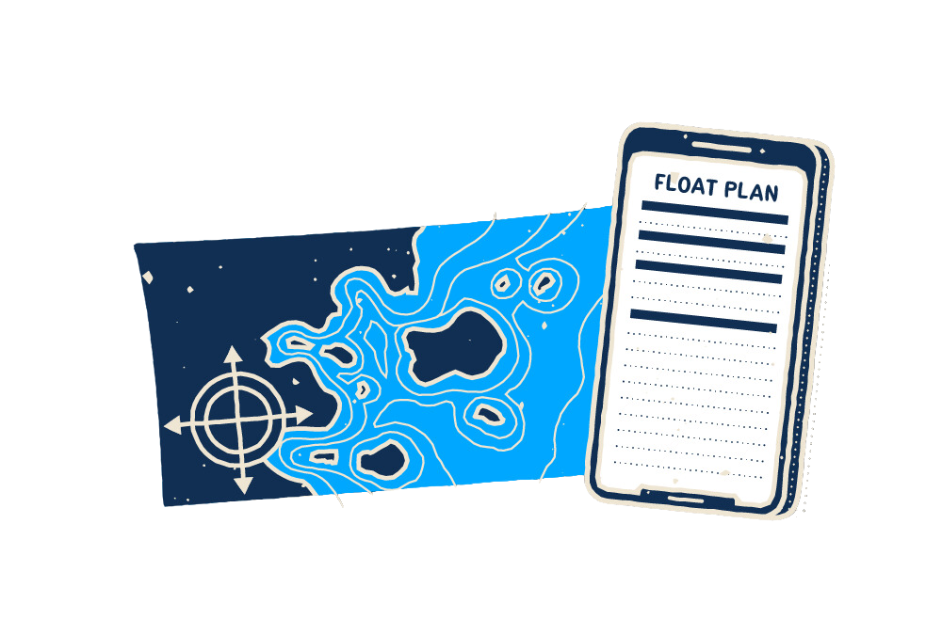

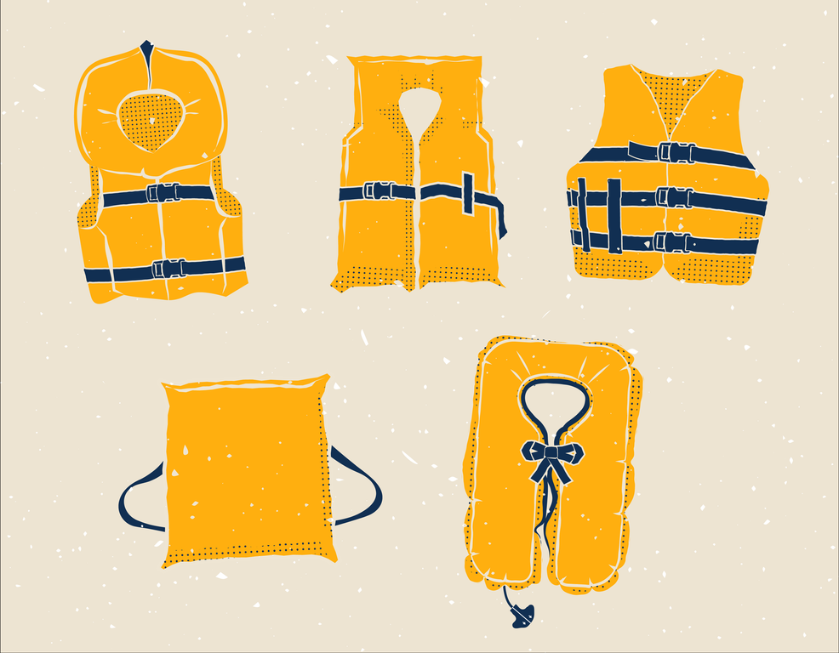

Smart Plan
  Float Plans
  Life Jacket Wear Requirements
  Rendering Aid
  Reporting Accidents
  Invasive Species
  Leave No Trace Principles

Slide 9
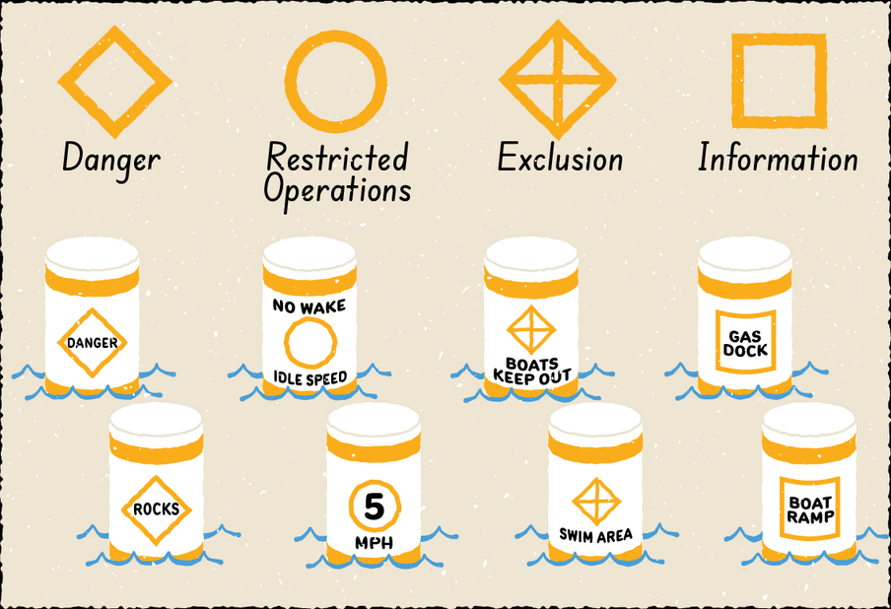



Smart Decisions
  Go / No-Go Decisions
  Paddler’s Responsibilities
  Group Management and Communication
  Alcohol & Drugs
  Avoiding Multi-Use Waterway Conflict
  Paddling in Proximity to other Vessels
  Rules of the Road, Aids to Navigation, Regulatory Markers

Slide 10

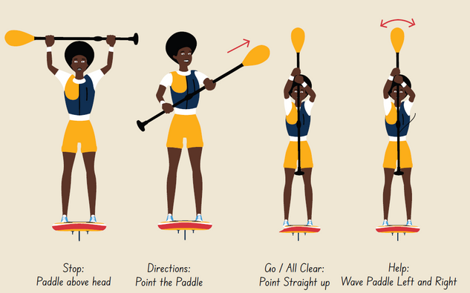
Appendix
  Glossary of Terms
  Heat & Cold Issues
  Dressing for Comfort and Performance
  International Regulations for Prevention of Collisions at Sea
  VHF Communications and Signals
  Common Paddling Accident Types
  International Scale of River Classification
  ANSI / NASBLA Standards Reference Guide

Slide 11
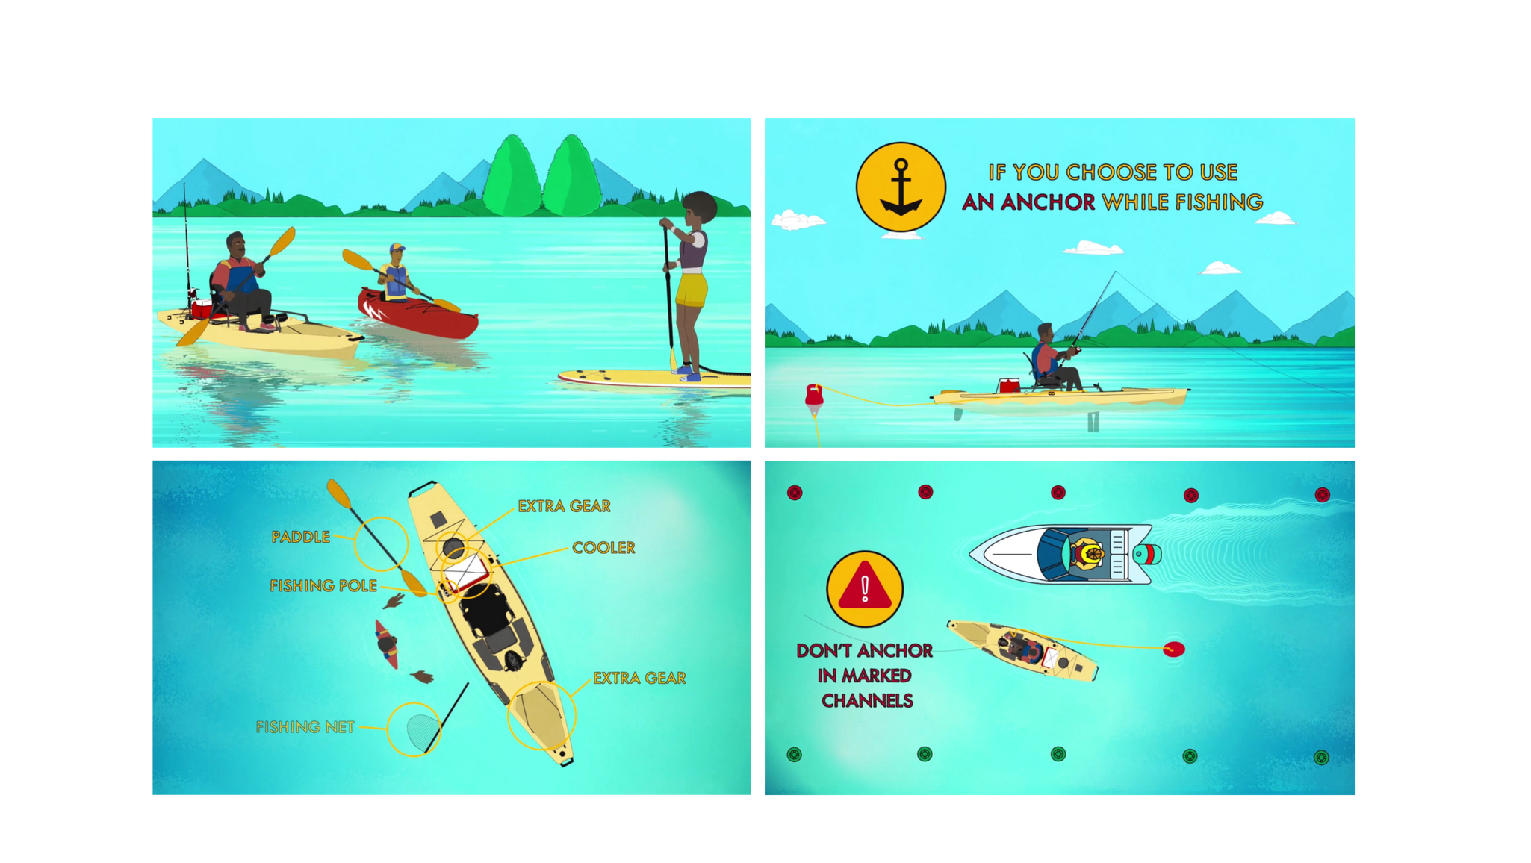
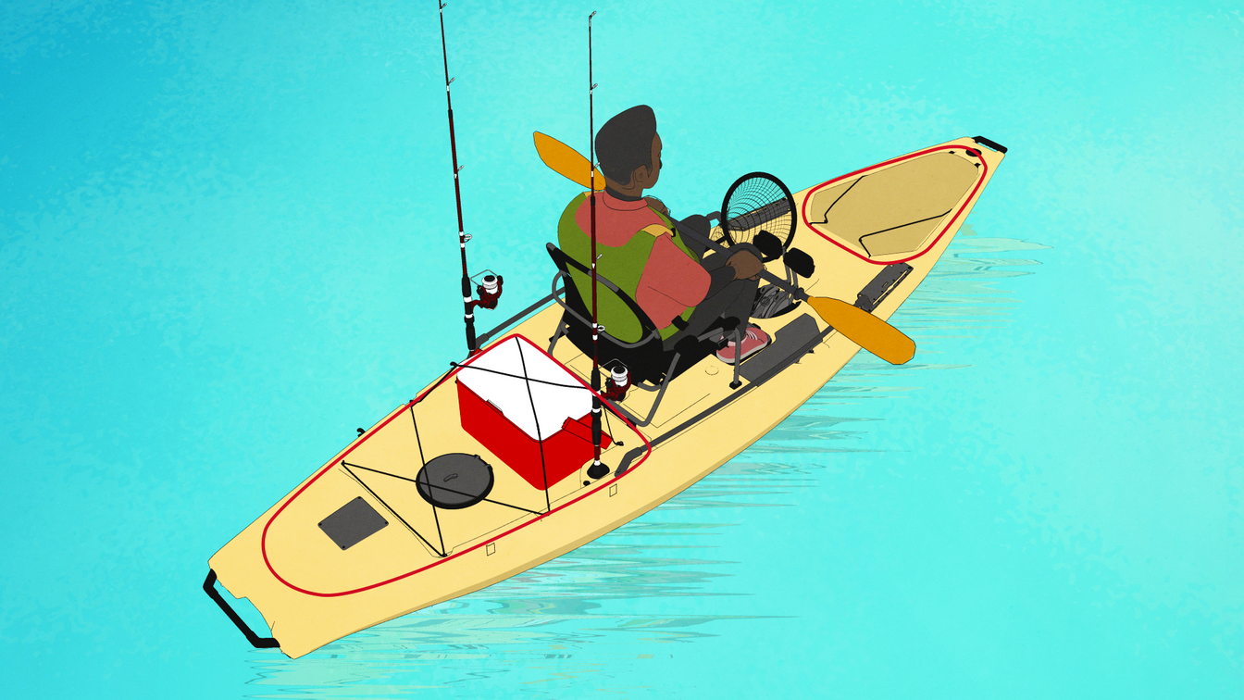
Smart Start Online Course
  Shopping for equipment and gear
  Securing a new boat to your car
  Building a float plan with friends
  Check-ins before the trip starts
  Changing your trip plan on the go
  Recognizing hazards
  Dealing with changing weather
  Staying safe while kayak fishing
  Navigating multi-use waterways
  How to self rescue or assist someone else in the water
Coordinated branding, content, and USCG approved

Slide 12







Connect With Us!
Smart Start
https://americancanoe.org
@acapaddlesports
For
aca@americancanoe.org
Safe Paddling
540-907-4460
The American Canoe Association’s (ACA) vision is to engage millions of paddlers with safe and healthy opportunities for challenge, learning, service, and enjoyment. ACA’s Smart Start for Safe Paddling is a holistic program which features comprehensive books, student activity workbooks, free online coursework, instructor’s guide with presentation slides, and a wide collection of complementary resources.
Find all this and more:
https://americancanoe.org/smart-start

