Slide 1
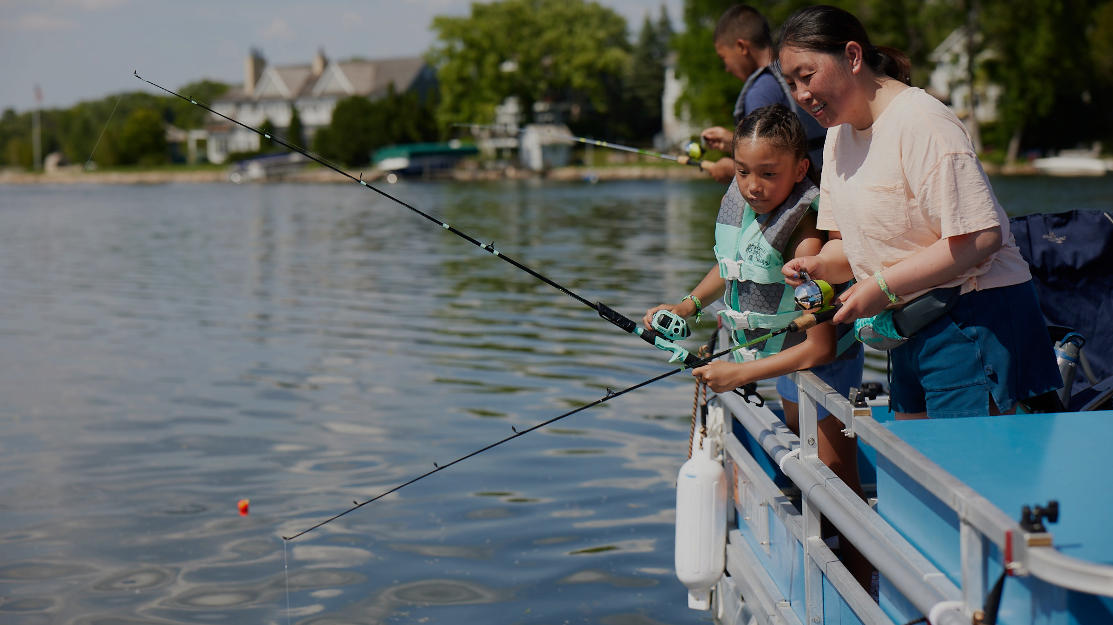

HOOKED ON BOATING:
HOW FISHING FUELS THE INDUSTRY & ENHANCES SAFETY
RBFF I IBWSS
APRIL 15, 2025 I GLENDALE, AZ
Notes:
Agenda:
-Who is RBFF?
-Participation & Consumer Trends
-Strategies for Growth; Churn Research Insights

Slide 2
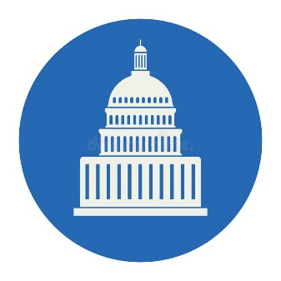


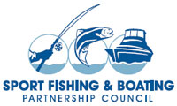
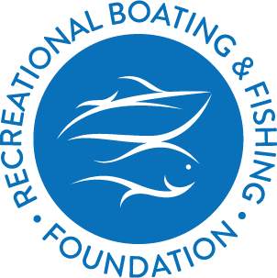
RBFF’s
History
Hearings on Capitol Hill
DOI to Create NOCP
RBFF Created to Carry it Out
National Outreach and Communication Plan to address recreational boating and fishing participation and aquatic resource stewardship.
Concerns over declining fishing and boating participation
1998
SFBPC Developed Plan
Sport Fishing & Boating Safety Act Passed
Notes:
SFBPC established in 1993
The Recreational Boating & Fishing Foundation (RBFF) is a 501(c)(3) non-profit organization. RBFF was officially established in 1998, but the groundwork was laid well before then.
It started in hearings and at meetings on Capitol Hill, where industry, conservation and public policy leaders voiced concerns that boaters and anglers were spending less and less time on the water. It appeared that many people were forgetting — or had never experienced — how recreational boating and fishing could enrich their lives and contribute to a healthier environment around them.
When Congress passed the Sport Fishing and Boating Safety Act in 1998, it required the Secretary of the U.S. Department of the Interior to implement a national outreach and communication plan to address recreational boating and fishing participation and aquatic resource stewardship. The Sport Fishing and Boating Partnership Council (SFBPC) developed the plan and RBFF was created to carry it out — ensuring the legacies of boating, sport fishing and aquatic resource stewardship are never lost.
The Recreational Boating and Fishing Foundation, a tax-exempt corporation, was established in 1998 to carry out this program to increase participation in recreational boating and fishing and to encourage greater public involvement in aquatic stewardship as mandated in the Sportfishing and Boating Safety Act of 1998 (Title VII, Subtitle D of P.L. 105-178).
Congressional Research Service “The Sport Fish Restoration and Boating Trust Fund Updated May 10, 2012”

Slide 3
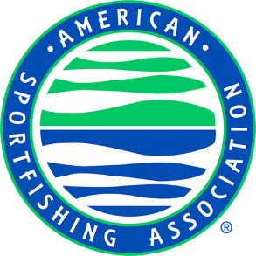

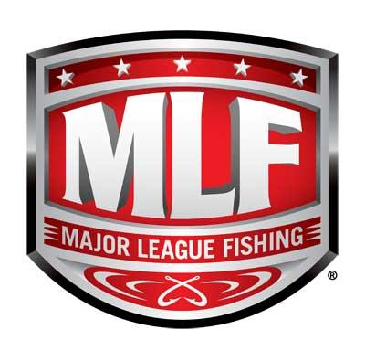
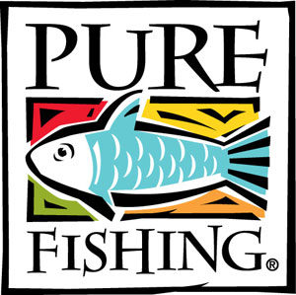
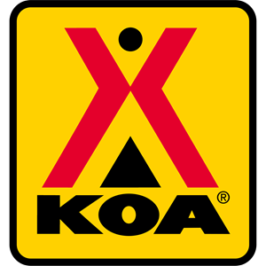



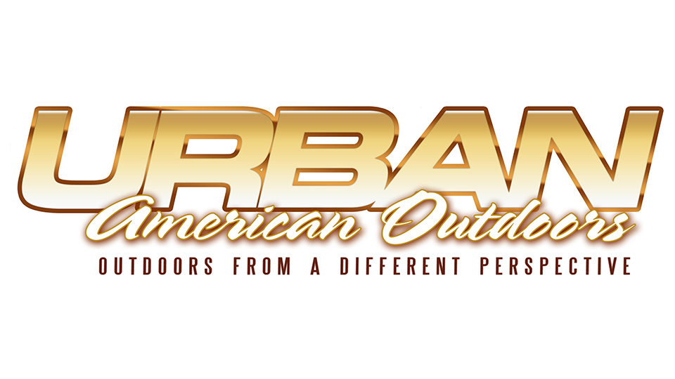
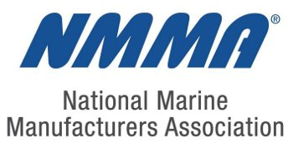
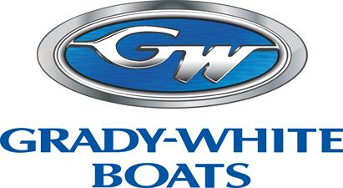
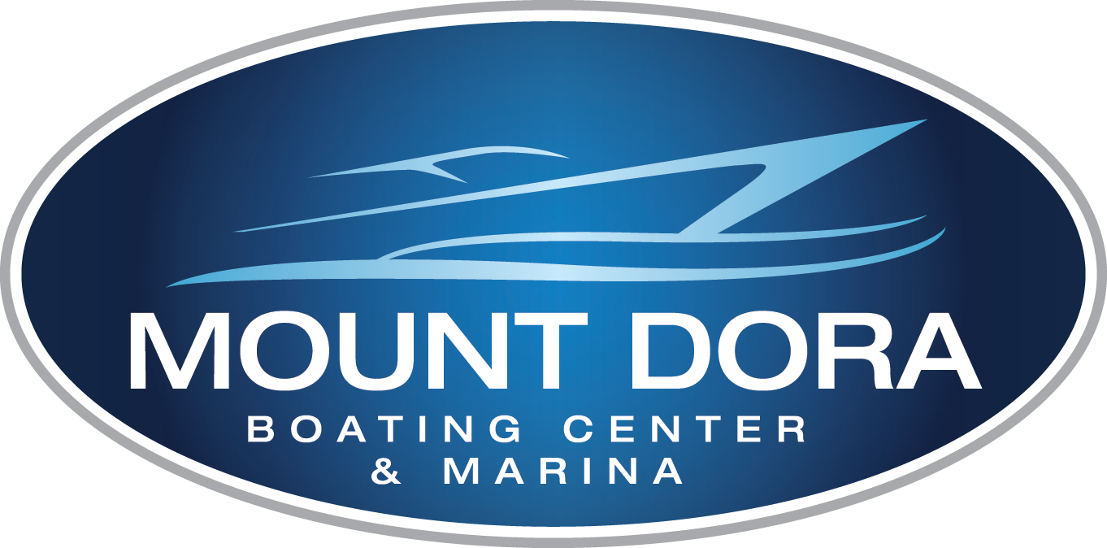

Board
Makeup
1 seat
Non-voting
5 seats
RBFF Board of Directors
7 seats
5 seats
5 seats
3 seats
AT LARGE
Notes:
The Board consists of one Non-voting Representative and no fewer than four and no more than twenty-five Directors appointed as follows:
U.S. Fish and Wildlife Service (one Non-Voting Representative)
Association of Fish and Wildlife Agencies (seven seats)
National Marine Manufacturers Association (five seats)
American Sportfishing Association (five seats)
Sport Fishing and Boating Partnership Council (five seats)
At-large (three seats)

Slide 4
Mission & Vision
Our Organizational Mission
Our Brand Vision
Increase participation in recreational boating & fishing
The water is open to everyone
Notes:
Our mission… increase participation in recreation
RBFF’s mission is to implement an informed, consensus-based national outreach strategy that will increase participation in recreational angling and boating and thereby increase public awareness and appreciation of the need to protect, conserve and restore this nation's aquatic natural resources.
RBFF is committed to spreading the joy of fishing and boating to all ages, genders and cultures; we envision one nation united in our passion for fishing and boating. A nation committed to the pursuit of leisure activity on the water. A nation that embraces our fishing and boating heritage, and conserves, restores and protects the resources that sustain it.
al fishing and boating, contributing to conservation

Slide 5
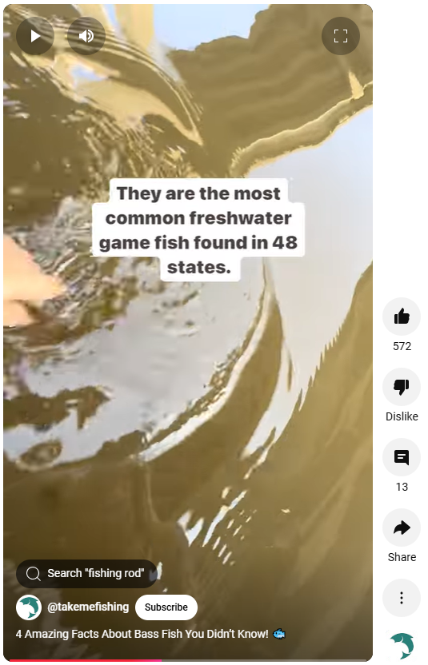
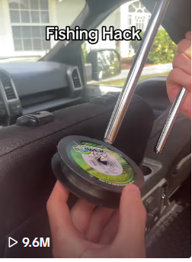
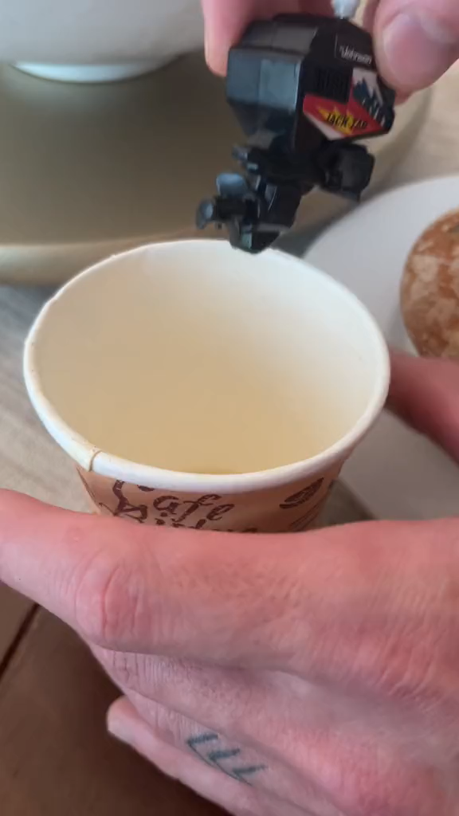
Content Creation
Beginner, Newcomer
Mix of education + entertainment
Notes:
Content tends to skew beginner, and newcomer in nature. We steer clear of too-avid given our charge and mission.
Content is a good healthy mix of educational and entertainment to keep the activities top of mind among consumers. A few examples.
We are present on most priority social media channels (FB, IG, X, Pinterest, YT, Ytshorts) and have seen huge growth in YT Shorts.

Slide 6
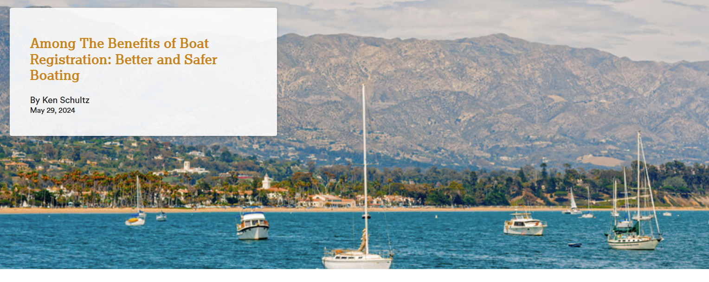
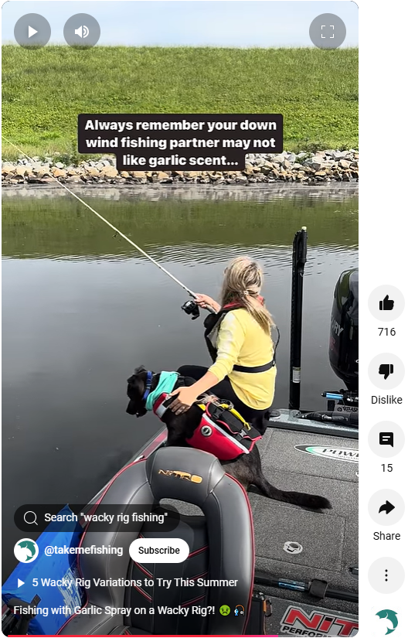
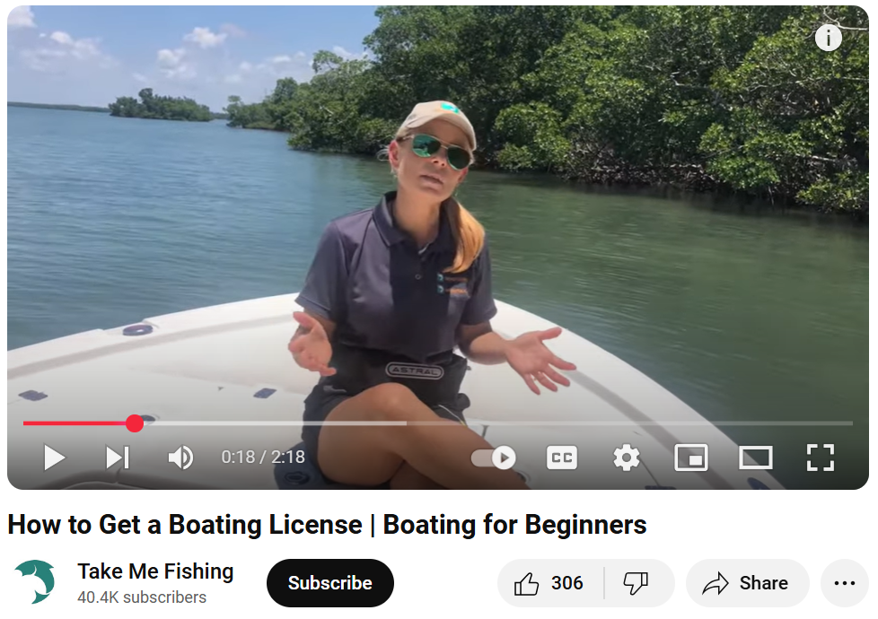
Safety & Education
Public Access
Law Enforcement
Navigational Maintenance
Environmental Cleanup
Water Rescue Services
Add another content piece
Notes:
What Are the Benefits of Boat Registration?
Most states specify in their statutes how collected boat registration fees are to be allocated. This may differ among states. Some of the collected funds may be redistributed to counties for boating-related purposes. Here’s a review of the usual allocations, and how boaters benefit.
• Safety and Education Programs. The highlight of state boating programs is boater education and outreach. This takes many forms, including boating safety courses, development of educational materials regarding navigation, safety equipment, pollution, interaction with the environment (such as seagrass scarring), and interactions with marine mammals (manatees, whales, etc.). Such education results in safer boaters and better boating experiences.
• Public Access. No other country has as much public access to its waterways as does the United States. Acquiring and developing sites for public access to waterways is key to this and is one of the best possible benefits of boat registration.
• Infrastructure Maintenance. Periodic maintenance of public access sites, especially boat ramps (launches), is necessary and funds from registration fees may be available to do this without having to rely on legislative appropriations.
• Law Enforcement. Marine law enforcement agencies are necessary to ensure safe boating, compliance with regulations, and monitoring or preventing illegal activities, including pollution.
• Navigational Maintenance. Channel markers and other waterway markers are sometimes maintained by state or local agencies. Florida, for example, allocates funds back to counties for this purpose.
• Environmental Cleanup/Monitoring. The removal of derelict boats or hazards to navigation, and the monitoring of invasive species transportation via boats, are among the activities of state boating agencies funded by boat registration fees.
• Water Rescue Services. Some state boating agencies provide training for water rescue operations. The Pennsylvania Boat and Fish Commission, for example, has the largest water rescue training program in the U.S, and has trained over 75,000 fire and rescue personnel in water and ice rescue activities. Search and rescue may also be part of this.
These are some of the benefits of boat registration you may not have known about, and which you might think of the next time you renew your boat registration.

Slide 7
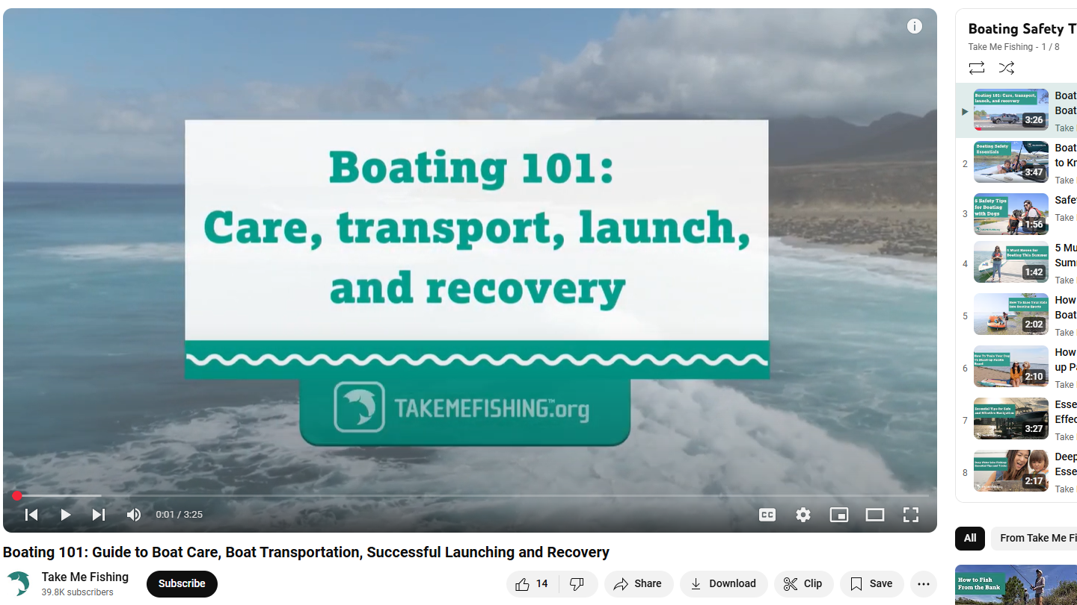

Slide 8
Participation & Consumer Trends

Slide 9
Fishing Participation (2010-2023)
57.7M
#1 activity done from a boat
Source: 2024 Special Report on Fishing
Notes:
#1 activity done from a boat (focus on fishing cause boating comes along with it)

Slide 10
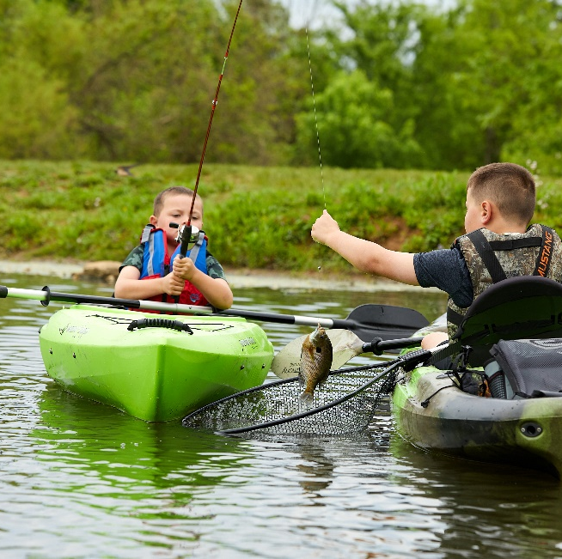
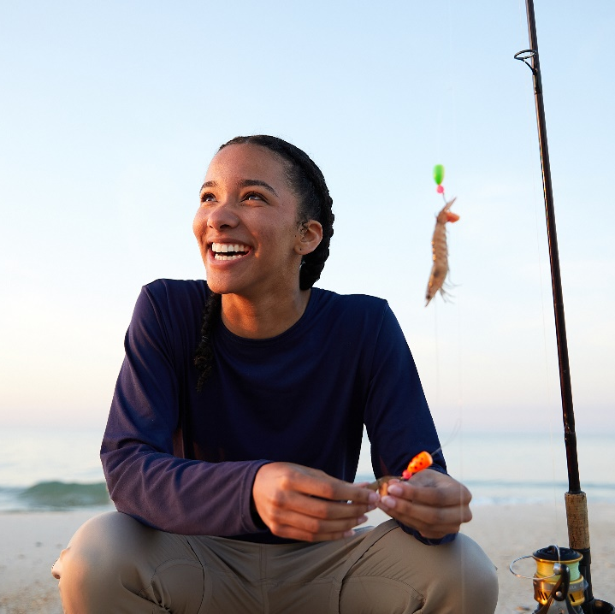
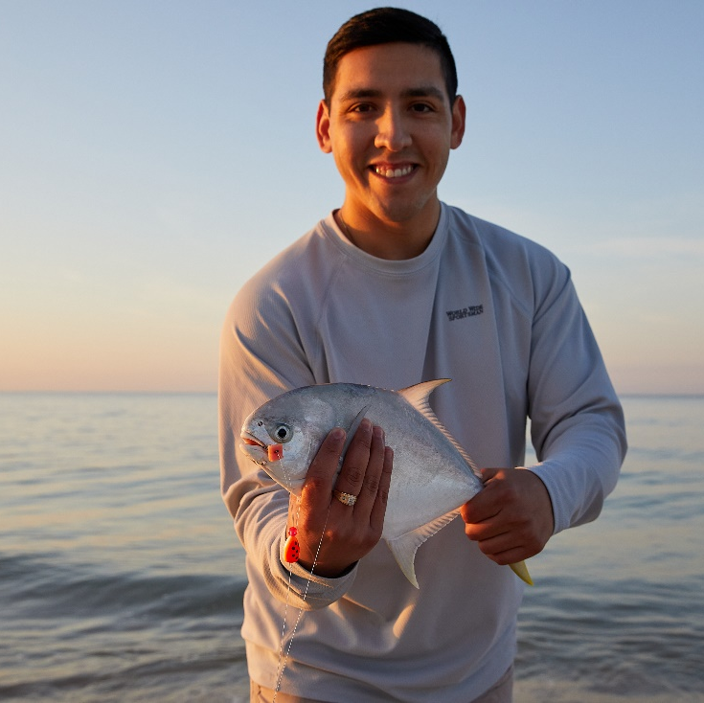
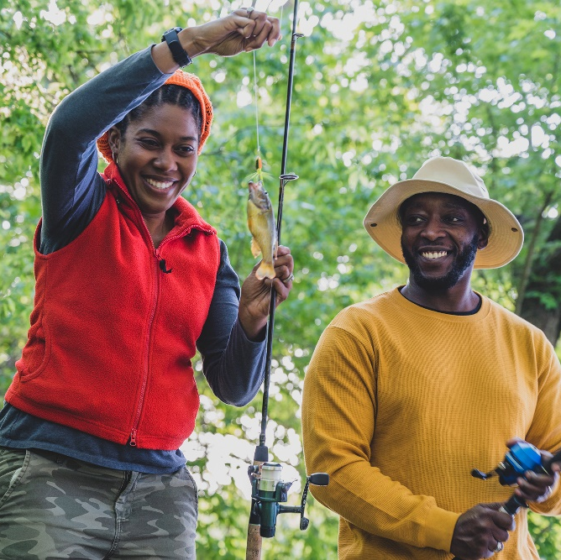
Key Audiences Continue to Grow
Youth
Female
Hispanic
Black
Source: 2024 Special Report on Fishing
Notes:
We’ve also seen tremendous gains in our key segments for growth in fishing…
Women: activity planners, spending decisions driven by women, gateway to growth.
Now when we talk about new audiences – let’s take a look back at our journey over the last few years…
We’ve seen over time that engaging women presents a significant growth opportunity
Female participation in fishing is steadily growing, (16M 2016 up to over 20M in 2023) - but retention remains a challenge, with only 19% of women ‘seeing themselves’ in the sport/activity.

Slide 11
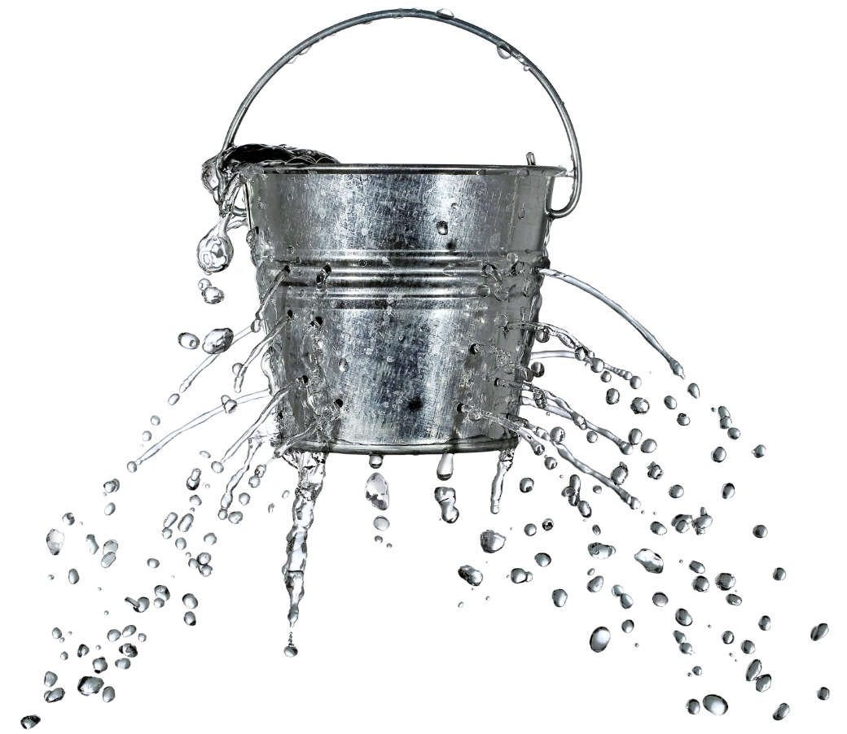
Retention Issue
Losing Participants (Yet Still Net Increase)
2015
2023
Source: 2024 Special Report on Fishing
Notes:
We hover anywhere from 3 to 4M first-time anglers each year. That is a steady gain assuming ZERO drop out; sadly, we are seeing large attrition and have anywhere from 10-14M drop out each year.

Slide 12
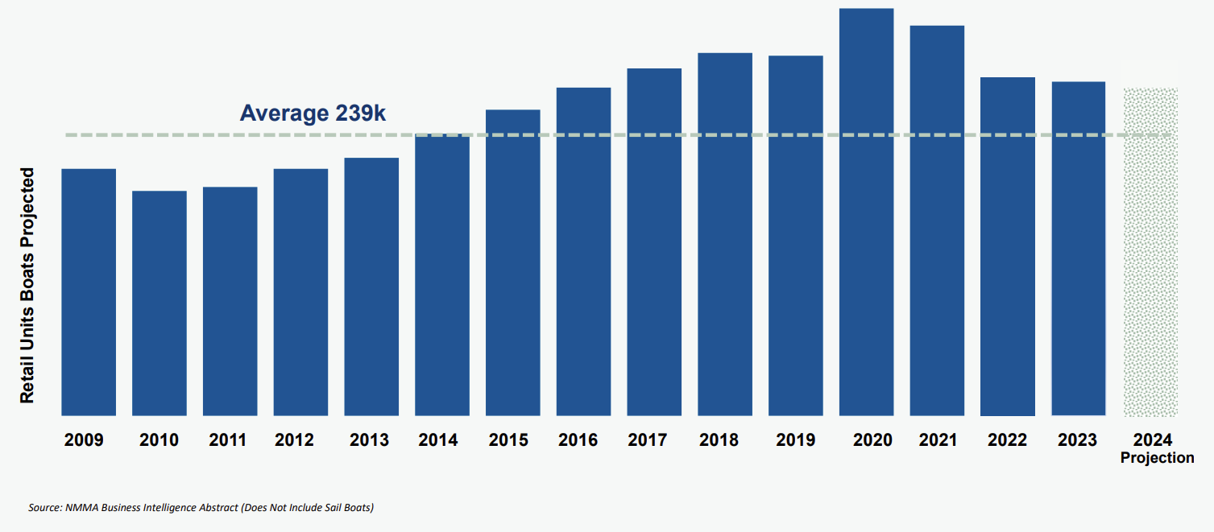
New Powerboat Unit
Sales Slowdown
Notes:
Boating participation is facing similar headwinds
There has been a steady decline in powerboat sales since the COVID peak in 2020
From a 13-year high of 320,000 new units sold in 2020, fewer new boats are being sold, with an estimated 260,000 units in 2022 and 180,000 units in 2023.
An estimated 85 million Americans went boating in 2023, down from about 100 million in 2020
Psychology of Churn Research Executive Summary - Copy.pptx

Slide 13
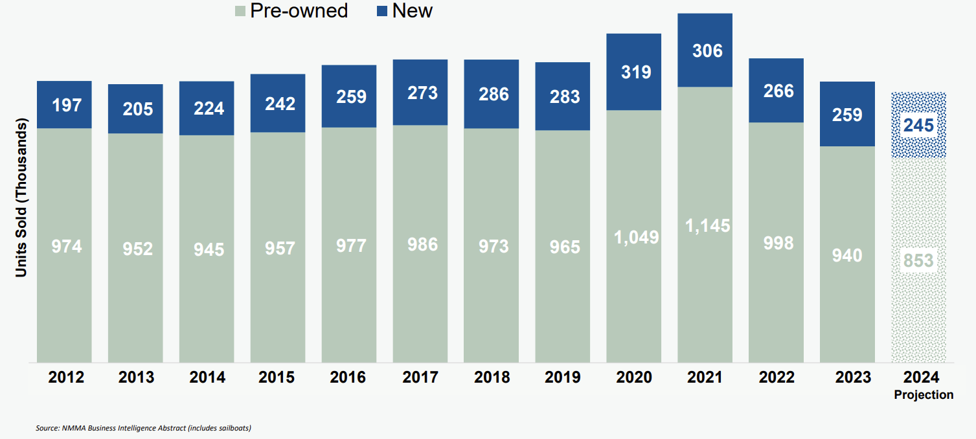
Boating
Marketplace
Notes:
Both new and used boat sales are trending downward.

Slide 14
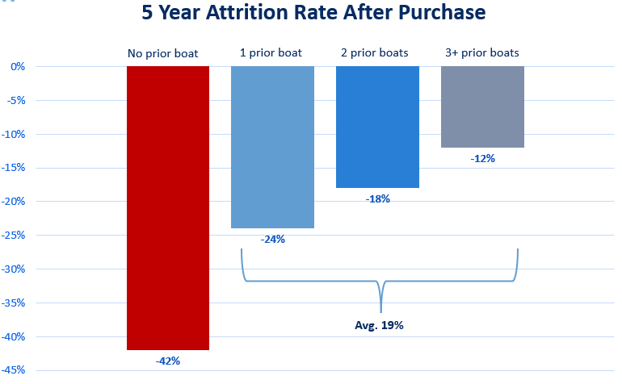
Boating Attrition
5 Years After Purchase
Notes:
Less Attrition with Repeat Boat Buyers: Research shows that almost half of first-time boat buyers dropped out of boating after 5 years, so retaining existing participants is key.

Slide 15
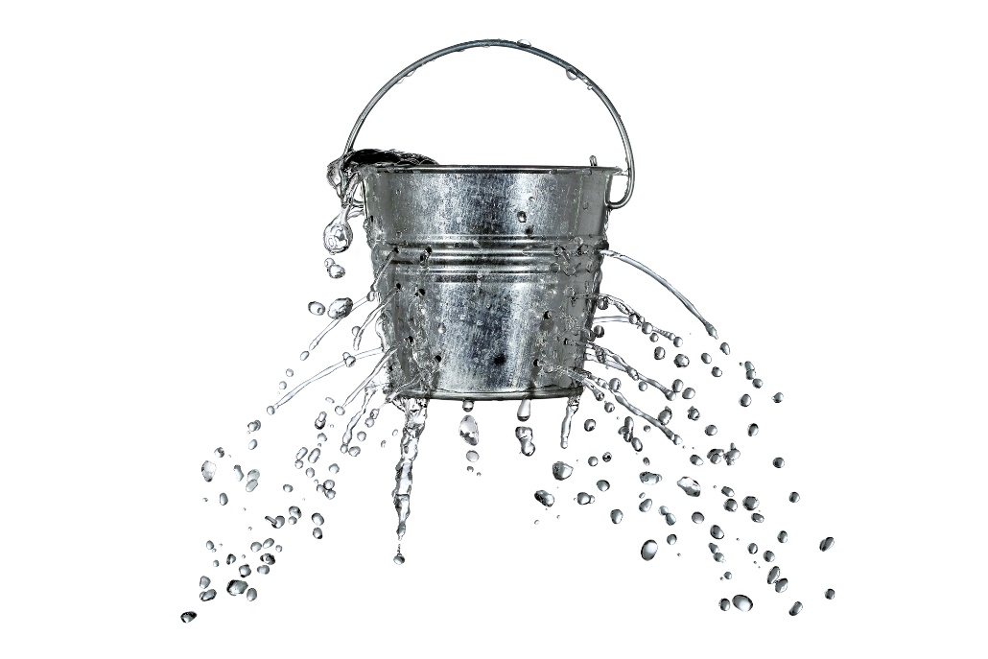
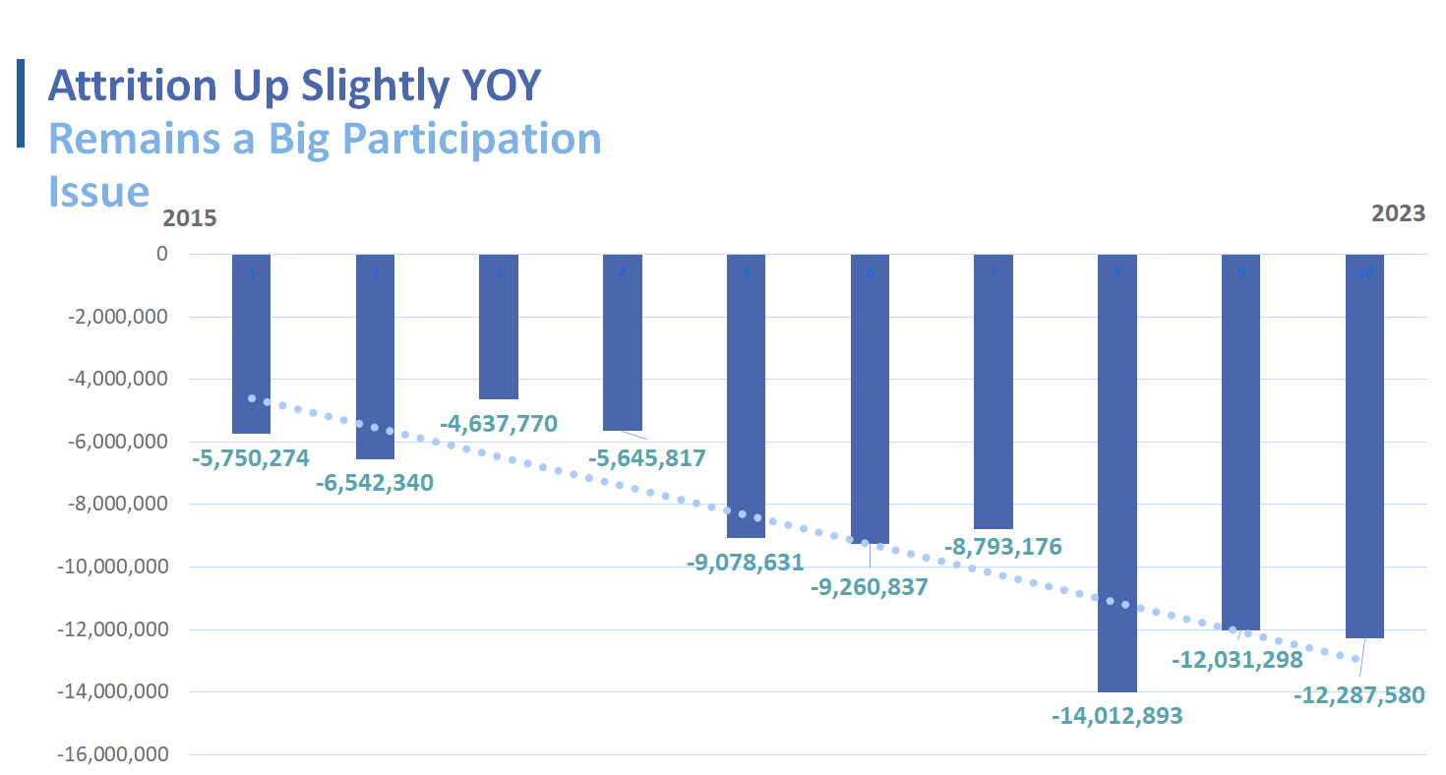

Why Prioritize
Churn
Fishing
THE LEAKY BUCKET
MONEY TALKS
Average Spend Per Angler= $1,500
~$1,000 per female participant
~$1,700 per male participant
Retaining just ½ of 2023’s lost anglers =
$9.2 billion in revenue!
Notes:
The “leaky bucket” analysis measures the annual churn of fishing participants—those joining or rejoining the activity compared to those quitting. Following modest declines in 2021 and modest gains in 2022, there was a sizable net increase of 3.1 million fishing participants in 2023. 15.4 million new or returning anglers fished, while 12.3 million left the sport.
-RBFF & The Outdoor Foundation, 2024 Special Report on Fishing
-Women’s Spending for Sportfishing, Southwick Associates, 2023

Slide 16
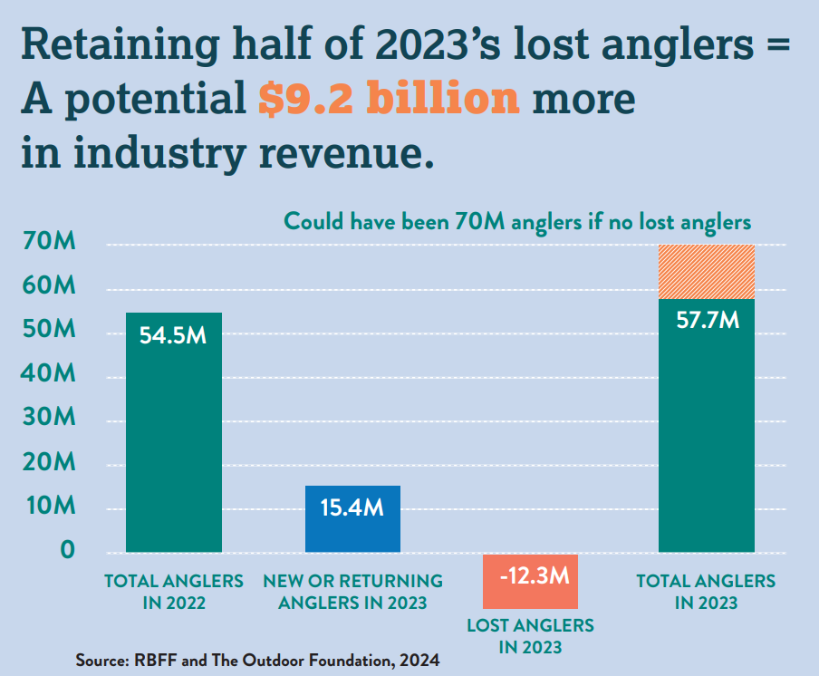
70M anglers in 2023 w/o churn!
The Impact
of Churn
70M anglers without churn!
Notes:
If we could retain just half of 2023’s lost anglers – the industry stands to benefit from $9.2 BILLION more in revenue.

Slide 17
It’s Sensible Business:
Loyal Customers Lead To Growth
THEY SPEND MORE
LIKELY TO MAKE THE SALE
INCREASES PROFITS
ACQUISITION COSTS UP
Research found that existing customers are 50% more likely to try new products and spend 31% more, on average, compared to new customers.
According to Marketing Metrics, the probability of selling to an existing customer is up to 14 times higher than the probability of selling to a new customer.
Bain & Company and Harvard Business School report that "increasing customer retention rates by 5% increases profits by 25% to 95%.”
New customer acquisition costs have increased by almost 50% in the past five years.
Acquiring a new customer is anywhere from five to 25 times more expensive than retaining an existing one. (Harvard Business Review)
Source: Forbes, 2022

Slide 18

The Introvert economy has given rise to a loneliness epidemic
Nearly 60% of Americans find it harder to form relationships and more than half (56%) feel more isolated since the onset of the pandemic.
Our digital bubbles have become our worse enemies and take center stage in our pursuit of ‘aloneness.’ Because of our relationship with our tech, many people feel ‘socially stunted.’
Source: Forbes 2022, The Guardian 2023
Notes:
Why community? Here’s why:
The introvert economy is a term that describes the shift in consumer behavior that has occurred since the pandemic:
Less social outings: Consumers are spending more time at home and less time going out.
Earlier outings: Consumers are going out earlier in the day, if at all. For example, in New York City, reservations at restaurants are more popular at 5:30 PM than 8 PM.
Less risk-taking: Consumers are becoming more risk-averse in social settings, choosing screens over face-to-face engagements.
Less drinking: People are drinking less, especially Gen Z.
Online shopping: Americans are shopping online more than they did before the pandemic.
https://www.forbes.com/health/mind/social-anxiety-since-covid-survey/
https://www.theguardian.com/society/2023/jun/19/socially-stunted-how-covid-pandemic-aggravated-young-peoples-loneliness

Slide 19
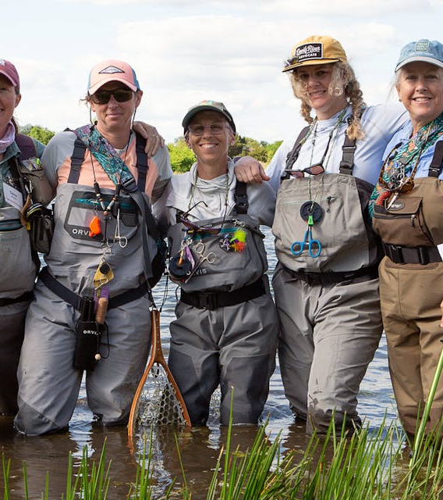
we need community
We need community as much as we need solitude. Supportive connections meaningfully contribute to our overall wellbeing.
“The people in this group have been fanning my flames rather than trying to put them out.”
Source: VOX 2022
Notes:
This epidemic has been so acute, that recognition of our need for connection and the contribution of community to our overall wellbeing has now gone mainstream.
https://www.vox.com/22992901/how-to-find-your-community-as-an-adult – great vox article citing a lot of studies

Slide 20
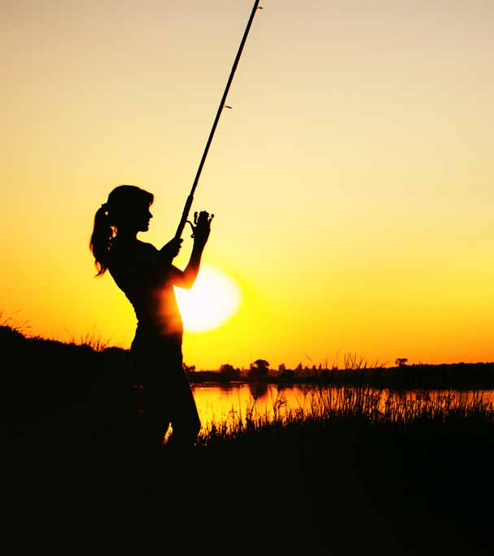
our own research shows the power of female community for retention and reactivation
5%
of active female anglers fish as much as they want to
14%
don’t have anyone to go fishing with
40%
want a women’s fishing club to help them fish more often
Ipsos & RBFF 2022

Slide 21



Slide 22


Research into Action
Retaining Boaters & Anglers
01
Create a sense of community (“shared experiences”)
02
Piggyback onto other, more familiar routines or locations
03
Tie to other higher-order goals (health, wellbeing, social benefits, etc.)
Source: Psychology of Churn (2024)
Notes:
To close, we have the high-level strategies from Psychology of Churn… 1-6 key takeaways….
Sharing economy, leading to community

Slide 23

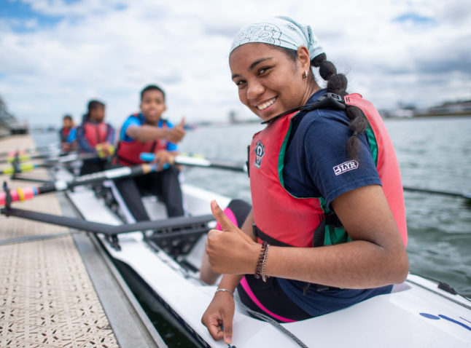

Research into Action
Retaining Boaters & Anglers
04
Appeal to innate desire for nostalgia, both retro and forward-looking
05
Offer up fresh, new starts and experiences
06
Use broader, more inclusive imagery
Source: Psychology of Churn (2024)
Notes:
To close, we have the high-level strategies from Psychology of Churn… 1-6 key takeaways….

Slide 24
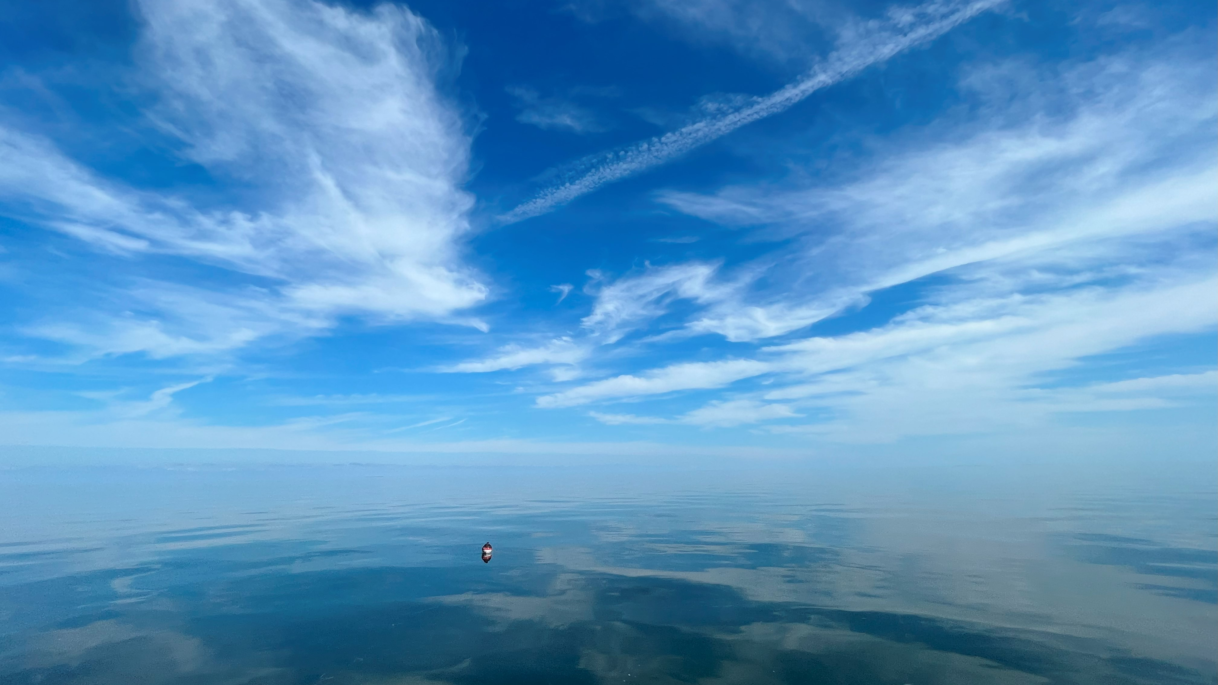





Questions?
Rachel Piacenza, Sr. Director Marketing & Communications
rpiacenza@rbff.org; 608-206-6707
LinkedIn:
Recreational Boating & Fishing Foundation
Produced under cooperative agreement #F23AC00806 from
the Sport Fish Restoration and Boating Trust Fund administered
by the U.S. Fish and Wildlife Service.
Notes:
Thank you. Questions?

