Slide 1
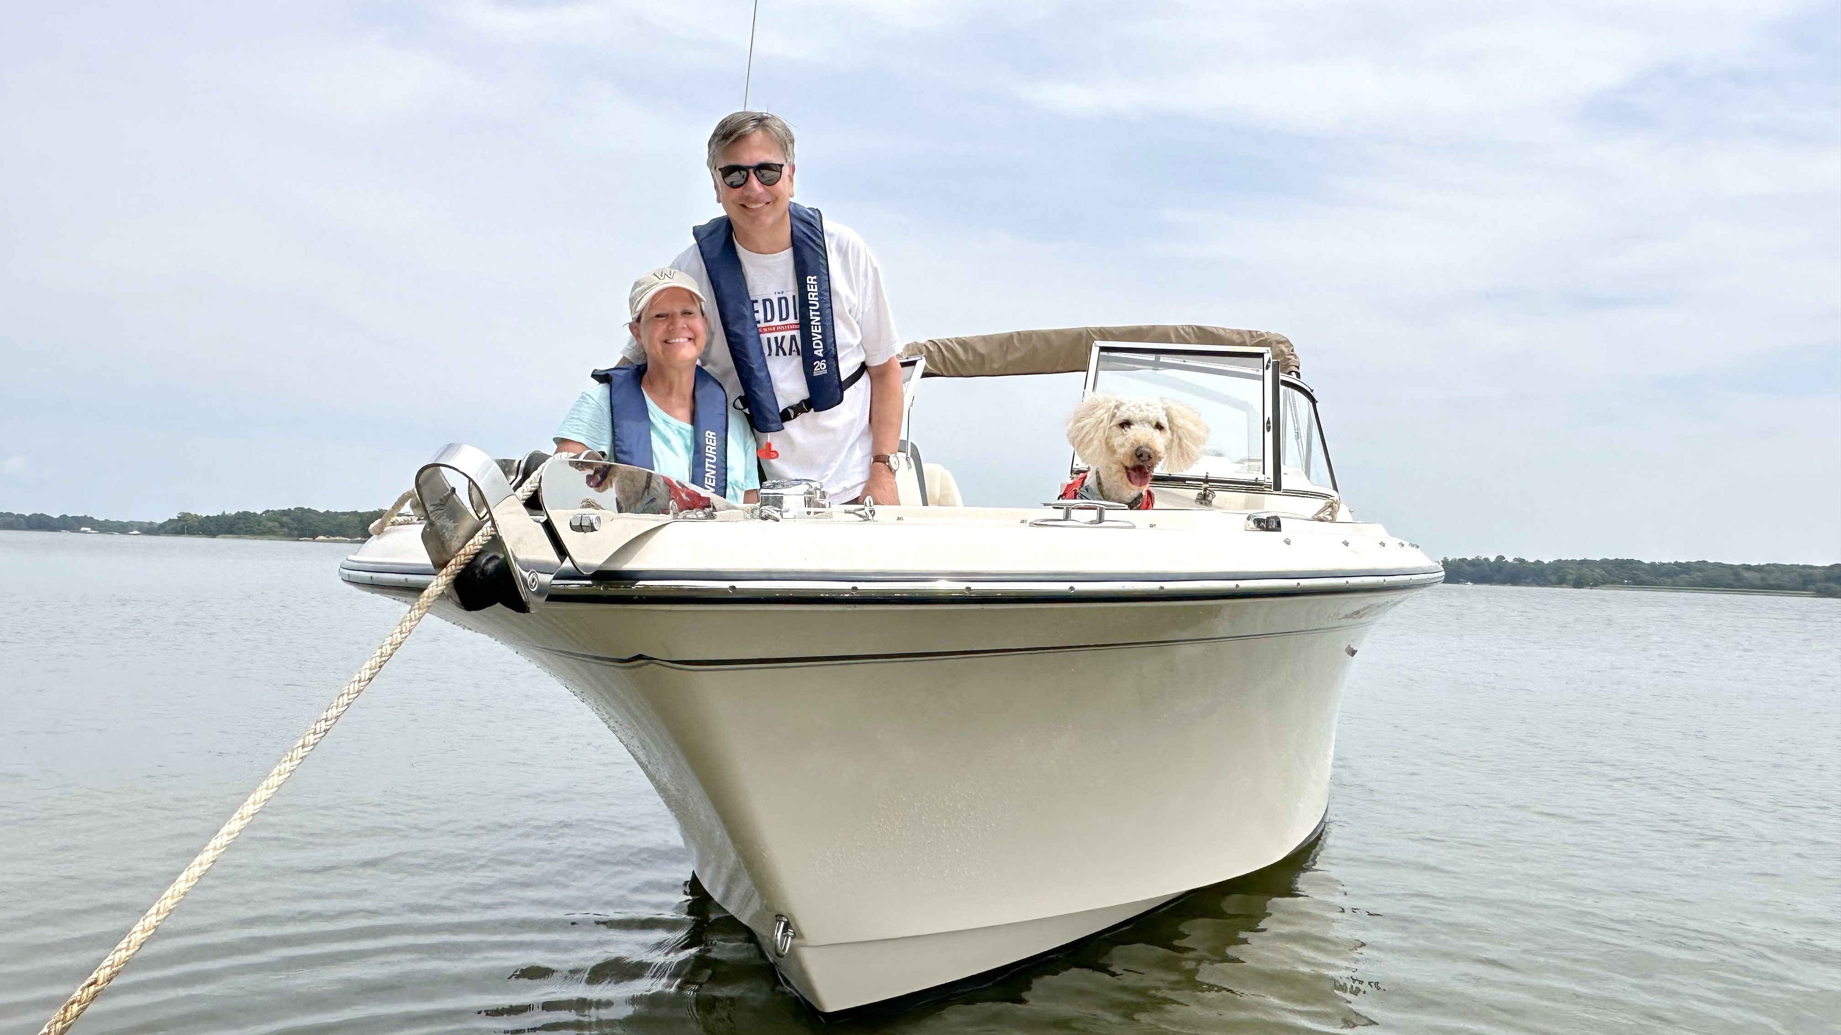

Slide 2
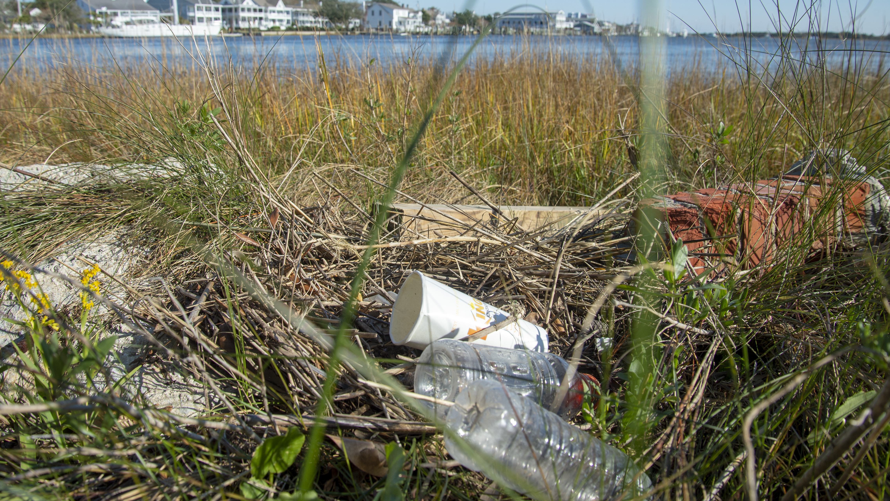
The BoatU.S. Foundation for Boating Safety & Clean Water is an innovative leader “promoting safe, clean and responsible boating”
The Foundation provides educational outreach directly to boaters and supports partner organizations nationwide.
With millions of boaters on the water, our aim is to reduce accidents and fatalities, increase stewardship of our waterways and keep boating a safe and enjoyable pastime.
BoatU.S. Foundation
is a national 501(c)(3) nonprofit organization. Our work is primarily funded by
individual donations.

Slide 3
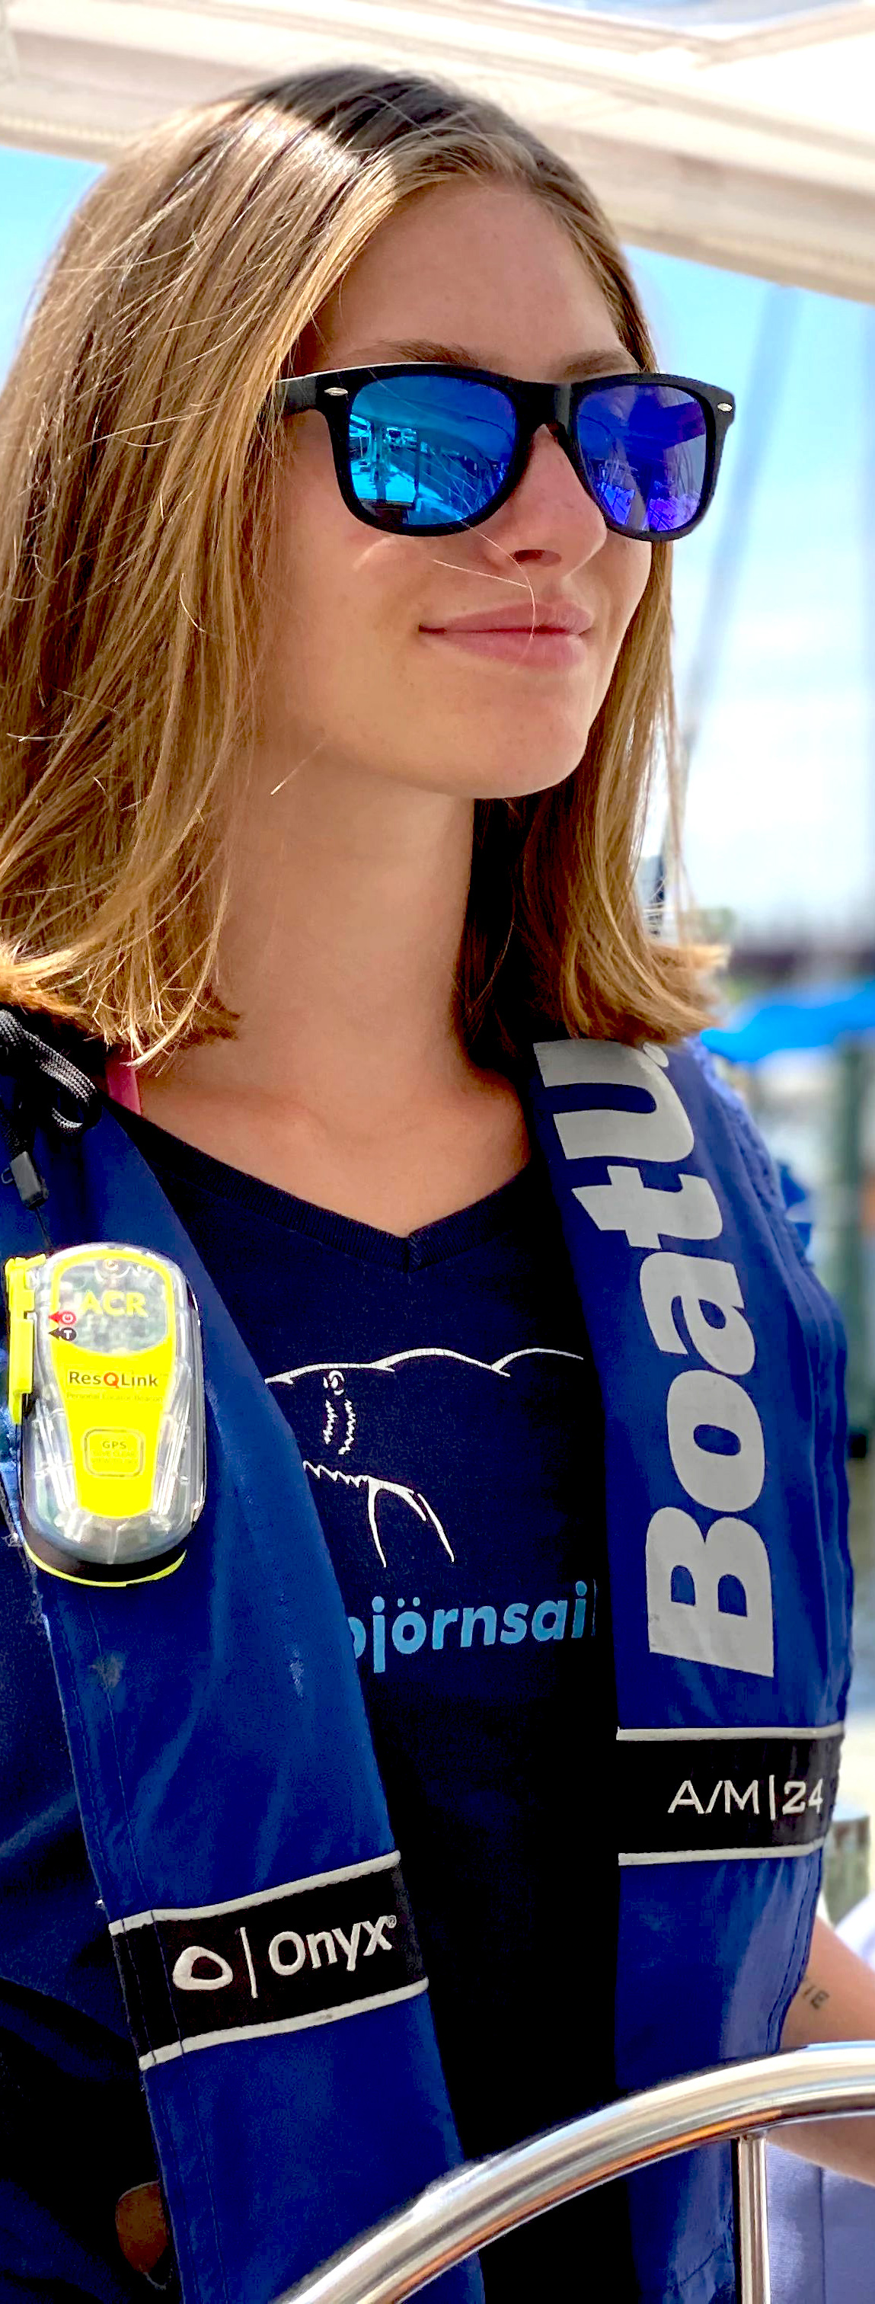
PROGRAMS AND
INITIATIVES
LIFE
JACKET
LOANER
PRODUCT
TESTING
ADVANCED
COURSES
RESOURCE
PORTAL
CLEAN
BOATING
COURSE
STATE
COURSES
EPIRB
RENTALS
INVASIVE
SPECIES

Slide 4
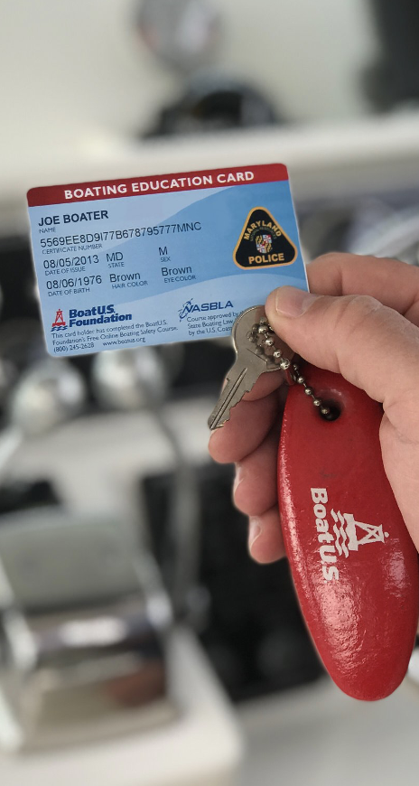
FREE ONLINE
BOATING SAFETY COURSE
The Nation’s
Only FREE
Online boating
Safety course
Meets 37
States
Educational
Requirements
Like a Driver’s
License for
Boating
May be Eligible
For Marine Insurance
Discount
1.7 Million
Students Completed the
Course
BoatUS.org/Free
1.7 million students have completed the course.
BoatUS.org/Free

Slide 5
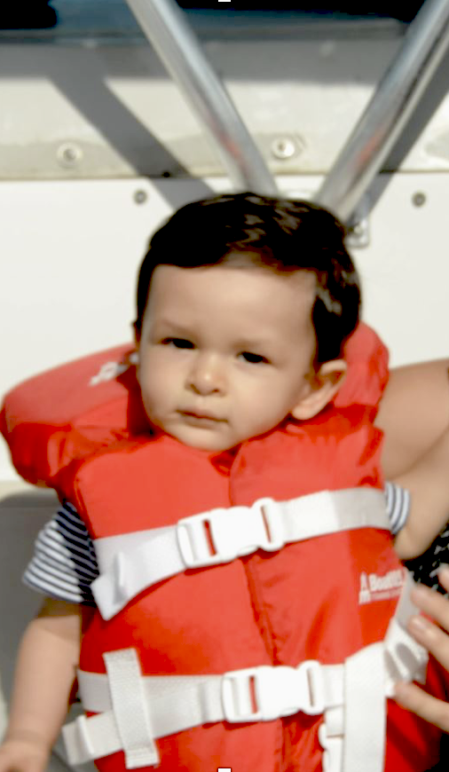
LIFE JACKET LOANER PROGRAM
Borrow life jackets for the day or weekend FREE
Nationwide program in all 50 states and DC
Partnering with TowBoatU.S.
Infant, child, youth and adult sizing available
Find a loaner site at the online locator map
140,000+ life jackets loaned per year

Slide 6
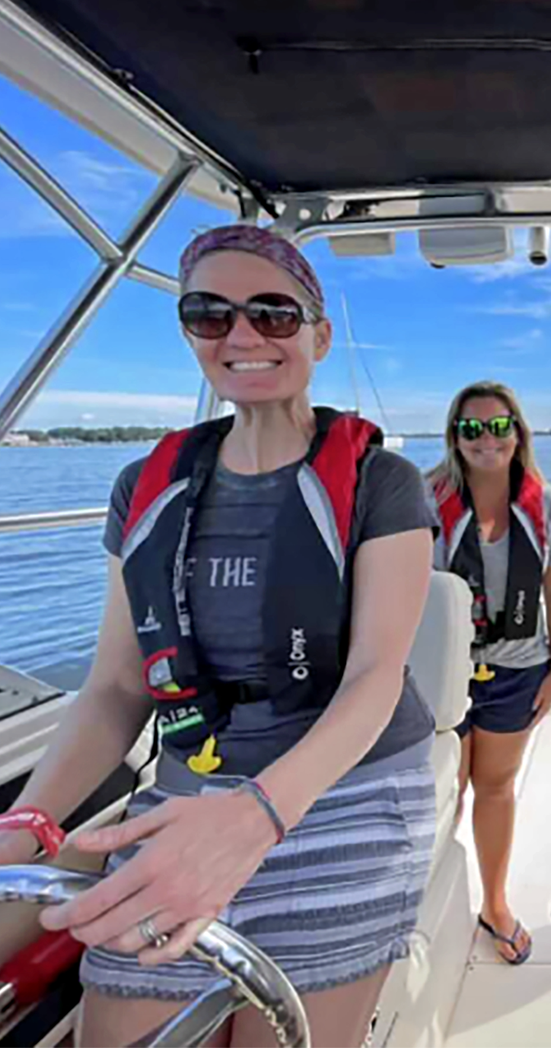
ON-WATER TRAINING LOCATER
We’ll Manage
the Marketing
You Handle
the Training
Reach 1 MILLION+
of our Boating
Audience

Slide 7
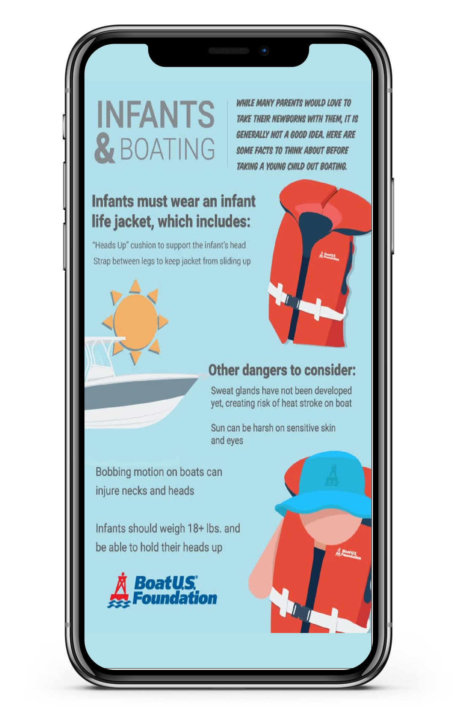
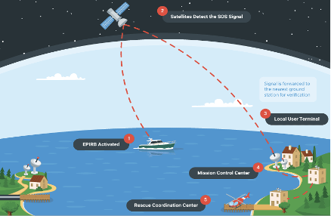
BOATING SAFETY
INFOGRAPHICS
How to Fit a Life Jacket
Rules of the Road
How to Use a Flare
How to Use a Flare

Slide 8
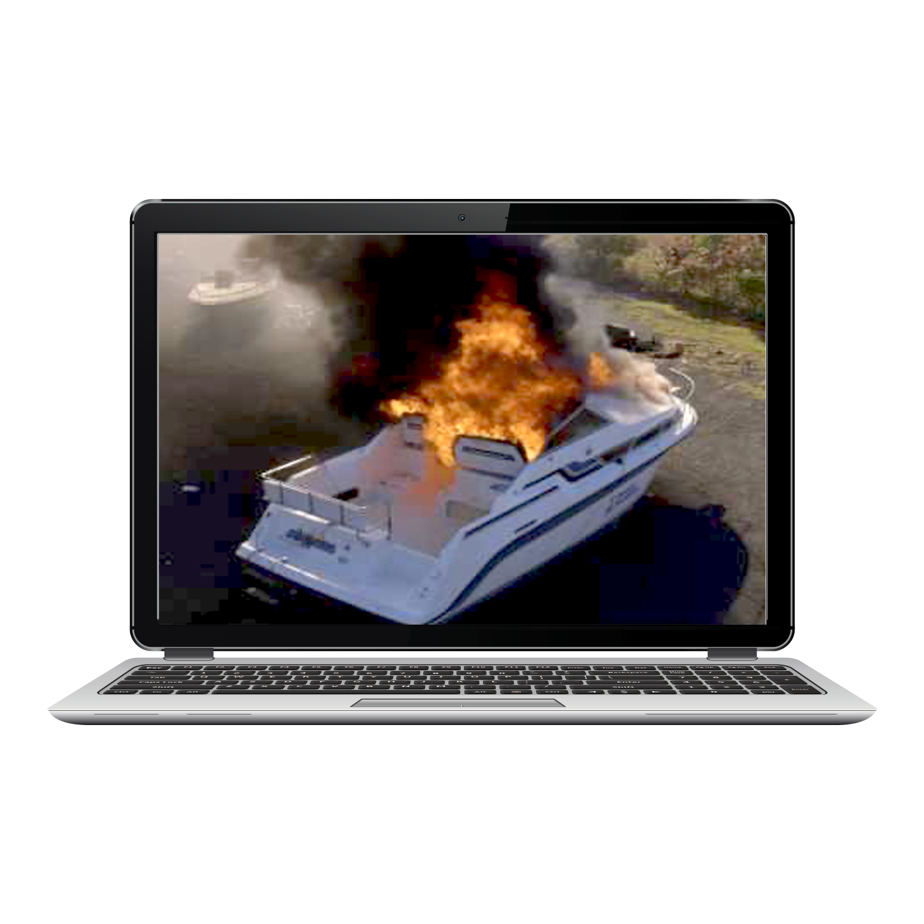
BOATING SAFETY
VIDEOS
HOW
NOT-TO VIDEOS
HOW-TO
VIDEOS
NATIONAL SAFE BOATING WEEK
REPOST ON YOUR SOCIAL CHANNELS
FOUNDATION
FINDINGS

Slide 9
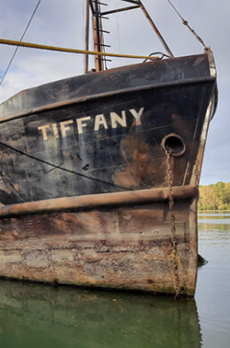
NOAA GRANT
COMPETITIVE SUB-AWARD GRANT PROGRAM
NATIONAL ADV DATABASE
MARINE RELATED DISPOSAL CONFERENCE

Slide 10
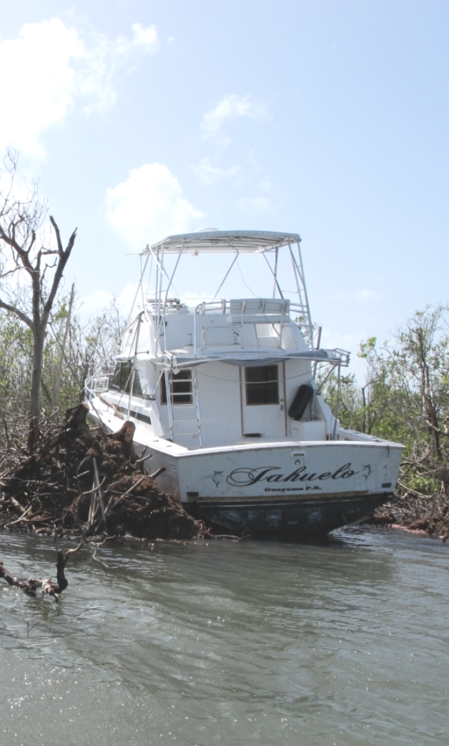
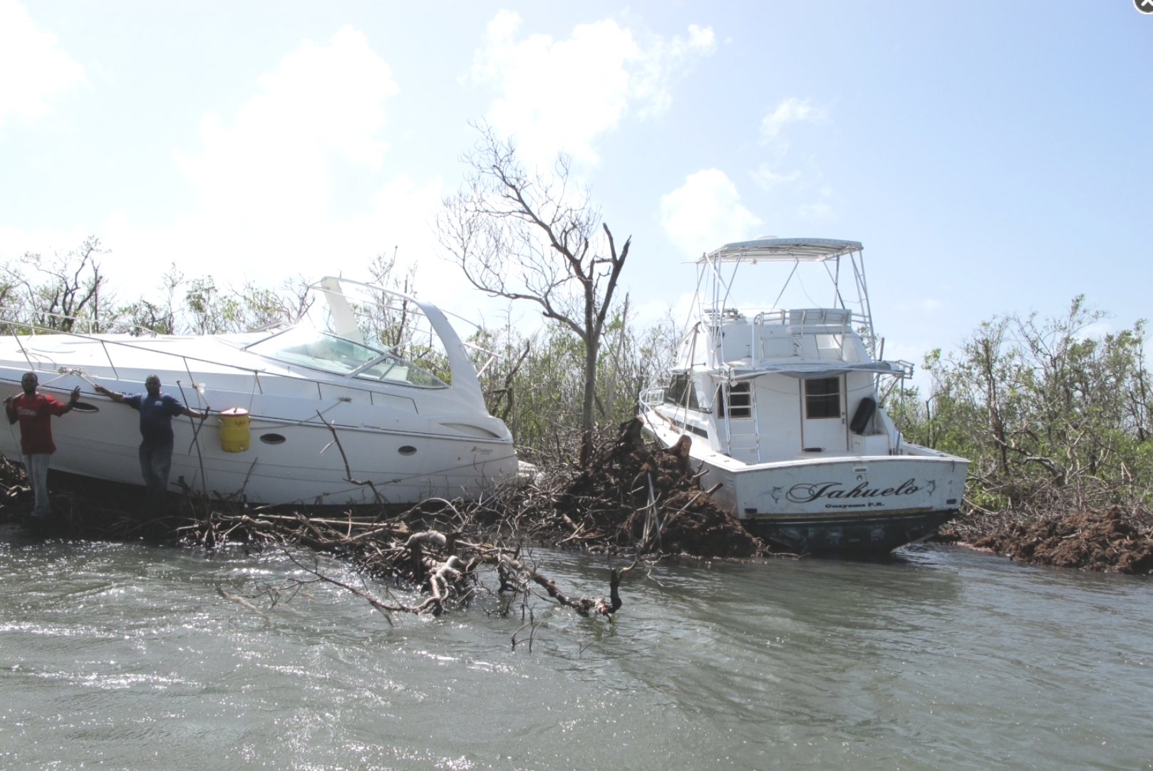
COMPETITIVE ADV
GRANT PROGRAM
Removal Projects with Education
and Outreach Components
Selections will be made in a few weeks!

Slide 11
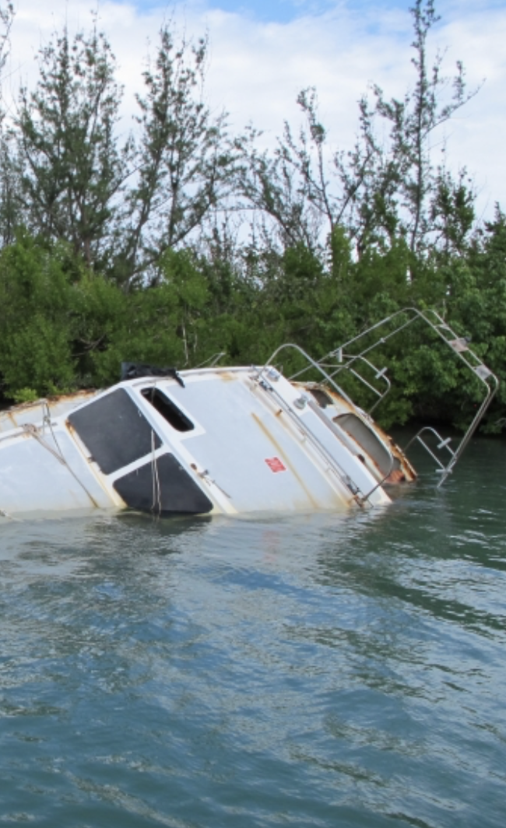
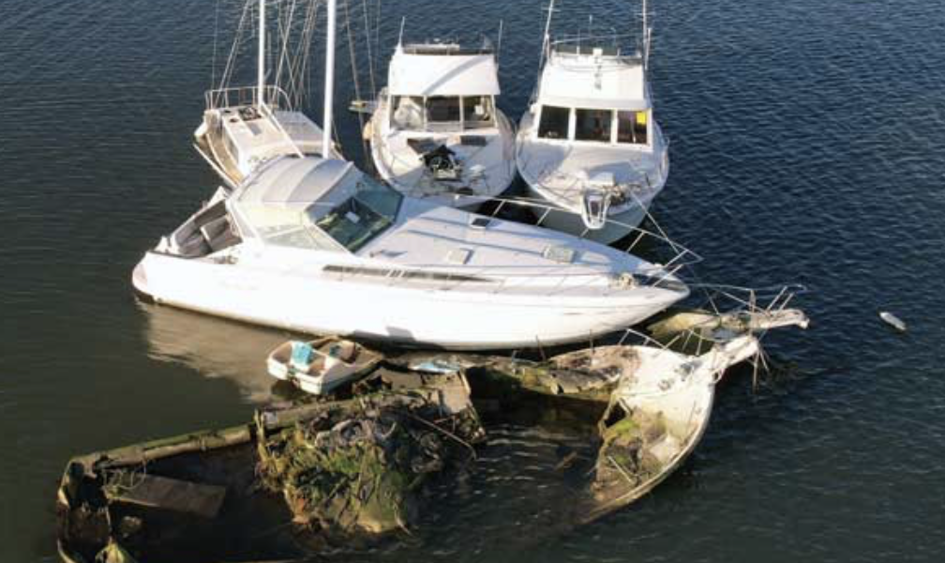
NATIONAL ADV
DATABASE
Document the Problem and Work Being Done
Public and
Private
Submissions
Anticipated to Be Live
June 2025

Slide 12
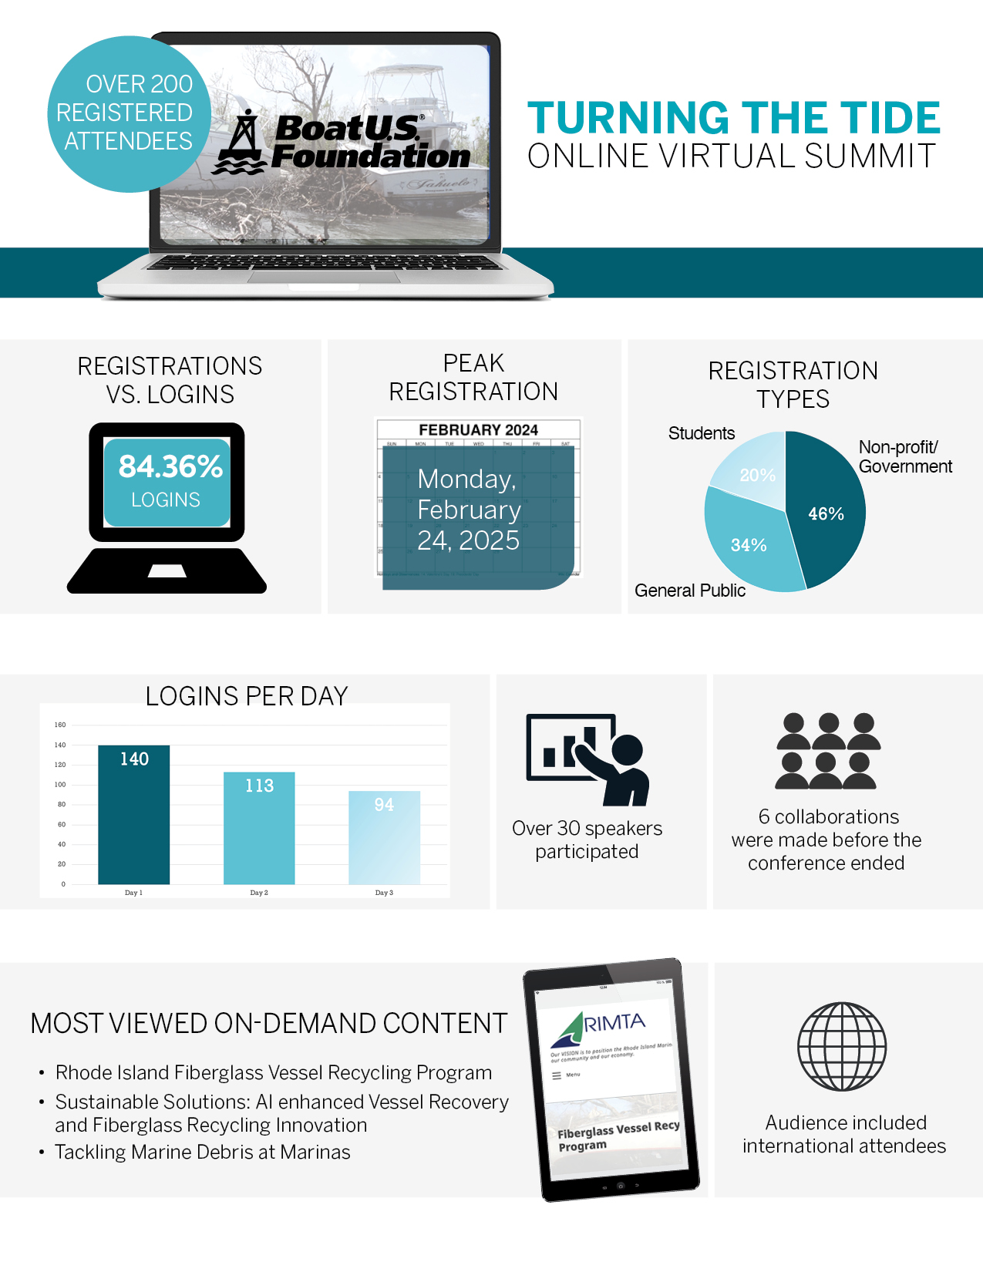
TURNING THE TIDE
SUMMIT
Current Efforts, Possible Future Efforts
Networking for Solutions
December 2026, New Orleans LA
Sponsorships/Exhibitor Booths Available

Slide 13
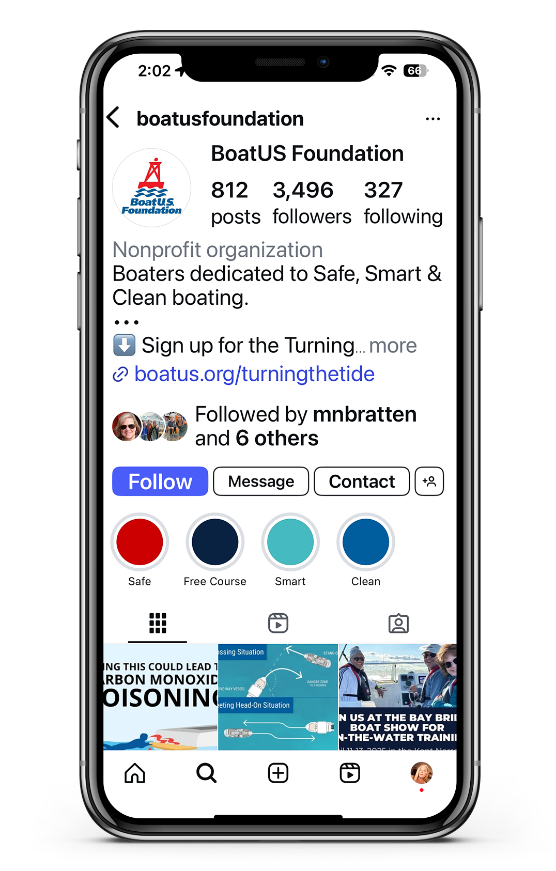
FOLLOW US ON
@boatusfoundation BoatUS.org

