Slide 1
National Recreational Boating Safety Survey (NRBSS): Data in Relation to the Future of Recreational Boating in the United States
Susan Willis, Ph.D., Gina Kilpatrick, M.Ed. and Amy Ryder-Burge M.S.
RTI International
Donald Kerlin, P.E.
U.S. Coast Guard
Edward Mahoney, Ph.D.
Michigan State University
March 26, 2019

Slide 2
Overview
NRBSS Background and Goals
Description of Surveys
Materials
Survey Instruments
Sampling Considerations
Data Collection Process
Study Completion, Data and Reporting

Slide 3
NRBSS Background and Goals
Designed to enhance effectiveness and efficiency of safety efforts conducted by USCG’s National Recreational Boating Safety Program, state and other federal agencies, non-profit organizations and the boating industry
Authorized by Congress
Provides key data related to recreational boating exposure including the total number of days and hours boaters spend out on the water at the state level along with estimates of boating participation in the U.S.
Also provides information about the characteristics of boats, boaters, and recreational boating activities (including outings) in the U.S
Notes:
Conducted since 2002
Previously NRBS (added safety)
Previously administered by phone

Slide 4
Description of Surveys
NRBSS entails two scientific survey efforts (Exposure and Participation) with attempts to contact over 200,000 sample members
Exposure Survey
State-level estimates – number of boats
Fielded monthly
One month reference period
Address-based general population (ABS) sample and registered boat sample
Participation Survey
National and division-level estimates – outings, boating activities
Fielded quarterly
Three month reference period
Address-based general population (ABS) sample
Notes:
The Address-Based Sampling Frame, commonly known as an ABS frame, is a list of all mailing addresses serviced by USPS. RTI maintains a national ABS frame in-house which we update monthly. We also have additional data points that we merge with the in-house frame to do robust modeling for predicting household characteristics etc.

Slide 5
Materials
Registered and unregistered boats and
activities of interest
Voluntary, translation available, help line/email
Confidential
Administered by mail (scannable) and web
Development and testing: Question Appraisal System (QAS), cognitive interviewing, and web program usability
$1 pre-incentive included with second mailing
$5 online gift code after completing mail survey
$10 online gift code after completing web survey
Notes:
Wordcloud
Reference boat type item as example of scope of data
Push to web
Respondents can request physical gift card

Slide 6
Survey Instruments
Exposure Survey – Comprehensive Data for Boats
Information for boats in household captured
Registered, unregistered, USCG-documented boat counts
Type, length, operation status
Days and hours used
Bodies of water, storage
Boat ownership information
Outings (trip data), activities, people on board, boat operator characteristics
Life jacket/vest use, safety equipment, accident information
Household demographics by person
Notes:
Reminder of reference period
Six boats captured
Accident information also includes “mishaps”

Slide 7
Survey Instruments
Participation Survey – Comprehensive Data for Household Member Recreational Boating Participation
Data captured for all household members
Participation status (out on water) for respondent
Household member demographics
Outing (trip data) and activities information
If no participation, reasons why
Days out on water for each household member
Type, ownership, and operation of boats on outings
Number, length, type, registration/documentation status, and ownership arrangement for boats owned by household
Life jacket/vest frequency
Boating safety course participation
Notes:
Five household members addressed
Reminder of reference period
All information (including outing boat information) for all household members – choose all that apply
Information captured for six boats owned

Slide 8
Sampling
Address-based sample use increased likelihood of identifying non-registered boat owners and boats
Registry information from states useful for Exposure Survey, not available for all states
RTI prepared prediction models using registry data to aid in predicting boat ownership in households among general population sample (ABS), increased efficiency
Eligibility and response rates higher in registry sample
Flexibility to evaluate and adjust sample counts to meet response targets during data collection
Potential biases addressed: e.g., season, telescoping effects

Slide 9
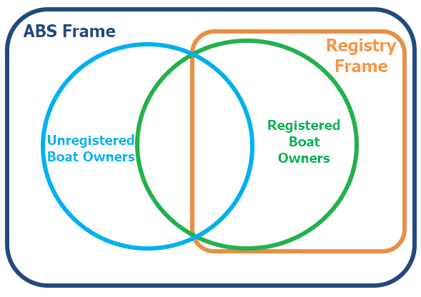
Sampling

Slide 10
Data Collection Process
Sample preparation
Seven mailings
Items included in mailing packets
Tracking of mail and web responses
Data processing
Ongoing dashboard reporting and feedback loop for design
improvements to address biases/improve estimate reliability
Experiments – instrument design, mailings, and incentives
Notes:
Experiments:
Are 7 mailings necessary and cost effective?
Change: Reduced mailings to 5 and increased the sample
Will higher post-incentives increase participation?
Experiment 1: Increased post-incentive to $10 Mail & $20 Web
Will an improved look of the mail survey increase mail response and improve data quality?
Experiment 2: Printed full color survey booklet and simplified introductory pages containing screening questions
Will Registry sample respondents be more likely to complete online than paper if we delay mailing the full questionnaire similar to the ABS sample?
Experiment 3: Delay full questionnaire packet mailing to mailing 4 for the Registry sample

Slide 11
Study Completion, Data and Reporting
Data collected January 2018-December 2018. Data collection completion April 2019
Ongoing intensive data processing and cleaning
Examples of data cleaning
Participation Survey > 5K completions and met 100 percent of division and national targets
Exposure Survey > 30K completions and met 100 percent of state targets and 100 percent of national targets
Notes:
Data cleaning examples: no boats but reported boat information, boat type not matching registration status type
Describe examples of data queries (by state, by boat type etc.)

Slide 12
Study Completion, Data and Reporting
Reports and Data Analysis Query System October and November 2019
DAQS will allow users to run queries by variables such as state, boat type, and usage (days/hours)
DAQS will provide a simple user interface with dropdown boxes to select criteria for analyses
Notes:
Describe dashboard and graphic

Slide 13
Thank You. Questions?
Contact:
Susan Willis
swillis@rti.org

