Slide 1
Why can’t we all get along?
A Facilitated, light-hearted conversation as we all learn to share the waterways responsibly and respectfully.

Slide 2
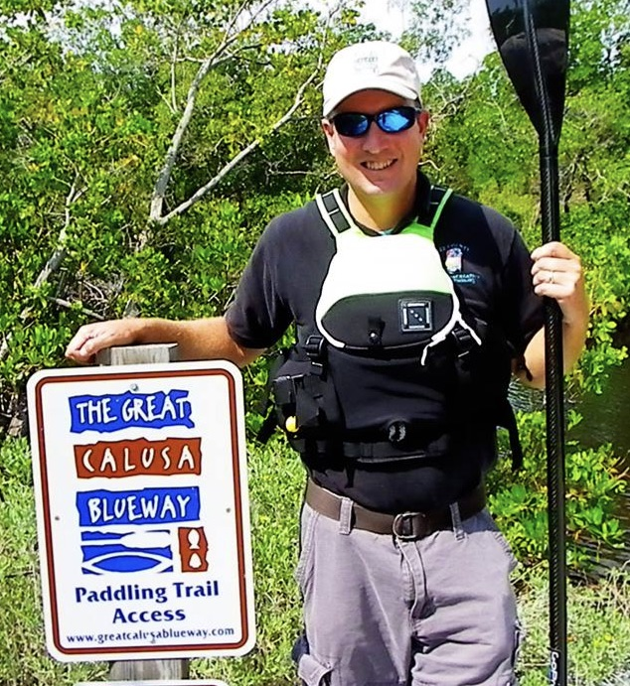
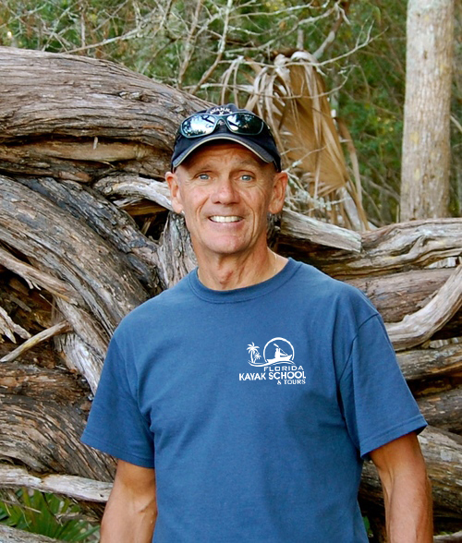
"Tommy Thompson: Active kayak instructor, guide, and
owner of the Florida Kayak School and Tours,
American Canoe Association’s Florida Executive Council."
Mike Hammond: Great Calusa Blueway Paddling Trail
coordinator and American Canoe Association
and Special Olympics certified instructor.
Notes:
Michael and Tommy will give a short introduction of themselves.

Slide 3
Is there a conflict on the water between various user groups?
Notes:
As the title of this breakout session suggests, we are here to identify who are using the waterways and how we can avoid conflicts between the various user groups.

Slide 4
Notes:
Michael and Tommy will give out some sort of swag/candy/party favors for those who contribute to the conversations in response to these initial photos. Have any of you heard of this term for kayakers?. Where does that come from?

Slide 5
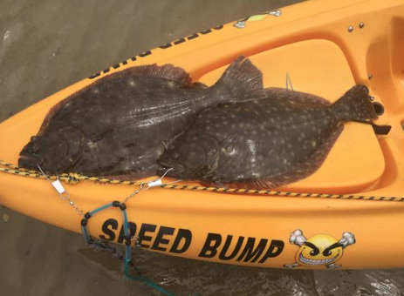
Notes:
This kayak supplier is obviously primarily a motor boater.

Slide 6
What are some of the issues that contribute to this conflict?

Slide 7
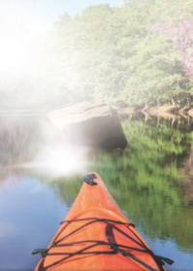
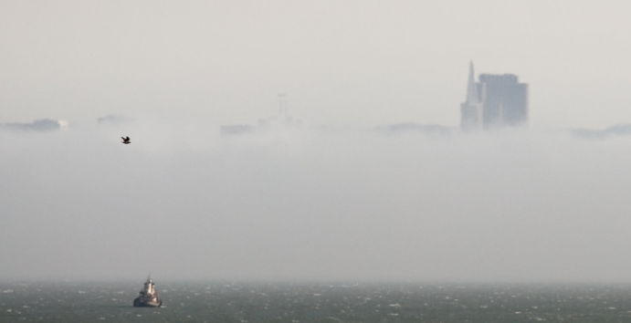
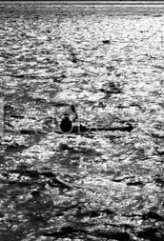
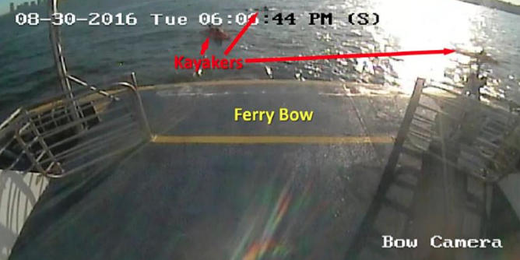
Limited Visibility
Notes:
There are issues that contribute to the animosity between user groups. Facilitators will discuss various factors contributing to potential conflict.

Slide 8
Who has the right of way, anyway?

Slide 9
It is just too crowded out there!

Slide 11
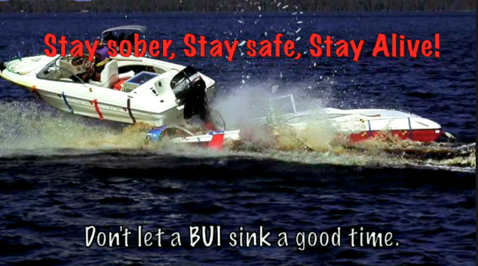
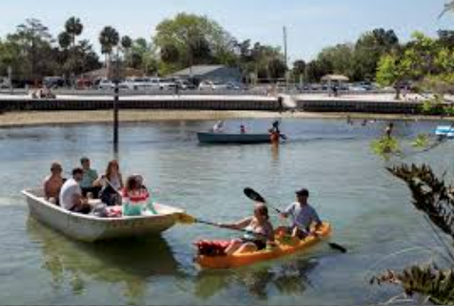
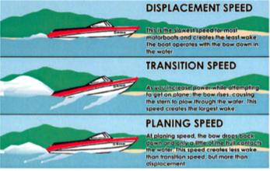
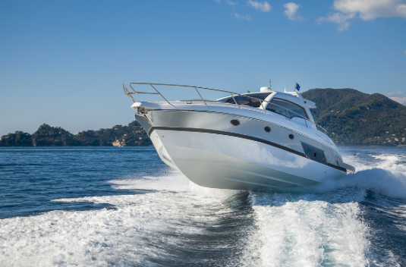
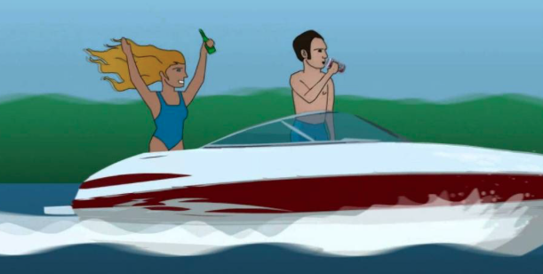
Dangerous behaviors – are everywhere
Notes:
Point out the dangerous behaviors to inspire conversation.

Slide 12
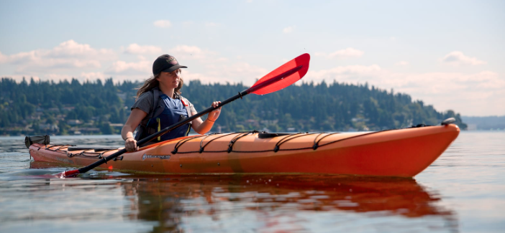
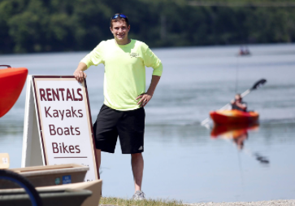
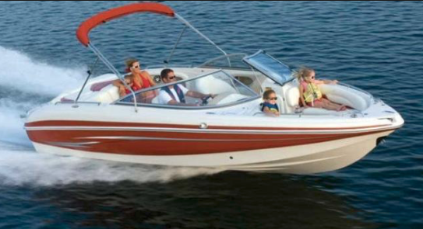
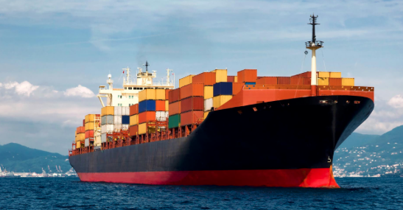
Who has a right to be on the water, anyway?
Notes:
There are conflicting intentions for the day on the water.

Slide 13
Who are the paddle sport users?
Experienced Paddle Sport Enthusiasts
Periodic Paddle Sport users
Big-Box-Store users and new to the activity
Vacation users/borrowed a canoe or kayak for the day, never been on the water and perhaps never will again.
Notes:
Michael and Tommy will explain who are the people who make up the “Paddle Community”

Slide 14
Who are the motor/sail craft Users?
Experienced Motor or sailboat/recreation Enthusiasts
Professional/commercial users of the waterways
Vacation users, unfamiliar with the local waterways, local etiquette
New boat owners who know nothing about the “rules of the road”, local etiquette
Notes:
A mirror to the paddling community, who are the motor/sail users of the waterways?

Slide 15
shared waterways require rules, knowledge of rules, adherence to the rules
What are you seeing as areas of conflict between the paddle sport community and the motor/sail boating communities?
What are the ways we can address the areas of conflict?
Notes:
Facilitated conversation:

Slide 16
Areas of Conflict?
“What are the areas of conflicts between motor boaters and paddle sport users?”
“What are you seeing from the launch site and/or wheelhouse?”
“What issues are being seen from a local government perspective – for example, the Calusa Blueway?”
“What issues are law enforcement officers having with paddle sport users?”
Notes:
Facilitated conversation:

Slide 17
Who’s responsibility is it to minimize conflict and dangerous behaviors on the shared waterways?
Notes:
Facilitated conversation:

Slide 18
What can you do to reduce conflict between these user groups?
Notes:
Facilitated conversation:

Slide 19
Thank you!
Thank you for your in-put, suggestions, patience, and continued engagement to make recreational boating rewarding and safe for everyone.

