Slide 1
New Life Jacket Labels Hitting the Market What You Need to Know
2019 International Boating and Water Safety Summit
Jacksonville, Florida
March 26, 2019

Slide 2
PFD Type and Label Change Update
Why the update?
What this means to you.
Notes:
I am referring to this as the type and label change, but I could refer to this as one single change. If you are wondering why this update, it is because we are already seeing new labels in stores and on the water. The changes have been discussed for years, now the new labels are here.
.
What this means to you and me is that we can take this information and inform the boaters and the law enforcement officers.

Slide 3
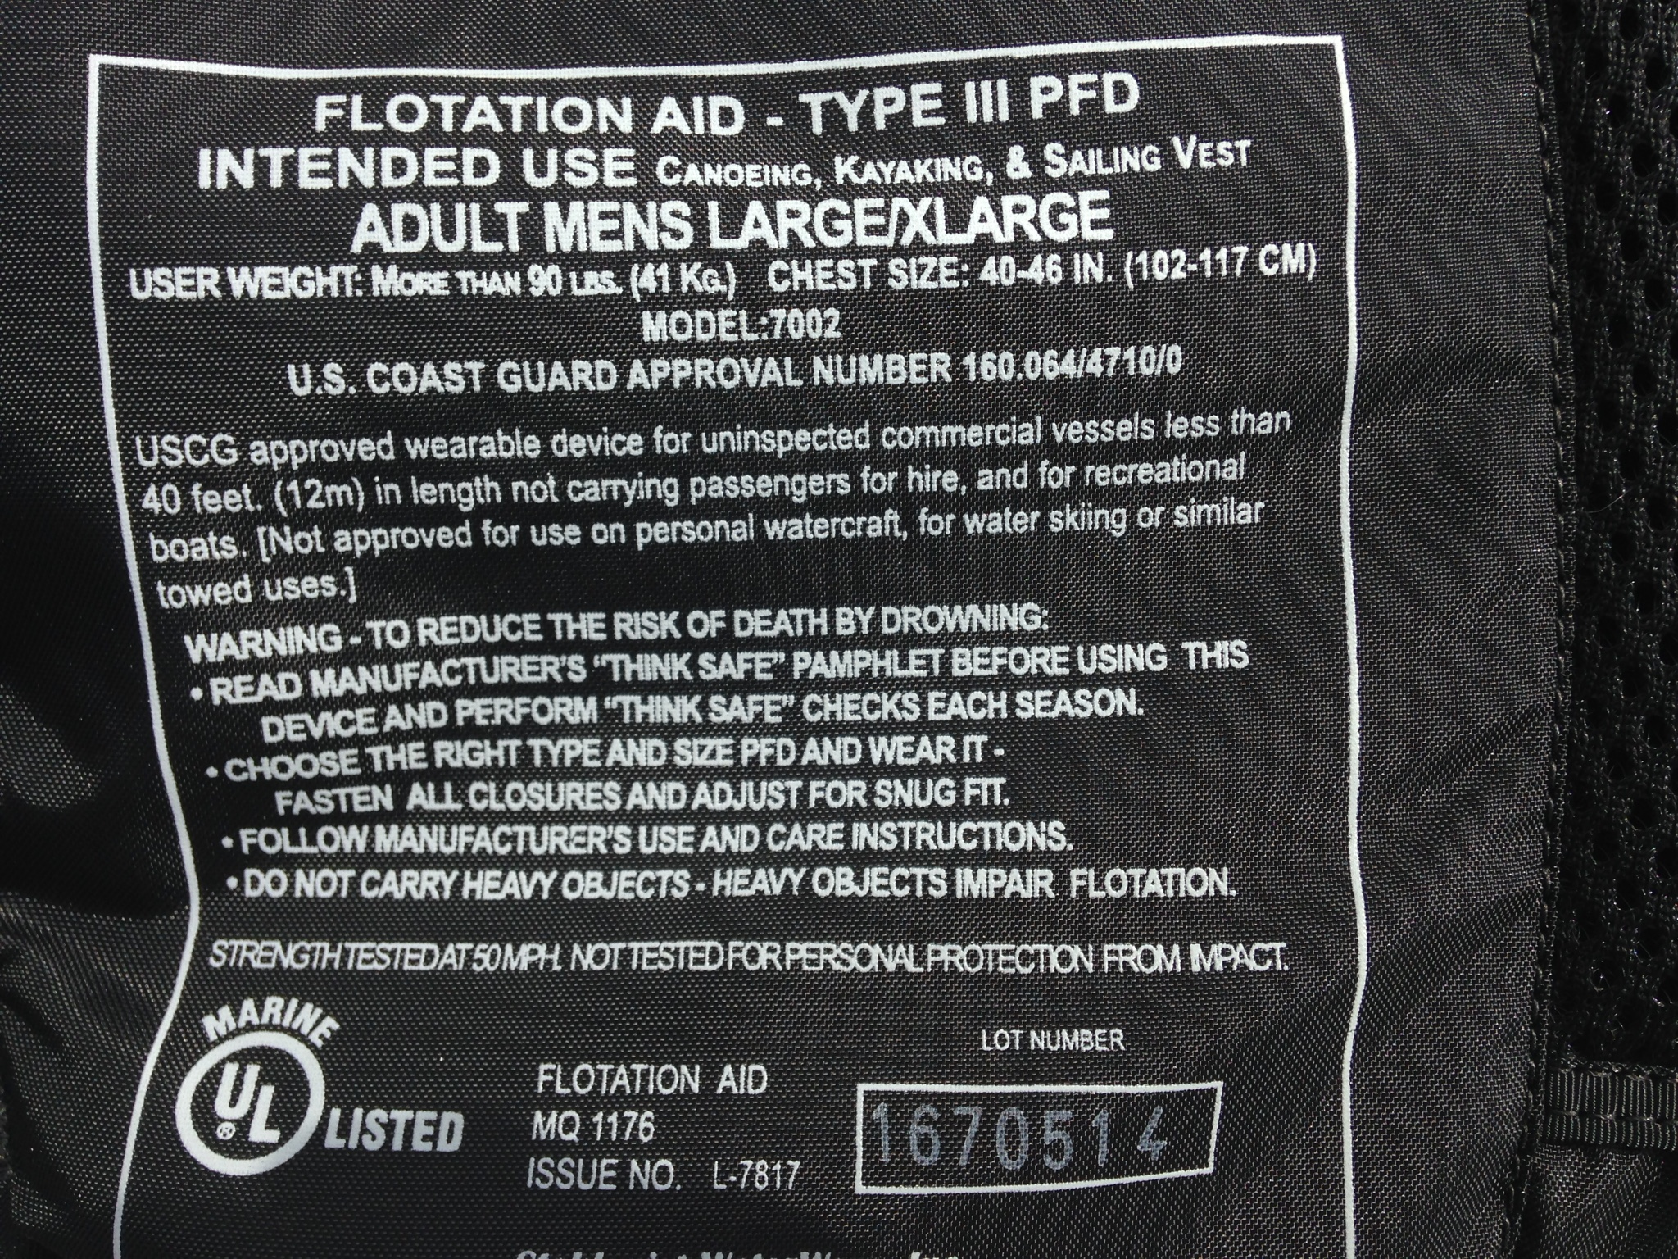
“Legacy” Label
Notes:
This is the “legacy” label we are most familiar with. This image only shows a portion of the label…and you see a lot of words!

Slide 4
Life Jacket (PFD) Type Codes
The Coast Guard issued a Rule on October 22, 2014 removing references to Type codes In regulations on the carriage and labeling of Coast Guard-approved personal flotation devices (PFDs).
Notes:
In the fall of 2014, the US Coast Guard removed the “Type” codes from the Code of Federal regulations. States (and territories) followed suite and removed “Types” from their laws.

Slide 5
PFD Type Code Change
The rule change removed references to longstanding PFD type codes from regulations for the carriage and marking of Coast Guard-approved PFDs.
Notes:
This means instead of “Type 1” or “Type 3” PFDs for example, the Federal Regulations refer to PFDs as either “Wearable” or Throwable”.

Slide 6
Life Jacket Label Change
Life jacket label change is part of a larger change in life jacket standards.
PFD label is part of a harmonization of regulations with PFD requirements in North America.
Notes:
This label change is part of a change to the standards that will eventually include more life jackets than the “level 70” life jackets. The Type Code change and the label change are part of an effort that will allow a life jacket to be approved both by the US Coast Guard and Canada (and maybe Mexico). This means the same life jacket could be sold, and used, in both countries.

Slide 7
PFD Label Change
We will see icons that transcend written information!
Notes:
As part of this label change, we will see fewer words and more icons on the approval labels. We know it is more difficult than ever to have people read a large amount of wording on a label or in a booklet. The move toward icons and less wording is something we see in many consumer products. The new labels will also have information in other languages.

Slide 8
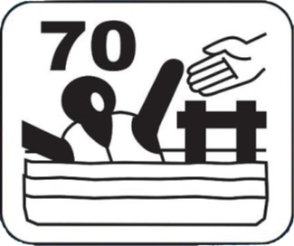
PFD Label Change
Level 70 Device:
Designed for sheltered water were help is close at hand.
Notes:
Currently, all the new labels you will see will be for “Level 70” devices. Although there is not a an exact parallel (in buoyancy) between a level 70 device and the “type” life jackets, this device will be very similar to a Type 2 or 3. Here is an example of the performance icon for a Level 70 device. You can see the icon showing the person near shore (represented by the dock) and close to help (represented by the helping hand.)

Slide 9
Brochure (tag) Attached to new life jacket:
Notes:
This tag will be a quick reference guide for the life jacket, and the life jacket label. As you can see, the information on this tag will cover size and fit, performance (including icon information), water safety, design types (various types of devices), maintenance, warnings (the icons are related to activities the PFD is not designed for), and the approval information for this life jacket.
Underneath the ‘Warnings” heading, you see three sentences:
Approved only when worn
Drowning hazard if not worn
Must be fastened and properly adjusted to float the wearer
You will notice there is a link to an website….www.wearitlifejacket.org. This life jacket has expanded information on the topics covered in this page, including a short video for some of the performance icons.

Slide 10
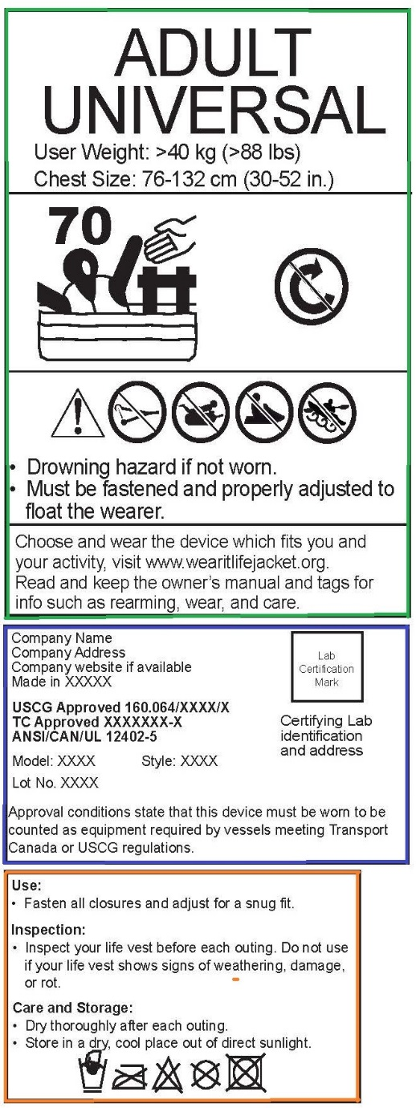
PFD Label Change
Notes:
So, here it is…the new label. You can see there are several panels. The top panel (outlined in green) has size information, performance information – in this case, level 70 performance – and we discussed this in a previous slide. Nearshore performance. There are also icons to the right of the Level 70 icon that describe the turning ability of this life jacket. The box shows the turning performance, and in this case, the semi-circle arrow with a strikethrough indicates it is not intended to turn a person in the water.
The next set of icons Icons are used to inform the user that a device may not be appropriate for certain activities, such as water-skiing, towed sports or personal watercraft. In most states and territories, there will be laws prohibiting the use of certain life jackets for certain activities. These icons show the intended use, and may not reflect state laws.
Lastly, the warnings include information such as whether or not the life jacket must be work in order to meet carriage requirements.
There are two other panels, the Certification and Approval Panel (outlined in purple), which will contain something you always want to look for…the USCG approval number. The last panel (outlined in orange) is the maintenance panel. Most of this information is pretty standard, but keep in mind that an inherently buoyant life jacket is not going to be cared for the same way and inflatable life jacket will be.

Slide 11
Web Site Information
A website has been created to help explain this this change.
This is a companion piece for the brochure (tag) that will be attached to life jackets.
Wearitlifejacket.org
Notes:
A website has been created for this change and this site (a companion piece to the placard/brochure that will be attached to the life jackets) will explain the information on the new label. The site has information, graphics, and videos. Take a few minutes to look at it when you can. The site can be reached at Wearitlifejacket.com or Wearitlifejacket.org. The site was funded by the USCG and maintained by the National Safe Boating Council.

Slide 12
PFD Label Change
You may see some jackets that are approved in Europe and will have a label that looks similar to the new label.
This does NOT make the vest USCG approved.
Notes:
Just a quick cautionary note. The new label may look similar to life jackets that are approved in Europe. While these life jackets may (and likely are) very good life jackets…they are not US Coast Guard-approved and don’t meet carriage requirements. Boaters and Law Enforcement will still need to look for the US Coast Guard approval number.

Slide 13
PFD Label Change
No matter which label is on the life jacket…
READ THE LABEL
Both new and old labels have common items to determine which is appropriate
User weight:/41kg (90 lbs)
Chest size: 76-132 cm (32-52in)
USCG Approval:#
Notes:
So, new or current label…it does not matter. Reading the label is the only way you will be able to find the critical information. And, both labels have common information that will help you determine which is best for the wearer. The “old” or current labels are not going away…and as long as the life jacket is USCG (or in Canada, Transport Canada) approved, in serviceable condition, it will still be acceptable. We will have life jackets with the current label around for the next 20 years or more.

Slide 14
What is Next
Education and Marketing Committee Charge
Tool kit for states and territories
Notes:
For the next steps, there will probably be a charge in the Outreach and Marketing Sub-committee for getting out information to states (and others) regarding the new label. We want to make sure we provide consistent information.
One of the goals will be to provide a tool for states and territories to use. This could include a video describing what boaters and law enforcement will need to know about this change, templates for press releases and social media posts, and any number of other tools.
The third bullet make not make any sense, but there may be a few labels out there now…and you will see many more next year.

Slide 15
Recap
The label still holds the key
You may see both types of labels on the water
Read the label to look for the US Coast Guard approval number
Read the label to find the intended use for the life jacket
Notes:
And, don’t forget, we will soon see both labels on life jackets and all current approved lifejackets and PFDs (personal flotation devices) will continue to be legally approved for carriage as long as they are still in good condition, readily available and of the correct size to be worn for each person on board.
Read the label for USCG approval number and for information on the intended use of the life jacket.

Slide 16
For more information contact the Coast Guard’s Lifesaving and Fire Safety Division.
Email “typeapproval@uscg.mil”

Slide 17
Questions?
Brian.Rehwinkel@MyFWC.com
850-617-9480
Notes:
Questions? Feel free to contact me. Although I do not claim to be an expert on this subject, I am familiar with the basics, and I will be glad to give you an idea of what we are doing on the state level.

