Slide 1
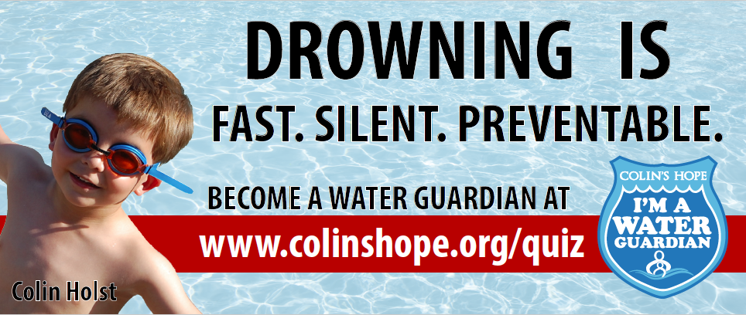
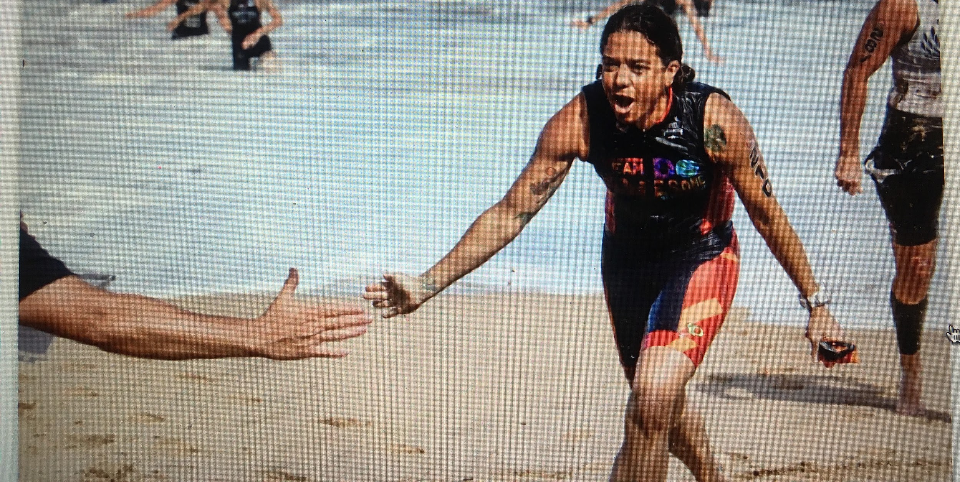
Alissa Magrum
Executive Director, Colin’s Hope
Board Member, TxDPA, Safe Kids Austin
Advisory Board Member, NDPA
CoFounder, Families United to Prevent Drowning
Triathlete, Open Water Swimmer & Athlete Ambassador to Prevent Drowning
BRIDGING THE GAP: FROM CLOSED TO OPEN WATER

Slide 2
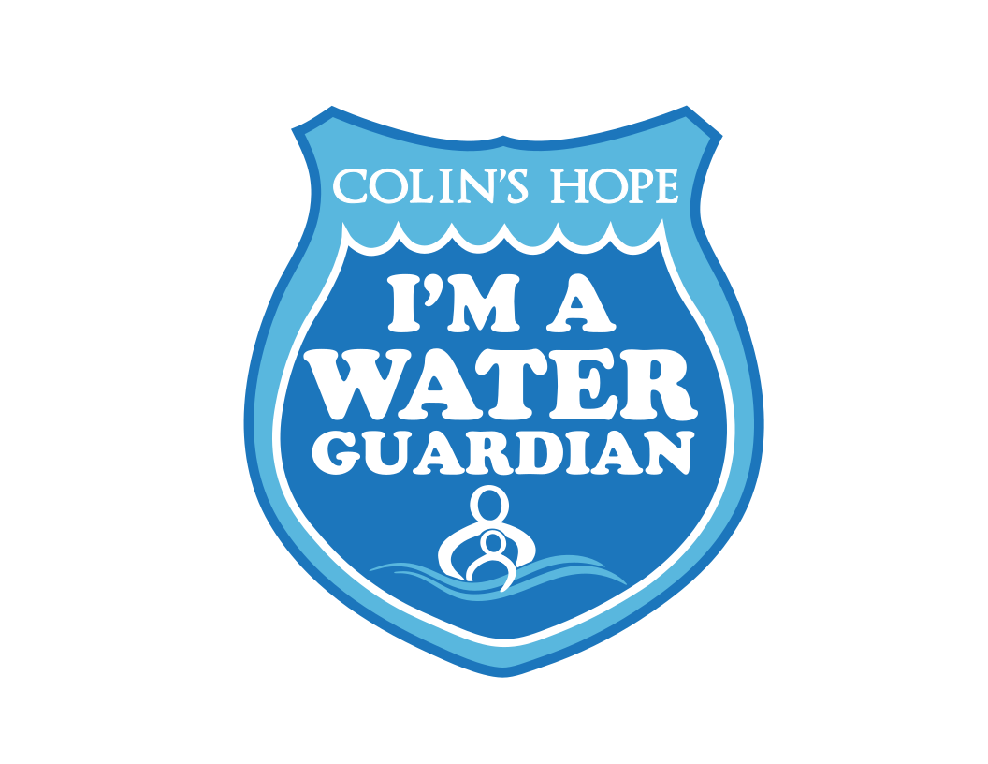
Our Agenda
Introductions (Who am I? Who are You?)
Learning Outcomes
Closed Water to Open Water Questions
Differences: Closed and Open Water
Lessons from Maui & Honduras & Lake Austin
Families United Stories - tool for education
Resources (Colin’s Hope, RNLI, USLA, ISLA and more)
Safety Brainstorm
Different Floatation Devices
Pairs participation activity : Action Plan
Action Plan Sharing
Q&A

Slide 3
Colin Holst was 4 when he tragically drowned in a public lifeguarded pool in South Austin on June 13, 2008.
Lifeguards were on duty. Family members were present.
It was a busy summer day and Colin got into water over his head.
Colin slipped quickly and silently under the water, unnoticed by everyone.
Colin was found at the bottom of the pool by a swimmer.
Multiple attempts to resuscitate Colin were unsuccessful.
After his death, Colin’s family learned that drowning is the number 1 cause of unintentional injury related death for children under 5 and a leading cause for ages 1-14. Yet, drowning is preventable. They made it their mission to prevent drowning. Colin’s Hope was formed.
Notes:
insert image of Colin

Slide 4
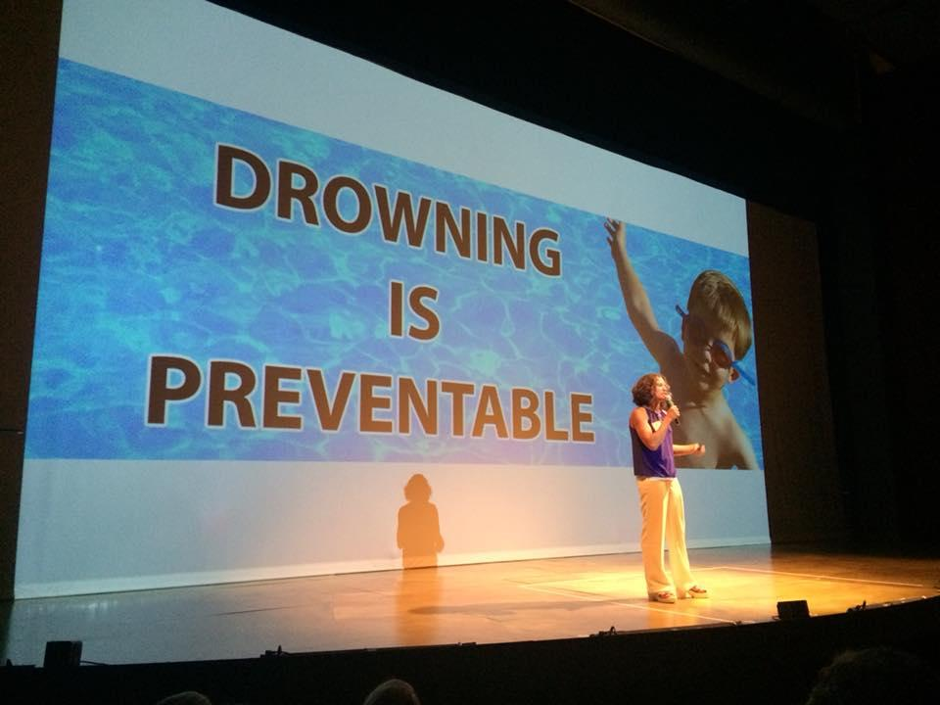
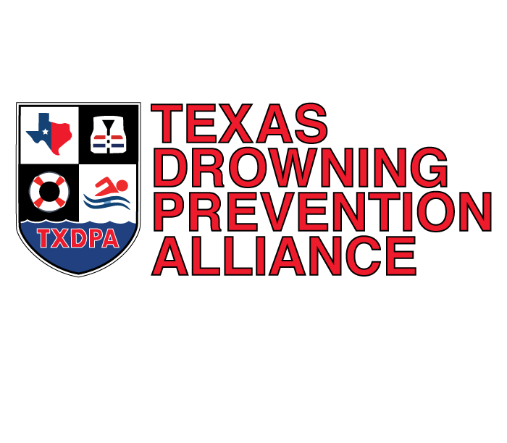
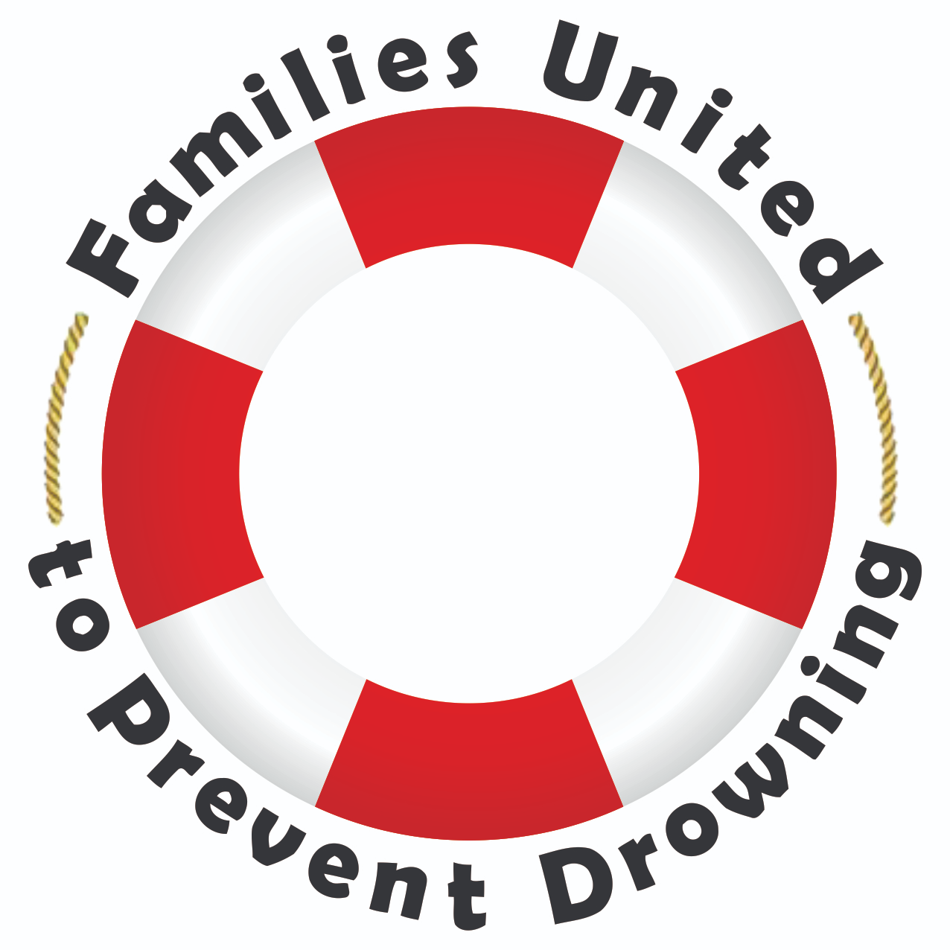
Over the last 10 years,
small but MIGHTY
Colin's Hope
has become
a leading drowning prevention organization
in Texas and across the U.S.

Slide 5
LEARNING OUTCOMES
1) Participants will hear and learn Colin’s story and will be able to share his story and other stories of children who drowned in all types of water to bring real faces to drowning- in hopes of changing behaviors to be safer around water.
2) Participants will differentiate between closed and open water and learn about resources that address these differences for those who recreate in their water in order to prevent drowning
3) Participants will learn, refresh and/or relearn basic water safety tips when they take the Colin’s Hope online water safety quiz after the session.
4) Participants write a mini action plan and commit to doing at least 1 thing to increase drowning prevention efforts when they return home as it relates to their work.

Slide 6
Drowning Stats
Data from the National Vital Statistics System, Mortality
From 1999 through 2010, a total of 46,419 deaths from unintentional drowning (including boating) occurred in the US, an average of 3,868 deaths per year.
Drowning death rates decreased over time for all age groups except adults aged 45–84.
The average daily number of deaths from unintentional drowning on a weekend day was 48% higher than that on a weekday (13.8 versus 9.3 deaths).
Drowning occurred most often in a bathtub for persons under 1 and for adults aged 85 and over, in a swimming pool for children 1–4 years, and in natural water ages 5–84.

Slide 7
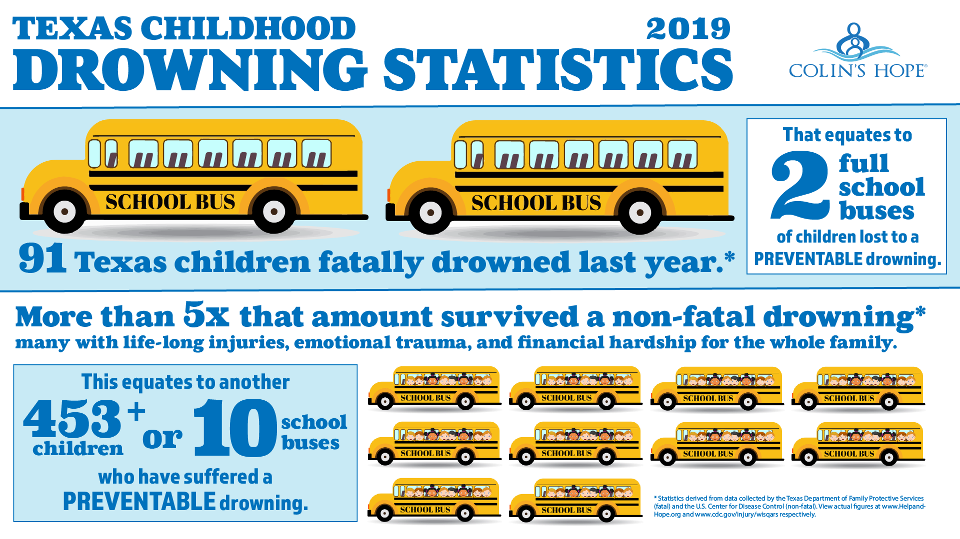

Slide 8
2018 Texas Drowning Stats
Texas Fatal Child Drowning Stats:
Of the 91* fatal drownings
61 Male (67.7%), 29 Female (32.2%)
63 were 5 years old or under, (70%)
27 were ages 6-17 (30%)
29 Open water-ponds (13), lakes, rivers, beaches (32.2%)
48 Pools (36 backyard, 10 apt, 1 Hotel, 1 Swim School (53.3%)
11 Bathtubs (12.2%)
1 storage container (1%) and 1 jacuzzi (1%)
We have had 8 fatal drownings of Texas children already in 2019.
1 WAS IN OPEN WATER (7M, POND)

Slide 9
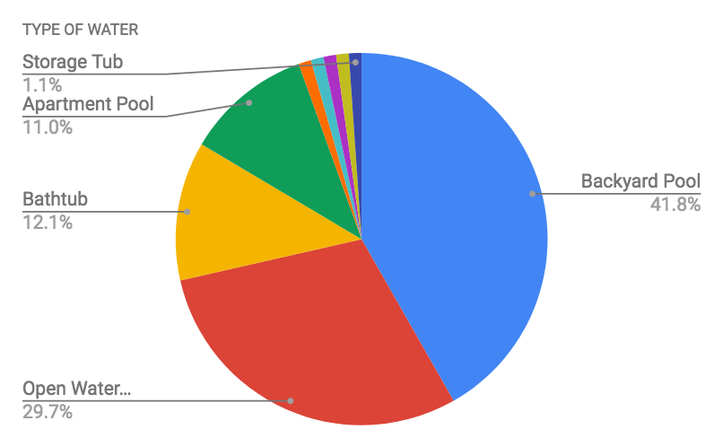
WHERE DID TEXAS CHILDREN DROWN?

Slide 10
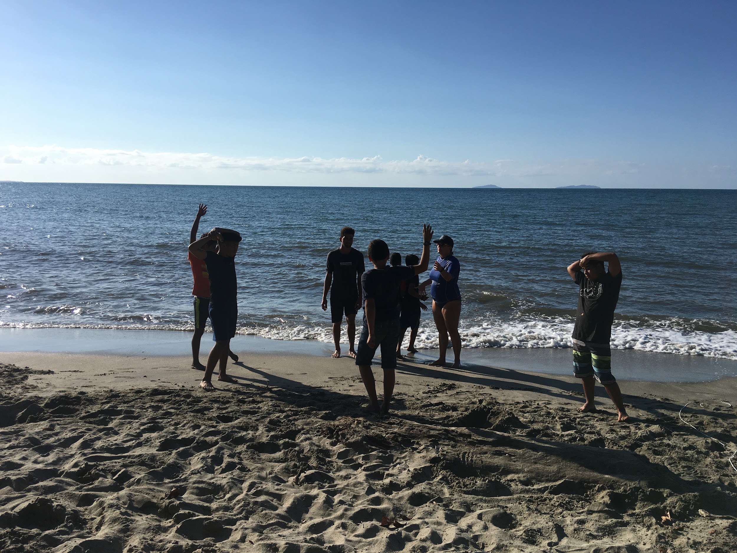
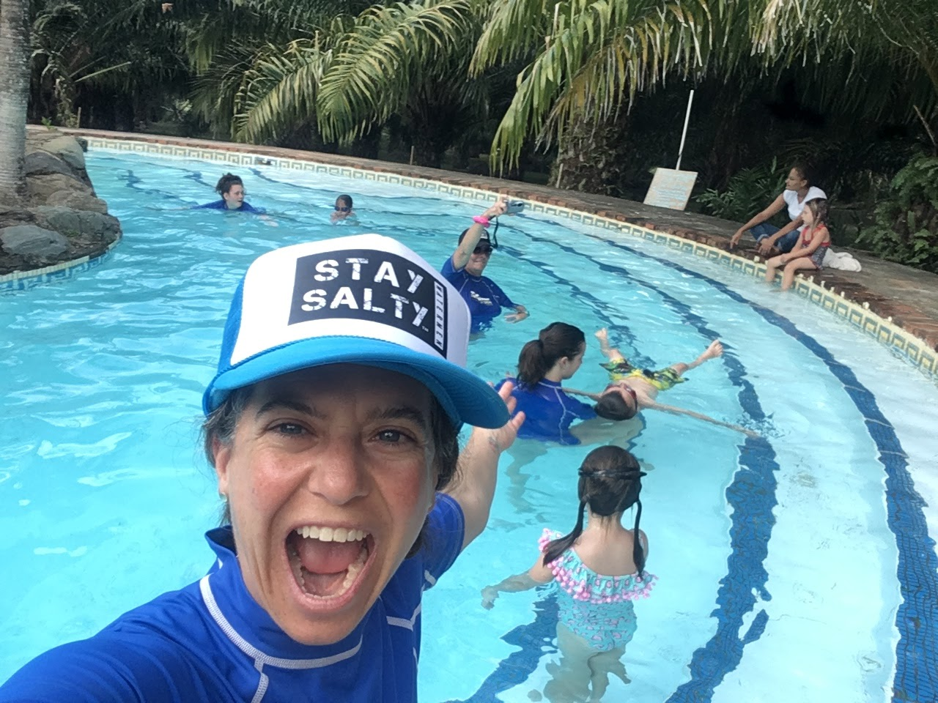
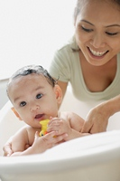
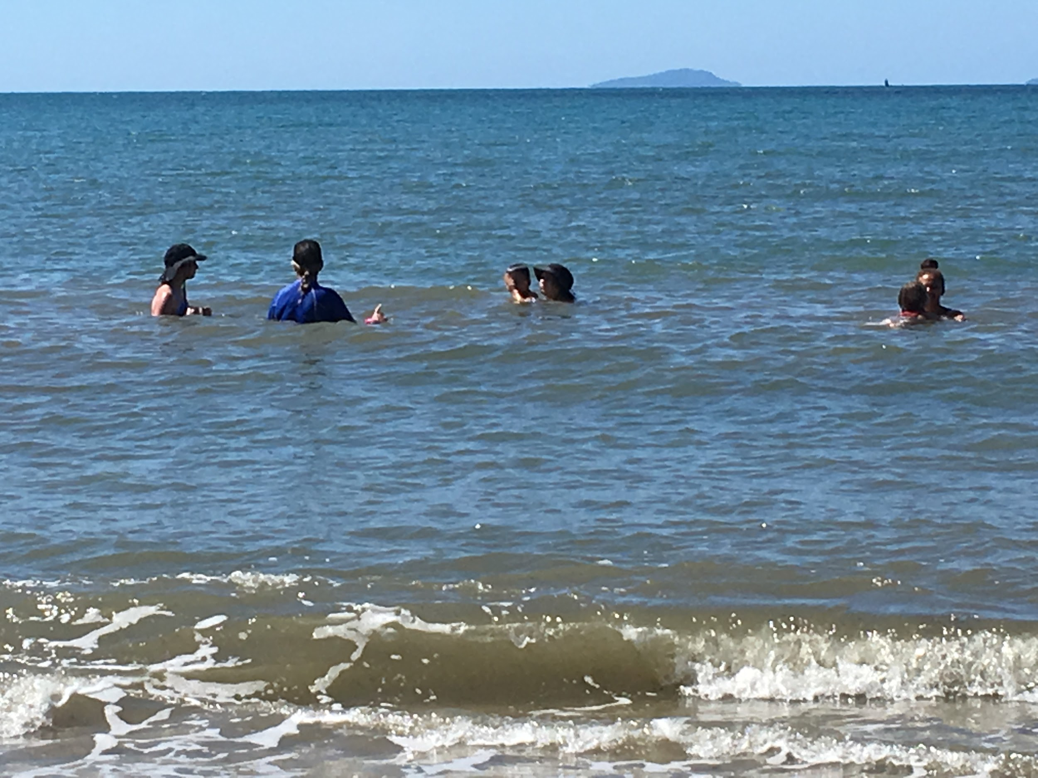
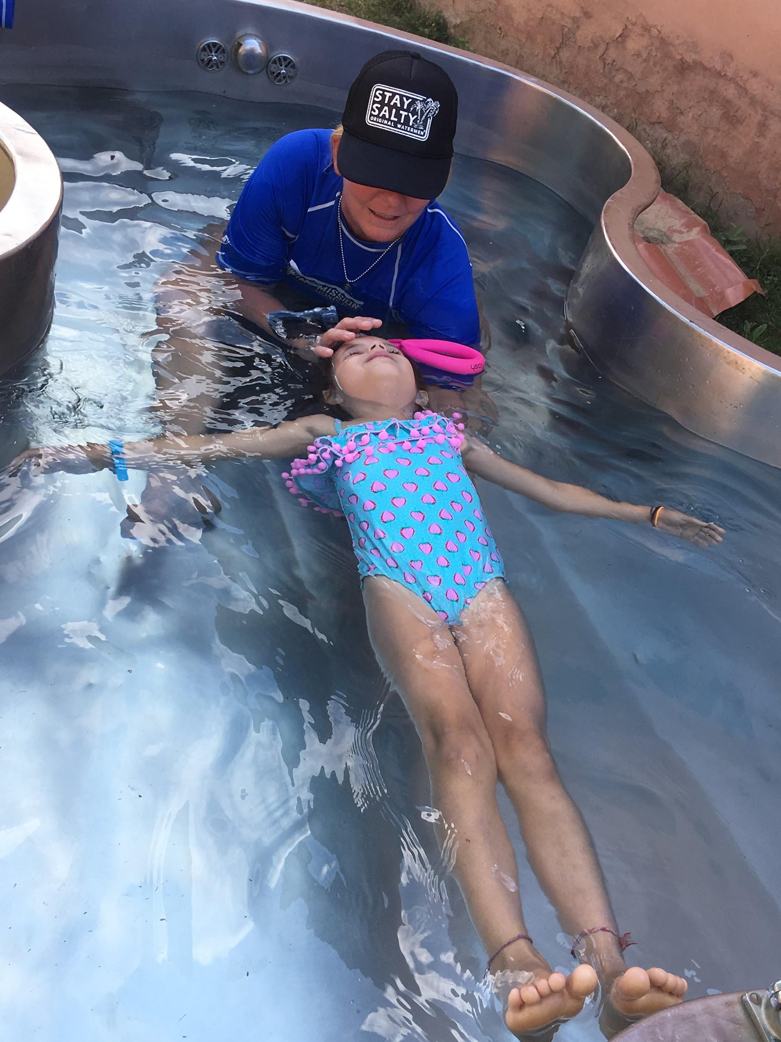
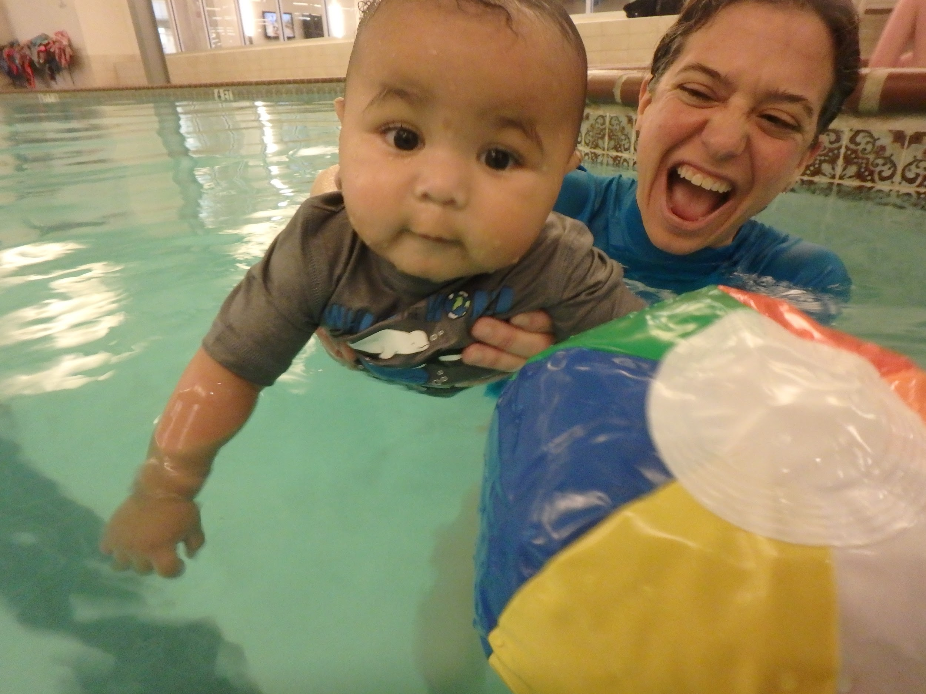
WHERE ARE PEOPLE LEARNING TO SWIM AND INTERACT WITH WATER?
C

Slide 11
WHAT ABOUT YOU?
WHO CAN SWIM?
WHERE DID YOU LEARN TO SWIM?
WHAT WAS THAT EXPERIENCE LIKE?
WHAT WAS YOUR FIRST OPEN WATER EXPERIENCE?
WHAT WAS THAT EXPERIENCE LIKE?
HOW WAS IT DIFFERENT FROM A CLOSED WATER EXPERIENCE?
HAVE YOU HAD A DROWNING INCIDENT?
WHAT WATER DO YOU MANAGE OR INTERACT WITH NOW?

Slide 12
CLOSED WATER VS. OPEN WATER
CLOSED WATER
WARM
CLEAR
CALM
CONTROLLED
KNOW DEPTH
ENTER/EXIT EASILY
??????
OPEN WATER
TOO COLD/TOO WARM
DARK OR MURKY
ROUGH/WAVES/CURRENT
UNPREDICTABLE
AMY NOT KNOW DEPTH
NO EASY ENTRY/EXIT
??????

Slide 13
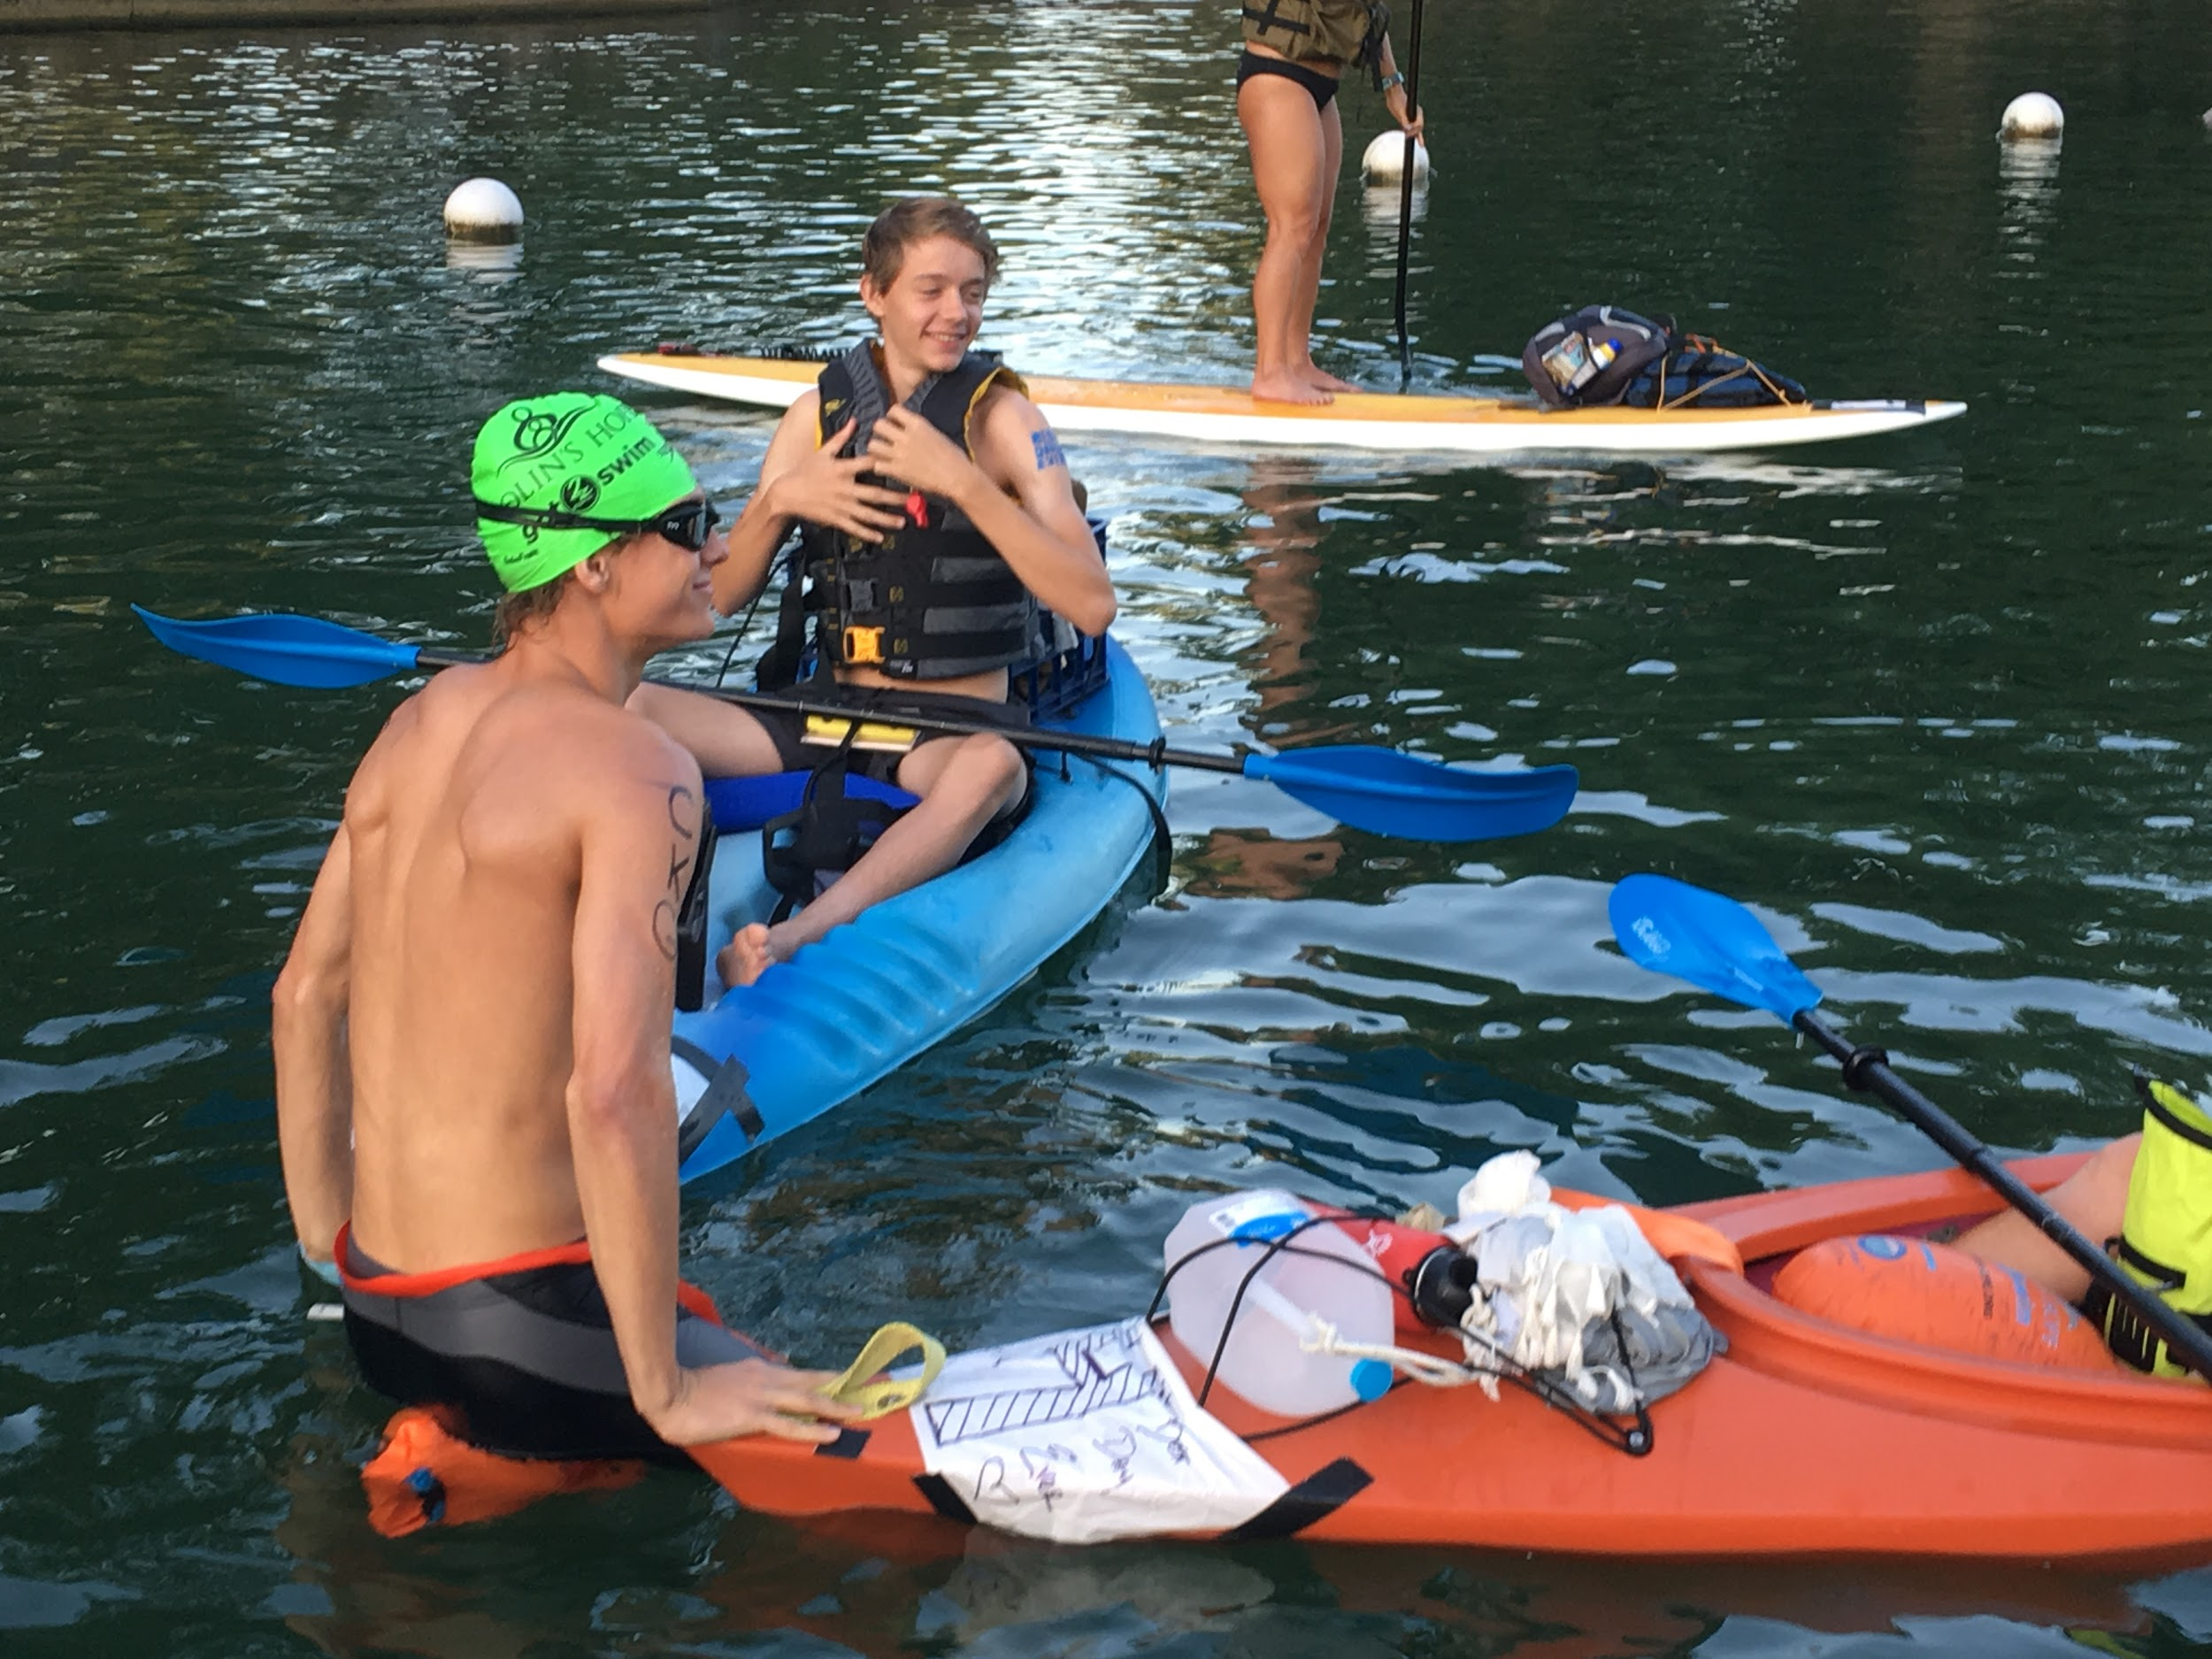
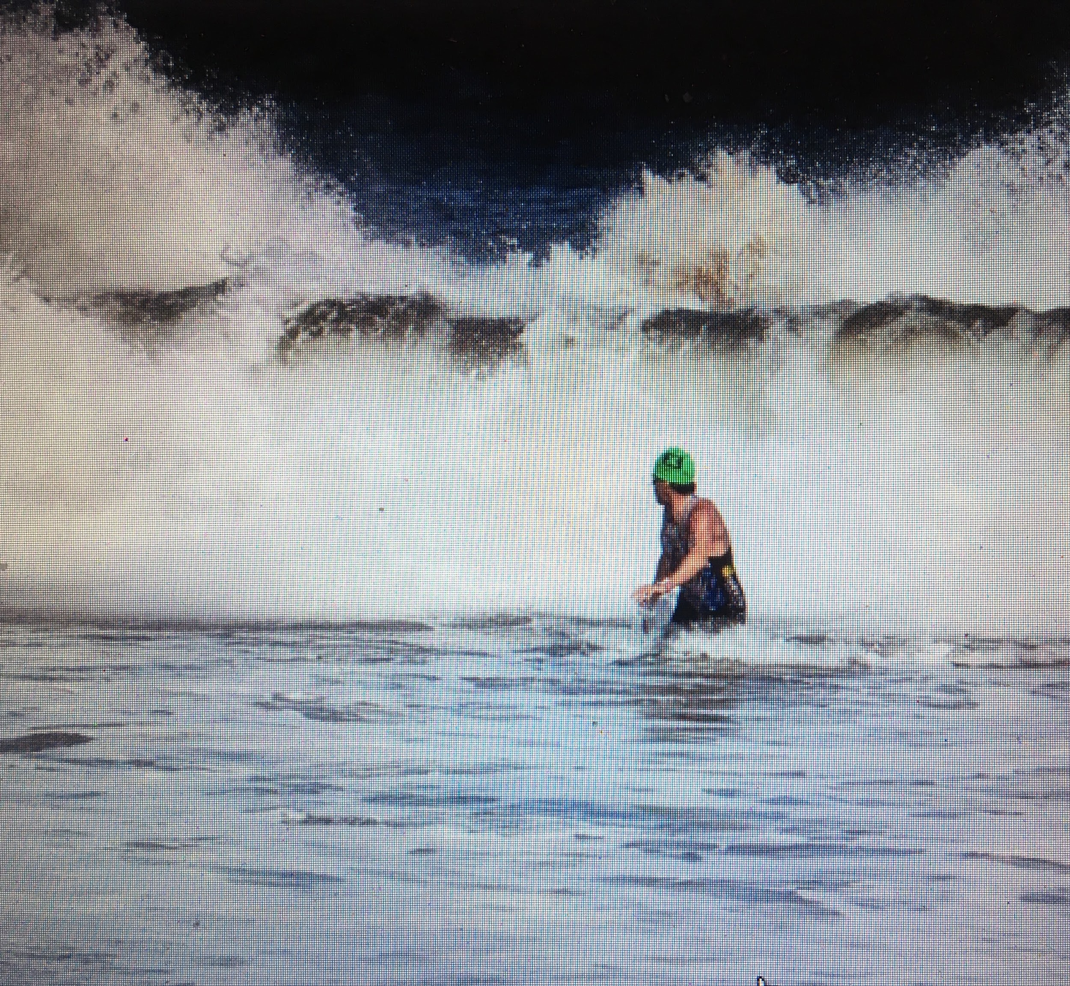
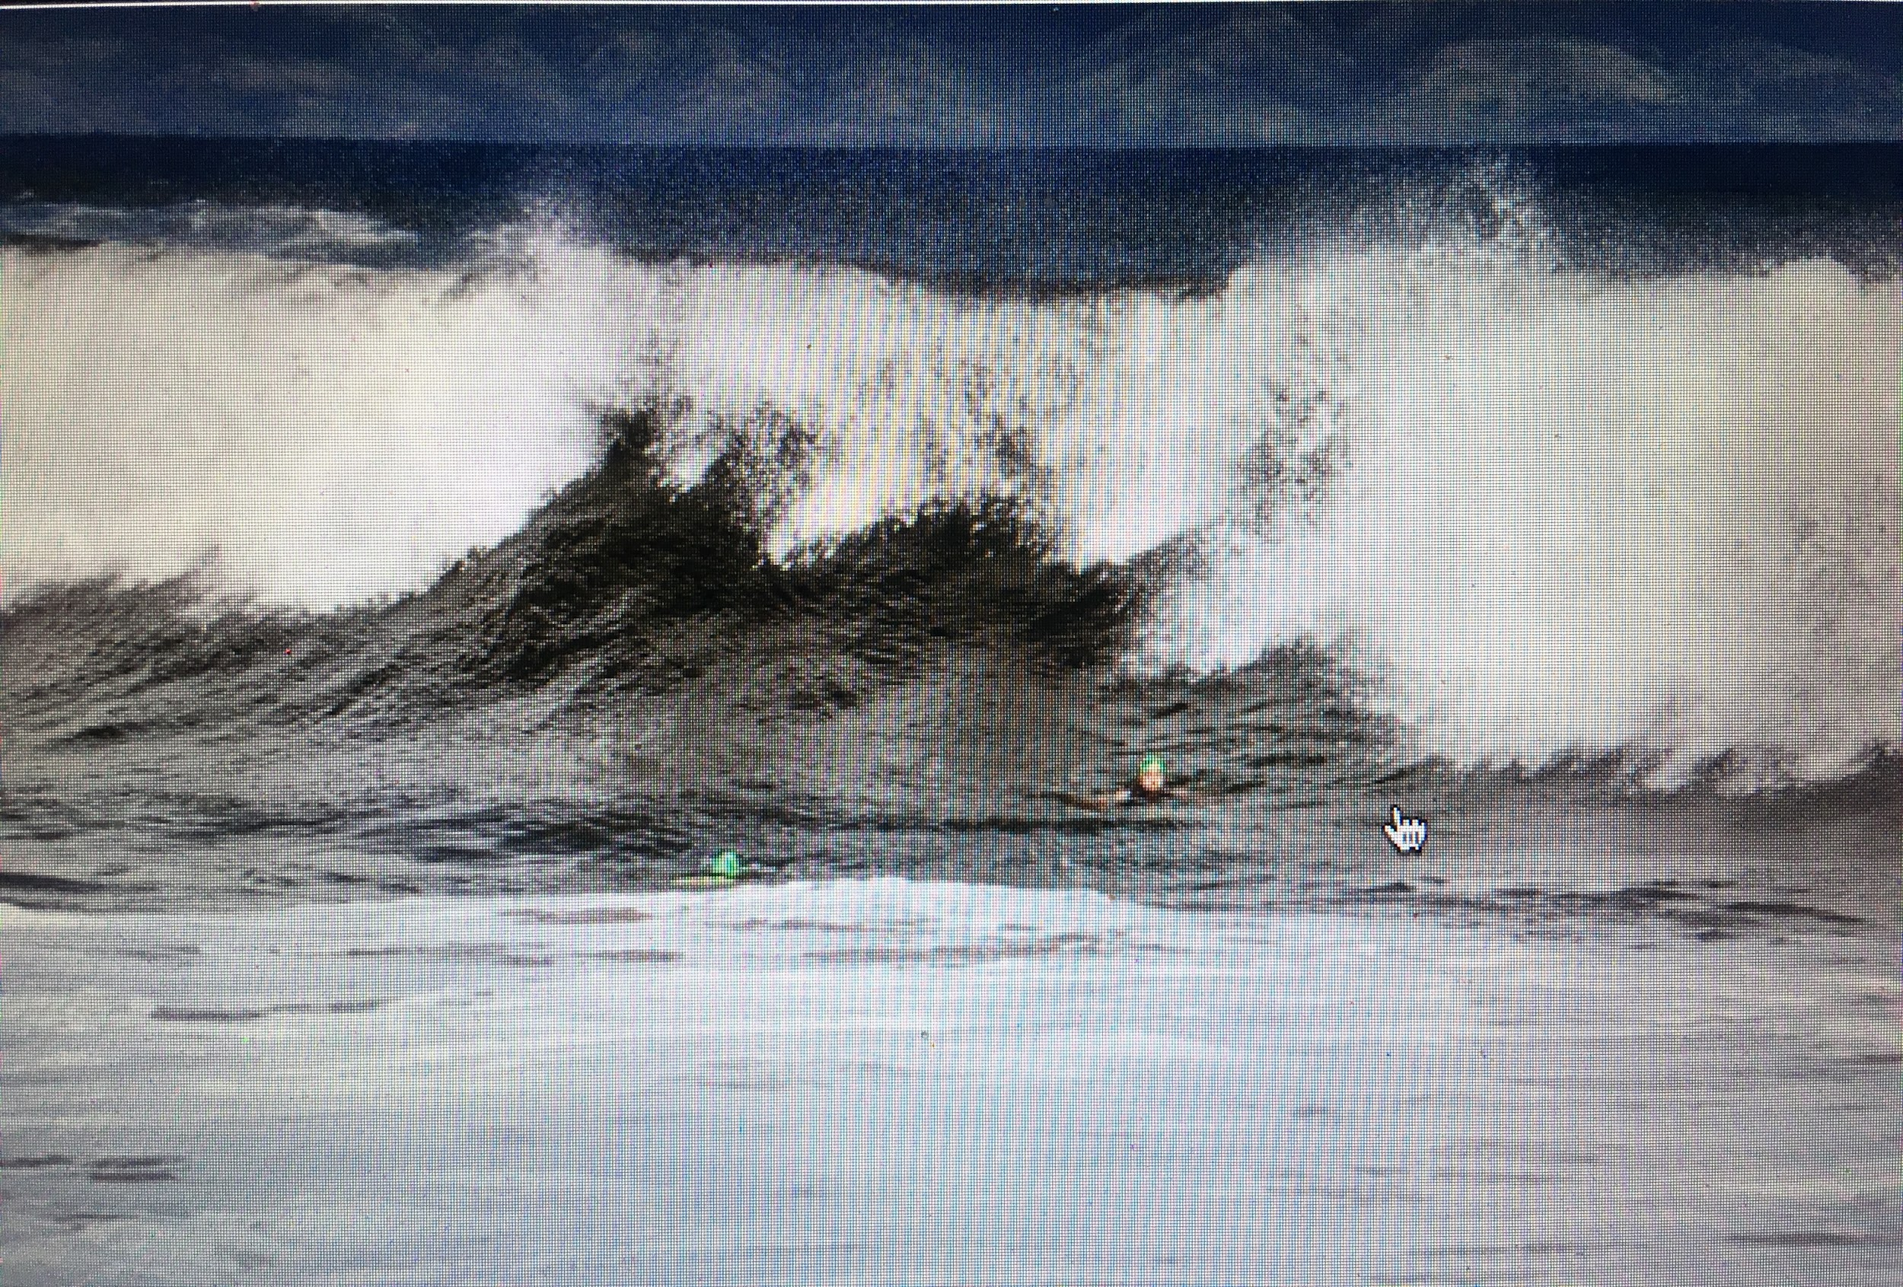
LESSONS FROM: MAUI, HONDURAS & LAKE AUSTIN
JELLYFISH, WAVES, DROP-OFFS, CURRENTS
BAD DECISIONS
OVERESTIMATED ABILITY
UNDERESTIMATED WAVES, POWER OF WATER
WATER TEMP, DEHYDRATION
WATER GUARDIANS, LIFEGUARDS
RIVER CROSSINGS
THROWABLES- ROPES, BOTTLES

Slide 14
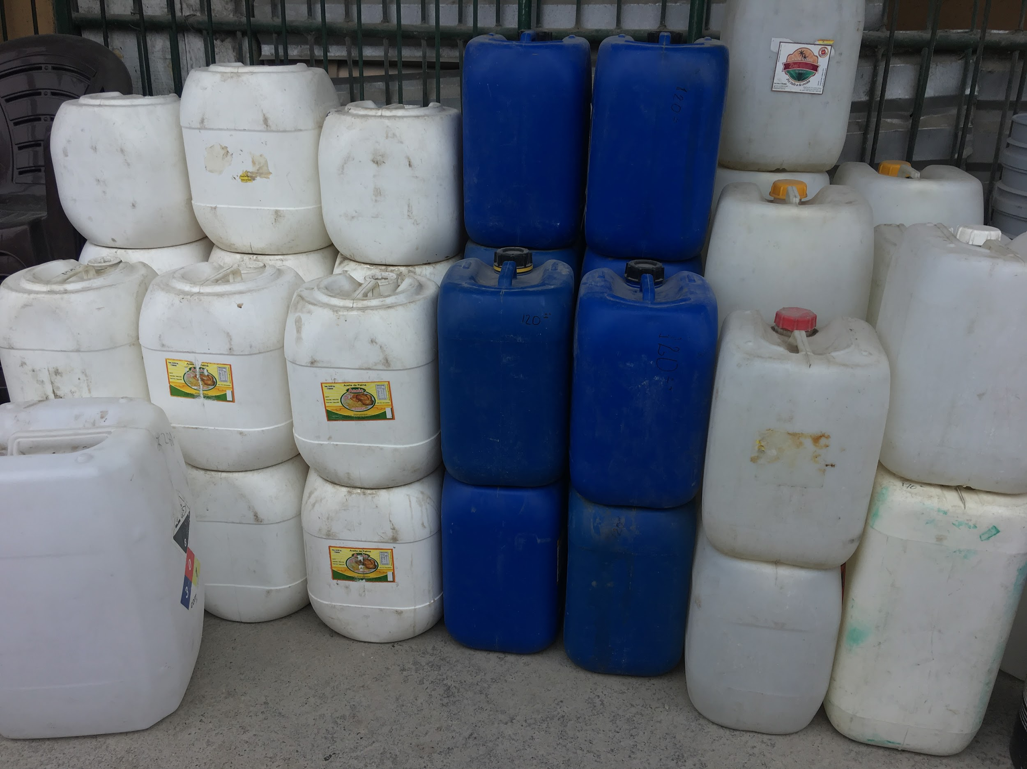
IDEAS FOR CLOSED AND OPEN WATER SAFETY
EDUCATION OF STAFF AND PATRONS
SAFETY SIGNAGE
DEPTH MARKING
SAFETY ROPES
LIFE JACKET LOANER STATIONS
THROW RING STATIONS
TRAIN STAFF IN BASIC WATER RESCUE
TEACH OPEN WATER SAFETY IN SWIM LESSONS
TEACH RIP CURRENT SAFETY
OPEN WATER EXPERIENCES FOR ALL
OTHER IDEAS?

Slide 15
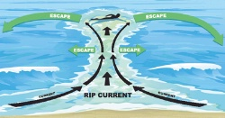
RIP CURRENT SAFETY: CALM. FLIP. FLOAT. FOLLOW

Slide 16
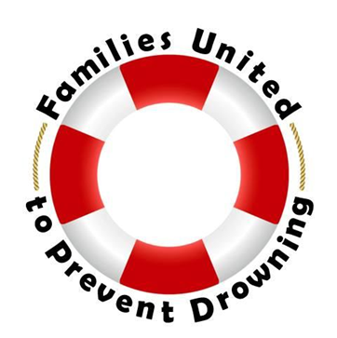
Open Water Resources

Slide 17
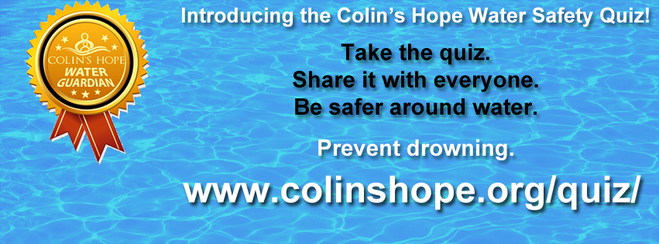
Promote the Colin’s Hope Online Water Safety Quiz
Please Take and Share on Facebook

Slide 18
ACTION: WHAT WILL YOU DO?
Get a partner.
Commit to at least 1 thing you will do to increase your water safety and drowning prevention efforts as it relates to bridging the gap from closed to open water safety when you return home.
Share with the group.
Be accountable.

Slide 19
Questions & Answers

Slide 20
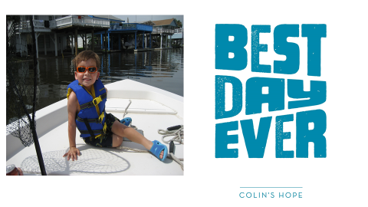
Thank you for sharing our vision of a world where no child drowns.

