Slide 1
Waves of Hope: Tips for First Responders from Families of Water Tragedies March 25, 2019

Slide 2
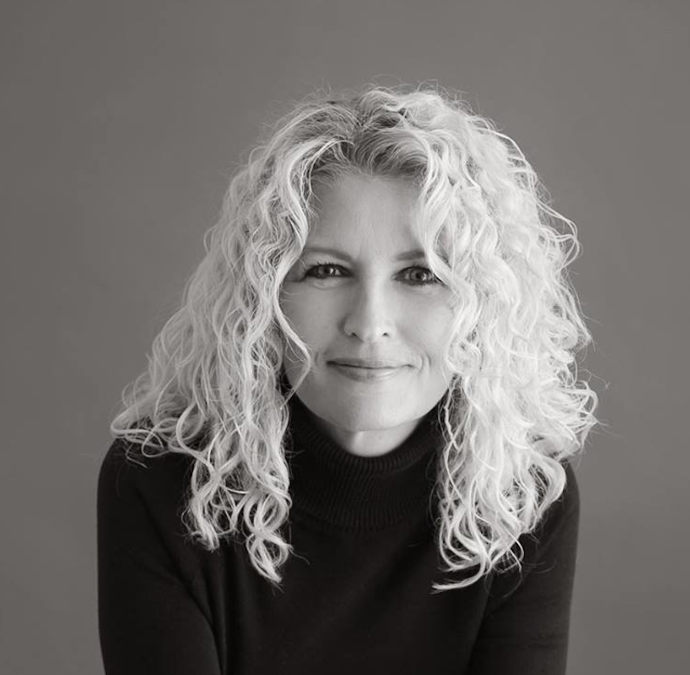
Moderator
Dana Gage
Founder
The LV Project
dana.gage@theLVproject.org
connor.
Notes:
There’s a big story behind that story – and that’s what we’re here to discuss today.
Thank you to Cameron Brown who prompted this conversation over a beer last year;
To Yvonne and Peg for providing the opportunity
To the families twho participated
And to the first responders who are willing to listen and learn

Slide 3
Our goal
Help first responders help families of water tragedies:
let’s talk about it.
Multi-phase project:
Phase 1: Family feedback
Phase 2: First responder feedback (peer to peer)
Phase 3: Best practices overlay from tested critical incident programs
Family Feedback
First Responder Feedback
Critical Incident Response
Notes:
Hand over heart – no right way to do a wrong thing.
Scope of this project
Sudden loss is, by its very definition -- sudden

Slide 4
Our approach
Let’s start the conversation.
What’s in your packet?
Waves of Hope family stories
20/10/30 – Feedback from families
We asked families… What helped? What didn’t?
We want your feedback, too.
”You’re not alone.” card.
Let’s wrap up with a chat.
Notes:
I want to hear your papers rattling; read through this;

Slide 5
The basics of a critical incident scene
Families.
In shock.
Scattered, incapable of rational thought.
In denial.
First responders.
Wearing many hats.
Compartmentalizing.
Managing business and emotions.
Notes:
Not an exhaustive list;
If we were all asked to describe the basics of a critical incident scene, we could fill up 10 pages single column
Fundamental…

Slide 6
> Be honest. (we need the truth, no matter what) > Be kind. (wrap truth in love) > Be careful. (we may be able to hear you) > Be direct. (give us the facts) > Be human. (your tears are not a sign of weakness)
The five recurring themes from families:
Notes:
The basics

Slide 7
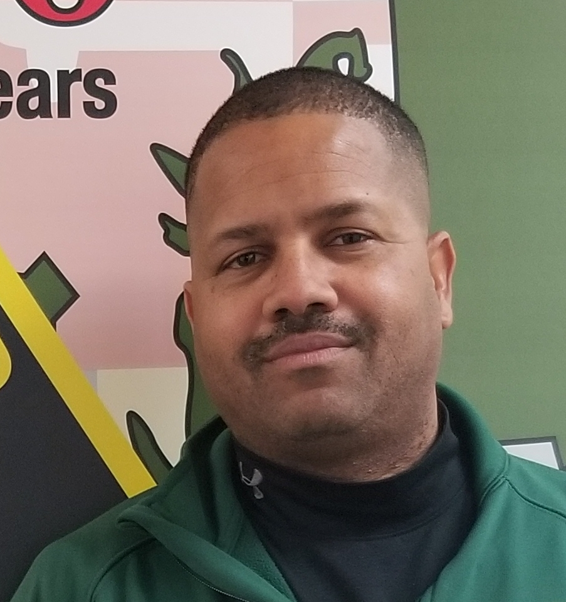
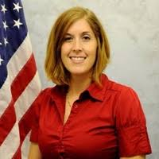
Panelists
Cameron Brown
Maryland Natural Resources
Heather Lanier
Orange Park Police Dept.
Jan Iserman
Ashleigh Iserman Boating
Safety Foundation
Notes:
Tell you a bit about themselves and their work;
Give you some insight on the challenges in a critical incident situation
Share an experience.

Slide 8
let’s talk about …
on the scene
with Cameron and Heather.
Notes:
Cameron Brown intro

Slide 9
let’s talk about …
families
with Jan and Dana.
ashleigh & connor
Notes:
Cameron Brown intro

Slide 10
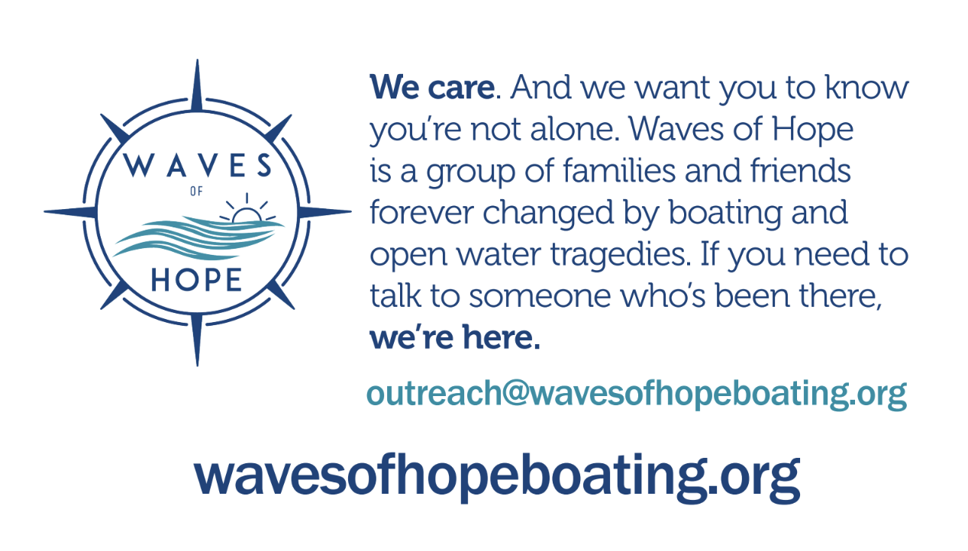
> The 20 / 10 / 30 sheet will be available to share. > NSBC will share this content in an upcoming webinar. > Give the “you’re not alone” card to families who may need it.
Use these resources.
Notes:
Use these resources

Slide 11
Join us
tomorrow
first responder
brainstorm session.
Notes:
Cameron Brown intro

Slide 12
thank you.

