Slide 1
Changing Life Jacket Wear Behavior Through Enforcement and Education
Pam Doty
HQUSACE National Water Safety Program Manager
Rachel Garren
The Corps Foundation Special Programs Director
26 March 2019
International Boating and Water Safety Summit: Jacksonville, FL

Slide 2
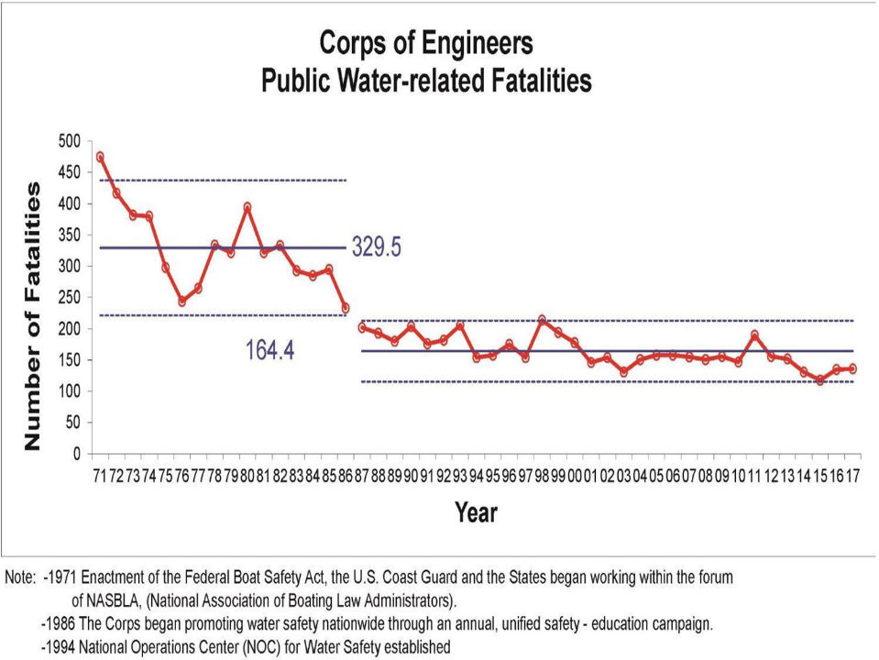
134.4

Slide 3
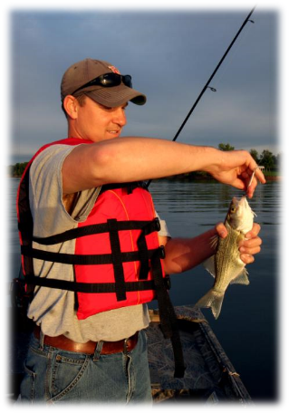
USACE Public Recreation
Fatality Trends FY1998-2017
Gender: Male (88%)
Age: 18-35 (38%) 36-53 (24%)
Not Wearing a Life Jacket: 89%
Activity:
  Boating: 44%
  Falls from boat: 12%
  Swimming in association with: 10%
  Capsized: 8%
  Collision: 5%
  PWC: 2%
  Other: 6%
  Swimming: 45%
  Undesignated area: 37%
  Designated area: 8%
Notes:
Other under Boating includes Control/Speed, Electrical, Carbon Monoxide, Skiing/Towing

Slide 4
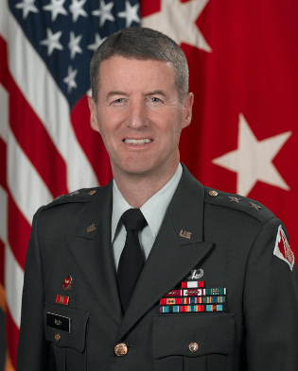
Command Decision to Test
In 2007,
“…explore the feasibility of establishing a life jacket wear policy on all U.S. Army Corps of Engineers waters.”
MG Don T. Riley

Slide 5
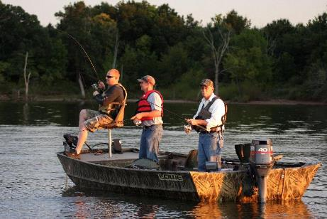
Reason For Life Jacket
Wear Policy
Fatality Reduction
(To Save Lives.)

Slide 6
Life Jacket Policy Study
Conducted study in three areas:
Vicksburg District (2009-2011) Policy Is Still In Place
– Arkabutla, Enid, Grenada, and Sardis Lakes in Mississippi
Sacramento District (Apr – Oct 2011) Very short preparation period, District discontinued policy after study
– Pine Flat Lake in California
Pittsburgh District – Policy established 1990
All small watercraft 16 feet and under, canoes, and non-swimmers
Three-year study ended on 31 October 2011
Policies enforced under 36 CFR 327.12(a) – Restrictions

Slide 7
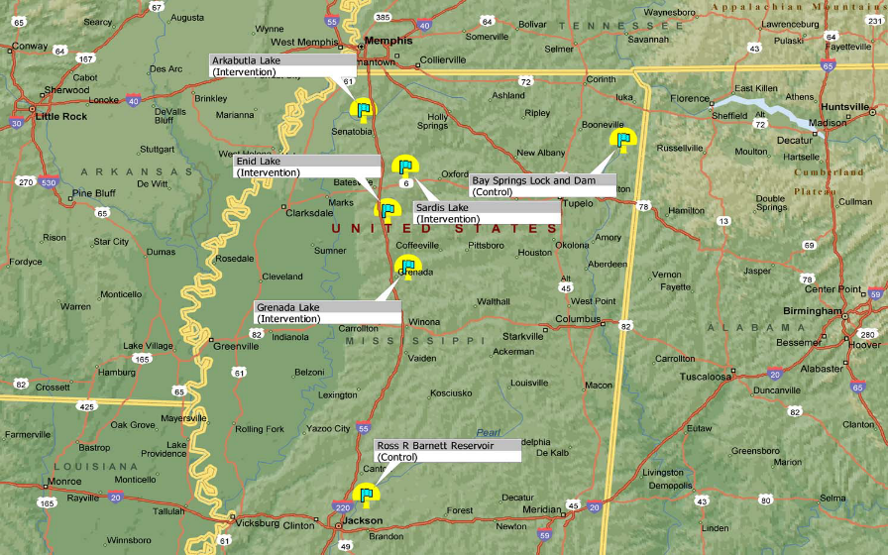
Mississippi Lake Locations
Four USACE Lakes: Arkabutla, Enid, Grenada, Sardis
Two Control Lakes: Ross Barnett, Bay Springs

Slide 8
Not An Overnight Process
First identified the scope of policy
  Policy based on statistical trends
    Greatest risk groups
      Boaters in small watercraft
      Boaters underway
      Swimmers outside of designated swim beaches
Prepared region for policy: Notifications began in 2008 to Congressional offices, state and local law enforcement agencies, Federal Magistrates, local media, and public. The one-year communication process was vital to success.

Slide 9
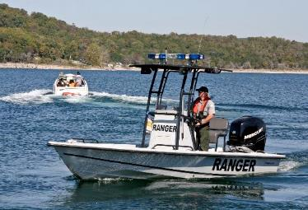
Clear and calm mindset, park ranger’s attitudes determined visitor’s actions/reactions, full understanding of the policy necessary for uniform enforcement between lakes
State officers did not enforce, but cooperated through education contacts
Enforcement began 22 May 2009
Study ended 31 October 2011
Vicksburg District decided to continue policy
and it is still in effect today

Slide 10
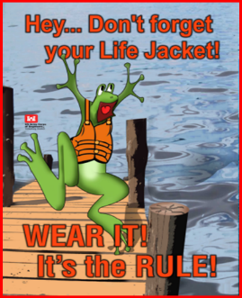
USACE Mississippi Lakes Policy
A life jacket must be worn…
At all times on powered vessels less than 16 feet in length and on all non-powered vessels, regardless of length
On vessels 16 to 26 feet in length whenever under power by the main propulsion engine
When being pulled by a vessel,
regardless of vessel length
When swimming outside a designated
swimming area

Slide 11
USACE Mississippi Lakes Measurements
Measurement | Baseline 2008 | 2009 | 2010 | 2011 | 2017
Boat Patrol Hours | - | 1248 | 1199 | 1291 | 483
Congressional Inquiries | 0 | 0 | 0 | 0 | 0
Public Letters/ Emails/Phone Calls | - | 34 | 2 | 1 | 0
Visitation | 5,580,752 | 5,264,829 | 5,246,112 | 4,943,903 | 2,969,930
Warnings Issued | - | 876 | 1488 | 945 | 99
Citations Issued | - | 0 | 3 | 120 | 38
Adult Life Jacket Wear | 13.8% | 75.6% | 71% | 67.7% | 62.3%

Slide 12
USACE Mississippi Lakes
Life Jacket Wear Rate by Age

Slide 13
USACE Mississippi Lakes
Adult Life Jacket Wear Rate by Powerboat
Notes:
These wear rates do not include in the totals any boats that were not part of the policy (powered boats greater than 26 feet or powered boats 16-26 feet that were drifting or anchored).

Slide 14
USACE Mississippi Lakes
Adult Life Jacket Wear Rate by Boating Activity

Slide 15
USACE Mississippi Lakes
Number of Boating Related Fatalities
66.67% decrease
USACE Vicksburg District Public Water-related Fatalities
FY2014: No fatalities
FY2015: One fatality (Sardis Lake)
FY2016: Four fatalities (Arkansas Lakes)
FY2017: No fatalities

Slide 16
Summary of Mississippi Findings
Mandatory wear regulations are making a difference when it comes to saving lives.
Wear rates remain very high.
Boats that don't fall under the policy, which include boats 16-26 feet in length that are anchored or drifting and boats 26+ feet in length regardless if underway or not, showed an increase in life jacket wear.
Influencers such as kids play a role. Adults boating with children exhibited higher wear rates than boats that had only adults and teens on board.
Use of inflatable life jackets among those wearing life jackets did increase, the increase was substantially lower than one might reasonably expect.

Slide 17
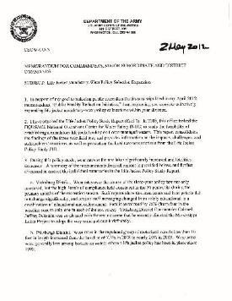
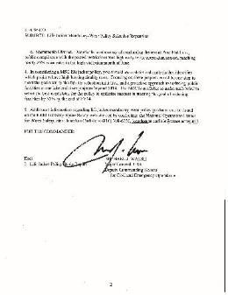
Life Jacket Mandatory Wear Selective Expansion
Life Jacket Mandatory-Wear Policy Selective Expansion signed 2 May 2012 by MG Michael J. Walsh

Slide 18
Life Jacket Mandatory Wear Selective Expansion
New Orleans District - Bonnet Carre Spillway and Port Allen Lock.
All operators of vessels less than 18' must wear a life jacket when operating the vessel alone.
St. Louis District - Carlyle Lake. All single occupants in vessels less than 21’ while under main propulsion.
St. Louis District – Lake Shelbyville. Life jacket wear and possession is included in Boat Rafting Policy.
Albuquerque District – Cochiti Lake. Anyone using an inflatable (raft, inner tube, rubber boat, other floating objects, etc) on the lake must wear a life jacket, even in the swim area.
Pittsburgh District - All persons on a recreational vessel engaged in the locking through process and all persons on a personal watercraft or any paddle craft while locking through are required to wear a life jacket.
More USACE locations would likely develop policies if
states were willing to support policy if put in place.

Slide 19
Lives Have Been Saved
Arkabutla Lake: Summer of 2009
Two fisherman were thrown into the water when their boat overturned. This was the first time they wore their life jackets while boating because they knew of the life jacket policy. They stated they were glad that they did have them on because, if not, they would not be alive.
Sardis Lake: Summer of 2009
Two fisherman fell overboard when their boat was swamped by a large wave. They were wearing their life jackets and were found nine hours later clinging to overhanging limbs.

Slide 20
Lives Have Been Saved
Sardis Lake: Labor Day Weekend 2013
Four people were in small aluminum boat. The lake was choppy and the waves overtook the boat and caused it to capsize. All four people had life jackets on and all survived.
Five people in a ski boat were thrown from the boat after it hit some rocks in shallow water. There were some injuries but no fatalities. The driver of the boat said that if it were not for the life jacket mandate they likely would not have been wearing their life jackets.

Slide 21
What We Have Learned…
High levels of compliance may be leading to developing a norm of wearing life jackets.
Levels of enforcement is working.
Advance coordination and continued communication is critical.

Slide 22
What We Have Learned…
Boaters will comply when faced with a regulation; swimmers outside designated areas are tough to regulate.
Lives have been saved.
Education still plays a role.

Slide 23


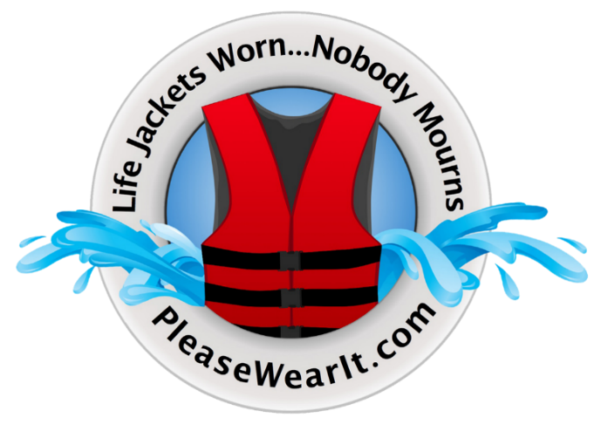
Education Plays a Role

Slide 24
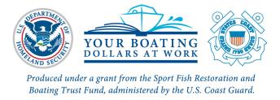



USCG Safety Grant Awards
Four $175,000 Grant Awards
15 Video & 3 Audio PSAs
Tailgate Wraps
Vinyl Banners
2 Mobile Games
Social/Digital Media Marketing
  Please Wear It
Focus Groups
All Materials at PleaseWearIt.com

Slide 25
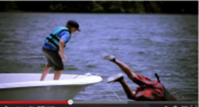





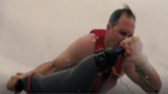

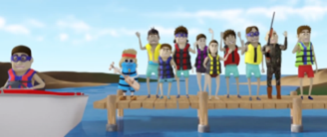
Video PSAs
Man Overboard
Drowning in 60 Seconds
Girl Overboard
Life Jacket Debate
Doggone Shame
Swim Challenge
Cell Phone Rescue
Close Calls
LJ Song

Slide 26
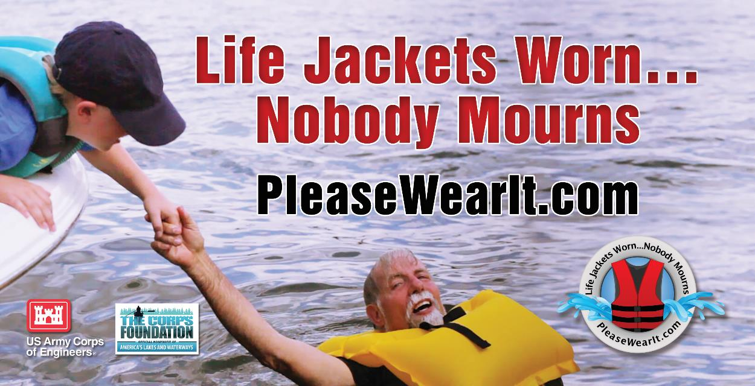
Man Overboard PSA

Slide 27

Life Jacket Debate PSA

Slide 28
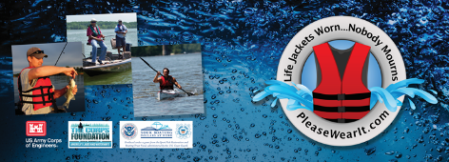

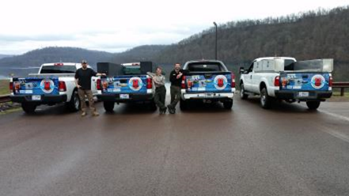
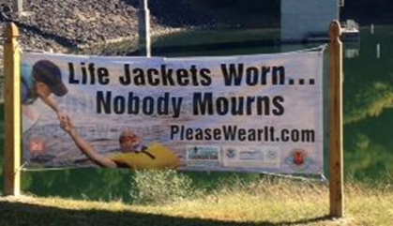
Tailgate Wraps / Banners
Tailgate Wrap
New Banner – Dec 2018
Youghiogheny River Lake
Previous Banner

Slide 29




Mobile Game Apps
Lake Guard and LJ vs the Lake are free, fun and highly competitive mobile game apps designed for Apple and Android devices.
Enjoy the games yourself, share them with visitors, friends and family, and conduct game competitions.

Slide 30

LJ vs The Lake Mobile Game Video

Slide 31
Current USCG Grant
$175,000 Grant
(Oct 2018-Sept. 2019)
2 More Video PSAs
Inflatable Life Jacket Inspection Video
Campaign Stencils
Social/Digital Media Marketing
  Please Wear It

Slide 32




Resources available at PleaseWearIt.com
Please Wear It

Slide 33
Contact Information
Pam Doty
National Water Safety Program Manager
Pamela.J.Doty@usace.army.mil
817-886-1727
Rachel Garren
Special Programs Director
Jara15@charter.net

