Slide 1
Augmented Reality (AR)
for Education
There are a few key sectors where augmented reality can make a real impact and boating education can be one of them.
Turn educational materials into multi-media experiences serving video, audio, photos, polls, promotions, weblinks, 3D animation and other interactions.

Slide 2
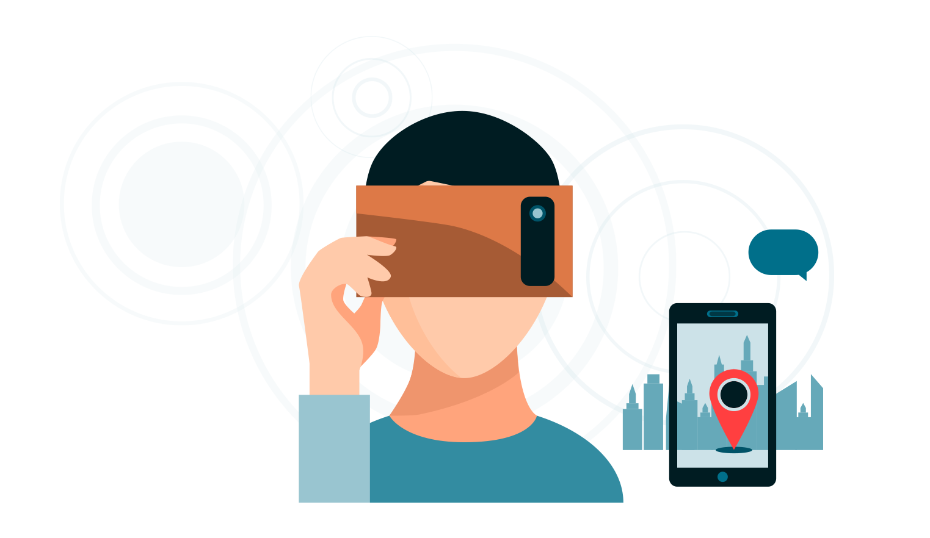
Next Steps
Safety That Speaks To You
Augmented Reality enhanced media
Content is delivered in the most dynamic & entertaining way possible
Posters that tell a story
Creates a feeling of personal connection
Multiple language choices

Slide 3
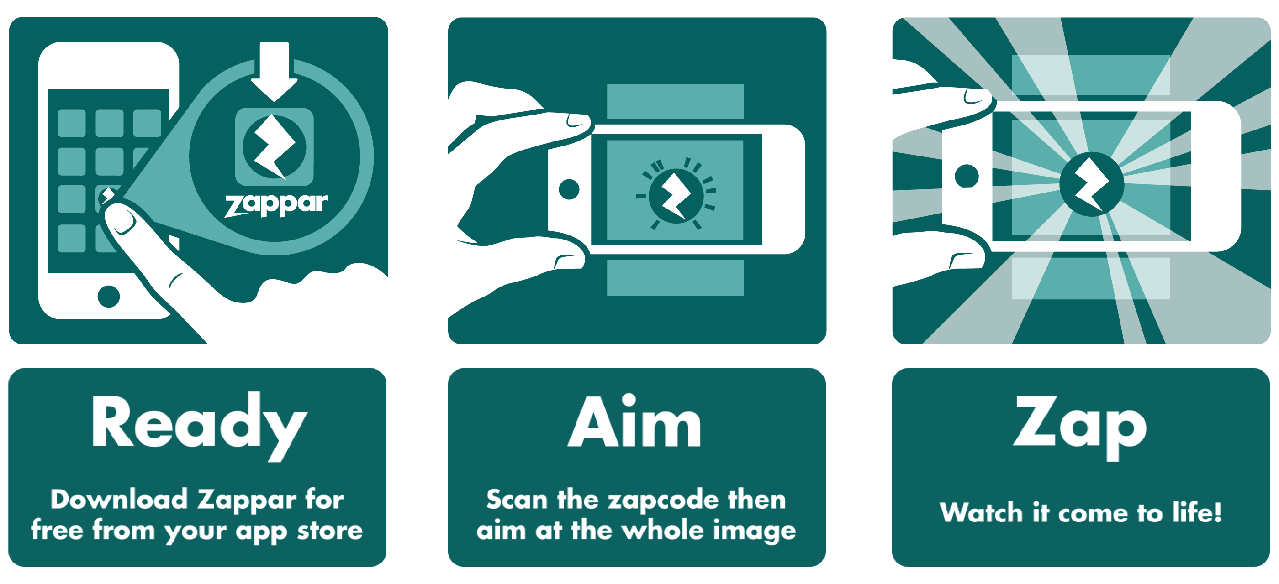

Slide 4
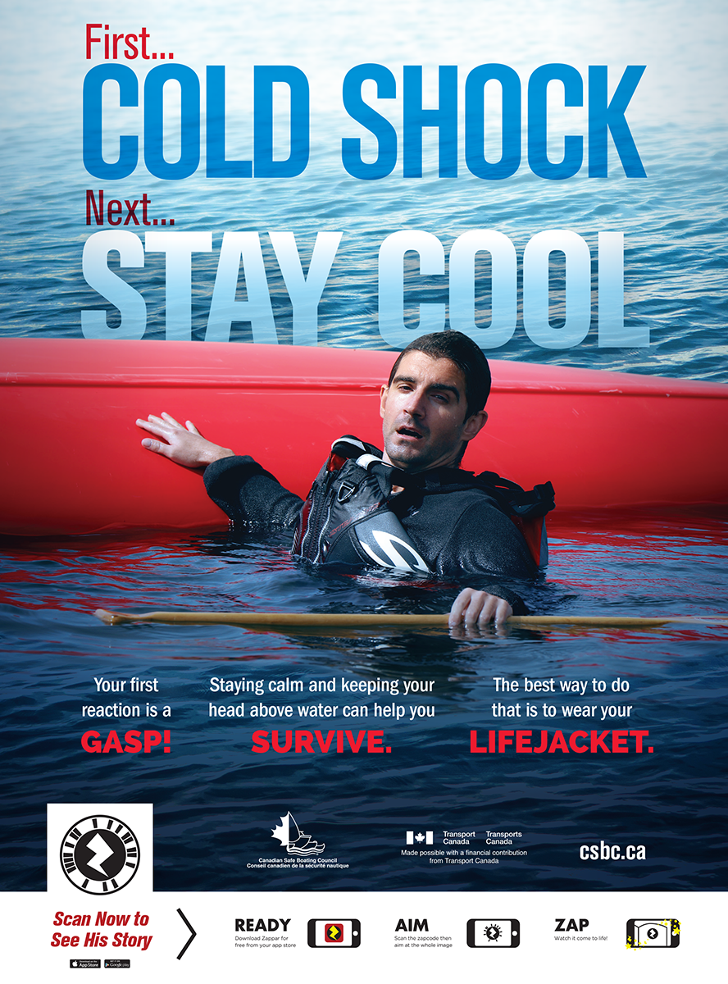
Augmented Reality
Cold Water Safety Ad
Video component
Additional information overlays

Slide 5
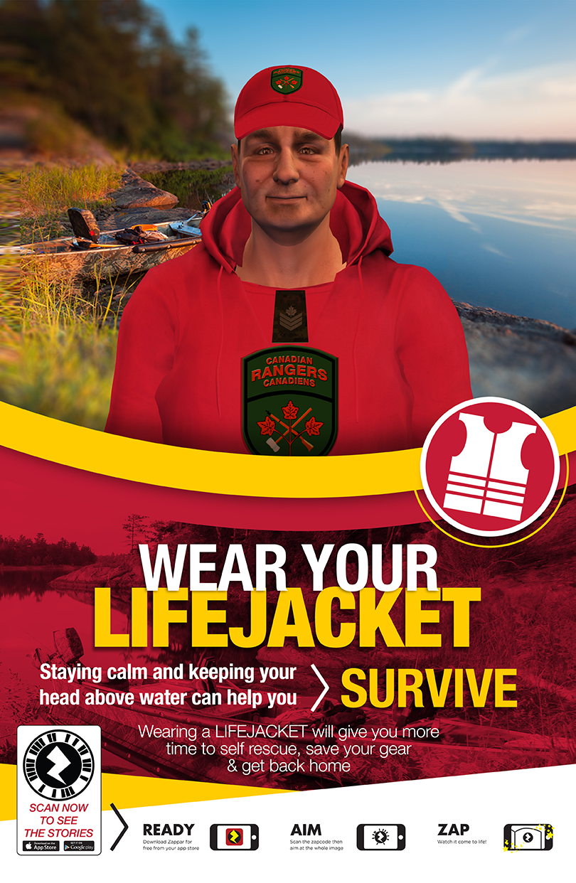
Augmented Reality
Cold Water Safety Ad
Animated Video component
Multiple Messages

Slide 7
Boating Safety Education Activities in Canada
Extending Our Reach EH !!
Lawrence Jacobs
thejacobs@telus.net
Ted Rankine
ted@playsafeproductions.com

