Slide 1
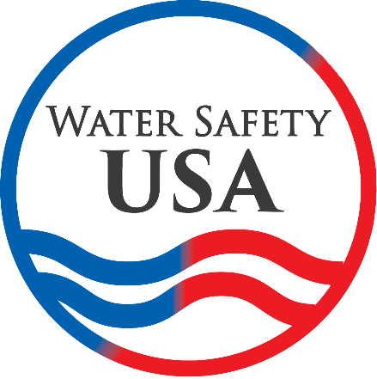
Developing a National Water Safety Action Plan for the U.S.
Keith Christopher Water Safety USA Boy Scouts of America
Representative

Slide 2
Outline
What is a National Water Safety Plan?
How does a National Water Safety Plan help?
What can we learn from countries where they are already in place?
What is the plan in the U.S.?
How can you get involved?

Slide 3
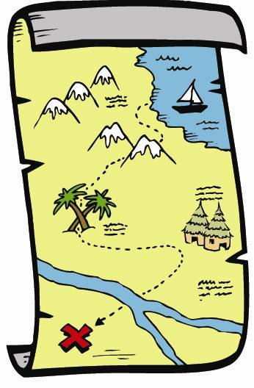
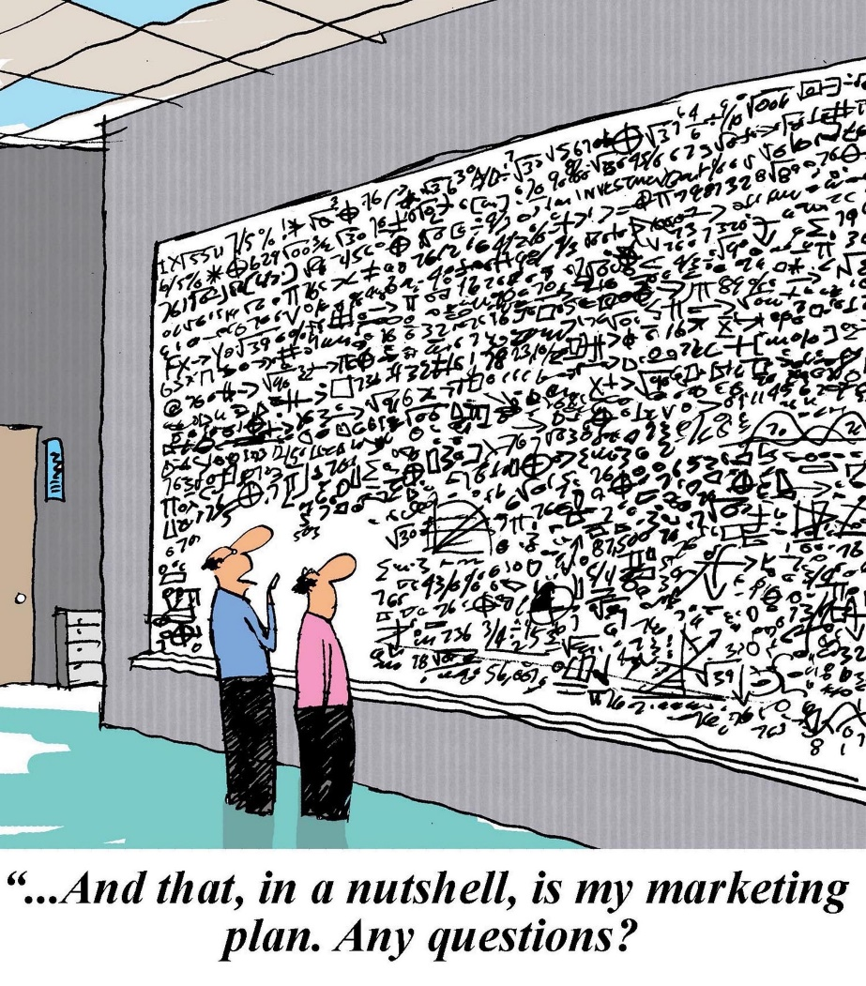
What is a National Water Safety Plan?
Notes:
Road map
Communication tool
Collaboration
One of the 10 actions to prevent drowning recommended to countries by the World Health Organization
National Action Plans are one of the most powerful tools governments, civil society, industry and other stakeholders have to:
Provide structure to achieve a common goal
Prompt meaningful changes in behavior, policies and funding
Create a space for government, multilateral organizations and civil society to work together

Slide 4
How does a National Water Safety Plan help?
Raises awareness of safety around water
Builds consensus around solutions
Results in a coherent effective response involving relevant partners
Provides strategic direction and a framework to align and guide multisectoral efforts
Sets priorities, coordinates action
Provides impetus to monitor action, including obtaining better data and reporting on drowning and prevention
Notes:
[Lead in to next slide] Without a plan the situation can look like this…

Slide 5
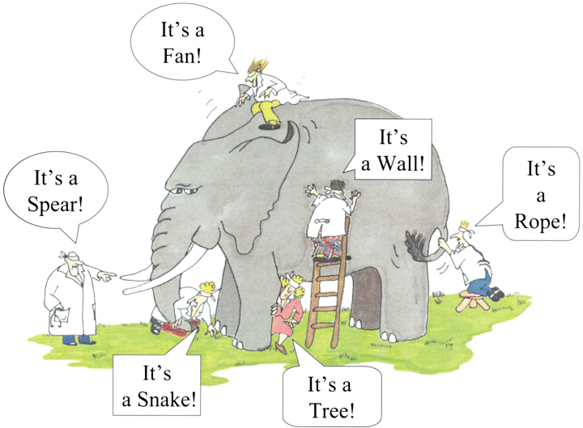
Six Blind Men & the Elephant
Notes:
[Lead in to next slide] Last year Water Safety USA, who most of you will know is a roundtable of longstanding national nonprofit and governmental organizations with a strong record of providing drowning prevention and water safety programs in the U.S., started talking about the need for a National Action Plan and started thinking through how that might happen. We suggested a three stage development process

Slide 6
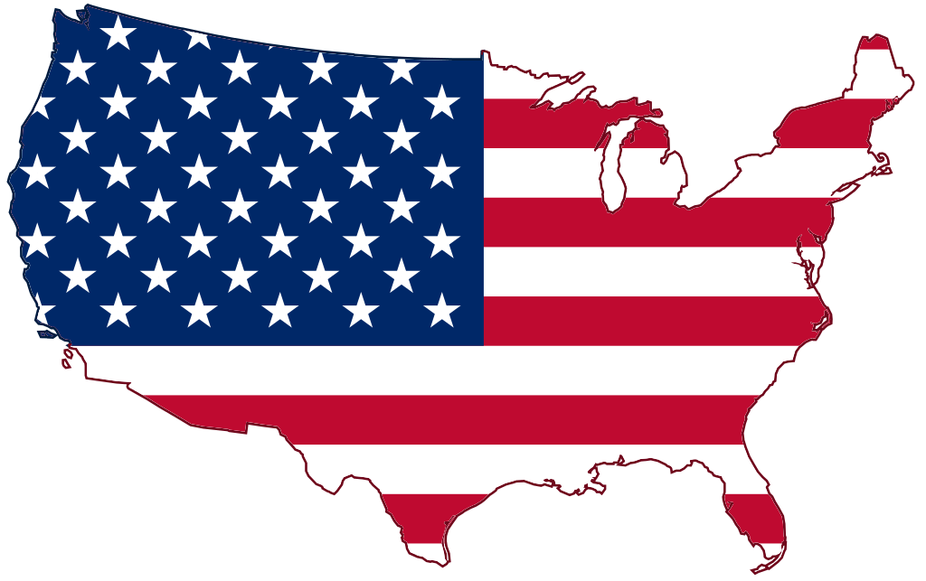
Three Stage Development Process
❶ | Establishing the scope and selecting a framework that supports development and implementation
❷ | Establishing multi-sectoral working groups to develop goals, objectives and actions
❸ | Convening a high-level expert panel to finalize the plan
All three stages supported by a communications plan

Slide 7
What can we learn from other countries?
Australia
Canada
Ireland
New Zealand
United Kingdom
Notes:
Our starting point was what can we learn from others who have already started and/or completed this task?
We looked at a number of plans and ended up reviewing in detail the national plans from five high income countries.

Slide 8
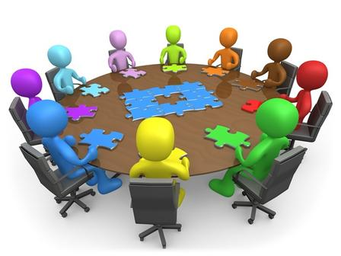
Lessons learned…
Strong leadership
Engage stakeholders
Provide opportunities for input, reflection and feedback
Data driven priorities
Set targets and plan to monitor progress
Utilize working groups on key focus areas
Identify unresolved research questions
Recognize the importance of changing culture
Align agency strategy and community action
Provide a framework to guide work of local authorities
Challenge stakeholders to take ownership and play their part
Notes:
Different lessons learned came from different countries. (Australia, Canada, Ireland, New Zealand, and United Kingdom reviewed to determine points of clarity.)

Slide 9
Area/Focus | Australia | Canada | Ireland | New Zealand | United Kingdom
Target high risk populations | X | X | X | X | X
Address different water settings | X | X | X | X | X
Address equipment and environments | X | X | X |  | X
Address disasters and extreme weather | X
Research | X | X | X
Policy / Advocacy | X |  | X | X
Workforce / Training / Sector Capability and Capacity | X |  | X | X
Water Safety Education | X |  | X children | X | X children
Community-level risk assessment and water safety planning |  |  | X | X | X
Public awareness | X | X | X | X | X
Notes:
Taking a look at where those plans focused, you can see some consistencies
High risk populations – children, young people, adult males, elderly, new immigrants, alcohol and drug use
Water settings – pools, coastal waters, inland waters
Equipment and environments – boating industry / aquatic industry / recreational activity organizations
Water Safety Education
Public Awareness
[Lead in to next slide] So last fall we undertook a brainstorming exercise and blew it up really big and then sorted and grouped and realized that in the end it was all focused around evidence-based strategies…

Slide 10
Proposed Scope
10-year plan
Focus on 5 evidence-based strategies plus the necessary infrastructure and capacity building to support their implementation
Life jackets/PFDs
Swimming lessons / Water competency
Supervision / Lifeguards
Rescue / CPR
Pool fencing
Notes:
[Lead into next slide] But what sort of framework will work in the U.S.
Given the size of the U.S. and the multiple jurisdictions involved in water safety across the country, the 1000s of stakeholders, one size will not fit all. But we know enough about what works that there is an opportunity to provide guidance, encourage standardization, develop minimum requirements, etc. But we also wanted a way to engage and challenge those jurisdictions to get involved, to respond to the issue.

Slide 11
Proposed Framework
Model-based – establishing what a “model” Water Safety State, Water Safety County, Water Safety City/Community should look like
Guidance in terms of standards, guidelines, model policies
National level action to support efforts at other levels including a monitoring plan to assess progress towards achievement of the models in the form of a report card every 5 years
Notes:
Monitoring on what we want to see in place (putting a flag in the system where we want change), and providing tools to support that change will hopefully drive action in the desired direction.
If some early adopters take up the charge, it will also help create a little bit of a competitive situation in neighboring states, between cities, etc. that will hopefully increase engagement and action over time.

Slide 12
Next steps
Presentations at relevant conferences/meetings to engage the field
Obtaining funding for a position to help coordinate the process
Establishing a way to identify interested stakeholders to make up the Working Groups
Notes:
We anticipate work will start later in 2019 but are currently short of our funding goal.

Slide 13
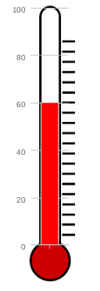
Funding contributions to date
GOAL PER YEAR TO GET STARTED $40K
Organization | Year 1 | Year 2
National Swimming Pool Foundation | $6,000 | $6,000
American Red Cross | $5,000 | $5,000
YMCA of the USA | $5,000 | $5,000
Safe Kids Worldwide | $5,000 | $5,000
United States Lifesaving Association | $5,000 | $5,000
Linda Quan (for AAP) | $5,000 | -
David Bell | $2,500 | $2,500
Notes:
We anticipate work will start later in 2019 but…

Slide 14
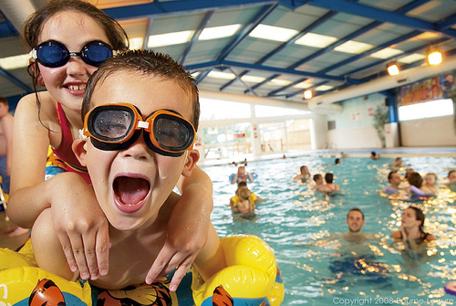
Questions?

Slide 15
For more information or to share your interest:
Keith Christopher
Member representative
Water Safety USA
keithchr@gmail.com
Cell: 682-701-7331

