Slide 1
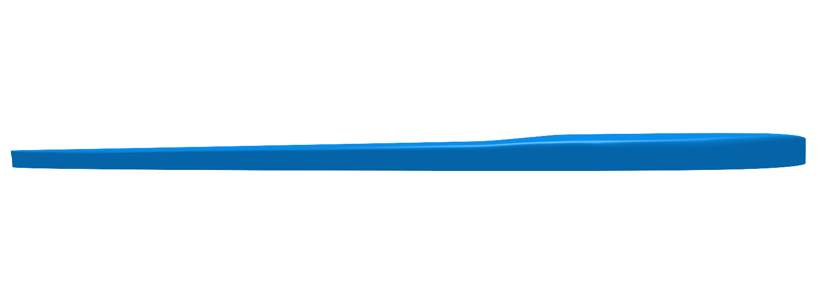
The Future of sup
Todd bishop

Slide 2
2003

Slide 3
2010

Slide 4
Insert cool wave pic here

Slide 5
Another one

Slide 6
“To err is human”
–Alexander pope

Slide 10
SUP explosion
Exposure by surfers
Social media and the internet
Millenials
Era of self employment, crowdfunding, online biz

Slide 11
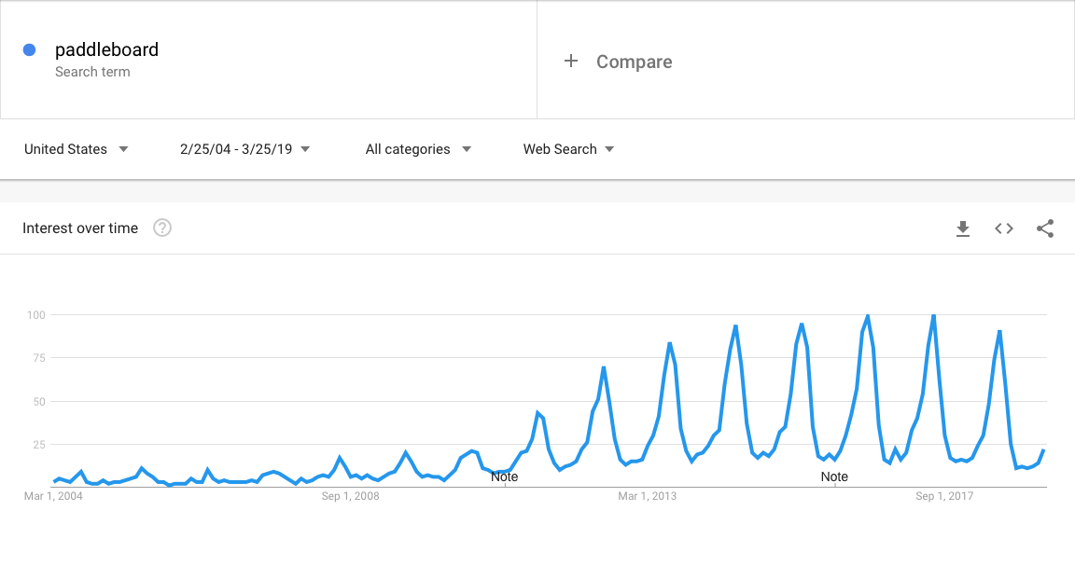

Slide 12
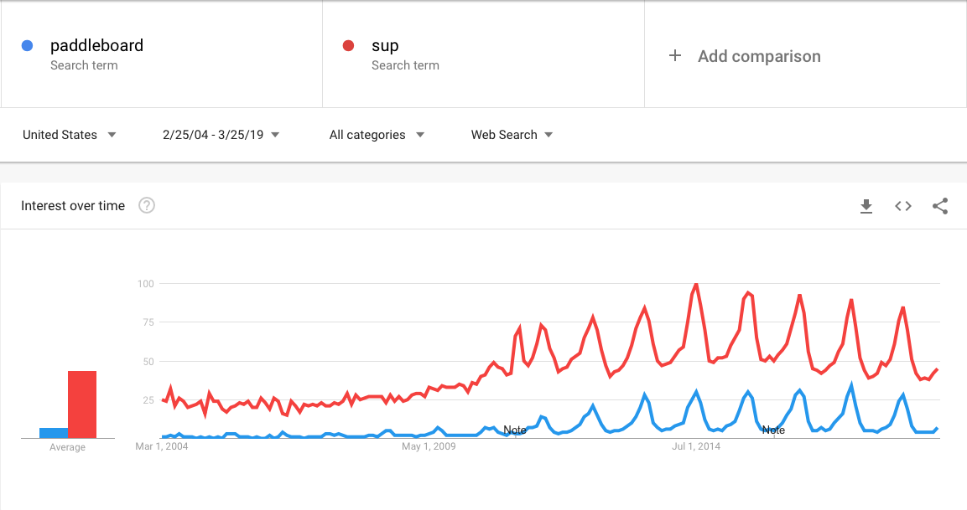
2009-2010 - recession ending

Slide 13
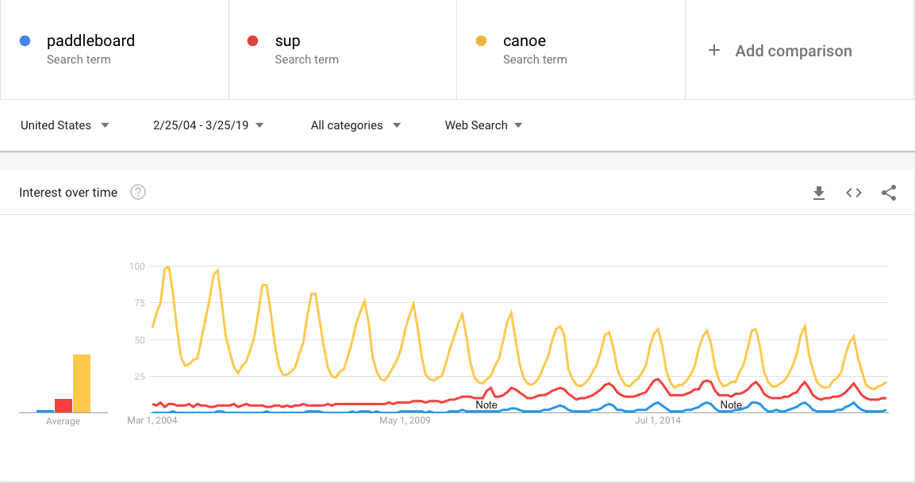

Slide 14
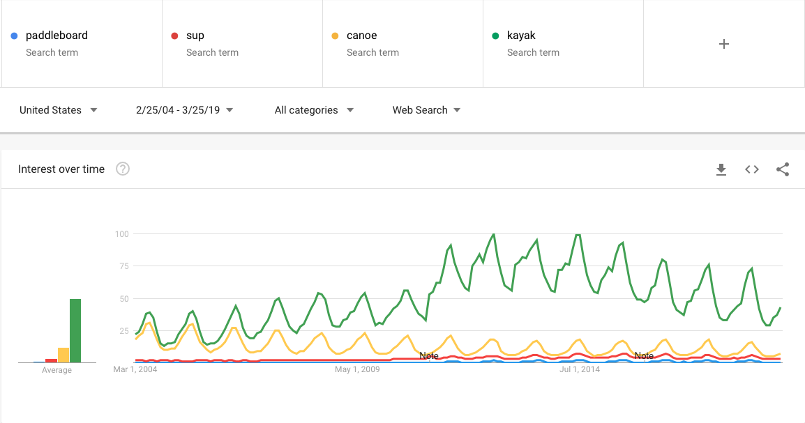
Kayak fishing?

Slide 15
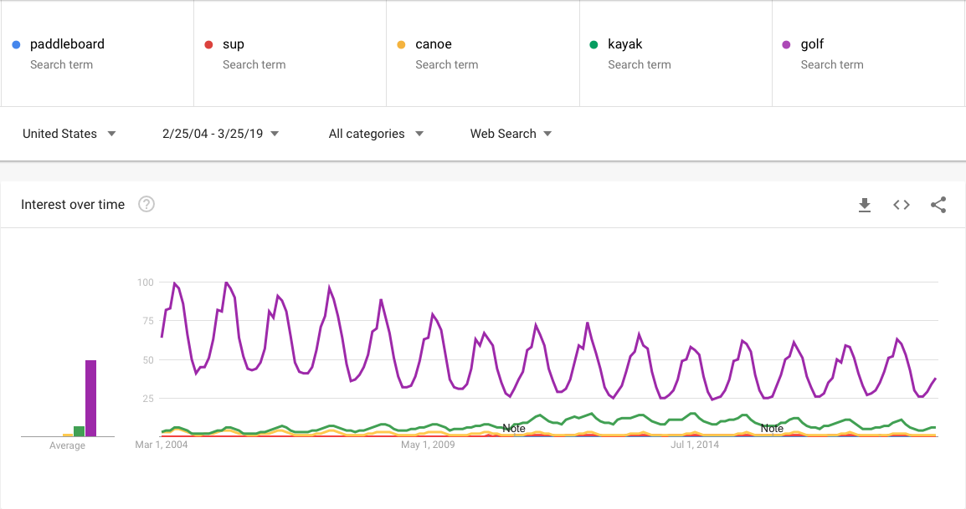

Slide 16
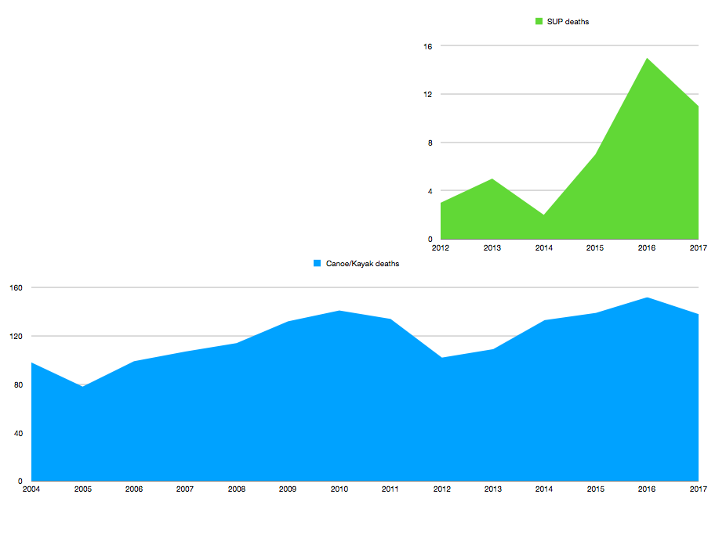

Slide 17
Causes of incidents
PFDs - Selection/use & wear
Venue - Understanding specific challenges
Self - Awareness of abilities and experience

Slide 21
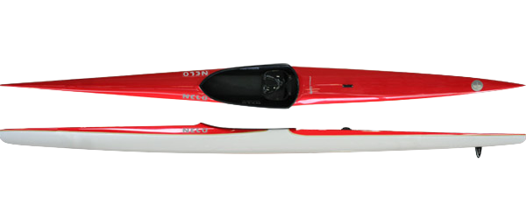

Slide 24
What can we do to support?
Specific signage - safety recommendations/gear
Sharing of videos - Cold water boot camp 1min/10min/1hr
PFD type education (type 3 vs 5 inflatables)
Social media campaigns

Slide 25
The future of sup
Todd bishop

