Slide 1
Engaging with Public Officials in Water Safety
Creating Opportunities for Advocacy
Liz Schmidt, Director of Community Water Safety
YMCA of South Palm Beach County

Slide 2
AGENDA
Civics 101
Understanding Advocacy
Who are you local, sate and federal officials – How to find them
Understanding the Legislator’s World
Building Relationship
How to Craft a Message
Communication with Law & Policy Makers
Advocating at the Community Level
Opportunitites in Advocacy
2
| CREATING OPPORTUNITY FOR ADVOCACY | ©2017 Florida Alliance of YMCAs

Slide 3
Civics 101

Slide 4
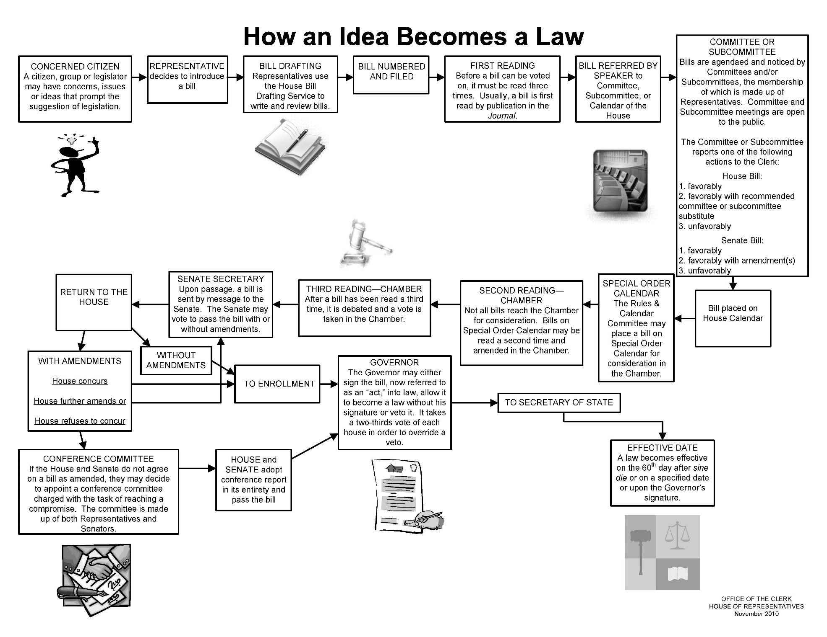
HOW AN IDEA BECOMES A LAW
4
| PRESENTATION TITLE HERE | ©2011 YMCA of the USA

Slide 5
How does an idea become a law?
Idea is brought to the attention of the elected official
Drafted into Bill/Legislation
Either Chamber can file a Bill –however a Companion Bill is very helpful
Proposed Bill is amended/debated through Committee(s)
Companion Bill is going through same process – if only filed in one Chamber them must go through the process again in second Chamber
Goes between Chambers until consensus is reached
Once identical Bills are passed in both House and Senate then goes to Executive Branch for signature (can be vetoed)

Slide 6
UNDERSTANDING ADVOCACY

Slide 7
Lobby or Advocacy?
Lobby
Advocacy
Attempt to influence a public official on an issue
Asking for something specific
Their vote on a Bill
Emailing members of a group asking them to contact an official
Generating petition
Arguing in favor of a cause or idea that have an effect people
Educating a political official on a specific issue
“Educate to Legislate”

Slide 8
ADVOCACY VS LOBBYING
ADVOCACY
“Ask your legislator to support healthy choices for our children!”
“Sign up to attend the walk for healthy foods in Corsicana!”
“As a concerned member of the Tampa community, I ask all my neighbors to join me in supporting access to healthy food in afterschool programs for our children.
LOBBYING
“Contact your legislator and ask him/her to support House Bill 267”.
“Click here to sign the petition to support Senate Bill 920”.
A communication that supports bills not yet introduced: “Florida should appropriate $6 million to support diabetes prevention.”

Slide 9
UNDERSTANDING ADVOCACY
What is Advocacy?
Activity by an individual/group whose goal is to influence public-policy
Why Bother?
Concerned citizens make the best spokesperson.
Politics is Not a Spectator Sport!
Successful groups know that increased public involvement works.
Legal Considerations…Advocating vs. Lobbying
Provide information
Educate lawmakers on problems in your community
Helping lawmakers understand the difficulty in funding
Provide opportunities for lawmakers to meet with those in treatment and recovery.
9
| CREATING OPPORTUNITY FOR ADVOCACY | ©2017 Florida Alliance of YMCAs

Slide 10
MY JOURNEY IN ADVOCACY

Slide 11
WaterSmart Palm Beach County
WaterSmart Broward Influence
Local community buy-in
Small wins and successes
Setting Goals
Strategic Plan and Operational Plan
Sharing our work

Slide 12
WaterSmart FL
Building a coalition
Best Practices and Lessons Learned
Same work, larger scale
Sharing progress

Slide 13
First Congressional Hearing on Water Safety
Partnerships, Partnerships, Partnership
Who is the constituent and making the most of it
Have a plan/agenda
Have a clear message
Working as a team

Slide 14
UNDERSTANDING THE LEGISLATOR’S WORLD

Slide 15
Who are your representatives & how do you find them?
Finding your Representatives
Know the representatives where you live
Know the representatives where you work
www.commoncause.org
www.house.gov
www.senate.gov
Learn about them
What are their major platforms?
What Committees are they on?
What previous legislation have they filed/sponsored?
What do they enjoy in their personal life?
What type of activities/industry is impacted in their District/State?

Slide 16
UNDERSTANDING THE LEGISLATOR’S WORLD
Legislators are Neighbors
You or someone you know probably has personal connection
Discover common interests and values you both share
Make an effort to build on them
Complexity of a Legislator’s Job
Represents a community with varying interests
They live in a world of COMPROMISE
They are expected to know something about everything
Constituent’s goals vs. personal values
Loyalty to political party
Personal friendships
Varying perceptions on a complex issue
Demands on Time
In high demand
Career in addition to legislating
Family
16
| CREATING OPPORTUNITY FOR ADVOCACY | ©2017 Florida Alliance of YMCAs

Slide 17
BUILDING RELATIONSHIPS

Slide 18
UNDERSTANDING THE LEGISLATOR’S WORLD
Understand the legislator
Understand the district
Be familiar with the legislator’s record and position in the legislature
Remember that everything is local
Recognize the legislator
Keep in touch with the legislator year round
Support their efforts
18
| CREATING OPPORTUNITY FOR ADVOCACY | ©2017 Florida Alliance of YMCAs

Slide 19
Opportunities to Lobby and Advocate
Letters
Phone Calls
Public Meetings/Committee Hearings
Summer Advocacy
Advocacy Days
Roundtable Discussions
Site Visits
Attending Local Meetings

Slide 20
Congressional Letters
Congressional letters very common
Introduce your case
Can provide evidence, reference past legislation
Can be group together with similar letters for canned response
Does not always convey the emotion behind the issue
Keep it brief and to the point
Ensure to state that you live or work in their district

Slide 21
Phone Class
Will usually reach a live person
Contact both District Office and DC Office
Great way to make connections with Staffers
Request a meeting with District Staff – important to make them your allies
Quicker follow up

Slide 22
Advocacy Days
Choose a date or join an already scheduled event – be sure to register
Able to reach a high volume of Staffers and Political Leaders
Great opportunity for face-to-face meetings
Able to form Coalitions with other groups and agencies
Create a string Call-to-Action and have a clear agenda– stay on same message
Ensure to have packets of information available to distribute
Promote the event on social media and local media (press release)

Slide 23
Summer Advocacy
Generally spend more time in Home District
Great time for site visits
Can be as simple as follow up from other advocacy days, roundtable discussions or meetings

Slide 24
Roundtable discussions
Great way to get a large group together of similar work
Time for Politician to listen and hear the issues/concerns at the local level
Be sure to provide constructive input - Have your talking points prepared
Select a strong Moderator
Be selective on the invites
Start with one great question “If you could do one thing to fundamentally make boating safer what would it be?” – really gets the conversation going

Slide 25
Site Visits
One of the best ways to see your work in action
Can be a “typical day” or can be a Special Event
Sometimes they have to see it to understand it
Be sure to plan the site visit
Have an agenda – who is going to do what, say what, provide what
Create an experience
Invite local media
Promote event on social

Slide 26
Show up!
Successful advocacy starts and continues by showing up and being consistent
Attend local meetings
Speak up when necessary/appropriate
Create connections with local District Staff
Ask how you can help

Slide 27
HOW TO CRAFT A MESSAGE

Slide 28
HOW TO CRAFT A MESSAGE
Who is your target audience?
What do you hope to accomplish?
What do THEY care most about?
Maximize on your “Story”
Fit your “Story” into what will most appeal to them
28
| CREATING OPPORTUNITY FOR ADVOCACY | ©2017 Florida Alliance of YMCAs

Slide 29
COMMUNICATING WITH LAW & POLICY MAKERS

Slide 30
COMMUNICATING WITH LAW & POLICY MAKERS
Remember the Legislative Staff
Legislators rely heavily staff
Face to Face Meetings with Legislator
Focus on a single issue
Speak clearly, brief, and provide materials
Always send a follow-up letter
Written Correspondence
Be sure to spell your legislator’s name correctly
Focus on single issue
Type/write briefly, clearly and on letterhead
Support your statements with facts
Always be polite
The No No’s
Never threaten a lawmaker
Never remind them of broken promises
Avoid communicating too often
Avoid using technical jargon.
30
| CREATING OPPORTUNITY FOR ADVOCACY | ©2017 Florida Alliance of YMCAs

Slide 31
COMMUNICATION TIPS - PART 1
Cordial
Greet with a smile
Thank a legislator for time and leadership
Credible
Provide accurate information
Be honest, especially when representing an opposing view.
Convincing
Speak with passion and confidence
Be firm and direct
Clear
Stay focused
State a problem AND a solution
31
| CREATING OPPORTUNITY FOR ADVOCACY | ©2017 Florida Alliance of YMCAs

Slide 32
COMMUNICATION TIPS - PART 2
Concise
Keep meetings and letter brief
Know all sides of an issue
Be able to articulate an opposing view
Creative
Present your message in a way that will be remembered
What’s your Y Story?
Coalitions and Partners
Identify community partners
Expand the group and let the legislator know of your broad- based support.
Celebrate Victories
Let your legislators know of your successes no matter how small
Thank them for their leadership. Look for ways to publicly thank them, too.
32
| CREATING OPPORTUNITY FOR ADVOCACY | ©2017 Florida Alliance of YMCAs

Slide 33
THANK YOU
Liz Schmidt, Director of Community Water Safety
YMCA of South Palm Beach County
Lschmidt@ymcaspbc.org

