Slide 1


The Next Generation of
Boating Education Standards

Slide 2
PRESENTED BY:
Jeff Wheeler, 2019 ESP Chair
Amanda Pérez, ESP Vice-Chair
Pamela Dillon, NASBLA
IBWSS – March 25, 2019| Jacksonville, FL

Slide 3
Submit questions via the IBWSS app!
Open the Attendify app
Click on “Activity Stream” in the menu
Click on “What’s on your mind?” at the bottom
Type @IBWSS2019 then your question
*All attendees received instructions to download the app in their email.

Slide 4
2019 NATIONAL BOATING EDUCATION STANDARDS PANEL MEMBERS
Last Name | First Name | City, State/ District / Province | Interest Category
Beck | Bob | Bentonville, AR | Commercial
Belmore | Carolyn | East Falmouth, MA | NGO/Nonprofit
Boivin | Gordon | Huntington Beach, CA | Public
Brandenstein | Bob | Freedom, PA | NGO/Nonprofit
Cossette | Edward | Dallas, TX | Commercial
Jackson | Kim | Anthem, AZ | State Boating Agency
Lentz | Ernie | Coldwater, MS | Federal Boating Agency
McCullough | Joe | Anchorage, AK | State Boating Agency
Munns | Harry | Hermosa Beach, CA | Public
Perez | Amanda | Annapolis, MD | Commercial
Chanski | Mark | Mystic, CT | Public
Spice | Tim | Smithville, TX | State Boating Agency
Taylor | Walt | Boston, MA | Federal Boating Agency
Underwood | Joshua | St. Augustine, FL | State Boating Agency
Wheeler | Jeff | Washington, DC | Federal Boating Agency
Dillon | Pam | Lexington, KY | NASBLA ESP Staff

Slide 5
WHY IS THIS IMPORTANT?
1
Let’s look at the numbers.

Slide 6
States have reported over 5 million course certificates issued based on the National Boating Education Power Standard 2007 - 2017!

Slide 7
EVOLUTION OF DEVELOPMENT
2
Timeline.

Slide 8
EVOLUTION OF DEVELOPMENT
NASBLA standards evolved via work of committees (LE and Education) and RBS Community
1987 – ‘98

Slide 9
EVOLUTION OF DEVELOPMENT
NASBLA standards evolved via work of committees (LE and Education) and RBS Community
Standard accepted/recognized by NASBLA membership for reciprocity concerns
1987 – ‘98
1999

Slide 10
EVOLUTION OF DEVELOPMENT
NASBLA standards evolved via work of committees (LE and Education) and RBS Community
Various changes adopted
Standard accepted/recognized by NASBLA membership for reciprocity concerns
1987 – ‘98
1999
2000 – ‘10

Slide 11
EVOLUTION OF DEVELOPMENT
NASBLA standards evolved via work of committees (LE and Education) and RBS Community
Various changes adopted
National Boating Education Standards Panel (ESP) created to open the process.
Standard accepted/recognized by NASBLA membership for reciprocity concerns
1987 – ‘98
1999
2000 – ‘10
2011

Slide 12
EVOLUTION OF DEVELOPMENT
NASBLA standards evolved via work of committees (LE and Education) and RBS Community
Various changes adopted
National Boating Education Standards Panel (ESP) created to open the process.
Standard accepted/recognized by NASBLA membership for reciprocity concerns
ANSI recognition of NASBLA/ESP as Accredited Standards Developer
1987 – ‘98
1999
2000 – ‘10
2011
2014

Slide 13
EVOLUTION OF DEVELOPMENT
NASBLA standards evolved via work of committees (LE and Education) and RBS Community
Various changes adopted
National Boating Education Standards Panel (ESP) created to open the process.
Standard accepted/recognized by NASBLA membership for reciprocity concerns
ANSI recognition of NASBLA/ESP as Accredited Standards Developer
1987 – ‘98
1999
2000 – ‘10
2011
2014
2014 – ‘18
4 knowledge standards and 2 Registered Tech Reports

Slide 14
EVOLUTION OF DEVELOPMENT
NASBLA standards evolved via work of committees (LE and Education) and RBS Community
Various changes adopted
National Boating Education Standards Panel (ESP) created to open the process.
Standard accepted/recognized by NASBLA membership for reciprocity concerns
ANSI recognition of NASBLA/ESP as Accredited Standards Developer
1987 – ‘98
1999
2000 – ‘10
2011
2014
2014 – ‘18
4 standards and 2 Registered Tech Reports
2019 – NEW APPROACH TO MOVE FORWARD!

Slide 15
CORE & CORE PLUS
3
Next Generation Standards.

Slide 16
WHAT IS CORE & CORE PLUS?
At this point…. A recommendation only!
Will be posted for public review/comment
Let’s take a closer look….

Slide 17




WHAT IS CORE & CORE PLUS?
Core content will be used in ANY boating course:
Power
Sail
Human Propelled
Other? (Passenger Safety, etc.)

Slide 18
PLUS
WHAT IS CORE & CORE PLUS?
?
?
Vessel specific content (e.g. Power, Sail, Human Propelled, Jet-Propelled) is the PLUS in Core-Plus!

Slide 19
WHAT IS CORE & CORE PLUS?
BOTH Core and Core Power would be needed for the NASBLA Course Approval Process.

Slide 20
CORE CONCEPT DRAFT
Title: Basic Boating Knowledge – Core
SCOPE: This standard establishes the essential knowledge needed to reduce recreational boating risk factors and mitigate their effects. This standard is designed to be combined with discipline-specific power, sail, and/or human-propelled standards (Core-Plus) for development of basic boating education courses and student assessment. This standard applies to basic boating knowledge for all disciplines of recreational boating in the U.S. states, territories, and the District of Columbia.

Slide 21
EXAMPLE: CORE CONCEPT DRAFT
The boater will be able to…
1.0 Terminology
1.1 Define and demonstrate knowledge of basic Nautical Terms (e.g. vessel, port, starboard, bow, stern, stand-on, and give-way).
2.0 Boat Types and Characteristics
  2.1 Describe three types of boats (power driven vessel, sailing vessel, and vessels under oars) as found in the Navigation Rules.
  2.2 Determine a boat’s capacity by locating and determining gross load capacity (total weight and number of persons) from the boat capacity plate.
  2.3 Determine a boat’s capacity if a capacity plate is not present.
  2.4 Describe how to determine acceptable loading including the benefits and methods of stowing and securing gear and equipment properly aboard a boat.
‘student outcome’ language vs. ’prescriptive language’

Slide 22
EXAMPLE: CORE CONCEPT DRAFT
The boater will be able to…
1.0 Terminology
1.1 Define and demonstrate knowledge of basic Nautical Terms (e.g. vessel, port, starboard, bow, stern, stand-on, and give-way).
2.0 Boat Types and Characteristics
  2.1 Describe three types of boats (power driven vessel, sailing vessel, and vessels under oars) as found in the Navigation Rules.
  2.2 Determine a boat’s capacity by locating and determining gross load capacity (total weight and number of persons) from the boat capacity plate.
  2.3 Determine a boat’s capacity if a capacity plate is not present.
  2.4 Describe how to determine acceptable loading including the benefits and methods of stowing and securing gear and equipment properly aboard a boat.
‘student outcome’ language vs. ’prescriptive language’
Additional detail added to help with NASBLA review/approval process

Slide 23
EXAMPLE: CORE CONCEPT DRAFT
Section Headers cover…
1.0 Terminology
2.0 Boat Types and Characteristics
3.0 Required Equipment
4.0 Trip Planning and Preparation
5.0 Seamanship and Safe Operation
6.0 Basic Response to Emergency Situations
7.0 Aids to Navigation
8.0 Environmental Concerns

Slide 24
PLUS POWER…
Title: Basic Boating Knowledge – Power
SCOPE: This discipline-specific standard, when combined with the Basic Boating Knowledge – Core standard, establishes minimum essential knowledge to reduce recreational powerboating risk factors. The combined standards are to be used for development of basic boating education courses and student assessment for power driven vessels. This standard applies to basic power boating knowledge in the U.S. states, territories, and the District of Columbia.

Slide 25
EXAMPLE: PLUS POWER DRAFT
The boater will be able to…
1.0 Vessel Registration/Documentation and Numbering
Describe how to adhere to state, and federal laws and regulations.
2.0 Equipment
2.1 Fire Extinguishers as legally required.
Describe:
Carriage requirements for fire extinguishers;
The types of fire extinguishers needed for different types of fires;
The importance of placing in “readily accessible” locations; and
The need for following manufacturer’s recommendations for inspection and maintenance.
2.2 Back-Fire Flame Control Device
Describe the requirement, purpose and maintenance of a back-fire flame control device.
2.3 Ventilation Systems
Describe the purpose, requirements, and maintenance of ventilation systems.

Slide 26
EXAMPLE: PLUS POWER DRAFT
Section Headers cover…
1.0 Vessel Registration/Documentation and Numbering
2.0 Equipment
3.0 Preventative Maintenance
4.0 Trailering
5.0 Fueling
6.0 Anchoring
7.0 Maneuvering
8.0 Power Boat Safety
9.0 Personal Watercraft

Slide 27
CURRENT STANDARD
►Draft Core ►Draft Plus Power
1.0 Vessel Registration/Documentation and Numbering
► 1.1 Boat Capacities
2.0 Boating Equipment
►2.1 PFD’s
► 2.2 PFD Availability and Sizing
► 2.3 Wearing Life Jackets
► 2.4 PFD Serviceability
► 2.5 Fire Extinguisher Equipment
► 2.6 Back-Fire Flame Control Device
► 2.7 Ventilation Systems
► 2.8 Navigation Light Equipment
► 2.9 Sound Signaling Equipment
► 2.10 Visual Distress Signal Equipment
3.0 Trip Planning & Preparation
► 3.1 Checking Local Weather and Water Conditions
► 3.2 Checking Local Information
► 3.3 Filing a Float Plan
► 3.4 Boat Preventative Maintenance
► 3.5 Launching and Retrieving from a Trailer
► 3.6 Fueling Procedures
► 3.7 Pre-Departure Checklist and Passenger Communication
4.0 Safe Boat Operation
► 4.1 Operator Responsibilities
► 4.2 Influence of Drugs and Alcohol
► 4.3 Navigation Rules
► 4.4 Aids to Navigation
► 4.5 Docking and Mooring
► 4.6 Anchoring
► 4.7 Carbon Monoxide
► 4.8 Propeller Intervention & Awareness
5.0 Emergency Preparedness
► 5.1 Rendering Assistance
► 5.2 Capsizing/Falls Overboard
► 5.3 Cold Water Immersion
► 5.4 Fire Emergency Preparedness
► 5.5 Running Aground Prevention and Response
6.0 Other Water Activities
► 6.1 Water-Jet Propelled Watercraft
► 6.2 Water Skiing, Towed Devices and Wake Sports
► 6.3 Diving and Snorkeling
► 6.4 Hunting and Fishing
► 6.5 Small Boats

Slide 28
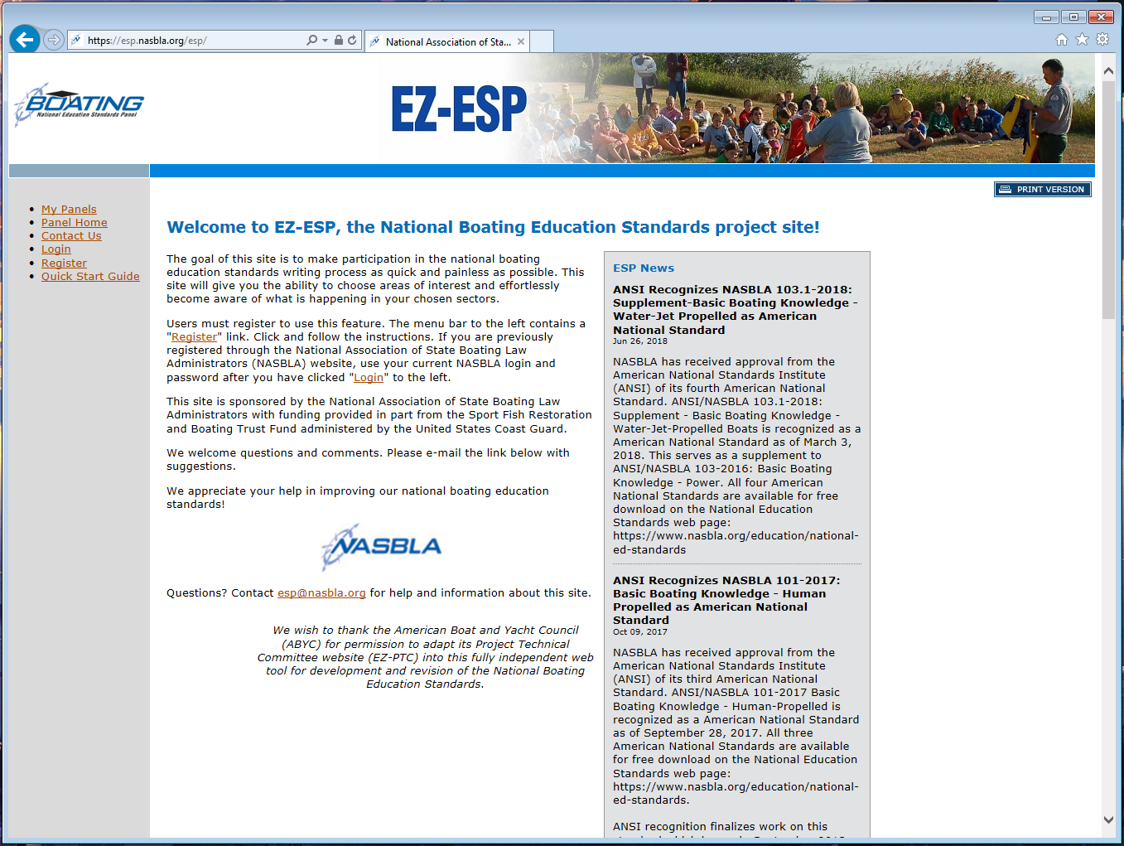
Place your screenshot here
HOW TO COMMENT
https://esp.nasbla.org/esp

Slide 29
Additional Updates on Boating Standards
4
Implementing the Standards.

Slide 30

On-Water Skills Standards
EDU-1 On-Water Power Standard
EDU-2 On-Water Human-Propelled Standard
EDU-3 On-Water Sail Standard
EDU-4 Instructional Approach
www.usnows.org

Slide 31
Third Party On-Water Skills Course Conformity Assessment
Verified Course Process based on….
EDU-1 On-Water Power Standard
EDU-2 On-Water Human-Propelled Standard
EDU-3 On-Water Sail Standard

Slide 32
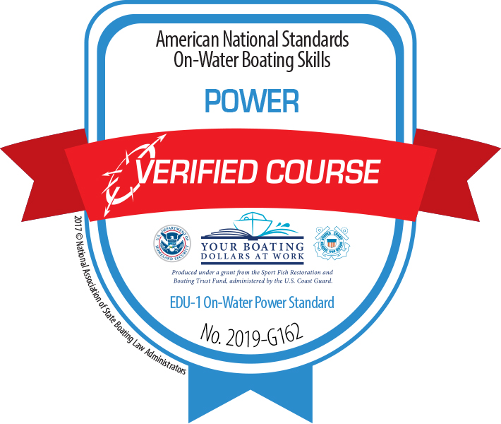
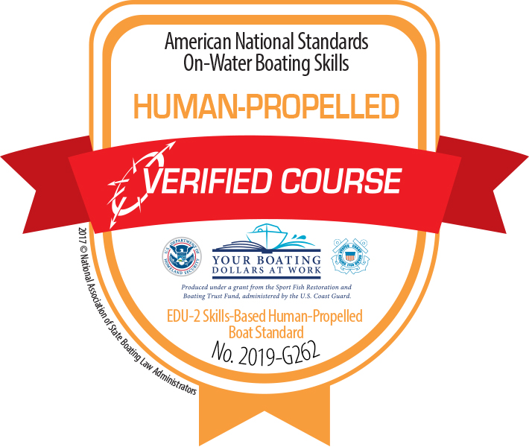
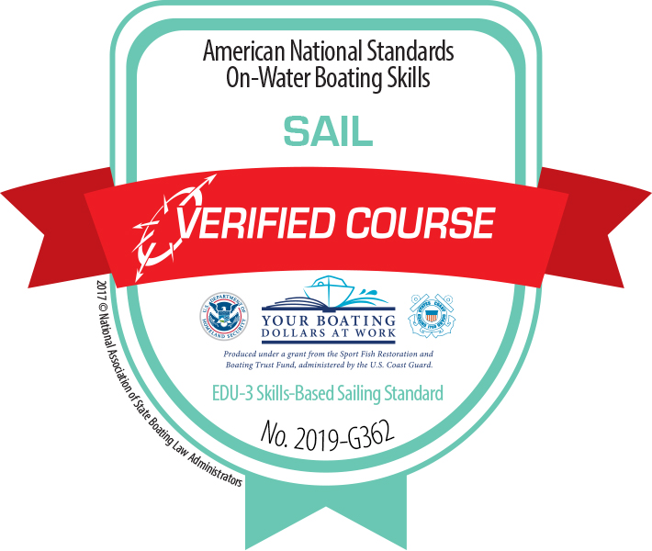
On-Water Skills Course Conformity Assessment
No-cost Verified Course Process (application deadline 7/1/2019)
www.nasbla.org/education/verified

Slide 33
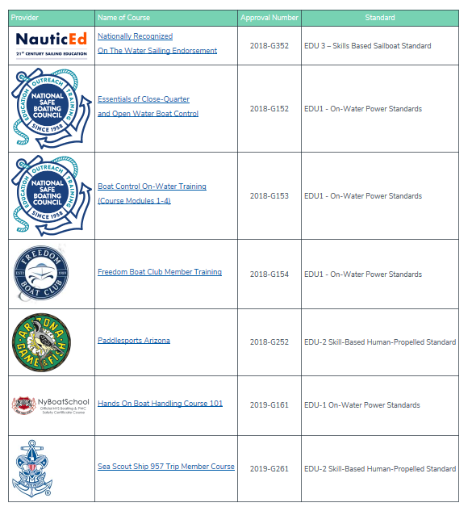
On-Water Skills Verified Courses
“The content of this course conforms to the American National Standard for on-water skills as verified through an independent third-party assessment process.”

Slide 34
THANKS!
Discussion & Questions?

