Slide 1
BUI Enforcement:
Present and Future
A Presentation for the
International Boating and Water Safety Summit
Presented by: Major Richard Moore (FWC ret.)
NASBLA BUI Program Manager
March 25, 2019

Slide 2
Why are we here?
…to make our waterways safer.

Slide 3
From a recreational boating safety perspective, just how significant is the problem with alcohol/drug use?

Slide 4
WHO
REALLY
KNOWS?

Slide 5
PRESENT SITUATION
Casualty Statistics
Officer/Investigator Training
Operation Dry Water
Changes in State Laws

Slide 6
PRESENT SITUATION
Casualty Statistics
“Alcohol use is the leading known contributing factor in fatal boating accidents; where the primary cause was known, it was listed as the leading factor in 19% of deaths.” (2017 report)

Slide 7
PRESENT SITUATION
Casualty Statistics
Officer/Investigator Training
Boating Accident Investigation
BUI Detection and Enforcement

Slide 8
PRESENT SITUATION
Casualty Statistics
Officer/Investigator Training
Operation Dry Water
Launched in 2009 with the goal of deterring boaters from operating under the influence of alcohol or other drugs

Slide 9
PRESENT SITUATION
Casualty Statistics
Officer/Investigator Training
Operation Dry Water
Changes in State Laws
Legalized use of marijuana

Slide 10
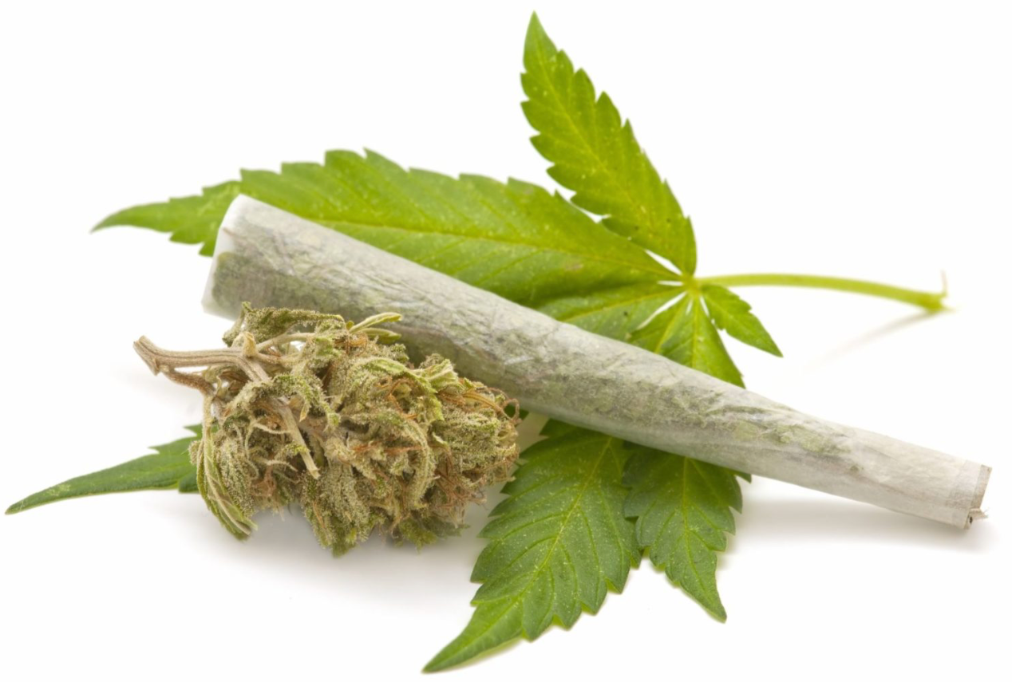
What’s On The Horizon?
Expanding use of the Seated SFSTs to include all states and territories
Instructor credentialing and currency improvements
Better prepare officers to deal with marijuana-impaired operators

Slide 11
Questions?

