Slide 1

Social Influences on Boating Safety
International Boating and Water Safety Summit
March 2019
Learn more at: FunEasyPopular.com

Slide 2
How can we make the world a better place?

Slide 3
Let’s make what’s good more fun, easy and popular.
This is our mission at Marketing for Change Co.

Slide 4
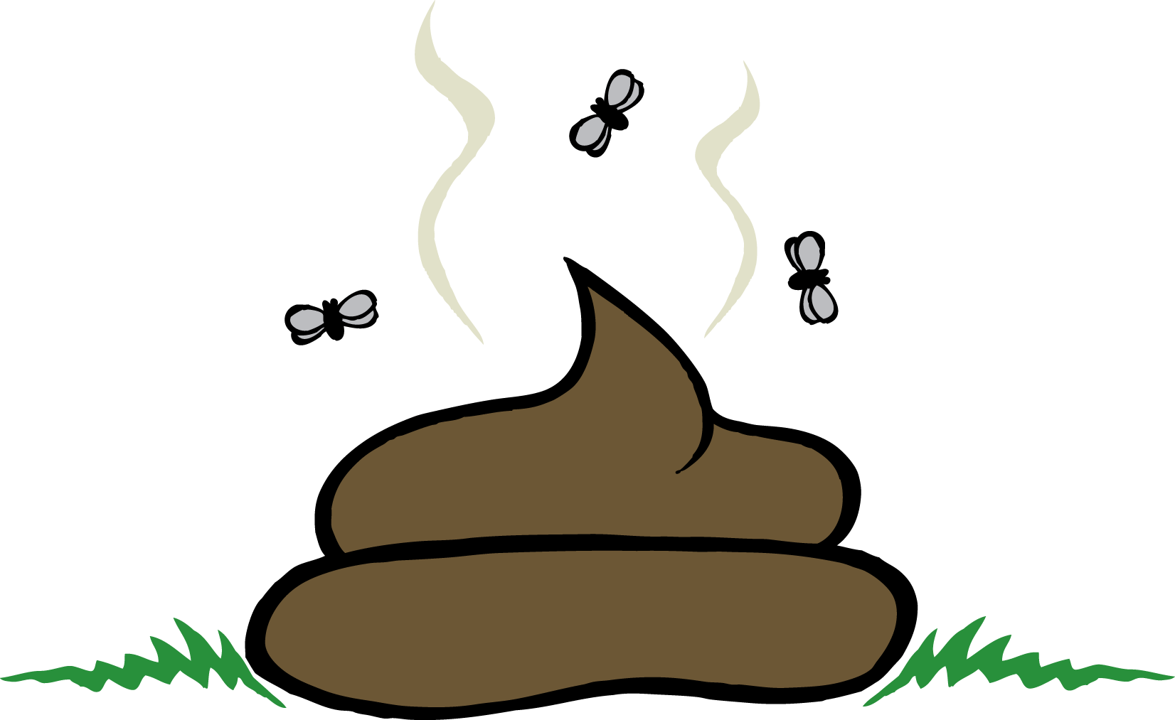
Just one problem:
What we’re selling doesn’t always seem that great
Our Product

Slide 5


We try hard to promote it.
TRY ME!
NEW &
IMPROVED

Slide 6
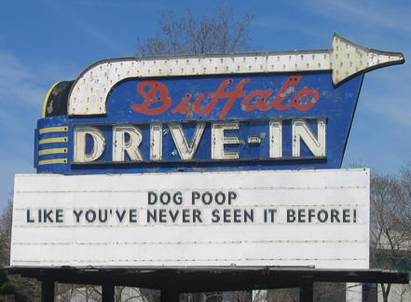
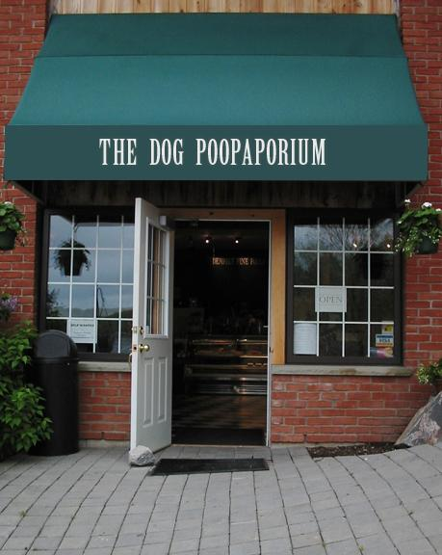
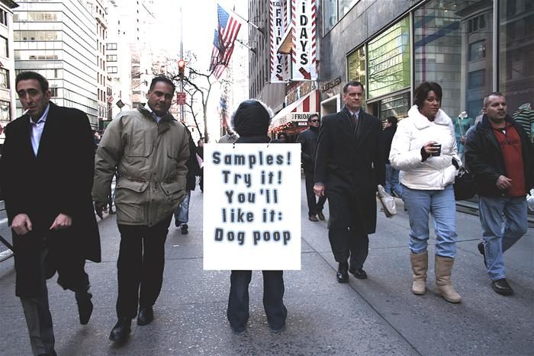
But no matter how creative we get, we can only get so far.

Slide 7

Assignment:
Create a campaign to promote marriage
Client: Social service non-profit with federal grant

Slide 8
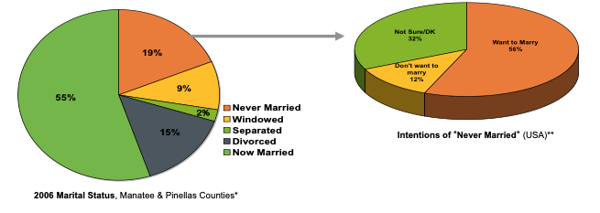
Let’s take a quick look at the data
92% have used or want our product

Slide 9





Marriage – the problem is the packaging
No product differentiation
Marriages all look pretty much the same from the outside. The different prices and benefits of different kinds of marriages are not clear.
Post-Wedding Sticker Shock
Maintenance costs!? Maybe I just got a lemon
Magical thinking
If you marry the right person, it all works out
Work = Bad Sign
Myth: Good marriages don’t need help
Another divorce
People want to return product because it didn‘t meet their unrealistic expectations

Slide 10
Three types of people when it comes to relationships
MAGICAL THINKERS
HELP SEEKERS
RULE FOLLOWERS
Magical Thinking
It is unlikely that a married couple that falls out of love can fall back in love.
Working on your relationship means your marriage is in trouble
As long as a married couple truly love each other everything else should work out.
Help Seeking
Married couples who regularly talk about their relationship are more likely to be happy than those that don’t talk regularly
I would be interested in learning more about creating a stronger relationship
Rule Followers
A child needs a home with both a mother and a father to grow up happily
If a man and a woman plan to spend the rest of their lives together as couple, they should legally get married
When an unmarried man and woman have a child together, they should legally marry
Doomed
Stay Together
Steady

Slide 11


Slide 12
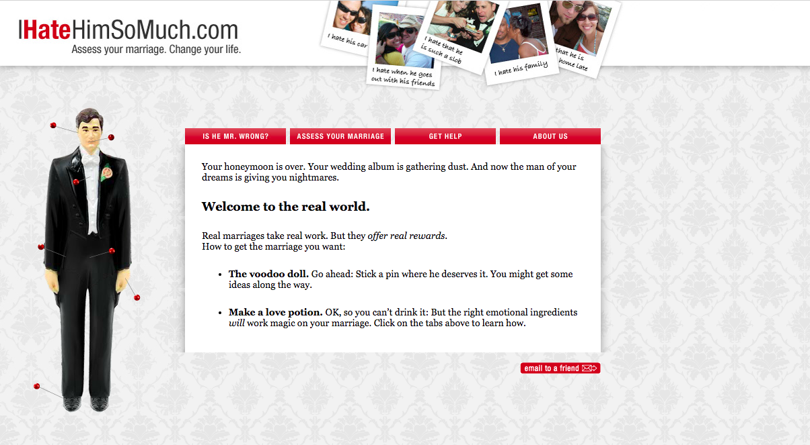

Slide 13

What should I be doing? Why?

Slide 14


Slide 15
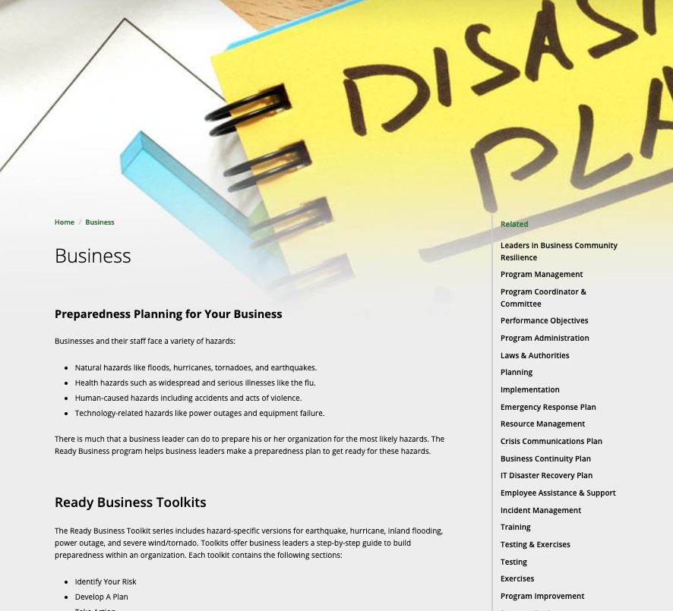
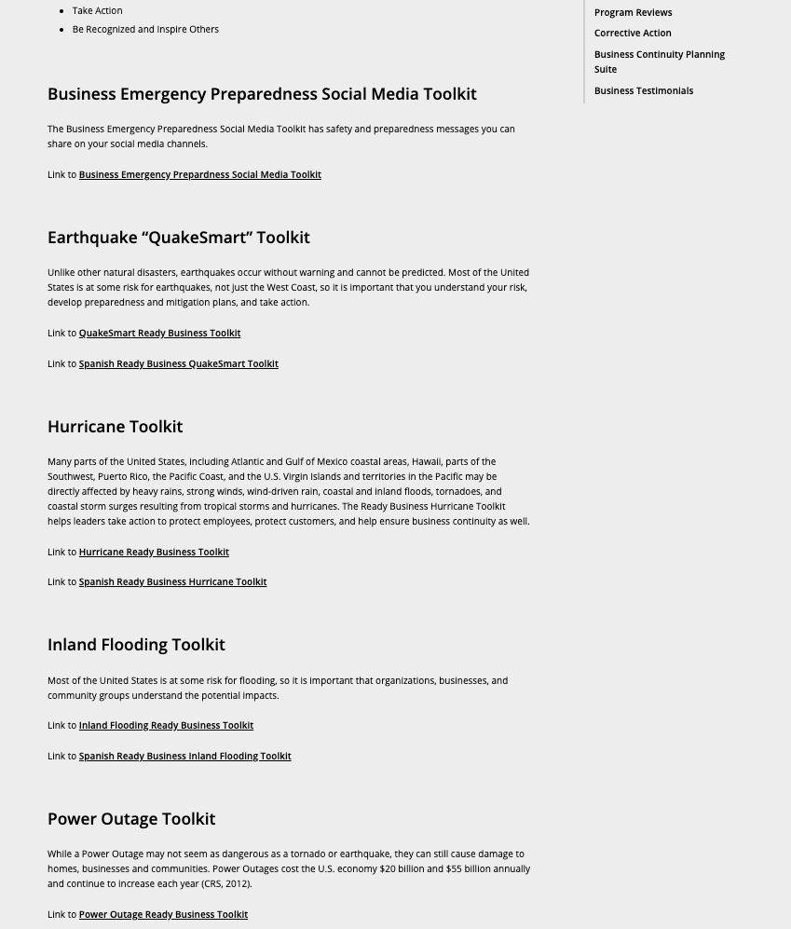

Slide 16
Marketing is an exchange
Buyer
Seller
If you give me that …
… I’ll give you this.
If we want change, we have to offer something in return

Slide 17
Behavior change is all about understanding this exchange: Connecting the change we want with the needs they feel.
What’s the connection?
What people want
What we want people to do

Slide 18
The behavioral determinant makes that link
Behavioral Determinant
(Fun-Easy-Popular)
Needs State
Target Behavior

Slide 19
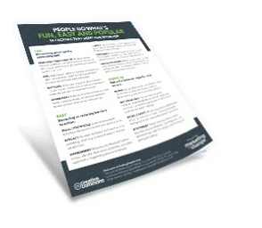
Behavioral determinants for the rest of us
People do what’s fun, easy and popular.
Behavioral Determinant
FUN: Make it more rewarding – or add a punishment. Play to people’s emotions and biases. Clarify risk.
EASY: Simpler or less costly; build skills and efficacy. Improve the environment. Give people more control.
POPULAR: Social norms, social identity, self-standards, attachment.
What Makes People Tick?
14 common factors that
influence human behavior
Available at: FunEasyPopular.com
Notes:
FUN: focusing on GOOD FEELINGS of getting empathetic help to get covered
EASY: reducing INVESTMENT / COGNITIVE LOAD (time needed to figure everything out), increasing SKILLS AND EFFICACY
POPULAR; leveraging LOSS AVERSION.

Slide 20
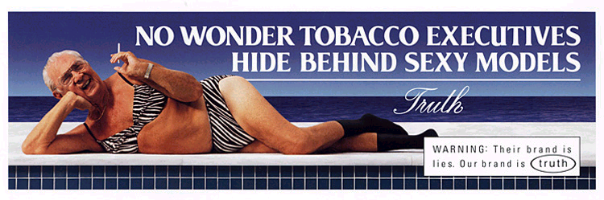
Smoking prevention message (circa mid-1990s):
Hey junior, if you don’t smoke, you can live to be old - just like us!
Better Offer:
Rebel against adults like us - only even more evil!

Slide 21
truth campaign
Behavioral Determinant
(Fun-Easy-Popular)
Needs State
Target Behavior
Teenager
I want to be independent
(and cool … really, really cool)
What to deliver
Control
Norms
Self-Standard
Teenager’s Action
Refuse a cigarette from a friend

Slide 22
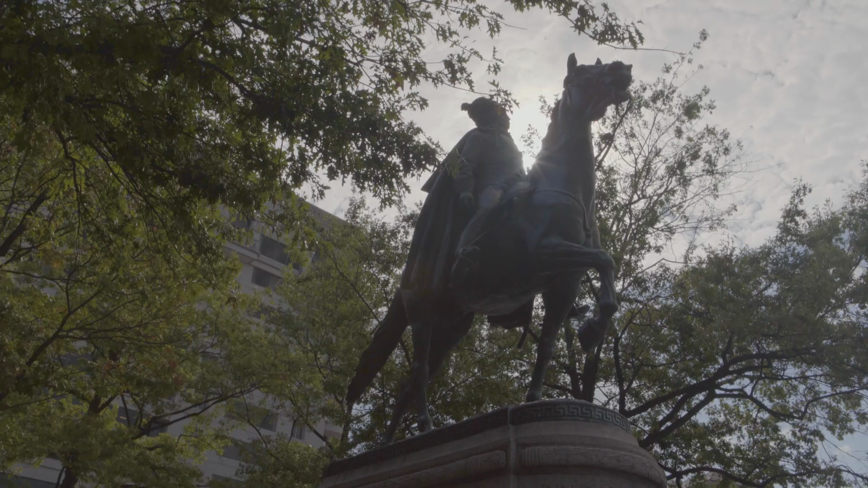

Slide 23
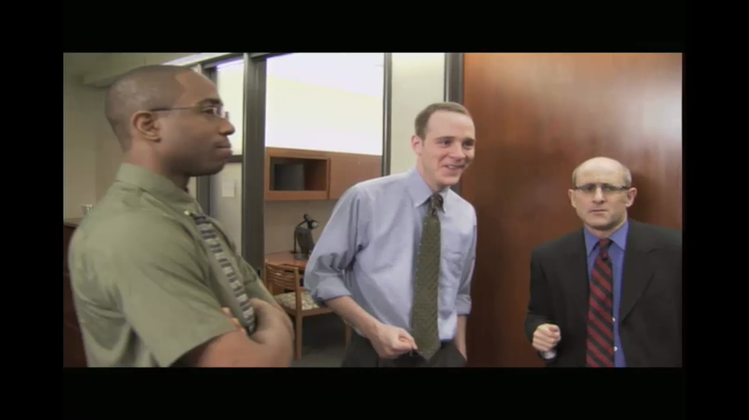
What is this an ad for?

Slide 24
Example: Doer/Non-Doer Analysis
Binge Drinking Research
Do you believe that alcohol has the following effect?
Makes me sexier
Facilitates sexual opportunities
Non-Doers
Drinkers
Doers

Slide 25
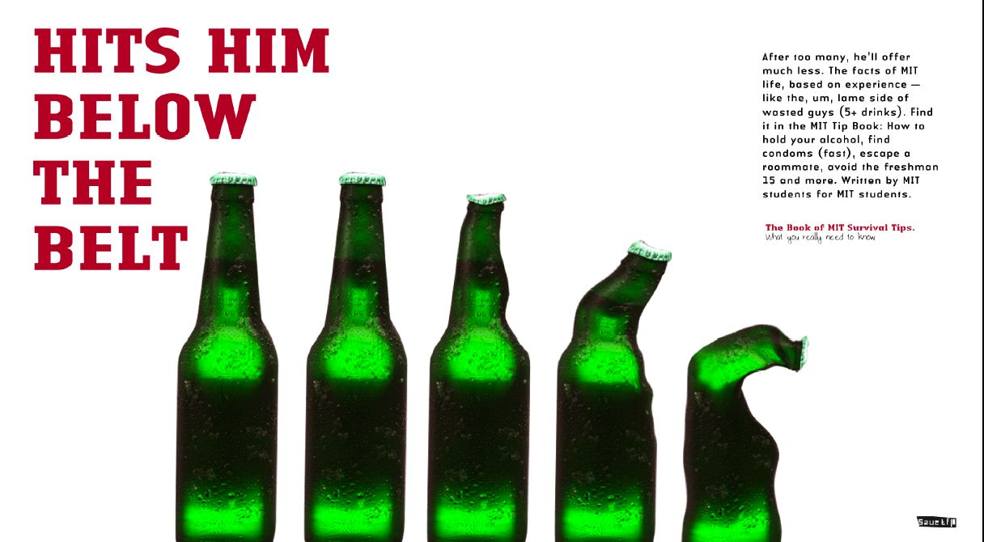

Slide 26
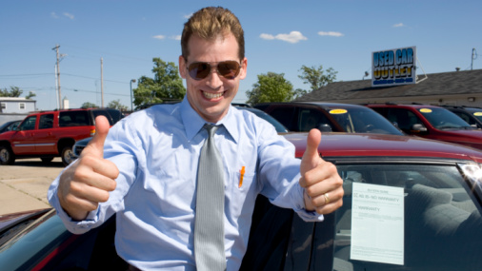
ONE MORE THING: STOP PERSUADING

Slide 27
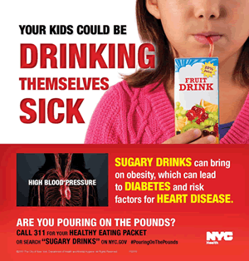
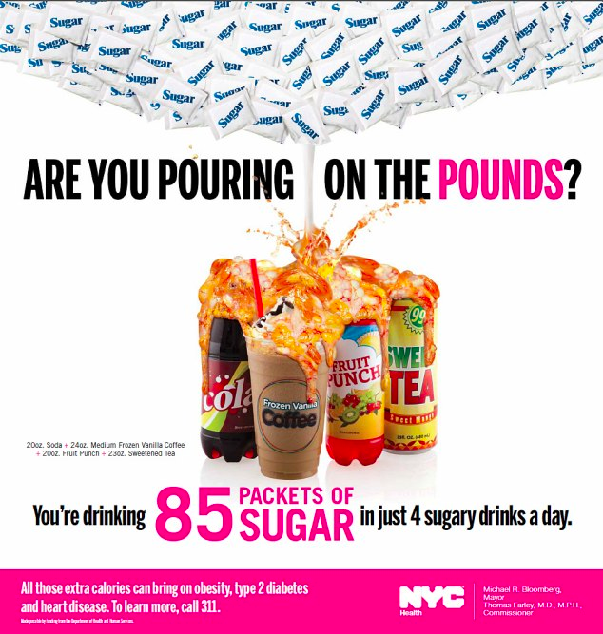

Slide 28
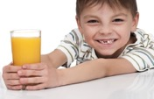
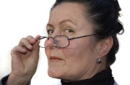
The Persuasion Assumption: They just don’t get it
“picking my battles”
“don’t want to make it taboo”
VS
Happiness
Guilt
“going to drink it anyway”
Doing my job as a parent (accomplishment)
NOT doing my job as a parent
(no accomplishment)
“moderation”
Kids are happy
Kids are less healthy
Refreshed/energized
Cavities, hyperactive, habit
Tastes good
Unhealthy ingredients

Slide 29
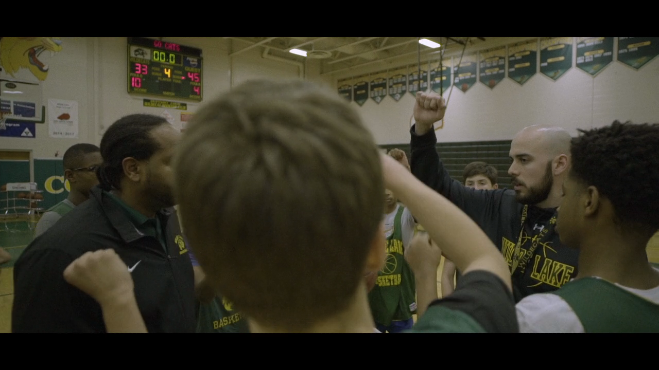

Slide 30


Okay, lets talk about … boat safety. Finally!

Slide 31
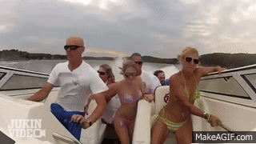
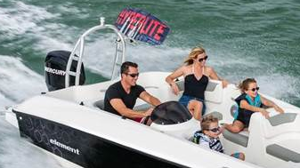
Let’s apply this fun-easy-popular idea to life jackets
47% DOERS
7% DOERS
Teen passengers and drivers (age 13-17) on motorboats under 21 feet
Target Action: Put on life jacket after boarding boat (currently 47%)
Relevant needs states (assumed):
Peer approval (seem cool)
Control, empowerment - act like an adult, make your own choices
Fun - seeking stimulus, excitement
Parents (age 29 - 49) on motorboats under 21 feet
Target Action: Put on life jacket after boarding boat (currently 7%)
Relevant needs states (assumed):
Leave behind worries and hassles
Appear competent and avoid problems
Find fun and relaxation, entertain kids
Show off and experience boat’s best attributes (Varies by boat: Could be speed, appearance, on-board conveniences, etc)

Slide 32
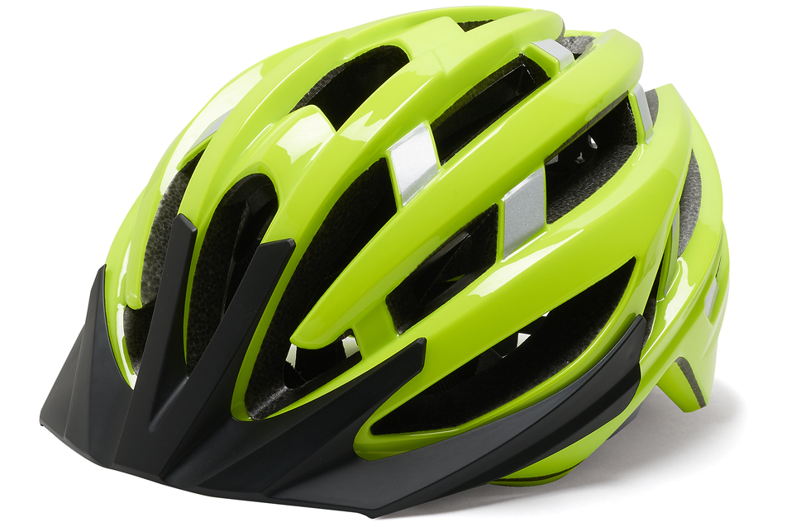
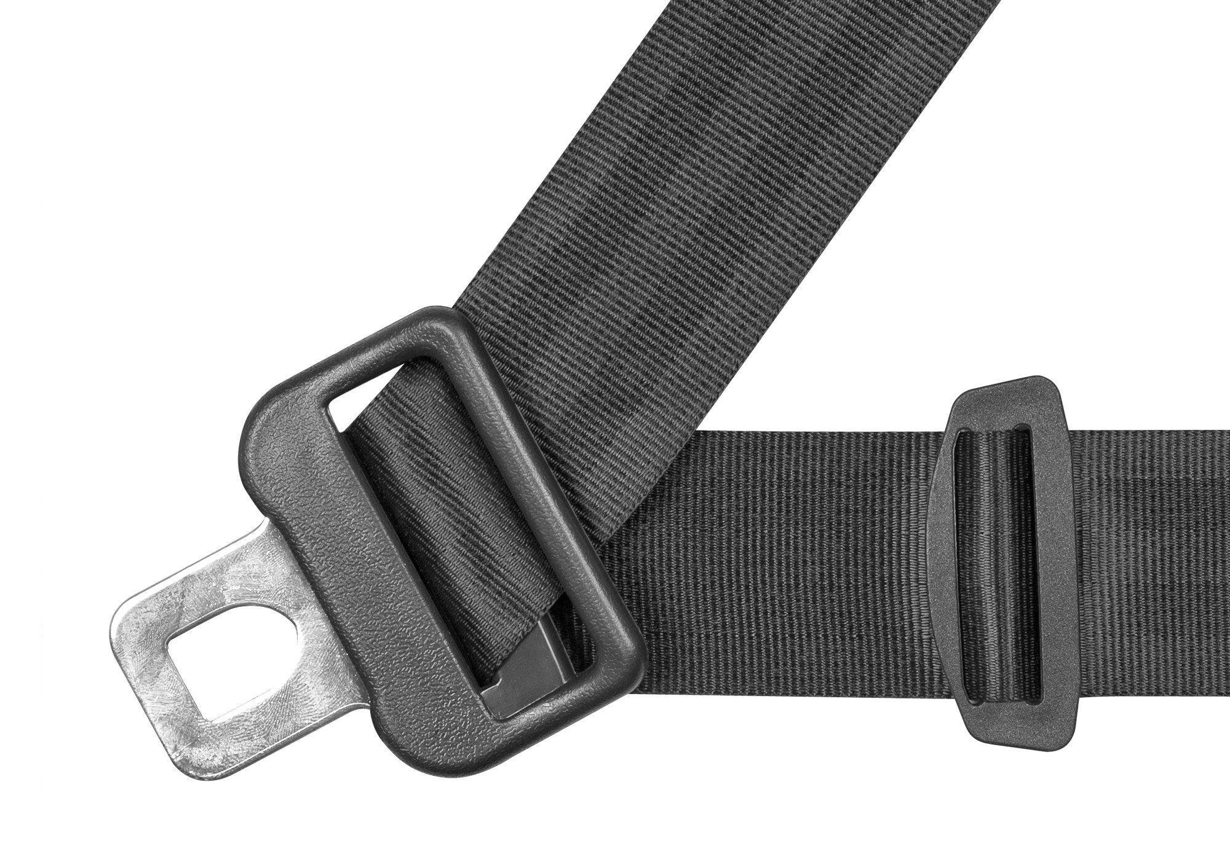
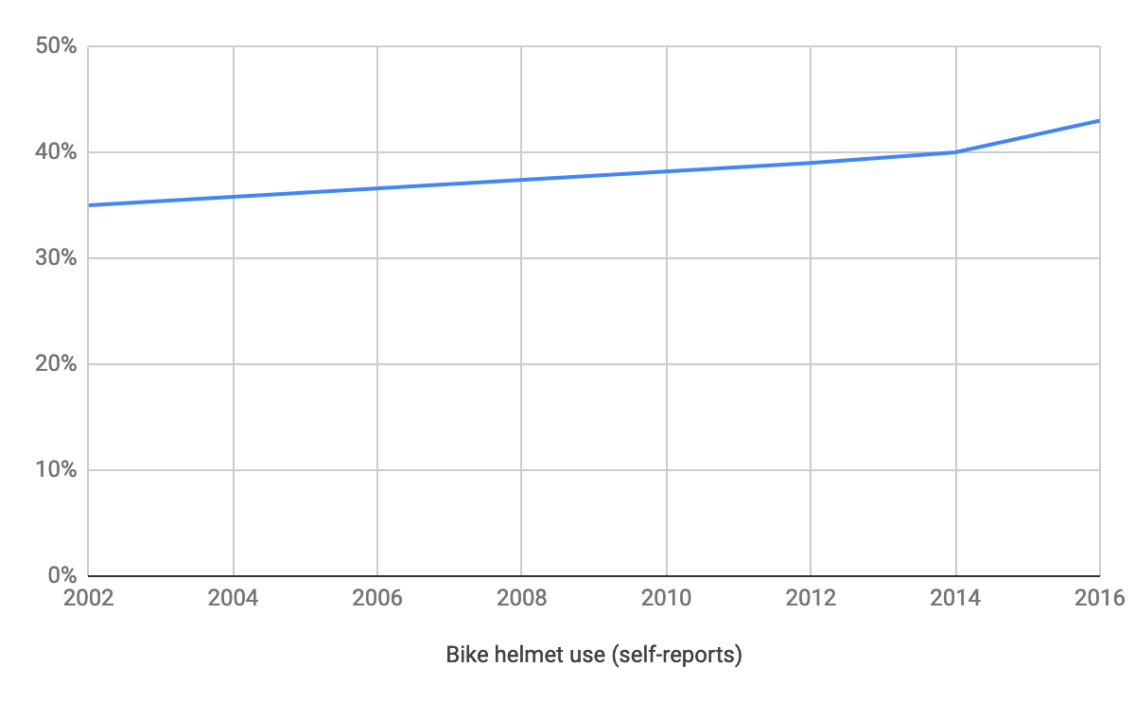
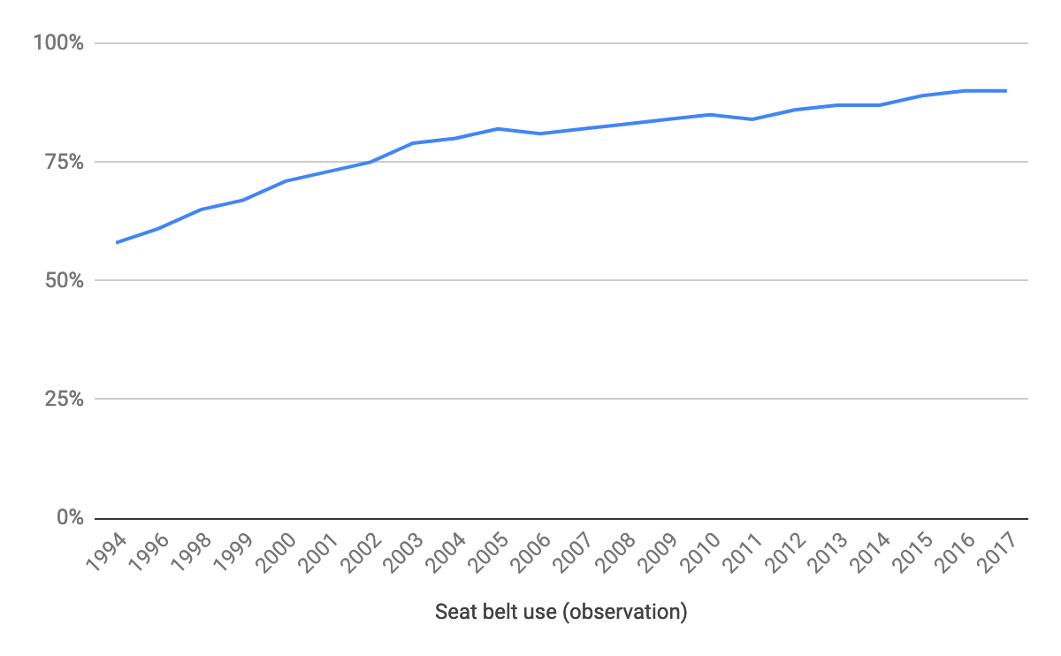
Where else have we seen a rise in a safety-related behavior?
Helmet use is up about 23% since 2002*
Belt use is up 55% since 1994
(*) Note: Lots of caveats due to measurement issues and other trends (older bikers replacing younger ones)

Slide 33
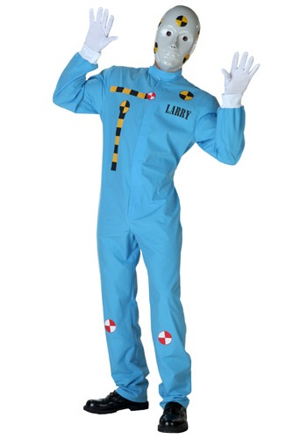

Why the change?
WHAT CHANGED
Penalties - Laws requiring compliance
Environment - Equipment easier to use
New Reminders / Triggers
Norms - Expectations of behavior triggered and amplified by campaigns
WHAT DIDN’T CHANGE
Risk of dying

Slide 34
How we are influencing motivation
Why aren’t more people doing the behavior?
It’s not rewarding
It’s not what’s expected or what people like me do
It’s not easy enough to do
Make it feel normal
Align the behavior with the person’s self-standards
Align the behavior with the person’s social identity
Connect the behavior to the person’s existing commitments
Frame the consequence of non-compliance as a potential loss
Intent

Slide 35
Issue #1: The need to REPOSITION life jackets*
Perception: Whose does NOT wear as PFD
Experienced boaters
Strong swimmers
Sporty people
Who DOES wear a PFD
Newbies, the inexperienced or uncomfortable
Weak swimmers
Nerdy people
[swap]
[eliminate this factor]
[swap]
(*) Our working assumption. Not all from research.

Slide 36
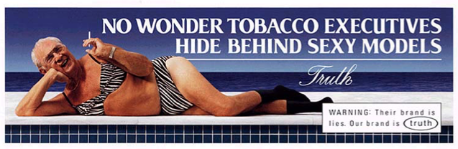
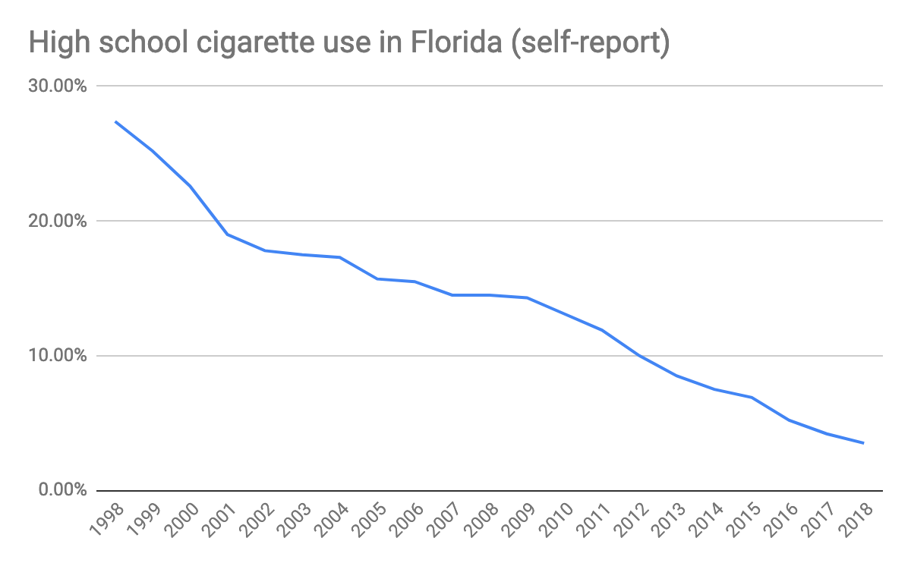
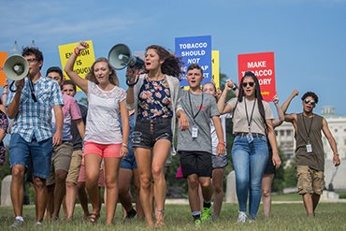
Key to any norms approach: Fulfilling audience needs states

Slide 37
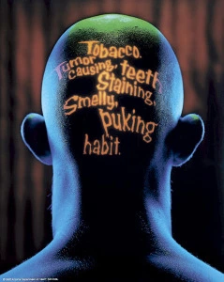
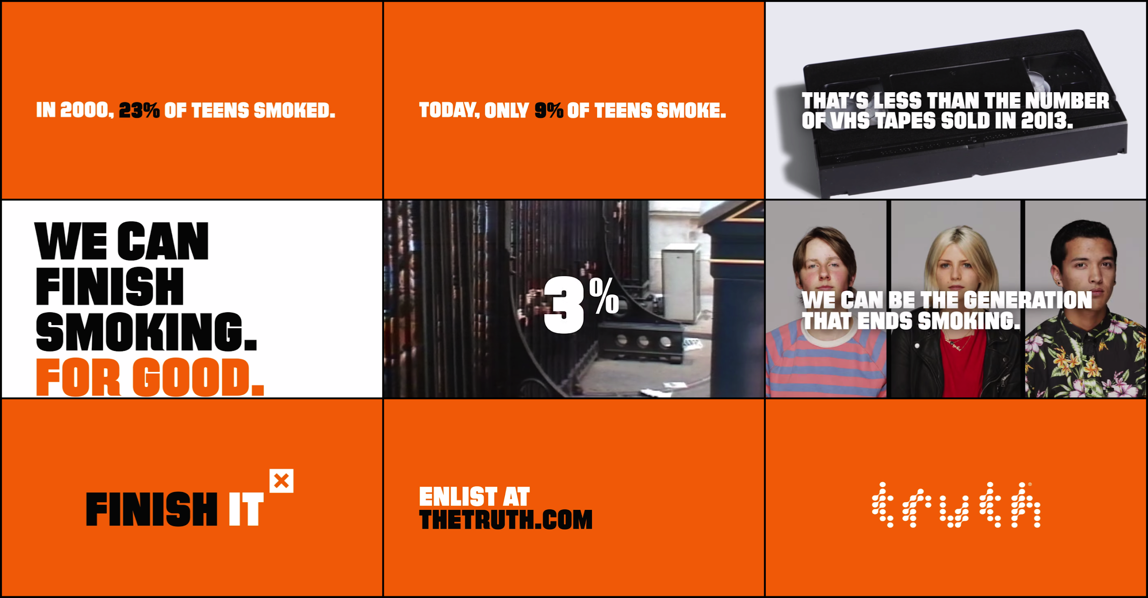
Norming efforts: The source of the message is critical
VS

Slide 38


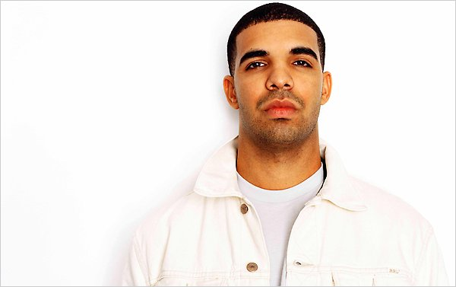
Issue #2: We’re not the most authentic source to do that
Life jackets are cool!
Oh yeah, so cool!
Yes, we are here to tell you what’s hip and popular. Because we have that kind of cred.
Man I wish I could be as cool as you all.

Slide 39
Our challenge as boating safety advocates
We don’t need to make safe boating smart. We need to make it normal.
Starting first with our most experienced boaters – our captains – who set the tone for us all.

Slide 40
This afternoon: Build your own behavior change campaign
Envisioning your intentional future
Research
Campaign
Insight
Strategy
Major Tactics
Executional Tactics
Evaluation
Select Behavior (Audience / Action)
Behavior Change Marketing Workshop
Today, 1:45 pm – 3:15 pm

