Slide 1
Multi-Use Waterway Conflict Management Roundtable
#IBWSS19

Slide 2
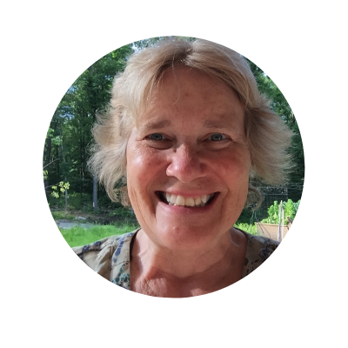
Moderator
Pam Dillon
National Association of State Boating Law Administrators
Director of Education and Standards Division
pam@nasbla.org

Slide 3
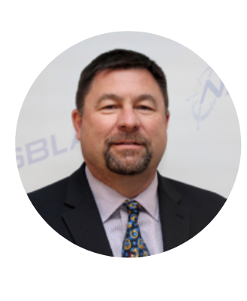
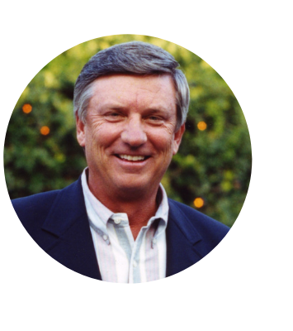
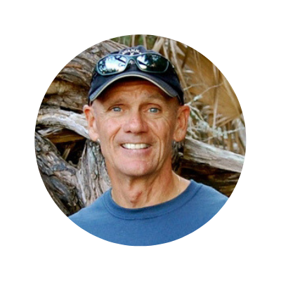
Panelists
Gary Klein
FWC
Florida Boating Law Administrator
Larry Meddock
Water Sports Industry Association
Chairman
Tommy Thompson
Florida Kayak School & Tours
Owner

Slide 4
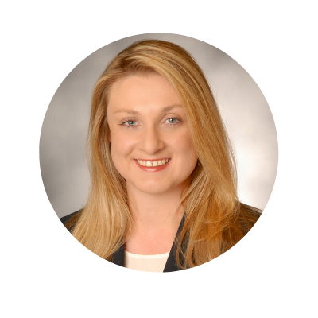
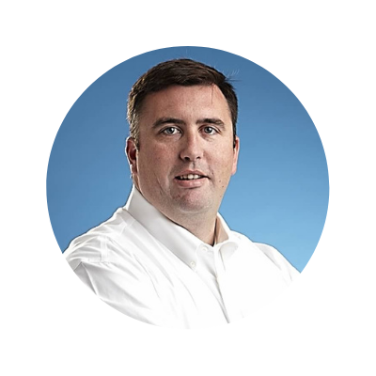
Panelists
Captain Joe
Frohnhoefer III
Sea Tow
CEO
Jen Wilk
Passenger Vessel Association Director, Development and Public Affairs

Slide 5
Ask a Question
Submit questions via the IBWSS app!
Open the Attendify app
Click on “Activity Stream” in the menu
Click on “What’s on your mind?” at the bottom
Type @IBWSS2019 then your question
*All attendees received instructions to download the app in their email.

Slide 6
Multi-Use Waterway Conflict Management Roundtable

Slide 7
Multi-Use Waterway Conflict Management
Captain Gary Klein
Florida Fish and Wildlife Conservation Commission
Division of Law Enforcement Boat and Waterways Section
gary.klein@myfwc.com

Slide 8
Multi-Use Waterway Conflict Management
Larry Meddock
Water Sports Industry Association
Chairman
larry@wsia.net

Slide 9
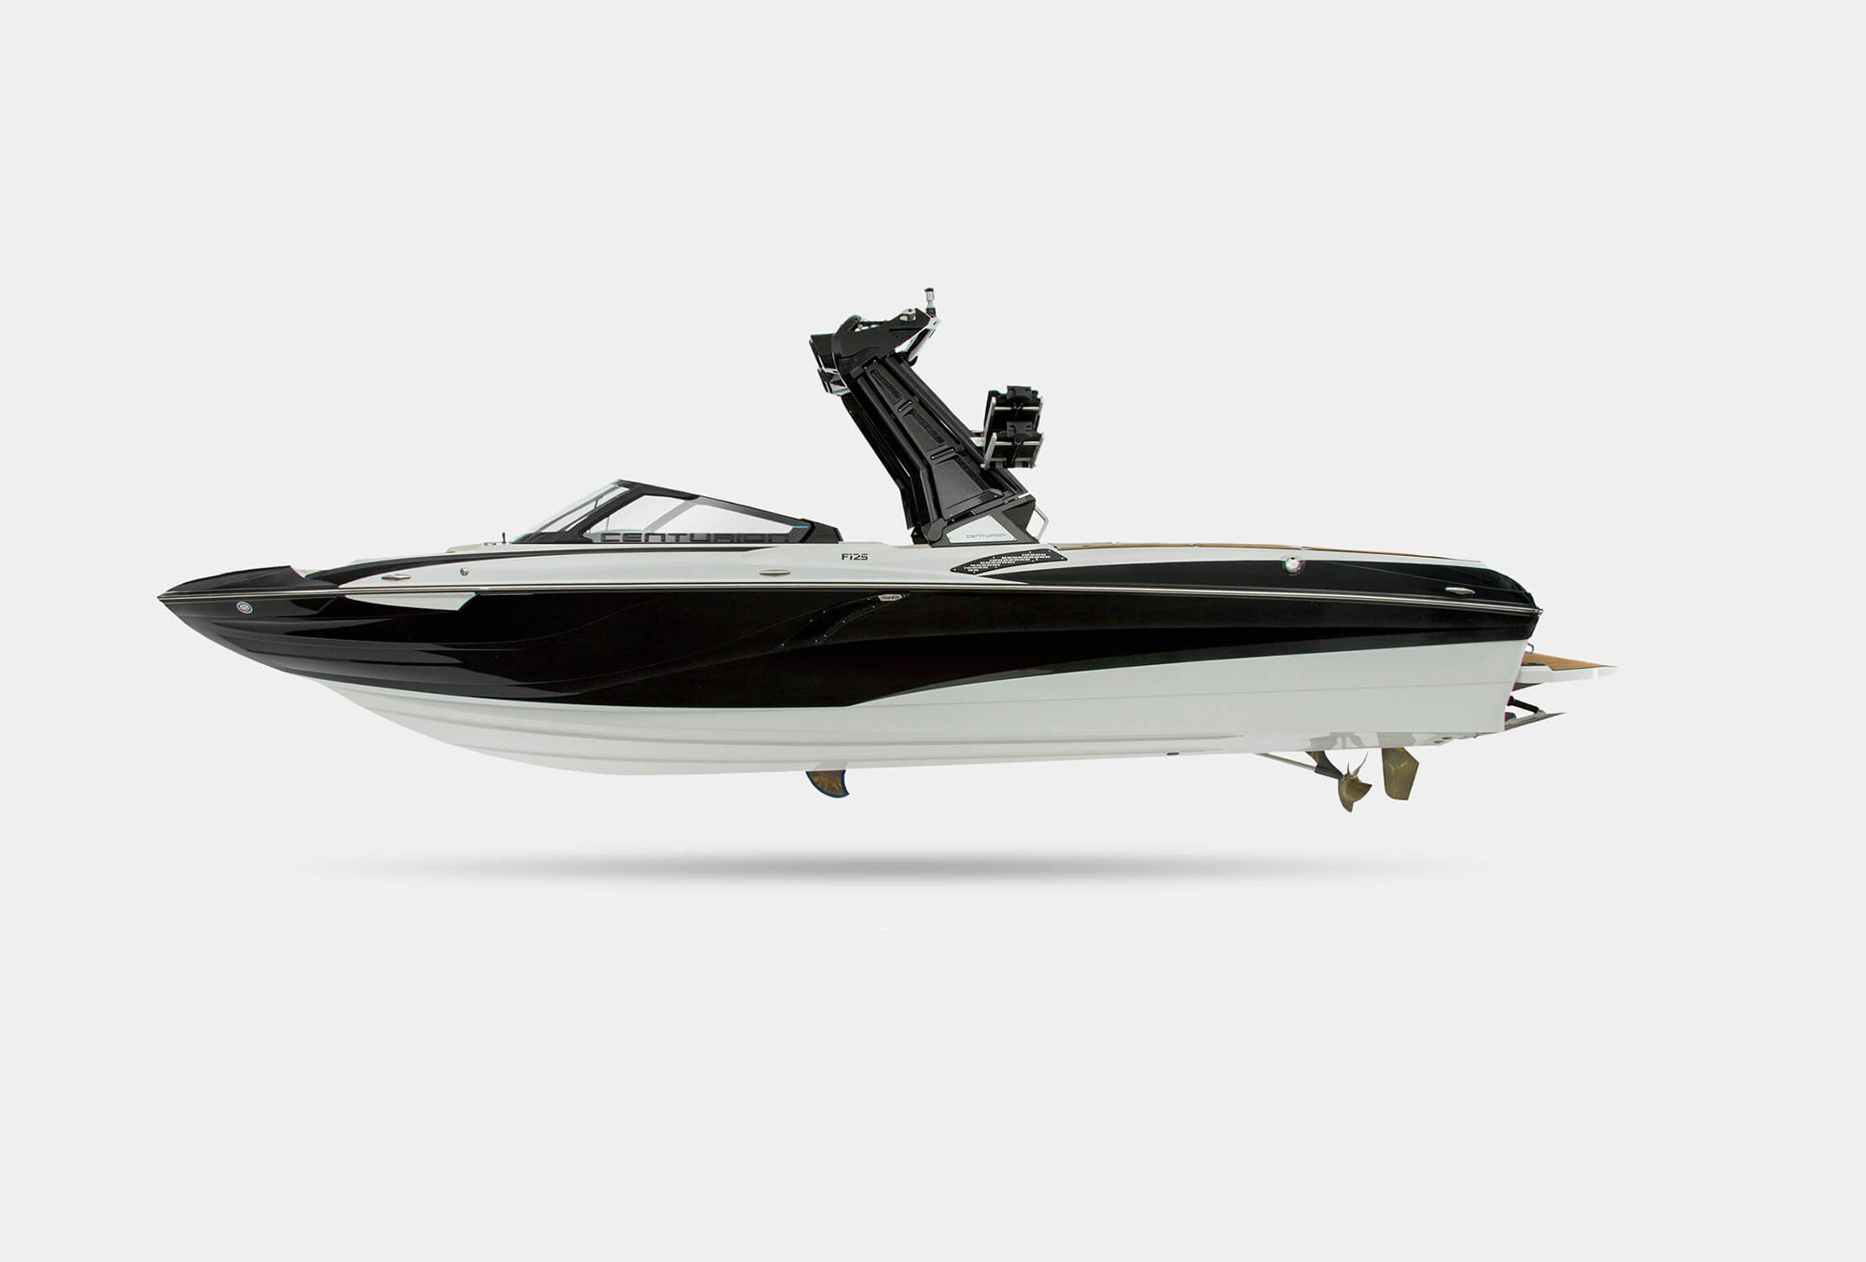
– BASIC ANATOMY OF A WAKE BOAT –
TOWER
CRUISE CONTROL
OPEN BOW
SWIM PLATFORM
DEEP V HULL
BALLAST
TRACKING FIN
PROP & RUDDER

Slide 10
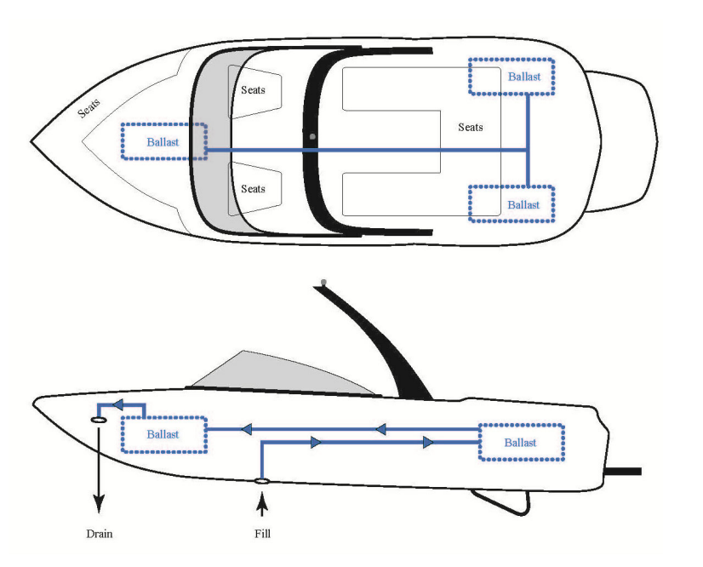
Multi-Use Waterway Conflict Management
The addition of ballast to a boat is intended, principally, to sink the boat down so it can displace more water and create a larger, better shaped wake.

Slide 11
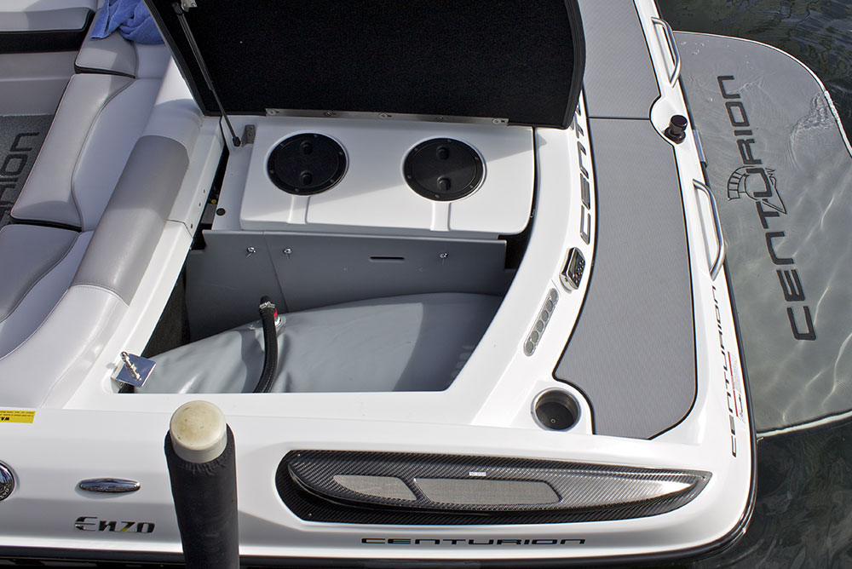
Multi-Use Waterway Conflict Management
Notes:
While wakeboard boat ballast systems are often custom and can differ from boat to boat, a common configuration is to have two ballast bags in the back storage and one in the center storage locker, although most new inboard boats have subfloor ballast systems. Water is typically drawn into the system on the bottom through the hull and it exits the system out of a through-hull fitting on the bow.

Slide 12
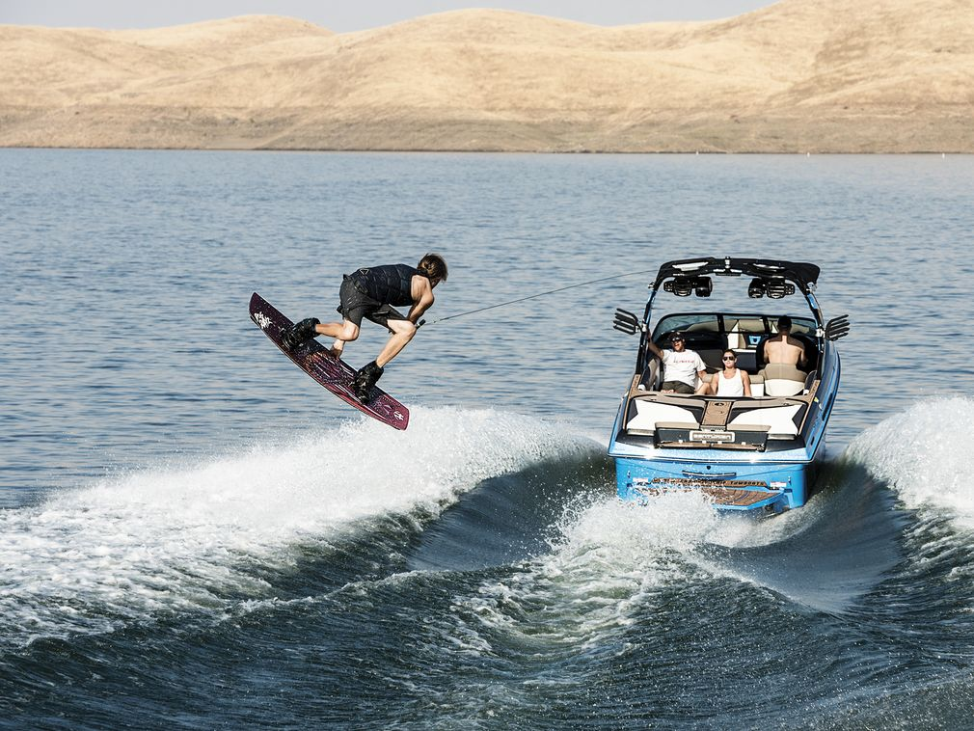
Multi-Use Waterway Conflict Management
Notes:
Some of today’s wake boats can hold a whopping 5,500 pounds of ballast.

Slide 13
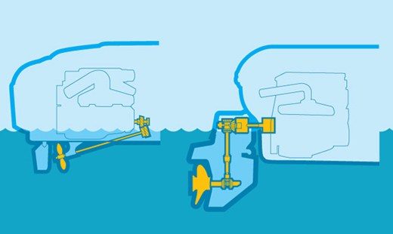
Multi-Use Waterway Conflict Management
INBOARD VERSUS IO/STERNDRIVE
Notes:
Inboard boats have long been the industry leader for wake sports, mainly because IO and outboard engines posed a very serious threat to in-water participants.

Slide 14
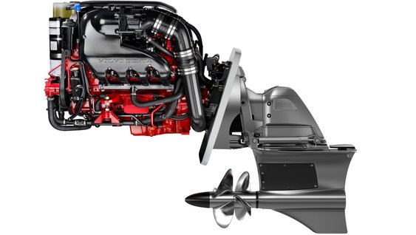
Multi-Use Waterway Conflict Management
ENTER: FORWARD DRIVE PROPULSION
Notes:
Forward drive propulsion is a safe, versatile, and effective alternative for IO boat manufacturers who have wanted to get into the water sports market.
Every boat manufacturer now makes ballasted boats for wakesurfing.
Wakesurfing boats is the #1 segment of boats

Slide 15
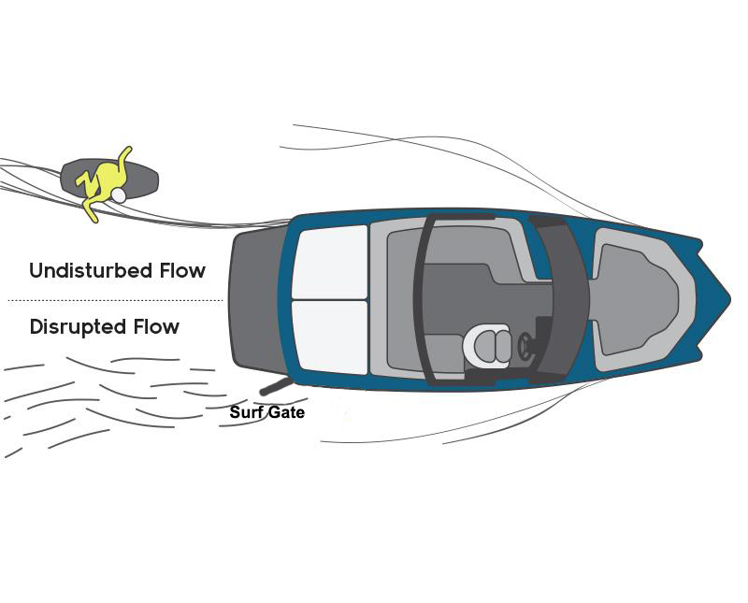
Multi-Use Waterway Conflict Management
Notes:
Most current inboards and IOs with surf systems utilize a sort of surf gate near the transom to form their surf waves. The gate engages on the side opposite of the surfer to introduce turbulence and disrupt the flow on that side in order to allow the surf side of the wake to clean up.

Slide 16
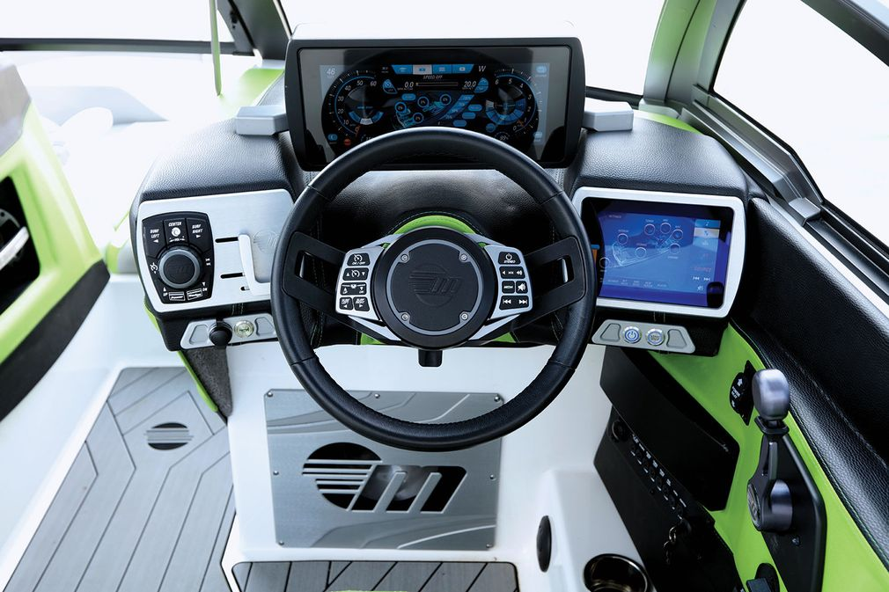
Multi-Use Waterway Conflict Management
Notes:
The shape of the wave is determined by three things: 1) The hull design of your boat. 2) The ballast amount and location within your boat. 3) Boat speed.
The latter two can be controlled at the helm.

Slide 17
Multi-Use Waterway Conflict Management

Slide 18
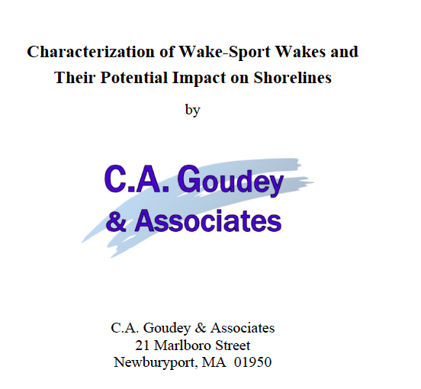
Multi-Use Waterway Conflict Management

Slide 19
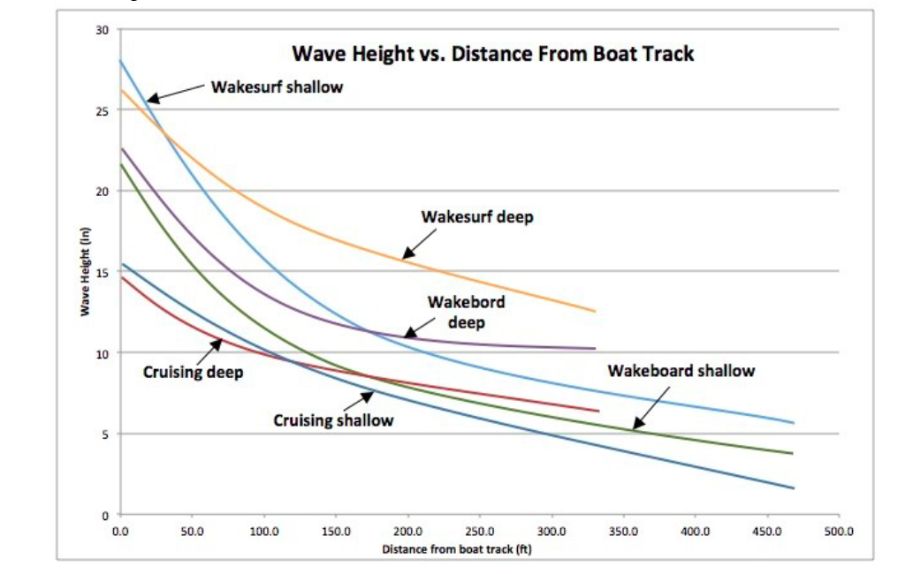
Multi-Use Waterway Conflict Management

Slide 20
Multi-Use Waterway Conflict Management
Tommy Thompson
Florida Kayak School & Tours
Owner
2beaswater@gmail.com

Slide 21
Multi-Use Waterway Conflict Management
Captain Joe Frohnhoefer III
Sea Tow
CEO
jfrohnhoeferiii@seatow.com

Slide 22
Multi-Use Waterway Conflict Management
Meet the Players
Coast Guard
Coast Guard Auxiliary
Police/Sheriff
Bay Constable
Harbor Master
Fire Department
Commercial Assistance
Other Commercial Ops
Power Squadron
Volunteer Groups
Recreational Boaters
Non-boaters

Slide 23
Multi-Use Waterway Conflict Management
So what was the Issue
Who is in charge?
State/Federal Concurrent Jurisdiction
Preemption
Training
Communications/Technology
Different focus or reason for being there

Slide 24
Multi-Use Waterway Conflict Management
What was the Solution
US Coast Guard took control
MOU Regarding Rec Boating Safety
SAR Council
Communications
Awareness

Slide 25
Multi-Use Waterway Conflict Management
US Coast Guard Addendum to the US SAR Supplement

Slide 26
Multi-Use Waterway Conflict Management
What was the Outcome
Communication between entities
Case review
Goals and concerns of entities
Interoperability training
Relationship building

Slide 27
Multi-Use Waterway Conflict Management
Still Work to Be Done
Change in personnel
New Assets come in
Continued training
Budgets
911

Slide 28
Multi-Use Waterway Conflict Management
CG Authorization Act
CG shall review CG policies and procedures for public safety answering points and SAR coordination with State and local law enforcement entities in order to:
(A) minimize the possibility of maritime 911 calls being improperly routed; and
(B) assure the CG is able to effectively carry out the CG’s search and rescue mission; and
(2) the Commandant shall—
(A) formulate a national maritime PSAP policy; and
(B) submit a report to the Congress on such assessment
and policy

Slide 29
Sharing the Waterways: Challenges & Opportunities
Jen Wilk
Passenger Vessel Association
Director, Development and Public Affairs
jwilk@passengervessel.com

Slide 30
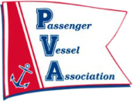
Sharing the Waterways: Challenges & Opportunities
Congested Waterways
It’s no secret the nation’s waterways are becoming more congested for everyone
In PVA’s view, an important contributor in addition to commercial traffic and traditional motorized recreational boats is a growing segment of new users including:
Human Powered Craft
Electric Boats
Rental Operations

Slide 31
Sharing the Waterways: Challenges & Opportunities
Safety Concerns
These new users:
May not be aware of risk of operating close to commercial vessels
May not be aware of responsibilities under the Navigation Rules of the Road
Concerned with rental operations sending inexperienced individuals out on the water
Not providing adequate training
Sharing the waterways – Promoting Safety and Communication
PVA is not trying to clear anyone off of the water
Working to harmonize the operating environment

Slide 32
Sharing the Waterways: Challenges & Opportunities
Awareness: Captain’s Perspective
These new users:
May not be aware of risk of operating close to commercial vessels
May not be aware of responsibilities under the Navigation Rules of the Road
Concerned with rental operations sending inexperienced individuals out on the water
Not providing adequate training
Sharing the waterways – Promoting Safety and Communication
PVA is not trying to clear anyone off of the water
Working to harmonize the operating environment
Notes:
Perspective of a commercial operator.
Accountability is on the Licensed Captain to operate safely. But we need all parties to participate in that commitment to safety.
Recreational boater may not be aware of these restrictions on commercial vessels.
Commercial vessels typically operate on a set/designated course. And they do not know what the recreational boater is less predictable. Commercial operators don’t know where they are going to go.

Slide 33
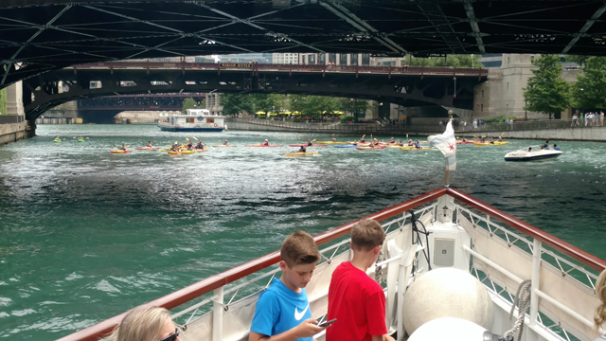
Sharing the Waterways: Challenges & Opportunities

Slide 34
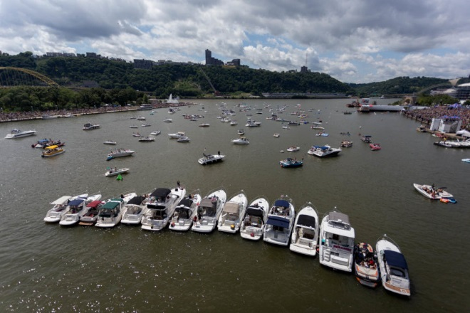
Sharing the Waterways: Challenges & Opportunities
Impeding Navigable Channels (Pittsburgh, PA)

Slide 35
Sharing the Waterways: Challenges & Opportunities
PVA Engagement: National Level
Encouraging Safety Education and Outreach by Working with:
Coast Guard
Boating Safety Advisory Committee and PVA Partnership
National Association of State Boating Law Administrators
Fellow Industry Groups and Waterways Stakeholders
American Canoe Association
Water Sports Foundation
National Marine Manufacturers Association
Support NTSB Safety Recommendation

Slide 36
Sharing the Waterways: Challenges & Opportunities
Engagement: Local Level
Chicago, IL
Harbor Safety Committee brings together all stakeholders
The Committee developed best practices guidance
Pittsburgh, PA
Formed a Congested Waterways Committee consisting of all stakeholders
Commercial participation in Annual Safe Boating Week Events
The Coast Guard established a special local regulation for parts of the navigable waters of the Allegheny, Monongahela, and Ohio Rivers
During special events “prohibits persons and vessels from loitering, anchoring, stopping, mooring, remaining, or drifting in any manner that impedes safe passage of another vessel”

Slide 37
Sharing the Waterways: Challenges & Opportunities
Moving Forward
PVA believes there is a need for a successful process model/template that can be implemented on the local level nationwide to:
Assist Harbor Safety Committees with this subject
Help create similar stakeholder groups
To facilitate communication, outreach, and education
PVA is committed to safety and we stand ready to work with all stakeholders towards a safe boating environment for all.
Notes:
PVA would like to continue be a part of any future discussion and work on this issue.
PVA is committed to safety and we stand ready to work with all stakeholders towards a safe boating environment for all.

Slide 38
Questions from the App
#IBWSS19

Slide 39
Rate Sessions on the IBWSS App
Feedback may be anonymous

Slide 40
COMING UP NEXT
10:00 – 10:15 a.m. Break
10:15 – 11:00 a.m. Paddling Lingo Florida D BUI Simulation Classroom Training Omni Ballroom Changing Life Jacket Wear Behavior Pensacola

