Slide 1
Leadership Skills for Boating & Water Safety
#IBWSS19

Slide 2
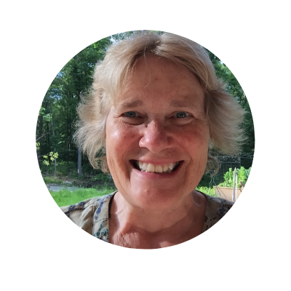
Moderator
Pam Dillon
Director of Education and Standards Division
National Association of State Boating Law Administrators
pam@nasbla.org

Slide 3
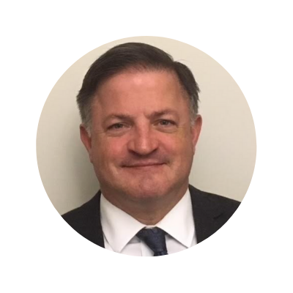
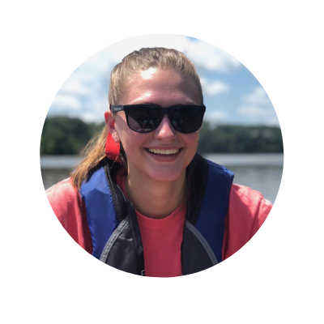
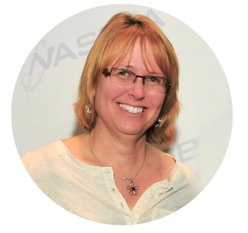
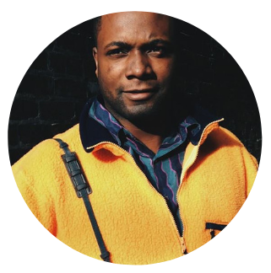
Panelists
Verne Gifford
U.S. Coast Guard
Chief, Boating Safety Division
MariAnn McKenzie
Oregon State Marine Board
Boating Safety
Education Coordinator
Gerry James
Explore Kentucky
Initiative
Executive Director
Diane Corish
NSBC
Program Manager

Slide 4
Ask a Question
Submit questions via the IBWSS app!
Open the Attendify app
Click on “Activity Stream” in the menu
Click on “What’s on your mind?” at the bottom
Type @IBWSS2019 then your question
*All attendees received instructions to download the app in their email.

Slide 5
Leadership Skills for Boating Safety

Slide 6
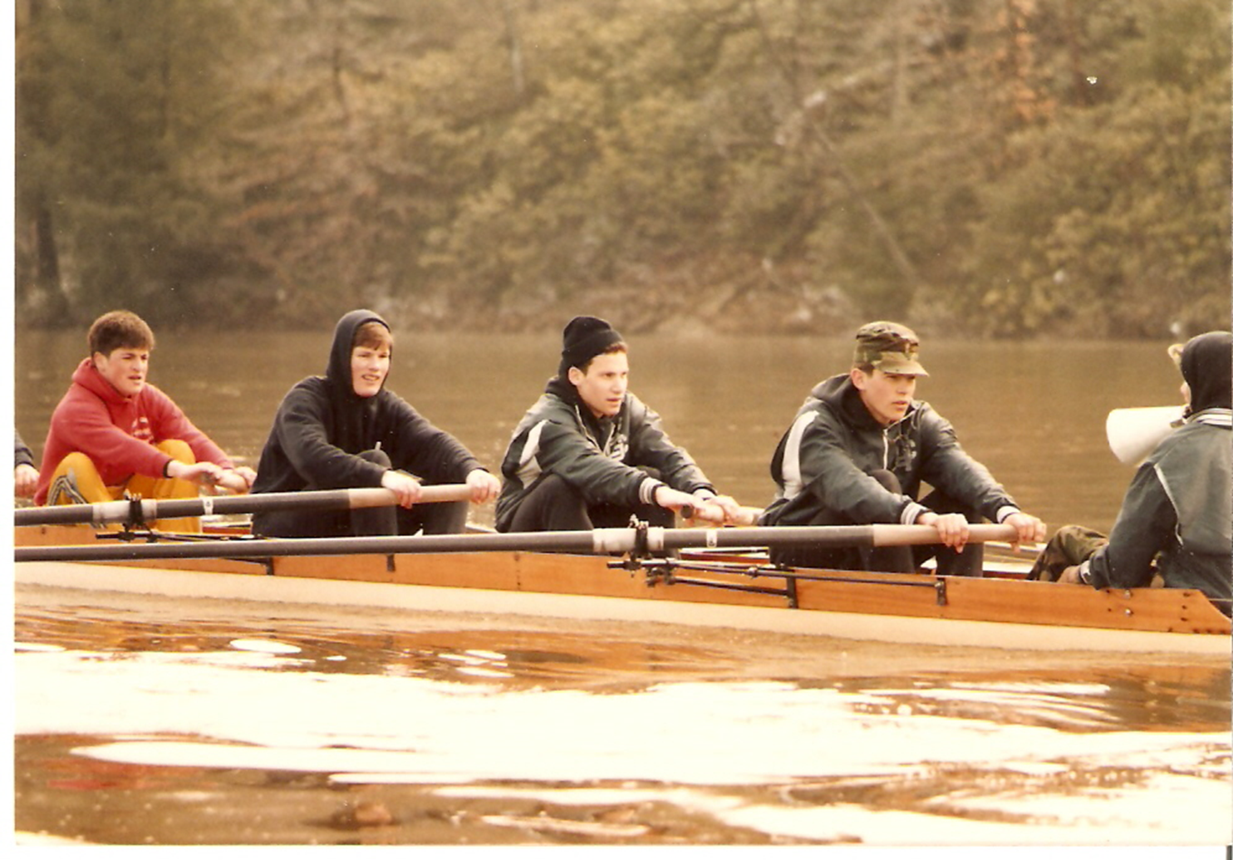
Verne Gifford
Me, Spring Break 1984, Occoquan, VA
Don Amadee, Team Captain

Slide 7
Leadership Skills
O
P
E
N

Slide 8
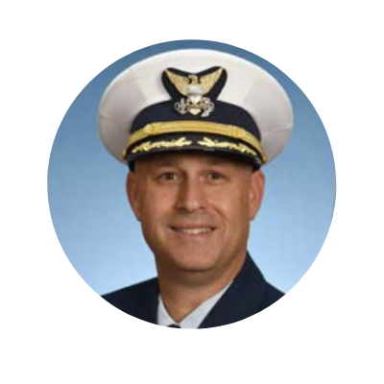
Leadership Skills
Captain Scott Johnson
U.S. Coast Guard
Chief, Office of Auxiliary and Boating Safety

Slide 9
Leadership Skills

Slide 10
Leadership Skills
1. Evaluate
The Disciplined Pursuit of Less
3. Execute
2. Eliminate

Slide 11
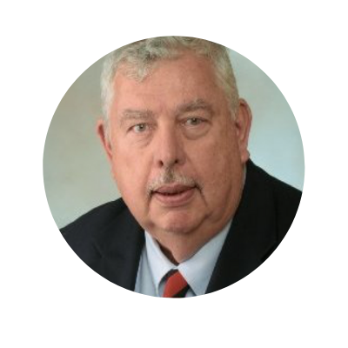
Leadership Skills
Dr. L. Dan Maxim
NBSAC
Chairman

Slide 12
Leadership Skills
“Dad, I’m talking with Mark right now.”
Mark, should my Dad buy me a Dodge Challenger?
Jack, Tell your Dad I’ve got it; I’ll buy you that car.

Slide 13
Leadership Skills
USCGboating.org
Facebook
Twitter
Boating Safety Circular
Liaisons
Content

Slide 14
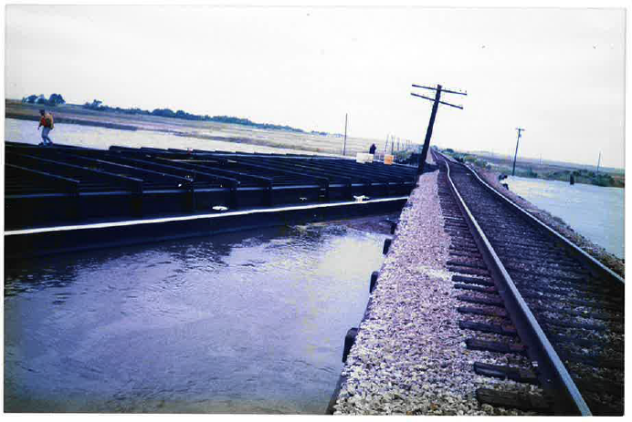
Leadership Skills

Slide 15
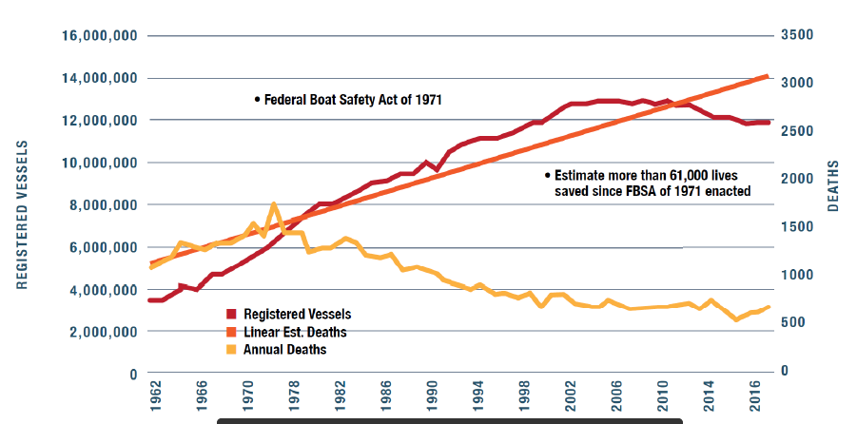
Leadership Skills
61K Lives Saved and Counting

Slide 16
Leadership Skills
Future Leadership
Perspective: Continue to think out of the box
Experience: Non-motorized program
Thoughts on Technology
MariAnn McKenzie
Oregon State
Marine Board
Boating Safety
Education Coordinator

Slide 17
2018 Promotions

Slide 18
2019 Promotions

Slide 19
Leadership Skills
Food for Thought
“A rising tide doesn’t raise people who don’t have a boat. We have to build the boat for them. We have to give them the basic infrastructure to rise with the tide.” ~ Rahul Gandhi

Slide 20
Leadership Skills
Gerry James
Explore Kentucky
Initiative
Executive Director

Slide 21
Leadership Skills
Perspective: We > Me, Dedication to social good, frequent communication, policy for policy’s sake, lateral management
Experience: Program and campaign
manager
Technology: Generational tension, learn from each other
Diane Corish
NSBC
Program Manager

Slide 22
Milllennial Stereotype

Slide 23
Rate Sessions on the IBWSS App
Feedback may be anonymous

Slide 24
COMING UP NEXT
10:15 – 11:00 a.m. Virtual Learning and Interactive Learning Stations Jacksonville Conference Room Youth and Boating Omni Ballroom Best Practices for Managing Federal Grants Pensacola Conference Room
11:05 – 11:55 a.m. Virtual Learning and Interactive Learning Stations Jacksonville Conference Room Inflatable Life Jacket Relay Race Omni Ballroom Developing a National Water Safety Plan for the U.S. Pensacola Conference Room

