Slide 1
How the Evolution of Learning Impacts Boaters
#IBWSS19

Slide 2
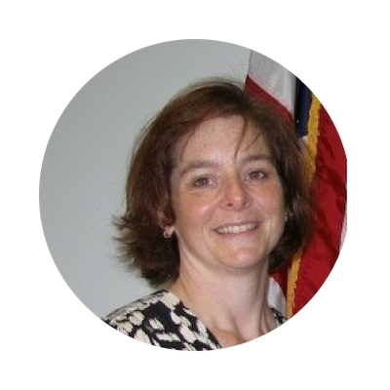
Moderator
Stacey Brown
Virginia Department of Game and Inland Fisheries
Recreational Boating Safety Manager
stacey.brown@dgif.virginia.gov

Slide 3
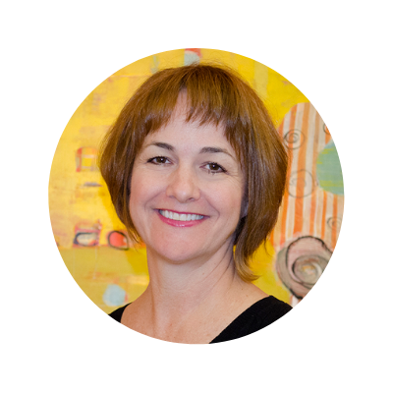
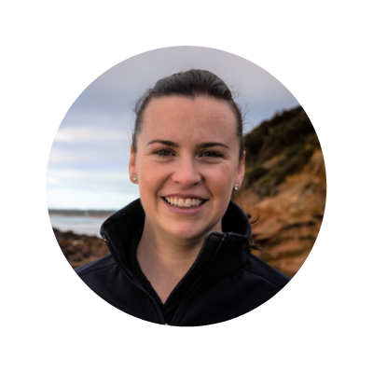
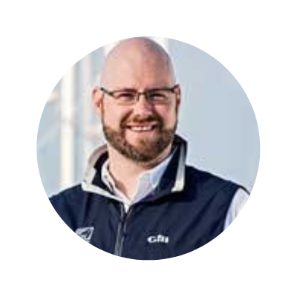
Panelists
Mary Winkler
Kalkomey Enterprises
Director of Content
Kate Simpson
Life Saving Victoria
General Manager of
Education and Sport
Stu Gilfillen
US Sailing
Director of Education

Slide 4
Ask a Question
Submit questions via the IBWSS app!
Open the Attendify app
Click on “Activity Stream” in the menu
Click on “What’s on your mind?” at the bottom
Type @IBWSS2019 then your question
*All attendees received instructions to download the app in their email.

Slide 5
How the Evolution of Learning Impacts Boaters

Slide 6
Evolution of Learning
Mary Winkler
Kalkomey Enterprises
Director of Content

Slide 7
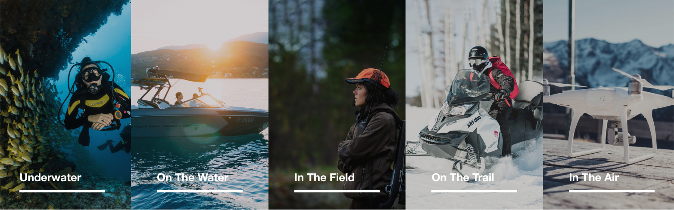
Evolution of Learning

Slide 8

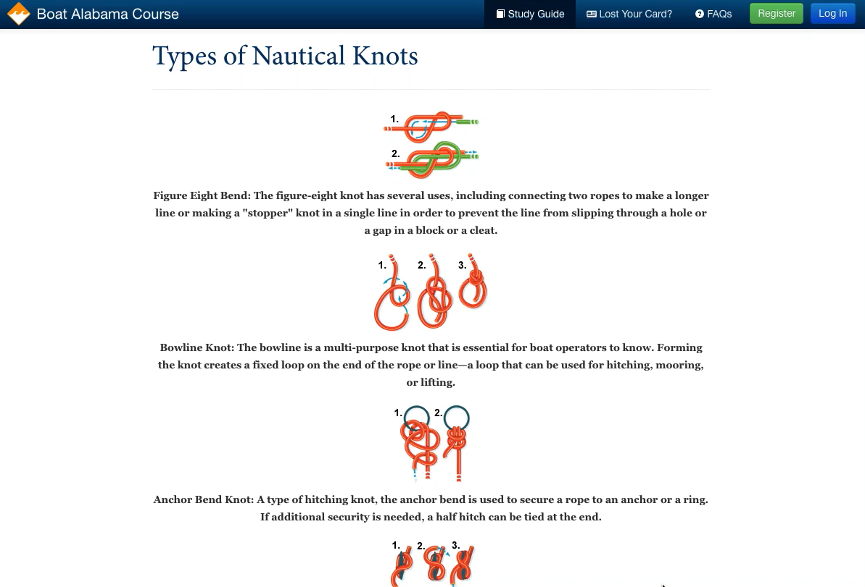

Slide 9

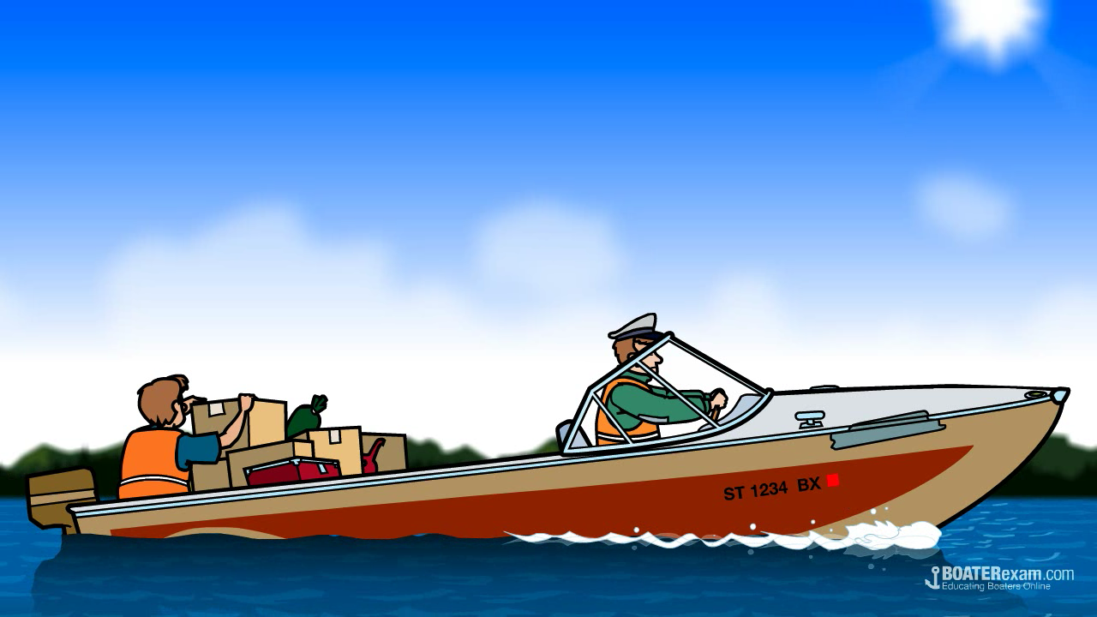

Slide 10

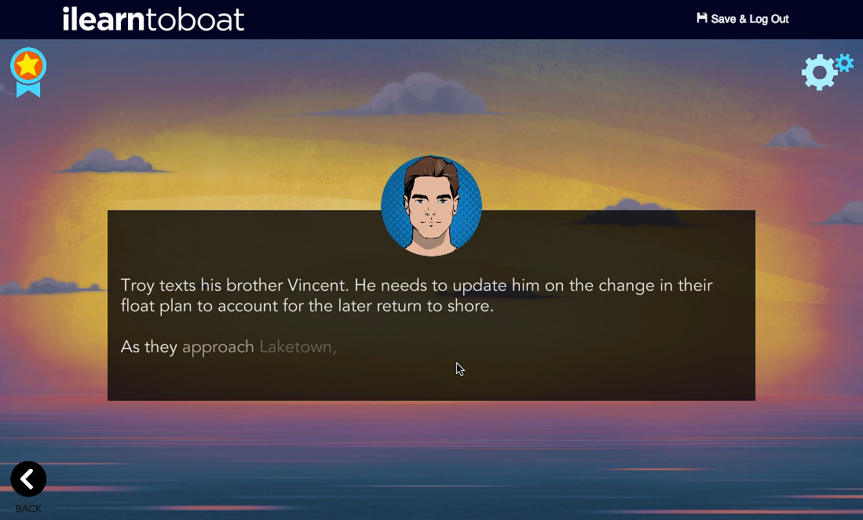

Slide 11

Evolution of Learning
Kate Simpson
Life Saving Victoria
General Manager of
Education and Sport

Slide 12
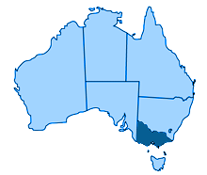



Life Saving Victoria

Slide 13
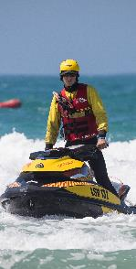

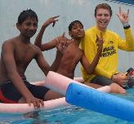
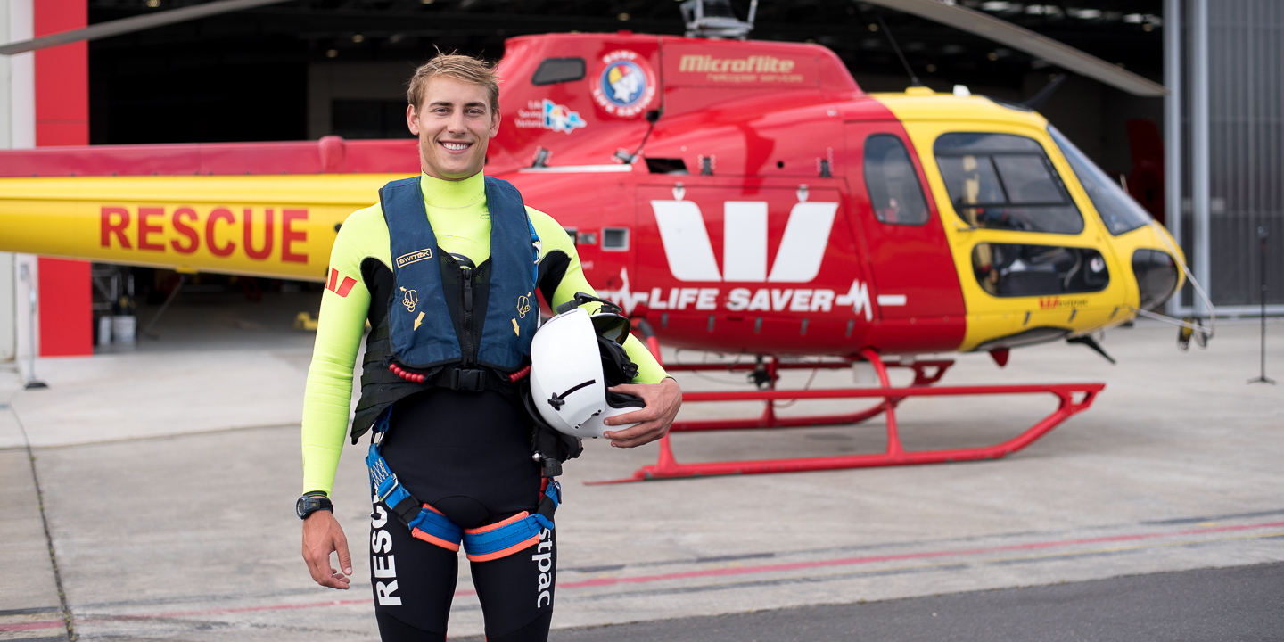
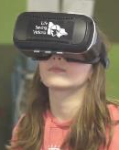
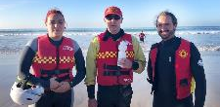

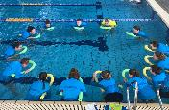

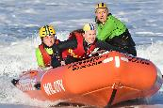
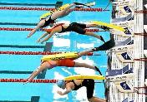
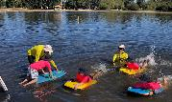
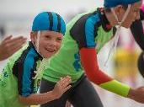

Life Saving Victoria
WHAT WE DO
4

Slide 14


Life Saving Victoria
everydaylifesaver.com.au
lsv.com.au/vr

Slide 15


Evolution of Learning
Stu Gilfillen
US Sailing
Director of Education

Slide 16

US Sailing

Slide 17
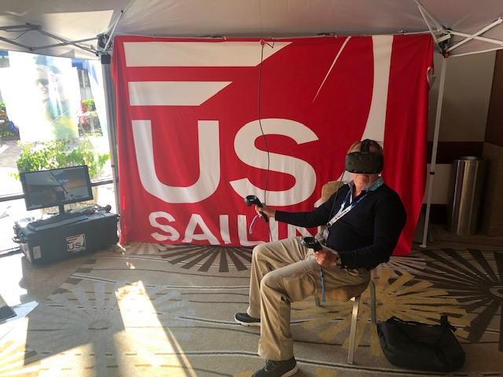
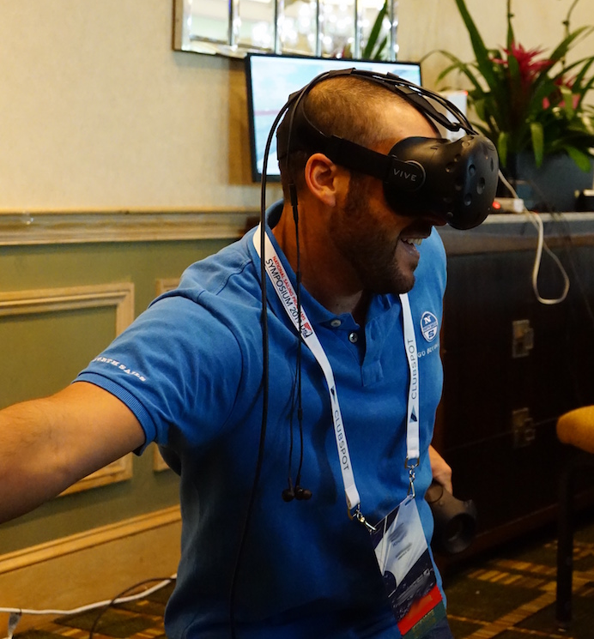
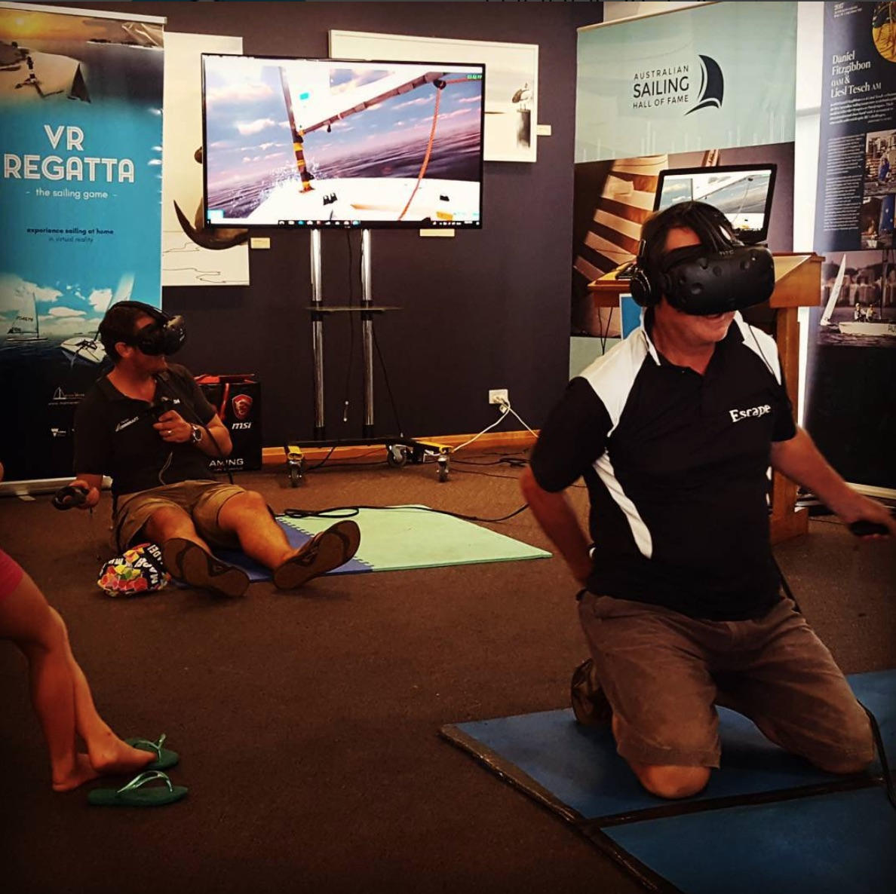
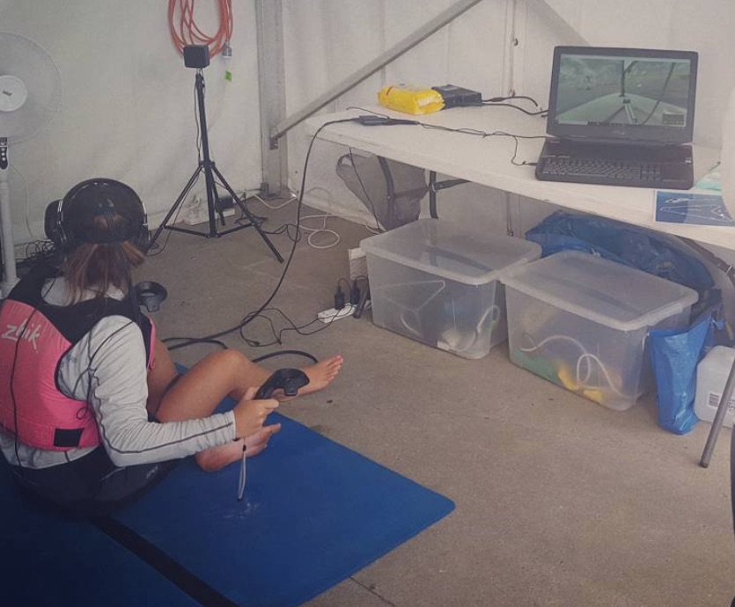
US Sailing

Slide 18
Rate Sessions on the IBWSS App
Feedback may be anonymous

Slide 19
COMING UP NEXT
9:15 – 10:00 a.m.
General Session | Leadership Skills for Boating Safety
Florida CD

