Slide 1
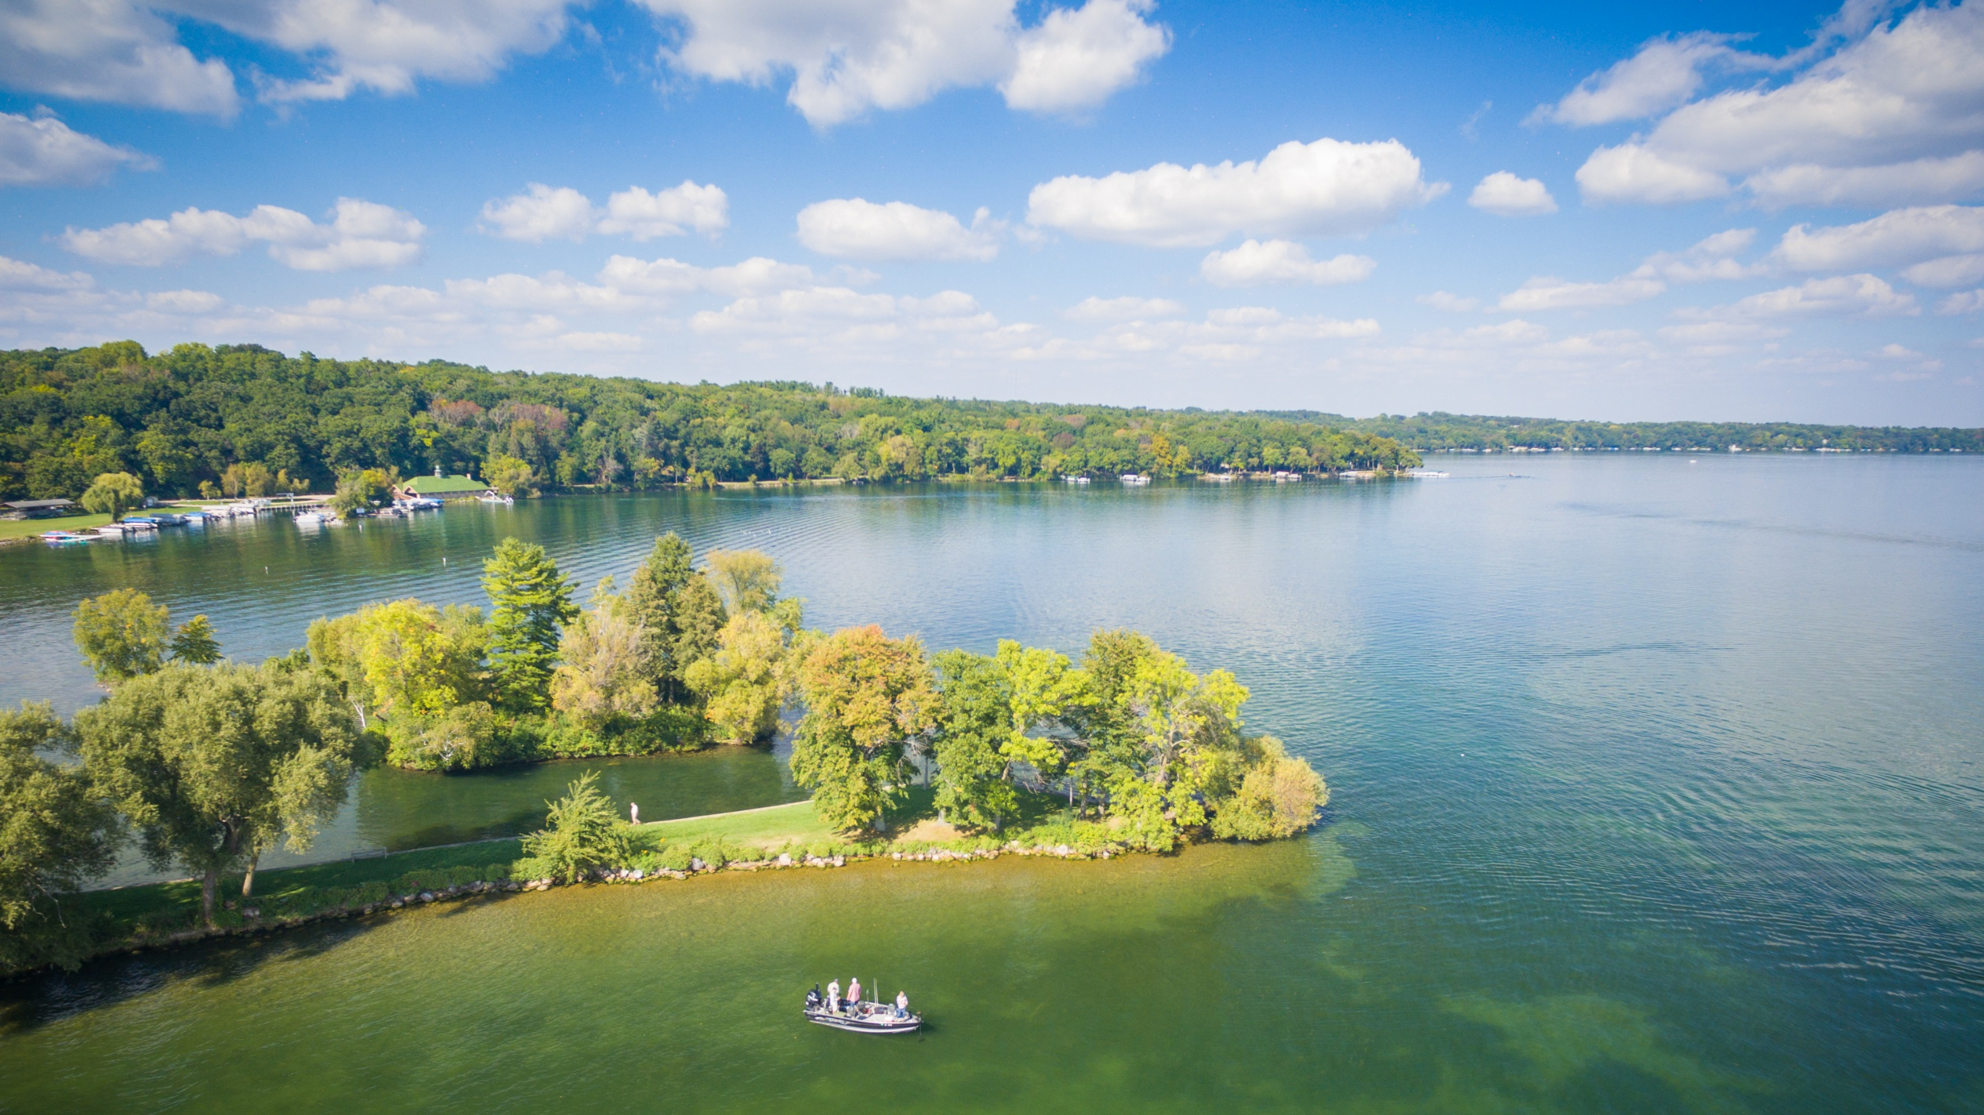
R3 and Recreational Boating
IBWSS
March 25, 2019

Slide 2
R3
Recruitment
Retention
Reactivation

Slide 3
Angler R3 Recommendations
Full Report Available Online

Slide 4
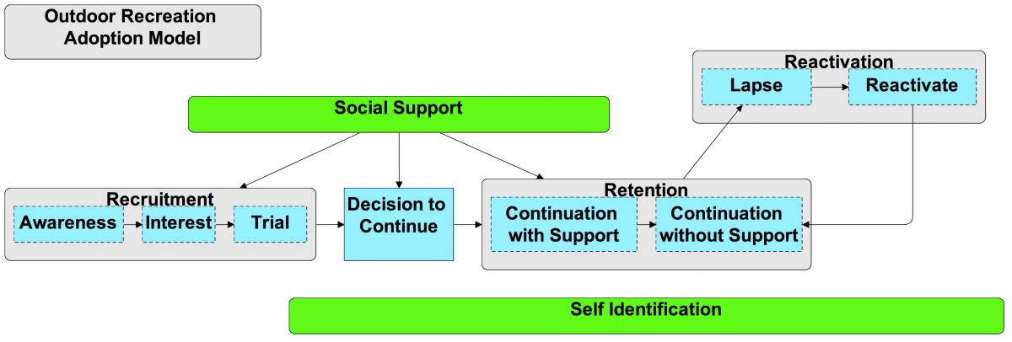
Outdoor Recreation Adoption Model

Slide 5
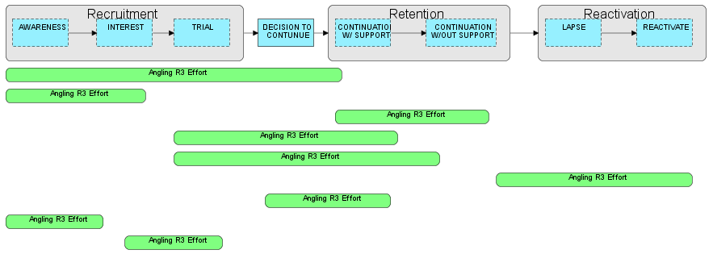
“Mapped” Efforts

Slide 6
Identify Gaps

Slide 7
The Pathway to Becoming an Angler/Boater/Outdoor Recreationist

Slide 8
Challenge: How do states succeed at R3?
STATES COMMIT TO:
Solution:
Implement AFWA
Task Force Recommendations
Develop an Angler R3 Plan
Reallocate agency resources to ensure R3 success
Establish a full-time Angler R3 Manager
Develop CRM system
Establish a repository for state agencies to share R3 program learnings

Slide 9
Angler R3 Plan Guiding Document
Resource for state agencies:
Overall R3 planning considerations
Marketing planning aspects
Worksheet to assess current angler R3 efforts
Notes:
Following the release of the Angler R3 Recommendations, many state partners requested guidance in developing an angler R3 plan.
RBFF has developed a new resource document, and has been pursuing a number of partnership efforts to help advance state angler R3 planning.
Recently released a guiding document to help state agencies in their angler R3 planning process.
This guiding document includes overall planning considerations, marketing planning aspects, and a worksheet to help assess current angler R3 efforts, as well as a resources list.

Slide 10
Additional R3 Resources & Training
Hired consultants to help provide state agencies with R3 workshop facilitation and R3 plan development
Partnered with NCTC/MAT/USFWS and CAHSS/WMI to develop and offer R3 training for coordinators and practitioners

Slide 11
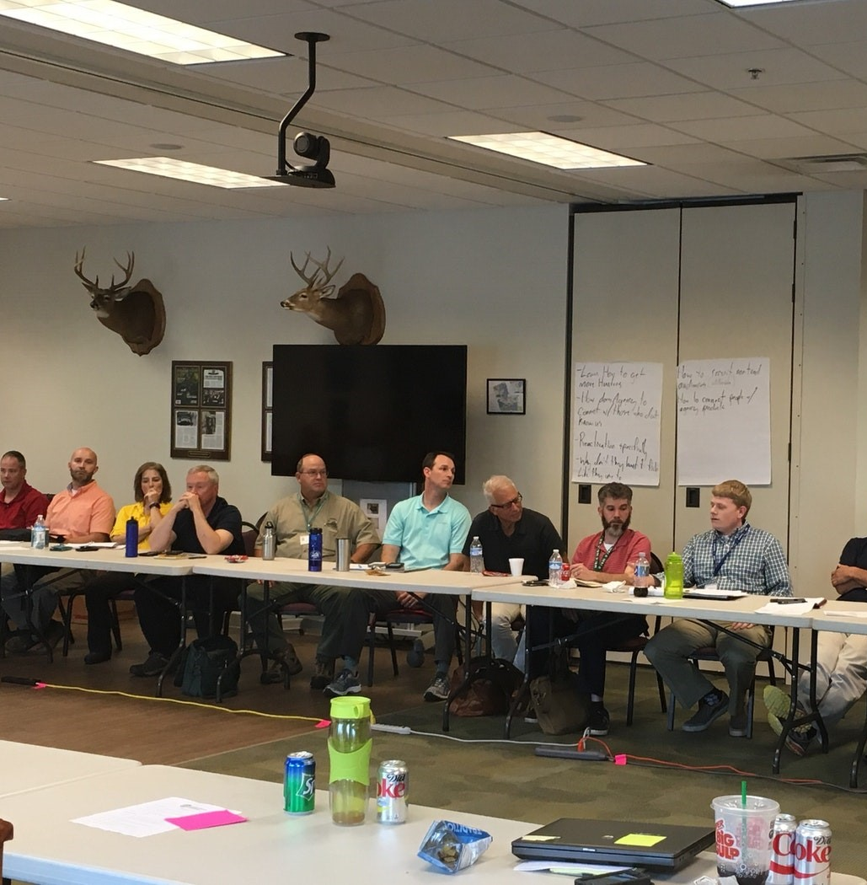
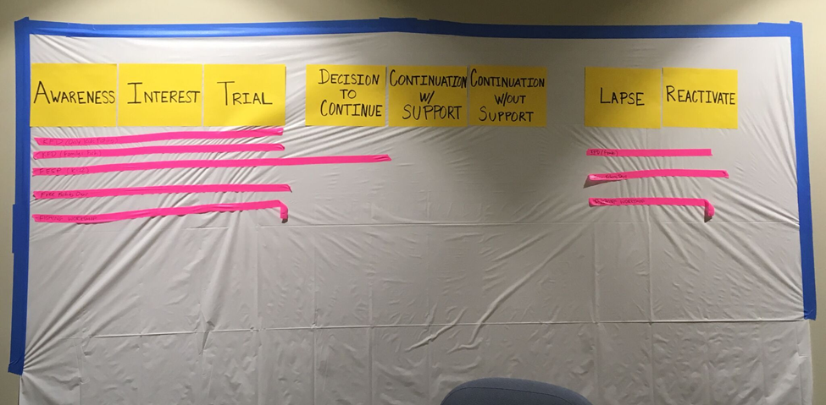
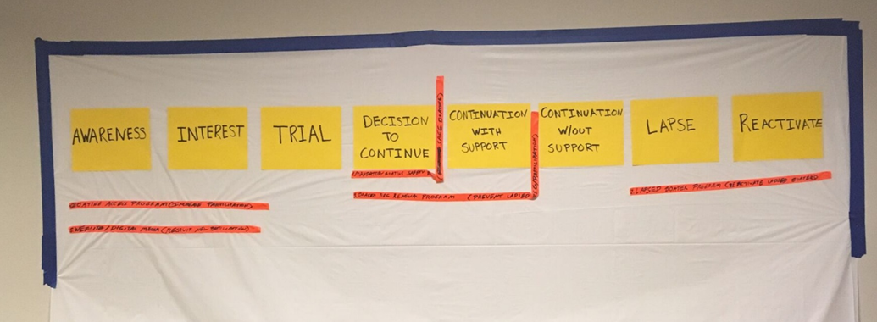
VA R3 Planning Workshop

Slide 12
State R3 Growth
21 STATE ANGLER R3 COORDINATORS
12 STATE PARTNERS DEVELOPING R3 PLANS
Marketing Campaign Success
New License System & Capabilities

Slide 13
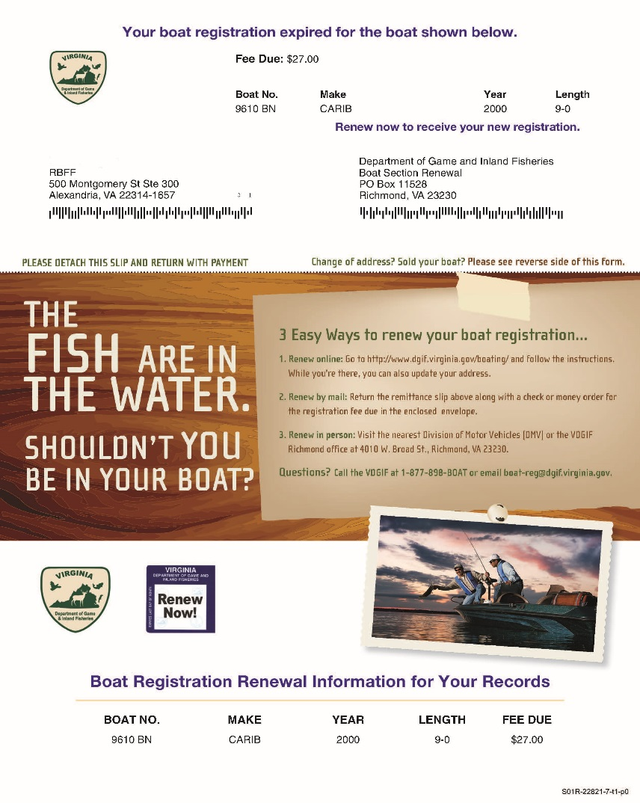
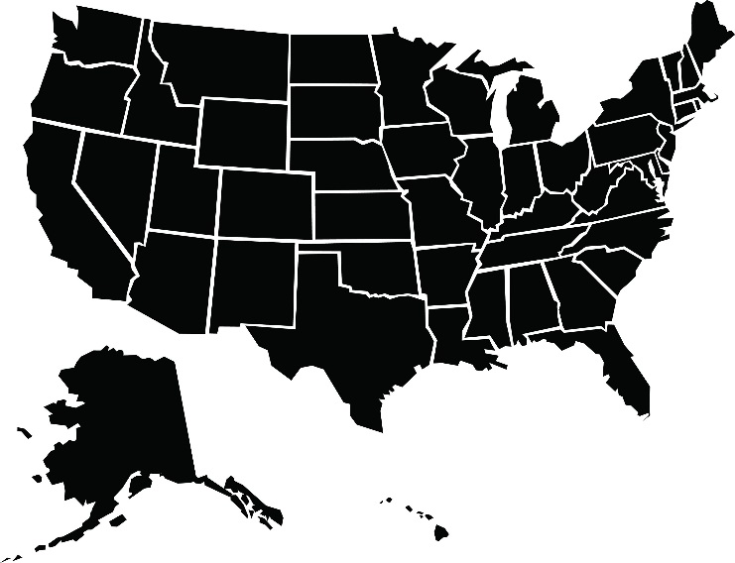
Boat Registration Marketing Program
$1.9M gross revenue

Slide 14
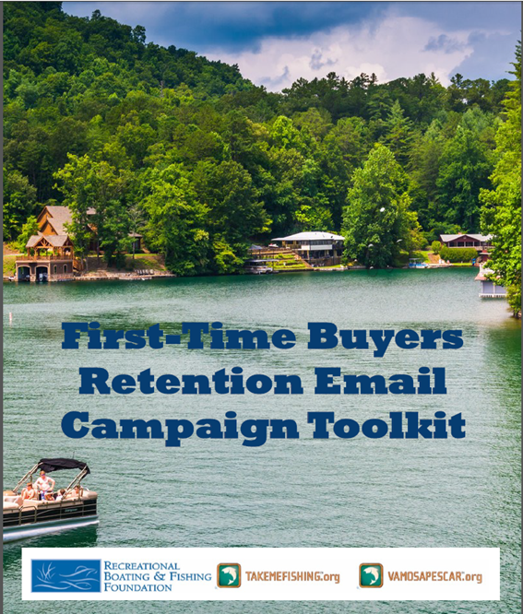
Retention & Reactivation Toolkits

Slide 15
R3 Webpage
TakeMeFishing.org/R3
Comprehensive destination for angler/boater R3 information and resources

Slide 16
What is R3? Why is it Important for RBS?

Slide 17
Introduction
Recruitment, Retention or Reactivation
Texas Parks and Wildlife R3 Plan (DRAFT)
This plan prescribes the processes, strategies, and actions that must be implemented to begin positively impacting participation in the four pillars: hunting, angling, boating and sport shooting
Data analytics will be included
Ongoing plan of action that will be updated bi-annually

Slide 18
Goals
Create lifelong participants in hunting, angling, shooting sports and boating
Build capacity to support increased participation as well as coordination for R3 efforts statewide
Increase public support for hunting, angling, shooting sports and boating
Increase funding for the future of wild things and wild places via license sales, boat registration and the sales of sporting related items

Slide 19
Outdoor Recreation Adoption Model (ORAM)

Slide 20
Strategies
1. ADD EVALUATION AND OUTCOME TRACKING TO ALL PROGRAMS
To gauge success of R3 efforts
2. INCREASE ACCESS AND OPPORTUNITY
For outdoor recreation in Texas
3. INCREASE CUSTOMER ENGAGEMENT AND SATISFACTION
Through improved customer management practices and services
4. COMMUNICATE VALUE OF OUTDOOR RECREATION
To ensure we reach all Texans interested in the outdoors
5. CREATE AND IMPROVE PARTNERSHIPS AMONG AGENCIES, ORGANIZATIONS, AND INDUSTRY
To collaboratively and effectively implement R3 efforts

Slide 21
Why is Boating important in the Texas R3 plan?
580,000 registered boats
Over 4.5 million people participate
Economic impact of $5.96 Billion
Paddle craft are not registered and there are estimated to be over 290,000 paddle craft in Texas
Over 623,000 new boaters, primarily paddlers
Large group of outdoor recreational users is an untapped resource
Successful powerboating reactivation program with RBFF

Slide 22
Why is Boating important in the Texas R3 plan?
Goals:
Establish a paddle craft taskforce to address the growth of paddling in Texas.
Maintain a 9% return on reactivation registration of lapsed boaters through the lapsed boater program.

Slide 23
Texas boat registration sales compared to Texas population.

Slide 24
Strategy 1: Add Evaluations and Outcome Tracking to all R3 Programs
Action 1.1: Implement system to allow for tracking of customers across all agency programs and activities
1.1 Priority Tasks
1.1.1 Assign one customer ID for all agency programs and activities
1.1.2 Continue to utilize License Utilization & Revenue Enhancement System (LURES) by agency staff
1.1.3 Develop evaluative tools for agency programs and activities
1.1.4 Ensure the collection of quality participation and license data by all agency staff
1.1.5 Conduct human dimensions research to identify R3 activities that have the greatest impact so that monies can be allocated properly
Action 1.2: Implement participant tracking into every R3 program
1.2 Priority Tasks
1.2.1 Established programs should use participation data to determine their success in R3 efforts and use this information to enhance program strategies
1.2.2 New programs will build in participant tracking strategies from the start

Slide 25
Recommendations
Be involved with your and or partner agencies implementing of an R3 Plan
Think in terms that include revenue generation, not just program participation
Think how you can collect scientific data
Don’t get stuck in the “Change the name of the existing program strategy” and keep on moving
Use existing successes to build innovation and new ideas

Slide 26
THANK YOU
TakeMeFishing.org/R3

