Slide 1
Automated Reporting and Boater Trends
Captain Joe Frohnhoefer III Sea Tow Services International

Slide 2
In all things we do, we help people enjoy boating. Sea Tow Mission Statement

Slide 3
Your Road Service at Sea ®
Serving boaters since 1983
Pioneered the industry of on-water assistance
100+ franchise locations
Still family owned and operated nationally and locally
Unique business model
24/7 Customer Care & Dispatch Center

Slide 4
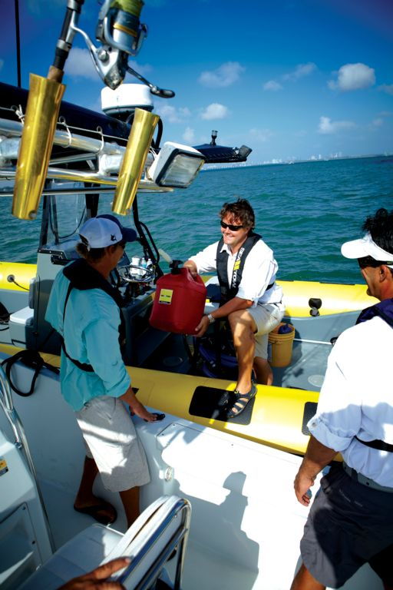
Membership Privileges Peace of Mind™ on the Water
FREE Towing, Fuel Delivery, Jump Starts, Prop Disentanglements
FREE Covered Ungroundings
100% coverage of Dock-to-Dock tows
Nationwide Coverage
Priority Service
Local, U.S. Coast Guard Licensed Captains
24/7 Customer Care Center
Exclusive Discounts via Sea Tow Savings Club
NO money out-of-pocket for covered services from Sea Tow
And more!

Slide 5
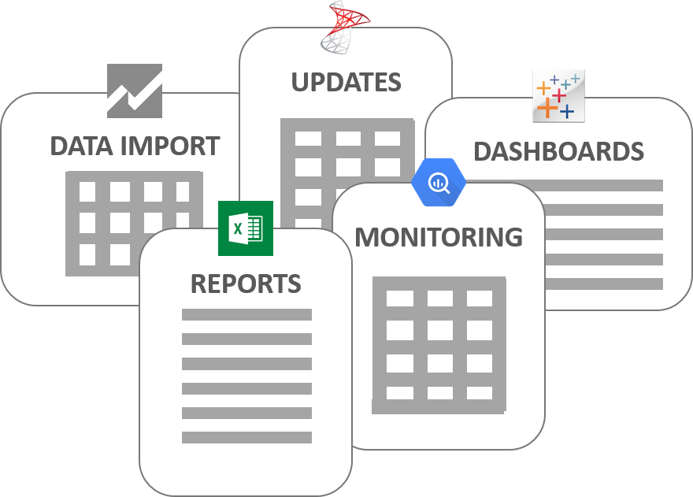
Automated Reporting
The act of delivering reports containing relevant business information at specified intervals or after a triggered event so users don’t have to spend the time finding the information themselves.
Can encompass many types of different reports depending on the needs of the end user.

Slide 6
Automated Reporting
80% of the time, Sea Tow provides marine assistance and service for problems related to human error!

Slide 7
Boating Trends that Sea Tow sees

Slide 8
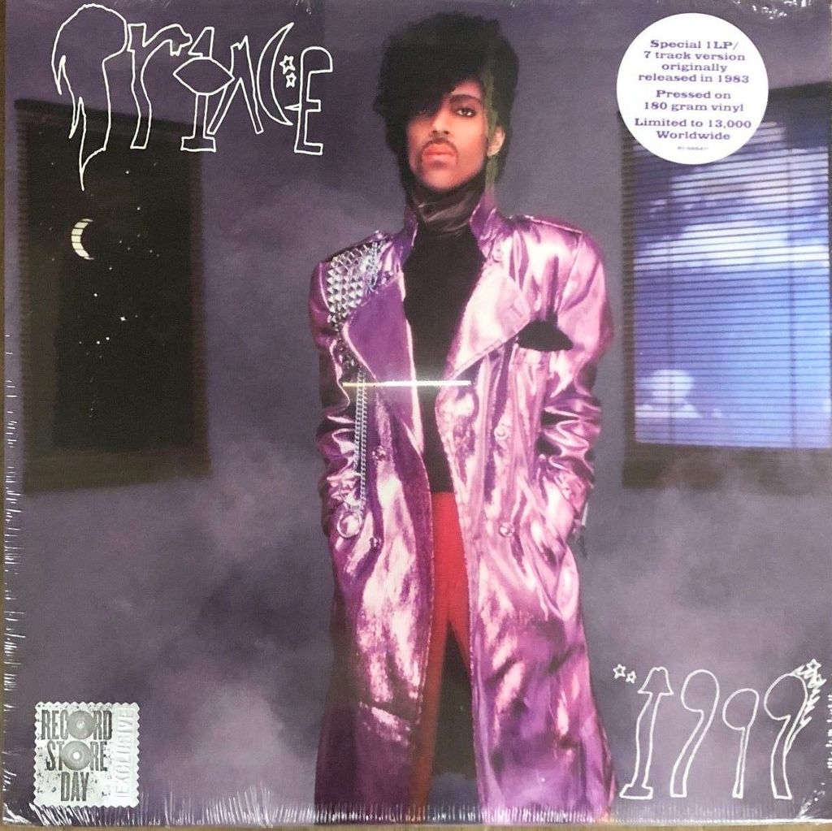
Boating Trends that Sea Tow sees
Average boat serviced by Sea Tow in 2018 was manufactured in

Slide 9
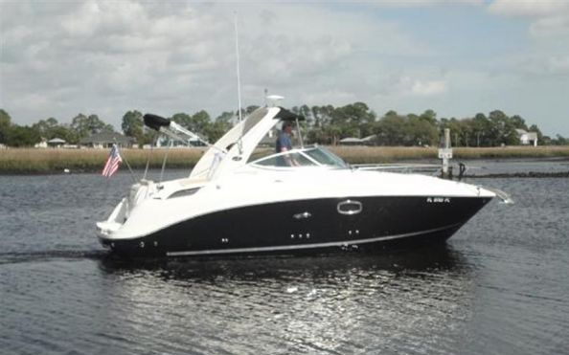
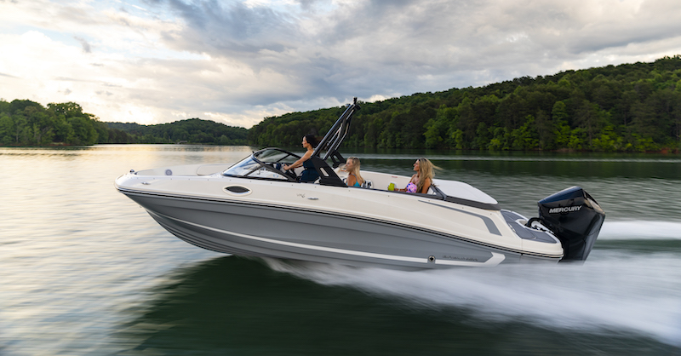
Boating Trends that Sea Tow sees
Average length of a boat serviced by Sea Tow in 2018 was 25 feet.

Slide 10
Boating Trends that Sea Tow sees
The most busy time of year for call activity is June, July and August which accounted for 47% of the 2018 service calls.
The Coast Guard sees 53% of all accidents and 48% of all fatalities taking place during the summer months.

Slide 11
Boating Trends that Sea Tow sees
Response times and length of the jobs were one of the first things that Sea Tow saw when automated reporting starting in 2016 and it was something we strived to improve.

Slide 12
Boating Trends that Sea Tow sees
The top 3 on-water services that can be attributed to operator error in 2018:
Ungrounding – 2,598 calls
Battery Jumps – 2,039 calls Total: 6,650 calls
Fuel Delivery – 2,013 calls
The Coast Guard’s top 4 contributing factors of accidents in 2017:
Operator inattention – 620 accidents
Improper lookout – 471 accidents
Operator inexperience – 436 accidents Total: 1,832 accidents
Machinery failure – 305 accidents

Slide 13
So what can we do about all of this data?

Slide 14
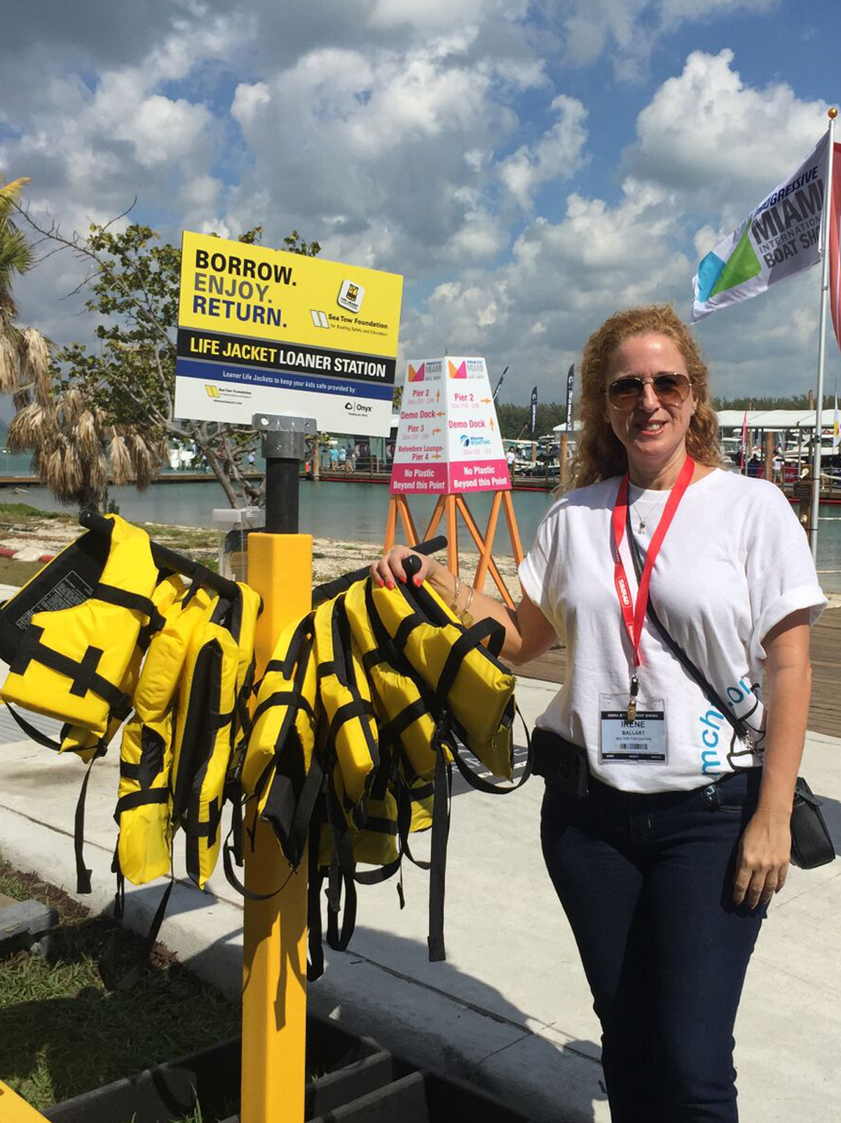
What other boating trends need to be addressed by RBS organizations?
Increase life jacket wear by boaters
76% of boating accident victims drowned
80% of boaters who drowned were in boats under 21 feet
JSI Life Jacket Wear Rate Study has shown that numbers have barely changed in the last 18 years for all boaters
15.4% in 1999
20.7% in 2017

Slide 15
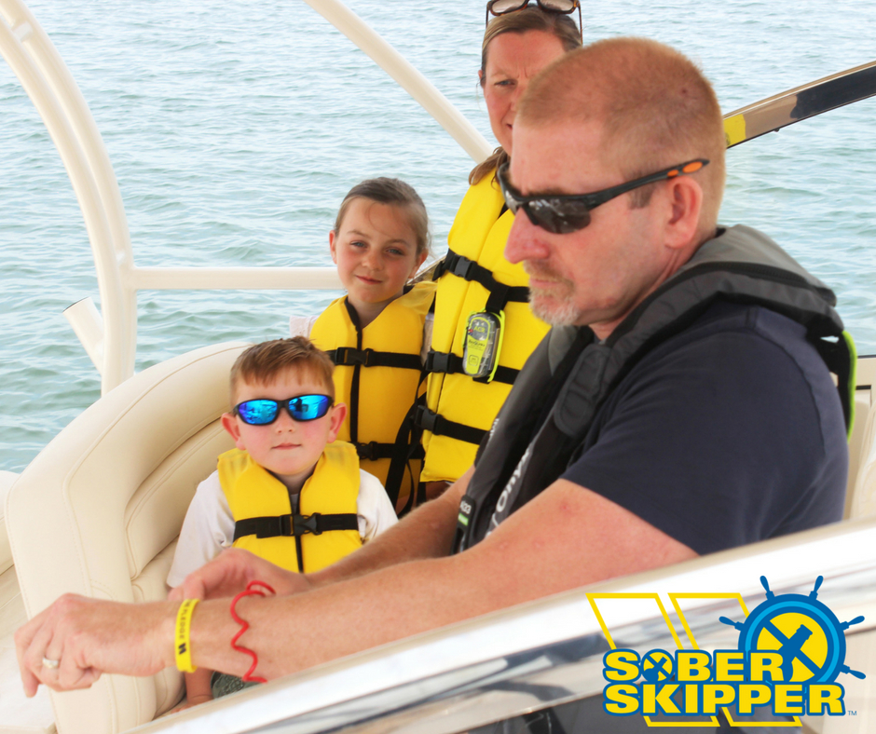
What other boating trends need to be addressed by RBS organizations?
Eliminate the number of BUI cases
Alcohol use is the leading known contributing factor in fatal boating accidents
Alcohol use is listed as the leading factor in 19% of deaths
275 accidents attributed to alcohol use in 2017
Legalized marijuana in many states will soon become a major problem on the water

Slide 16
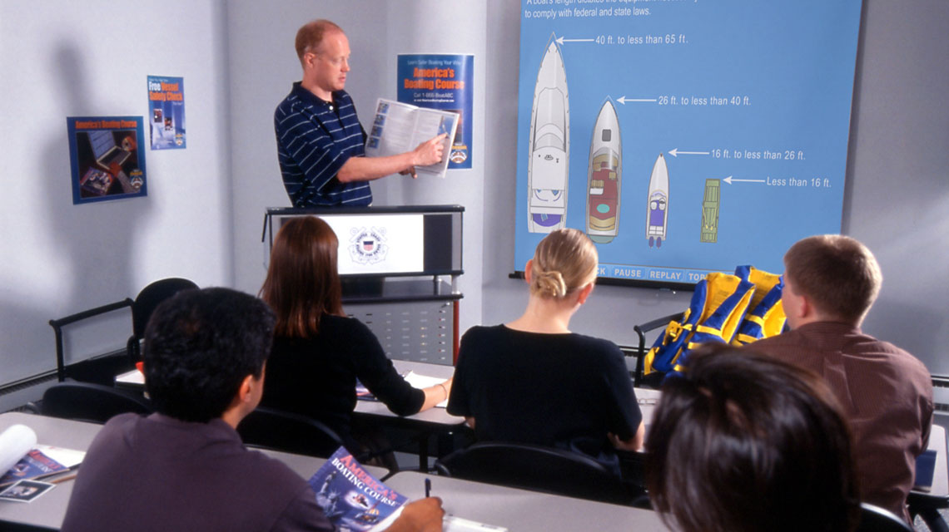
What other boating trends need to be addressed by RBS organizations?
Increase boating safety education requirements
81% of deaths occurred on boats where the operator did not receive boating safety instruction
Top 5 accident types: collision with another boat, collision with fixed object, flooding/swamping, grounding, falls overboard
172 accidents and 31 deaths related to propeller strikes

Slide 17
Where would more real-time automated reporting be beneficial in the boating industry?

Slide 18
Thank you!
Any Questions?

