Slide 1
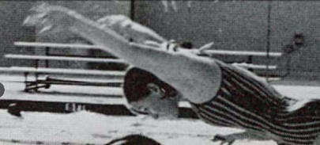
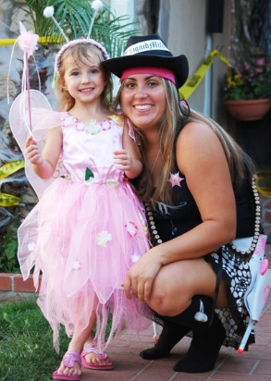
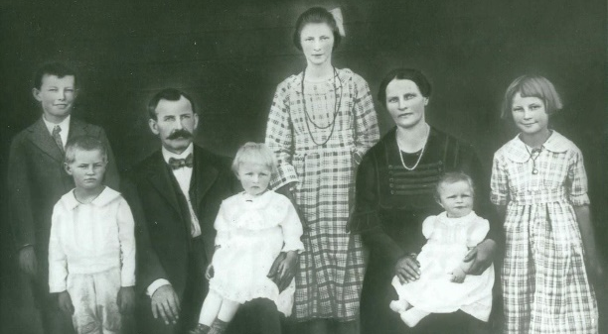
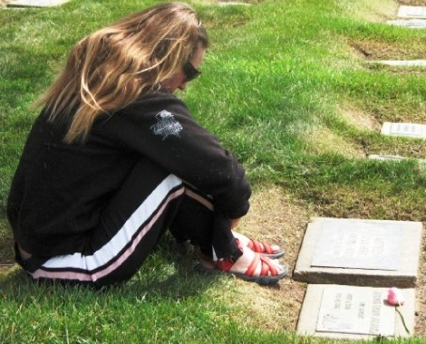
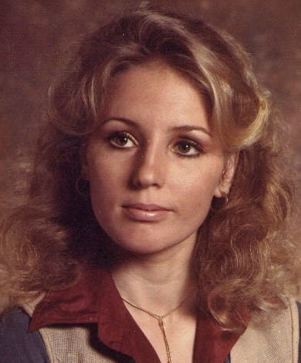
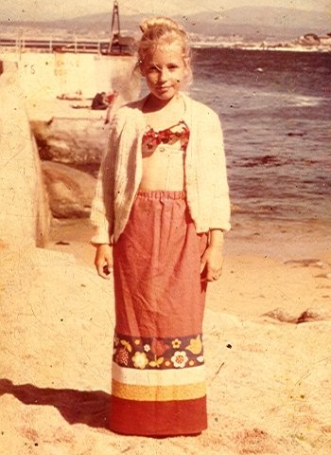
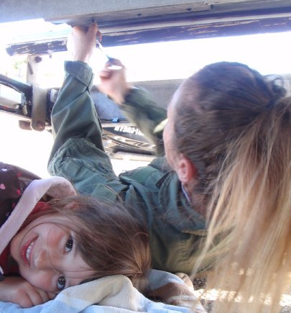
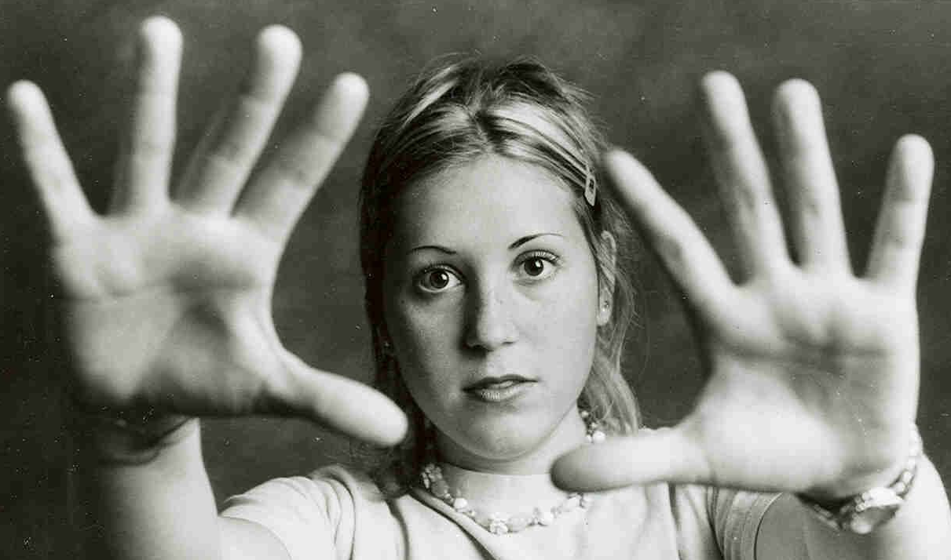
HOW I BECAME A TEACHER
MY EVOLUTION
Generational Family
Tragedy
The 1960’s
Being born in the USA
Technology
The Jet Ski
Racing
Difficult Failures
Motherhood
Rescue
The Struggle

Slide 2
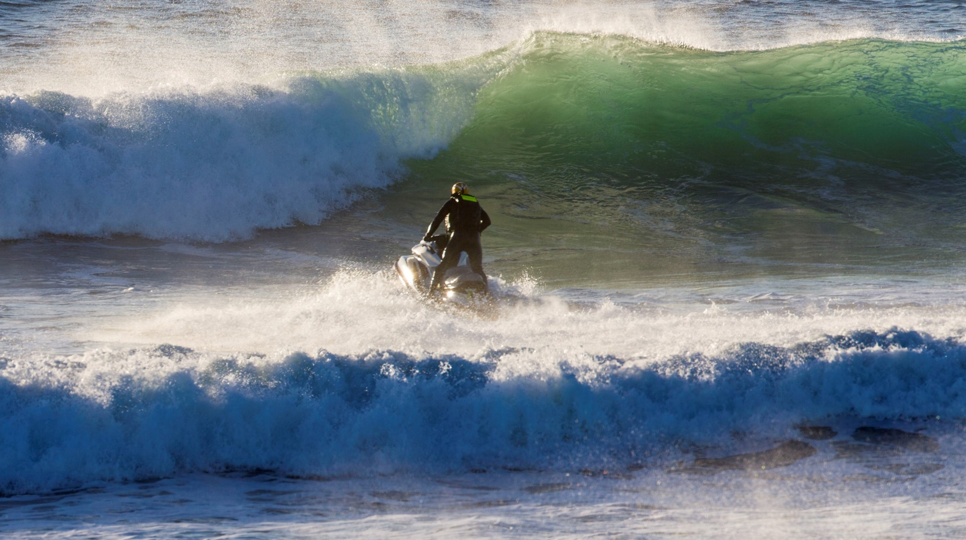
MY VOCATION
VALUES
SACRIFICE
Self Trained – Self Failed
I am my hardest critic
Personally funded equipment (Pride of Effort)
No taxpayer support (The old fashioned way like Gramps)
Original content and design created by hardship
Because I care
Challenges are difficult on our family – children are resilient
100% risk of death/injury – reality based choice
No support system for tragic events or trauma – deal with it
No paid vacations, retirement or sick days
Discrimination became a gift of opportunity
Low income - High Results

Slide 3
TRAINED BY THE TRAINERS
I had been teaching for over a decade without any guidance or credential in my community. My student cadre appeared
to approve of their training; my courses grew by word of mouth and the program outreach was getting stronger.
My students gave me GREAT advice. They shared with me what worked for them and what they wanted to trial. They
told me their story. I listened and adapted the course need direct to the client to solve their recurring problems. This
was before computers, I used a typewriter. I started with my own experiences translated effectively for others to test.
I wanted to become a better boating Safety instructor. The first boating course I ever took I was made an example by my
instructors. ‘You go first, you show us how to do it, you’re the expert’. I had no previous experience with the skills they
wanted me to tackle. I sucked up the challenge and passed their class.
But not before I observed the painful reality of being a student.
I had a hard time staying awake in their class. I was not learning much at all. I passed time and it was painfully slow.
When a topic became of interest the instructor would lose the class. Everyone else tolerated the course for the cert. I was
discouraged. Heading into the class I believed I would be enlightened instead I was annoyed and disappointed by their
training. Instead of attaining new knowledge I could transfer to others effectively, I took very little away from that class.
I made a promise to myself I would never be an instructor like the ones who were mine. I would care about my
students desire to learn. I would listen to them, adapt to their need. My one takeaway was how my role was to ‘think
like a student but act like an instructor’. And I promised they would ‘think like an Instructor but act like a student’.

Slide 4
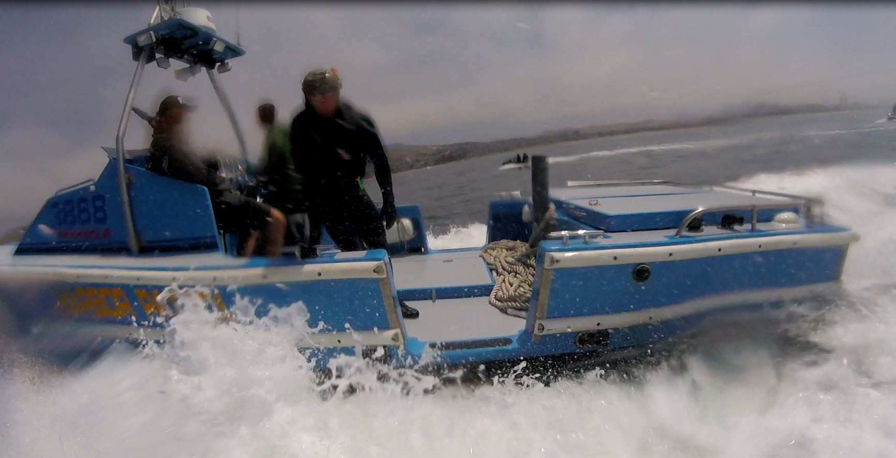
HOW MY STUDENTS TAUGHT ME TO TEACH
What have we been doing wrong?
Very Satisfied
Satisfied
Dissatisfied
Very Dissatisfied
NA (not applicable)
Get Me Out of Here

Slide 5
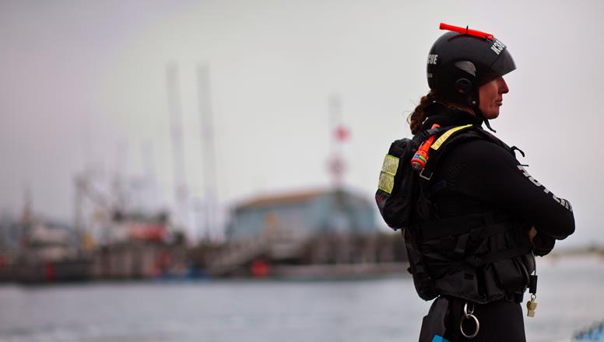
CHANGE IS GOOD RIGHT?
Only if it happens somewhere else.
What age are you? What age is the new entry level boat operator?
What kind of technology have you surrounded yourself with and are competent at managing?
When was the last time you were on the water With a student who took your course?
How easy do you adapt to the rapid changes of communication?
If you think its hard for you, it’s no different for our students
With the increase of technology this is happening right now, to you, to everyone:
Don’t want to talk on the phone
Don’t want to text
Don’t want to read emails
Don’t want to take another questionnaire or 5 more surveys
IT’S ABOUT TIME!
MAY I HAVE YOUR ATTENTION PLEASE?
I mean personal time management. Demand for our time is becoming more difficult to manage.

Slide 6
WHAT I WAS TOLD
Me: Can we change this and make it direct to the use, this is bit outdated.
Authority: This is how its taught.
Me: Why don’t we modernize?
Authority: Because this is the approved method.
Me: My students don’t like it, they say its wasting their time and it doesn’t apply to them
Authority: This method is build upon science, its been engineered for education.
Me: Have these scientists taken the class and then drove a boat?
Authority: Don’t be a problem, do it right.
Me: Why can’t we modernize? Everything else is around us. (THE REAL PROBLEM)

Slide 7
IS IT THE CONTENT?
IS IT THE DELIVERY?
IS IT THE AMOUNT OF TIME?
IS IT THE NEW WAY TO COMMUNICATE?

Slide 8
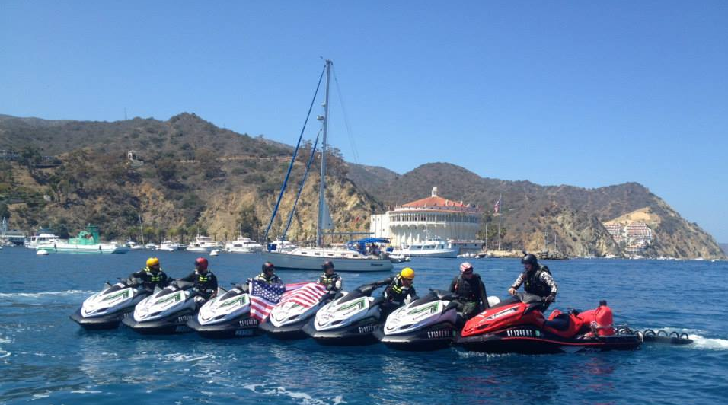
QUESTIONING STUDENTS ABOUT OTHER TRAINING PROGRAMS
‘WHAT I AM THINKING I’M GOING TO LEARN’
‘WHAT AM I ACTUALLY LEARNING?’
‘WHAT I THINK I’M GOING TO LEARN I NEVER LEARN’
‘I’M NOT LEARNING ANYTHING THAT IS GOING TO SAY TO ME ‘WOW I NEED TO DO
THAT OR THAT IS A GOOD IDEA OR THAT’S GOOD ADVICE!’

Slide 9
QUESTIONING STUDENTS ABOUT OTHER TRAINING PROGRAMS
‘EVERYONE IS REGURGITATING THE SAME STUFF AND THE INFORMATION IS
ALREADY OUT THERE ON THE INTERNET FOR FREE.’
‘I DON’T FEEL LIKE I HAVE LEARNED ANYTHING THAT HAS UPGRADED MY KNOWLEDGE’
‘I JUST NEED THE CERTIFICATE’
‘I’M BEING PAID TO BE HERE LMFAO’
‘IT’S GEARED FOR OLDER PEOPLE’
‘TIME IS WORTH MORE THAN MONEY NOW’
‘IT’S OLD SCHOOL THOUGHT LOL’
‘SERIOUSLY ! THEY TIME THE TEST ONLINE? WTF!’

Slide 10
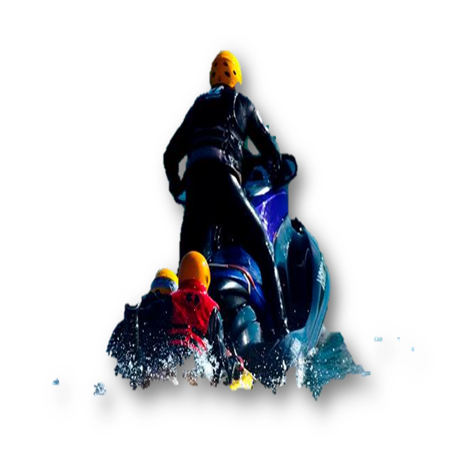
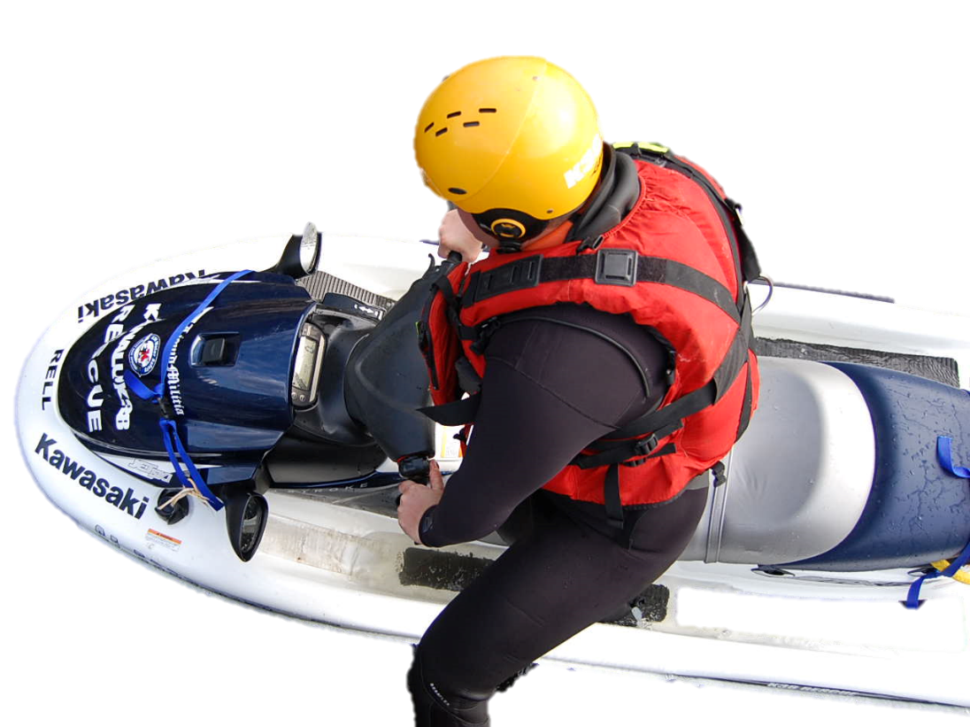
Does everyone qualify? No, they do not.
CAPABLE
INSTRUCTOR
LISTEN
QUALIFIED

Slide 11
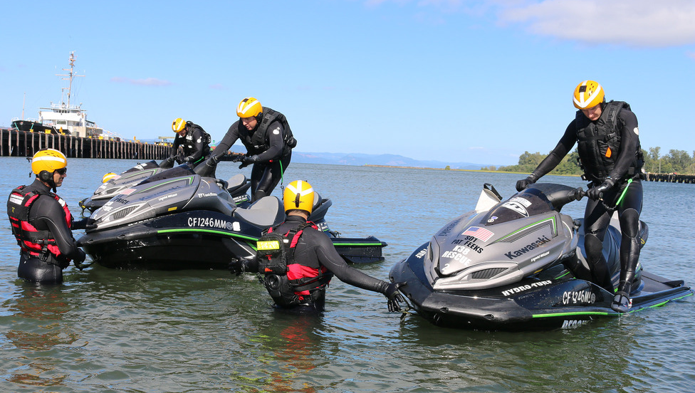
WHO IS ENFORCING OCCUPATIONAL RWC TRAINING?
……………….nobody
This is the problem.
The proof and evidence is overwhelming regarding trainers.
Accidents and injuries remain high on their watch after training.
These Instructors and their students protect incompetency and endorse liability that leads to recurring mishaps.
Yes there are solutions. We have them.
Question: Do Instructors visualize how they want their students to behave after training?
Do they follow up with students?
Do they counsel for poor behavior reported?
Do they monitor the media and investigate online news sources for mishaps?
Do they revoke certification for violations of standards?
Do they maintain records?
Do they recertify?
Do they send out updated news and industry alerts?

Slide 12
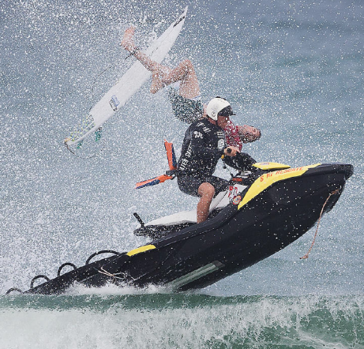
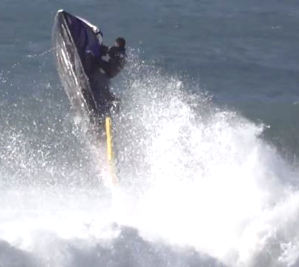
Not
CERTIFIED
THE RESULTS ARE IN!
Operators and Trainers who recklessly ignore the end results of poor behaviors must go or get properly re-trained.
Poor results endanger the public, the operators, crew and the equipment entrusted to them. Rescue and Safety are not words to hide behind, they are a way of complex and technical operation.

Slide 13
BAD MENTORS & PROGRAMS TRAIN MORE BAD STUDENTS
How does that translate?
More Occupational Accidents
More Occupational Excuses
More Occupational Injuries
More Occupational Equipment Ruined Unnecessarily
More Occupational Lack of Accountability
Then What?
These same bad trainers and students will aggressively defend their
Poor behaviors to the point of causing great harm to themselves, the general
Public, taxpayer funds and the end result of diminished public safety service.
Why be afraid of admitting flaws and problems?
Answer: Personalizing the methods used through ego and not through courageous scrutiny

Slide 14
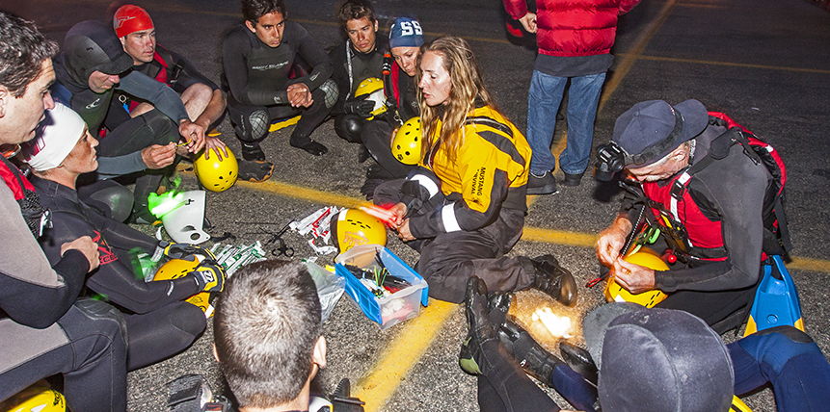
WHAT IS TEACHING TO ME?
My students and our relationship = Their Operational Competence and Capability is the real story

Slide 15
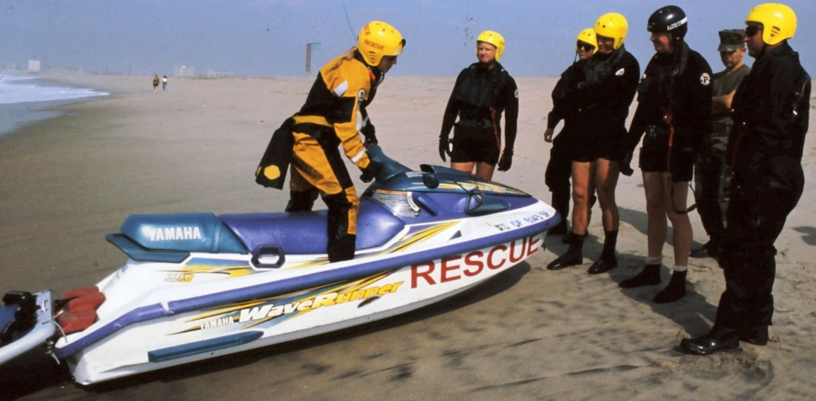
WHY PEOPLE TEACH?
Do students expect the same kind of boring class?
Are they inspired and motivated when they leave the course?
TO CONTRIBUTE TO COMMUNITY
PERCEIVED POWER AND INFLUENCE
TO MENTOR
SERVICE ORIENTED ALTRUISM
ASSIGNED BY DEPARTMENT

Slide 16
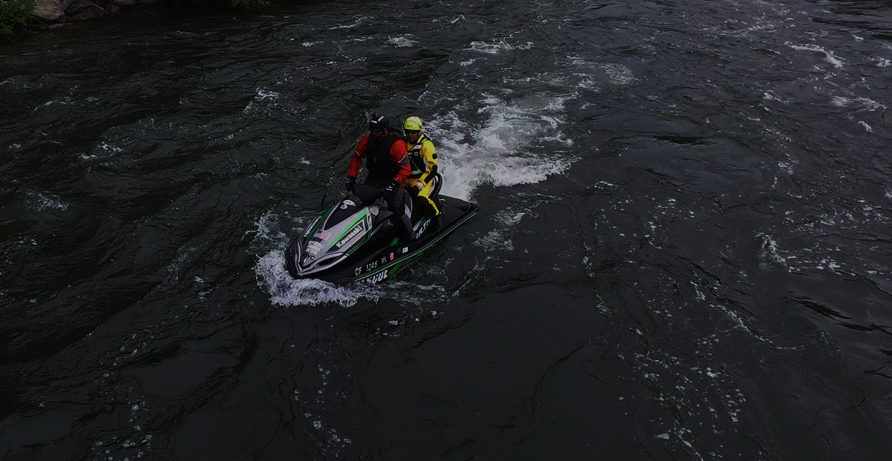
A training program alone increased productivity 28%, but the addition of follow-up coaching to the training increased productivity 88 percent.
That is because reminders uncover the hidden realm and reinforce the present.

Slide 17
HOW DOES MY K38 TRAINING APPLY DIRECTLY TO MY JOB?
PERSONAL GOALS
RESPONSES
Student One
Student Two
Student Three
Student Four
Student Five
Student Six
Student Seven
Student Eight
Student Nine
Student Ten
I want to be able to do better for my job
I don’t have any idea
I want to be able not to flip the RWC over
I want to know how to work on the RWC and maintain it
I want to know what I don’t know
I want to be more comfortable working with people on board
I want to know how to use a rescue board better
I am curious about how this boat works in surf
I’ve never ridden before, I am not sure
I want to know how to convince my department to take better care of our program
Why is a student in our audience?

Slide 18
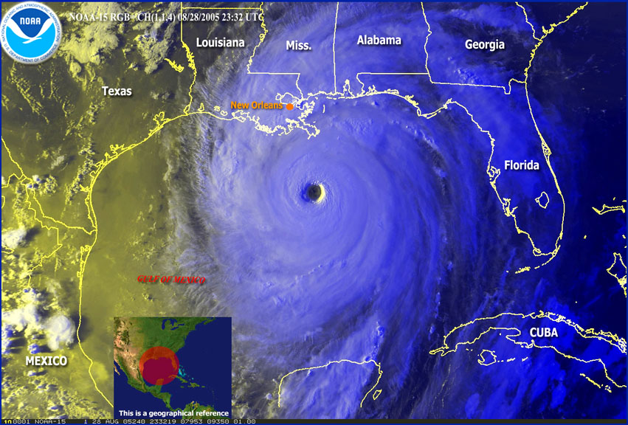
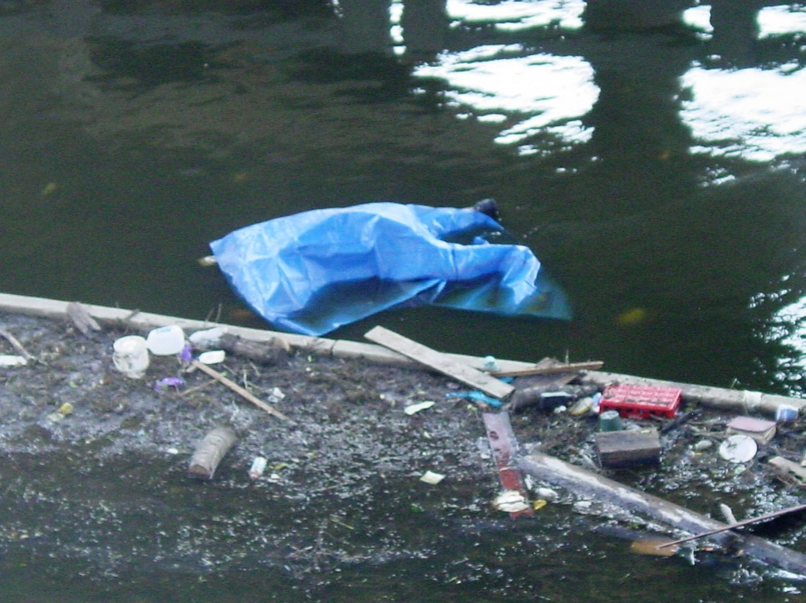
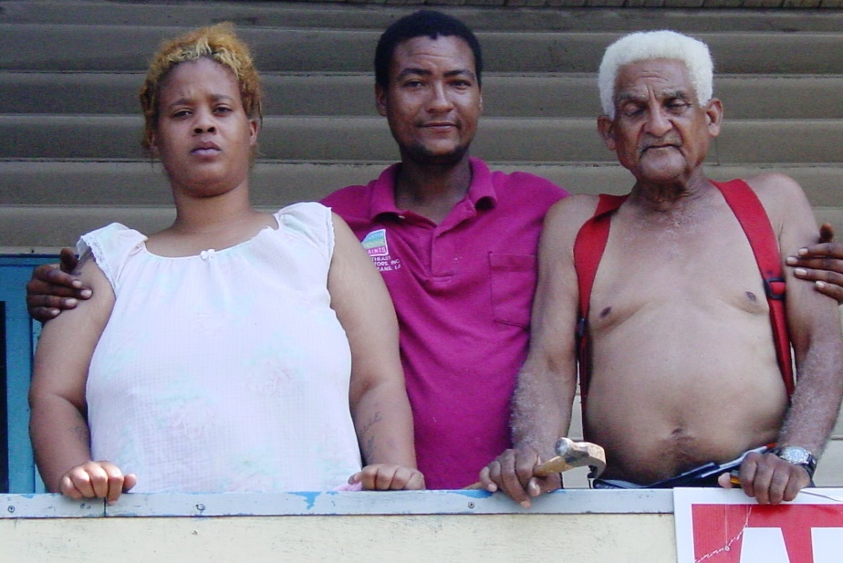
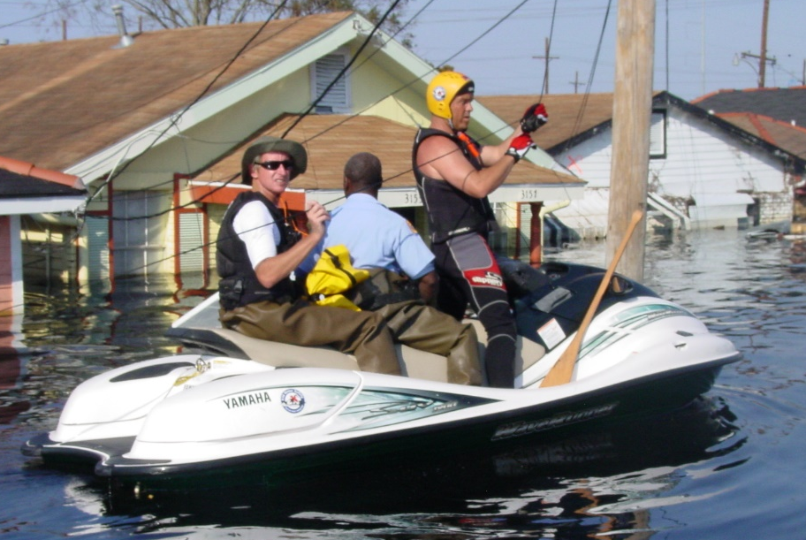
WHO IS IN CHARGE?
NATURE
DEATH
W
H
Y
W
E
T
R
A
I
N
UNDERSTANDS WEATHER
PERSONAL-& PRIVATE
HUMANS
BOAT
NEEDS RISK MANAGEMENT
EMOTIONAL SUPPORT

Slide 19
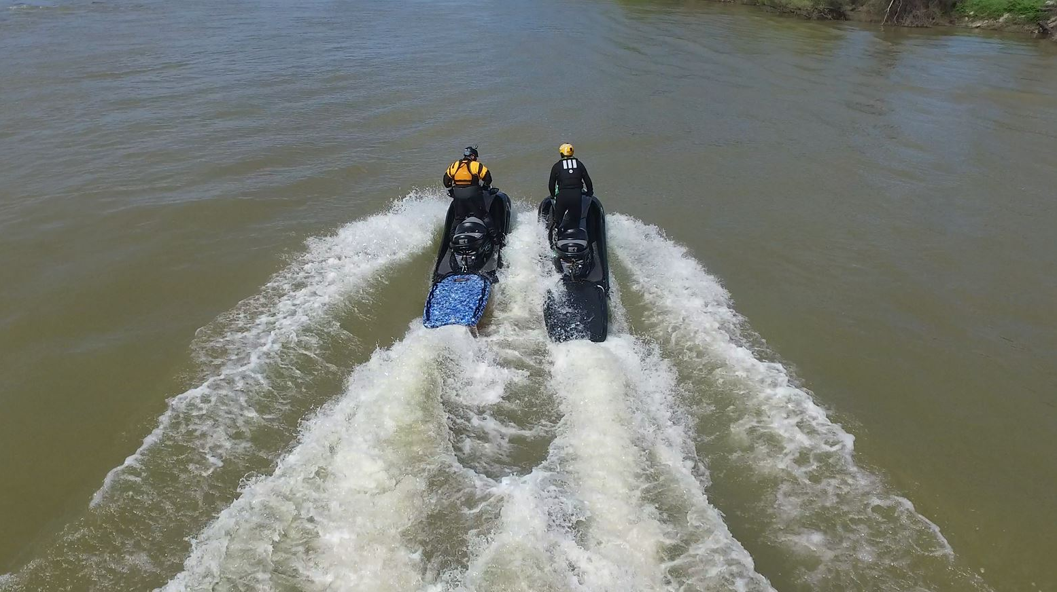
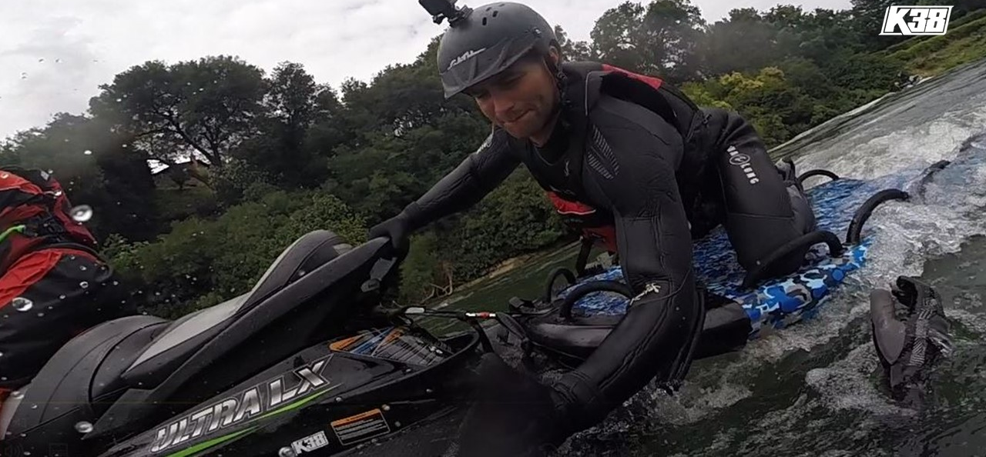
STUDENT NEEDS
Represent professionalism for the department
Become a competent operator
Maintain an operational RWC (as opposed to one always breaking down)
Saving Lives, catching Bad Guys and monitoring Public Safety
Solve Rescue Board problems
Operating in high risk areas and close proximity to people, boats and docks
Support from our department to have a better program
Knowledge structure and personal transformation
To earn a certificate of competence

Slide 20
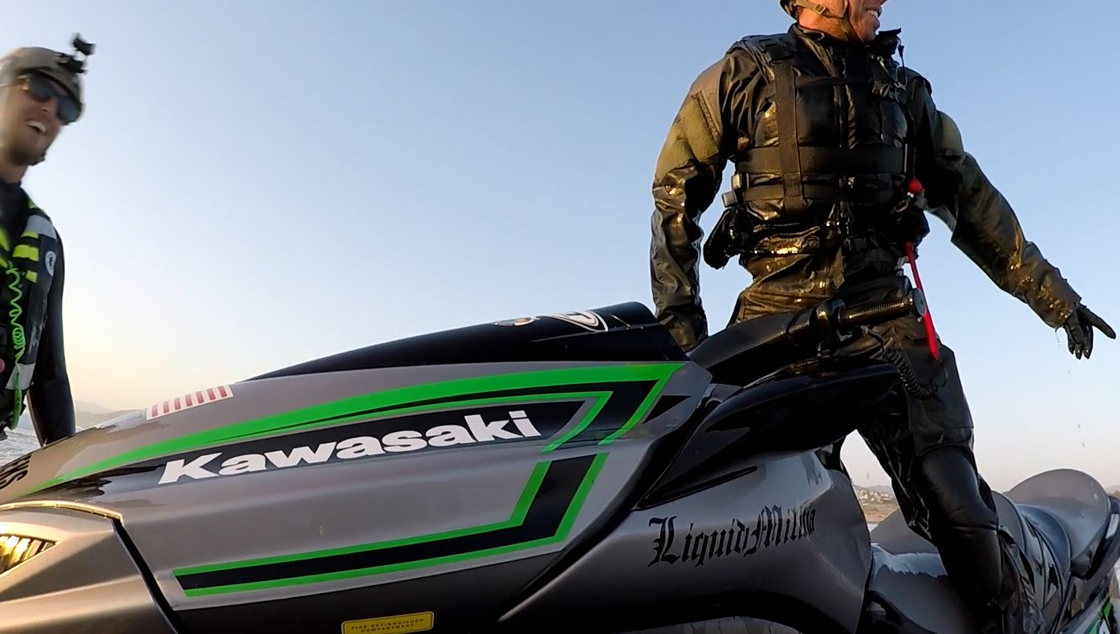
STANDARDS OF OPERATION
K38 provides stages of training, translated into daily hours (8-10)
Stage 1 – Day One – Foundation
Stage 2 - Day Two – Vessel Familiarization and 4 baseline operational skills
Stage 3 - Day Three- Rescue Board/Accessory introduction – Boat Handling – Night Qualification
Stage 4 - Day Four – One to Five persons on board craft – Technical handling begins
Stage 5 – Day Five- Students lead the training – Students self test their behaviors and decisions
Depending upon the client level, this represents a baseline of 40 hours instruction.
A custom course can be up to 50 hours of training for the type of qualification desired in a one week timeframe
Pre-requisites apply for some courses

Slide 21
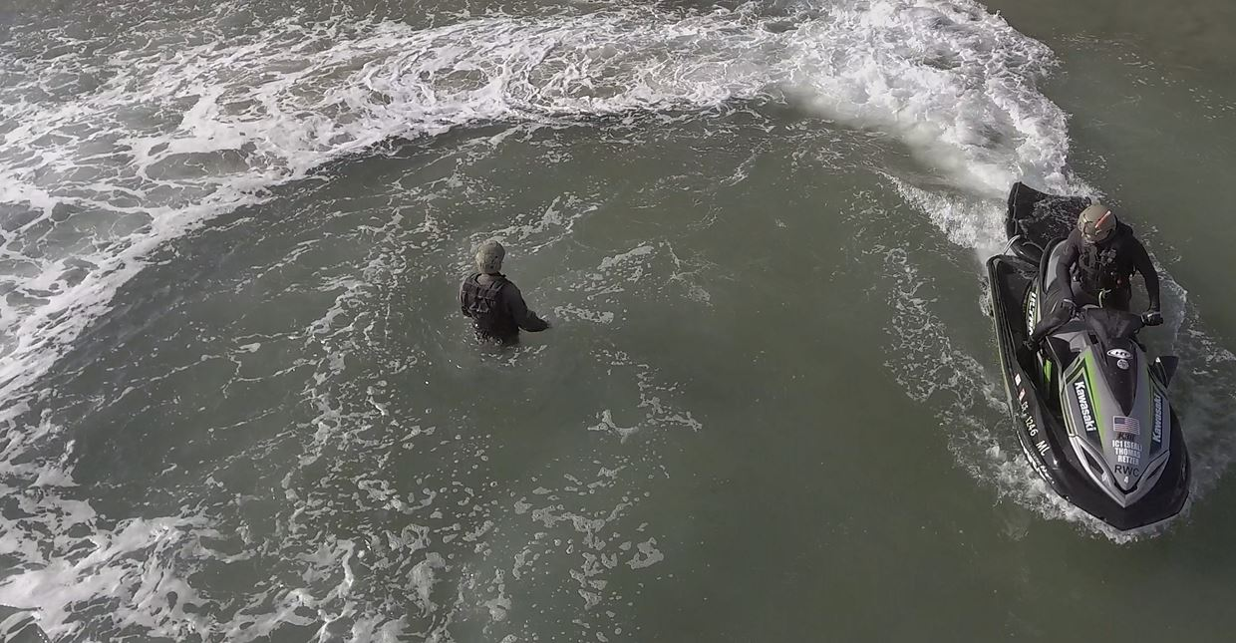
TEACHING IS A RELATIONSHIP
INSPIRE MY STUDENTS TO TEACH THEMSELVES
I CANNOT TEACH A STUDENT ANYTHING, THEY MUST WANT TO LEARN
THE CONTENT MUST BE INTELLIGENT
CONTENT MUST BE SCALED TO THE KNOWLEDGE BASE
STUDENTS MUST BE PART OF THE INSTRUCTING PROCESS
UNDERSTANDING OF OUR HUMAN NATURE AND FEARS
OVERCOMING PERSONALITY NEGATIVES AND CHALLENGE THE STUDENT TO ADAPT
WE HAVE TO COMMUNICATE THEIR INDEPENDENT GOALS AND ACHIEVE THEM AS A TEAM

Slide 22
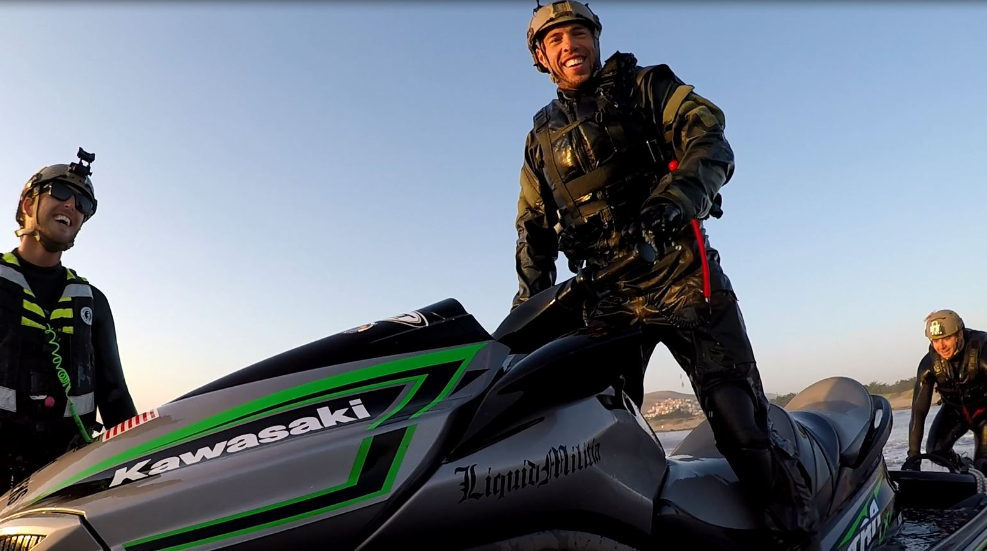
RESPONSIBILITY
CONSISTENT DAILY QUIZZES
DAILY COURSE ASSESSMENTS
STUDENT TASKS ASSIGNED
STUDENT LEADERSHIP REQUIRED
TRUST
EVALUATION
ACHIEVEMENT OR DISMISSAL
WHAT HAPPENS AFTER THE CLASS MATTERS MOST

Slide 23
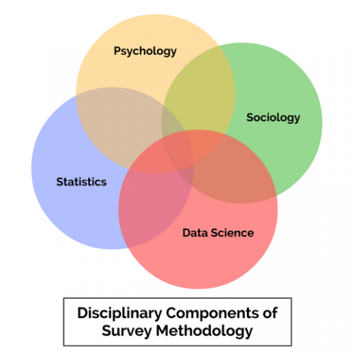
Master of Science in Survey Methodology
Survey methodology combines knowledge from
several different fields of study.
These fields include:
Sociology
Psychology
Statistics
Data science
Used to analyze the questions and apply towards future results or remedial actions or course or instructor changes.
We grade our instructors, they are given a rating A-B-C
A is Outstanding
B is Adequate
C is Needs Improvement
We process our data and update our curriculum quarterly if
We need to modernize any content
Source: http://psm.isr.umich.edu/master

Slide 24
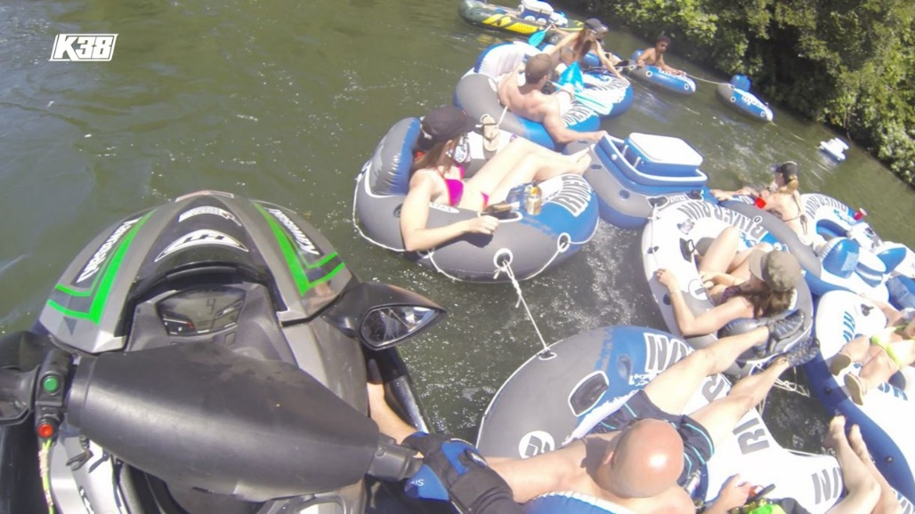
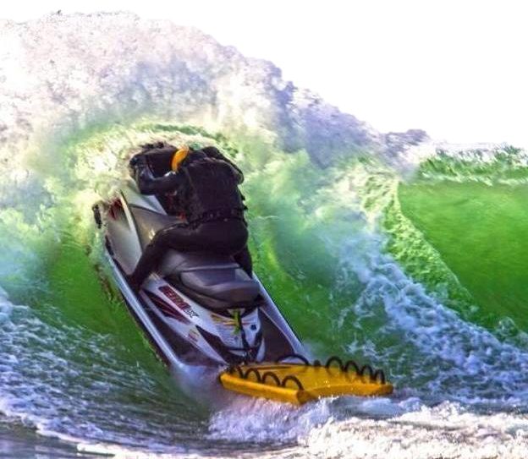
QUESTION?
Based off your student questionnaires, how do you determine the analytics?
What have you changed from the questionnaire results?
What have you dismissed from the questionnaire results?
QUESTION?
Do you evaluate your own instruction methods after every course?
How do you rate yourself?
When was the last time you reviewed your performance?
QUESTION?
Results of the changes? Anything different?

Slide 25
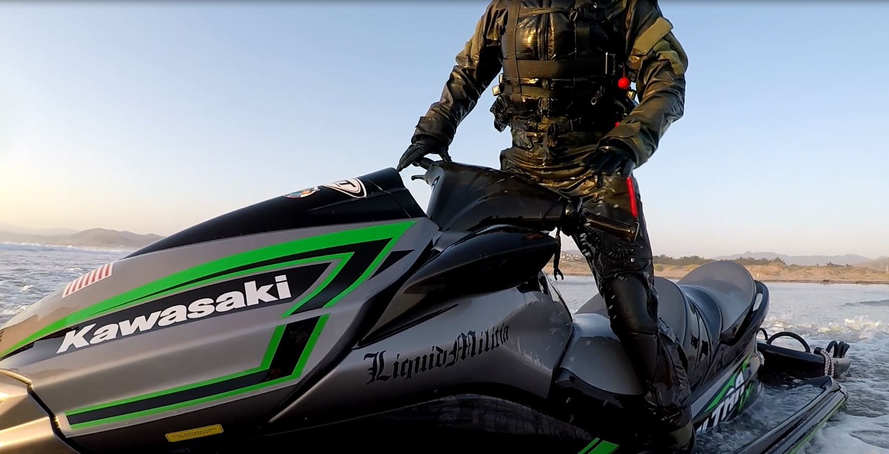
INTERPRETATION OF SURVEY RESULTS
Conducted by people who were not in attendance
Assumption
Personal Bias
Interest of the interpretation meaning
Unsure of the interpretation
Judging
Defensive
Understanding
Comprehending
Considerate
Supporting Further Development
Adjusting Mistakes
Changing Directions

Slide 26
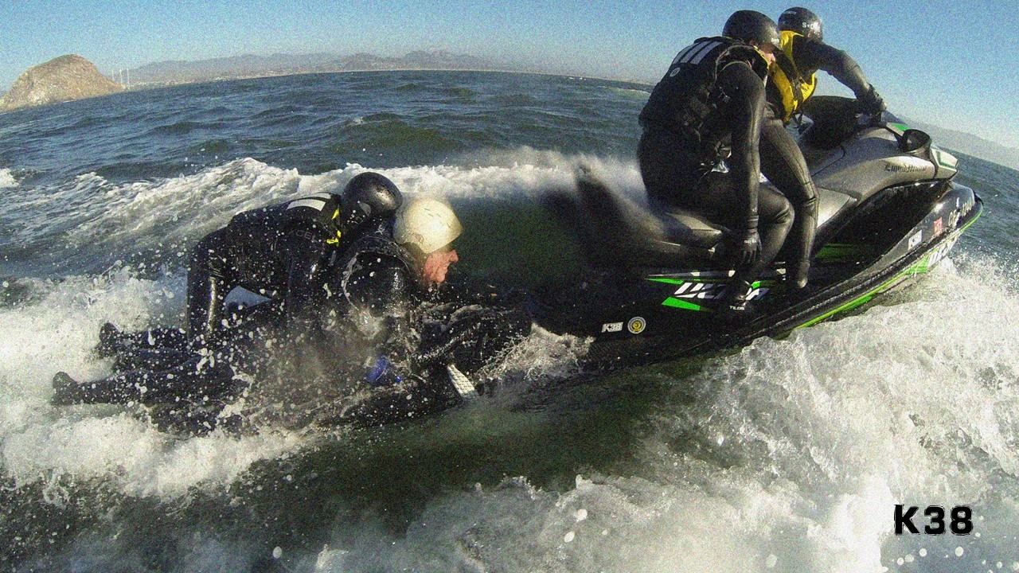
INSTRUCTOR RESPONSIBILITY
Vetted as a Subject Matter Expert
Understands the curriculum
Understands safety actions and planning
Compassionate and understanding but able to enforce
Course is pre-organized
Equipment is pre-organized
Daily Stages of course structure is readied
Procurement daily of course supplies
Understands the tempo of the class and timelines
Recognizes potential risks and is aware that there may be unknown risks - stays alert
Completes daily course assessments and documents, maintains the course database
As a scrutineer, logs the skillset capability of each student throughout course
Counsels students to self correct training and to be able to self lead the skillsets
Counsels students at risk of failing
Rolls back students who are a risk to themselves or the training, observes for any potential injuries
Enforces certification values for a period of 3 years during student qualification period, revokes as needed

Slide 27
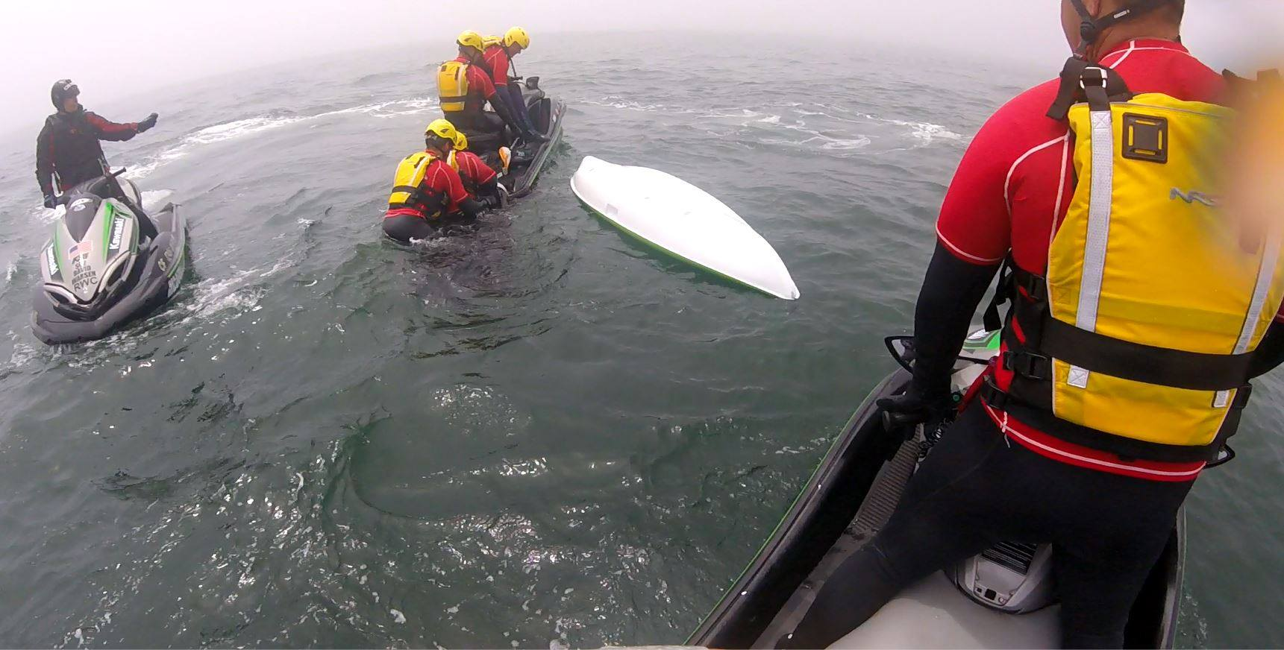
STUDENT RESPONSIBILITIES
REQUIRED TO COME TO CLASS PREPARED TO LEARN
NOTEBOOK AND PEN REQUIRED DAILY
STUDENTS WILL DRAFT THEIR OWN TRAINING MANUAL IN CLASS
NOTES TAKEN THROUGHOUT CLASS – INSTRUCTORS CHECK DURING BREAKS NOTES TO ENSURE UNDERSTANDING
STUDENTS TAKE SEVERAL COURSE ASSESSMENTS DAILY, ALL ARE WRITEN IN OR DIAGRAM DRAWN RESPONSES
STUDENTS ARE EXPECTED TO TAKE 100% RESPONSIBILITY FOR THEIR LEARNING
QUESTIONS ARE TO BE ASKED, BUT FIRST THEY MUST WRITE DOWN THEIR IDEAL ANSWER
WE USE FLASH CARDS AND FLIP CHARTS, LAMINATED WORKBOOKS
WE USE HAND DRAWINGS DONE BY THE STUDENTS IN CLASS
STUDENTS ARE ENCOURAGED TO USE THEIR SMART PHONE FOR SEARCHING CONTENT ONLINE
WE USE VIDEO REVIEWS. The good, the bad, the ugly.
WE FILM OUR STUDENTS, WE USE A UAV (DRONE) AT TIMES FOR SKILL REVIEW
PPE IS FULLY ENFORCED BEFORE WATER ENTRANCE (10’) AND CHECKED CONSTANTLY
STUDENTS ARE TO PROTECT TRAINING GEAR AND LANYARDS, THEY ARE TO BECOME SAFETY STEWARDS
STUDENTS WILL COMMUNICATE LOUDLY AND PRECISELY TO OTHERS WHILE OPERATIONAL
STUDENTS ARE TO REMOVE THEMSELVES FROM TRAINING IF SUSPECT OF ANY INJURY OR UNSURE OF TRAINING

Slide 28
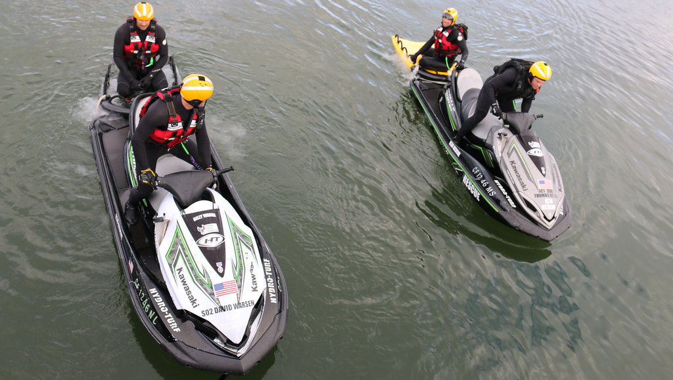
DAILY EFFECT
Our students constantly assess themselves.
In training they will support one another and give guidance
They decide if they need to continue the skill if they don’t feel comfortable
Name one skill you are a good at?
Name one skill you need to improve upon?

Slide 29
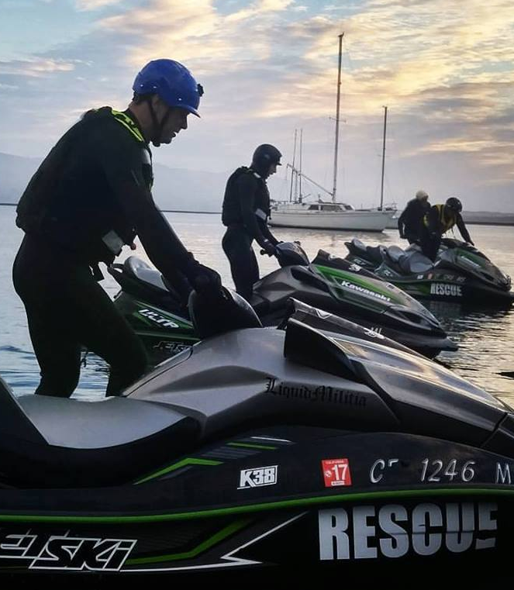
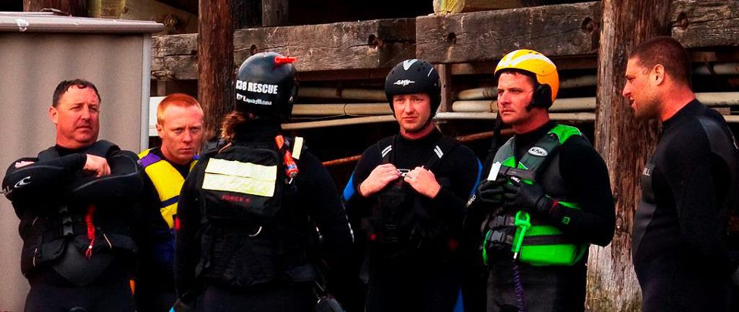
5
BEHAVIOR
If you cannot define it, you will not use it
Watch five
VISUAL
Do five
PHYSICAL
CORRECTION
needs

Slide 30
DEFINE YOUR ACTIONS
Depends upon how much individual effort is invested
Vessel Fundamental Knowledge
Maturity and Character
Body Movement and Weight
Sensory Motor Capacity
Domain Challenges
Practice of Sub Movements
Reflexive Behaviors Practiced
Practice of Layered Movements
Coaching other Students
Depends upon individual personal conflict, ego, and pride (willingness to learn)
Depends upon lack of individual self esteem and ability to test methods
Some personalities don’t belong on the water working under stress and must be removed

Slide 31
WHO WANTS TO TAKE ANOTHER SURVEY?
Are We Wasting Our Time With Outdated Methods?
Give a random or neutral response
Leave the question blank
Don’t fill out the Questionnaire

Slide 32
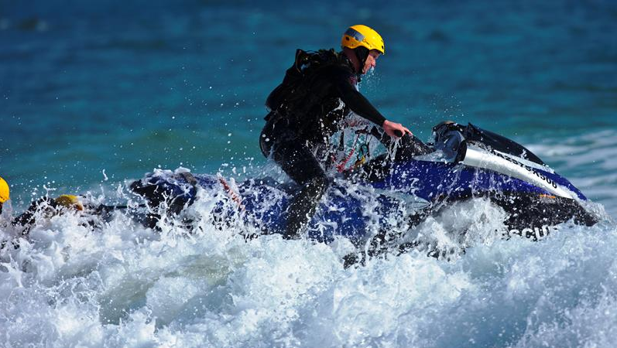
WHAT IS THE EFFECT?
PRO: A questionnaire is a research instrument consisting of a series of questions for the purpose of gathering information from respondents.
CON: A problem with questionnaires is that respondents may lie due to social desirability. Most people want to present a positive image of themselves and so may lie or bend the truth to look good, e.g., pupils would exaggerate revision duration.
PRO: Questionnaires can be an effective means of measuring the behavior, attitudes, preferences, opinions and, intentions of relatively large numbers of subjects more cheaply and quickly than other methods. An important distinction is between open-ended and closed questions.
CON: They lack detail. Because the responses are fixed, there is less scope for respondents to supply answers which reflect their true feelings on a topic.

Slide 33
Strengths
Rich qualitative data is obtained as open questions allow the respondent to elaborate on their answer. This means the research can find out why a person holds a certain attitude.
Limitations
Time-consuming to collect the data. It takes longer for the respondent to complete open questions. This is a problem as a smaller sample size may be obtained.
Time-consuming to analyze the data. It takes longer for the researcher to analyze qualitative data as they have to read the answers and try to put them into categories by coding, which is often subjective and difficult. However, Smith (1992) has devoted an entire book to the issues of thematic content analysis the includes 14 different scoring systems for open-ended questions.
Not suitable for less educated respondents as open questions require superior writing skills and a better ability to express one's feelings verbally.
McLeod, S. A. (2014). Questionnaire. Retrieved from www.simplypsychology.org/questionnaires.html

Slide 34
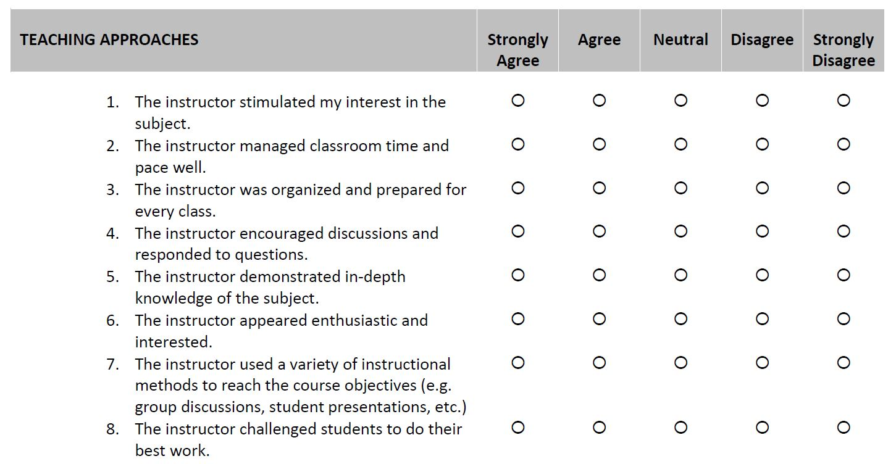
There are only two types of respondents, i.e. a) respondents that have opinions on any given issue and are aware of possessing those opinions and b) respondents that do not have opinions on any given issue and are equally aware of this. I.e. respondent with a fair amount of self-knowledge. Second, respondents are presumed to act rationally.
(Source: Checkmarket)

Slide 36
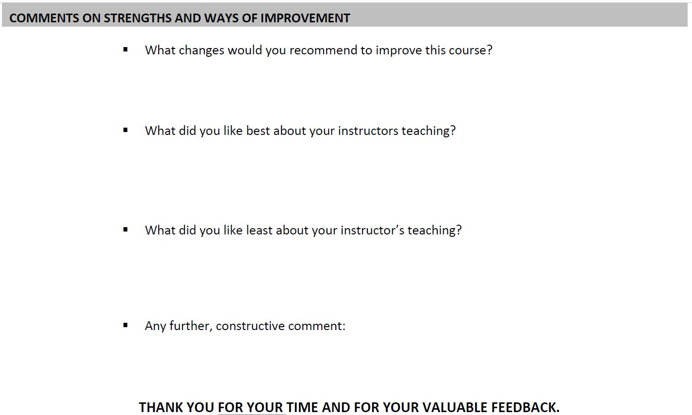
Will these changes be viable with budget, resources, logistics and requirements?
How will they know what those are before they answer?
Usually these responses are regarding personality rather than content delivered
Usually these responses are regarding personality rather than content delivered,
Or a reflection of frustration for the pace or structure of the curriculum the instructor
Is given to produce.
Get better coffee next time and some cream.

Slide 37
STUDENT COURSE REVIEW
Name____________________________________________Date________________Course Stage______________
Stage One Classroom-Answer this question:
WHAT ARE YOUR PERSONAL GOAL(s) WITH THIS TRAINING COURSE (return to instructor)
What do you believe you were strongest in command during the training drills?
What do you believe you need to work on?
Do you believe you are more familiar with preventative maintenance and what part most interested you?
Do you believe you are competent to operate a Rescue Water Craft in calm conditions? With added weight?
Are competent to operate a Rescue Water Craft with multiple persons on the rescue board? Any issues?
Are you better at operating in dynamic conditions than before you came to this course? With Added weight?
What area of the class most interested you?
What did you appreciate most about the Night Qualification training? (If applicable)
Are you better at working with survivors and passengers now than before you took this training course?
Was your personal Course Goal met? (refer to Question #1)
Comments:
The importance of this course review is to determine if you achieved your operational goals that will contribute to your professional
development by your course provider

Slide 38
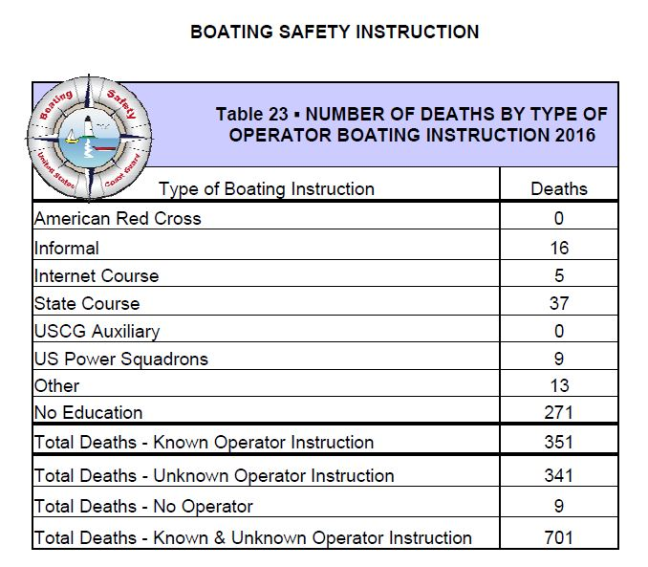
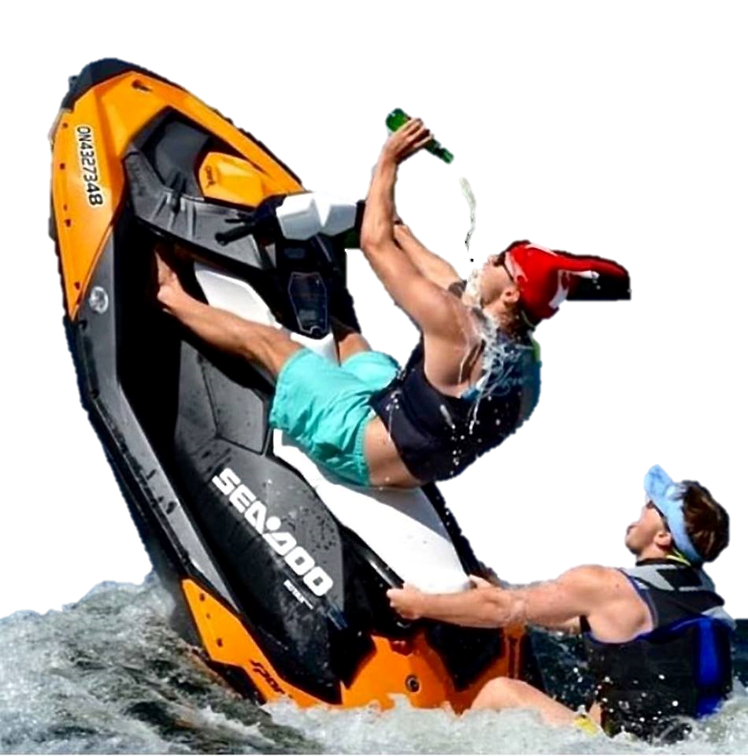
Is this how they want to operate?
For many, yes and it’s a big
Problem to reach these people before
They get killed or hurt someone.
SOURCE: USCG boating accident Report 2016

Slide 39
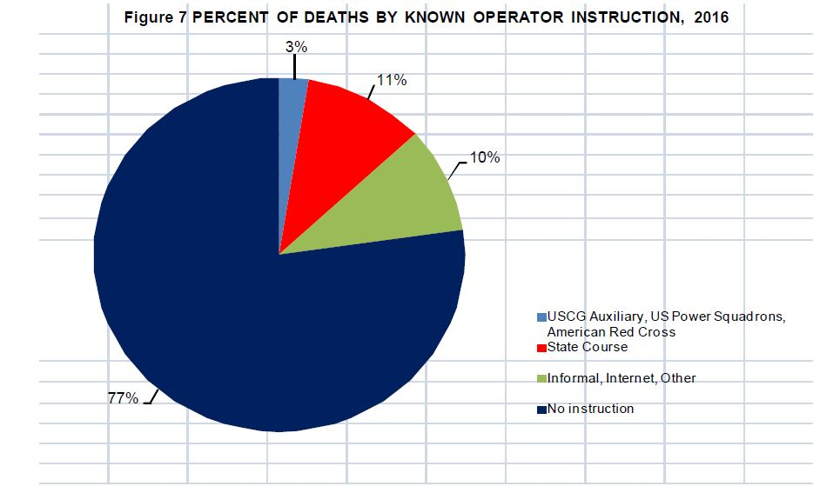
RESPONSIBILTIY IS NOT A CERTIFICATE IT IS A BEHAVIOR
SOURCE: USCG boating accident Report 2016

Slide 40
OUR SOLUTION
Go to the source. Modernize. Get people involved. Let them lead the audience.
Give them content they understand and are willing to endorse.
Created to solve these recurring generational problems
Created to serve the RWC – PWC community
Created to further develop the culture
What’s Next for us?
Become and Influencer. We can do so much more together. We want to open up minds and advance capability. Our partnerships can be so much more developed with covering all the different safety and knowledge disciplines involved. We are surrounded by talent. RWCA introduces you to the world. You bring your unique identity to the culture.
Join the Rescue Water Craft Association and you become one of many partners who identify with building an adventurous safety driven culture of ‘knowledge through action’. We’re ready to fuse our member ideas and capabilities together. We can help you build your individual identity in your pursuit of athletics, event management or occupational requirements. Become a RWCA collaborator! Escape the usual routine, we’re producing results in a modern tempo.

