Slide 1
Demystifying the legislative process: How to talk so your lawmakers will listen and listen so your lawmakers will talk
Peter Schrappen
Peter@nmta.net
March 5, 2018

Slide 2


Slide 3
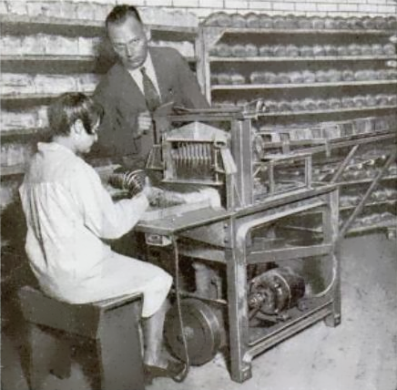

Slide 4


Slide 5


Slide 6


Slide 7


Slide 8

First, let’s talk IQ

Slide 9
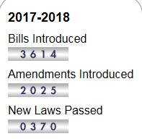
“There sure is a lot to keep track of.”

Slide 10
“It almost seems like the system is set up to not get things done than to actually bring about new laws.”

Slide 11

“When you are losing/getting ready to lose, try to drag out the clock.”

Slide 12


Slide 13


Slide 14
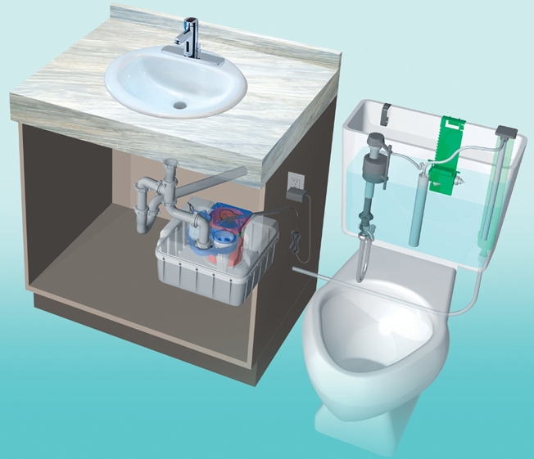
Legislative System = Systems Thinking

Slide 15
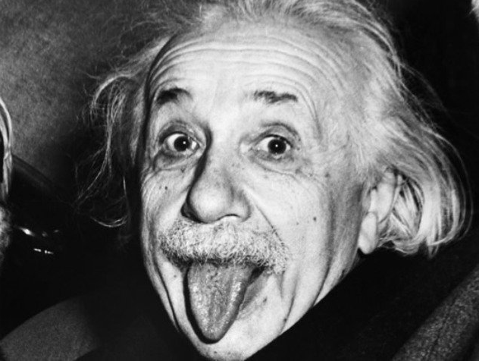
Now, let’s talk EQ.

Slide 16

“You are in sales…Get over it”

Slide 17
Sales Process:
Predisposing them to the ask.
Making the ask/presenting the opportunity.
Follow-up

Slide 18

1. Predisposing them

Slide 19
“We are there for legislators/staff, they are not here for us.”

Slide 20


Slide 21


Slide 22


Slide 23





Slide 24
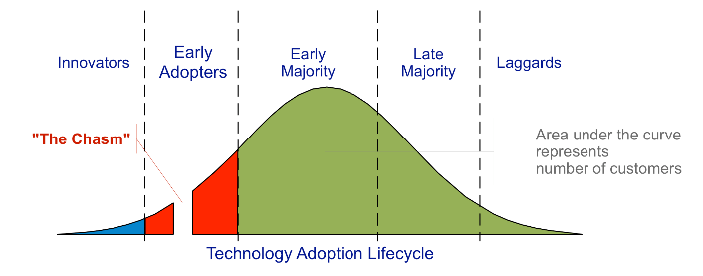

Slide 25

“If you help build it, you become part of it.”

Slide 26
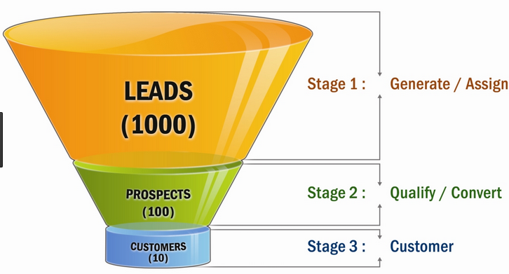
1. Predisposing: Interim period

Slide 27
2. Maximizing the Opportunity. Carpe Diem!
“Start where they are. Not where you are”

Slide 28

“Start where they are. Not where you are”

Slide 29


Slide 30
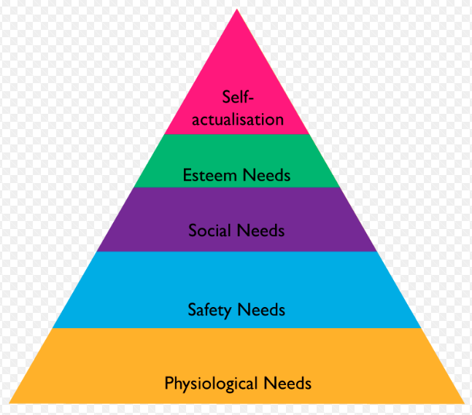
Are you helping them get self-actualized?

Slide 31
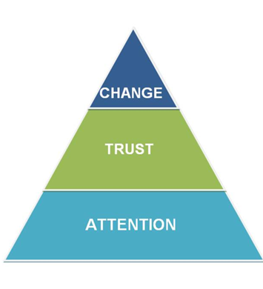
Speaking of pyramids…

Slide 32
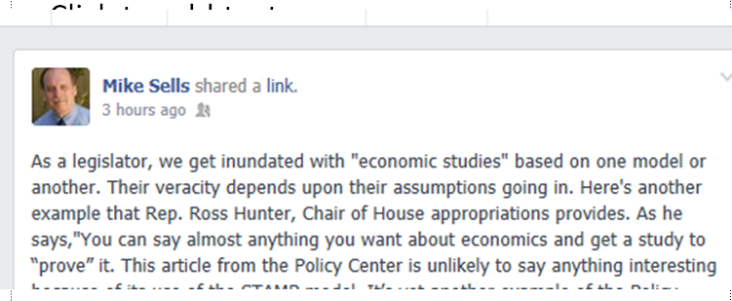
“Relationships trump information.”

Slide 33
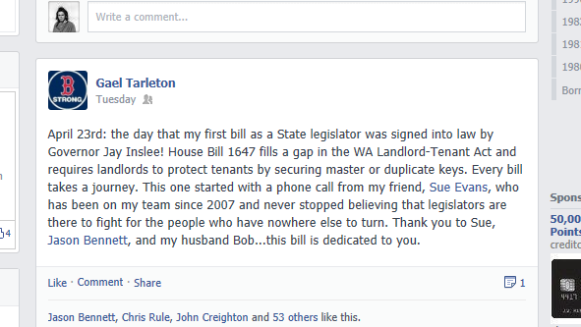
Relationships trump information

Slide 34

“No new friends (during session.)”

Slide 35
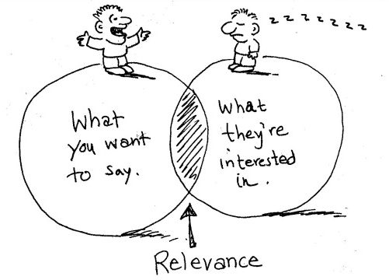

Slide 36


Slide 37

When does information matter?

Slide 38


Slide 39

3. Follow-up

Slide 40
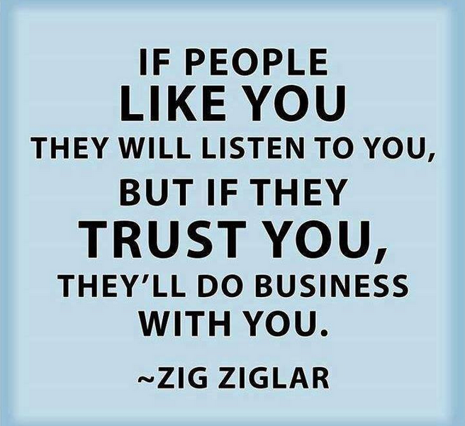

Slide 41

Thank You!
Questions? Please contact me at:
Peter Schrappen
206-634-0911
Peter@nmta.net
@Peterschrappen1

Slide 42


Slide 43

More resources…

Slide 44


Slide 45


Slide 46


Slide 47


Slide 48


Slide 49


