Slide 1
Knowledge is Power
NASBLA and Knowledge Management
Stacey Brown, Virginia Department of Game and Inland Fisheries
Ron Sarver, NASBLA
Notes:
Good afternoon – My name is Stacey Brown and I am pleased to be here with Ron Sarver to talk to you about Knowledge Management. I am the Recreational Boating Safety Manager for the Virginia Department of Game and Inland Fisheries. For the past two years, I have been working on NASBLA’s Education and Outreach Committee on how we share information through NASBLA. Today, we are going to talk about the need for knowledge management, a little bit on KM principles, and finally, how NASBLA will be integrating KM for NASBLA partners

Slide 2
Knowledge is Power
Have you ever been asked to provide a brochure for boating safety while waterfowl hunting?

Slide 3
Knowledge is Power
And because you are so busy, you figure, hey someone must have created this before, so you “google it”
Notes:
Which leads to thousands of pieces of information – most of which is not useful

Slide 4
Knowledge is power
So rather than weed through all that stuff – you decide you will just make it yourself
Notes:
All the while thinking – there has got to be a better way – I know someone else has created this – and probably done a better job (perhaps someone with a graphic designer on staff).

Slide 5
Knowledge is Power
Notes:
This is where a good knowledge management system comes in
Google can provide information – but a good well designed KM system will provide knowledge. And it could have saved me a lot of time to create a product, that may have already been created and was probably created by someone with more knowledge and skills than me.
So – if you were lucky enough to attend Sunday’s NASBLA committees’s report outs. You caught a small glimpse of what these committees do in a year

Slide 6
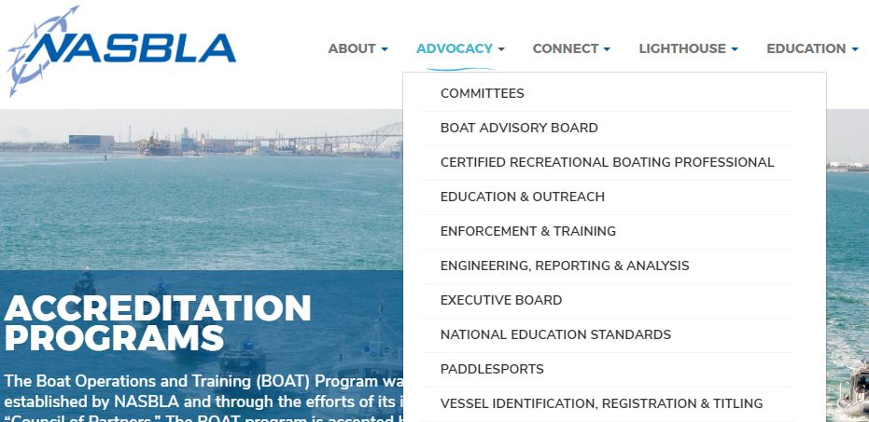
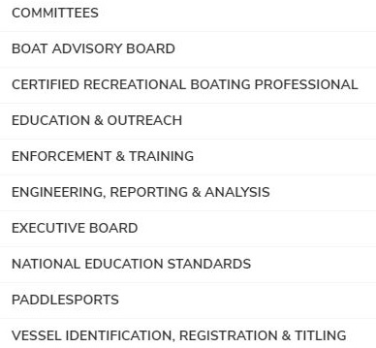
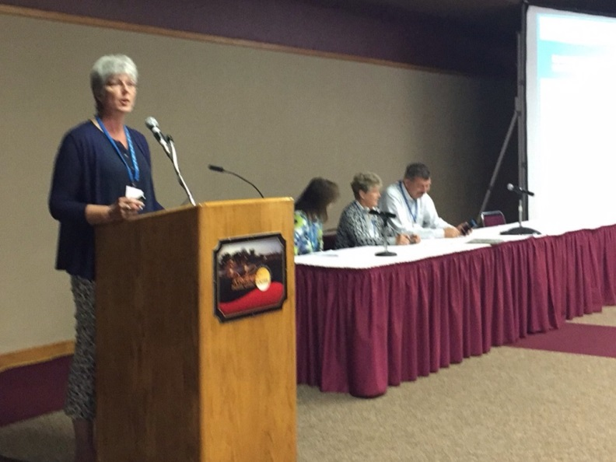
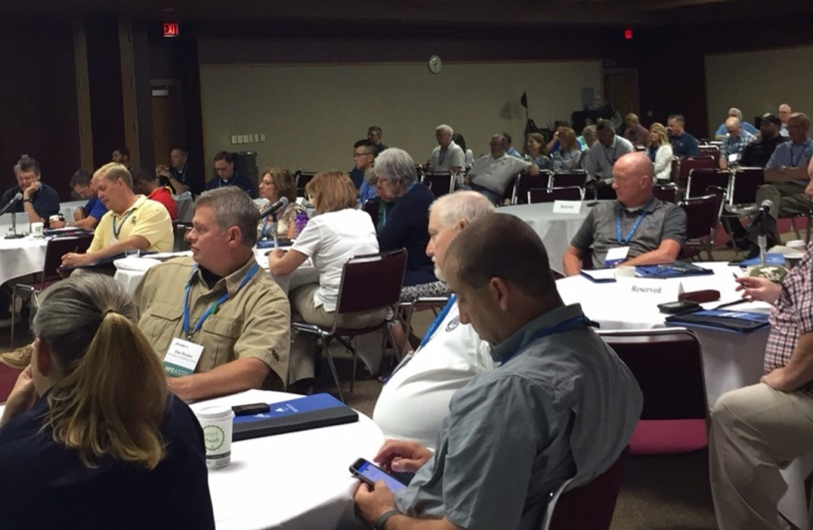
Knowledge is Power
Committee work
Notes:
Every year – NASBLA committees and work groups do fabulous work and many work products are created. But past work products sometimes get lost in all the new work that is done. And sometimes – we are too busy to read through all the final products of all the NASBLA committees to see what is going on. To be honest – sometimes I just don’t have the bandwith!

Slide 7
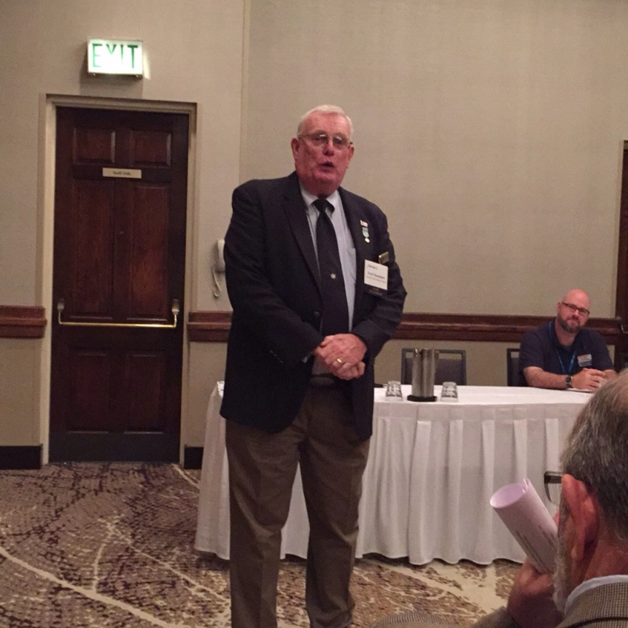
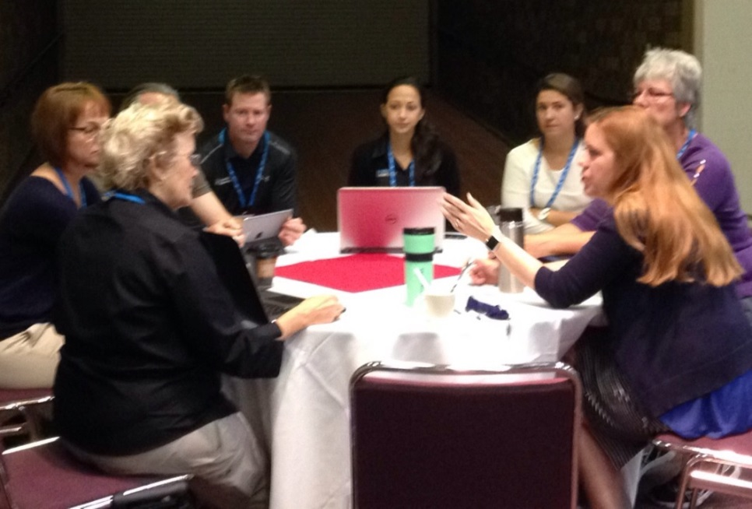
Knowledge is Power
Notes:
Even if you weren’t able to attend the committee report outs on Sunday – because your boss made the travel arrangements, undoubtably, in your time here at the conference, you have met some wicked smart people from all across the country.

Slide 8
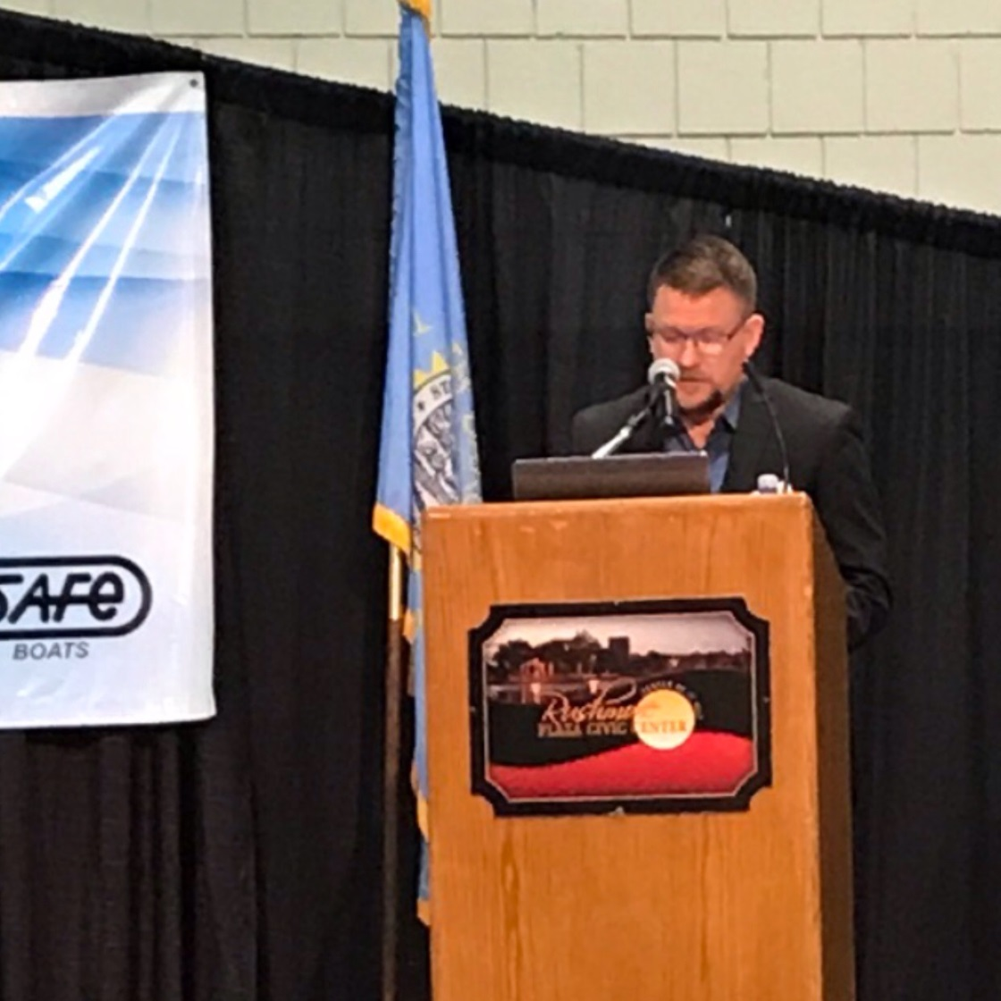
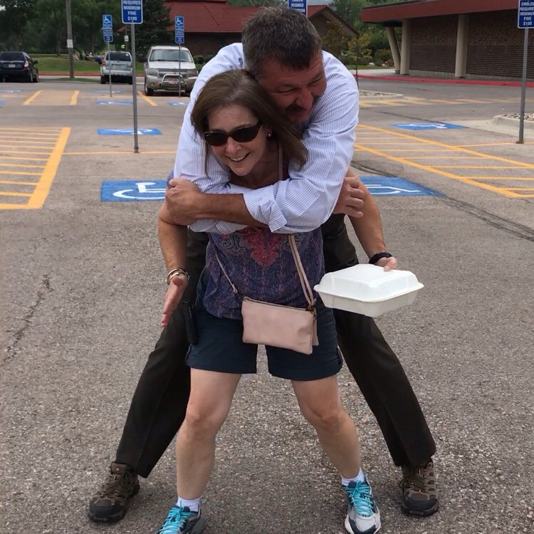
Knowledge is Power
Notes:
Our NASBLA is a community that is made up of the brightest, smartest, and best subject-matter experts on boating safety – well if nothing else – we are creative and we certainly can count on each other when we need to come up with solutions.

Slide 9
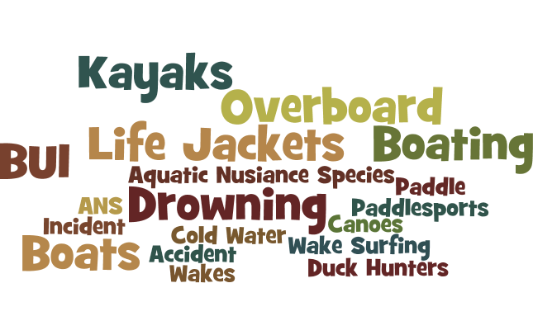
Knowledge is Power
Notes:
As we are at the end of the boating season for most states, I want you to think about what have been some of the issues for your state. Dramatic Pause….What did you create to help work on these issues? I bet some of you would have like to seen my blog on navigation lights, our state’s wake surfing report, or my presentation on Aquatic Nusiance Species

Slide 10
Knowledge is Power
Notes:
One of the most important roles NASBLA can play for member states is to be the Google of boating safety – the place members automatically turn; the trusted source. This is not only one of the tenants of NASBLA and their strategic plan. It is also an important piece of the RBS community’s strategic plan

Slide 11
Knowledge is Power
Notes:
So – have I convinced you that NASBLA needs to put efforts into a solid Knowledge Management System? Good – because we are

Slide 12
Knowledge is Power
What is Knowledge Management?
Getting the right information, to the right person, at the right time and cost
Organizing, distilling and presenting information in a timely, relevant, accurate and simple manner
Leveraging both tacit and explicit knowledge in a systematic way
Using the information delivered to enable informed decision making

Slide 13
Knowledge is power
Knowledge Management
Leadership
Culture
Technology
Process
Notes:
Organizations with good knowledge management in place don’t come to it by accident. They meticulously plan their approach – a good knowledge management system will include 4 aspects

Slide 14
Knowledge is Power
Knowledge Management
Leadership
Culture
Technology
Process
Leadership
Notes:
Committee Charge; draft policy

Slide 15
Knowledge is Power
Leadership
Draft Knowledge Management Policy
NASBLA’s mission is to strengthen the ability of the state & territorial boating authorities to reduce death, injury and property damage associated with recreational boating and ensure a safe, secure and enjoyable boating environment. NASBLA seeks to be a learning organization, active in knowledge management. It is NASBLA’s policy to make conscious efforts to encourage the creation, sharing, storing, and wider use of knowledge at all levels within the organization and partner organizations.
Notes:
Committee Charge; draft policy

Slide 16
Knowledge is Power
Leadership
Draft Knowledge Management Policy
It will learn systematically and collectively from its own projects, programs, and initiatives and from the experience of its partner organizations to strengthen the NASBLA mission and the mission of partner organizations. NASBLA will serve as content curator to assist partner organizations in achieving their missions. NASBLA will have a knowledge management system that provides the right information to the right person at the right time.
Notes:
Committee Charge; draft policy

Slide 17
Knowledge is Power
Leadership
Draft Knowledge Management Policy
NASBLA Knowledge Management Principles
NASBLA will provide a system that allows for the addition of content and gives guidance for the collection, creation, and validation of content
All products (brochures, PSAs, etc.) from NASBLA committees will be shared through this system
NASBLA partners will be able to easily share reports, brochures, PSAs, photos, videos, presentations, etc. related to recreational boating through this system
Notes:
Committee Charge; draft policy

Slide 18
Knowledge is Power
Leadership
Draft Knowledge Management Policy
NASBLA Knowledge Management Principles
NASBLA will provide guidelines to ensure all knowledge is correctly documented using similar taxonomy to ensure ease of use and searches for information
NASBLA will provide guidelines on content life cycle for maintaining and retiring content
NASBLA staff and partners will be able to easily access the knowledge curated through the system in a timely manner
Notes:
Committee Charge; draft policy

Slide 19
Knowledge is Power
Knowledge Management
Leadership
Culture
Technology
Process
Process
Notes:
Working on best practices; forming working group

Slide 20
Knowledge is Power
Knowledge Management
Leadership
Culture
Technology
Process
Technology
Notes:
Stacey turn over to Ron to showcase Website and Connect

Slide 21
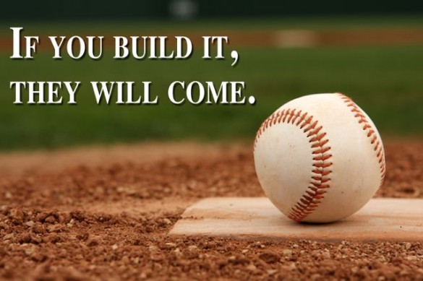
Knowledge is Power
Knowledge Management
Leadership
Culture
Technology
Process
Culture
Notes:
Users as curators

Slide 22
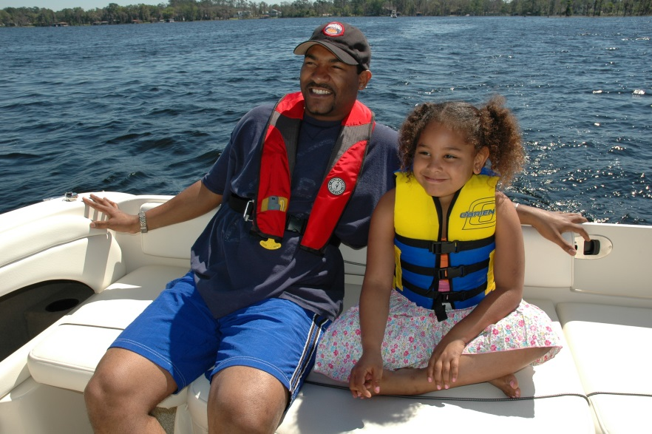
Knowledge is Power
Notes:
So in closing – I am appealing to you to help us build it. Make an effort. Contribute to NASBLA. Build expectations into all you do to share your work, post to NASBLA Connect. Ask your colleagues to contribute. When you hear of great work – ask them to share it. Let’s work smarter so we can make a difference for every person we are working for.

Slide 23
Knowledge is power

