Slide 1
Targeting Teens Grant Update
National Safe Boating Council
2018 IBWSS

Slide 2
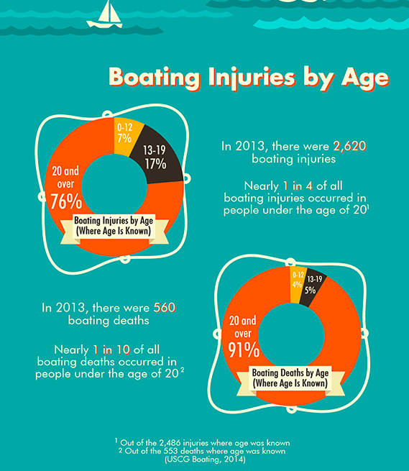
Targeting Teens Grant
Objective: Create an education campaign targeting teens with the focus on safe boating practices.
On-water instruction in three modalities:
Power
Human propelled
Sail
Notes:
According to the USCG, 1 in every 10 boating death occurs in people under the age of 20. And, nearly 1 in 4 injuries occurres within the same age group.
Whether taking the helm or being a passenger, the proper education on important safe boat practices can go along way in preventing these injuries and deaths.
As you may be aware, the National Safe Boating Council is managing a Targeting Teens grant form the US Coast Guard.
Our objective is to create a targeting campaign geared towards teens with focus on education of safe boating practices.
This plan will include programming; on-water instruction in three modalities including power, human propelled, and sail.

Slide 3
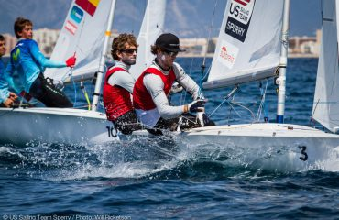
Targeting Teens Grant
Grant marketing components:
Printed and easily accessible resource materials
Robust social media element
Notes:
In addition, the grant will include several marketing components including printed and easily accessible digital resources as well as a robust social media element.

Slide 4
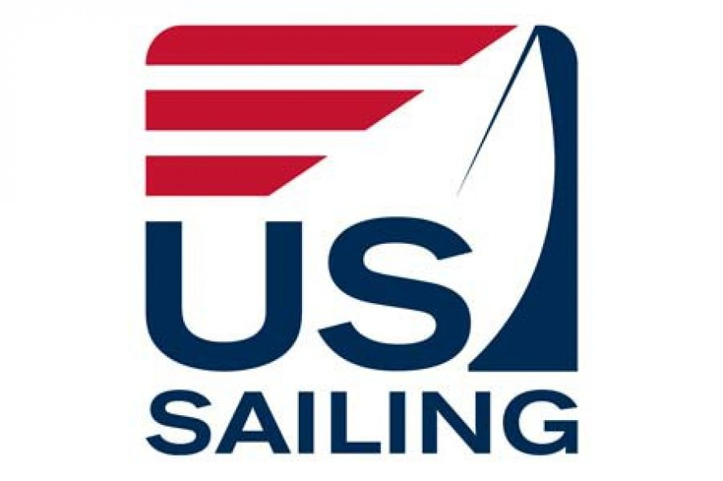
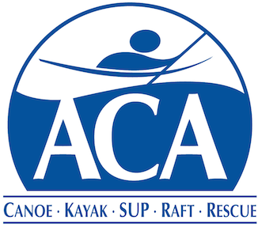
Targeting Teens Partnerships
The National Safe Boating Council is committed to establishing and maintaining an approach for boating safety awareness initiatives by leveraging organizational partnerships.
Notes:
To accomplish the grant objectives, we will be leveraging our organizational partnerships to provide on-water training for teens.
Our friends at the BoatUS Foundation will be leading on-water training for power boats, while the American Canoe Association will be leading the human propelled effort. And the sailing component will be led by a US Sailing partner organization.
We are excited to have these trusted partners participating in the program.

Slide 5
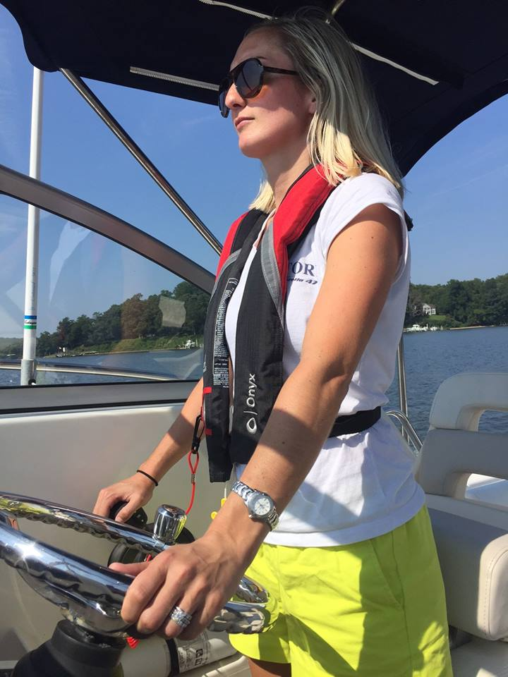
Targeting Teens Courses
Courses:
Complementary to participate
Multiple locations
Certified instructors
Students receive a certificate of completion
Notes:
Our goal is to make this program as easy as possible for teens to participate in.
All courses will be complimentary to participating students and provided in multiple locations.
All instructors will also be certified and students will receive a certificate of completion.

Slide 6
National Marketing Campaign
Brand, promote and market the campaign through:
National advertising
Social media
Public relations
Notes:
NSBC will be putting a lot of marketing horsepower behind this campaign by creating a national advertising, social media, and public relations campaign to build upon, promote, brand, and market the Targeting Teens campaign.

Slide 7
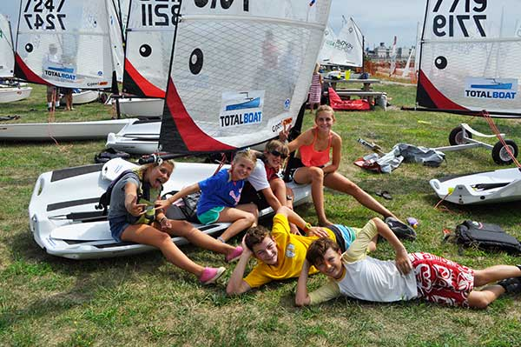
Targeting Teens Grant
Goal: Create a model for on-water boating introduction and education for the teen demographic that will be a sustainable summer course.
Notes:
Overall, our goal is to establish a model for on-water boating introduction and education, targeted to the teen demographic, which will become a repeated, ongoing summer course that takes place throughout the country.

Slide 8
Targeting Teens Grant Update
Thank You
© National Safe Boating Council
Notes:
As you can see, we are really excited about this grant program and we hope that you will be as well.
Thanks for letting us share our plans. Does anyone have any questions on the information we shared about the program?

