Slide 1
Safe Boating Campaign
2017-2018 Grant Update

Slide 2
Safe Boating Campaign
Tremendous Growth
Began in 1958 with National Safe Boating Week
Rapid growth in the U.S. and Canada
Now grassroots support in 9 countries
Simply the Safe Boating Campaign
Tagline, Wear It
Exciting changes for 2018
www.safeboatingcampaign.com

Slide 3
Simple vs. Complex
Logos that are most memorable to the general public use a clear and simple design.
www.safeboatingcampaign.com
Notes:
Simplicity and consistency are KEY to a strong brand.
Based on feedback from many of you, campaign partners and the general public a new logo was created.
Surveys in the summer and fall of 2017 revealed that the Wear It tagline resonates with boaters.
An orange life jacket image is a powerful and simple reminder to wear a life jacket.

Slide 4
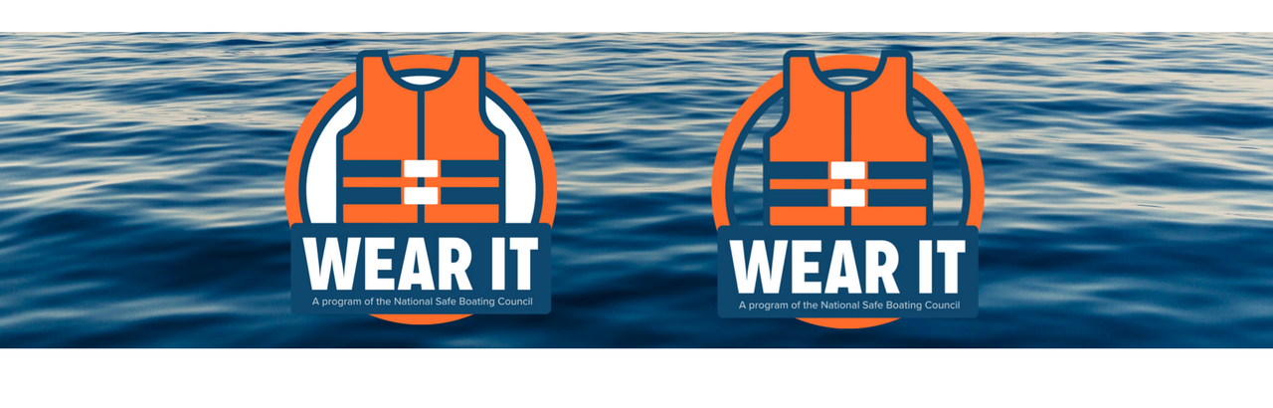
New Logo
White background Transparent background
www.safeboatingcampaign.com

Slide 5
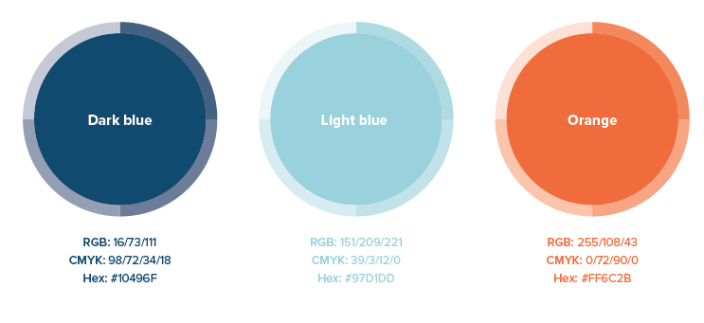
Brand Guidelines
Primary Colors
www.safeboatingcampaign.com

Slide 6
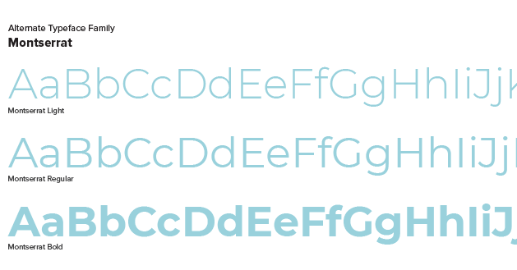
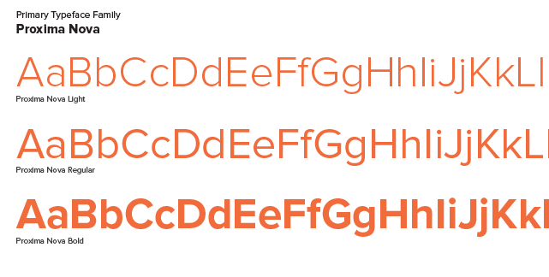
Brand Guidelines
Fonts
www.safeboatingcampaign.com

Slide 7
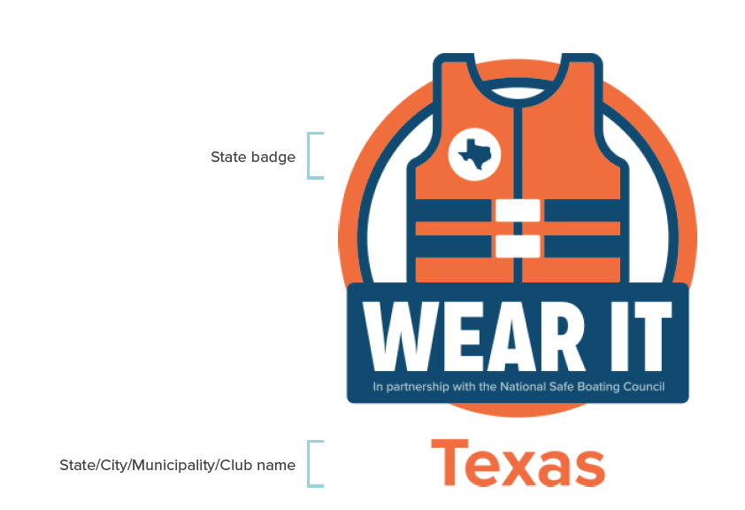
Co-Branded Logos
Custom Lockups
www.safeboatingcampaign.com
Notes:
Nearly 120 requests for co-branded logos. This may be customized for an organization as well.

Slide 8
Quality vs. Quantity
The impact of a marketing message increasingly depends on the quality of the experience.
www.safeboatingcampaign.com
Notes:
In our case, a quality website experience to engage a existing and potential campaign partners, boating enthusiasts, and the media.

Slide 9
Website Redesign

Slide 10
Website Redesign

Slide 11
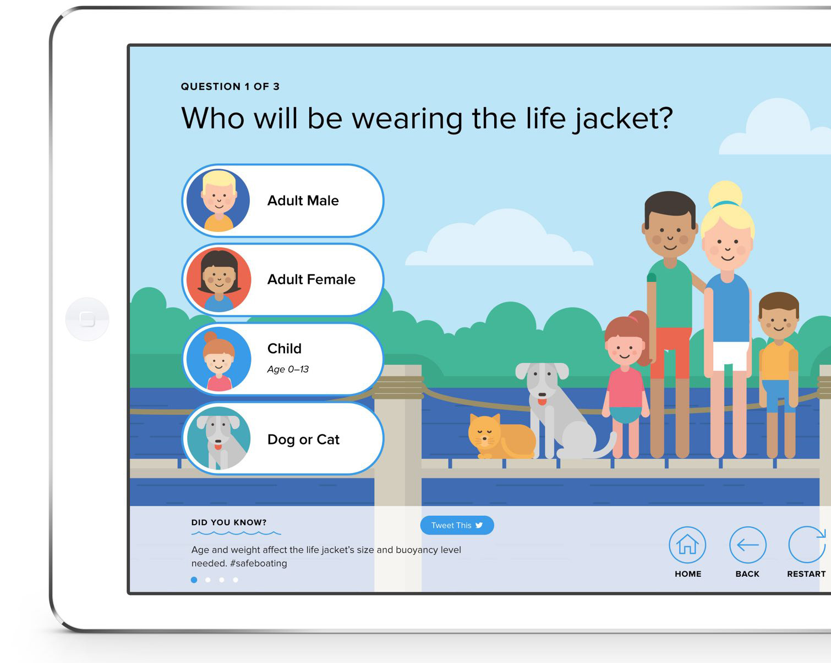
Life Jacket Quiz
No matter what the activity or style chosen:
Be responsible and always wear your life jacket while boating.
Looking for a life jacket?
www.safeboatingcampaign.com

Slide 12
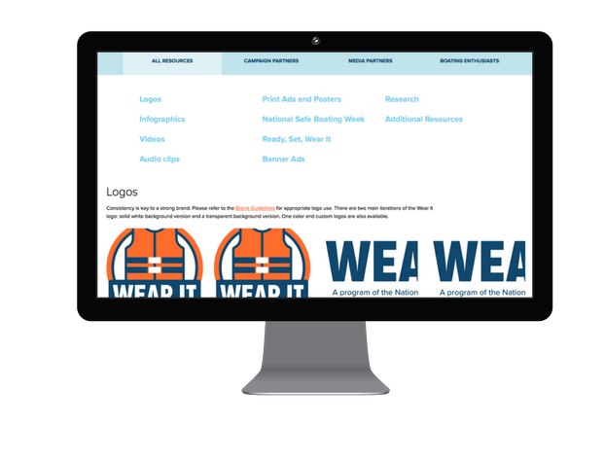
Quality Content
Resources
Campaign Partners
Media Partners
Boating Enthusiasts
www.safeboatingcampaign.com
Notes:
Logos, infographics, PSAs, social media template content, posters, and more!

Slide 13
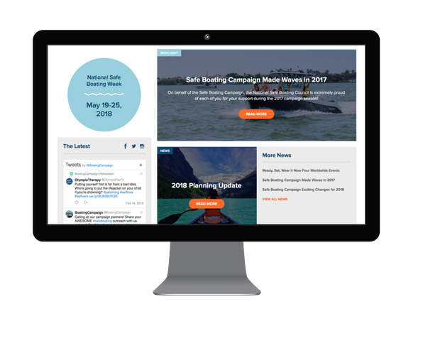
News & Blog
Showcase Global Reach
Guest posts
Latest resources
Grassroots updates
www.safeboatingcampaign.com
Notes:
Be the media. This will roll out this summer.

Slide 14
Yearlong Campaign
Wear Your Life Jacket to Work Day: May 18, 2018
RBS community and others participate #lifejacket2work
National Safe Boating Week: May 19 – 25, 2018
Grassroots events, such as festivals, marathons and trainings #safeboating
Ready, Set, Wear It events: May 19, June 9, July 7, August 11
Same goal = life jacket education #rswi18
Continues throughout the year!
Supports Spring Aboard, #406Day, Operation Dry Water, National Marina Days, National Fishing and Boating Week and more!
www.safeboatingcampaign.com

Slide 15
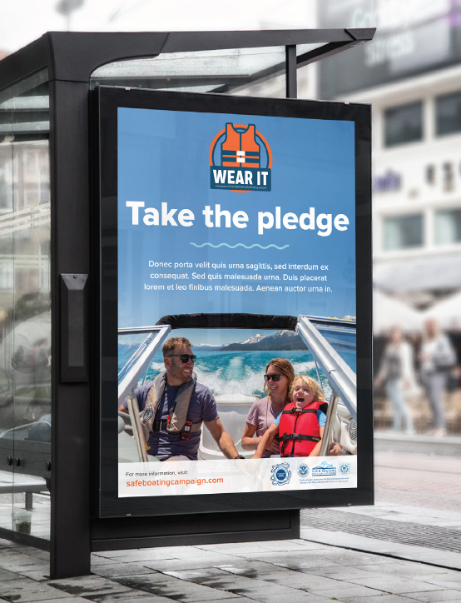
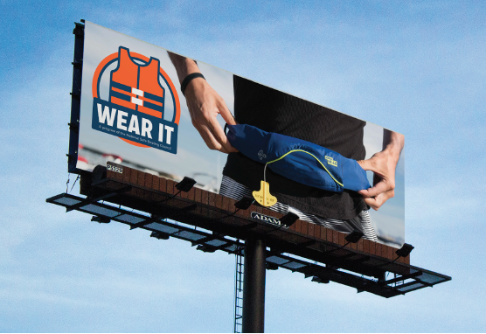
Grassroots Funding
Application to receive grassroots funding opens in April.
Vehicle Wraps
Life Jackets
Youth activity books
Billboards
www.safeboatingcampaign.com

Slide 16
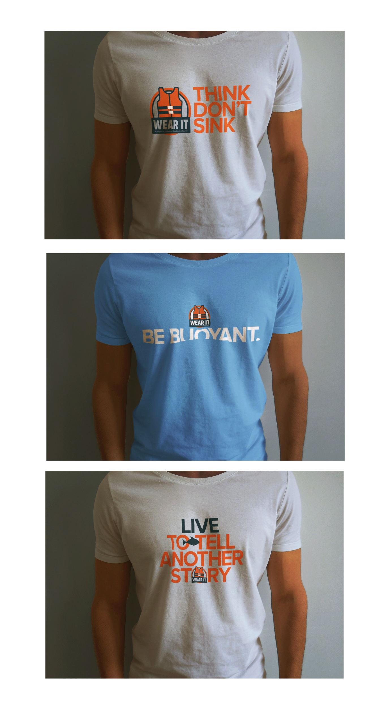
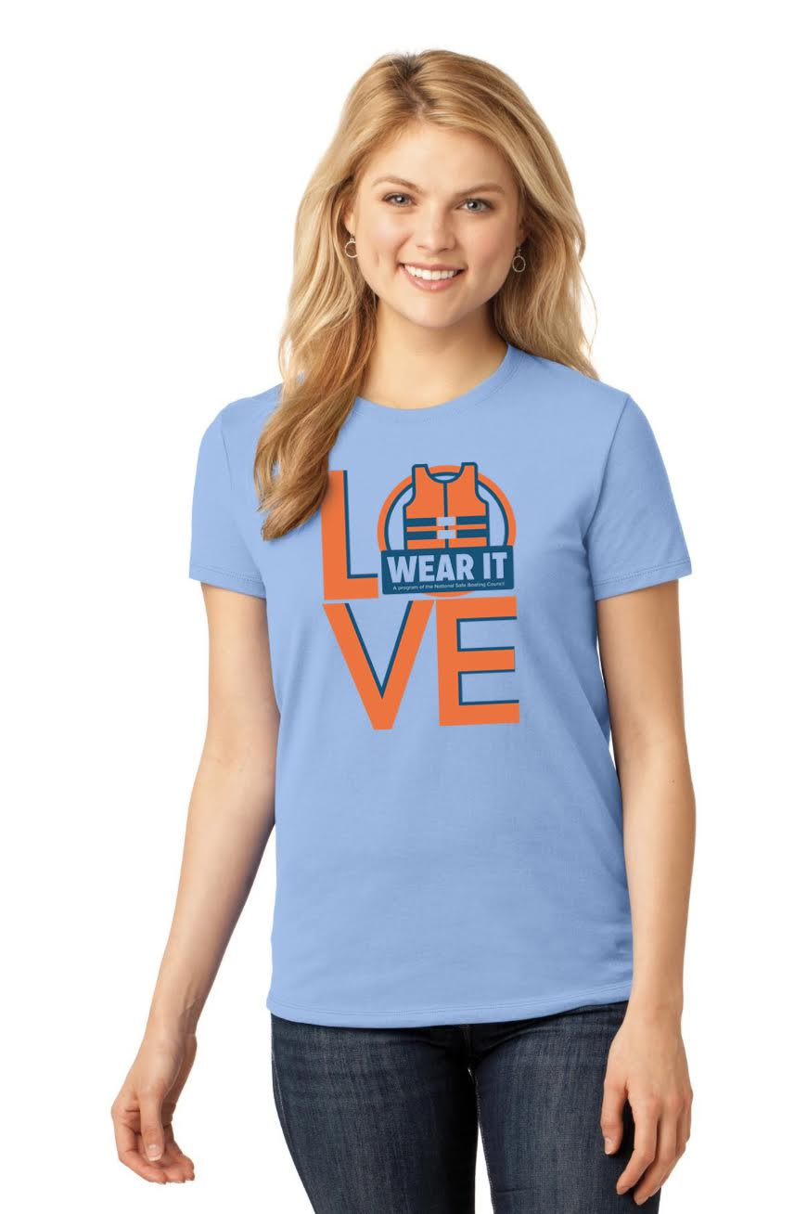
New Resources
Available in April 2018
T-shirts
Banners
Whistles
Dry bags
And more!
www.safeboatingcampaign.com

Slide 17
Outreach Plan
Tiered Approach
Campaign partners (website, social media, e-newsletter, personalized outreach)
Stakeholders (website, social media, personalized outreach)
Media (website, direct outreach)
Boating public (website, social media, advertising)
www.safeboatingcampaign.com

Slide 18
THANK YOU
www.safeboatingcampaign.com

