Slide 1
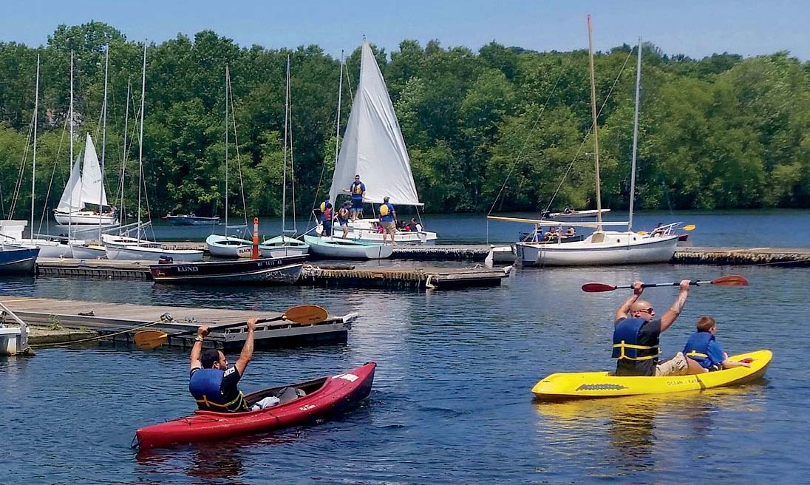
NASBLA Standards
A Guided Tour
Through the past, present and future

Slide 2
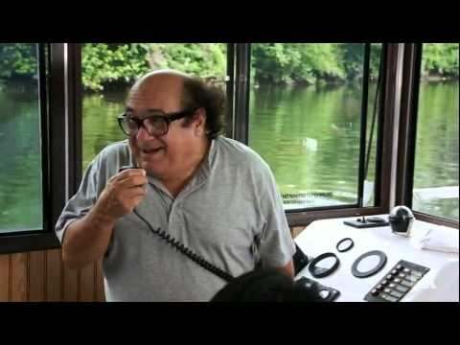
Tour Guide Introductions
Jeff Wheeler
Joe McCollough
Ed Huntsman
Bob Brandestein
Tim Spice
Kim Jackson
Harry Munns

Slide 3
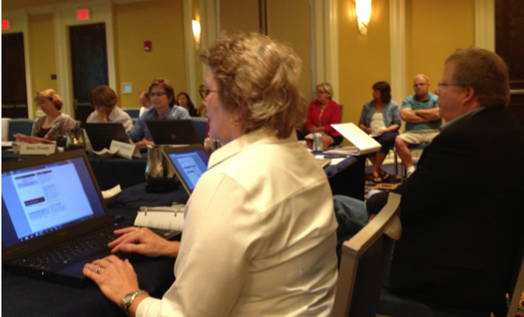
Current ESP Membership
Bob Beck
Hugh Gibson
Robert Kaufman
Emily King
Ernie Lentz
Amanda Perez
Robin Pope
Jeff Wheeler
Jeff Riecks
Joe McCollough
Ed Huntsman
Bob Brandestein
Tim Spice
Kim Jackson
Harry Munns

Slide 4
Take a closer look at ESP

Slide 5
Vision
A country of educated, safe, competent, and confident boaters.

Slide 6
Mission
Establish and maintain recreational boating education standards to increase safety on our nation’s waterways.

Slide 7
Background
The objective of the Standards Panel is to identify and implement a consensus-based process for developing, reviewing, revising, and promulgating knowledge and competency standards for the recreational boater and boating professionals.

Slide 8
History
Established in 2011
Open, consensus-based standards development process
Essential Requirements of the American National Standards Institute

Slide 9

The Institute oversees the creation, promulgation and use of thousands of norms and guidelines that directly impact businesses in nearly every sector.

Slide 10
Mission
To enhance both the global competitiveness of U.S. business and the U.S. quality of life by promoting and facilitating voluntary consensus standards and conformity assessment systems, and safeguarding their integrity.

Slide 11
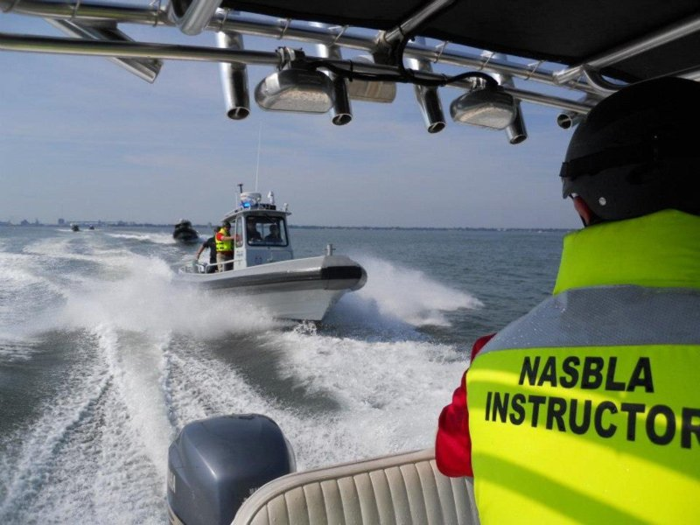
NASBLA Standards past and present
Previous Standards
Originally adopted by the NASBLA membership in 1999 and amended
seven times since.

Slide 12
NASBLA Standards past and present
Historical Empahsis
Course content
Risk-based

Slide 13
NASBLA Standards past and present
Current Standards
      Power
      Sail
      Human Propelled

Slide 14
Additional Standard Work
        Trailering
        Jet Propelled
        Passenger

Slide 15
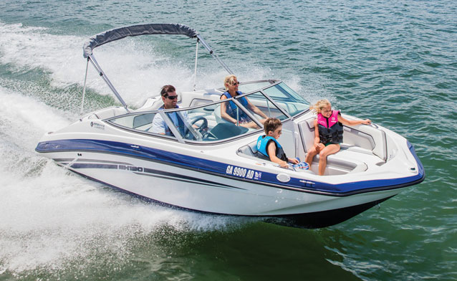
What we’ve learned
We’re pretty good

Slide 16
What we’ve learned
We’re pretty good
We can get better

Slide 17
Redundancy
Life Jackets – Power Standard
2.1 Personal Flotation Devices (Wearable Life Jackets and Throwable Devices) Types and Carriage
2.1.1 The course shall explain the:
• different classifications and types of U.S. Coast Guard approved personal flotation devices (PFDs), including wearable and throwable devices;

Slide 18
Redundancy
Life Jackets – Power Standard
(Continued)
• different sizes of U.S. Coast Guard approved PFDs; and
• respective uses, advantages, and disadvantages of life jackets based upon the activity for which they are intended.

Slide 19
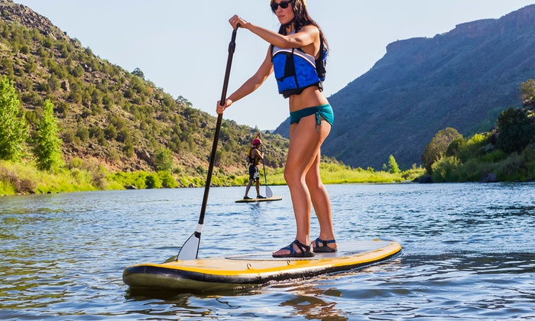
Redundancy
Life Jackets – Power Standard
(Continued)
Three additional Sub-sections deal with life jackets
2.2 Personal Flotation Device Availability and Sizing
2.3. Wearing Life Jackets
2.4. Personal Flotation Device Serviceability

Slide 20
Redundancy
Life Jackets – Human Propelled
2.1. Personal Flotation Devices (Wearable Life Jackets and Throwable Devices) Types and Carriage
The course shall explain the:
• different classifications and types of U.S. Coast Guard approved personal flotation devices (PFDs), including inflatable life jackets, hybrids, and throwable devices;

Slide 21
Redundancy
Life Jackets – Human Propelled
(Continued)
• the number and types of PFDs/life jackets that must be carried aboard the boat according to applicable regulations; and
• label information, how to read and understand them.

Slide 22
Redundancy
Life Jackets – Human Propelled
(Continued)
Three additional Sub-sections deal with life jackets
2.2. Personal Flotation Device Availability and Sizing
2.3. Wearing Life Jackets
2.4. Personal Flotation Device Serviceability

Slide 23
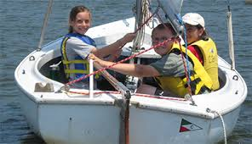
Redundancy
Life Jackets – Sail Standard
List all required equipment and examples of recommended equipment to be carried aboard a sailboat of less than 26 feet.

Slide 24
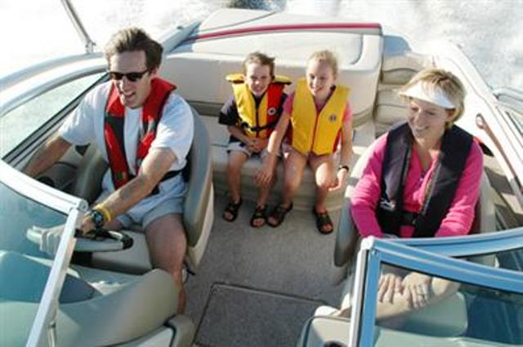
Journey into the future
Additional Examples
of Redundancy
Basic Nomenclature and Terminology
Boating Equipment
Boating Preparation
Seamanship and Safe Operations
Navigation Rules and Aids to Navigation

Slide 25
Journey into the future
Solution – CORE and CORE PLUS
CORE = applicable to all boats, operators and/or passengers

Slide 26
Journey into the future
Solution – CORE and CORE PLUS
PLUS = additional specific knowledge on a type craft they intend to operate.

Slide 27
Journey into the future
Example solution – Life Jackets

Slide 28
Journey into the future
Example solution – Life Jackets
CORE –Power and Human Propelled
2.1. Personal Flotation Devices (Wearable Life Jackets and Throwable Devices) Types and Carriage
2.2. Personal Flotation Device Availability and Sizing
2.3. Wearing Life Jackets
2.4. Personal Flotation Device Serviceability

Slide 29
Journey into the future
Identical information could be
extracted from both standards
and become part of the CORE.

Slide 30
Journey into the future
Information that appears in one
Standard and not the other
2.1.2 The course shall also:
• describe the number and types of PFDs/life jackets that must be carried aboard the boat according to applicable regulations;
• discuss and clarify label restrictions; and
• emphasize that the best life jacket is the one that will be worn all the time.

Slide 31
Journey into the future
This is the PLUS in CORE PLUS
2.1.2 would remain in the Power Standard because it is unique to that standard

Slide 32
Journey into the future
Part II
Our tour of future standards goes off in a different direction. For now, forget about CORE and CORE PLUS.

Slide 33
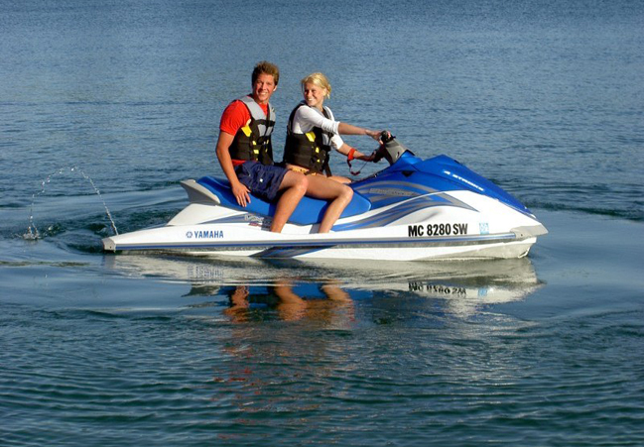
What we’ve learned
Our approach to Standards
content, philosophy
and Development
is outdated

Slide 34
What we’ve learned
Risk Based

Slide 35
What we’ve learned
Risk Based
Focus on Course

Slide 36
What we’ve learned
Example from Power Standard
4.1.1 The course shall describe boat operator’s ultimate responsibility for:
• operator proficiency,
• situational awareness,
• safety of boaters aboard and anyone coming into contact with the boat, and
• all activity aboard the boat.

Slide 37
What we’ve learned
Example from Sail Standard
5.6 List important safe navigation responsibilities of a sailboat operator.
5.5 Describe the operator’s responsibility for the safety of passengers/crew.

Slide 38
What we’ve learned
What are the differences?
Active verb, “describe” or “list”, replaces “the course shall”

Slide 39
What we’ve learned
What are the differences?
Active verb, “describe” or “list”, replaces “the course shall”
Emphasis shifts from course to boater

Slide 40

Journey into the future
Outcome based standards:
a process that involves the restructuring of curriculum, assessment and reporting practices in education to reflect the achievement of high order learning and mastery

Slide 41
Journey into the future
National On-water Standards Sample
The operator will be able to:
1.1 A: Put on a life jacket...
B: ensuring it is serviceable, fits properly, and is appropriate for the boat/activity.

Slide 42
Journey into the future
Current NASBLA Power Standard?
5.2 Capsizing/Falls Overboard
5.2.1 The course shall describe how to prevent and respond to these emergencies.

Slide 43
Journey into the future
Current NASBLA Sail Standard?
8.5 Describe the means for prevention of, and procedures for recovering, a person in the water, e.g. Man Overboard (MOB)…

Slide 44
Journey into the future
What are the differences?
Sail
Doesn’t reference “emergencies”
Outlines a requirement for what the student must know.

Slide 45

Our two paths meet
What will CORE PLUS combined with Outcome-based standards look like?

Slide 46
Our two paths meet
Current Sail and Human Propelled:
2.4 Personal Flotation Device Serviceability
2.4.1 The course shall describe:
• the characteristics of serviceable PFDs/life jackets, and
• when to replace PFDs/life jackets due to excessive wear or damage.

Slide 47
Our two paths meet
CORE – the entire section could be removed from both Power and Human Propelled standards and placed into CORE

Slide 48
Our two paths meet
CORE PLUS– there is no additional information from this item as it appears in either standard

Slide 49
Our two paths meet
Potential Outcome-based revision:
• Describe the characteristics of serviceable PFDs/life jackets.
• Explain when to replace PFDs/life jackets due to excessive wear or damage.

Slide 50
Our two paths meet
So what’s the big deal?

Slide 51
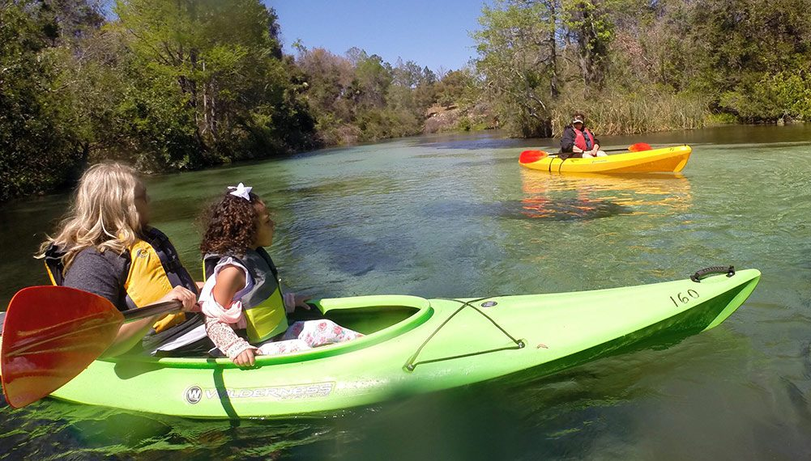
What’s in it for you?
CORE +
Increase courses and instructors
Easier to visualize
Build on existing system
Increased opportunities for public education
Easier framework for future revisions

Slide 52
What’s in it for you?
Outcome Based
Streamline course approval process
Closer alignment with NOWS
Easier instructor self-evaluation
Easier student self-evaluation
Closer alignment with interactive standard elements
Easier transition to on-water training

Slide 53
Immediate impact
States
Current power standard will remain largely intact
Course providers
Course content will evolve

Slide 54
Immediate impact
Instructors
Moderate adaptation
Students
Significant (hopefully) cognitive improvement

Slide 55
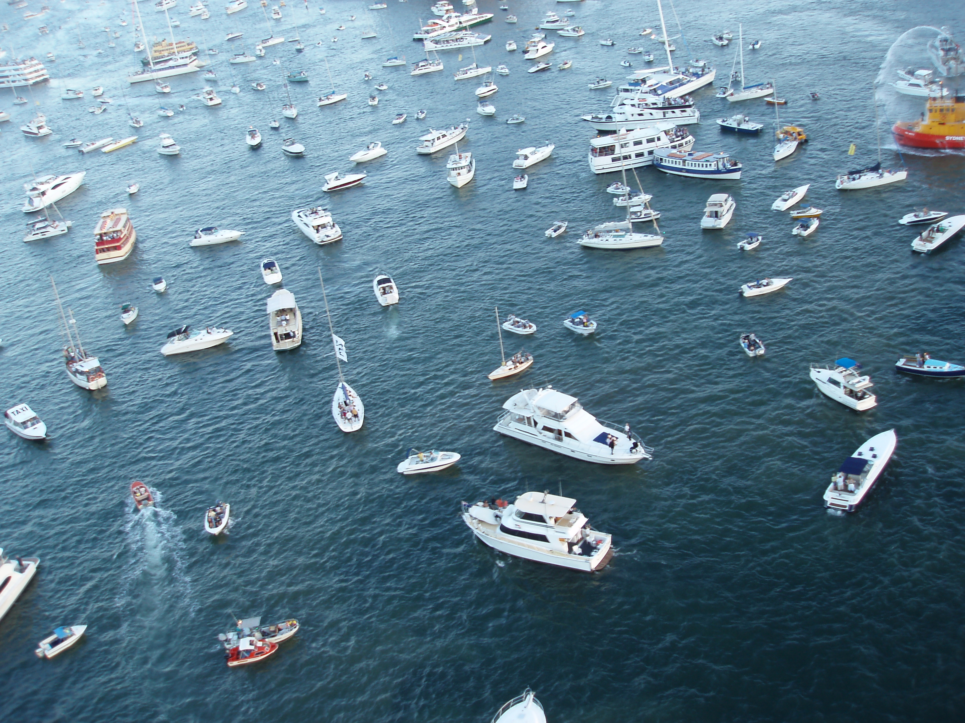
Research
US Military

Slide 56
Research
“The most beneficial attribute to OBTE is that it focuses on the total development of the individual in relation to his or her mission or responsibility.”

Slide 57
Research
West Point Study

Slide 58
Research
West Point Study
“We can also conclude from the assessment that cadets, who are exposed to this training, learn and retain the skills at a better rate than cadets who did not receive OBT&E approach at all.”

Slide 59
The Course Ahead
Immediate
Continued outreach/information
Stakeholder input/buy-in

Slide 60
The Course Ahead
Renewal Timeline
Power
Five year cycle
Approved January, 2016
Renewal January 2021

Slide 61
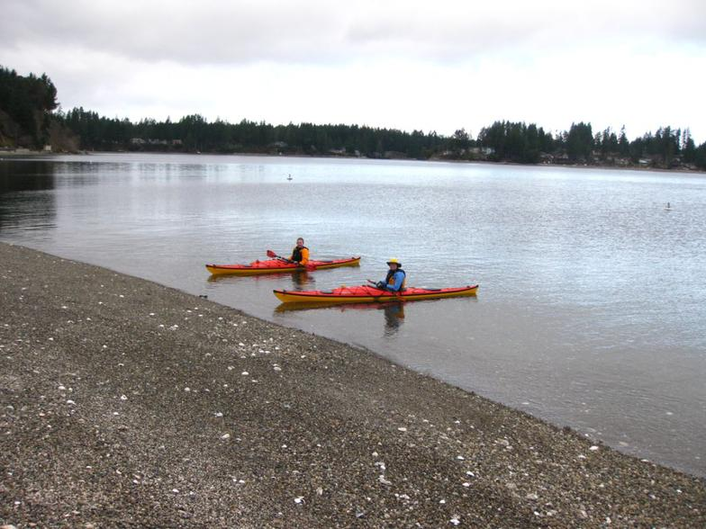
Wrap-up/conclusion
Questions/Discussion

Slide 62
