Slide 1
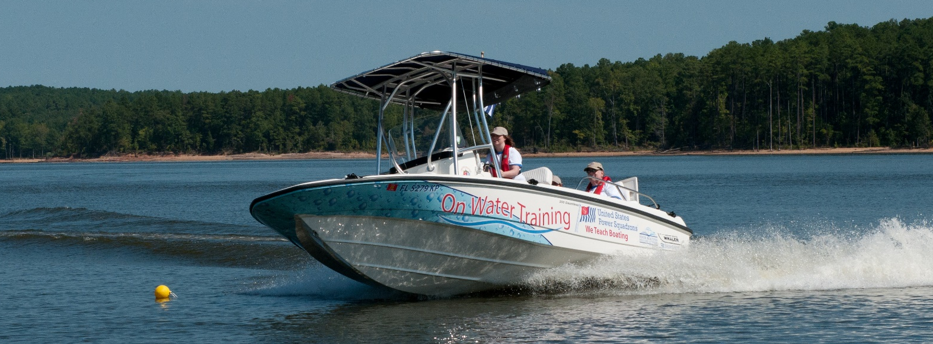


Slide 2

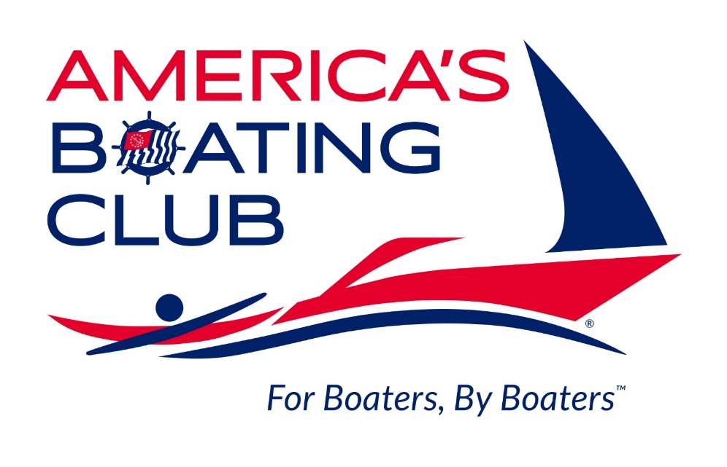
Introducing Our New Brand
=
We are still United States Power Squadrons®
New brand and logo: America’s Boating Club®
New tagline: For Boaters, By Boaters™
Update our public image, connect with our markets

Slide 3
Introducing
America’s Boating Club
Learning Centers

Slide 4

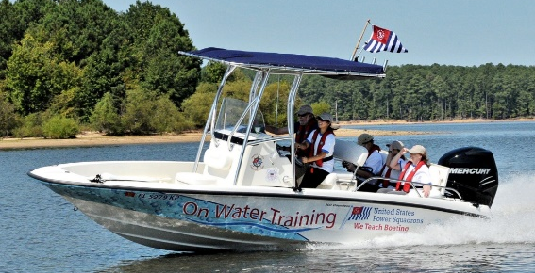
Learning Center Project
National network of training centers dedicated to teaching on-water standards
Fully equipped and staffed by professional instructors
USCG Grant Award for $250,000 to cover startup and first 3 learning centers

Slide 5
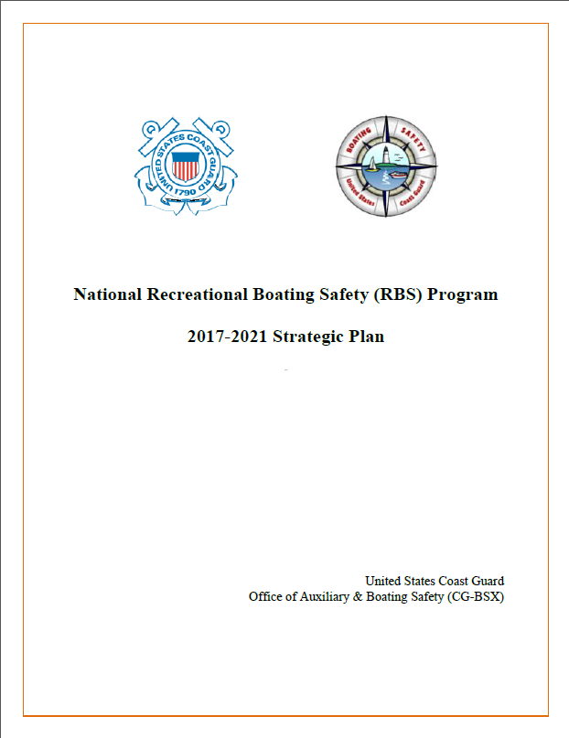
The Objective
From the Recreational Boating Safety Strategic Plan for 2017-2021:
Priority 1: Cultivate a boating public that is better prepared to engage in safer boating behaviors,
Initiative 1: Initiative 1: Improve and expand recreational boating education, training, and outreach
CoA 1: Focus on increasing the number of boaters who have the boating education, skills, and training needed to meet federal regulatory requirements and work toward universal adoption of national best practices and standards.

Slide 6
The Challenge
There are 11 million register powerboats in the U. S.
There are several million new boaters each year
Fewer than 1% of these boaters receive formal skill training in powerboat operation
Why is this so low?
Historical culture
Access to affordable training

Slide 7

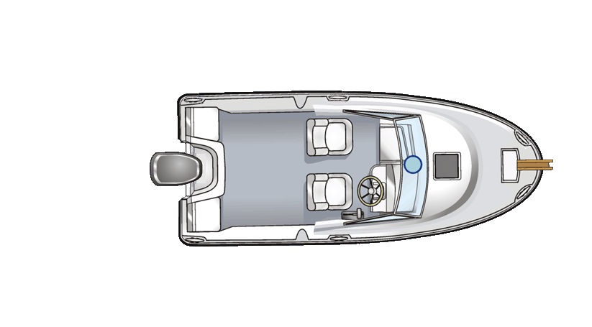

Limitations of a Volunteer Model
America’s Boating Club has several hundred trained instructors, but:
Volunteer Time: Only a handful teach more than once a year
Training Resources: The availability of suitable boats is limited
+

Slide 8
Our Solution
Apply the resources of a major non-profit entity:
  Our organization
  Our volunteer resources
  Our existing on-water training program
Add funding and support from the U. S. Coast Guard
Establish commercial, non-profit training centers

Slide 9
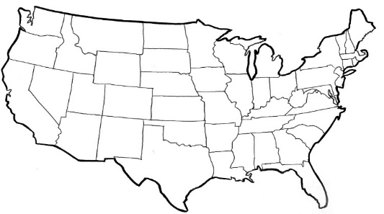
Learning Center Overview
National network of training centers dedicated to teaching on-water standards
Fully equipped and staffed by professional instructors
USCG Grant Award for $250,000 to cover startup and first 3 schools
To begin operations in 2018
Seeking partners for:
  Operating facilities
  Equipment and training assets
  Marketing and promotion
  Both local and national opportunities

Slide 10
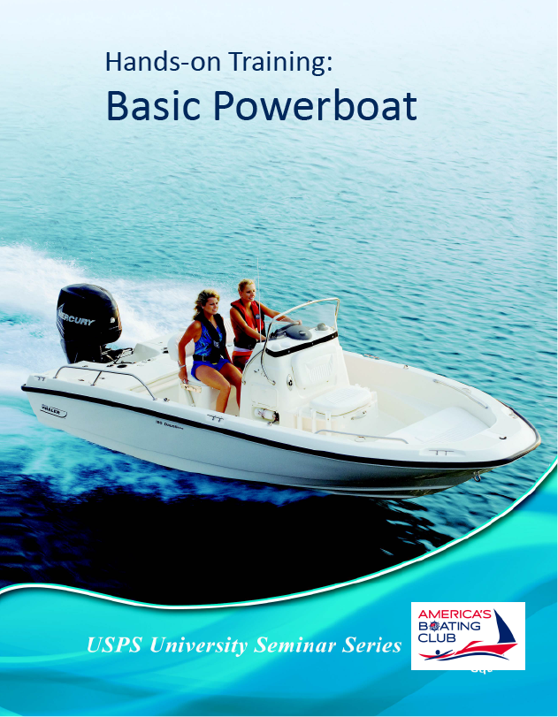
Our Training Product
Hands-On Training: Basic Powerboat
Formerly known as Practical On-the-Water Training (POTW)
Full Coverage of On-Water Power Standards
1 Day Program – 3 Hrs Classroom, 5 Hrs On-Water
A State-Approved Boating Safety Course is a Pre-Requisite

Slide 11
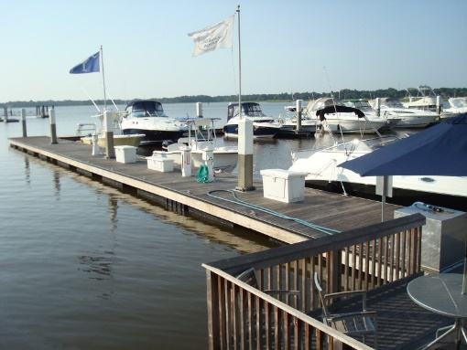

Our Approach
Partner with local organizations for Facilities
  Power Squadrons, Boat Clubs, Yacht Clubs
  Marinas and Dealers
Hire a professional staff
  Part-time Manager
  Contract instructors w/ Captain’s License
Equip the Learning Center
  2 training vessels
  Classroom Equipment
+
+

Slide 12
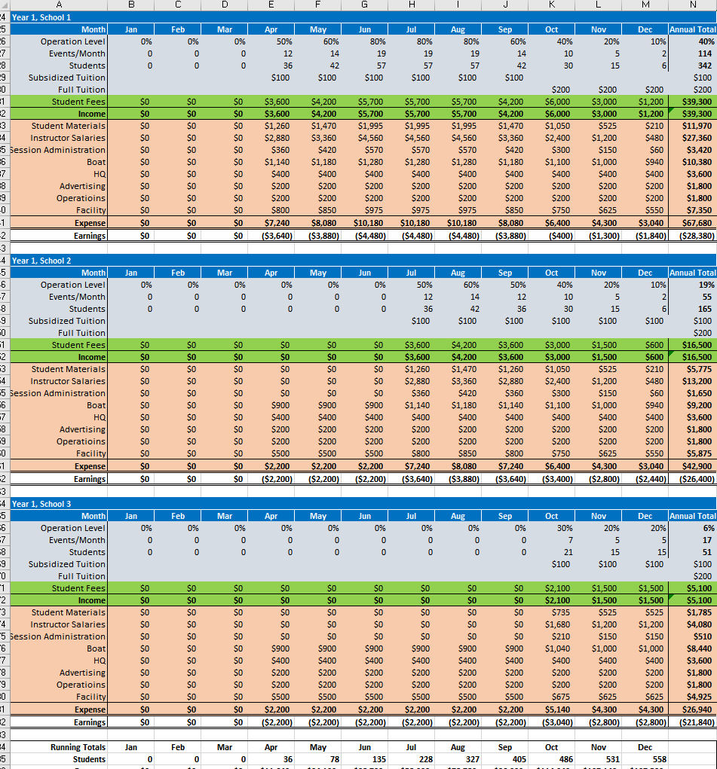
Evaluating the Business Model
We performed extensive modeling and stress testing
Seasonal curves
Local market variations
Variable operating expenses
Our Conclusions:
If we can get people into training classes, the learning centers can be self-sustaining
Marketing will be key to brining in students
Local partners will be important in managing overhead

Slide 13

Training Facility Requirements
Accessible to a large boating population
Public access facility with parking
Classroom for 8 students
Marina with docking
Water for on-plane operation
Suitable anchorage
Vessel storage (lift preferred)
Good partner relations

Slide 14

Instructor Requirements
Need a US Coast Guard license
Be a USPS Member
Receive training in On-water instruction
Become a USPS Boat Operator Certifier
Part time, seasonal employment

Slide 15
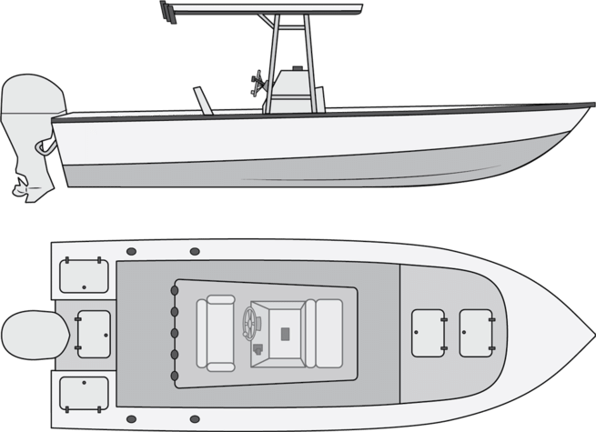
Training Vessel Requirements
2 Training Boats per facility
General Specifications:
  Center Console
  20-23’ long
  8-1/2’ wide
  T-Top
  150-200 HP Outboard
  Hydraulic Steering
  Seating for 5, capacity for 8
  Marine Radio, depth finder/chart plotter

Slide 16
The Project Plan
Setting Up the Business
  Organization Changes
  Develop a Marketing Campaign
  Developing the IT Infrastructure
  Updating the existing website
Setting up Local Operations
  Site Selection
  Partner Agreements
  Equipping Facilities
  Staffing
  Initiate Operations

Slide 17

Project Timeframe Timeframe
Startup and Marketing – June 4, 2018
Site 1 - Florida
  Establish Operating Agreement – May 25, 2018
  Equip and Begin Staff Training - June 4, 2018
  Begin operations – July, 2018
Site 2 - Texas
  Establish Operating Agreement – August, 2018
  Equip and Begin Staff Training – September, 2018
  Begin operations – October, 2018
Site 3 - California
  Establish Operating Agreement – November, 2018
  Equip and Begin Staff Training – December, 2018
  Begin operations – January 2019

Slide 18

Marketing Strategy
An effective Online Presence
  A quality website
  Online course registration
  Extended social media
Marketing Automation
  Email Campaigns
National Marketing
  National Press Releases
  National Print Media
Local Marketing
  Local Press Releases
  Local print media
  Online partnering

Slide 19


Strategic Information
Integrating an information strategy into the program.
Reaching our Customers
Learning from our Customers

Slide 20
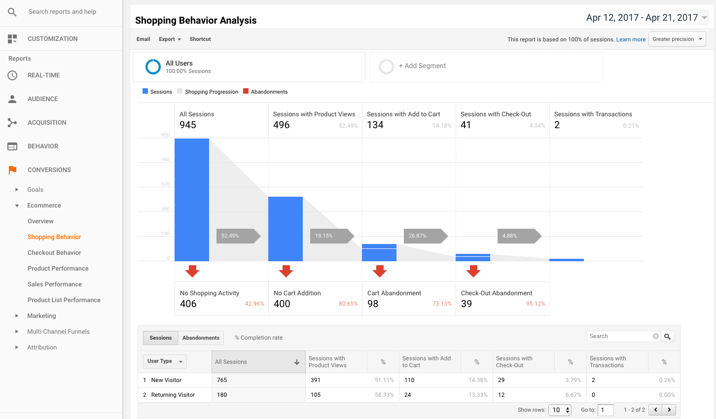
Marketing Analytics
Site Selection
  Finding the optimal locations for Centers
  Respecting the market of existing providers
Web Site
  Search Engine Optimization
  Google Analytics
Additional Marketing
  Targeted email campaigns
  Print media campaigns

Slide 21

Customer Analytics
Feedback on Customer Experience
  Improve the curriculum
  Improve instructor technique
  Deliver better customer value
Feedback on Customer Awareness
  Understanding the impact on customer perception
  Understanding the impact on customer behavior
  Tracking the local market perception

Slide 22
Data Visualization
A picture is worth 1000 words
Fatal Accidents by Location
Source: Recreational Boating Statistics 2016

Slide 23
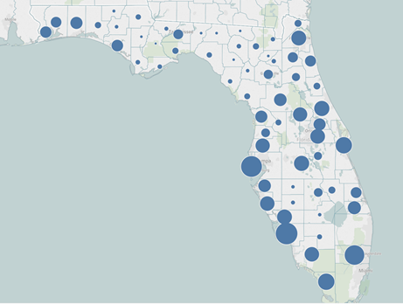

Data Visualization
Utilizing Tableu software
Reporting and Analytics
Built-in Geocoding
Available on Tech Soup
Pictured: Vessel Registrations for Florida
By County

Slide 24

Impact to Squadrons
The impact on squadrons should be very positive
This cost of the Learning Center course is about $200
Squadrons can teach for free to members
Huge market, minimal direct competition
National marketing will help promote squadrons
Direct customers to squadrons for more classes

Slide 25

Partnering Opportunities
Training Facilities
Equipment
Joint Marketing
Social Media
Qualified Instructors
WE WANT YOU!

Slide 26


SOBOS Project
Self-Reported On-Water Boating Operator Survey
Cell phone application
GPS-enabled real-time crowd sourcing
Anonymous data collection
Survey results through NASBLA dashboard
Dr. Ernest Marshburn, East Carolina University

Slide 27

Questions ?
Comments ?
Notes:
Please provide any feedback to the BOC Committee.

Slide 28
