Slide 1

Situational Awareness
Dr. L. Daniel Maxim,
Everest Consulting Associates

Slide 2

Disclaimer
The views expressed in this presentation are those of the author and do not necessarily represent findings or positions of the U. S. Coast Guard (USCG), the U. S. Coast Guard Auxiliary (USCGAUX), the National Boating Safety Advisory Council (NBSAC) or the ERAC Committee of the National Association of State Boating Law Administrators (NASBLA)

Slide 3
Outline of presentation
1
Definition and importance of maintaining SA
2
Attention threats related to SA
3
Clues to the loss of SA:
Regaining SA
4
Conclusions and relevance to boating safety courses

Slide 4
SA Definition
Situational Awareness (SA) is the ability to identify, process, and comprehend the essential elements of information (EEIs) about an evolution (voyage, flight, activity)
EEIs are context specific
More simply, it’s “knowing what is going on around you”
As much a mindset as a hard skill
Notes:
Consider what the EEIs would be for a vessel operator, a fireman about to enter a burning building, a police officer planning to make a traffic stop, etc. The EEIs are quite different in each case. The claim that it more of a mindset than a hard skill is elaborated at http://www.stratfor.com/weekly/practical-guide-situational-awareness.

Slide 5

It’s knowing what’s going on around you!

Slide 6

It’s knowing what’s going on around you!

Slide 7
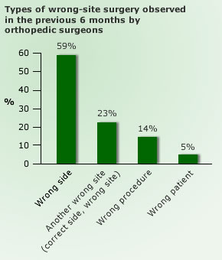
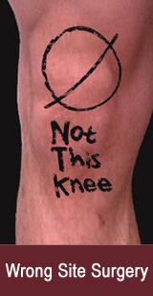
It’s knowing what’s going on around you!
Notes:
For more information on wrong site surgery and counter measures see https://www.ncbi.nlm.nih.gov/books/NBK2678/, https://www.ncbi.nlm.nih.gov/pmc/articles/PMC1857133/, or https://psnet.ahrq.gov/primers/primer/18/wrong-site-wrong-procedure-and-wrong-patient-surgery.

Slide 8
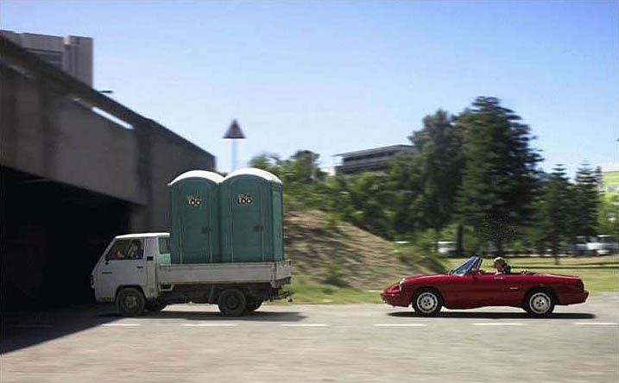
It’s knowing what’s going on around you!

Slide 9

It’s knowing what’s going on around you!

Slide 10

It’s knowing what’s going on around you!

Slide 11
SA broadly applicable in fields such as
All transportation modes
Police/fire/emergency response
Military
Industrial safety, nuclear power plants
Weather forecasting
Health care

Slide 12

Levels of SA (Dr. Mica Endsley) and follow-on activities
SA level 1: Perception
SA Level 2: Understanding
SA Level 3: Projection
Decision(s)
Action(s) and monitoring
Notes:
Each level is relevant to SA. Dr. Mica Endsley (onetime Scientist for the Air Force and author of several books) offers data on loss of SA by level for various aircraft accidents. Others have looked at commercial shipping accidents and reached the same conclusions.

Slide 13
Boating example, loss of SA
At 0445 on a dark morning, a single 14’ fiberglass open motorboat (powered by an outboard motor with tiller steering) with two occupants was cruising on the St. Johns River, having departed at 2200 the evening before
Occupants sat on a bench seat at the rear of the boat:
  The male (Mr. B) on the starboard side (using an App on his phone to navigate) and the female (his girlfriend, Ms. A) on the port side, was actually controlling the vessel
Notes:
Details of this case are available at Florida Fish and Wildlife Conservation Commission case FWNE16OFF003472.

Slide 14
Additional facts
The boat, operating at approximately 20 MPH on plane, struck an unlit channel marker on the port side ejecting Ms. A:
  Ms. A was wearing a lanyard with an engine cutoff switch, which functioned correctly and stopped the boat, but was not wearing a life jacket
  Mr. B, who was not ejected, jumped (without wearing a life jacket) into the water to rescue Ms. A, but was unable to find her

Slide 15
Additional facts
Mr. B was looking down at his phone to navigate and looked up when he heard Ms. A yell
At this time, the vessel was being turned hard to the starboard by Ms. A just before it struck the channel marker
Ms. A located by authorities the following day having drowned
Ms. A’s BAC was 0.162, Mr. B had also consumed beer

Slide 16
Comments on this case
Case illustrates several unsafe acts, including
  Perceptual error (not seeing marker)
  Decision errors (excessive speed for conditions, use of phone App for navigation, failure to wear life jackets, operation in fatigued state, alcohol involvement, etc.)
These errors caused both persons to lose SA (boat position and proximity to navigational hazards)

Slide 17
Importance of SA—study findings

Slide 18
Two quick “take home” messages
Human error is the major cause of most accidents
Most human errors involve a loss of situational awareness

Slide 19
Threats to effective situational awareness

Slide 20
Threats
A threat is anything that increases hazard, risk, or operation complexity that, if not managed properly, can decrease the safety margin(s)
Threats are not errors per se, but increase the likelihood of errors
Threats need to be identified, assessed, prioritized, managed, and (when necessary) communicated
Notes:
In the lexicon of HFACS, threats are preconditions to unsafe acts.

Slide 21
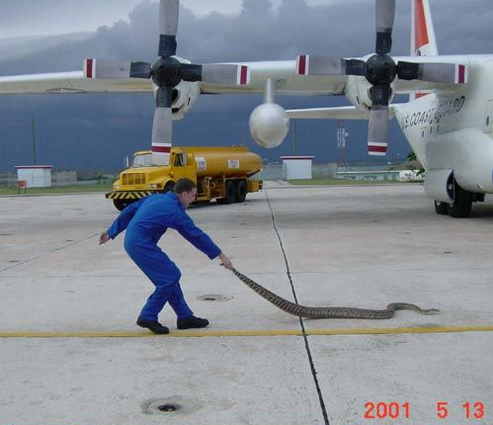
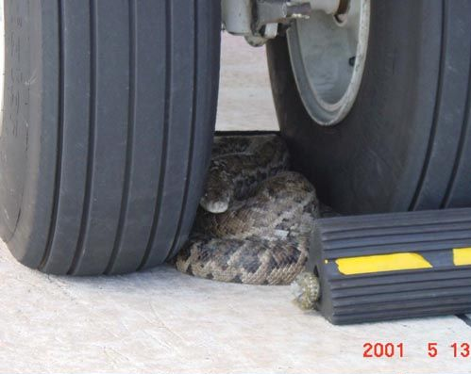
Threats must be managed
Threat detection
Threat control
Notes:
Photo credit USCG 5/13/2001. Although this is intended as comic relief, it also serves to remind us that the threats we need to be vigilant about depend upon the context. Snakes crawling between the tires of a C-130 are probably not an issue in Maine, for example. But, as these remarkable photos illustrate, even removing the chocks might present hazards in some locations. This photo is also posted on the Navy Safety Center website at http://www.safetycenter.navy.mil/photo/archive/archive_1-50/photo13.htm. It was taken at the Coast Guard Air Station in Mobile, Ala. They said it was a diamondback and that the rattler is that thing you see next to the wheel chocks. I defer to any expert on snakes.

Slide 22
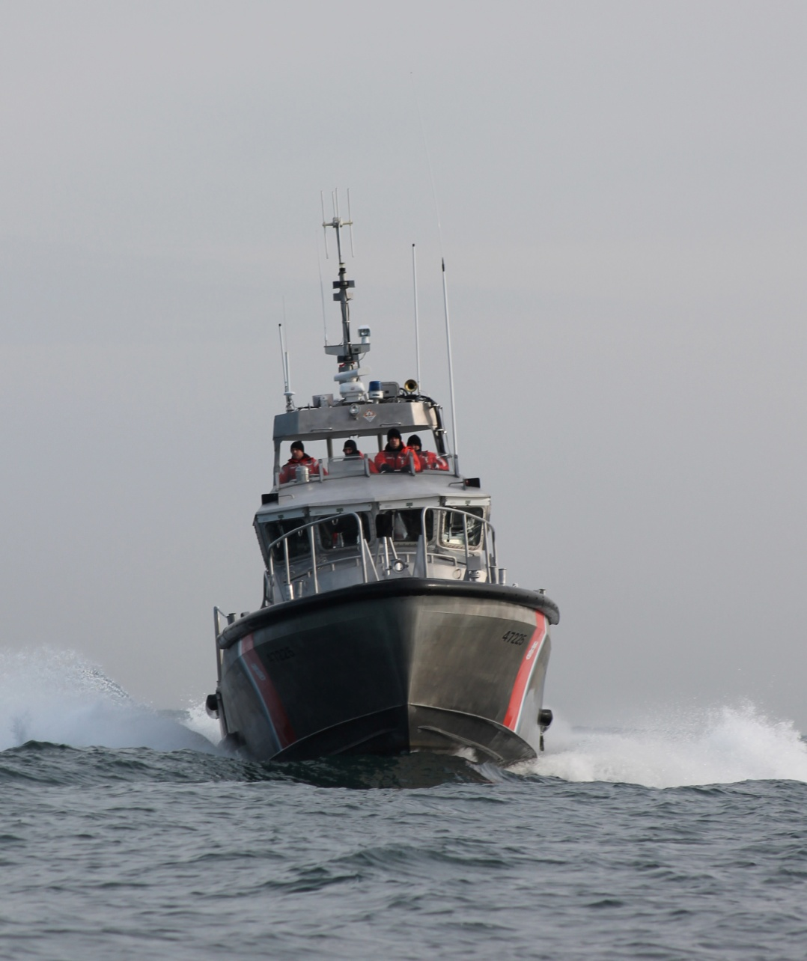
Threats
System
malfunction
Low
fuel
Distractions
Weather
Fatigue
Time
pressures
Mission
change
Illness
Unfamiliar
area
Communications
difficulty
Notes:
Examples of various threats to effective SA.

Slide 23
Attention threats related to SA

Slide 24

Eight attention threats
Temporal distortion
Distraction
Channelized attention
Task saturation
Expectancy
Inattention
Habituation
Negative transfer
Notes:
See presentation by A. M. Quartarone, Maristaeli luni health service on Situational Awareness available at http://ninowebspace.altervista.org/Pubblicazioni/Situational%20Awareness.pdf. Additional references available at http://quizlet.com/20500060/new, fcfirefighters.org/.../MAYDAYMAYDAYMAYDAYPowerpoint.ppt‎, http://frontpage.okstate.edu/coe/toddhubbard/CRM%20stuff/CRM%20FAA%20Training/AT-M-06A.pdf, http://wps.prenhall.com/wps/media/objects/5123/5246605/Article_Mayday_Mayday_Mayday.htm, and http://www.slideserve.com/hallie/maj-paola-verde-md-phd-forl-enav-academy-19-th-sept-2012.

Slide 25

Temporal distortion
Temporal distortion is a factor when the individual experiences a compression or expansion of time relative to reality leading to an unsafe situation
New word: “tachypsychia”

Slide 26
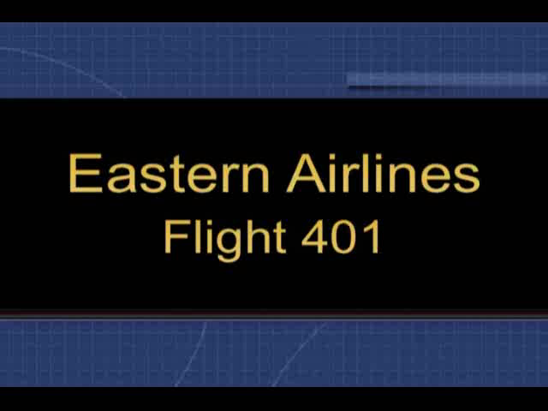
Distraction
Distraction is the interruption of conscious attention to a task by a non or less important task-related cue
Leads to channelized attention
“The main thing is to take care of the main thing”
Notes:
Eastern Flight 401 is the classic example. See e.g., http://www.airdisaster.com/special/special-ea401.shtml and the NTSB report available at http://libraryonline.erau.edu/online-full-text/ntsb/aircraft-accident-reports/AAR73-14.pdf. In this case one of the three landing gear down and locked indicator lights failed to illuminate causing the crew to be concerned that they might have to make a gear up landing, which could result in damage. They left the landing pattern and went to an area over the Florida Everglades to trouble shoot the problem. However, they became fixated on the problem and failed to notice that the aircraft was in a gentle descent. The aircraft crashed with the loss of many lives. Later investigation revealed that there was no landing gear failure, just a burned out bulb.

Slide 27
Channelized attention
Channelized attention means that we focus on only a limited number of environmental cues while excluding other cues of possibly higher or more immediate priority
Mishap investigators have identified channelized attention as the number one human performance factor causing a loss of situational awareness
Notes:
Claim is from the Air Traffic Control Training Series (AT-M-06A CRM US) Basic concepts of Crew resource management Manual (1998). This is available electronically at http://frontpage.okstate.edu/coe/toddhubbard/CRM%20stuff/CRM%20FAA%20Training/AT-M-06A.pdf.
According to the DOD HFACS system, channelized attention is the name given to what many psychologists term ‘inattentional blindness’ (see following slide). Useful reference is Gibb, R., Gray, R., and Scharff, L., (2010). Aviation Visual Perception, Research , Misperception and Mishaps, Ashgate, Burlington, VT. Other terms used in the literature to describe channelized attention include ‘attentional narrowing’ or ‘cognitive tunneling.’

Slide 28
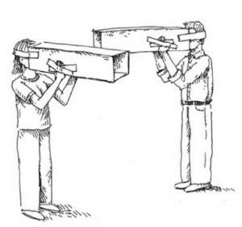
Channelized attention
Contributing factors:
  Fatigue
  Failure to maintain proper scan
  Excessive motivation (pressing)
  Temporal distortion
  Emergencies or contingencies
Notes:
Aviat Space Environ Med. 2006 Sep;77(9):963-70. Fatigue and related human factors in the near crash of a large military aircraft. Armentrout JJ, Holland DA, O'Toole KJ, Ercoline WR.
433rd Airlift Wing, U.S. Air Force Reserve Command, Lackland AFB, TX, USA. jeffrey.armentrout@lackland.af.mil
INTRODUCTION:
During approach to a remote island location, a U.S. Air Force heavy-airlift aircraft was flown into an aerodynamic stall, resulting in the loss of more than 4000 ft. of altitude, with the crew recovering the aircraft just before impact would have occurred.
METHODS:
An analysis of the mishap was conducted through a review of non-privileged USAF mishap data, cockpit voice recordings, flight data records, and interviews of the aircrew involved. A thorough examination of fatigue-related factors was conducted, including computerized fatigue modeling.
RESULTS:
The crew traveled over 11,000 mi in a westward direction over a 6-d period. They had been on duty for nearly 21 h on the day of the mishap, with minimal in-flight rest. The pilots were late beginning their descent for landing, and a minor aircraft malfunction distracted the crew, contributing to channelized attention and degraded situational awareness. A breakdown in crew communication and failure to adequately monitor and interpret true aircraft state culminated in loss of aircraft control. Analysis of the crew's work/rest schedule confirmed that multiple elements of fatigue were present during this mishap, including acute and cumulative fatigue, circadian disruptions, and sleep inertia. Additionally, reduced situational awareness and spatial disorientation, exacerbated by the underlying fatigue, were causal in this mishap.
DISCUSSION:
This mishap highlights the importance of maintaining a high degree of situational awareness during long-haul flights with a continuing need to address issues regarding spatial disorientation, proper application of human engineering principles in modern cockpits, and mitigation of aircrew fatigue factors.

Slide 29
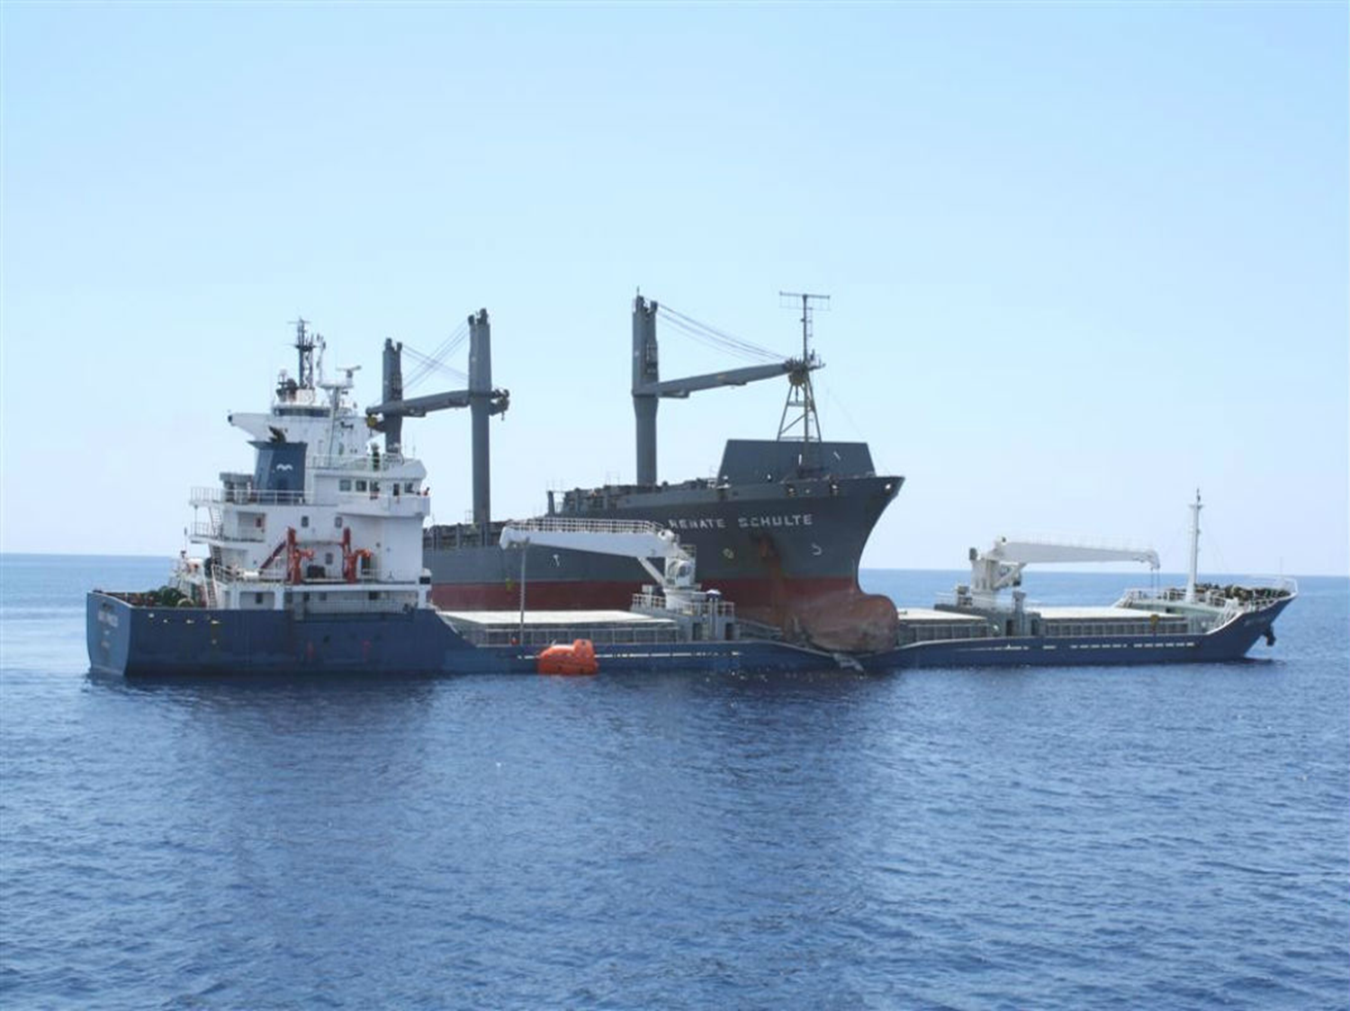
Collision between Renate Schulte and Marti Princess
On a dark moonless light in June 2009 vessels collided off Bozcaada Island (Aegean Sea, near the western exit of Dardanelles in Turkey)
OOWs on both vessels lost SA resulting from focus on avoiding a third vessel, Ilgaz, and, in the case of Renate Schulte, responding to a unrelated radio call from area VTS
Investigation conclusion: “Collision was the result of a series of decisions on both vessels which were based on inaccurate situational awareness”
Notes:
The accident report from the government of Malta for this crash concludes that loss of SA was a key element. This report is a very interesting read, see:
http://www.bsu-bund.de/SharedDocs/pdf/EN/Investigation_Report/2012/Investigation_Report_230_09.pdf?__blob=publicationFile.

Slide 30
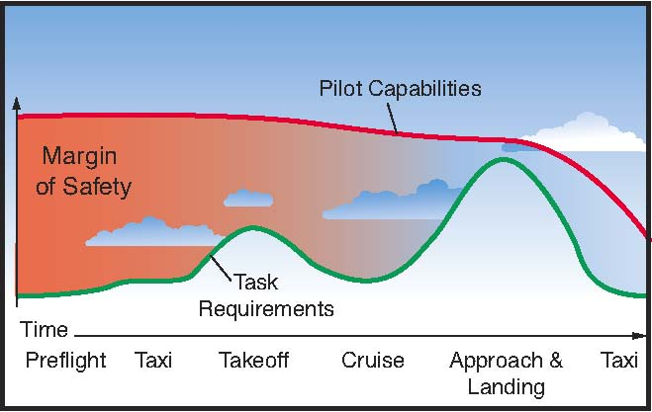
Task saturation
Cognitive task saturation is a factor when the quantity of information an individual must process exceeds their cognitive or mental resources in the amount of time available to process the information
Why most aircraft accidents occur
during the approach/landing phases
Notes:
See e.g., http://www.faa.gov/regulations_policies/handbooks_manuals/aviation/pilot_handbook/media/PHAK%20-%20Chapter%2017.pdf.
http://www.faa.gov/regulations_policies/handbooks_manuals/aviation/helicopter_flying_handbook/media/hfh_ch14.pdf.
http://www.americanflyers.net/aviationlibrary/pilots_handbook/chapter_16.htm.
http://download.aopa.org/epilot/2008/8083-25-chap16.pdf.

Slide 31
Data confirming this hypothesis
Activity | % of mission time | % of fatalities
Take-off and initial climb | 2% | 17%
Climb | 14% | 26%
Cruise | 57% | 5%
Descent | 11% | 15%
Initial approach | 12% | 14%
Final approach and landing | 4% | 23%
Notes:
Boeing data. Available at http://www.yozawa.com/flight/boeingstatics.pdf.

Slide 32
Task saturation
Contributing factors
  Experience level
  Ability to delegate/load share
  Demanding tasks
  System design
  Emergencies
Strategies for dealing with task saturation
  Shift workload to another person or another time
Notes:
The second point is critical. See if it is possible to shift activities to a less demanding time in the evolution. Alternatively, see if you can shift work to other members of the crew, so that no one get overburdened. Here is an interesting comment:
In a world where we are encouraged to do more with less, and are increasingly distracted by everything around us, “task saturation” has been named by the NBAA Safety Committee to its list of the top 10 threats to business aviation safety.
Three Symptoms of Task Saturation
“Task saturation is having too much to do without enough time, tools or resources to do it,” said Eric Barfield, director of operations at Hope Aviation Insurance and chairman of the NBAA Safety Committee. “That can lead to an inability to focus on what really matters.”
As task saturation increases, a pilot, cabin crewmember, flight line employee or maintenance technician might start shutting down, unable to continue performing. Another symptom is constantly shuffling and reorganizing while accomplishing nothing. A third symptom is a marked increase in errors, Barfield said.
Instances of task saturation in business aviation are on the rise, he noted, possibly as a lingering effect of the recent recession.
“We were told to do more with less,” explained Barfield. “If we needed 10 people, we got five people. We ended up with tremendously bright people who are highly cross-functional, but it comes at a cost.” That cost, he said, is degradation of our ability to focus on specific tasks as we try to accomplish all tasks in a list of things-to-do that becomes too big to manage.
Barfield also suggested the proliferation of technology has led to an increase in task saturation. Ironically, the very advances that were meant to make work easier have, in many cases, had the opposite effect.
“The rapid development and implementation of technology, as well as information overload, ...leaves us with yet another system to train on, another system to master, more data to sift through,” said Barfield.
Another contributing factor in task saturation is what Barfield called “the tyranny of the urgent.”
“Everything is due right now. You can’t plan ahead. You’re always on defense,” he said.
http://www.nbaa.org/ops/safety/20130617-task-saturation-how-much-is-too-much.php.

Slide 33
Preplanning: an antidote for task saturation
Do as many tasks as possible (voyage planning) before getting underway, e.g.,
  Read LNMs and listen to BNMs
  Make tide and tidal current calculations
  Lay out charts in anticipated order of use
  Enter necessary/planned waypoints in GPS
  Identify/preplan visual fix opportunities
  Study weather forecasts
  Plan for diversions/alternates in advance

Slide 34
Expectancy
Expectancy is a factor when an individual expects a particular outcome and that expectation is strong enough to create a false perception of that outcome
Examples:
  Hearing what you expect to hear in a checklist response
  Seeing what you expect to see e.g., a clear runway when cleared to land
  Tenerife collision
Notes:
Here are relevant references:
http://asasi.org/papers/2011/The%20Direction%20of%20Aviation%20Safety%20(Merged)%20-%20Ian%20Brown.pdf.
http://www.airforcemag.com/SiteCollectionDocuments/Reports/2012/June2012/Day01/052212_ACC_MQ-1_AIB.pdf.
http://gradworks.umi.com/3492476.pdf.
.

Slide 35
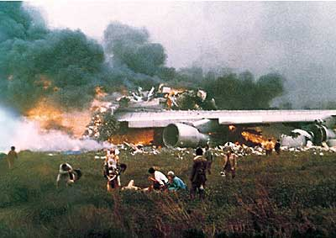

Expectancy example: Tenerife crash
KLM 747 took off on fog-shrouded runway, ran into Pan AM 747 taxing down runway for take-off position
Crash killed 583 people, making it the deadliest accident in aviation history
Complex story, but key was lack of SA
KLM received route clearance and Captain believed that he had received take-off clearance (expectancy)
KLM Captain failed to hear Pan AM report that he was not clear of the active runway
Notes:
Many references discuss this disaster in more detail, see e.g.,
http://www.telegraph.co.uk/travel/comment/tenerife-airport-disaster/.
http://lessonslearned.faa.gov/ll_main.cfm?TabID=1&LLID=52&LLTypeID=2.
http://project-tenerife.com/engels/PDF/alpa.pdf.
http://www.project-tenerife.com/engels/PDF/Tenerife.pdf.
https://ntl.bts.gov/lib/7000/7500/7585/jatww3-1wilson.pdf.
https://www.fss.aero/accident-reports/dvdfiles/ES/1977-03-27-A-ES.pdf.

Slide 36

Inattention
Inattention is a factor when the individual has a state of reduced conscious attention due to a sense of security, self-confidence, boredom or a perceived absence of threat from the environment which degrades crew performance
Inattention often results from highly repetitive tasks
Need to manage crew stress
Notes:
It’s not just aircraft or boats. Check out the following on highway accidents:
http://www.nhtsa.gov/About+NHTSA/Traffic+Techs/current/Driver+Inattention+Is+A+Major+Factor+In+Serious+Traffic+Crashes.

Slide 37
Habituation
Becoming so used to a stimulus that it is no longer attended
Contributing factors:
  Routines
  System design
  Evolution of informal work practices
  Workload
Examples:
  Backup alarms on forklifts
  High rates of false alarms
  History of accident free performance
Notes:
See Bliss, J. P., and Dunn, M. C., (2000). Behavioural implications of alarm mistrust as a function of task workload. Ergonomics, Vol. 43, 9, 1283-1300. This laboratory study determined that the effects of false alarms depended upon the workload of the subjects. Higher workload, led to more incorrect responses. Relevant theory has also been developed for vigilance. The systematic study of vigilance was initiated by Norman Mackworth during World War II. Mackworth authored "The breakdown of vigilance during prolonged visual search" in 1948 and this paper is the seminal publication on vigilance. Mackworth's 1948 study investigated the tendency of radar and sonar operators to miss rare irregular event detections near the end of their watch. Mackworth simulated rare irregular events on a radar display by having the test participants watch an unmarked clock face over a 2 hour period. A single clock hand moved in small equal increments around the clock face, with the exception of occasional larger jumps. This device became known as the Mackworth Clock. Participants were tasked to report when they detected the larger jumps. Mackworth's results indicated a decline in signal detection over time, known as a vigilance decrement. The participants' event detection declined between 10 and 15 percent in the first 30 minutes and then continued to decline more gradually for the remaining 90 minutes. Mackworth's method became known as the "Clock Test" and this method has been employed in subsequent investigations. See also Duchon and Laage (1986) The Consideration of Human Factors in the Design of a Backing-Up Warning System: “Despite the use of automatic backing-up warning systems, large mobile equipment is still involved in reversing collisions, causing injuries, fatalities, and property damage. This paper discusses specific human factors that contribute to the failure of this type of system as used on front-end loaders in the surface mining industry. The use of the backing-up automatic alarm causes the operators to lose the perception of responsibility for vigilant behavior, while the ground crew predictably become habituated to the alarm. These human factors and their interaction with the noise pollution created by the alarms sets up a potentially unsafe condition. Bureau of Mines' research into discriminating backup warning systems could provide an effective alternative to the conventional backup alarm.”

Slide 38
Habituation and “normalization of deviance”
Most evolutions to not result in accidents
Time pressures and other factors tempt us to take short cuts—without penalty
This leads us to believe that more elaborate procedures are unnecessary—a phenomenon termed “normalization of deviance”
We learn the wrong lessons from success and ultimately drift into unsafe practices
Notes:
Sociologist Dr. Diane Vaughan coined this phrase in her excellent analysis of the Challenger Launch Decision, a book published by the University of Chicago Press, (1996, 2016). This book is really worth reading. For additional reading, see https://sma.nasa.gov/docs/default-source/safety-messages/safetymessage-normalizationofdeviance-2014-11-03b.pdf?sfvrsn=4. Here are some additional references:
https://www.ncbi.nlm.nih.gov/pmc/articles/PMC2821100/pdf/nihms157603.pdf.
http://www.fireengineering.com/articles/2013/05/firefighter-safety--the-normalization-of-deviance.html.
https://my.bridgew.edu/departments/Aviation/SiteAssets/SitePages/SAFETY%20LINK/Normalization%20of%20Deviance.pdf.
http://www.flightsafetyaustralia.com/2017/05/safety-in-mind-normalisation-of-deviance/.

Slide 39
The Heinrich Ratio
Fatal Accident 1
Non-fatal accidents 10
Reportable incidents 30
Unsafe acts 600
Source: Naval Aviation Center
School of Aviation Safety
39
39
Notes:
This is a very important slide. While the specific numbers (e.g., 600 to 1) might be debated (and have), all agree that there are very many more unsafe acts than fatalities. For more on Heinrich, see https://www.isnetworld.com/Events/ugm/Osha2016/Sessions/Micah%20Backlund%20-%20Comparing%20the%20Heinrich%20Triangle%20Theory.pdf.
https://en.wikipedia.org/wiki/Herbert_William_Heinrich.

Slide 40
Negative transfer
Negative Transfer is a factor when the individual reverts to a highly learned behavior used in a previous system or situation and that response is inappropriate or degrades mission performance
Examples:
  Switch from car with conventional brakes to one with anti-lock brakes
  Switch from one aircraft or vessel to another with different controls or equipment
Notes:
See an interesting article by Rayman, R. B., (1982). Negative transfer: a threat to flying safety, Aviat. Space Environ Med., 53(12), 1224-6. Here is the abstract: “Negative transfer is defined in the context of this paper as the transfer from one cockpit to another--of different design or configuration--of habits or responses which were appropriate in the former but are inappropriate in the latter, thereby posing a threat to flying safety. This danger has been demonstrated not only experimentally but also in a number of aircraft accident investigation reports. As new aircraft become available to the commercial, military, and private sectors and pilots consequently must transition from older to newer models, the phenomenon of negative transfer becomes increasingly significant. To illustrate the concept of negative transfer and aviation, the author compares the cockpits of two USAF aircraft and how their differences could adversely affect pilot performance. Recommendations are then made on ways organizational flight surgeons can minimize the negative transfer threat to aviation.” Here are some other sources:
https://livingsafelywithhumanerror.com/tag/negative-transfer/.
http://www.sciencedirect.com/science/article/pii/S1071581904000886.
http://onlinelibrary.wiley.com/doi/10.1111/j.2044-8325.1983.tb00136.x/full.

Slide 41
Negative transfer
Problem is not learning the new, it is “unlearning the old”
Contributing factors:
  New environment/design
  Long experience with older system
  High workload
  Emergencies
Notes:
Here is a portion of a NY Times article describing an aircraft crash:
Pilot Error Found in Crash That Killed Russian Hockey Players Nov 2, 2011.
By ELLEN BARRY
MOSCOW — Russian air safety officials said Wednesday that a September plane crash that killed an elite hockey team was caused by an extraordinarily basic human error: one of the pilots accidentally pressed the brakes on the landing gear, so that the aircraft was moving too slowly when it tried to take off.
Aleksei Morozov, who led a team investigating the crash for Russia’s Interstate Aviation Committee, said it was not clear whether the error was committed by the pilot or co-pilot of the plane, a Russian-made, three-engine Yak-42 chartered to carry the team, Yaroslavl Lokomotiv, to a game. Investigators noted that both men had more experience flying Yak-40 aircraft than Yak-42s. The Yak-40’s pedals are laid out differently, and “a negative transfer of Yak-40 skills” may have led to the error, they said. An autopsy also found that the co-pilot had phenobarbital — a depressant that can slow reaction times — in his system.

Slide 42
Opportunities for negative transfer?
Control sequence on throttle quadrant
Aircraft | Left | Middle | Right
B-25 | Throttle | Propeller | Mixture
C-47 | Propeller | Throttle | Mixture
C-82 | Mixture | Throttle | Propeller
Fitts and Jones, 1947
Notes:
This is one of the classic studies on human factors and “pilot error.” Fitts, P.H., and Jones, R.E., (1947). Analysis of factors contributing to 460 “pilot error” experiences in operating aircraft controls, Memorandum Report TSEAA-694-12. Aero Medical Laboratory, Air Materiel Command, Wright-Patterson Air Force Base, Dayton, Ohio. Fitts and Jones did not use the term “negative transfer,” but noted that pilots accustomed to operating one type of aircraft experienced problems when transitioning to another. Your grandmother would have called this “an accident waiting to happen.” The Fitts and Jones report is cited in numerous books and articles and is very difficult to find. This and another of their classic contributions can be found in Sinaiko, H. W., Ed. (1961). Selected papers on human factors in the design and use of control systems, Dover Publications, New York, NY. The B-25 medium bomber and C-47 (civilian version of DC-3) were well known. Developed by Fairchild, the C-82 was intended as a heavy-lift cargo aircraft to succeed prewar civilian designs like the Curtiss C-46 Commando and Douglas C-47 Dakota using non-critical materials in its construction, primarily plywood and steel, so as not to compete with the production of combat aircraft. However, by early 1943 changes in specifications resulted in plans for an all-metal aircraft. The aircraft was designed for a number of roles, including cargo carrier, troop transport, parachute drop, medical evacuation, and glider towing. It featured a rear-loading ramp with wide doors and an empennage set 14 feet off the ground that permitted trucks and trailers to back up to the doors without obstruction. The single prototype first flew on 10 September 1944. The aircraft were built at the Fairchild factory in Hagerstown, Maryland, with deliveries beginning in 1945 and ending in September 1948.

Slide 43
Technology can help
What is a geographic position?
  Latitude and longitude
  Proximity to hazards
  Implications for action
Example:
  Position 41º 38.753 N 70º 15.825 W in Lewis Bay, Hyannis, MA

Slide 44
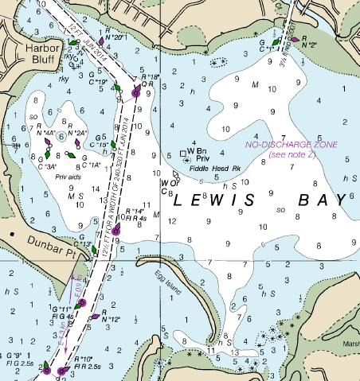
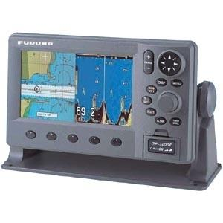
Options
Plot Lat/Long on chart
Use chart plotter

Slide 45
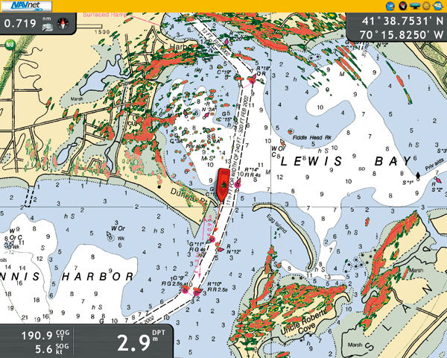
Technology can help

Slide 46
Examples of useful technology
  Radio
  Depth sounders/fishfinders including those with forward looking feature
  Autopilot
  Radar
  Night vision equipment
  Chart plotter tied to GPS and fluxgate compass
  Automatic Identification System (AIS)
  Some of these available on cell phones

Slide 47
Clues to loss of SA

Slide 48
Clues to loss of SA
Confusion or “gut feeling”
No one watching for hazards
1
2
Improper procedures
Departure from regulations
3
4
Notes:
These, and others to follow, are included in the CG material on TCT.

Slide 49
No one minding the store
Studies on the effectiveness of lookouts date back to World War II (RADAR and SONAR)
These concluded that there was a ‘vigilance decrement’ of lookouts after one-half hour of monitoring—which could be prevented if lookouts were given rest periods
Implications

Slide 50
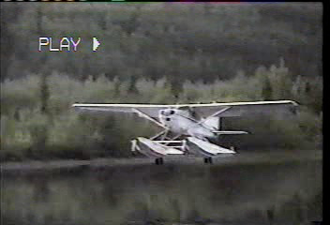
Improper procedures: failure to use checklist
Notes:
Numerous sources discuss accidents resulting from failure to properly use checklists, see e.g., http://www.avweb.com/news/safety/183042-1.html. http://www.ntsb.gov/doclib/reports/1997/aar9701.pdf. http://libraryonline.erau.edu/online-full-text/ntsb/aircraft-accident-reports/AAR88-05.pdf. https://blog.globalair.com/post/The-Importance-of-Checklists-4-Accidents-Checklists-Could-Have-Prevented.aspx. https://www.ntsb.gov/investigations/AccidentReports/Pages/AAR1503.aspx. http://flightdeck.ie.orst.edu/ElectronicChecklist/HTML/accidents.html. https://iflyamerica.org/checklist_checkup.asp. https://www.ntsb.gov/news/speeches/RSumwalt/Documents/Sumwalt_130916_sop.pdf. https://ti.arc.nasa.gov/m/profile/adegani/Cockpit%20Checklists.pdf.

Slide 51
More clues to loss of SA
Ambiguity
Unresolved discrepancies
5
6
Fixation/preoccupation
Failure to meet planned targets
7
8
51

Slide 52
Regaining and maintaining SA

Slide 53
Regaining SA
Look for clues of degraded SA
Verbalize Loss of SA; admit the problem, tell somebody
Deal with unanticipated problems
Go to the nearest “stable, simple, and safe situation”
Return to conscious monitoring
Notes:
See suggestions found in http://www.crm-devel.org/resources/paper/alkov.htm. See also http://www.airbus.com/fileadmin/media_gallery/files/safety_library_items/AirbusSafetyLib_-FLT_OPS-HUM_PER-SEQ06.pdf.

Slide 54
Drilling down
What does “Go to the nearest stable, simple, and safe situation” mean for boaters?
  Follow rules and procedures
  Change level of automation (e.g., disconnect autopilot)
  Buy time (all stop, delay procedure)
  Stay in or head to safe water

Slide 55
Tips for maintaining SA
Follow best practices
  Communicate (keep crew and others informed)
  Manage attention (set priorities, avoid distraction)
  Manage workload (time and person shifts)
  Consider using “Sterile cockpit” or “Red Bridge” policies
  Always use checklists!
Notes:
http://www.airbus.com/fileadmin/media_gallery/files/safety_library_items/AirbusSafetyLib_-FLT_OPS-HUM_PER-SEQ06.pdf. Here is an excerpt on the sterile cockpit rule from Wikipedia. The Sterile Cockpit Rule is an FAA regulation requiring pilots to refrain from non-essential activities during critical phases of flight, normally below 10,000 feet. The FAA imposed the rule in 1981 after reviewing a series of accidents that were caused by flight crews who were distracted from their flying duties by engaging in non-essential conversations and activities during critical parts of the flight. One such notable accident was Eastern Air Lines Flight 212, which crashed just short of the runway at Charlotte/Douglas International Airport in 1974 while conducting an instrument approach in dense fog. The National Transportation Safety Board (NTSB) concluded that a probable cause of the accident was distraction due to idle chatter among the flight crew during the approach phase of the flight. Similar is the case of Colgan Air Flight 3407 in 2009.
There is an analogous concept in bridge team management termed “Red Bridge.” For details, see the MAIB report on the Pride of Canterbury grounding, see https://assets.publishing.service.gov.uk/media/547c700ded915d4c0d000071/PrideofCanterburyReport.pdf, for details.

Slide 56
In short
“Watch out when you are busy or bored”
“The main thing is to take care of the main thing;” safe operation of the vessel
“Select and direct;” manage workload by:
  Shifting tasks to another time in the mission
  Shifting tasks to another person
“Debrief after each voyage;” identify lessons learned

Slide 57
Quick review
Human error is the major cause of most accidents
Most human errors involve a loss of situational awareness

Slide 58

SA attention demons
Temporal distortion
Distraction
Channelized attention
Task saturation
Expectancy
Inattention
Habituation
Negative transfer

Slide 59


