Slide 1




22nd International Boating and Water Safety Summit
5 March 2018 Lexington, Kentucky
CAPT Mitsuru Eguchi, Director, Safety Measures Division,
Maritime Traffic Department, Japan Coast Guard
Notes:
【日本語】
皆さんこんにちは。海上保安庁の江口です。
まずはこのプレゼンの機会を設けていただいたUSCG,NASBLA及びNSBCに感謝いたします。
【英語】
Hello, everyone. I’m Eguchi of Japan Coast Guard.
I appreciate USCG, NASBLA, and NSBC in which I had the opportunity of this presentation prepared first of all.

Slide 2
Last year…
Japan Coast Guard come back again!
Notes:
【日本語】
昨年の事を覚えておられる方もいらっしゃるかと思いますが、昨年、我々海上保安庁はNSBCの招聘を受け、初めてIBWSSに参加し、プレゼンの機会をいただくことができました。
そこで私は、「来年も戻ってくるぜ！」と宣言したわけですが、本日その言葉通り、制服を着用した上で皆様の前でプレゼンを披露する事ができ、大変うれしく思っている次第です。
今回のIBWSSにおいても、様々な団体の皆様と情報共有を図ることにより、小型船舶の安全に寄与したいと考えておりますので、皆様方も我々海上保安庁に質問があればいつでも聞いていただければと思います。
さて本日は、我々海上保安庁の概要を紹介するとともに、海上保安庁が実施する小型船舶の安全対策について詳しく説明したいと思います。
【英語】
Last year is kept in mind. We Japan Coast Guard was able to receive invitation of NSBC, was able to participate in IBWSS for the first time, and was able to obtain the opportunity of the presentation last year.
Then, " I'll come back next year!" Although declared, after wearing a uniform, I am very glad in front of you today to be able to announce a presentation as the language.
Also in this IBWSS, since I think that he would like to contribute safely [ a small vessel ] by planning information sharing with you, various organizations, I think if you also have a question in us Japan Coast Guard and you will hear it always.
Now, while introducing today the outline of Japan Coast Guard, us, I wish to explain in detail the safety measures of the small vessel which Japan Coast Guard carries out.

Slide 3
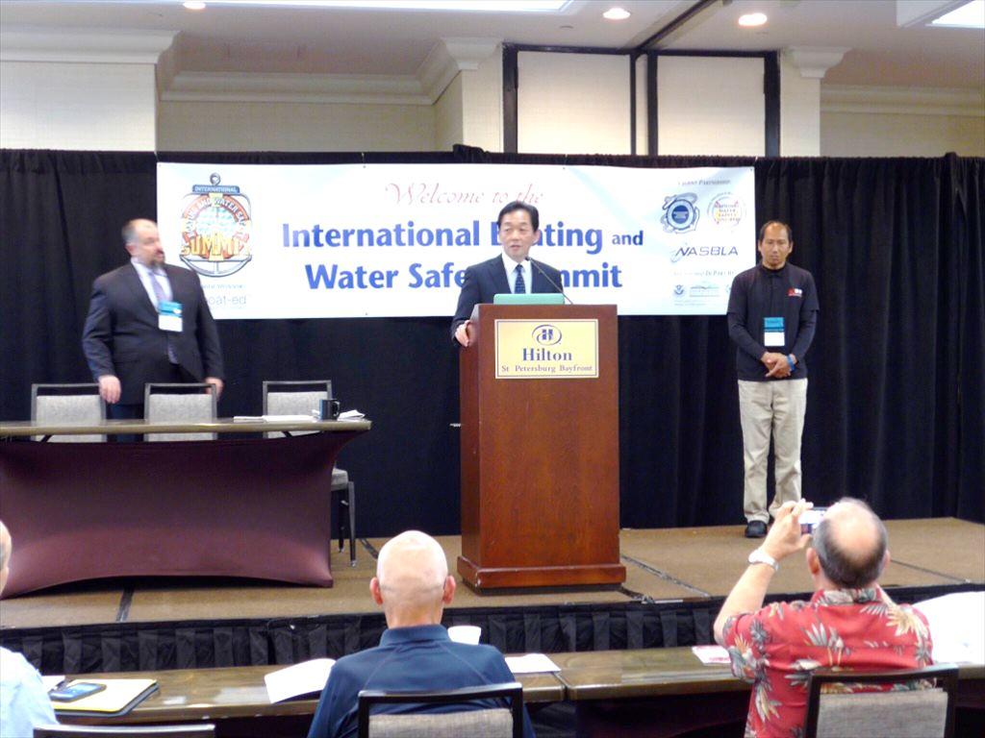
Notes:
【日本語】
昨年のIBWSSで私が挨拶をしている状況です。
【英語】
It is in the situation where I am greeting by the IBWSS last year.

Slide 4
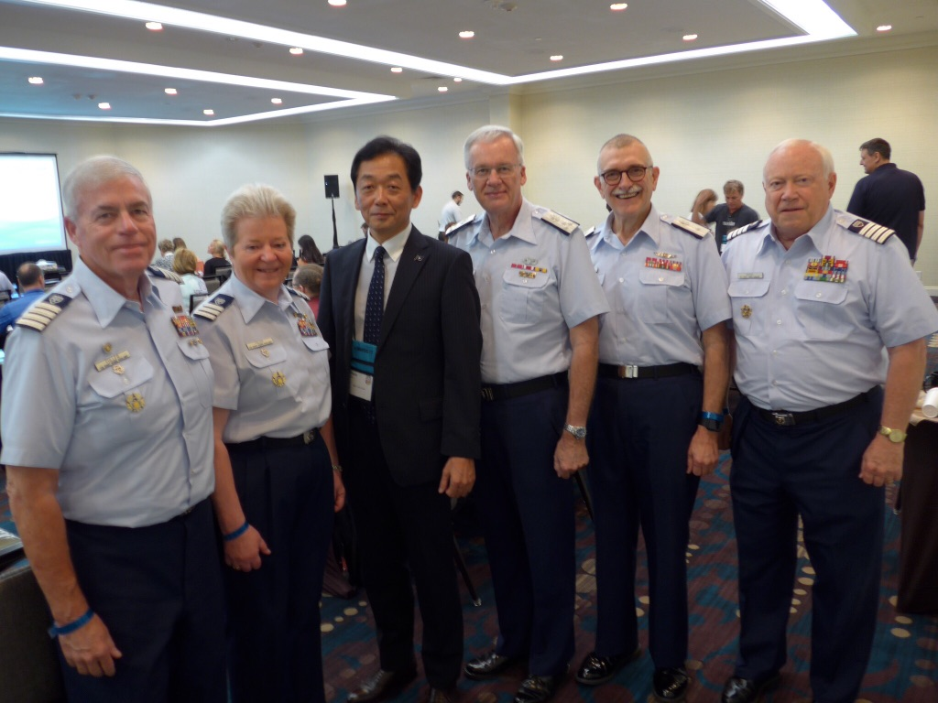
Notes:
【日本語】
昨年は、USCG Auxuallyの方々との交流を行う事ができました。
【英語】
The exchange with people of USCG Auxually was able to be performed last year.

Slide 5
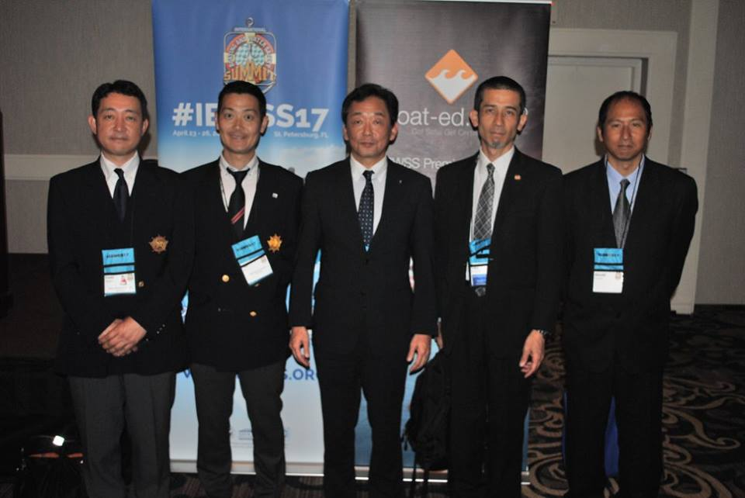
Notes:
【日本語】
昨年、日本からは海上保安庁のほか、マリンスポーツ財団及び日本海洋レジャー安全・振興協会を含めた５人のメンバーで望みました。
今年は海上保安庁のメンバーを１名増強するとともに、ＪＥＴＲＯや大使館の職員も参加させていただいております。
【英語】
From Japan, it wished last year with five members including Marine Sports Foundation and Japan Marine Recreation Association besides Japan Coast Guard.
While reinforcing one member of Japan Coast Guard this year, the personnel of JETRO or an embassy are also allowed to participate.

Slide 6
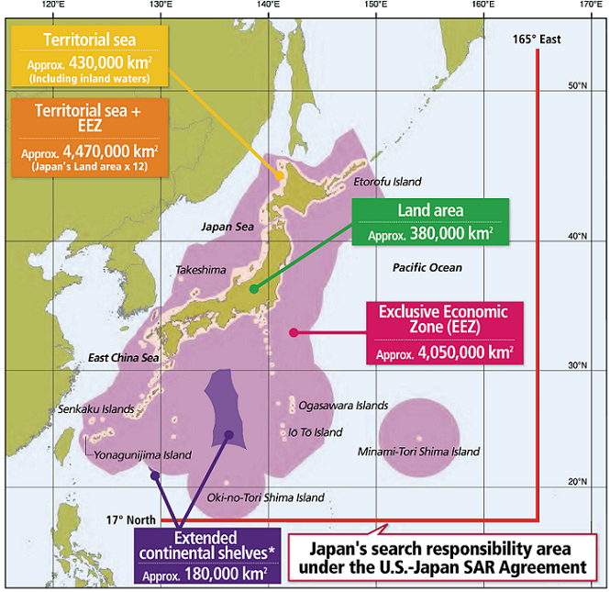
What’s JCG?
Notes:
【日本語】
皆さんは日本に来た事がありますか？
ご覧のとおり日本は島国で、領土面積は世界第６１位にすぎませんが、領海及び排他的経済水域の面積は領土面積の約１２倍と広大です。
広大な海で四面を囲まれた海洋国家である我が国は、貿易や漁業により恵みを得る一方、海難や密輸・密航といった海上犯罪、そして領土や海洋資源の帰属について国家間の主権主張の場となるなど、海上において様々な事案が発生しています。
【英語】
Have you come to Japan?
Although territory area is only the 61st in the world in an island country as looking in Japan, the area of territorial waters and an exclusive economic zone is as vast as about 12 times of territory area.
While our country which is the maritime state which had the fourth page surrounded in the vast sea acquires a blessing by trade or a fishing, in marine, various cases have generated it about attribution of a marine accident, marine crimes, such as smuggling and a secret passage, and a territory, and marine resources, such as becoming a place of the sovereignty opinion between states.

Slide 7
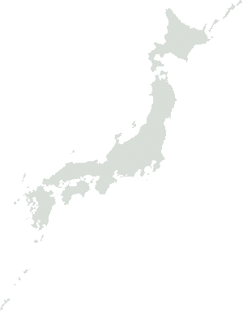

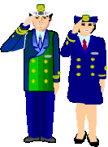
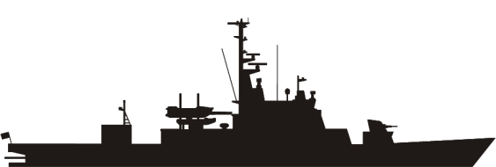
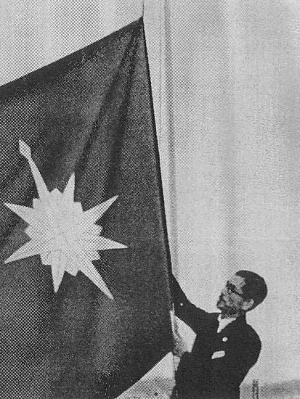


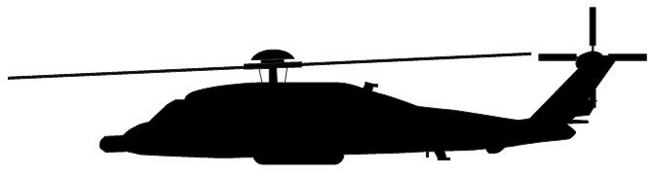


What’s JCG?
Established: 1948
Personnel: 13,744(As of March 31, 2018)
Patrol vessels: 131
Patrol craft: 238
Airplanes: 26
Helicopters: 48
Aids to Navigations: 5,299
The First Commandant, JCG
Admiral OKUBO hoisting JCG Flag
on the JCG HQs Building
JCG Flag
Notes:
【日本語】
ここで、我々海上保安庁について紹介しましょう。
海上保安庁は第二次世界大戦終了後、1948年にUSCGをモデルとした、国内における海上治安の一元的な管理機関として設立されました。
右の写真は、海上保安庁初代長官である大久保武雄が、初めて庁旗を掲げた場面です。
今年は日本における海上保安制度創立７０周年となる記念すべき年で、国内において各種セレモニーが予定されています。
【英語】
Here, let's introduce us Japan Coast Guard.
Japan Coast Guard was founded as a unitary management organization of the domestic marine peace which made USCG the model after the end of World War II in 1948.
A right photograph is a scene where Takeo Okubo who is the Japan Coast Guard founder commandant flew JCG flag for the first time.
It is a memorable year used as the 70th anniversary of marine security system foundation in Japan, and, at home, various ceremonies are planned this year.

Slide 8
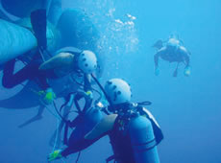
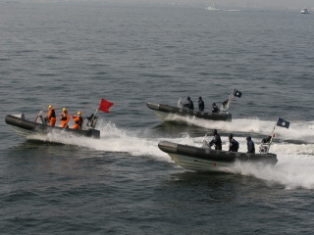
What’s JCG?
Established: 1948
Personnel: 13,744(As of March 31, 2018)
Patrol vessels: 131
Patrol craft: 238
Airplanes: 26
Helicopters: 48
Aids to Navigations: 5,299
Rescue operation in water
Security means at sea
Notes:
【日本語】
海上保安庁の職員数は、２０１８年３月現在13,744名です。
近年、尖閣諸島周辺海域における中国公船や外国漁船の領海侵入や、外国海洋調査船による調査活動等が活発化していることなど、我が国周辺海域をめぐる状況がいっそう厳しさを増していることを踏まえ、海上保安庁の人員は増加傾向です。
【英語】
The number of the personnel of Japan Coast Guard will be 13,744 persons as of March, 2018.
Based on the situation of traveling the surrounding ocean area of our country increasing severity further -- the territorial-waters invasion of the China state-operated ship or a foreign fishing boat in the Senkaku Islands surrounding ocean area, the investigation activities by a foreign oceanographic ship, etc. are activating in recent years -- the staff of Japan Coast Guard is an upward tendency.

Slide 9
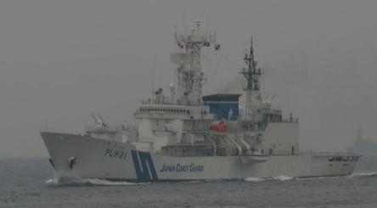
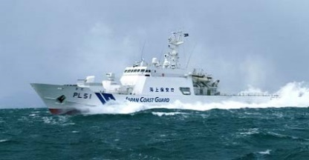
What’s JCG?
Established: 1948
Personnel: 13,744(As of March 31, 2018)
Patrol vessels: 131
Patrol craft: 238
Airplanes: 26
Helicopters: 48
Aids to Navigations: 5,299
Notes:
【日本語】
海上保安庁は１３１隻の巡視船を保有しています。主に1,000トンクラスの船が多いですが、最も大きいタイプとして、7,000トンクラスの巡視船を２隻保有しています。
【英語】
Japan Coast Guard holds 131 patrol vessels.
Although there are mainly many ships of a 1,000-ton class, two patrol vessels of a 7,000-ton class are held as largest type.

Slide 10
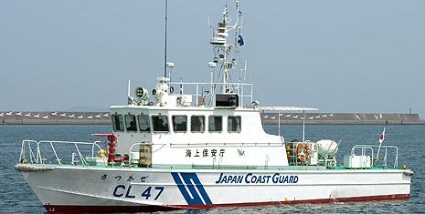
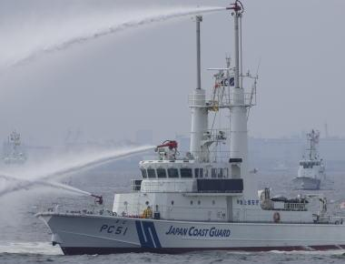
What’s JCG?
Established: 1948
Personnel: 13,744(As of March 31, 2018)
Patrol vessels: 131
Patrol craft: 238
Airplanes: 26
Helicopters: 48
Aids to Navigations: 5,299
Notes:
【日本語】
小型の巡視艇は２３８隻保有しています。３０メートルクラスが主流で、警備救難及び航路哨戒など、さまざまな業務に対応しています。私も船長の経験があります。
【英語】
238 small patrol vessels are held.
A 30-meter class is in use and corresponds to various business, such as defense rescue and a route patrol.
I also have an experience of a captain.

Slide 11
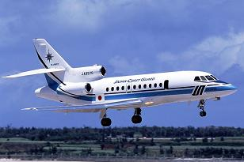
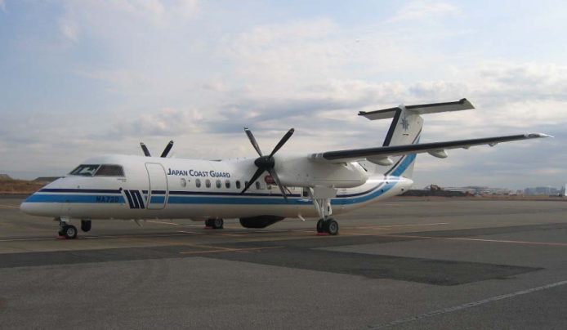
What’s JCG?
Established: 1948
Personnel: 13,744(As of March 31, 2018)
Patrol vessels: 131
Patrol craft: 238
Airplanes: 26
Helicopters: 48
Aids to Navigations: 5,299
Notes:
（11ページ）
【日本語】
固定翼は現在２６機保有しています。
ガルフストリーム社製などのジェット機が４機で、その他はプロペラ機です。
【英語】
26 fixed wings are held now.
There are four jet aircrafts, such as Gulf Stream system company make, and others are propeller planes.

Slide 12
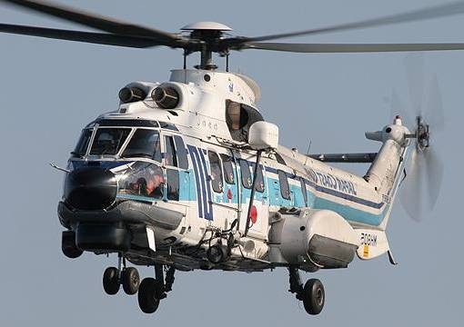
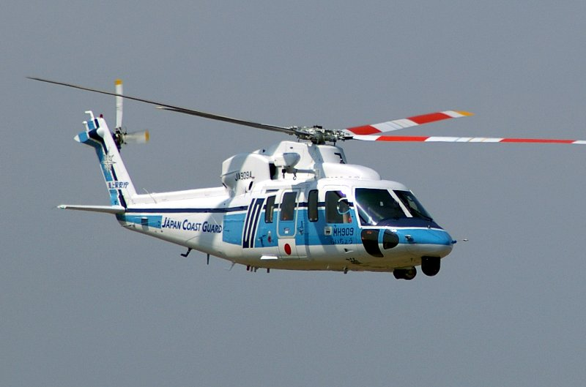
What’s JCG?
Established: 1948
Personnel: 13,744(As of March 31, 2018)
Patrol vessels: 131
Patrol craft: 238
Airplanes: 26
Helicopters: 48
Aids to Navigations: 5,299
Notes:
【日本語】
回転翼機は４８機で、全国に１２ある航空基地のほか、ヘリコプター格納型の巡視船にも配備されています。
【英語】
The rotor machine is arranged by the patrol vessel of the helicopter storing type besides the air base which the number of is 48 and is all over the country 12.

Slide 13
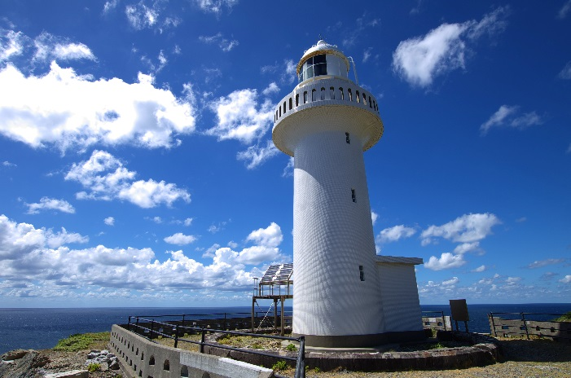
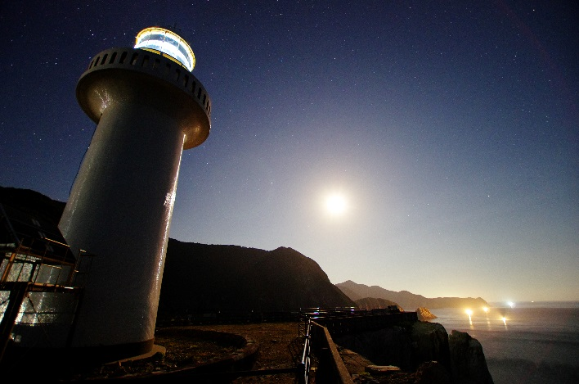
What’s JCG?
Established: 1948
Personnel: 13,744(As of March 31, 2018)
Patrol vessels: 131
Patrol craft: 238
Airplanes: 26
Helicopters: 48
Aids to Navigations: 5,299
Notes:
【日本語】
灯台をはじめとする航路標識は、国内に5,299基設置されています。
日本における航路標識の歴史は海上保安庁の歴史より古く、初めて洋式灯台が設置されたのは、今から１５０年も前のことです。今年はちょうど１５０週年を迎えたことから、国内において様々なＰＲ活動を展開する予定です。
【英語】
5,299 beacons including a lighthouse are installed in Japan.
The history of the beacon in Japan is older than the history of Japan Coast Guard, and, from now on, it will be a front that the foreign style lighthouse was installed for the first time no less than 150 years.
Since a 150-week year was greeted exactly this year, various PR activities are due to be developed at home.

Slide 14
Organization
Commandant Regional Coast Guard HQs(1st-11th)
Administration Department
Equipment and Technology Department
Guard and Rescue Department
Hydrographic and Oceanographic Department
Maritime Traffic Department
Administration and Planning Division
Navigation Safety Division
Aids to Navigation Engineering Division
Safety Measures Division
Established: 2016
Duty：1.Investigating marine accidents.
2.Providing safety information.
3.Planning safety measures against small vessels.
Notes:
【日本語】
私の所属する安全対策課について説明しましょう。
安全対策課は、小型船舶の海難を減少するために２０１６年に設置された、海上保安庁で一番新しい課で、海難の調査、安全情報の提供及び安全対策の企画立案の３つの任務を担っています。
【英語】
Let's explain Safety Measures Division to which I belong.
Safety Measures Division is bearing three duties, investigation of a marine accident, offer of safety information, and the draft plan of safety measures, in the newest section at Japan Coast Guard installed in 2016, in order to decrease the marine accident of a small vessel.

Slide 15
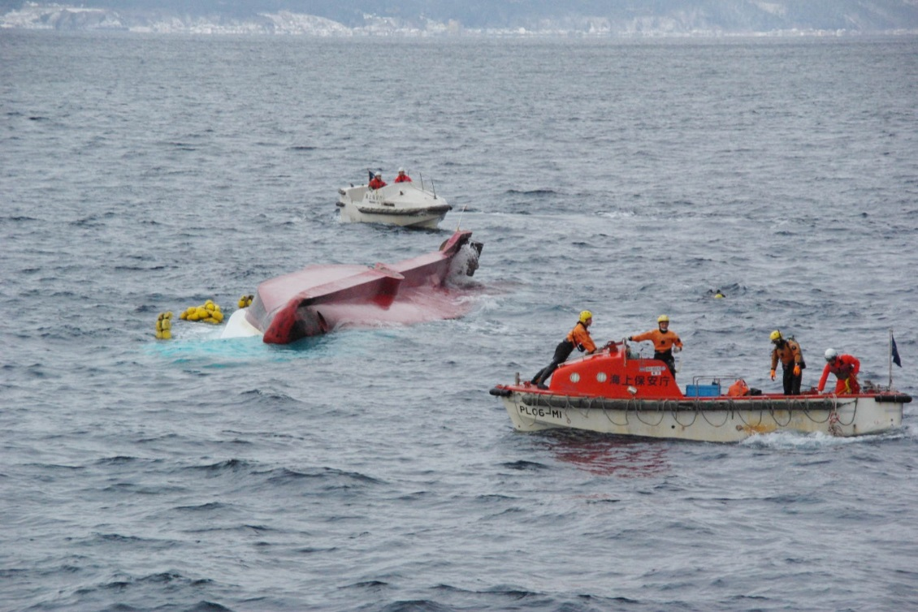
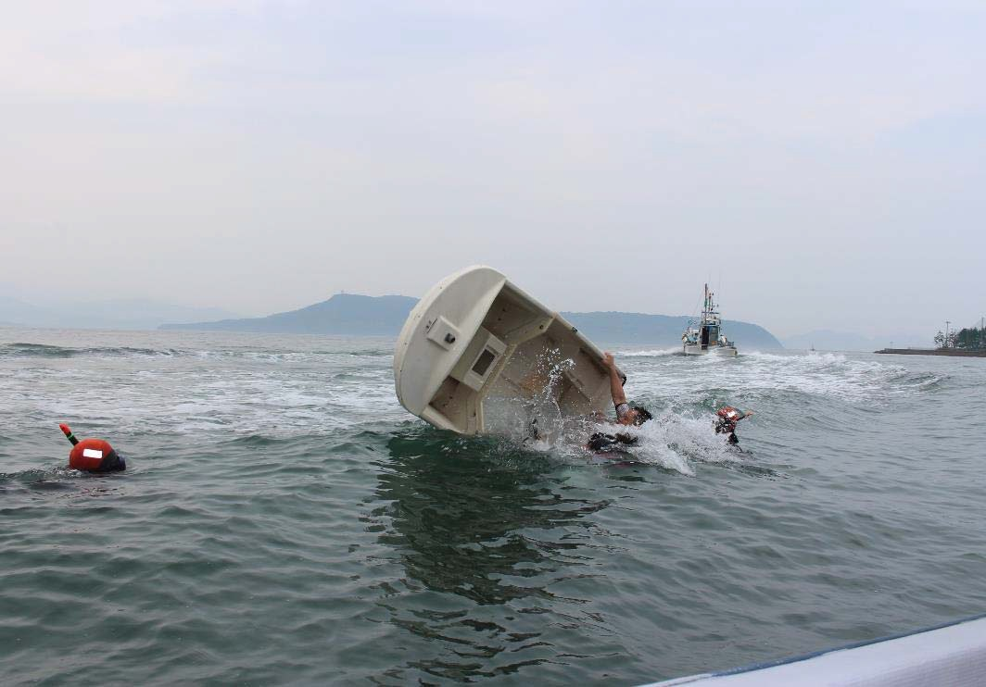
Organization
Safety Measures Division
Established: 2016
Duty：1.Investigating marine accidents.
2.Providing safety information.
3.Planning safety measures against small vessels.
Notes:
【日本語】
１つ目の任務は、海難の調査です。
海難が発生した場合にその実態・原因等について詳細な調査を実施しているともに、本庁に配置された専門のスタッフにより、多角的な分析を行っています。
【英語】
The 1st duty is investigation of a marine accident.
When a marine accident occurs, many-sided analysis is conducted by the special staff who is conducting investigation detailed about its actual condition, cause, etc. and who is both stationed at central government office.

Slide 16

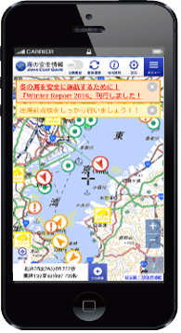
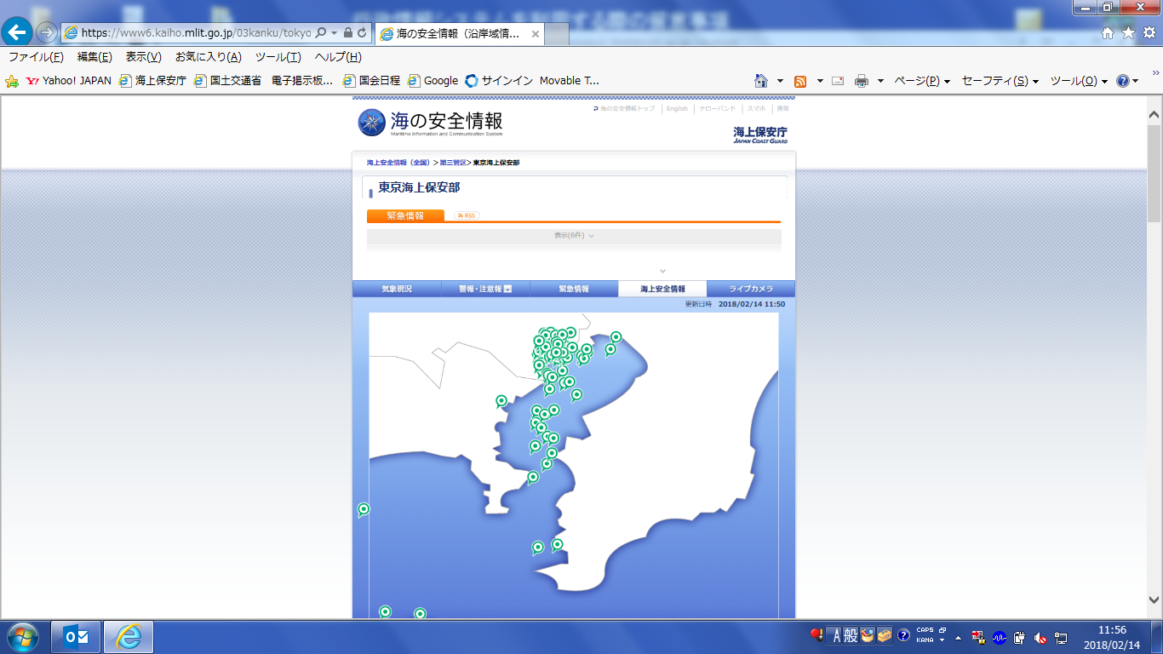
Organization
Safety Measures Division
Established: 2016
Duty：1.Investigating marine accidents.
2.Providing safety information.
3.Planning safety measures against small vessels.
Notes:
【日本語】
２つ目は安全情報の提供です。
船舶事故の防止のため、全国各地の灯台などで観測した気象・海象の現況、海上工事の状況などの「海の安全情報」をインターネットで提供しており、パソコンやスマートフォンなどで誰でも簡単に利用することができます。
【英語】
The 2nd is offer of safety information.
For prevention of a vessel accident, "marine safety information", such as the present condition of the weather and oceanographic phenomena observed in the lighthouse of national every place, etc. and a situation of marine construction, is offered on the Internet, and anyone can use easily with a personal computer, a smart phone, etc.

Slide 17
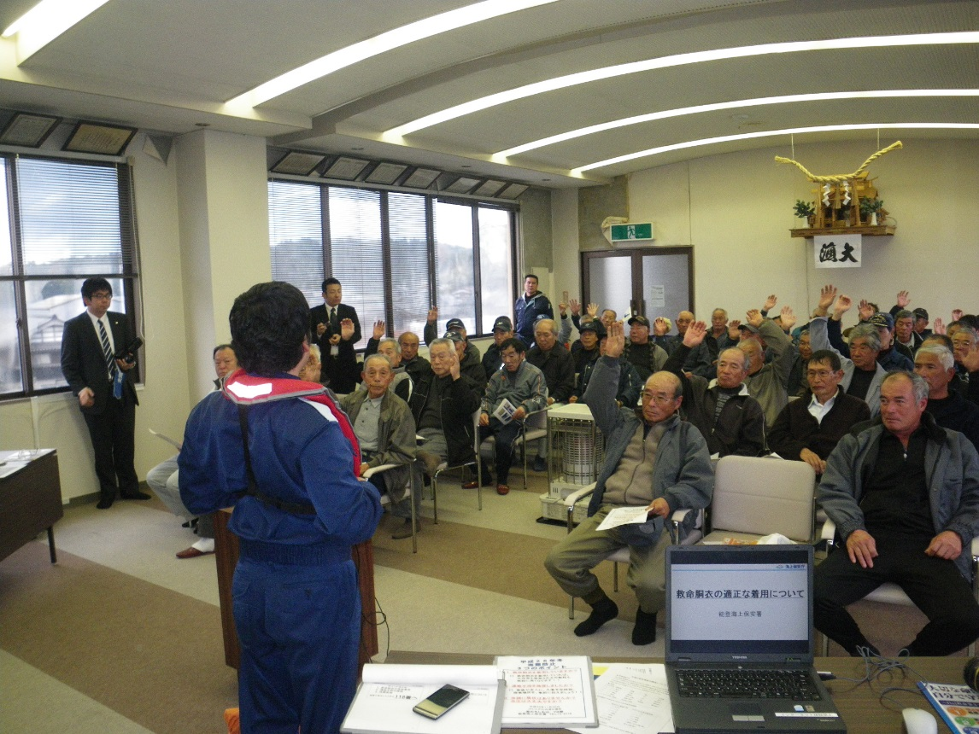
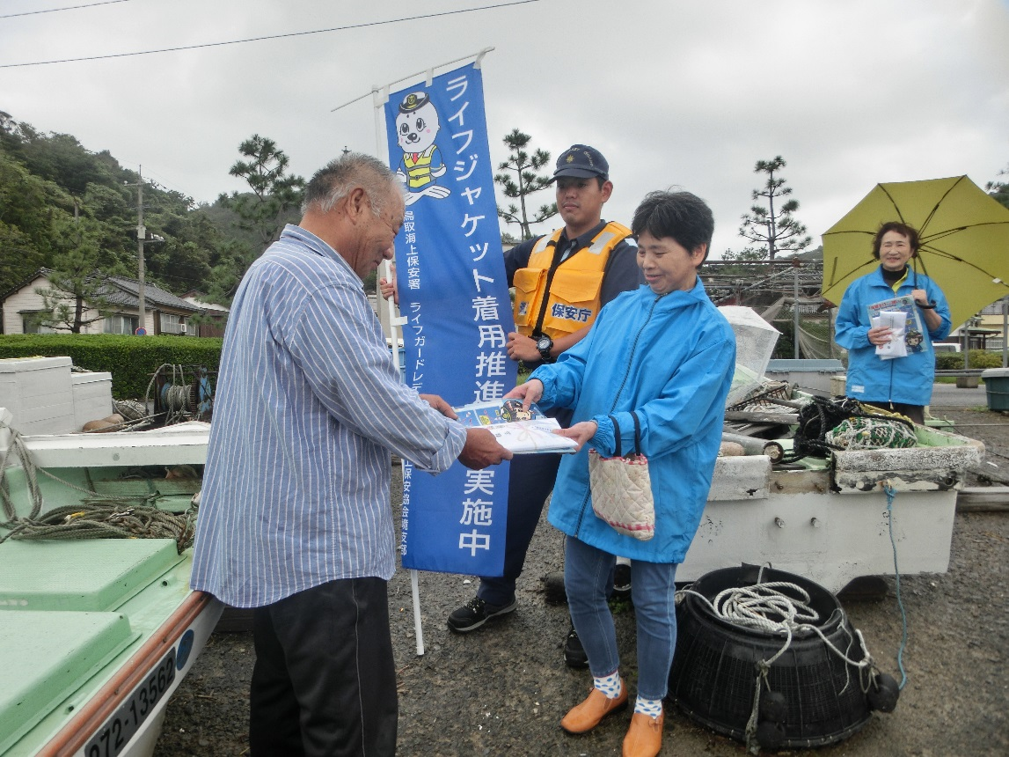
Organization
Safety Measures Division
Established: 2016
Duty：1.Investigating marine accidents.
2.Providing safety information.
3.Planning safety measures against small vessels.
Notes:
【日本語】
最後の任務は安全対策の企画立案です。
事故データの分析により得られた傾向を踏まえ、効果的な安全対策を企画立案するほか、必要に応じて政府内あるいは関係機関等との調整などを実施しています。
【英語】
The last duty is the draft plan of safety measures.
The plan for effective safety measures is drafted based on the tendency acquired by analysis of accident data, and also adjustment with the inside of the government, the organs concerned, etc., etc. are carried out if needed.

Slide 18
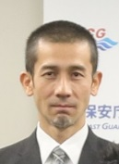
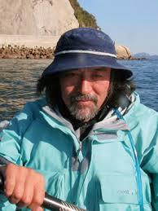
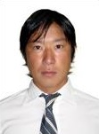
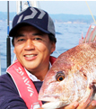
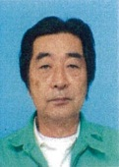
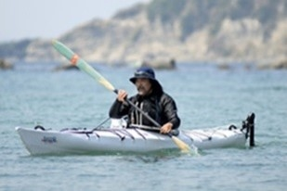
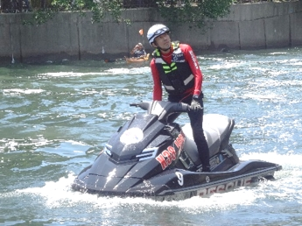
Safety Measures
Safety promotion advisor
Members
Mr. Takahiro Yoshimura
Mr. Masahiro Uchida
PWC specialist
K38 Japan instructor
General Manager Operations of Marine Sports Foundation
Sea Kayak specialist
Director of Japan Recreational Canoe Association
Mr. Toshinori Ishikawa Ph.D.
Mr. Nobuaki Ono
Drowning Prevention specialist
Director of Japan Lifesaving Association
Associate Professor of CHUO University
Boat Fishing specialist
DAIWA field tester
FURUNO field tester
Mr. Yoshio Shoichi
Vessel Engine specialist
General Manager Operations of Marine Engine Service Association of Japan
Notes:
【日本語】
ここで、我々が実施している施策のうち、主なものをピックアップして説明したいと思います。
まずは、海の安全推進アドバイザー制度です。
海の安全推進アドバイザーは、それぞれの分野のスペシャリストから海上保安庁に対する助言や指導をいただく制度です。
現在（そちらにいる）K38 JAPANの吉村氏を含め、５名のアドバイザーを指名しています。
残念ながら、海上保安官でも専門的な知識や技術が不足している場合もありますので、アドバイザーから知見や経験をいただけることは、我々の業務遂行上極めて有効です。
【英語】
I would like to take up and explain the main things here among the measures which we are implementing.
First of all, it is a marine safe promotion adviser system.
A marine safe promotion adviser is a system which obtains advice to Japan Coast Guard, and instruction from the specialist of each field.
Five persons' advisers including Mr. Yoshimura of K38 JAPAN are nominated now (it is there).
Though it is regrettable, since special knowledge and technology may be insufficient also for a maritime safety official, it is very effective on our performing a task to get knowledge and experience from an adviser.

Slide 19
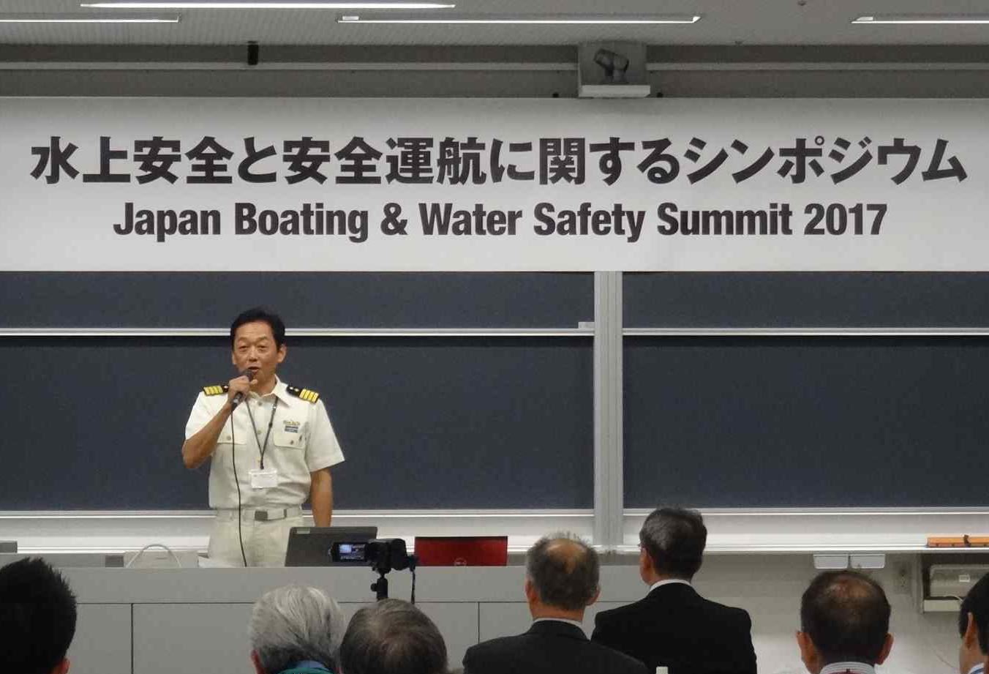
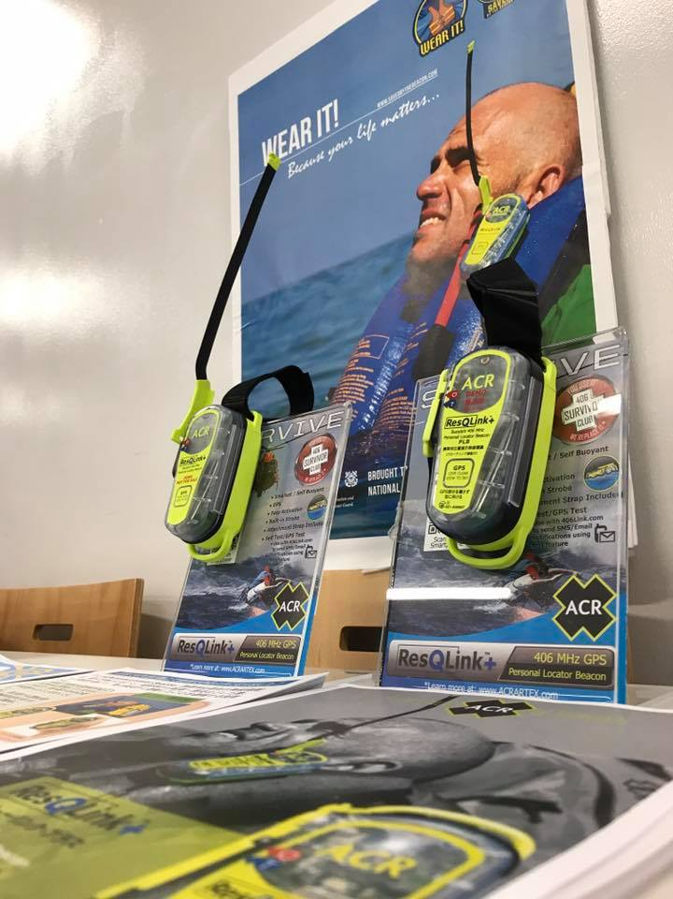
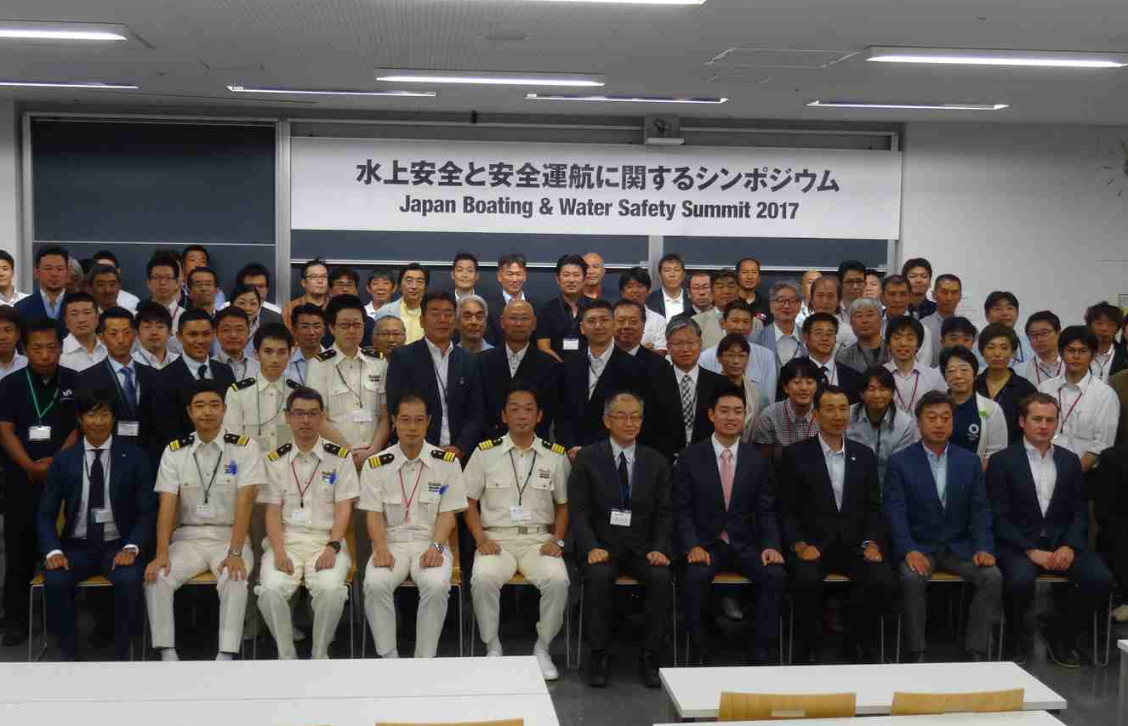
Safety Measures
JBWSS (Japan Boating and Water Safety Summit)
in 11th June 2017 at Tokyo Japan
About 40 organizations including several governmental organizations
Exhibits by companies
Notes:
【日本語】
我々はIBWSSの存在を知ったとき、大変驚きました。
日本国内にも水上安全を目的とした団体は数多く存在しますが、各団体がネットワークを構築したり、ましてや国の機関と連携した活動を行うことは、とても珍しいことだからです。
そこで、日本国内においてもIBWSSと同様な枠組みを構築しようと、以前からIBWSSに参加しているマリンスポーツ財団と海洋レジャー安全・振興協会が中心となり、日本版のIBWSSであるJBWSSが２年前に開催され、団体間の情報共有が進められてきたところです。
昨年からは国の機関である海上保安庁及び国土交通省もJBWSSに参画し、国の機関と民間団体の連携も進めているところ、今年のJBWSSは６月に東京で行われる事が決定しておりますので、ぜひ機会があれば皆様にも参加いただきたいと思います。
【英語】
We were very much surprised, when existence of IBWSS was got to know.
It is because it is very new for each organization to build a network, furthermore to perform activity which cooperated with the organization of the country, although many organizations aiming at aquatic safety exist also in Japan.
Then, it is to build the same framework as IBWSS in Japan, Marine Sports Foundation, and the ocean leisure safety and the promotion association which have participated in IBWSS take the lead from before, JBWSS which is IBWSS of a Japanese version is held two years ago, and information sharing between organizations has just been going to be advanced.
From last year, Japan Coast Guard and the Ministry of Land, Infrastructure and Transport which are the organizations of a country also take part in the planning of JBWSS, and if there is an opportunity by all means, I also wish you to participate, since being carried out in Tokyo in June has determined JBWSS this year the place which is also advancing cooperation of the organization of a country and a private enterprise.

Slide 20






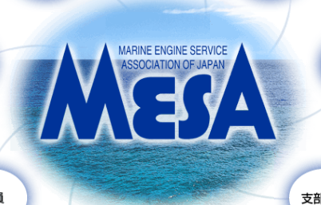

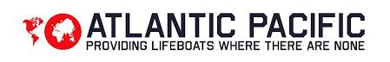
Safety Measures
Safety Measures
Members
Members
Ministry of Land, Infrastructure, Transport and Tourism
水難学会
The Society of Water Rescue and Survival Research
Japan Marine Recreation Association
K38 JAPAN
Japan Lifesaving Association
Marine Engine Service Association of Japan
Blue Sea and Green Land Foundation
Notes:
【日本語】
JBWSSの主な参加団体です。実際には４０近い団体が参加し、それぞれの活動についての発表、メーカーによる展示が行われています。
規模はIBWSSに遠く及びませんが、近い将来にはIBWSSに肩を並べる規模の会議に成長させる事が私の目標です。
【英語】
They are the main participating parties of JBWSS. The organization close to 40 participates in fact, and announcement about each activity and exhibition by a maker are performed.
It is my target to grow up a scale into IBWSS in a long distance and the meeting of a scale which arranges the shoulder in IBWSS in the near future although it does not become precocious.

Slide 21
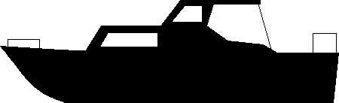
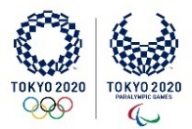
Traffic safety basic plan
Number of ship accidents
2,400
Achieved!
in2017
2,000
1,600
1,200
2010
2020
2025
2030
Notes:
【日本語】
我々海上保安庁は、海難減少のために様々な対策を講じているところですが、政府としては具体的な目標を掲げ、将来的に一層海難を減少させる事が求められています。
この目標は政府が制定した「交通安全基本計画」に掲げられていますが、2010年に約2,400隻発生していた船舶事故を、2020年には2,000隻、2030年までには1,200隻にするという極めて意欲的なものです。
この目標達成を目指し、海上保安庁をはじめとする政府が一丸となって取り組んでいるところ、近々の目標である2,000隻については、一足はやく2017年にクリアする事ができました。
ただし、最終的な目標達成のためには、今後も継続した努力が必要だと考えています。
【英語】
It is called for that we Japan Coast Guard holds up a concrete target as the government, and will decrease a marine accident further in the future although it has just been going to take various measures for marine accident reduction.
Although this target is hung up over the "traffic safety master plan" which the government enacted, the vessel accident which had occurred about 2,400 boats in 2010 will be made [ very highly motivated ] into 1,200 boats by 2,000 boats and 2030 in 2020.
Aiming at this goal achievement, it was able to clear a little earlier in 2017 about 2,000 boats which is a target before long the place where the governments including Japan Coast Guard are tackling together.
However, for final goal achievement, I think that the continued efforts are required.

Slide 22
Number of Marine accidents
Number of ship accidents in Japan
2017
2015
2016
1,979
2,137
2,014
Safety Measures Division Established
Safety promotion advisor
IBWSS2017&JBWSS2017
Notes:
【日本語】
ここ数年の船舶事故隻数の推移です。
2015年には約2,100隻の事故が発生していましたが、安全対策課が設置された2016年以降は、確実に船舶事故が減少している事がお分かりいただけると思います。特に2,000隻を下回った2017年の事故隻数は、海上保安庁の歴史上においてもベストの数値でした。
当然、我々スタッフの努力が実を結んだものと考えていますが・・・
【英語】
It is transition of the number of vessel accident boats for the past several years.
Although the accident of about 2,100 boats had occurred in 2015, it is thought that it can turn out that the vessel accident is decreasing certainly in and after 2016 when Safety Measures Division was established.
In the history of Japan Coast Guard, the number of accident boats in 2017 which was less than especially 2,000 boats was the best numerical value.
Although I naturally think that efforts of us the staff bore the fruit ...

Slide 23

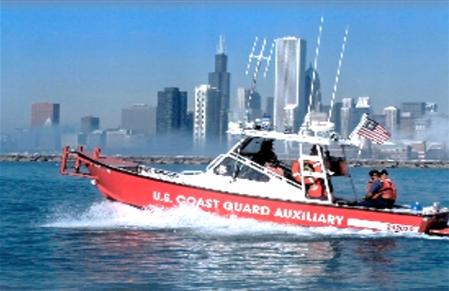
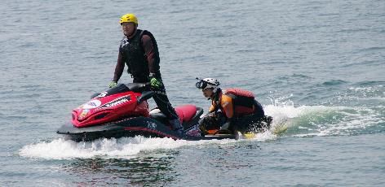
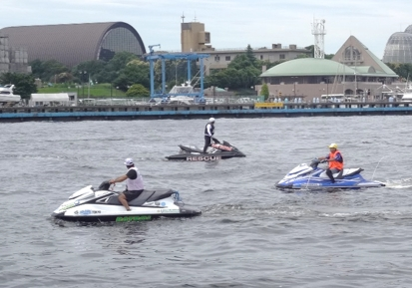
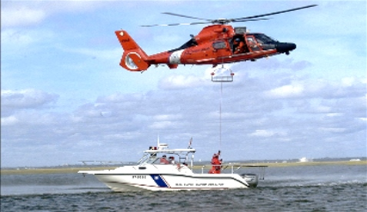
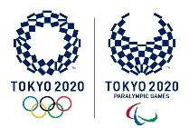
Safety Measures
U.S. Coast Guard Auxiliary
Japan Coast Guard Auxiliary by PWC
Requirement
Morals
Techniques
Knowledge
In Tokyo bay
For TOKYO2020
Mission
Safety guidance
Event security
Notes:
【日本語】
もうひとつ、昨年のIBWSSで私が学んだことがあります。それはUSCG Auxiliaryです。
日本国内とは違い、ボランティアが多くの勢力を持ち、安全指導や救助業務を実施していることに少なからず驚きを覚えました。
海上保安庁も限られたアセットにより様々な業務を遂行しているなか、民間勢力を活用した安全対策は極めて有効と考えられます。
日本と米国では文化事情が大きく異なるため、国内導入は困難でしたが、まずは喫緊の課題となっている水上オートバイ安全対策を中心に、２０２０年に行われる東京オリンピック・パラリンピックに向けた東京湾周辺における海上保安業務補助員として、民間の水上オートバイ運航体制の確保に向け、政府として推進していくこととなりました。
２０２０年には、K38 JAPANなどの団体が海上保安庁の協力者として活躍する姿が想像できます。
【英語】
I have learned by the IBWSS of one more and last year. It is USCG Auxiliary.
Unlike the inside of Japan, the volunteer had much influence and memorized surprise not a little to carry out safe instruction and rescue business.
While carrying out various business by the asset to which Japan Coast Guard was also restricted, it is thought that the safety measures which utilized private sector influence are very effective.
Although domestic introduction was difficult in Japan and the U.S. since cultural situations differed greatly,Focusing on the wet bike safety measures which have been important subjects first of all, it will promote as the government towards reservation of private wet bike operation organization as a marine security operating assistant in the outskirts of Tokyo Bay towards the Tokyo Olympic Games Paralympics performed in 2020.
The figure in which organizations, such as K38 JAPAN, play an active part as a cooperator of Japan Coast Guard can be imagined in 2020.

Slide 24
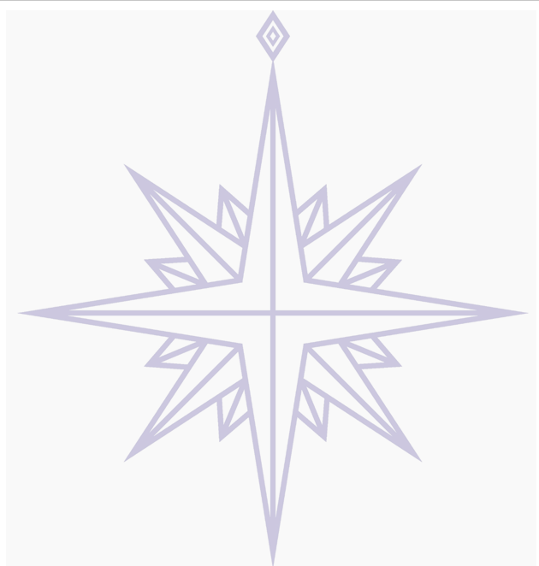
Thank you for your attention
Notes:
【日本語】
ご清聴ありがとうございました。
ご質問があれば喜んでお答えしたいと思います。
また、海上保安庁を紹介する英語版のパンフレットもいくつか用意していますので、ご希望があればオーダーしてください。
【英語】
Thank you for your attention.
I would like for it to be glad if there is a question, and to answer.
Moreover, since some pamphlets of the English-language edition which introduces Japan Coast Guard are also prepared, if hopeful, please order.

