Slide 1
Verified Course Process Overview March 5, 2018 IBWSS – Deep Dive Pamela Dillon, NASBLA Education and Standards Director USCG Grant Project Director Mark Chanski, Verified Course Program Manager
Notes:
Welcome

Slide 2
Goals and Overview of the Verified Course Program

Slide 3
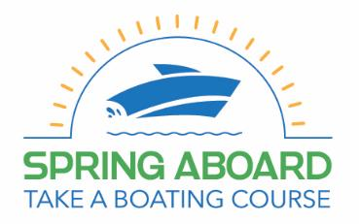
USCG Grant Funding (1502.12, 1602.09, 1702.14)
Spring Aboard – Take a Boating Education Course Campaign Grant
Notes:
The project is produced under a grant from the Sport Fish Restoration and Boating Trust Fund, administered by the US Coast Guard. We thank them for this support.

Slide 4
Goal: Educate/Train boating public
Sub-goal: Motivate students to take a boating course.
https://www.springaboard.org
Notes:
The project is produced under a grant from the Sport Fish Restoration and Boating Trust Fund, administered by the US Coast Guard. We thank them for this support.

Slide 5
Grant Deliverables
2016
2017
2018
Develop/implement Verified Course Mark conformity assessment process
Determine distinct measures of effectiveness including data collection from course provider.
Marketing Campaign
Determine student recognition or and influence to enroll based on Verified Course Mark
Collect Data

Slide 6
Why NASBLA?
Body authorized to establish recreational boating standards.

Slide 7
Conformity Assessment Relationship to Standards
National Boating Education Standards
National On-Water Skill Standards
Third-Party Conformity Assessment Process
Notes:
.
Most of you who have applied to be a part of this process have previously worked on the development or validation of national standards, either of the Knowledge side or skill side.
You are now about to enter a separate but equally vital component process of Third Party conformity assessment. The Conformity Assessment process is a stand-alone process separate from the standard itself, and while it will work directly with the standard and is an important step in advancing and implementing the standard, its purpose is not to change, revise, or broaden the standard. Changes to the standard fall outside of the Conformity Assessment process. the Standards are now set in stone and whether or not you agree or disagree with standard they are what they are. It is our job to make ensure the course meets the prescribed standard regardless of reviewer’s personal opinion.

Slide 8
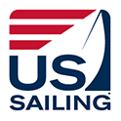
American National Standards for the Verified Course Process
EDU-1 On-Water Power Standard
(On-Water Recreational Boating Skills Standard – Power)
EDU-2 On-Water Human-Propelled Standard
(On-Water Recreational Boating Skills Standard-Human-Propelled)
EDU-3 On-Water Sail Standard
(On-Water Recreational Boating Skills Standard-Sail)
Notes:
Pam – There are three American National Standards that we will be using in this process (review list).
These are ANSI approved and were developed under a US Coast Guard grant to US Sailing. They are filed with ANSI under the American Boat and Yacht Council, an ANSI Accredited Standards Developer.
Define an American National Standard and ANSI

Slide 9
What is Conformity Assessment??
Is the graphic purple in color?
Yes
No
Not sure
Notes:
PAM
It is easiest to use an example?
Is this graphic purple in color?
Some of you may have said YES, others NO, several NOT SURE

Slide 10
What is Conformity Assessment??
THIS BOX IS PURPLE
Is the graphic purple in color?
Yes
No
Not sure
Notes:
PAM
But if we post the ‘Standard’, in this case an example of the color of purple, you can see that it is not a match to the color in the graphic. We can then all agree (or due to color-blindness or other sensitivities at least two out of three of us will agree) that the color in the graphic is NOT purple.
This is a very simplified example of the process we will complete to review on-water skill course submissions.

Slide 11
Conformity Assessment: methods of evaluating whether products, processes, systems, services and personnel comply with a standard. (per ANSI)
Third-Party Conformity Assessment: a defined process by which a neutral third party takes the necessary steps to determine that a product complies with a designated American National Standard.
Notes:
PAM
Read definition

Slide 12
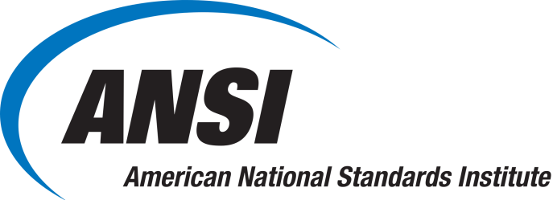
On-Water Skill Conformity Assessment
VERIFICATION ASSESSMENTS
FIRST-PARTY VERIFICATION – Preformed by the organization that provides the product
SECOND-PARTY VERIFICATION – Preformed by an organization that has a user interest in the product (customers of the product)
THIRD-PARTY VERIFICATION – Preformed by an organization that is independent of the organization that provides the product or has user interests in that product
Notes:
PAM
The highest level of Conformity Assessment is Third Party (review slide)

Slide 13
On Water Skills Course Conformity Assessment
Verified Course Process
Notes:
Pam – I will now turn this over to Mark Chanski to present an overview of the Third-Party Conformity Assessment process we will be using to review On-Water Skills courses for award of the Verified Course mark.

Slide 14
Source Documents
3 Standards
3 Technical Support Documents
Verified Course Forms/Materials
Notes:
Mark – Thanks Pam.
Pam mentioned the 3 standards and 3 TSDs. We will also use various forms and other materials in this process.

Slide 15
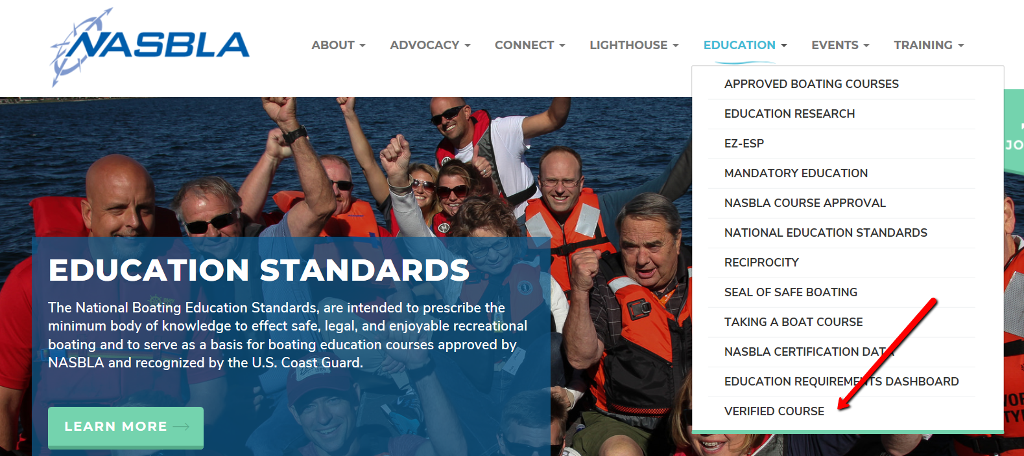
www.nasbla.org

Slide 16
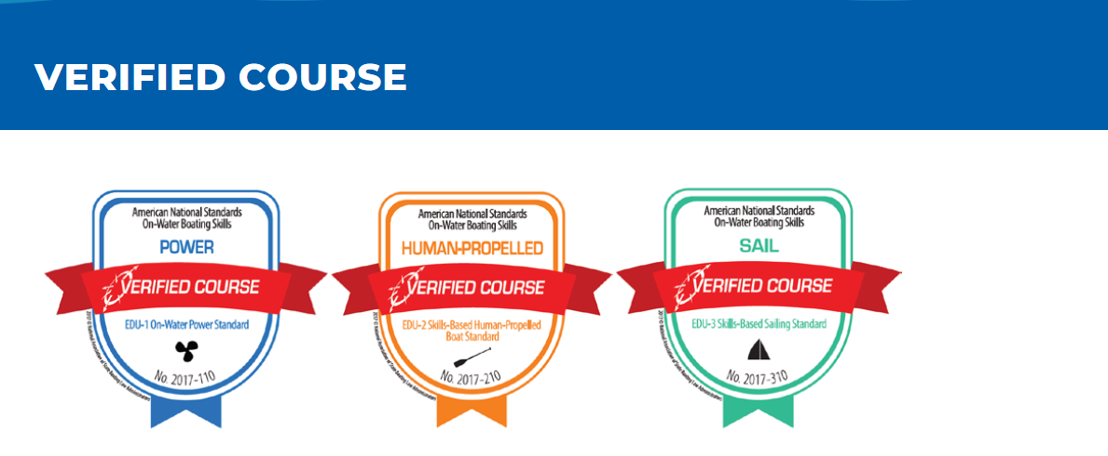
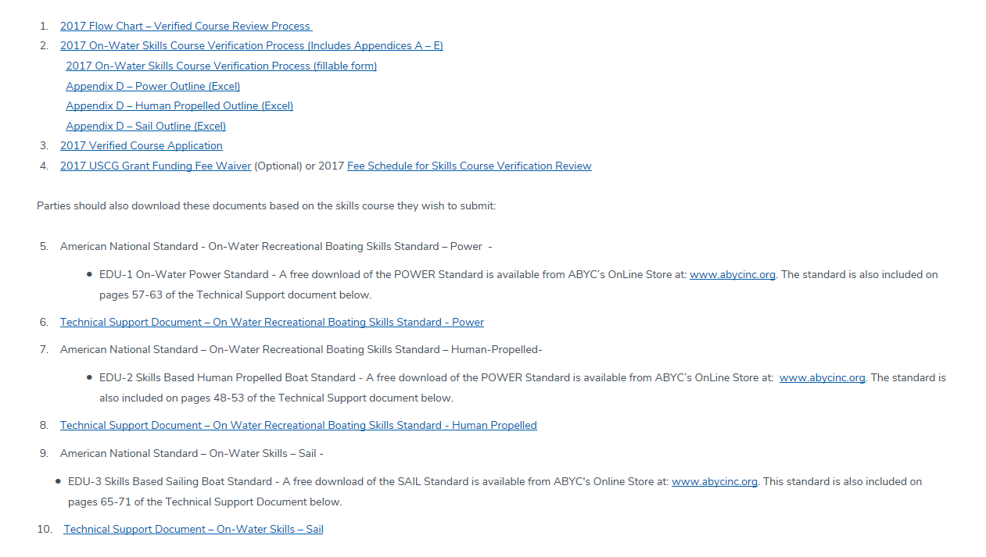
Much more!

Slide 17
On-Water Skill Conformity Assessment
On-Water Skills Course Third-Party Conformity Assessment Procedure
For Award of ‘Verified Course’ Mark
Statement of Introduction
Definitions
Verification Requirements
Use of ‘Verified Course’ mark of conformity
Verification Terms and Conditions
Additional Considerations
Changes Affecting Verification
Termination / Reduction, Suspension or Withdrawal of Verification
Materials To Be Supplied For Review
Review Process Impartially
Management of competency for personnel involved in the verification process
Confidentiality Statement
Application and Review Process
Verification Plan and Procedure
Verification Body Composition and Responsibilities
Verification Review Body, Plan and Procedure
Verification Body Procedure
Evaluation Plan
Appeals
Notes:
Mark – (Review list of items in process)

Slide 18
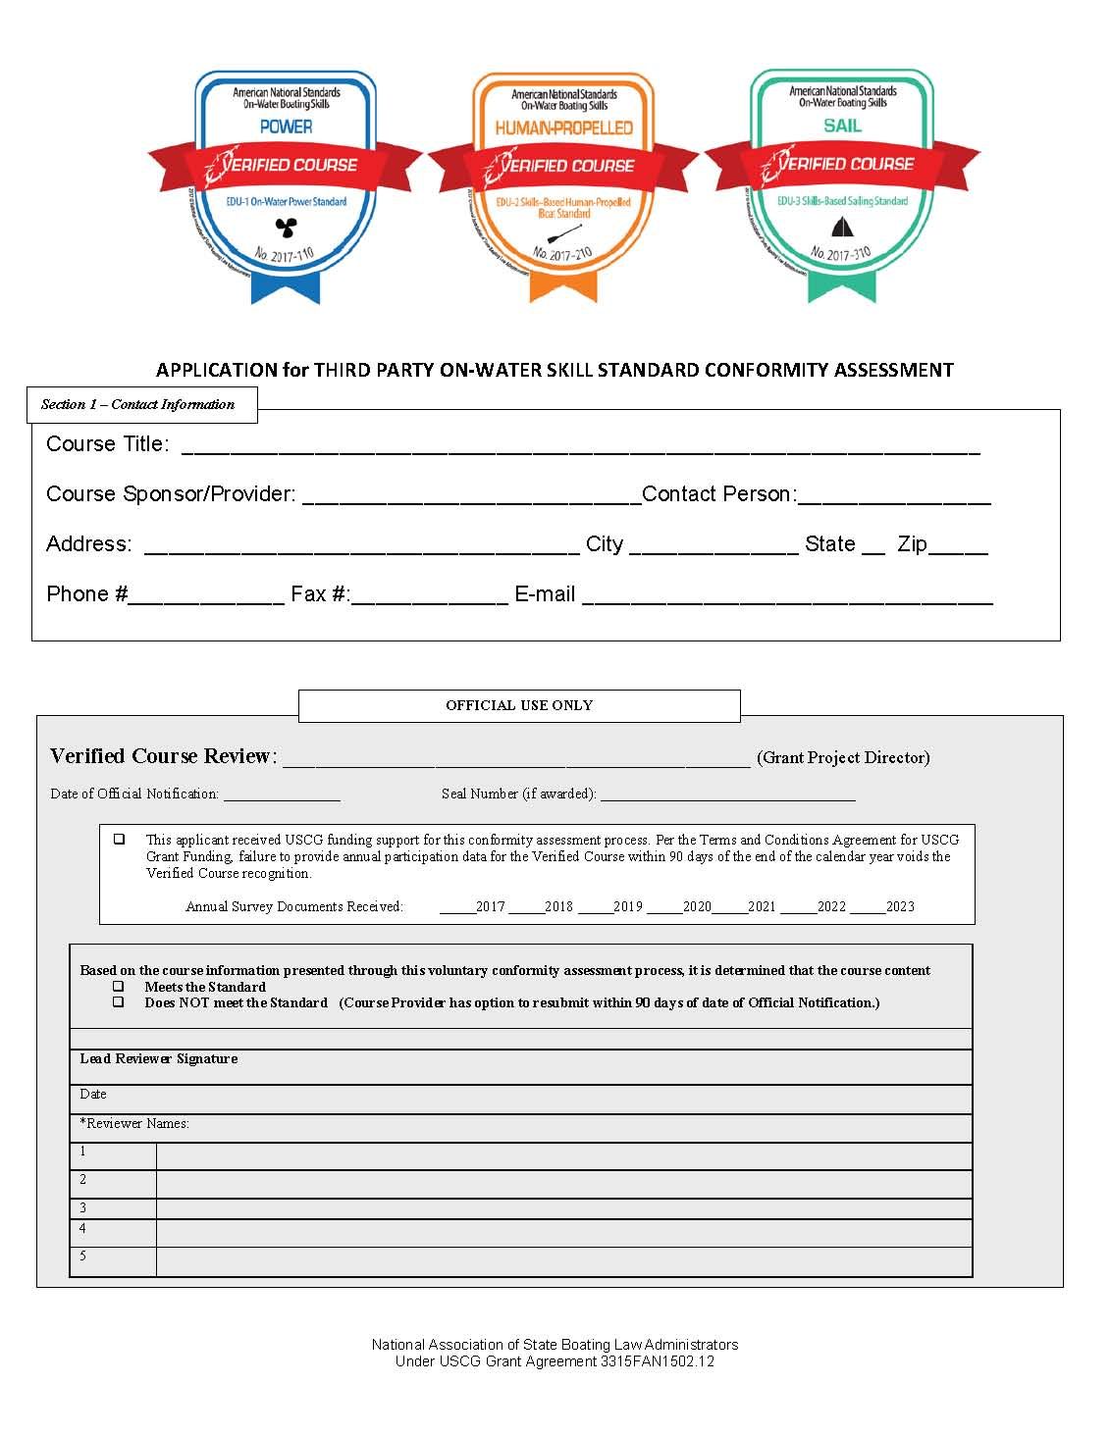
On-Water Skill Conformity Assessment
On-Water Skills Course Third-Party Conformity Assessment Procedure
For Award of ‘Verified Course’ Mark
Simple application process
Notes:
MARK
Application

Slide 19
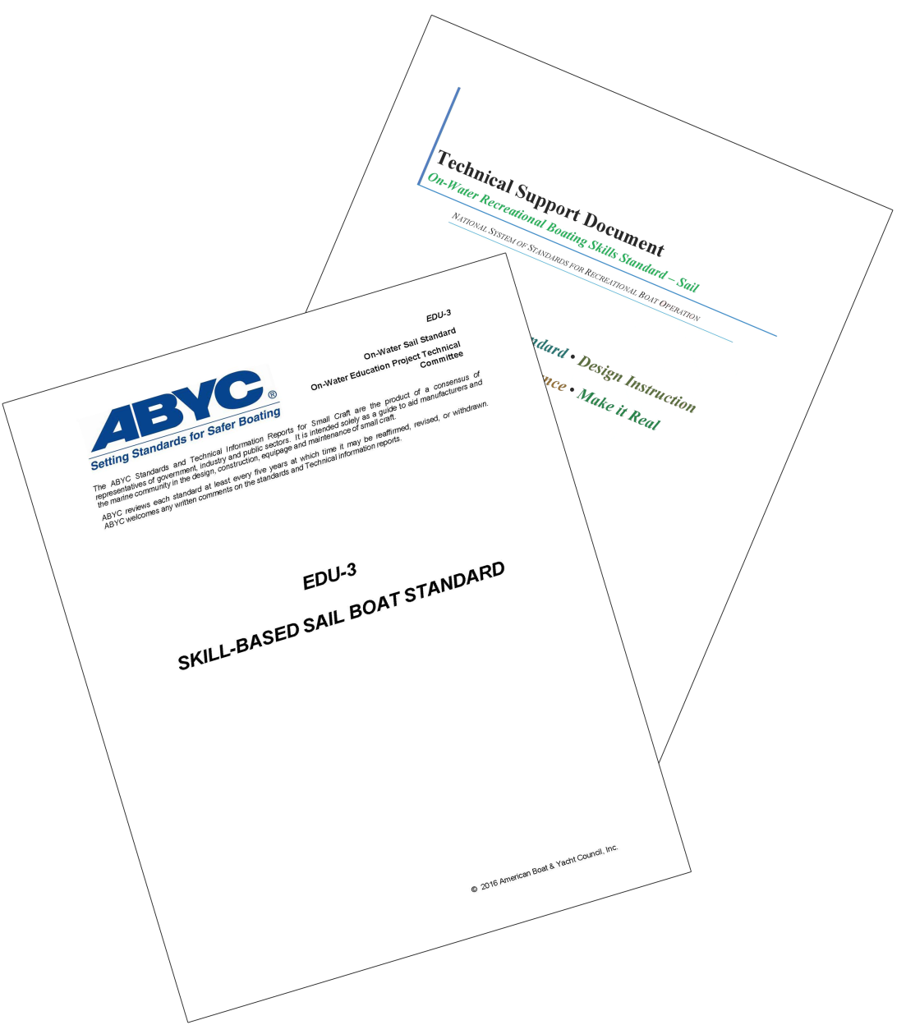
On-Water Skill Conformity Assessment
On-Water Skills Course Third-Party Conformity Assessment Procedure
For Award of ‘Verified Course’ Mark
List where the required subject material can be found in the course materials for each standard element.
Notes:
MARK
List of required subject material

Slide 20
On-Water Skill Conformity Assessment
On-Water Skills Course Third-Party Conformity Assessment Procedure
For Award of ‘Verified Course’ Mark
List where the required subject material can be found in the course materials for each standard element.
1.1
Best sailing
Page 10, par 3
observation
Notes:
MARK
Where required material is found

Slide 21
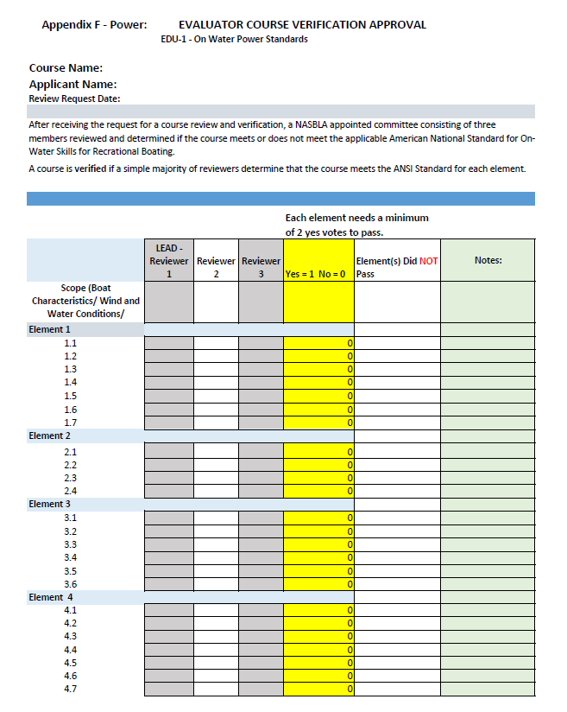
On-Water Skill Conformity Assessment
On-Water Skills Course Third-Party Conformity Assessment Procedure
For Award of ‘Verified Course’ Mark
Three subject matter experts will review the
materials provided and decide if each element meets the standard.
An element will meet the standard if the simple majority of the review panel agrees it does.
Every element of the standard must receive a passing vote in order for the course to be awarded the verification mark.
Notes:
MARK
The master review and scoring checklist

Slide 22
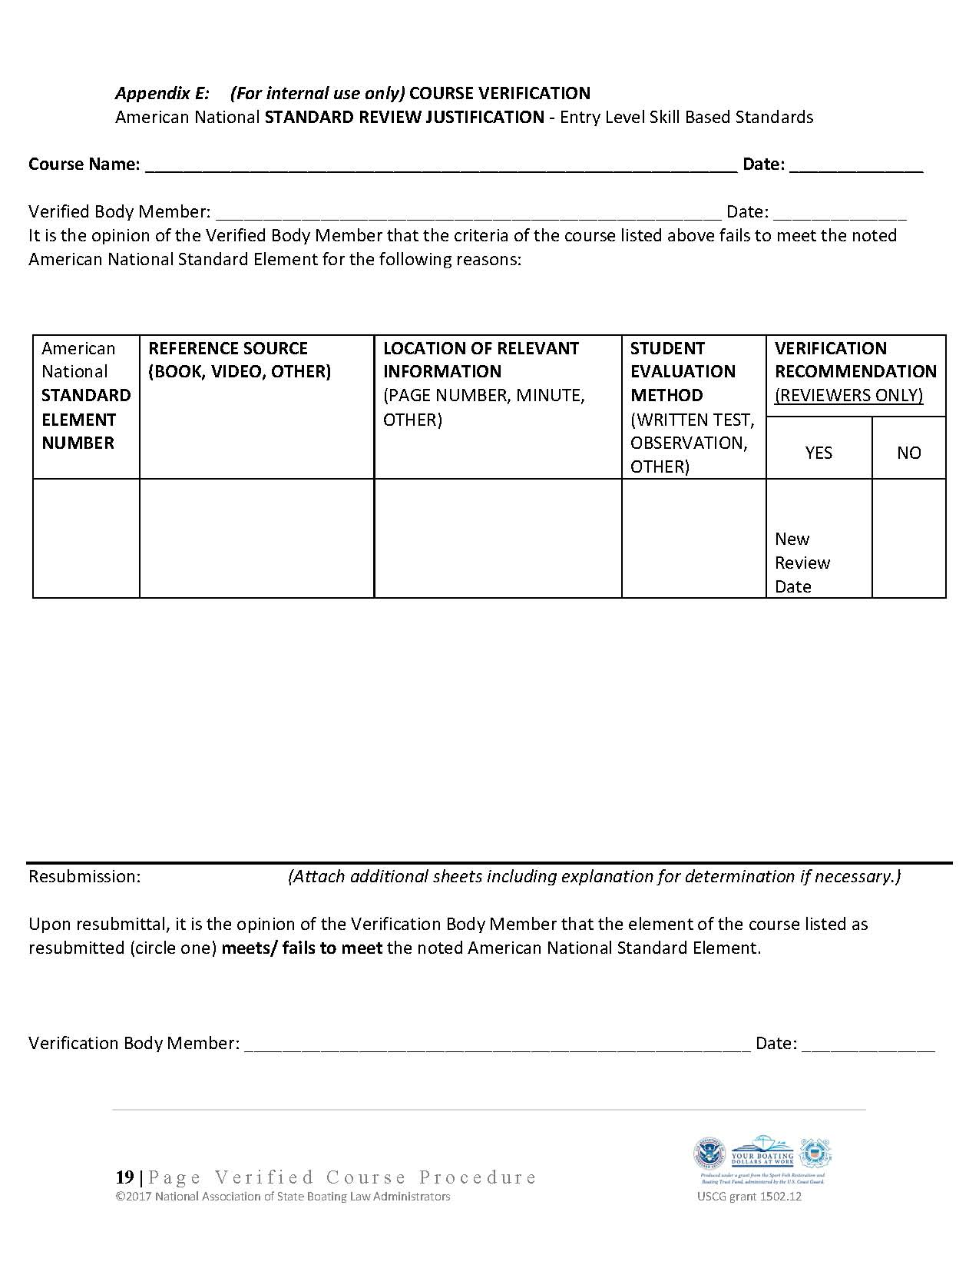
On-Water Skill Conformity Assessment
On-Water Skills Course Third-Party Conformity Assessment Procedure
For Award of ‘Verified Course’ Mark
Should the reviewers agree a course element DOES NOT MEET THE STANDARD, the course provider will receive a written explanation for each flawed element and be given the opportunity to correct the deficiencies
Notes:
MARK
The deficiency report

Slide 23
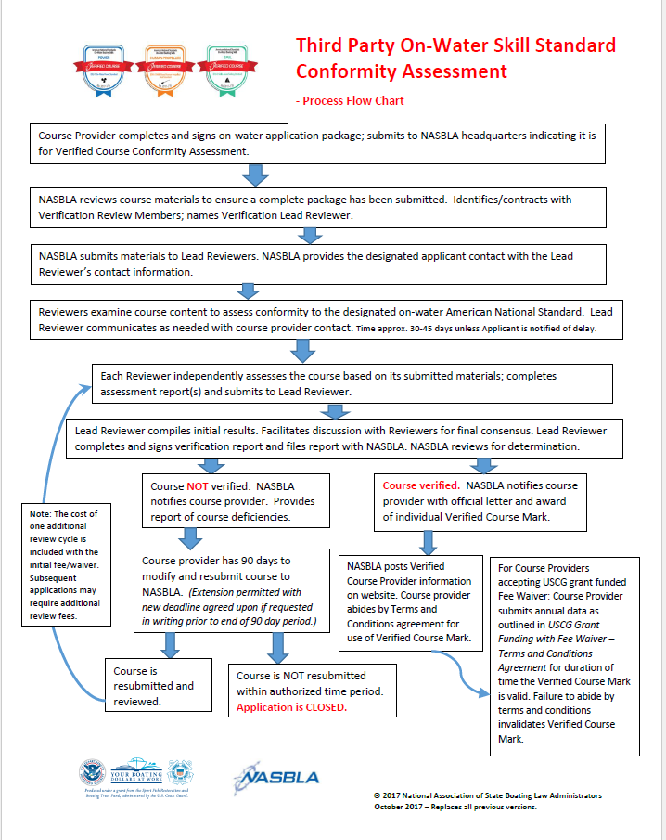
On-Water Skill Conformity Flow Chart
Notes:
MARK
Process flow chart

Slide 24
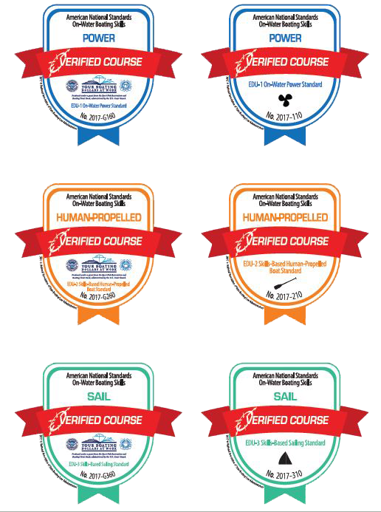
Marks Awarded for USCG-Grant Supported Review
Free Review Under USCG grant funding
Notes:
MARK Courses receiving the Marks with the USCG grant logos to indicate that the review is paid for with USCG grant support.
All courses will be entered into a web data base for public review and confirmation of award.
Let’s go back to Pam for an overview of how this process will work.

Slide 25
Questions?
Questions? Contact:
Pamela Dillon - pam@nasbla.org
Mark Chanski – mark.Chanski@nasbla.org
Notes:
PLEASE LET US KNOW IF YOU HAVE QUESTIONS.
THANKS AGAIN FOR TODAY’S PARTICIPATION.

