Slide 1
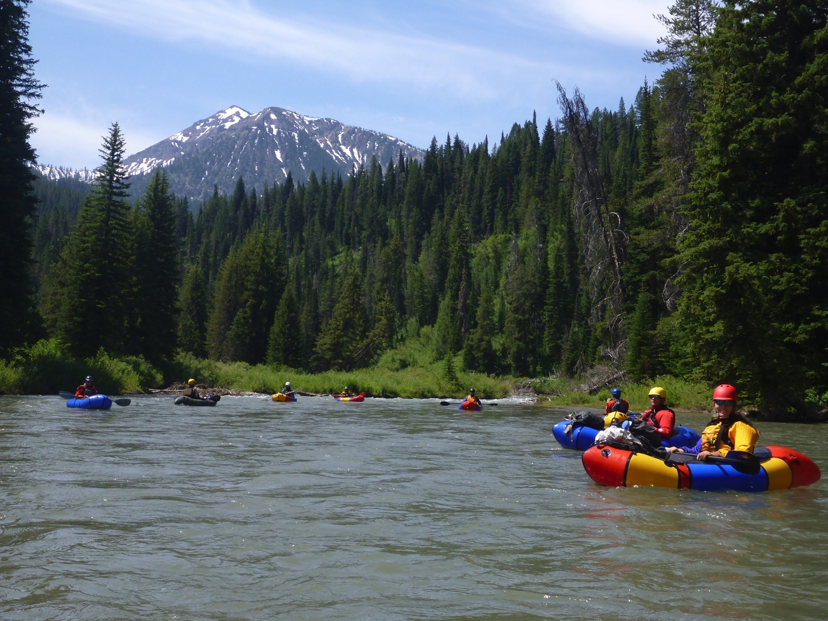
Better Information For Safer Paddling
American Whitewater’s
National Whitewater Inventory
By: Kevin Colburn

Slide 2
American Whitewater
To conserve and restore America’s whitewater resources and to enhance opportunities to enjoy them safely

Slide 3
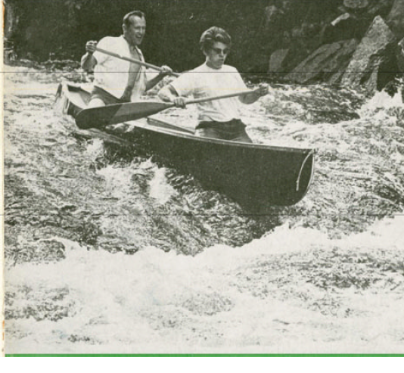
AUTUMN, 1969

Slide 4
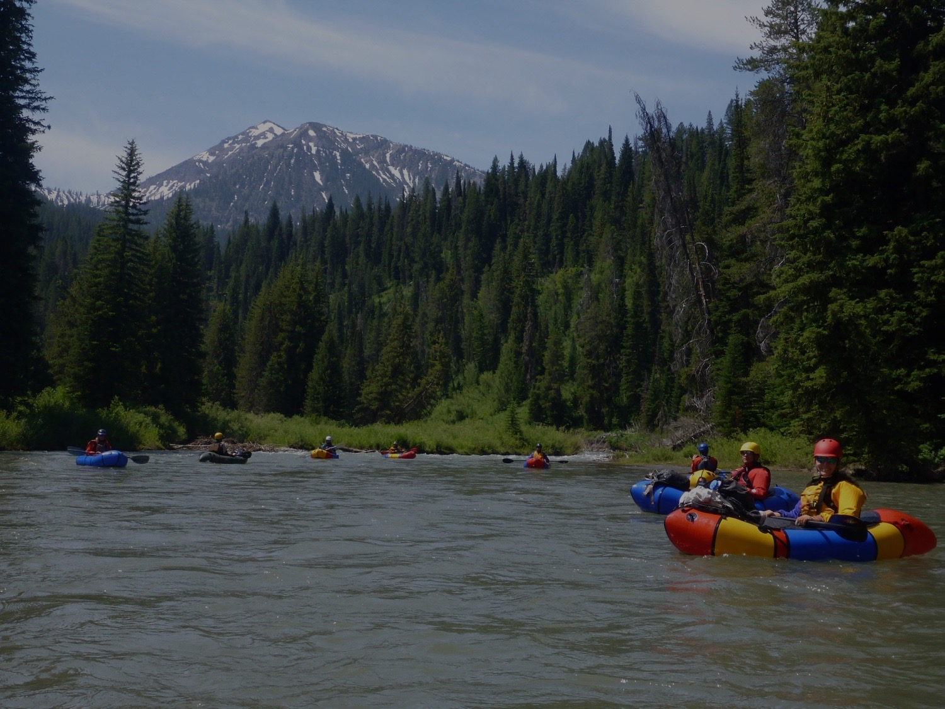
National Whitewater Inventory
Began in the 1980’s
> 5,760 river reaches in all 50 states
> 44,000 stream gages
> 33,000 photographs
> 1,600 accidents
Almost 1 million unique annual visitors

Slide 5
National Whitewater Inventory
Planning a River Trip

Slide 6
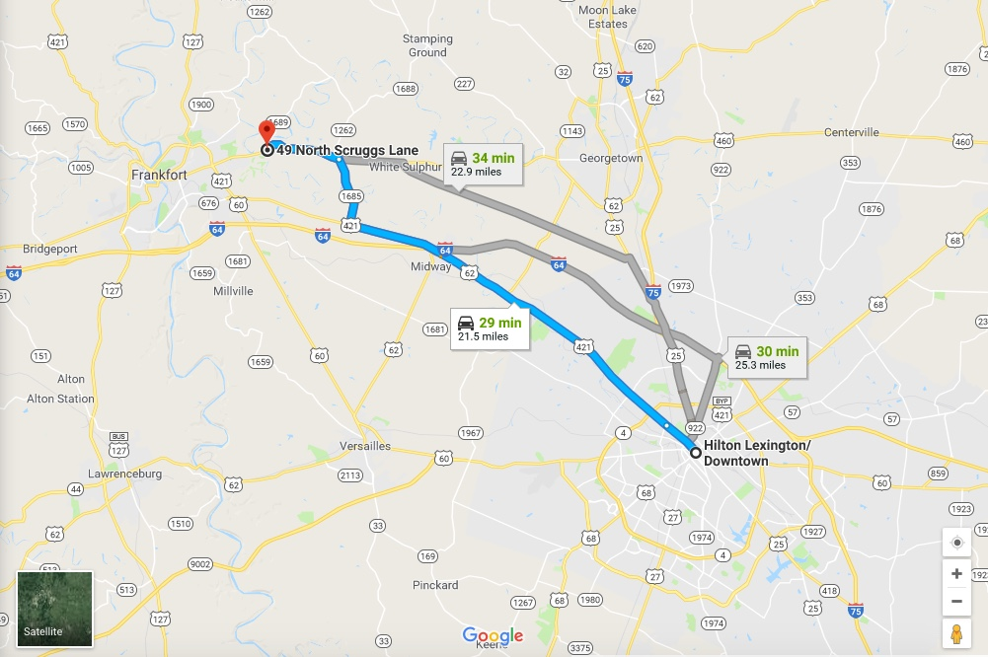
Time + Distance

Slide 7
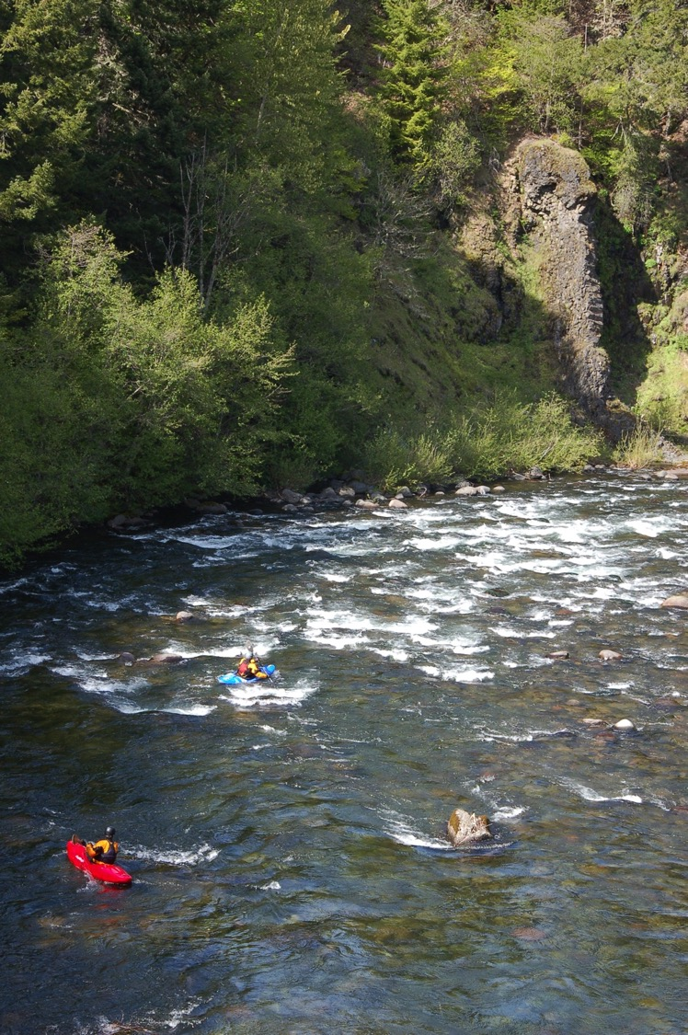
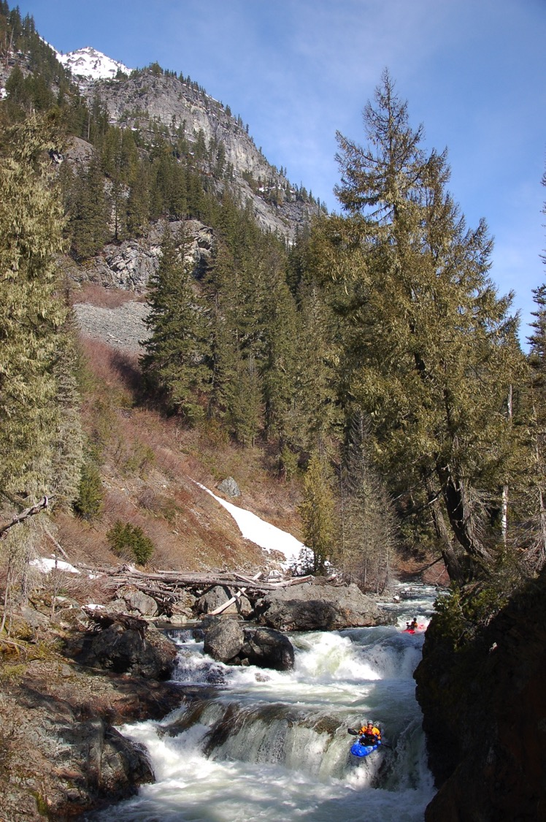
How Difficult Is It?

Slide 8
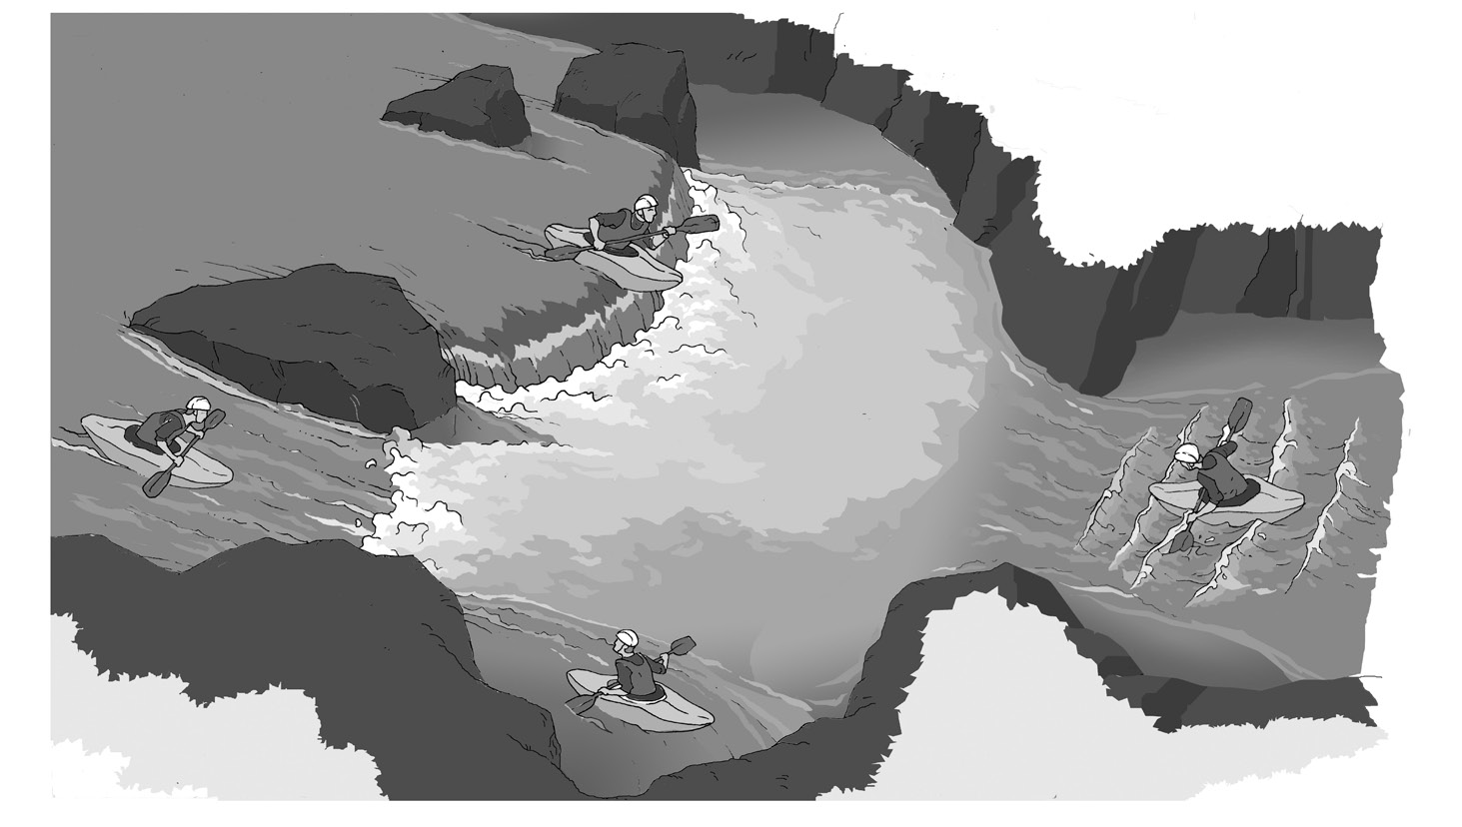
Is It Relatively Safe?

Slide 9
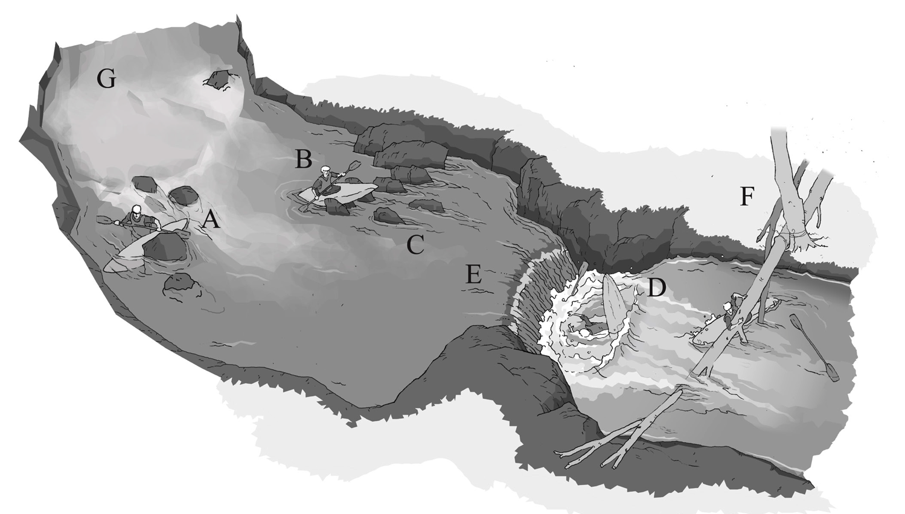
Or Ripe With Objective Hazards?

Slide 10
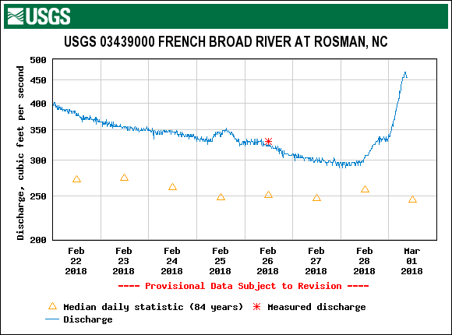
What is the Level?

Slide 11
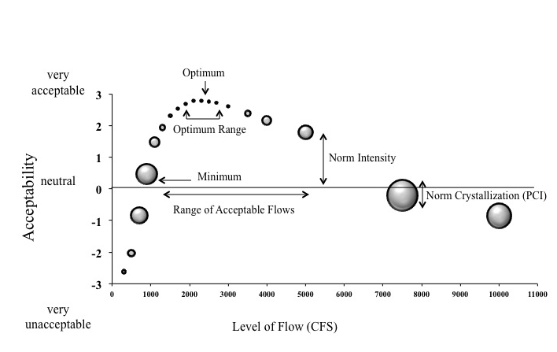
Is the Level Right For Me?

Slide 12
Who Else is Going?

Slide 13
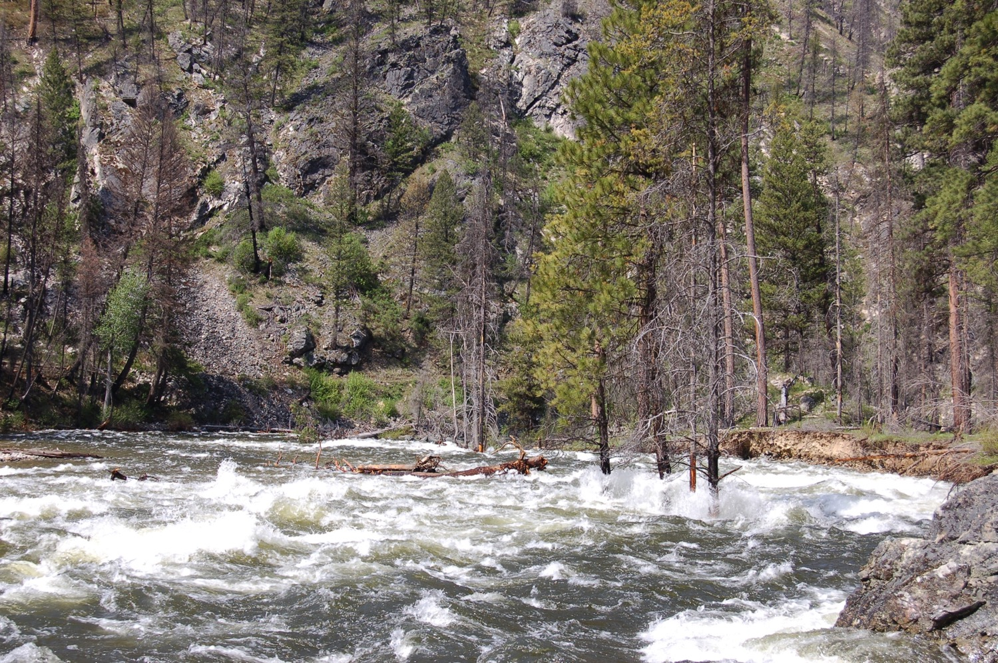
Has the River Changed?

Slide 14
National Whitewater Inventory
Hazards to Mitigate

Slide 15
26% Fatalities Associated with Cold Water

Slide 16
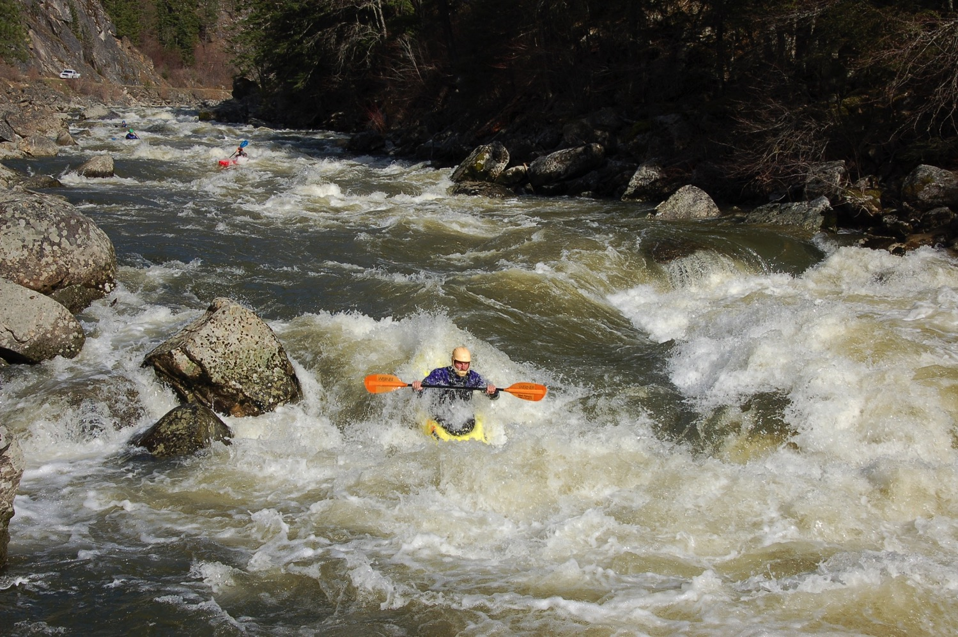
25% Fatalities Associated with Flush Drowning

Slide 17
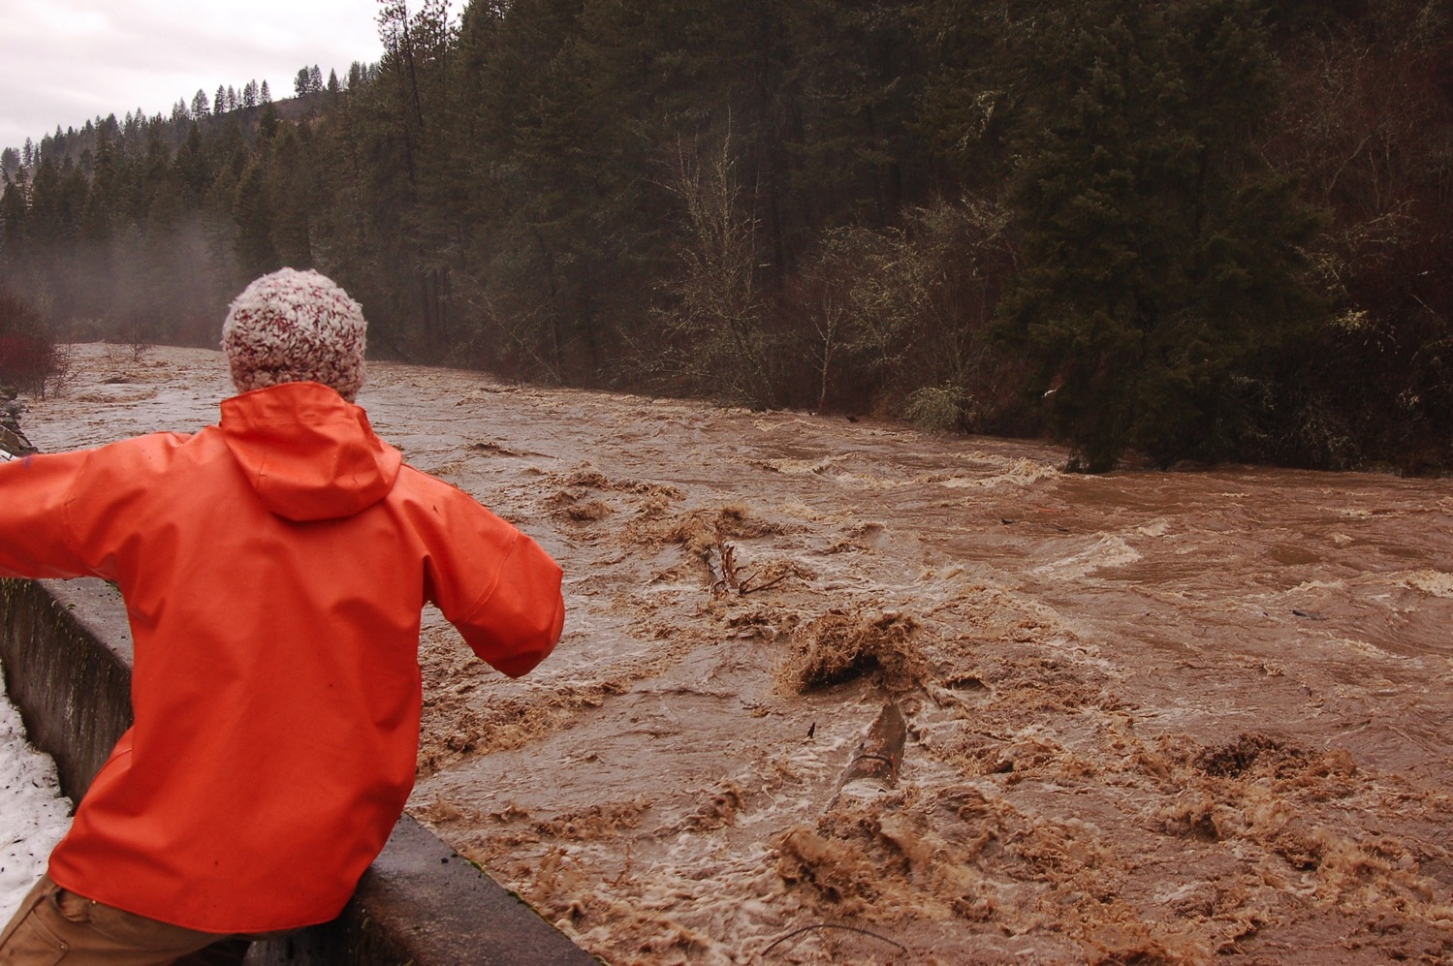
23% Fatalities Associated with High Water

Slide 18
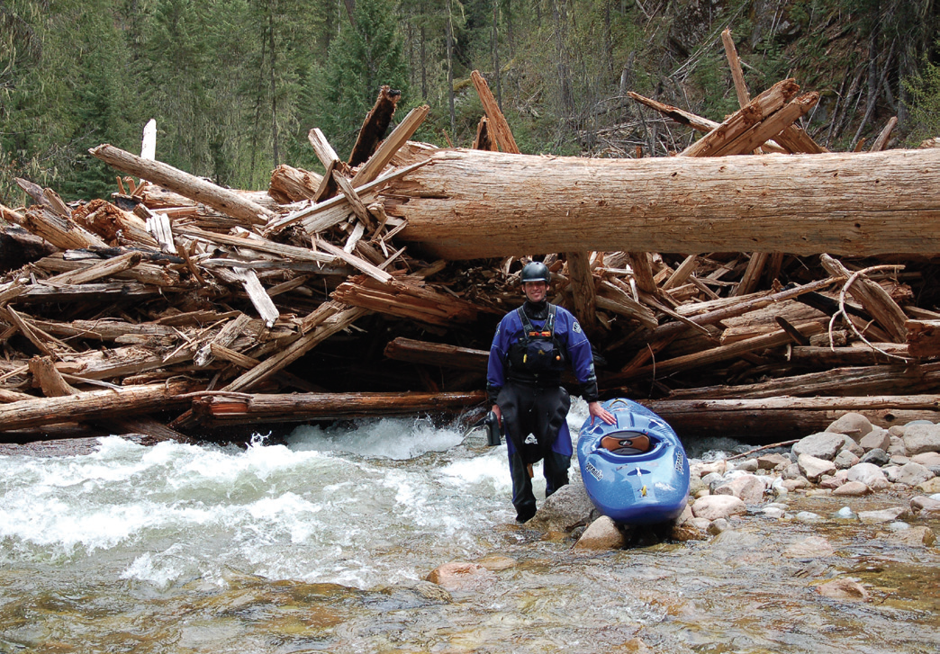
16% Fatalities Associated with Strainers

Slide 19
16% Fatalities Associated with No PFD

Slide 20
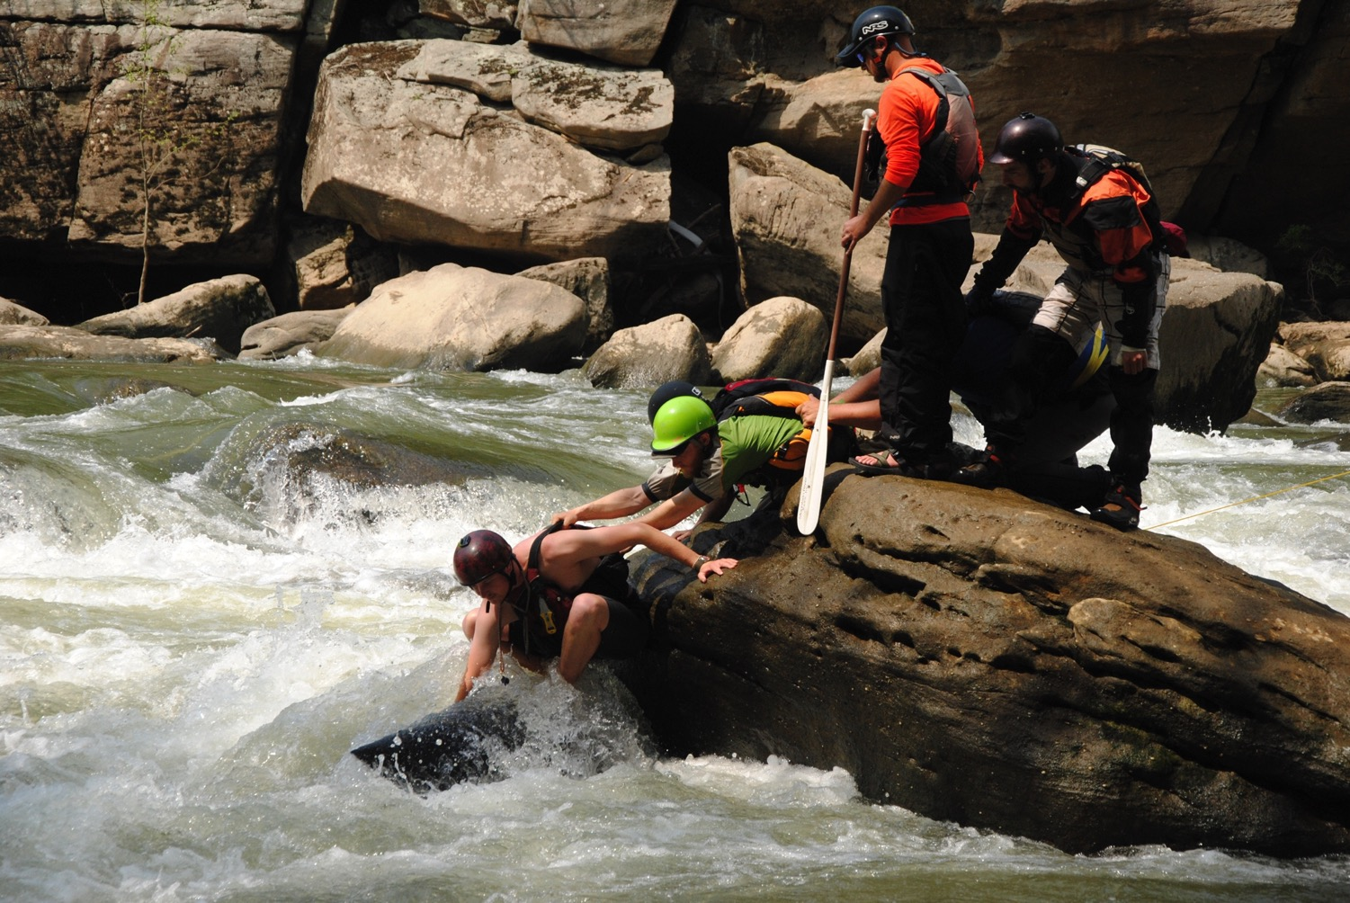
13% Fatalities Associated with Undercuts / Sieves

Slide 21
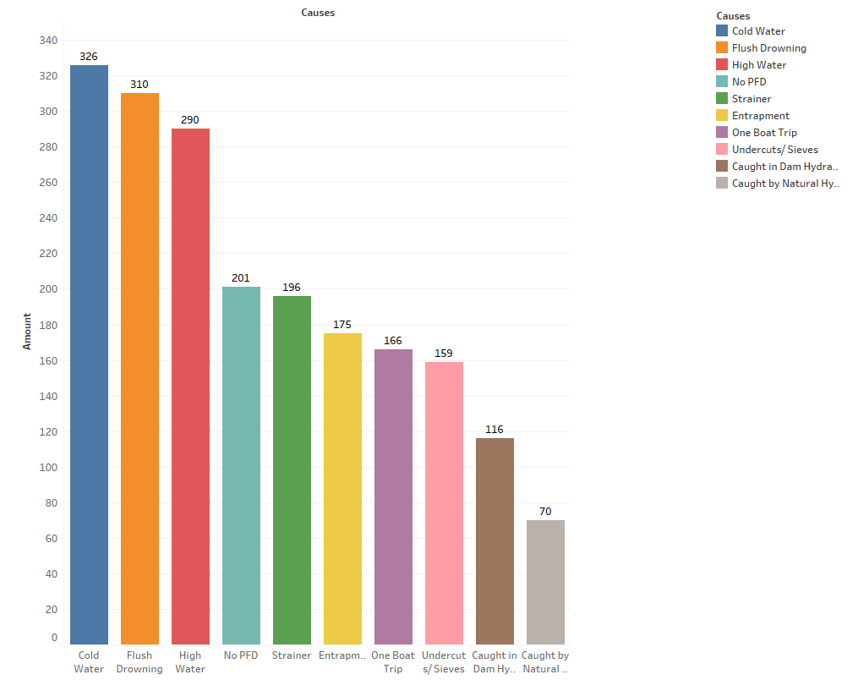
Top 10 Accident Factors

Slide 22
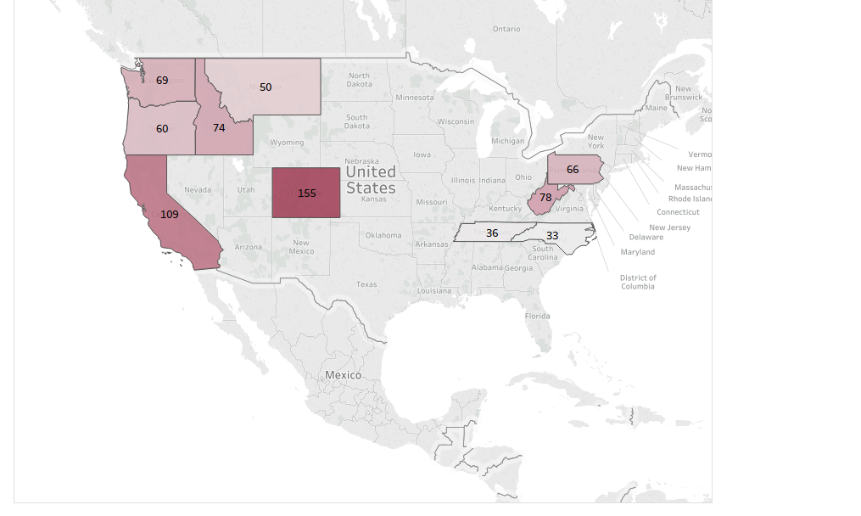
Most Accidents Since 1975

Slide 23
National Whitewater Inventory
The Website

Slide 24
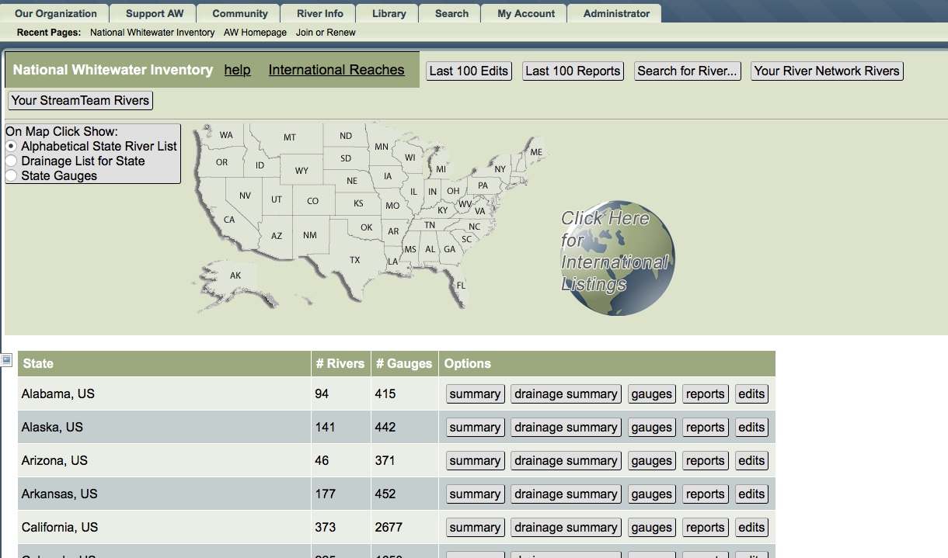

Slide 25
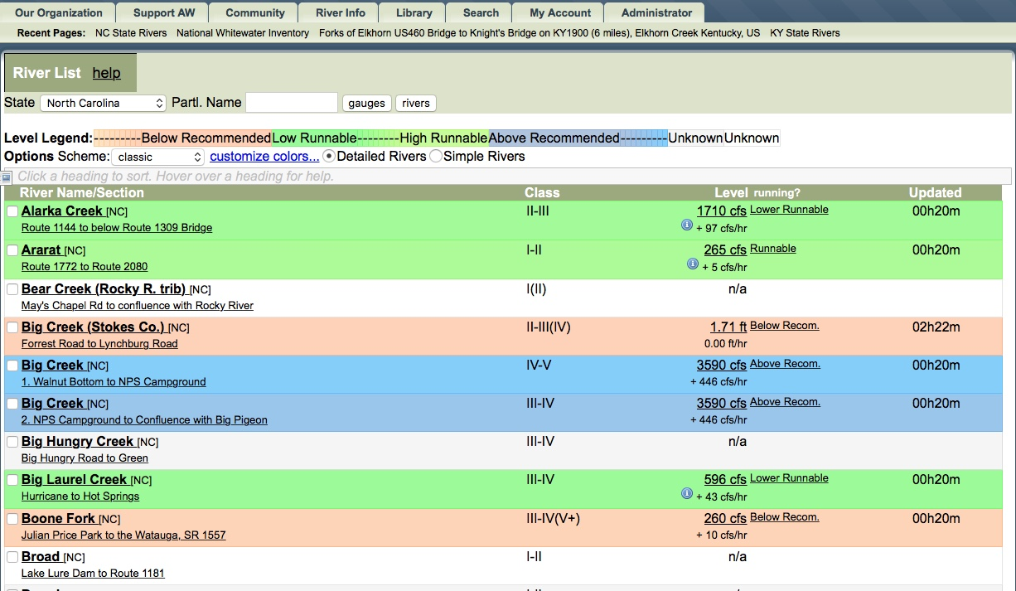

Slide 26
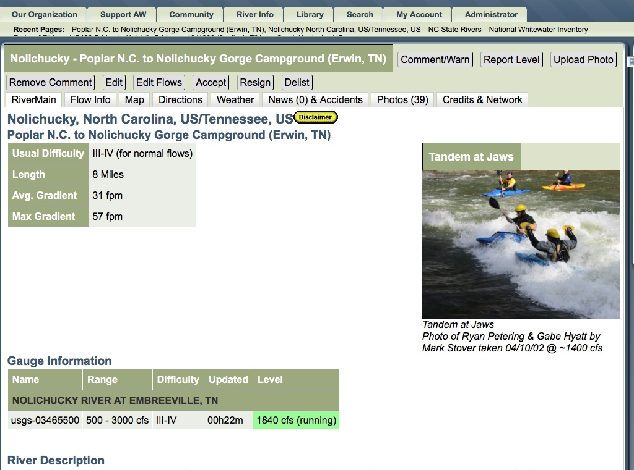

Slide 27
Other Activities

Slide 28
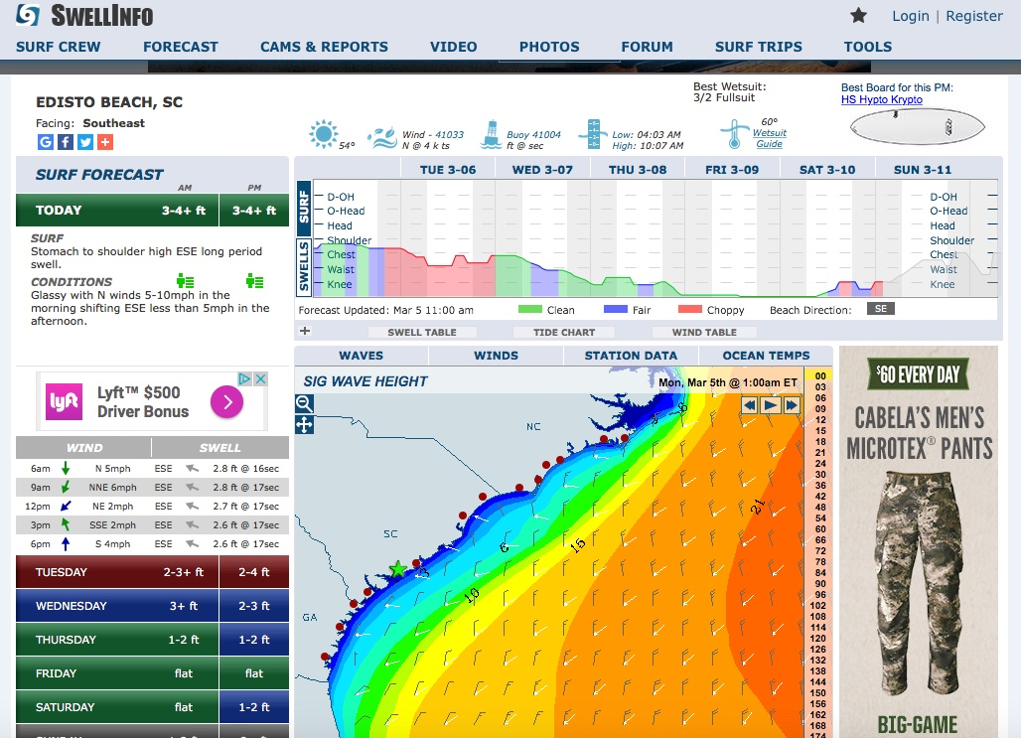
Time + Distance

Slide 29
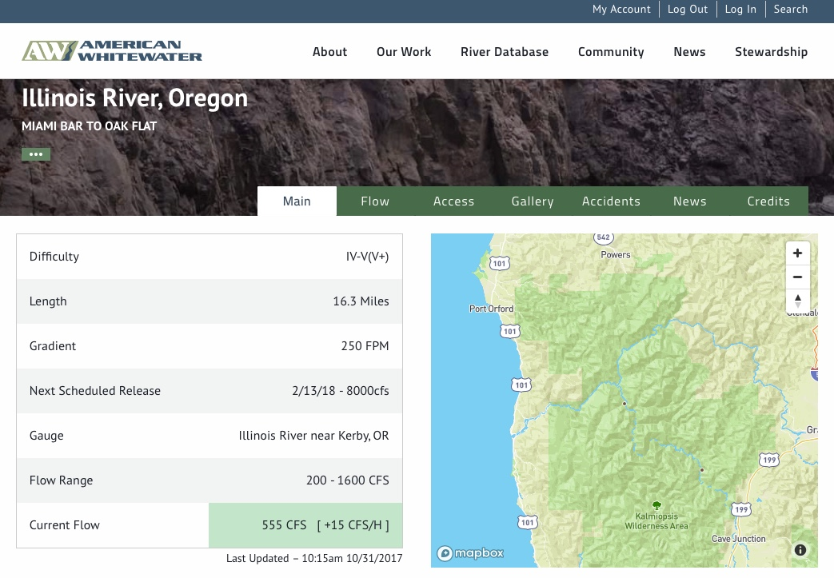

Slide 30
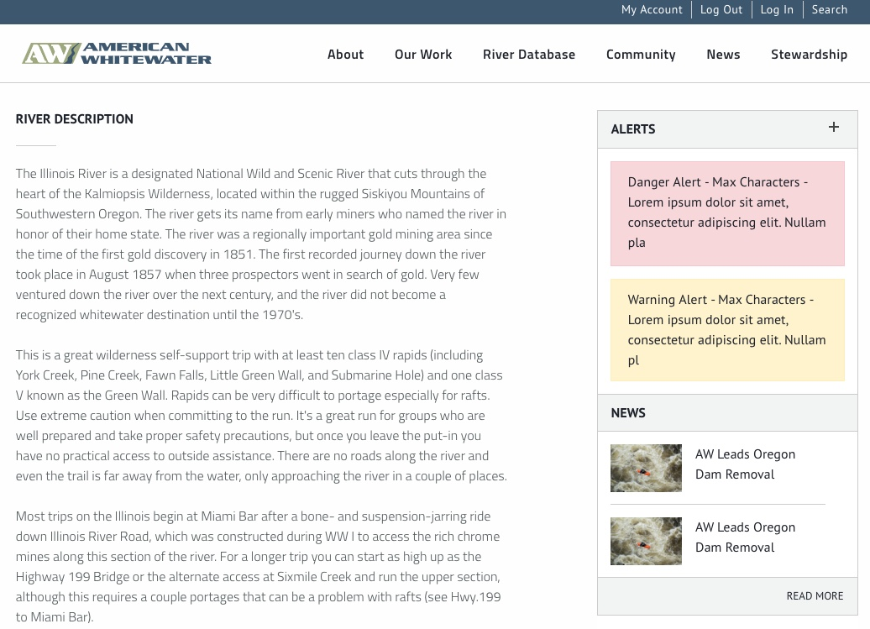
Recent Rainfall

Slide 31
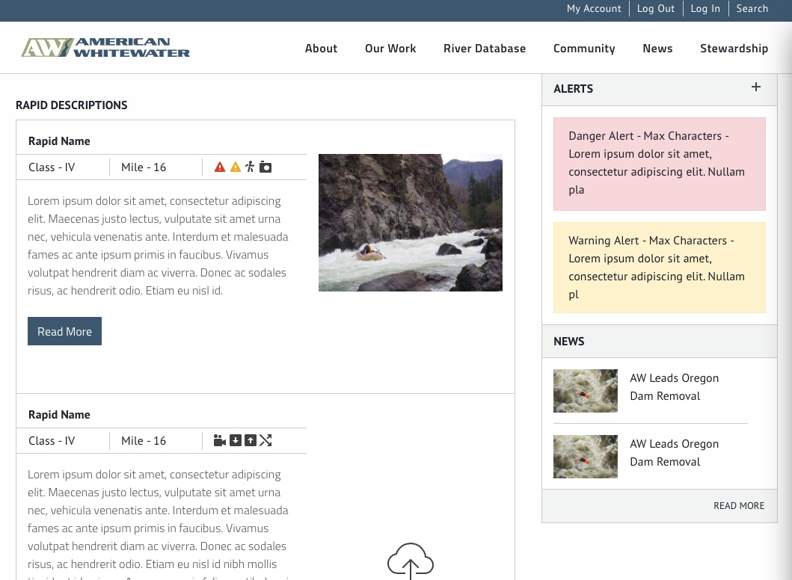
Recent Rainfall

Slide 32
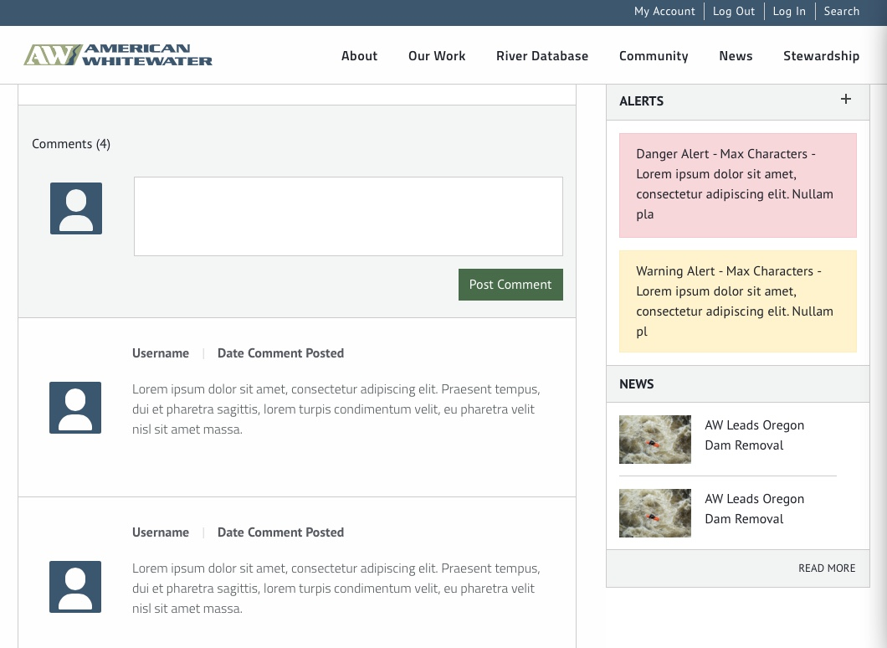
Recent Rainfall

Slide 33
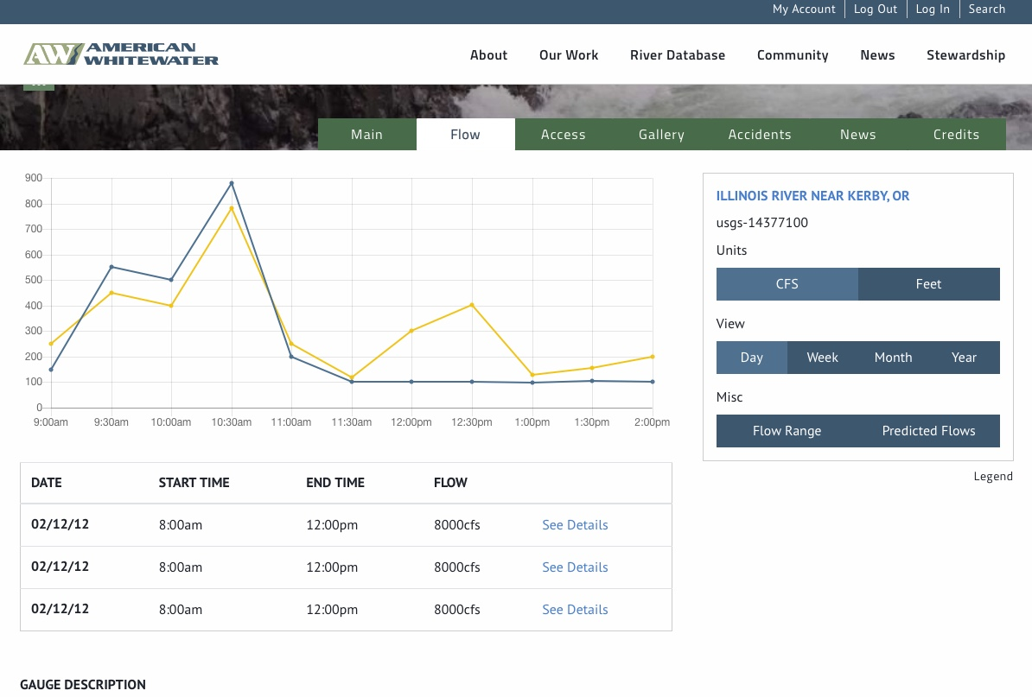

Slide 34
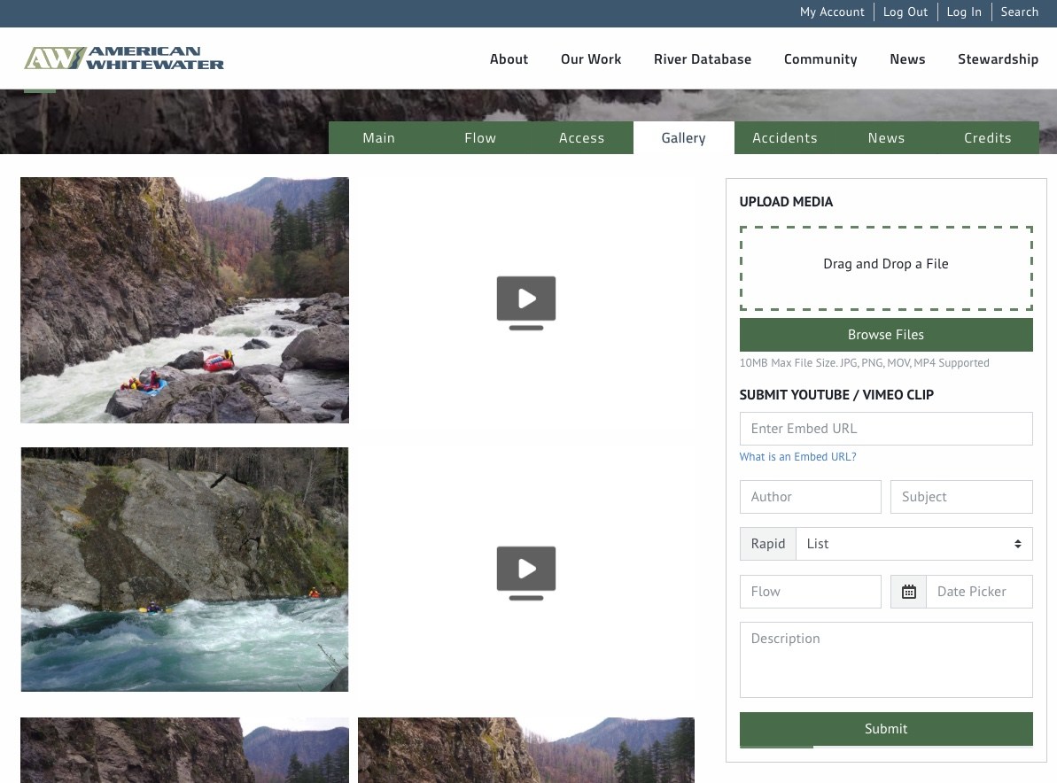
Recent Rainfall

Slide 35
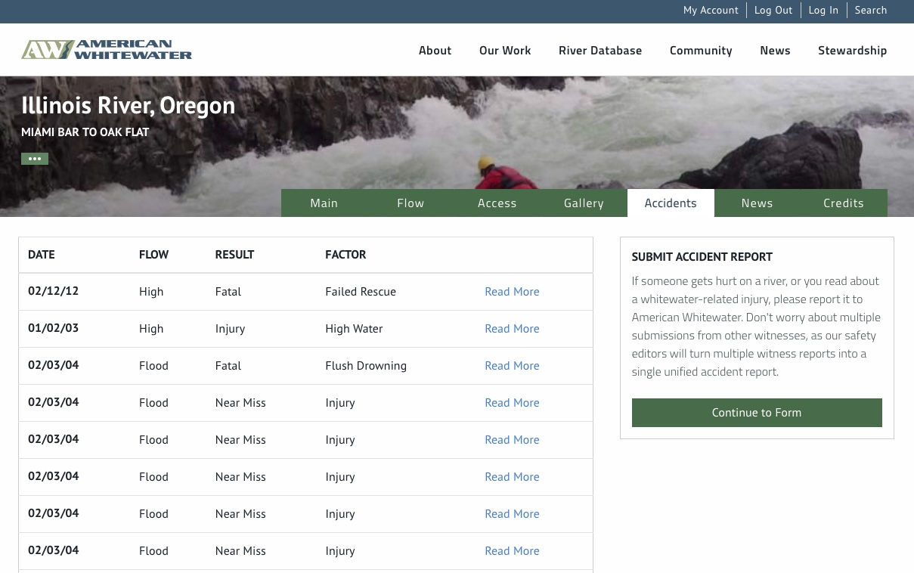

Slide 36
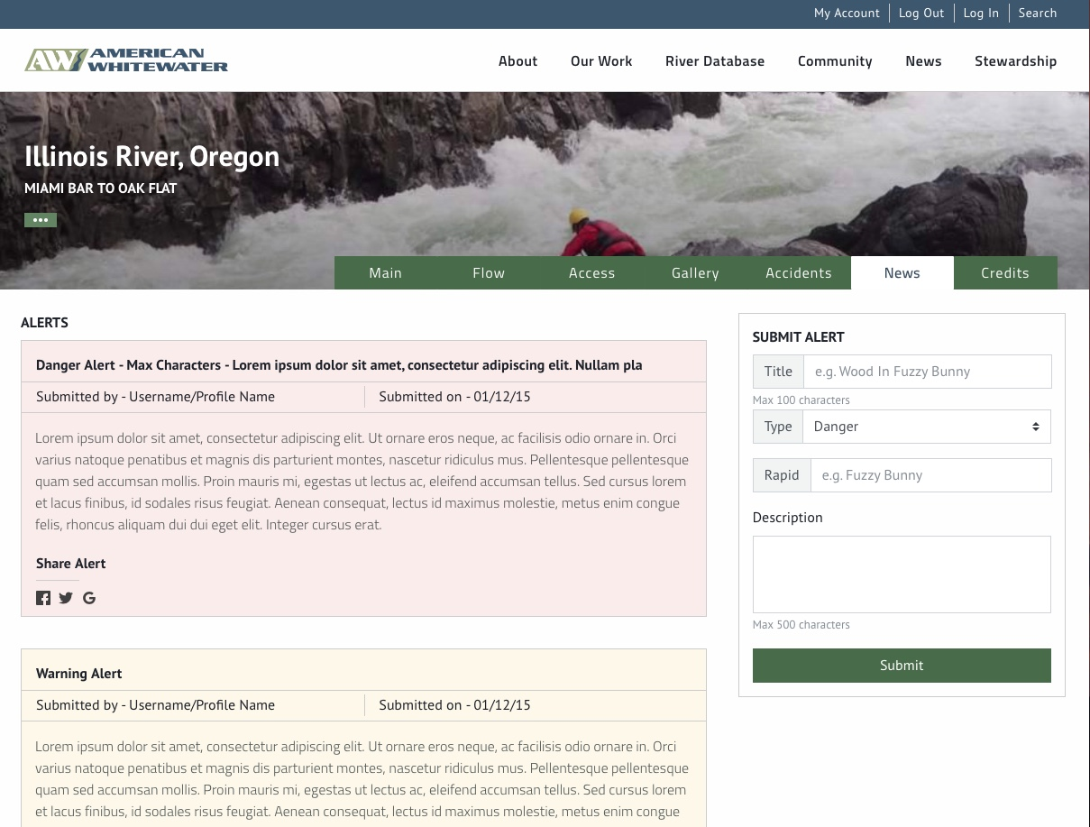
Recent Rainfall

Slide 37
National Whitewater Inventory
Phase 2

Slide 38
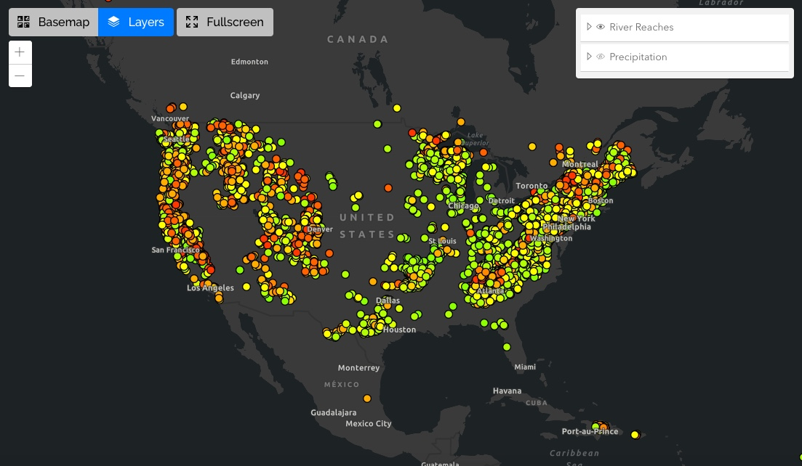
Find a River

Slide 39
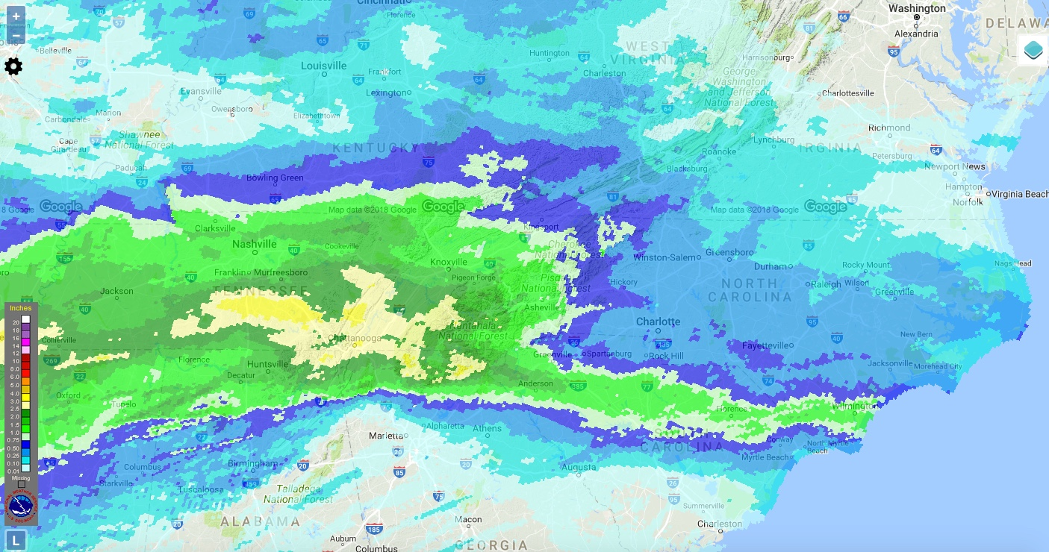
Precipitation

Slide 40
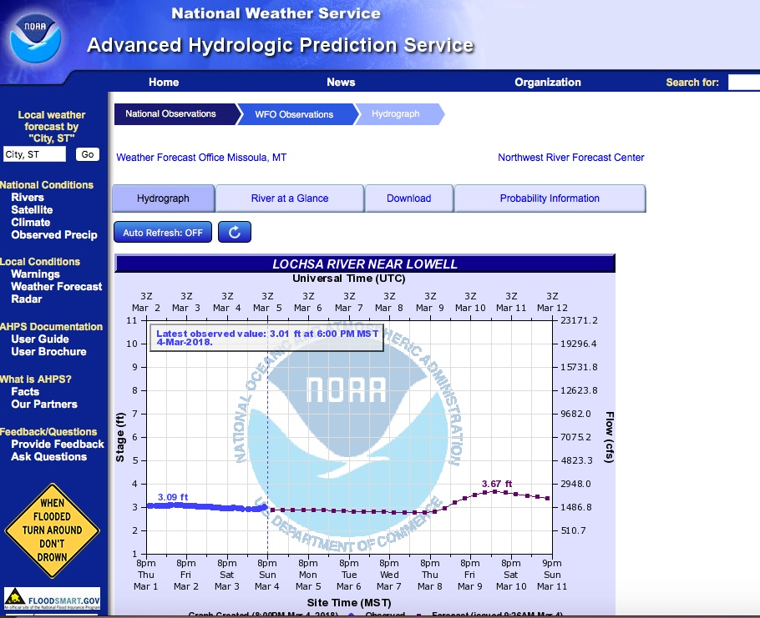

Slide 41
National Whitewater Inventory
Questions?

Slide 42
National Whitewater Inventory
Technical Specifications
DB: Postgresql 10
Language: PHP 7.1
Framework: Laravel 5.5
JS: DOJO 1.12
OS: CentOS 7.3

