Slide 1


Drowning: A Hard look at the facts and planning for the future
Dr. Adam b. Katchmarchi, ph.d., m.s., emt-b

Slide 2
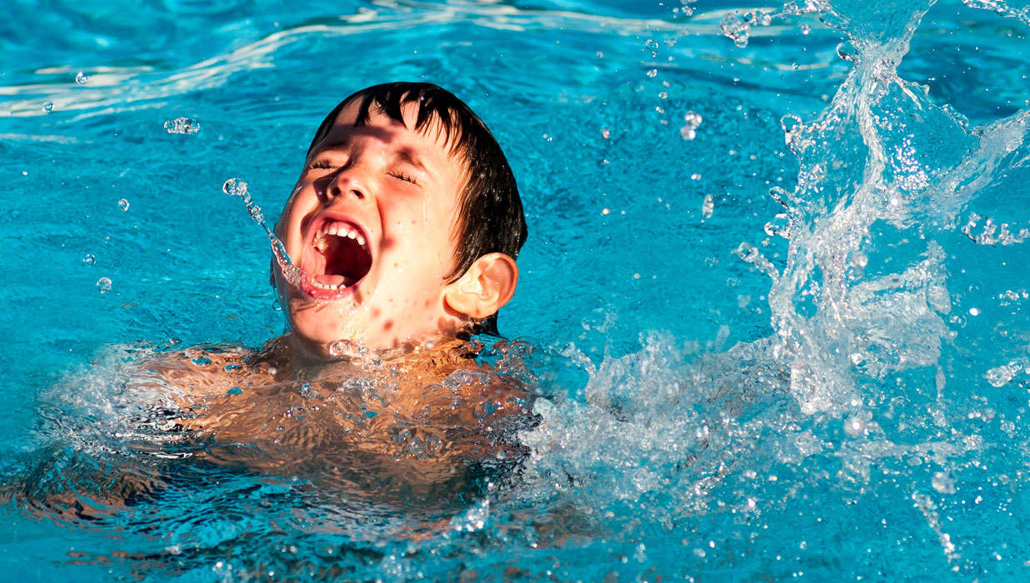
OVERVIEW
The Centers for Disease Control and Prevention (CDC) classify drowning as an unintentional injury related death.
Drowning is the leading cause of unintentional injury related death for children 1-4.

Slide 3
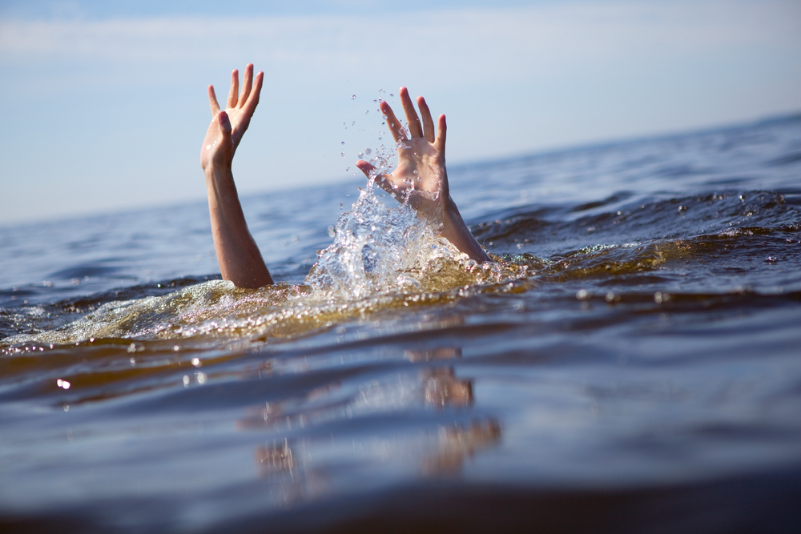
THE DROWNING PROCESS
Drowning is the process of experiencing respiratory impairment from submersion/immersion in liquid (World Congress on Drowning, 2002).
Drowning Victims:
  Endangered
  Distressed
  Active
  Passive
Outcomes:
  Non-Fatal
  Fatal

Slide 4
Significance of the problem
United States Drowning Data:
Fatal Drowning Deaths 1981-2015
1981 | 6,227 (2.57 per 100,000)
1991 | 4,621 (1.77 per 100,000)
2001 | 3,281 (1.15 per 100,000)
2011 | 3,556 (1.14 per 100,000)
2016 | 3,786 (1.17 per 100,000)
Non-Fatal Drowning Injuries 2001-2011
2001 | 5,691 CI [2,518, 8,864]
2011 | 7,488 CI [4,327, 10,648]
2015 | 9,001 CI [2,511, 15,490]
(Centers for Disease Control and Prevention, 2018)

Slide 5
(Centers for Disease Control and Prevention, 2018)

Slide 9
 | Age Groups
Rank | <1 | 1-4 | 5-9 | 10-14 | 15-24 | 25-34 | 35-44 | 45-54 | 55-64 | 65+ | All Ages
1 | Unintentional Suffocation 1,125 | Unintentional Drowning 390 | Unintentional MV Traffic 351 | Unintentional MV Traffic 412 | Unintentional MV Traffic 6,787 | Unintentional Poisoning 11,231 | Unintentional Poisoning 10,580 | Unintentional Poisoning 11,670 | Unintentional Poisoning 7,782 | Unintentional Fall 28,486 | Unintentional Poisoning 47,478
2 | Unintentional MV Traffic 64 | Unintentional MV Traffic 332 | Unintentional Drowning 129 | Unintentional Drowning 87 | Unintentional Poisoning 3,920 | Unintentional MV Traffic 6,327 | Unintentional MV Traffic 4,686 | Unintentional MV Traffic 5,329 | Unintentional MV Traffic 5,008 | Unintentional MV Traffic 6,860 | Unintentional MV Traffic 36,161
3 | Unintentional Drowning 30 | Unintentional Suffocation 131 | Unintentional Fire/burn 72 | Unintentional Other Land Transport 51 | Unintentional Drowning 504 | Unintentional Drowning 445 | Unintentional Fall 492 | Unintentional Fall 1,298 | Unintentional Fall 2,504 | Unintentional Unspecified 5,204 | Unintentional Fall 33,381
4 | Unintentional Fire/burn 22 | Unintentional Fire/burn 100 | Unintentional Other Land Transport 32 | Unintentional Fire/burn 41 | Unintentional Fall 217 | Unintentional Fall 324 | Unintentional Drowning 374 | Unintentional Suffocation 469 | Unintentional Suffocation 777 | Unintentional Suffocation 3,837 | Unintentional Unspecified 6,930
5 | Unintentional Natural/ Environment 12 | Unintentional Pedestrian, Other 75 | Unintentional Suffocation 31 | Unintentional Poisoning 36 | Unintentional Other Land Transport 201 | Unintentional Unspecified 194 | Unintentional Suffocation 240 | Unintentional Drowning 450 | Unintentional Unspecified 696 | Unintentional Poisoning 2,198 | Unintentional Suffocation 6,914
6 | Unintentional Unspecified 12 | Unintentional Fall 30 | Unintentional Natural/ Environment 24 | Unintentional Suffocation 26 | Unintentional Unspecified 135 | Unintentional Other Land Transport 181 | Unintentional Unspecified 238 | Unintentional Unspecified 395 | Unintentional Fire/burn 565 | Unintentional Fire/burn 1,171 | Unintentional Drowning 3,602
7 | Unintentional Poisoning 9 | Unintentional Poisoning 29 | Unintentional Pedestrian, Other 20 | Unintentional Unspecified 16 | Unintentional Firearm 121 | Unintentional Suffocation 181 | Unintentional Other Spec., classifiable 210 | Unintentional Fire/burn 372 | Unintentional Drowning 491 | Unintentional Drowning 699 | Unintentional Fire/burn 2,711
8 | Unintentional Other Land Transport 5 | Unintentional Struck by or Against 27 | Unintentional Poisoning 17 | Unintentional Firearm 15 | Unintentional Pedestrian, Other 118 | Unintentional Other Spec., classifiable 145 | Unintentional Fire/burn 150 | Unintentional Other Spec., classifiable 278 | Unintentional Natural/ Environment 322 | Unintentional Natural/ Environment 670 | Unintentional Natural/ Environment 1,579
9 | Unintentional Struck by or Against 5 | Unintentional Unspecified 26 | Unintentional Struck by or Against 17 | Unintentional Other Transport 14 | Unintentional Suffocation 97 | Unintentional Fire/burn 139 | Unintentional Other Land Transport 143 | Unintentional Natural/ Environment 231 | Unintentional Other Spec., classifiable 253 | Unintentional Other Spec., NEC^{N} 623 | Unintentional Other Land Transport 1,360
10 | Unintentional Fall 4 | Two Tied 25 | Unintentional Unspecified 14 | Unintentional Fall 13 | Unintentional Fire/burn 78 | Unintentional Pedestrian, Other 124 | Unintentional Natural/ Environment 134 | Unintentional Other Land Transport 202 | Unintentional Other Spec., NEC^{N} 207 | Unintentional Other Land Transport 355 | Unintentional Other Spec., classifiable 1,251

Slide 10
THE FACTS
In 2015 – Drowning accounted for 1/3 of the unintentional injury related deaths for children 1-4 (out of top 10 incident types).
In 2015 – The CDC reports 636 drowning fatalities among children 0-14.
In 2015 – Drowning is in the top 3 unintentional injury related fatalities for ages 1-35.
More than 1 in 5 people who die from drowning are children 14 and younger.
For every child who dies from drowning, another 5 received emergency department care for nonfatal submersion injuries. (CDC)

Slide 11
THE FACTS
From 2005-2014 there were an average of 3,536 fatal unintentional drownings (not including boating) in the US.
  An average of 332 people died each year in boating related fatalities (about 9.4%)
There are an average of 10 drowning deaths per day.
Drowning is the number 2 cause of unintentional death for children under 14 – number 1 is motor vehicle accidents.

Slide 12
NON-FATAL DROWNING COMPLICATIONS
There are no medically accepted conditions known as near-drowning, dry drowning, and secondary drowning. (Hawkings, Sempsrott, & Schmidt, 2017)
Although extremely rare, a victim who suffers a non-fatal drowning may develop repertory distress after the event (2-3 hours).
If a non-fatal victim experiences respiratory symptoms after exiting the water, they should be examined and observed in the Emergency Department. If symptoms do not persist they will be released in 4-6 hours.
The victim with minimal symptoms will either get better or worse in 2-3 hours.

Slide 13
Higher risk populations
Higher drowning risks among:
    Immigrant Populations
    Minority Communities
    Individuals with Disabilities
80% of drowning victims are male (CDC, 2015)

Slide 14
MINORITY POPULATIONS
African Americans ages 5-19 drown in swimming pools at a 5.5 times higher rate than Caucasian children.
African Americans ages 11-12 drown in swimming pools at a 10 times higher rate than Caucasian children.
American Indian and Alaskan Native children drown at a 3.1 times higher rate than Caucasian children.
(CDC, 2015)

Slide 15
FACTORS INFLUENCING DROWNING
Lack of Swimming Ability
Lack of Barriers
Lack of Supervision
Location
Use of Lifejackets
Alcohol & Drug Use
Medical Conditions

Slide 16
INDIVIDUALS WITH DISABILITIES
Studies show that people with intellectual disabilities (ID) such as autism have a higher standardized mortality ratio (SMR).
SMR greater than 1.0 means the observed death rate exceeds expectations.
SMR for drowning with individuals with mild autism was 3.9.
SMR for drowning with individuals with moderate, severe, or profound ID was 13.7. (Myers, S.)

Slide 17
RECOMMENDATIONS
Learn to Swim
Use layers of protection.
Always swim in a designated swimming area.
Use approved floatation devices.
NEVER swim alone.
Use a water watcher or swim near a lifeguard.
Know CPR and First Aid.
Have quick access to call 911.
Have rescue equipment ready to go.
Supervision is KEY!

Slide 18
Where do we go from here?
Collaboration is KEY!
Foundations
Boating
Local Community
Corporate Entities
Rescue Training
Educational Programs
Non-Profit Organizations
EMS Fire
Lifeguards
Volunteers
National Action
Schools

Slide 19
Who is the
The National Drowning Prevention Alliance is a 501(c)3 non-profit organization.
Lead by an executive and a volunteer board of directors.
We focus all keeping all persons of any age safer around all bodies of water.
We believe that through collaboration we can make a difference in drowning prevention.

Slide 20
“UNITED, we can prevent the tragedy of drowning!”

Slide 21








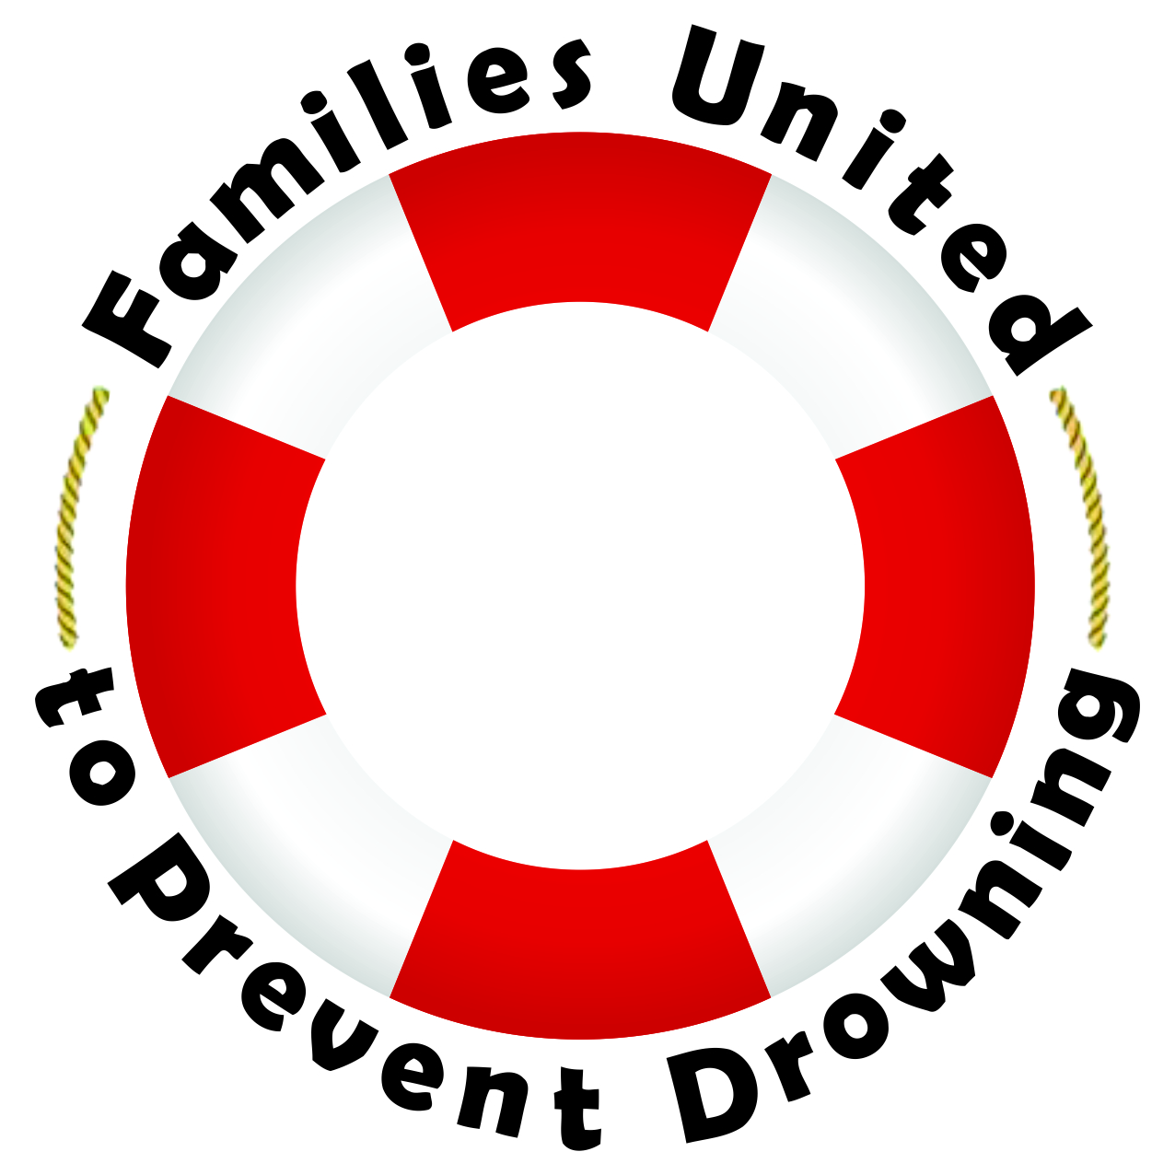















Slide 22
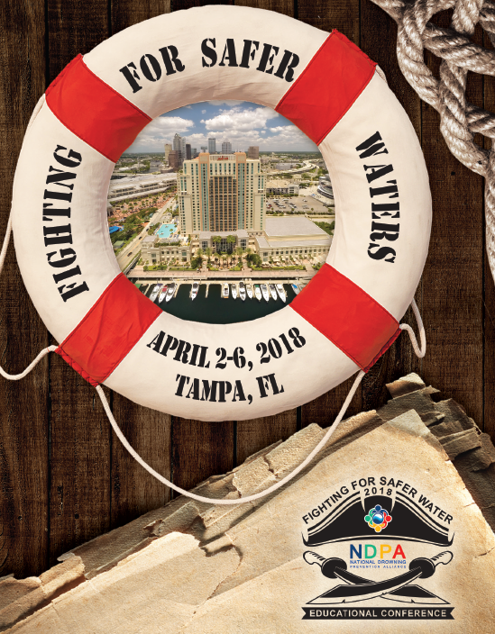

2018 National Drowning Prevention Educational Conference
Tampa, FL - April 2-7

Slide 23
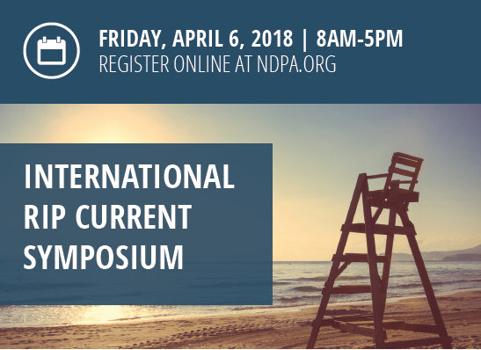
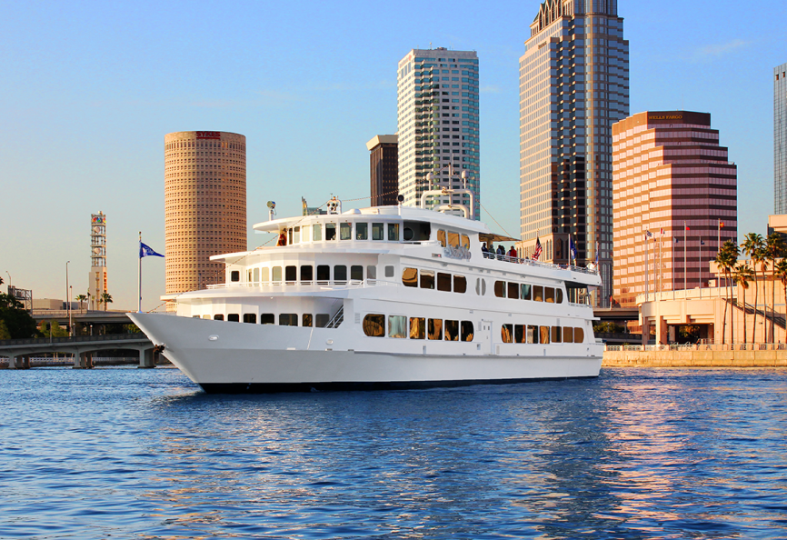
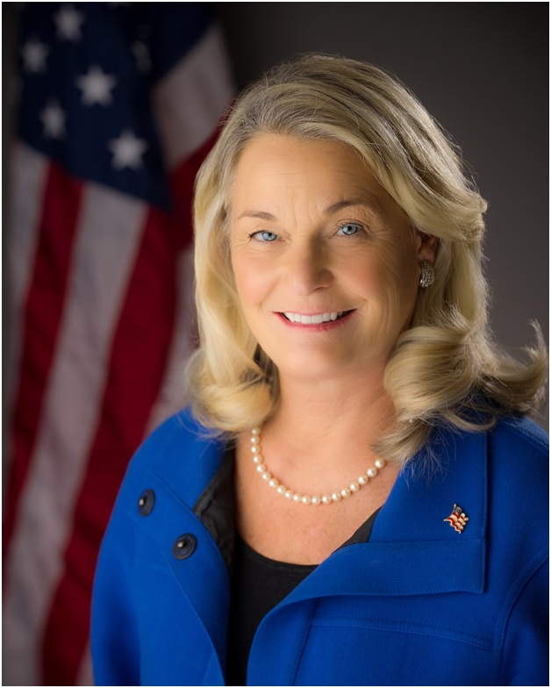

2018 Special Events

Slide 24


2019 National Drowning Prevention Educational Conference
New Orleans, LA - April 15-19, 2019

Slide 25
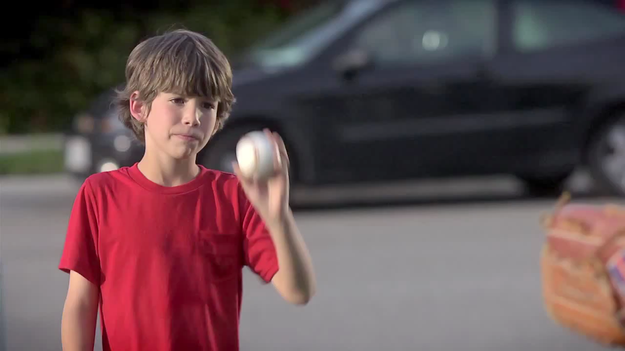

Slide 26
THANK YOU FOR SAVING LIVES!

Slide 27
Dr. Adam Katchmarchi, Ph.D.
Executive Director, NDPA
Assistant Professor & Aquatics Director, IUP adam@ndpa.org - 951-659-8600

Slide 28


