Slide 2
Public Access Television as an Education and Outreach Platform
Presented by Jerry Desmond/ Gwendolynn Flynn
IBWSS 2018

Slide 3
Todays Presentation
What brought using television to the DEEP
Our Production Team
Changing the boating education paradigm
The benefits of using public television
Challenges of producing and airing shows
Marketing the shows
Producing a specific show
Shows that we have produced

Slide 4
The Public Television Experience
First experience was as a Youth Officer
Students of Dare Program and messaging for other students
Brought recognition to Police Department
Brought custom messaging to the public

Slide 5
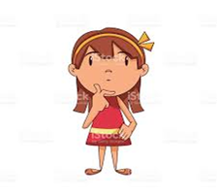
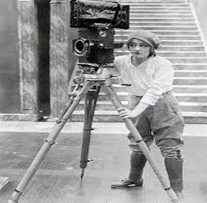
Introducing our Production Team
Better Boating in Connecticut
Jerry Desmond-
Wendy Flynn -
Yolanda Cooley-
Paul Gibson and Roy Sanden- Volunteers

Slide 6
Changing the Boating Education Paradigm
Traditional Education
Reaches more boaters than potential boaters
Uses the classroom for instruction
Uses the internet for classes
Tends to enhance the knowledge of boaters as well as qualifies them for boating certificates
Jerry is always teaching

Slide 7
Changing the Boating Education Paradigm
Traditional Outreach
Driven toward boating communities
Difficult to educate large numbers at one time without financial resources
Tends to draw a smaller percentage of attendees making inquiries at public events

Slide 8
Changing the Boating Education Paradigm
Goals to Enhance Boating Education and Outreach
Reach more boaters and potential boaters through an initiative
Make information readily available and evident to the recipients on an ongoing basis
Make the access to the information easy and available at convenient times
Empower future boaters to take steps toward boating as an activity

Slide 9
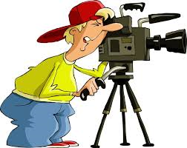
Why Public, Education, and Government Access Channels ?
Most importantly-they are free
They reach out to households around your state
Boaters and non-boaters can relax from home and get great boating safety and operational information
Potential new boaters can learn and become more knowledgeable, possibly wanting to enter boating
Reaches a diverse group of viewers

Slide 10
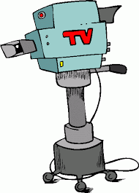
Why Public, Education, and Government Access Channels ?
You can control your own message through a television medium
Public is more apt to take moment at home to tune in
Scheduling of episodes and frequency of showing is flexible when setting up a show
The shows can be posted on You Tube for boaters who utilize streaming platforms

Slide 11
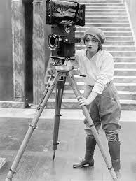
Why Public, Education, and Government Access Channels ?
Shows can be shared once posted on streaming platforms
Managers of Public Television tend to want shows with great information that the public will appreciate and want to watch
Managers of Public Television offer assistance and training for production of aired shows

Slide 12
Challenges of producing boating education shows ?
Getting buy in and support from superiors
Creation of a viable production team
Selection of personnel
Obtaining support and approval through state communications authorities
Access to television video equipment
Most are administered by a Cable Co.

Slide 13
Challenges of producing boating education shows ?
Training on television equipment
Development of topics
Creation of proper format and design for transfer
Creation of closed captioning for platforms that require it

Slide 14
Developing a specific show
Assure that Intro and close to show is ready
Topic is decided
Decide if best filmed in studio or in the field
Messaging high points are developed
Schedule any special guests for the show
Determine if B-roll shots will be used
Determine if still shots will be used, such as a picture of your website, ect…

Slide 15
Developing a specific show
Brief guests on high points
Produce cue signs with main message points
Shoot the B-roll shots
Send in the lower thirds to the studio or have them ready
Determine if PSA’s will be used and where
Select PSA’s from resources or film them

Slide 16
Developing a specific show
Shoot the show
Edit the show in the studio
Format the show for exterior platforms

Slide 18
Jerry and Wendy taping a show at the studio

Slide 19
Yolanda preparing a guest at our television studio

Slide 20
Yolanda learning the ropes with Public Television Studio Tech, Frank Fulchiero

Slide 21
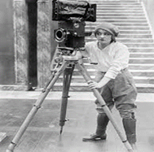
Current and future shows taped by Connecticut DEEP Team
Boating Certification and Registrations
Boating accident reconstruction
DEEP Student Ambassador Program
Boating Infrastructure Grant Program
CVA Grant Program
Launching and Winterizing your vessel
Cold water paddling

Slide 22
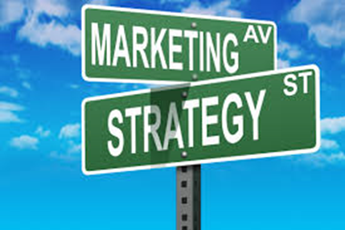
Marketing your Television Show
Announcing and posting shows on your website
Announcing the show at classroom boating classes
Flyers in boat re-registration mail
Information handout or attachment to boating certificates issued

Slide 23
What do these shows look like?
We have attached some of the shows we have produced
Our staff continues to learn and get better at production
Lets take a look!!!!

Slide 24
Questions?
Jerry Desmond/ Wendy Flynn
860-447-4350

