Slide 2
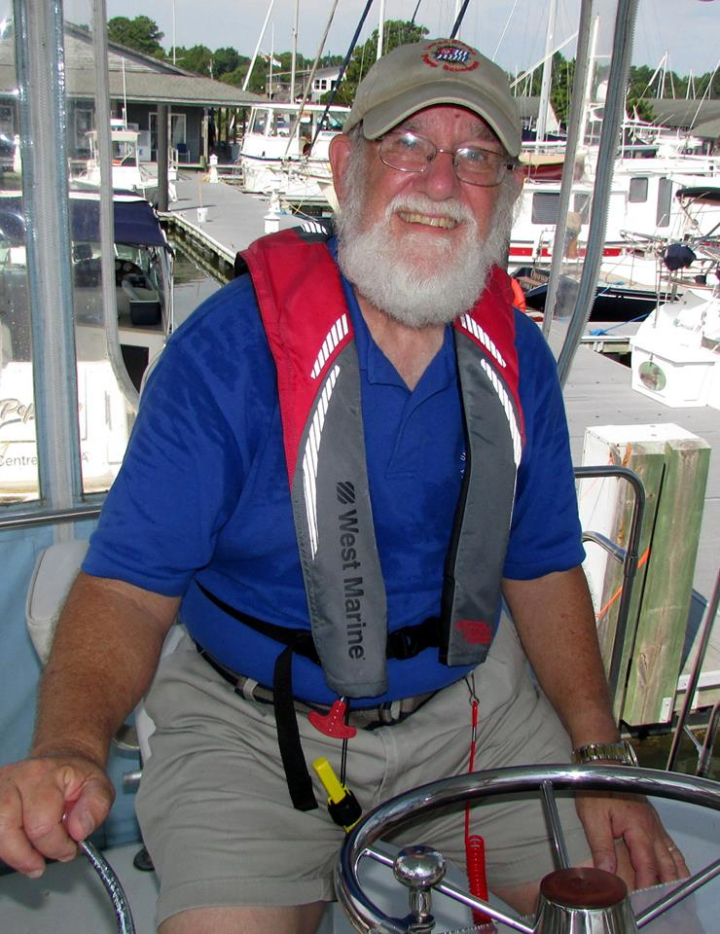
The Movement

Slide 3
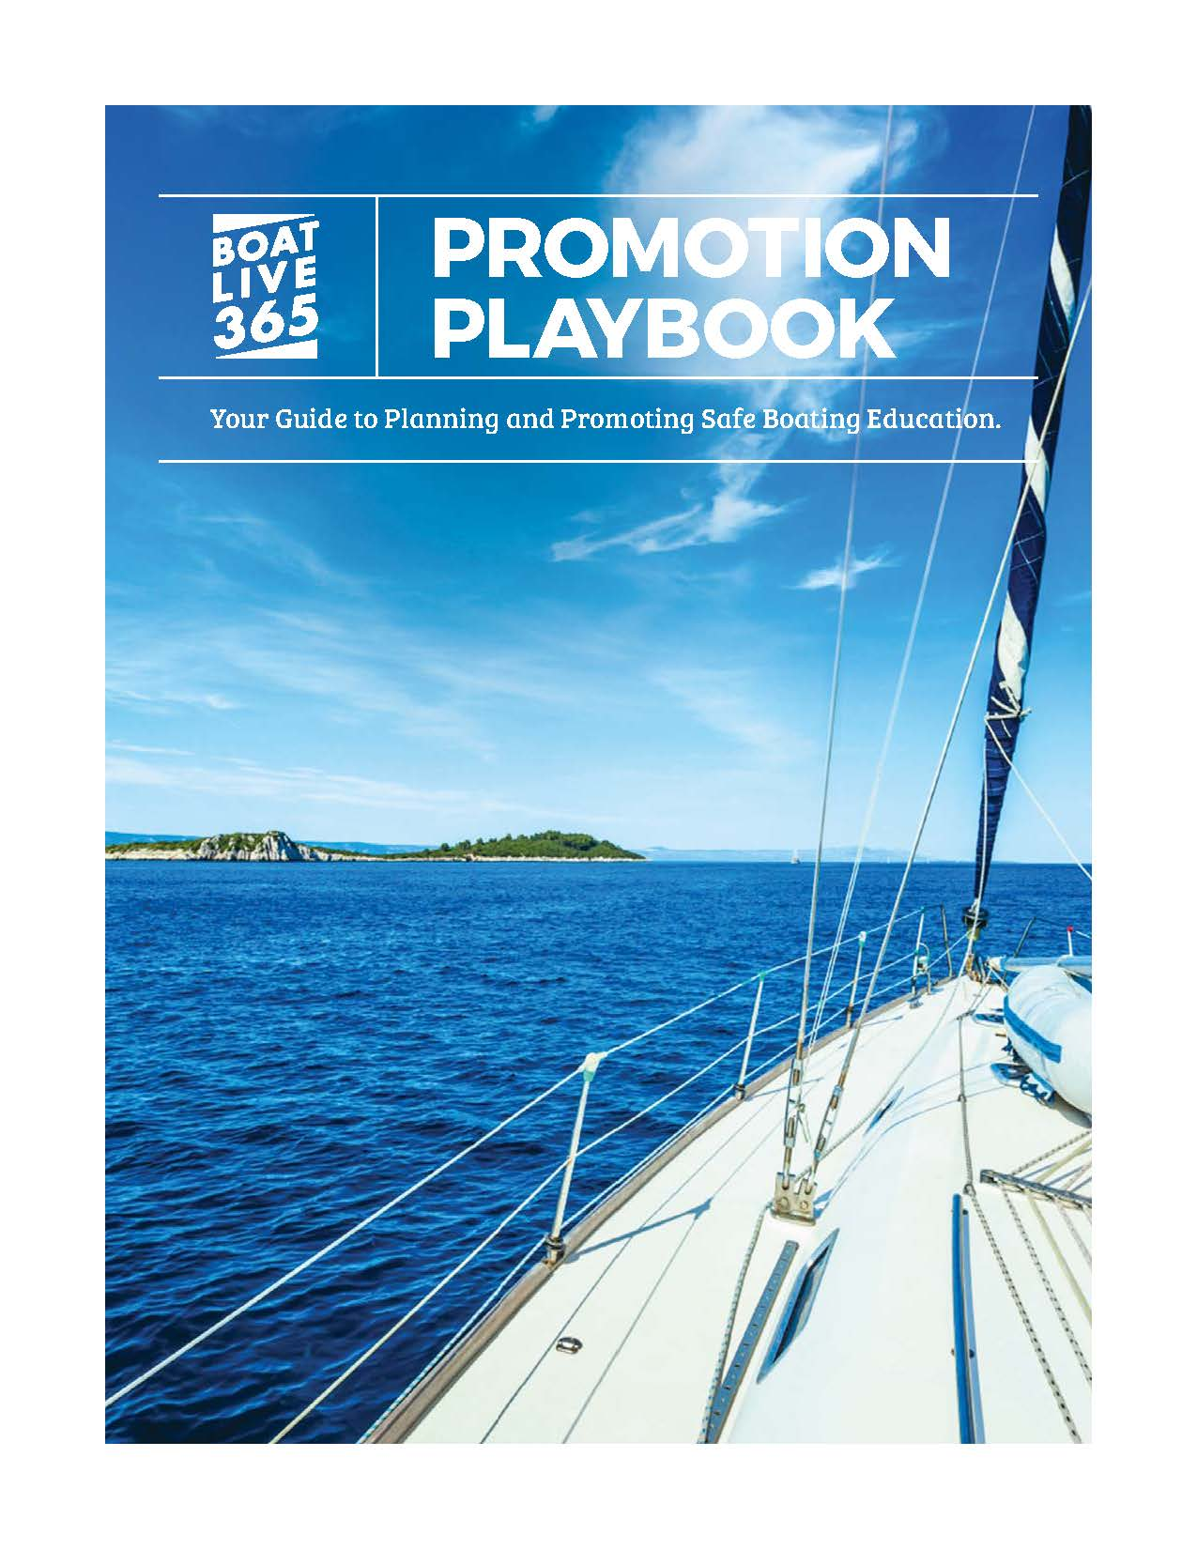
Empower Advocates
Playbook
Boat Live 365: Assets
Planning for Promotion
Tools for Promoting Safe Boating
Planning + Executing an Event
Measurement

Slide 4
Best Practices + Considerations
Effective Timelines
Motivating Volunteers
Community Relations
Public Relations
Advertising
Agreements + Requirements
Social Media Platforms
Hashtags
Developing Your Plan
Checklist

Slide 5
Tactical Deployment + Tools
Calendar Planning Template
Community Relations + Template Resources
PR, Media + Template Resources
Best Practices Checklist
Advertising + Sample Layouts
Social Media Promotion + Creative Samples
Email Campaigns + Promotional Content

Slide 6
Promotional Materials
◊ Pamphlet Series
◊ Event Banner
◊ One-Page Handout

Slide 7
Promotional Materials

Slide 8
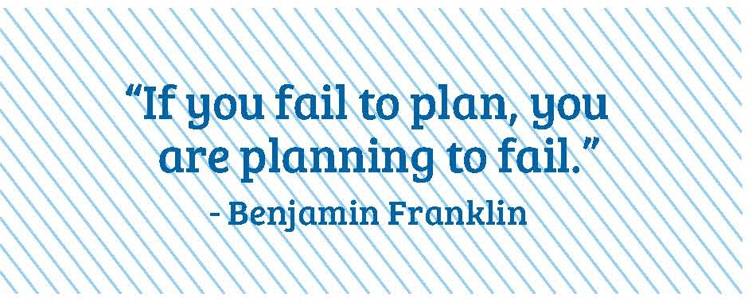
Planning + Executing an Event
Getting Your Volunteers Ready
Event Engagement

Slide 9
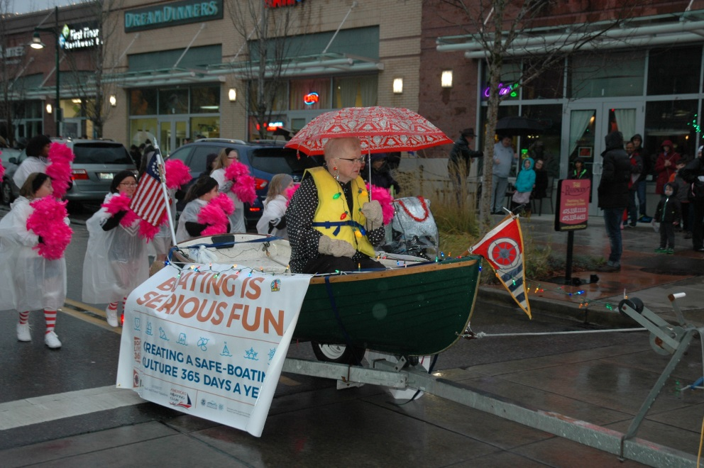
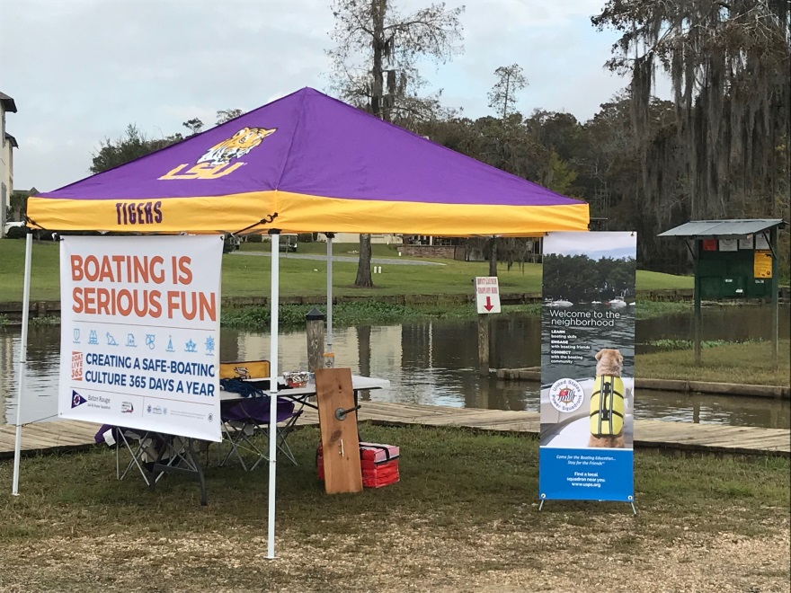
Out in the Field

Slide 10
Coming Spring 2018

Slide 11
Coming Spring 2018

Slide 12
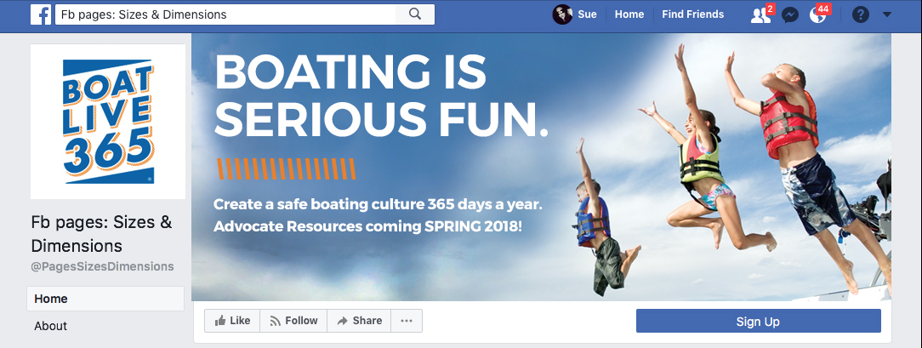
Coming Spring 2018
www.facebook.com/boatlive365
www.boatlive365.org

Slide 13
Join the Movement!

