Slide 1
Presentation to IBWSS, Wednesday March 7, 2018
John Gullick, Chair,
Canadian Safe Boating Council

Slide 2
Organization
National organization
Directors and members from coast to coast to coast
20 directors with a Chair and Executive Committee
Run by volunteers: no ongoing paid staff, no ongoing government funding support
Established over 25 years ago
Contact:
John Gullick,
jrag@nexicom.net

Slide 3
CSBC Mission
Reduce the incidence of deaths that occur as a result of boating activities
Cultivate partnerships with government, water safety organizations and the boating industry
Partner to provide significant boating safety outreach to various boating communities across Canada

Slide 4
What We Do
Safe boating campaigns
Research
Boating safety resources
Cold water training
Canadian Safe Boating Awards
Annual Symposium
International and Government liaison
(US NSBC, International Lifejacket Wear Principles Agreement, NRBAC, CMAC)

Slide 5
More than just safety equipment
safetyfirstmarine.ca

Slide 6
Why ?
CPS-ECP / CCGA Courtesy Checks found that 40% of boats checked were not in compliance with carriage regulations
Goal to reach those on the front line who can influence better carriage habits with boaters
Targets
Canadian Tire sales associates
Other major retailers
3000 marinas and chandleries
Notes:
Recreational Vessel Safety Checks

Slide 7
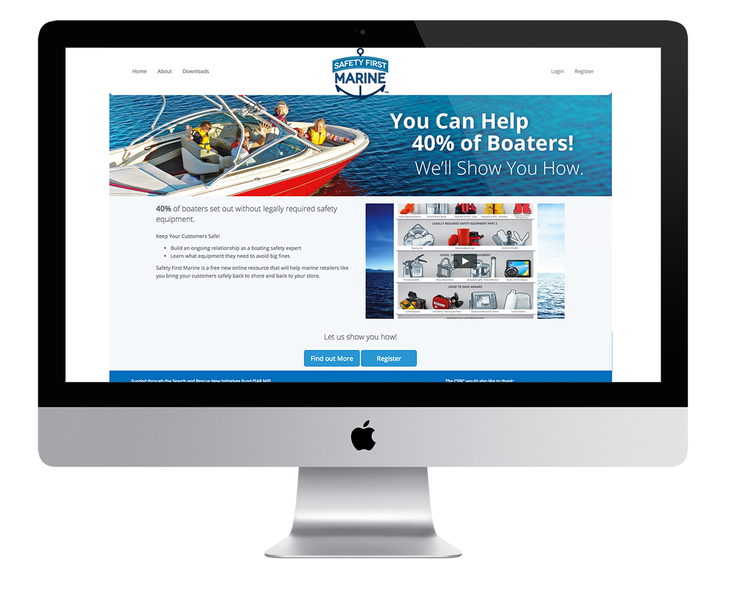

Slide 9
Notes:
Learning modules covering a variety of equipment, regulatory and need to know topics.
Self paced learning
Testing knowledge
Downloadable certificate of completion

Slide 10
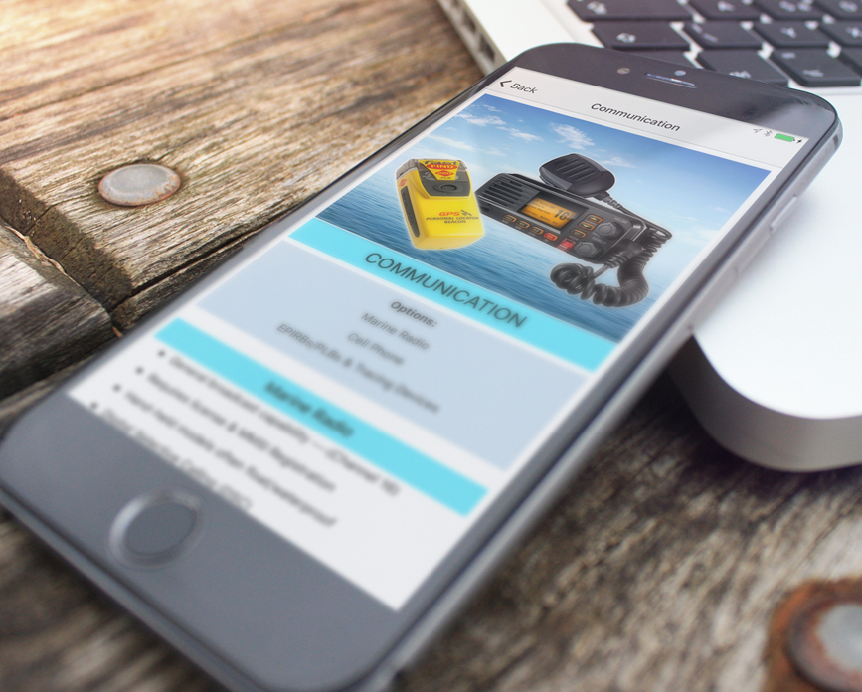
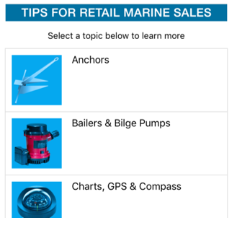
Sales APP
Notes:
Extension of the safety first marine web site / course which delivers visual support and information through the sales associate to the customer
For example, the APP can demonstrate why a particular anchor works best in sand or mud.

Slide 11
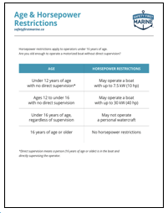
Downloadable resources
Standard and Customized
Age and horsepower
Pre-departure checklists
Safety Equipment
Float Plans

Slide 12
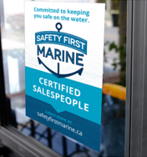
Outreach

Slide 13
Research with Marine Retail Staff
Very positive reaction to the program
“ It is informative, useful, should be mandatory.”
“I need this because people don’t believe me. They think I am just a kid!”
Notes:
Canadian Tire sales associate

Slide 14
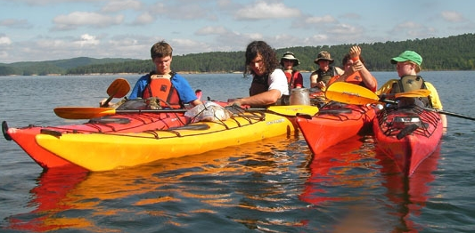
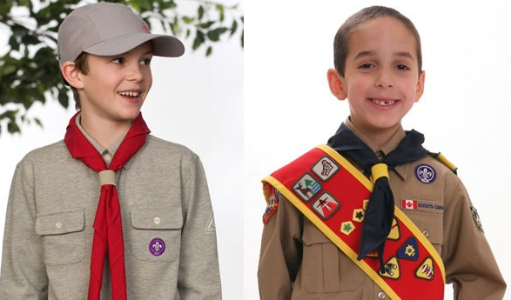
Train youth:
In general boating safety practices.
To act as trainers for other youth.
To be a force multiplier delivering
messages to the public.

Slide 15
A Perfect Day on the Water
Multi-lingual program for new boaters in entry level boats
Free on line delivery
6 languages

Slide 17
OPERATION LIFE PRESERVER
In Northern Communities
Educate on life jackets
Cold water immersion
Reboarding
Trip plans
A GREAT way to recycle life jackets and pfd’s that are no longer good for you but still good for use
A gift of one device may be a gift of life

